Slide 1
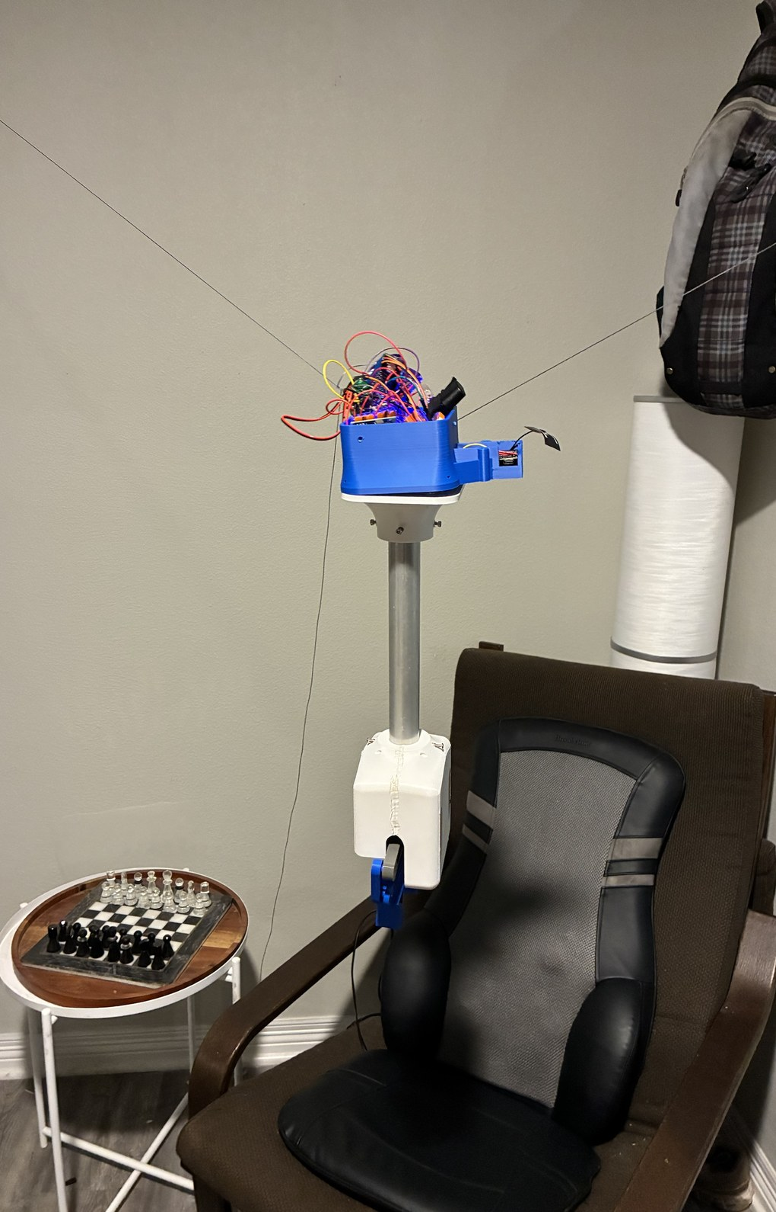
RoomCleaner
A four-cable ceiling robot that picks laundry off the floor
Jasper Buntinx | Mechanical Engineering | Texas A&M
October 27, 2026
Notes:
Title. Photo 42: the claw suspended from three cables in the room corner, the first time it hangs (docs/presentation/photos/README.md, row 42, Oct 27). Byline per DECK_V10_BRIEF.md (name | Mechanical Engineering | Texas A&M). Subtitle wording from DECK_V9_NOTES.md slide 1 title.

Slide 2
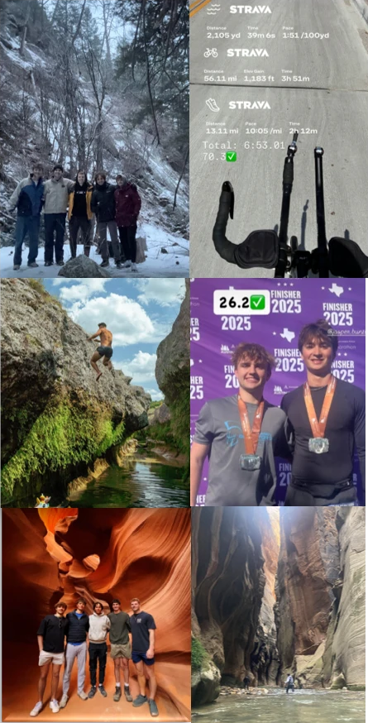
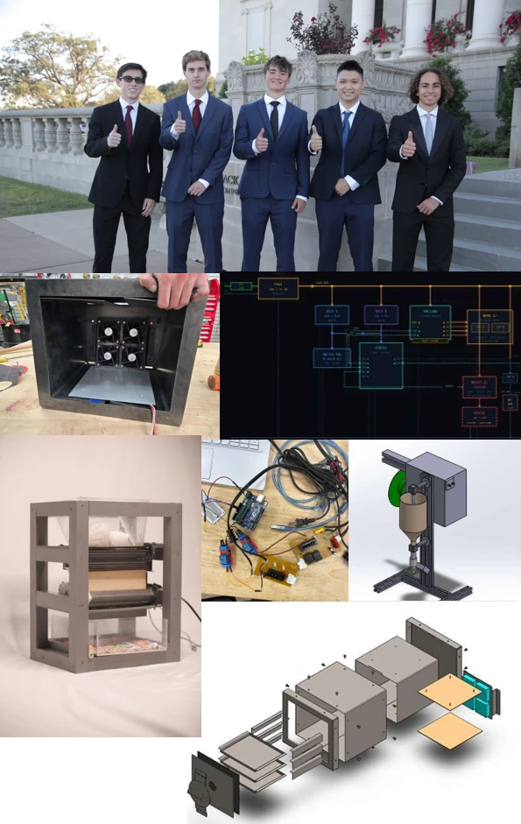

About me
Education: Texas A&M
Bachelor's, Mechanical Engineering, August 2027
Experience
ITP Lab, undergraduate research
Rochester Sensors, mechanical intern
Petrobras, mechanical intern
Aggies Create, EcoFil electrical lead
Hobbies
Personal projects
Soccer
Running
Bouldering
And man, do I love hiking.
Outdoors and endurance
Engineering
Community
Notes:
About me. The three collage columns are Jasper's About Me collage (docs/presentation/photos/README.md, about_me/ row, 10/22): outdoors and endurance (hikes, Ironman 70.3, 2025 marathon), engineering (EcoFil, team photo), community (Gladiator Dash for Still Creek Ranch). Degree and school per the brief's byline. Nothing else on the slide; add numbers only from memory you can back up.

Slide 3
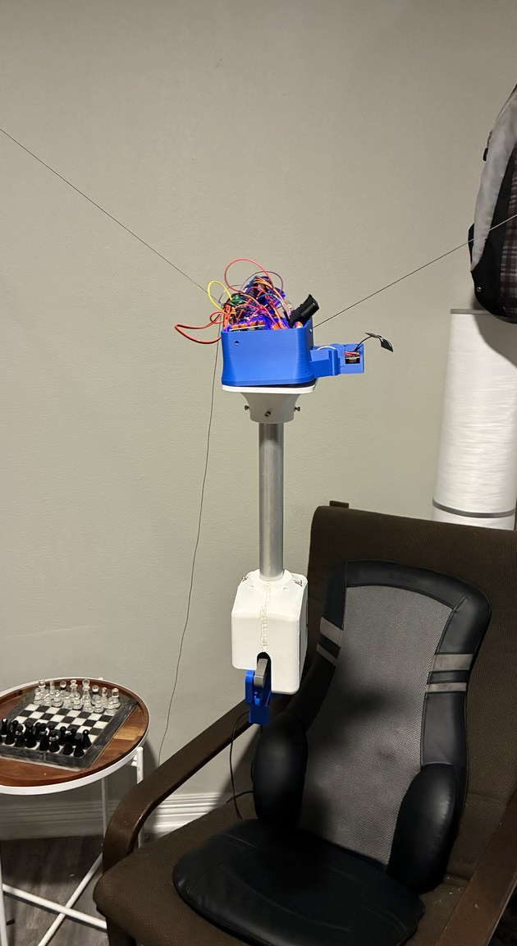
Project scope
The problem
Laundry on the floor of a 3.35 x 2.74 m room (as reported)
Ceiling 2.74 m; four studs near the ceiling corners
Design load: a pair of jeans, 0.9 kg (screening value)
Plus 2 m/s² for stops and snags (assumed)
The solution
Four ceiling winches, one claw on four cables
Nothing on the floor; the room is the frame
A camera on the claw finds the laundry
Floor to hamper with no human touch
How we do it
I approve each move on the phone
PAUSE holds position with torque on
The switched power strip is the emergency stop; it drops the claw
First gate: a 1 lb test weight, then jeans
Parts in the robot: about $211 for three stations, plus $38 filament (partly estimated)
The claw hanging in the room corner (Oct 27)
Notes:
Scope. Room 3.35 x 2.74 m under a 2.74 m ceiling, as reported (DECK_V9_NOTES.md slide 3; v9.1 origins). Design load 0.9 kg jeans, a screening value, plus 2 m/s^2 assumed (REQUIREMENTS R1/R7 via v9.1). Four winches in the studs, one claw on four cables (slide 3 row). PAUSE holds torque; the switched power strip is the emergency stop and drops the claw (D21 via slide 3). Success: one garment floor to hamper, each move approved on the phone; first gate a 1 lb test weight (D19). Cost: $210.78 of parts in the robot for three stations plus $37.74 filament, prices partly estimated (COST_BREAKDOWN_20261026.md headline table). Photo 42 (README row 42).

Slide 4
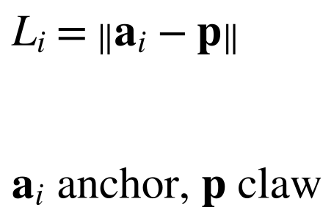

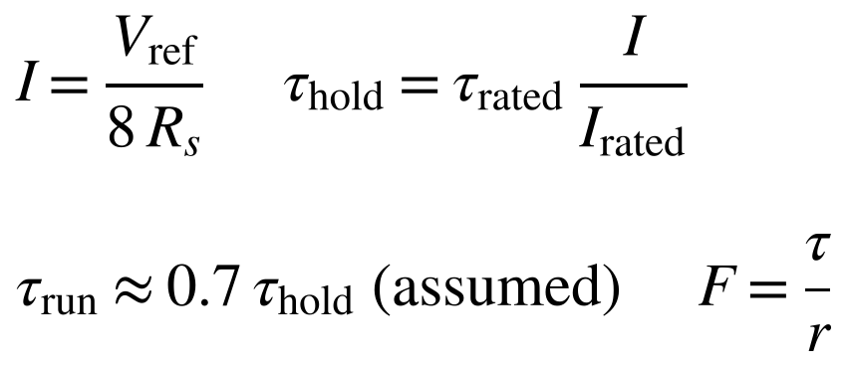
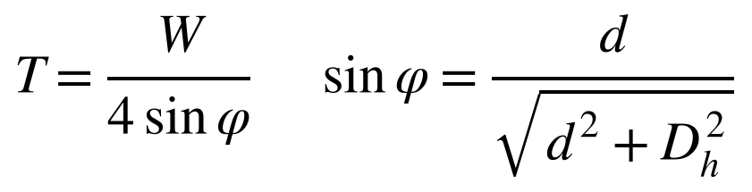
How cable length becomes position, and torque becomes pull
Cable length → position
Line per spool turn = 2π·r: 2π·7.5 mm = 47.1 mm (empty) → 2π·10 mm = 62.8 mm (full) (calculated)
Four cable lengths, three position unknowns: overdetermined, solved by least squares
The camera on the floor board fixes the anchors and cable lengths at startup (calibration)
Validated in the simulator and by held-out poses during calibration (simulated); no physical position measurement yet
Torque → pull on the line
At 1.5 A: τ_run = 0.7 × 0.36 N·m = 0.252 N·m; F = 0.252 / 0.0075 m = 34 N empty, 0.252 / 0.010 m = 25 N full (calculated)
Validated: Vref measured on the board; the 0.7 running fraction is assumed; the pull test is planned
Pull → what four cables hold
W = (0.454 + 0.45 kg) × 9.81 = 8.86 N, D_h = 2.166 m; d = 0.15 m: 8.86 / (4 × 0.069) = 32 N; 16 / 8.3 / 4.6 N at 0.3 / 0.6 / 1.2 m (calculated)
Shallow cable: T ≈ W·D_h / (4d), so halving the depth doubles the tension
Why the planner keeps the claw at least 0.4 m below the anchors
Validated: calculated only; no cable tension has been measured on the rig
Notes:
Fundamentals. Card A: straight taut cable, L_i = ||a_i - p|| (roomcleaner/cdpr/kinematics.py docstring; the full form adds R b_i for the spaced attachments). Line per revolution 2 pi r: 47.1 mm at r 7.5 mm to 62.8 mm at r 10 mm (FUNDAMENTALS.md section 2, spool-core study table: Ø15 core, full radius 10.0 mm). Four cable lengths against three position unknowns: overdetermined, least squares (kinematics.py docstring; the TENSION split is the indeterminate one); the camera on the floor board fits the anchors and cable lengths at startup (DECK_V9_NOTES slide 15); held-out poses check the fit (CALIBRATION_SIMPLE step 5, 'surprise spots'): SIMULATED, no physical position measurement. Card B: I = Vref / (8 R_s), tau_hold = tau_rated I / I_rated, tau_run = 0.7 tau_hold assumed, F = tau / r (FUNDAMENTALS section 2); at 1.5 A, the motor's rated current (DECISIONS D37), tau_hold 0.36 N.m, tau_run 0.7 x 0.36 = 0.252 N.m, running pull 0.252 / 0.0075 = 33.6 N and 0.252 / 0.010 = 25.2 N (calculations/lift_chain_weakest_link.json fuse.run_empty / run_full). Vref MEASURED on the board; 0.7 ASSUMED; pull test PLANNED (FUNDAMENTALS section 2 evidence line). Card C: T = W / (4 sin phi), sin phi = d / sqrt(d^2 + D_h^2); W = (0.4536 + 0.45) x 9.81 = 8.86 N (1 lb + the 0.45 kg claw budget), D_h = sqrt(1.676^2 + 1.372^2) = 2.166 m; 32.1 / 16.2 / 8.3 / 4.6 N at 0.15 / 0.3 / 0.6 / 1.2 m (FUNDAMENTALS section 1 table, recomputed); T ~ W D_h / (4 d) for a shallow cable; keep the claw at least 0.4 m below the anchors; CALCULATED, no tension measured on the rig (FUNDAMENTALS section 1). Figure: deck_v3/fig/position_vectors.png.

Slide 5
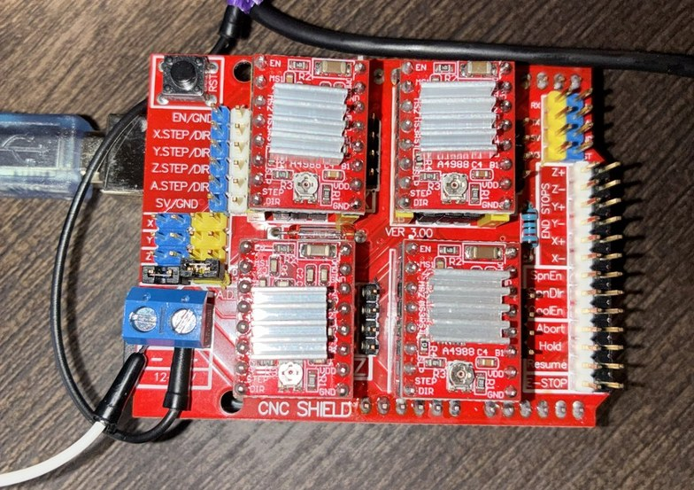
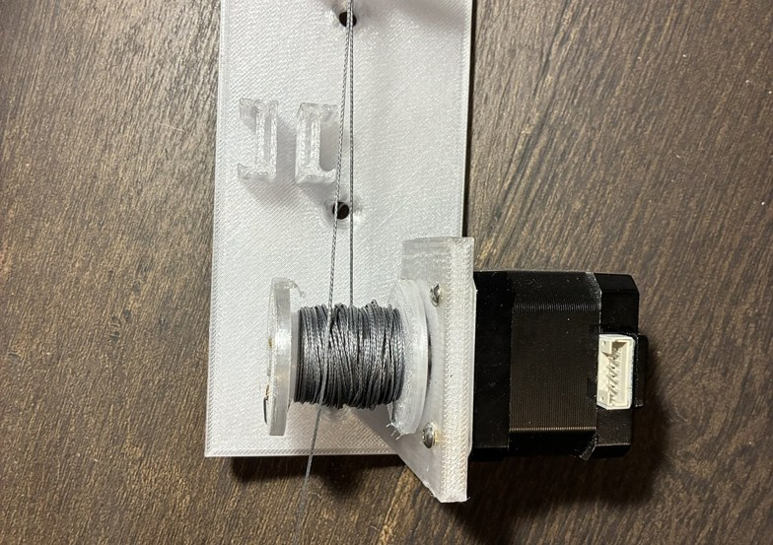

Generation 1: one central unit
The first design
One Uno and one CNC shield drove four corner motors
Wires from that one box to every corner
An overhead ceiling camera scanned the room
A printed corner plate screwed into a joist: a hook is a pivot, a plate is not
Each cable found zero against a bead at the outlet
Bench: a station lifted a test weight; the cable math held (measured)
The central board; a gen-1 corner plate; a gen-1 station lifting a test weight
Notes:
Generation 1. One central unit (an Uno with a CNC shield) drove all four corner motors over wires run to each corner; an overhead ceiling camera scanned the room (DESIGN_INTENT_20261027.md 'Iteration 1'; DECK_V9_NOTES.md v9.2 slide 7 row; DECISIONS D33 for the ceiling camera). A printed corner plate screwed into a joist replaced hanging hooks: a hook is a pivot, about 1:1 anchor error to claw error (slide 8 row, D13). Each cable homed against a crimped bead at the outlet (PANEL_FEEDBACK_ANSWERS, 'what bead homing is'). Bench: the station lifted a test weight (slide 8 row; the weight and height not logged). Photos 05, 13, 14 (README rows).

Slide 6
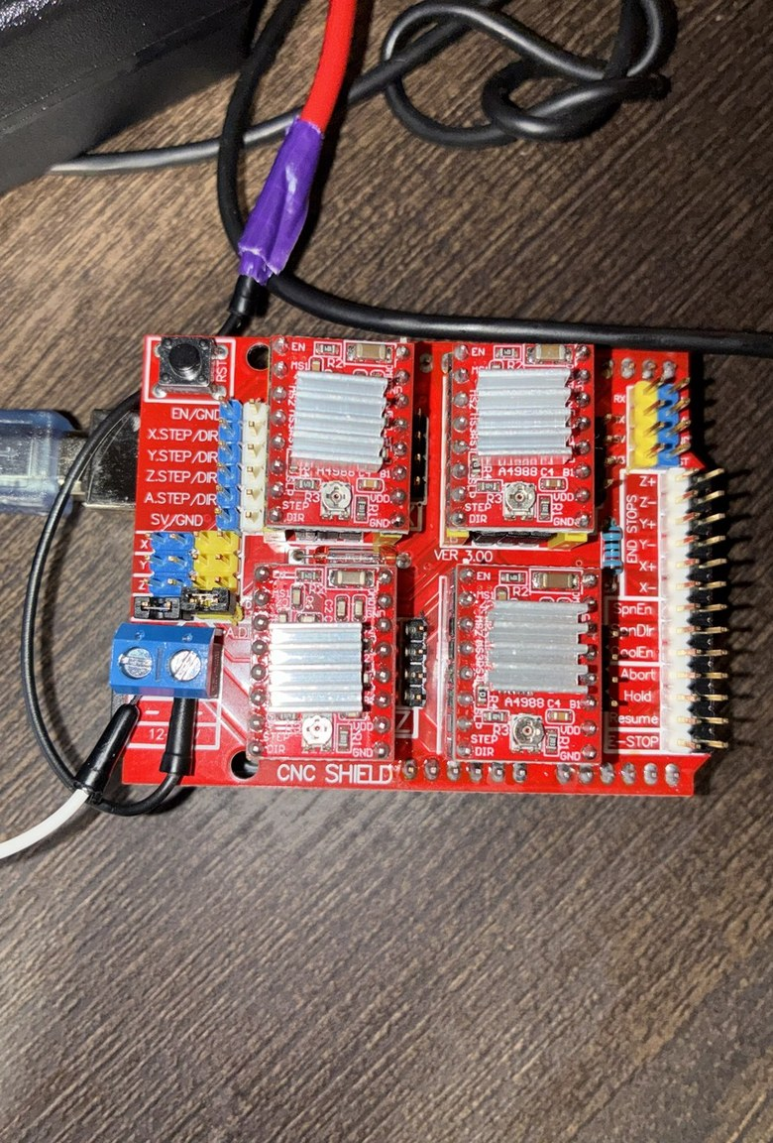
Problems with Generation 1
One central board
Every motor and every sensor wired back to one place
One board steps all four motors; a timing error skews the cables
Skew Δx = v·Δt = 50 mm/s × 0.05 s = 2.5 mm per 50 ms (calculated)
Moving a winch means re-running wire to the box
Ceiling camera and bead homing
The ceiling camera: one more device to mount, wire and calibrate per room
From above, the claw and cables hide the grasp spot
Its floor map assumes a flat floor; retired Oct 21
Bead homing fixes a minimum length on every cable: next slide
The central board: one shield, four drivers
Notes:
Problems with Gen 1. Every motor and sensor wired back to one place (DESIGN_INTENT_20261027.md 'Iteration 1'). One board stepping four motors: the cables skew by dx = v dt = 50 mm/s x 0.05 s = 2.5 mm per 50 ms of timing error (DECK_V9_NOTES.md slide 10 row; 50 mm/s maximum cable speed, FUNDAMENTALS.md section 2 supplied facts). The ceiling camera: one more device to mount, wire and calibrate in every room; the claw and cables hide the grasp spot from above; its floor map assumes a flat floor; retired Oct 21 (DECISIONS.md D33). Bead homing limits the reachable volume: next slide. Photo 14 (README row 14). Bench fixes from this period are in DOWN_THE_LINE.md.

Slide 7
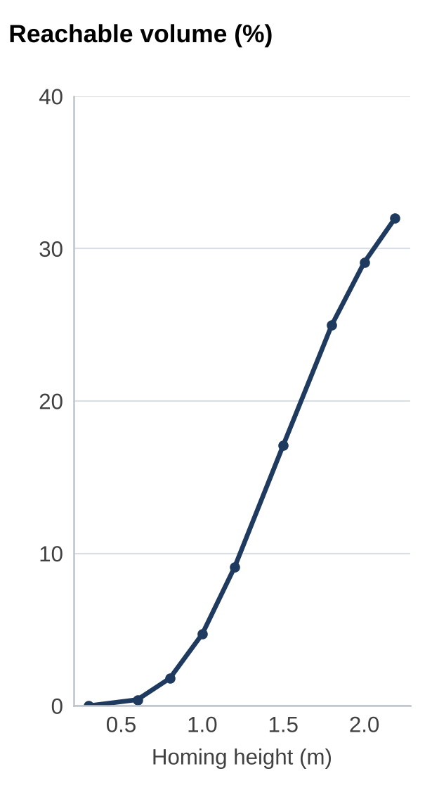
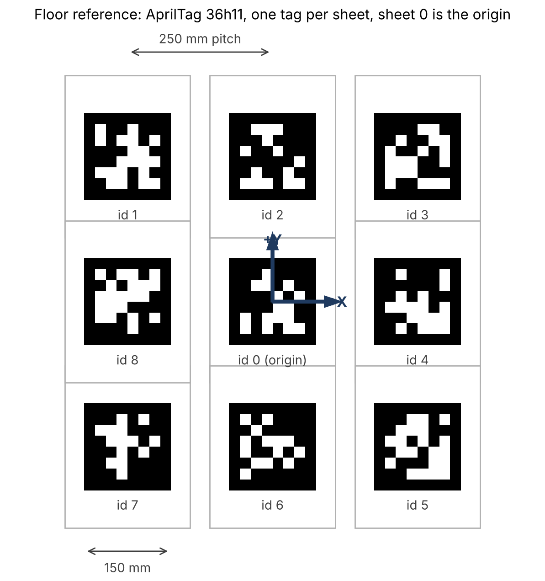
Homing: one floor board instead of four beads
Bead homing
A stopper bead cannot pass its outlet: after homing, no cable can be shorter than at home
Homing all four at once fixes a minimum length on every cable at the same time
Reachable volume, grid count (calculated): 0.0 % (home 0.3 m) to 32.0 % (home 2.19 m); 4.7 % at 1.0 m, 29.1 % at 2.0 m
Floor-board homing
The camera measures the claw pose against tag 0
Cable lengths follow from L_i = ‖a_i − p‖
No length is clamped: the whole working volume stays available
Nine sheets, 150 mm tags, 250 mm pitch, id 0 = origin
Grid count of the condition above
Notes:
Homing. Bead homing: a stopper bead cannot pass its outlet, so after homing no cable can be shorter than at home; homing all four with the claw at one pose fixes a minimum length on every cable at once: reachable(p) iff ||a_i - p|| >= L_i,home for every i (calculations/bead_reach.py docstring). Reachable share = fraction of grid points in the working volume (60 x 50 x 50 grid, 0.2 m wall margin, z 0.3 to 2.19 m) that satisfy it, home at the room centre: 0.0 % at 0.3 m up, 4.7 % at 1.0 m, 29.1 % at 2.0 m, 32.0 % at 2.19 m (calculations/bead_reach.json). Floor board: nine US-Letter sheets, one AprilTag 36h11 per sheet, 150 mm tags, 250 mm pitch, id 0 = origin (tools/print_floor_board.py; make_floor_board_figure.py). The camera measures the claw pose against the board; cable lengths follow from L_i = ||a_i - p|| (roomcleaner/cdpr/kinematics.py docstring); the startup fit estimates anchors and zero lengths (roomcleaner/cdpr/startup.py, SLACK_TAKEUP to CALIBRATION). No length is clamped, so the whole working volume stays available. Beads stay on the cables as end-of-travel switches (startup.py docstring, REFERENCE_VERIFICATION).

Slide 8
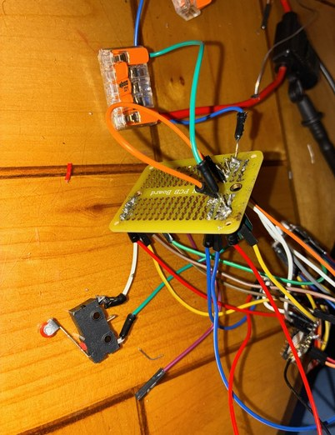
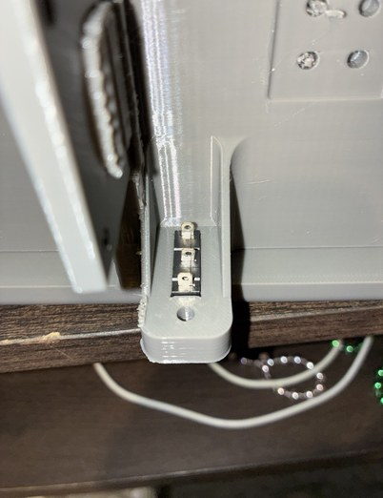
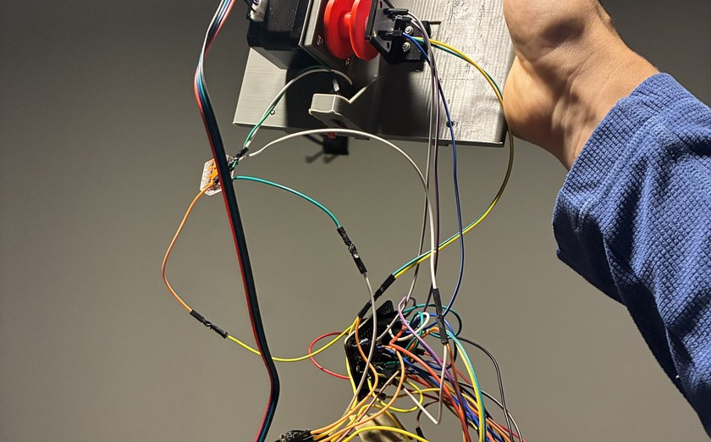
What a winch on a wall needs to work
The switch (button)
Things go wrong: a camera fails, a spool overwinds, tension rips a mount out, a motor stalls
A switch the cable's bead can hit: that station stops
Fail-safe wiring: LOW at rest, HIGH pressed or with a broken wire
The encoder
On the spool: measures the discrepancies while testing; data first
Confirms every commanded step
Catches slip: the tension sensor
If the camera proves good enough, it can go later
Homing switch
Switch pressed into the slide-in
And now all this wiring, from one box
Motor, switch and encoder in every corner: 10 conductors per corner
Routes 6 + 21 + 23 + 32 = 82 ft; × 10 conductors = 820 ft (250 m) of wire to one box (calculated)
One slide-in, its harness hanging
Notes:
What a winch needs. A motor bolted to a wall cannot just run: a camera can fail, a spool can overwind, tension can rip a mount out, a motor can stall; so each winch gets a switch (button) and a spool encoder (DESIGN_INTENT 'Why it changed'). The encoder measures discrepancies while testing; if the camera proves good enough it can go later; data first (same). Its two jobs today: confirm every commanded step, catch slip as the tension sensor (DECK_V9_NOTES slide 20 row). Fail-safe switch wiring: LOW at rest, HIGH pressed or with a broken wire (slide 20 row). Beads stay as end-of-travel switches (PANEL_FEEDBACK_ANSWERS 'bead homing'). Wiring from one box: routes 6 + 21 + 23 + 32 = 82 ft, x 10 conductors = 820 ft (250 m) (DECK_V2_OUTLINE.md line 85; DECK_V9_NOTES v9.2 slide 10 row). Photos 09, 23, 39 (README rows).

Slide 9
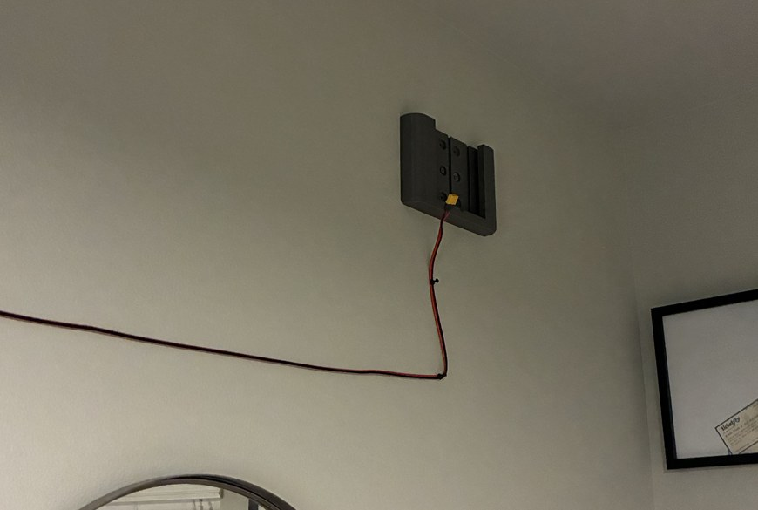
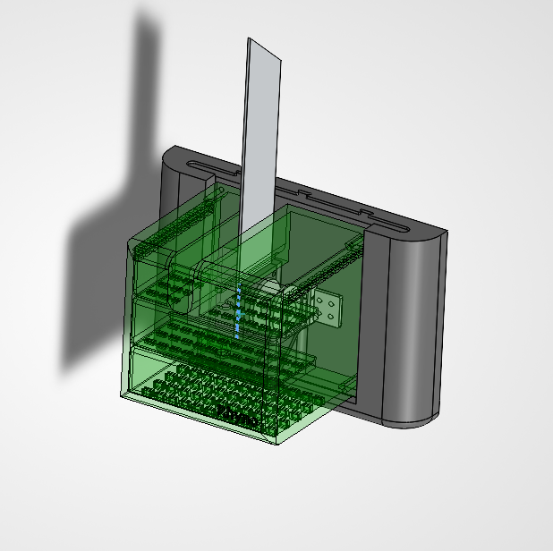
The solution: a modular box that only needs power
A box with its own brain
An ESP32 in each box, with its driver, buck, switch and encoder
The only thing going in is power: one 12 V pair
82 ft × 2 conductors = 164 ft (50 m) of wire, not 820 ft (calculated)
Power can come from anywhere, so a box sits in any position and orientation
The room's geometry no longer limits where the winches go
Wire drop: Gen 1 leads vs one power pair
V = I·ρ·2L/A; copper ρ = 1.724×10⁻⁸ Ω·m, L = 9.75 m (32 ft) one way, I = 2 A
24 AWG Gen 1 motor leads, A = 0.205 mm²: R = 1.64 Ω, 3.29 V (27 % of 12 V), 6.6 W (calculated)
16 AWG power pair, A = 1.309 mm²: R = 0.257 Ω, 0.51 V (4.3 %), 1.0 W (calculated)
Thin motor leads over a room-length run lose a quarter of the supply; one thick power pair loses 4 %
16 AWG: $30 per 100 ft × 65 ft = $19.50 (price estimated)
The wall mount: one power plug
The station: board, driver, motor, fin (CAD)
Notes:
Modular box. Each box has its own ESP32 and everything it needs; the only thing entering is power, on a thicker wire (DESIGN_INTENT 'Iteration 2'). 82 ft of routes x 2 conductors = 164 ft (50 m) instead of x 10 = 820 ft (250 m) (DECK_V2_OUTLINE.md line 85). Any position and orientation (DESIGN_INTENT). Wire drop: V = I R' L_loop; longest branch 32 ft one way, 64 ft of loop; 16 AWG loop resistance 0.257 ohm over 64 ft = 4.02 ohm/kft; at 2 A: 2 x 0.257 = 0.51 V, 2 A illustrative (FUNDAMENTALS.md section 10; Gen 1 comparison: 24 AWG motor leads, Jasper 10/27, computed with the same formula: R = rho 2L / A, rho = 1.724e-8 ohm m, L = 32 ft = 9.75 m one way, AWG diameter 0.127 mm x 92^((36 - n)/39): 24 AWG A = 0.205 mm^2, R = 1.64 ohm, V = 2 x 1.64 = 3.29 V (27 % of 12 V), P = I^2 R = 6.6 W; 16 AWG A = 1.309 mm^2, R = 0.257 ohm, 0.51 V (4.3 %), 1.0 W (FUNDAMENTALS section 10 table). PANEL_FEEDBACK_ANSWERS 'How longer wires increase voltage drop'). Cost: 16 AWG 100 ft roll $30.00 (est.), 65 ft used for three stations, $19.50 prorated (COST_BREAKDOWN_20261026.md section 1, 16 AWG row). Photos 33, 46 (README rows); SolidWorks screenshot of the station shell, transparent (deck_assets/screens).

Slide 10
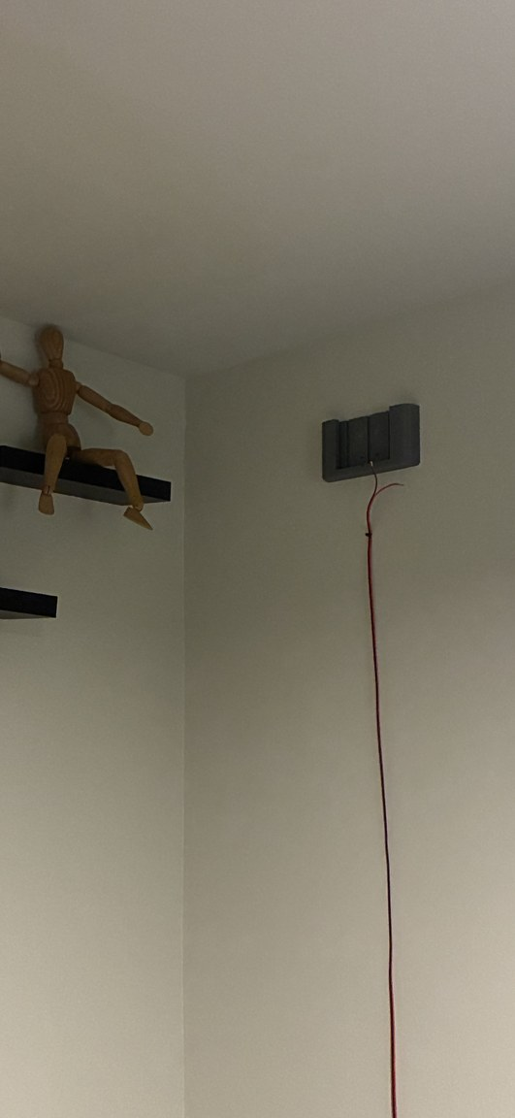
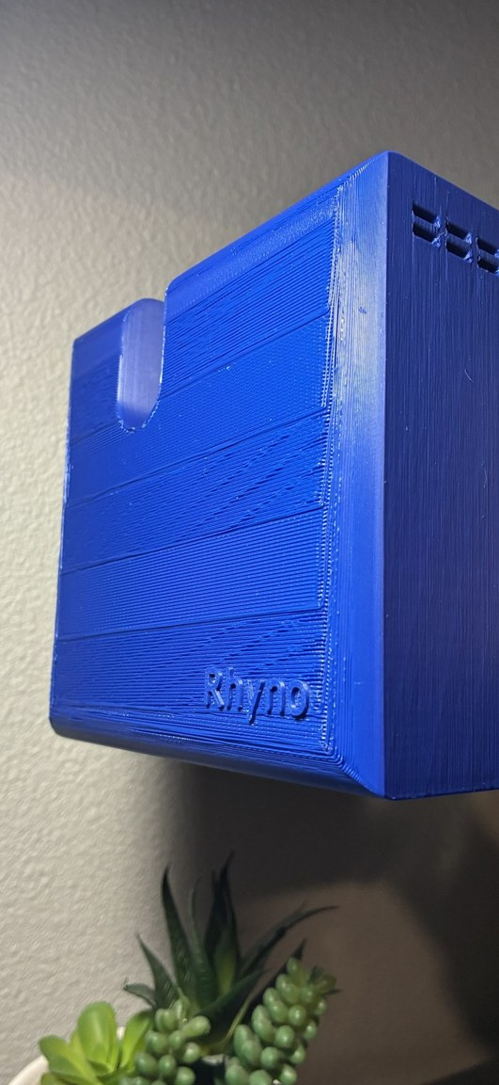
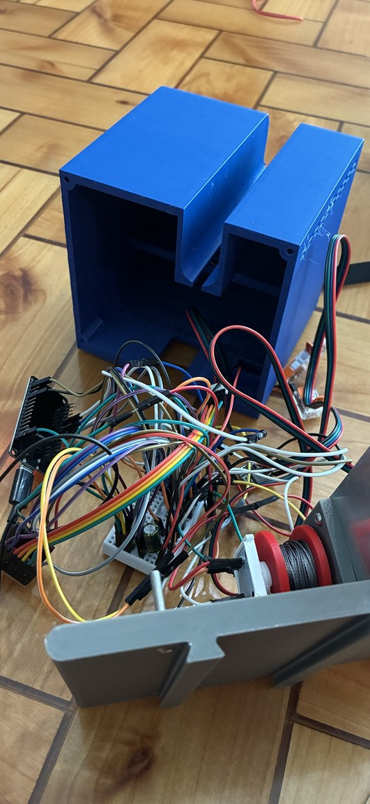
Modular, for the everyday user
Unmount, remount, plug in
A box slides off its wall mount and unplugs
Guests coming: each box goes in a drawer
Back on: one plug, it joins the Wi-Fi by itself
No screwdriver on the wall
Slip the station out of the mount, open the electronics
Close it, slide it back: the mount and its screws stay in the stud
The mount is separate: a stud today, a pole clamp later
The wall mount alone, lead hanging
The station slid onto it
Shell open on the bench
Notes:
Everyday use. Plug and play: once a box works it works; it slides on and off the wall and plugs and unplugs; guests come, each box slips off and goes in a drawer; back on, one plug, it joins the Wi-Fi by itself (DESIGN_INTENT 'Iteration 2'). Slip the station out of the mount to open the electronics, close it, slide it back; no unscrewing from the wall: the wall mount and its screws stay in the stud (DECK_V9_NOTES slide 12 row 'One plug per station'). A product, not a tangle: individual packaged boxes with one plug and a Wi-Fi setup (DESIGN_INTENT). The mount is separate: today a slide-in screwed into a stud, later a clamp onto a pole, like gym equipment (DESIGN_INTENT). Photos 45, 24, 31 (README rows).

Slide 11
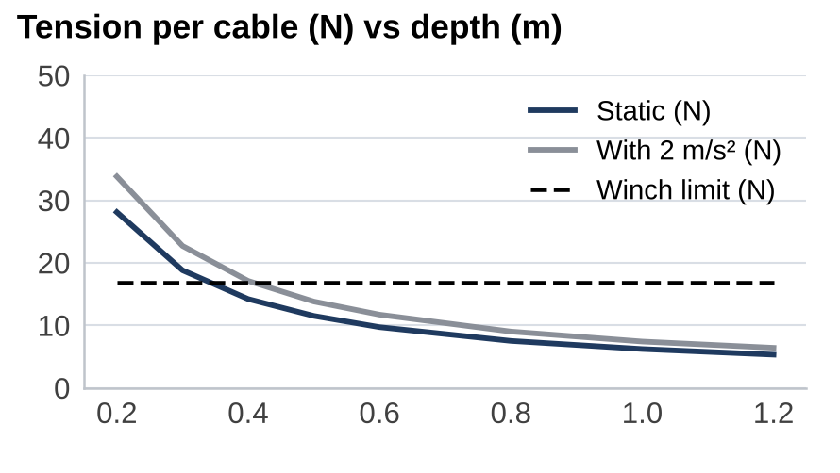
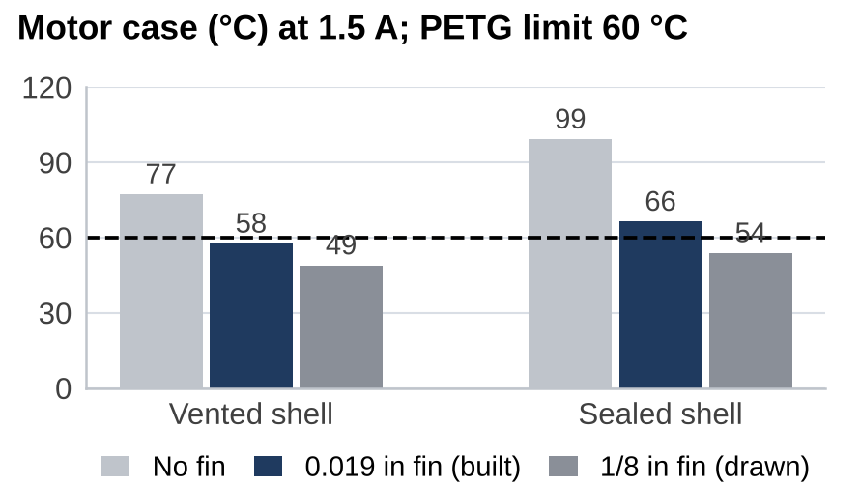
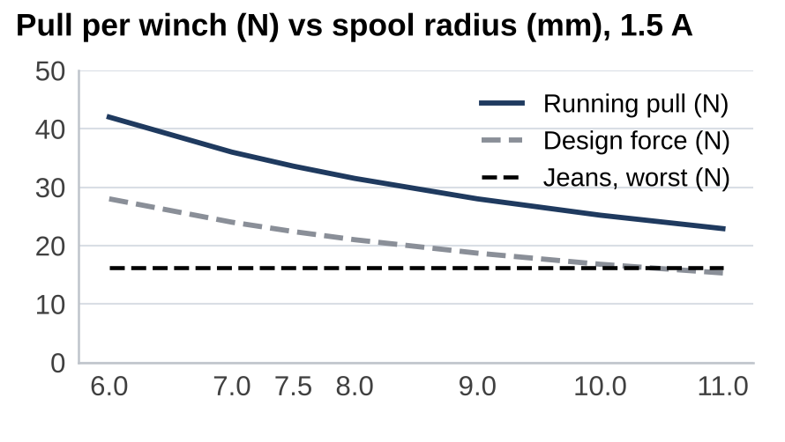
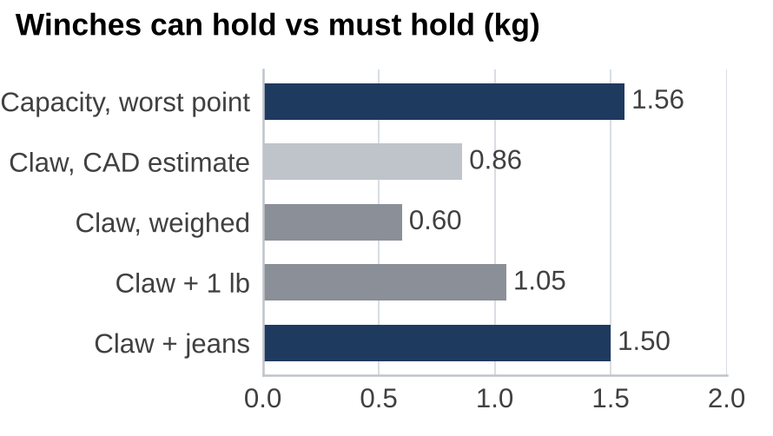
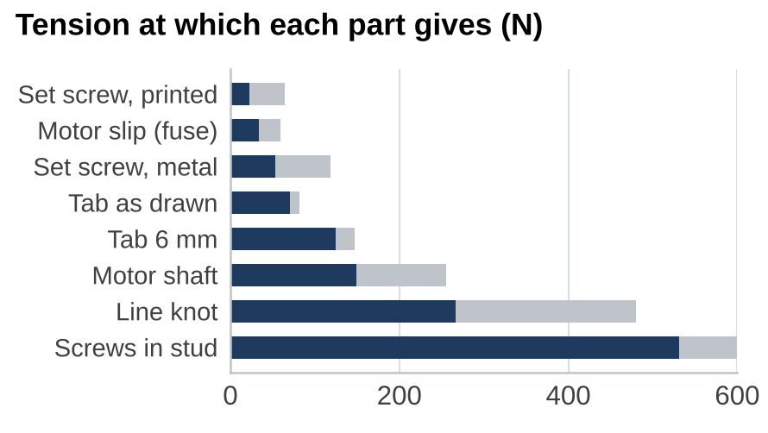
Trade-offs: what each component needs
T = m(g + a) / (4 sin φ): 1 lb at d 0.4 m → 17.1 N vs 16.8 N limit; jeans need d ≥ 0.6 m (16.6 N)
Need < 60 °C. Two-node thermal network; input P = I²R = 1.5² × 1.8 Ω = 4.05 W
F = 0.252 N·m / r: 34 N (7.5 mm), 25 N (10 mm); ÷ 1.5 = 16.8 N ≥ 16.2 N jeans
The factors
Pull ∝ I; heat P = I²R ∝ I²
1.0 → 1.5 A: pull × 1.5, heat × 1.5² = 2.25 (calculated)
Every gram on the claw is a gram of payload
Printed set screw (22–64 N) may slip first: metal insert
16.8 N / (1.101 × 9.81) = 1.56 kg vs 1.50 kg: +4 %; claw 0.60 kg weighed vs 0.45 budget
Motor slip 0.36 N·m / 7.5 mm = 48 N; × 1/√2 = 34 N, × 1.11 / cos 26° = 59 N
Notes:
Trade-offs, all calculated unless marked. Tension vs depth: T = W / (4 sin phi) with the weighed claw plus 1 lb; at 0.4 m below the anchors 14.3 N static, 17.2 N with 2 m/s^2, against the 16.8 N winch limit; with jeans the claw stays 0.6 m down (DECK_V9_NOTES slide 6 row; FUNDAMENTALS section 1). Motor temperature at 1.5 A, 23 C room: no fin 77.2 / 99.1 C vented / sealed, 0.019 in prototype fin 57.6 / 66.3, 1/8 in design fin 48.9 / 53.8; PETG limit 60 C (deck_v8/fig/sheet_motor_temperature; calculations/fin_sizing_4w.md coupled results 55.9-58.8 C vented). Winch pull: 0.7 x 0.36 N.m holding (0.7 assumed) over the spool radius: 34 N empty core, 25 N full; design force = running / 1.5 = 16.8 N; jeans worst cable 16.2 N (calculations/lift_chain_weakest_link.md 'Demand and the fuse'; slide 17 row). Weight: 0.45 kg budget (R7), 0.86 kg CAD estimate with battery, 0.60 kg weighed 10/22 (PANEL_FEEDBACK_ANSWERS slide 16); capacity m = F_design / (k g) = 16.8 / (1.101 x 9.81) = 1.56 kg, k = 1.101 the worst-cable tension per unit weight (LP, lift_chain_weakest_link.md; winch_gear3.json direct_drive.capacity_kg 1.555); jeans 1.50 kg: (1.56 - 1.50) / 1.50 = 4 %. Motor temperature chart: two-node thermal network (fin_sizing_4w.py), input P = I^2 R = 1.5^2 x 1.8 = 4.05 W; no temperature measured. Tension Need line: 1 lb + 0.60 kg claw at d 0.4 m: 1.054 x 11.81 / (4 x 0.1816) = 17.1 N; jeans + claw 1.50 kg at d 0.6 m: 16.6 N. Weakest link: cable tension at which each part gives, one station at 1.5 A (lift_chain_weakest_link.md ranking table): motor slip 0.36 / 0.0075 = 48 N; low 48 / sqrt 2 = 33.9 N; high 0.36 x 40/36 / 0.0075 / cos 26.05 deg = 59.4 N (json fuse); the set screw in the printed thread 22-64 N may give first, so it moves into a metal insert; screws in a stud 531 N and up (bar capped at 600).

Slide 12
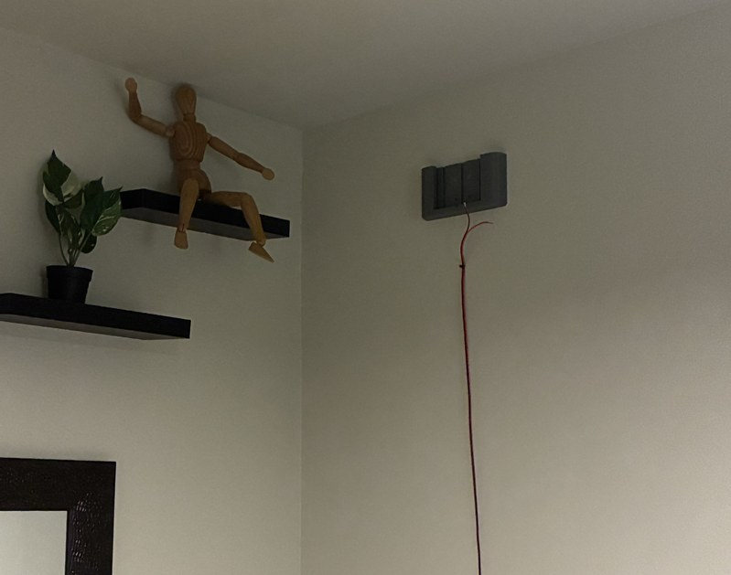
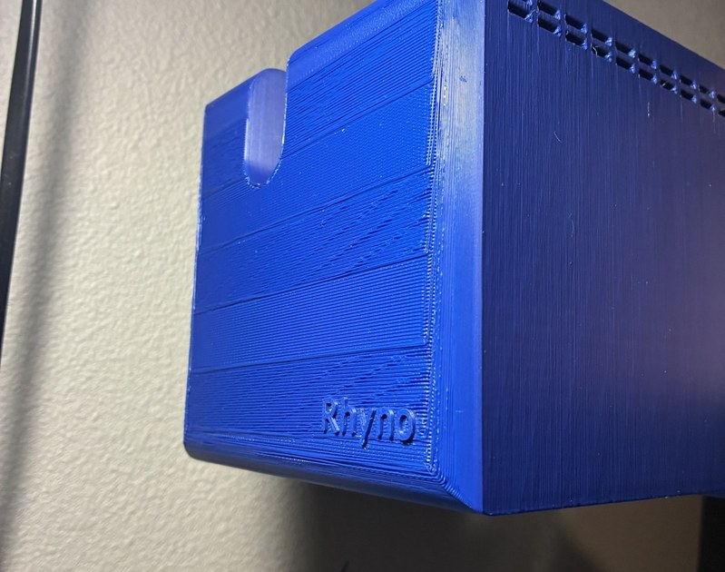
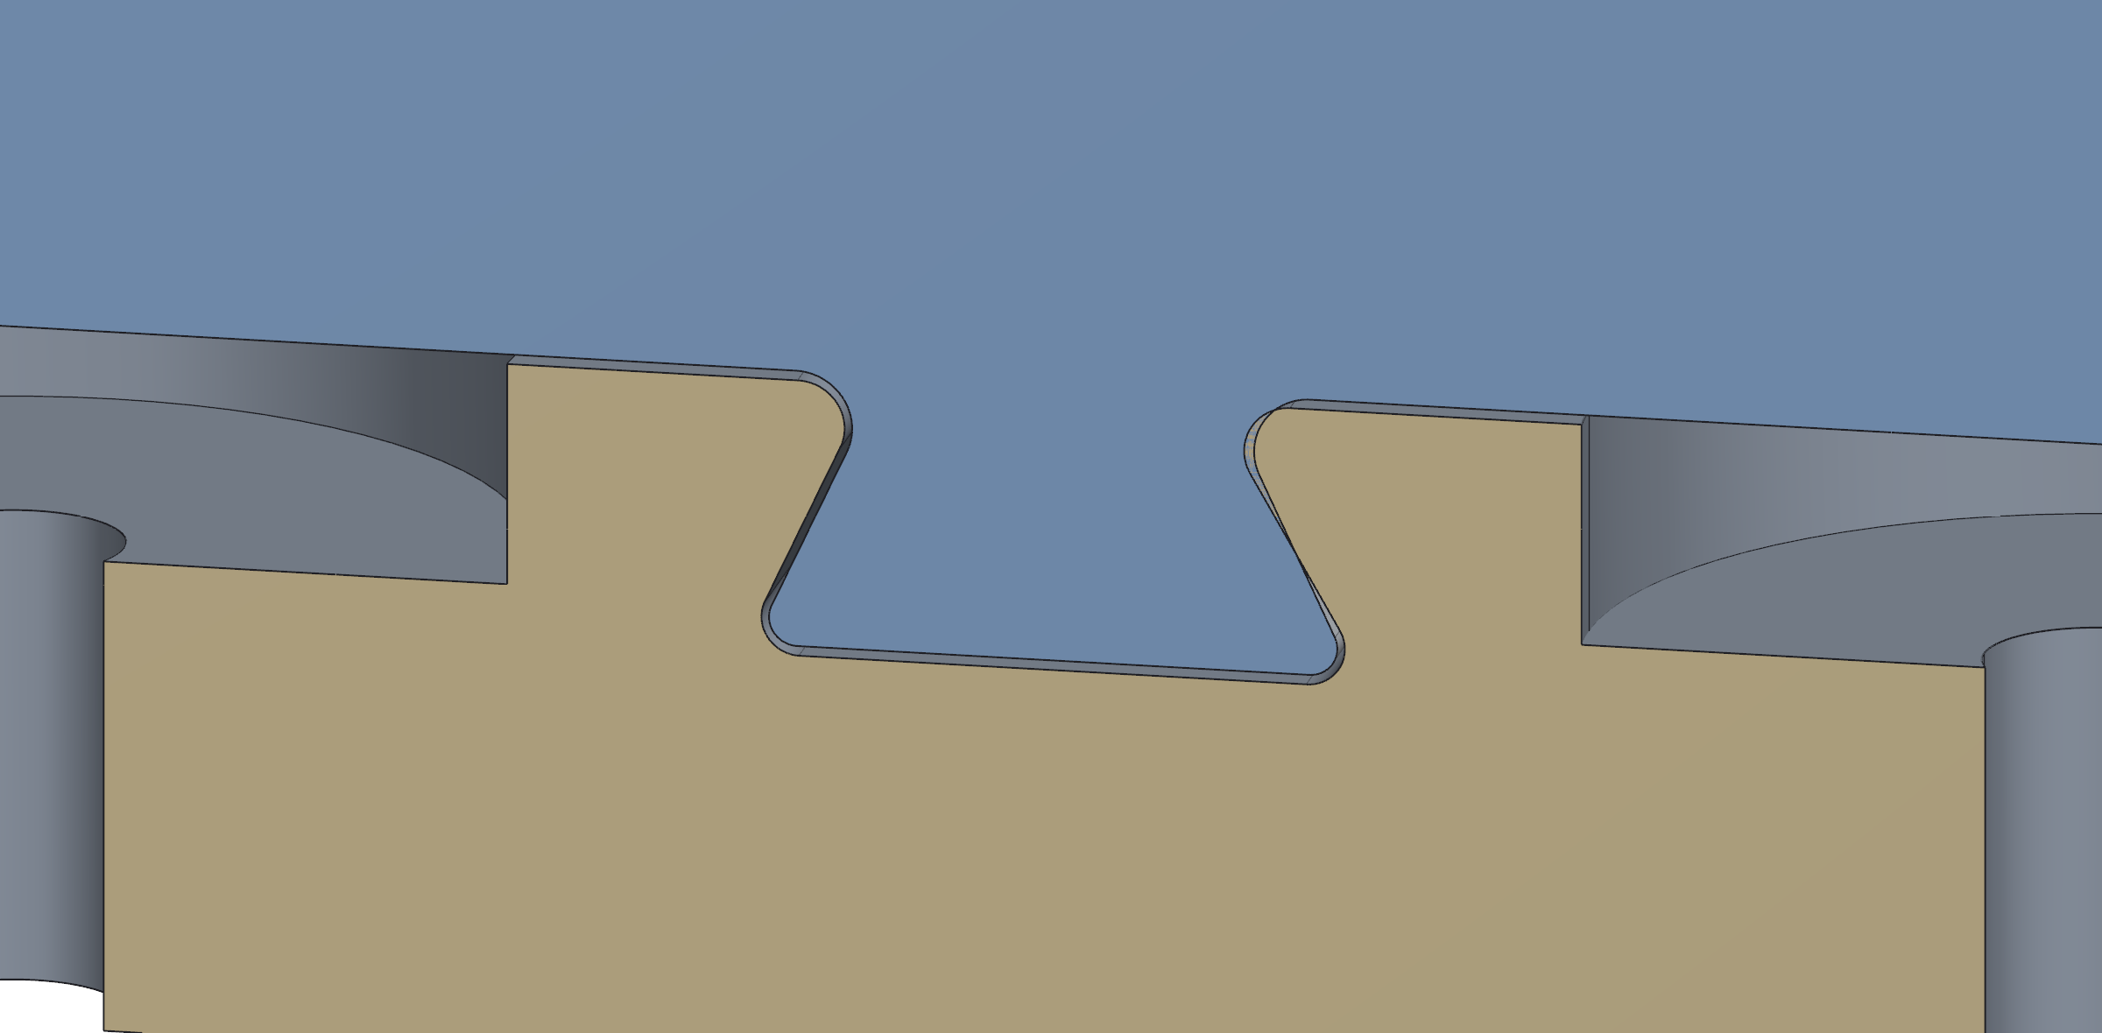
The mount assembly: slide-in on a dovetail
Slide-in mount and load path
The wall mount screws into a stud; the station slides onto it on a dovetail
Dovetail clearance 0.175 mm per side on 30° flanks (measured on the CAD)
Load path: cable, spool, set screw, motor, tab, mount, screws, stud
Motor slips first: F = τ/r = 0.36 N·m / 7.5 mm = 48 N; 34–59 N over torque vector and cable angle (calculated)
The spool encoder sees the slip: tracking fault, every station holds
The mount alone, before the station slides in; the station on the mount
Rib in the dovetail groove (CAD); the station with its shell transparent (CAD)
Notes:
Mount assembly 1. Slide-in wall mount: the station lifts off its dovetail; the wall mount and its screws stay in the stud (DECK_V9_NOTES slide 12 row). Load path: cable, spool, set screw, motor, PETG tab, slide-in, wall mount, screws, stud (same row; lift_chain_weakest_link.md 'The chain and the rule'). The motor slips at 34-59 N before anything breaks, the designed fuse; the spool encoder sees the spool fall behind the commanded steps: a tracking fault, every station holds (slide 13 row). Fuse: 0.36 / 0.0075 = 48 N, 33.9 to 59.4 N (lift_chain_weakest_link.md 'The chain and the rule'). Dovetail 0.175 mm a side on 30 deg flanks, measured on Jasper's STEP files (PANEL_FEEDBACK_ANSWERS 'Manufacturing fits', row 'Slide-in mount'; deck_v8 fits table). Photos 45, 24; snap_dovetail.png (deck_v8/fig); station_shell_transparent_1022.png.

Slide 13
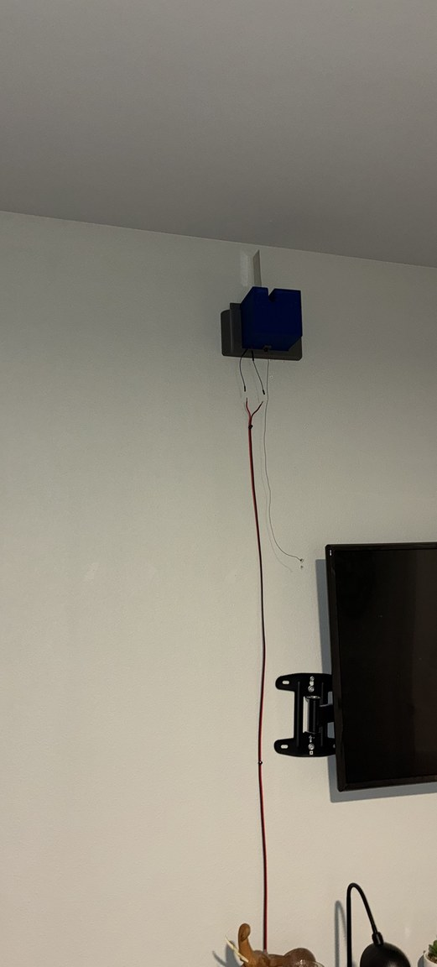
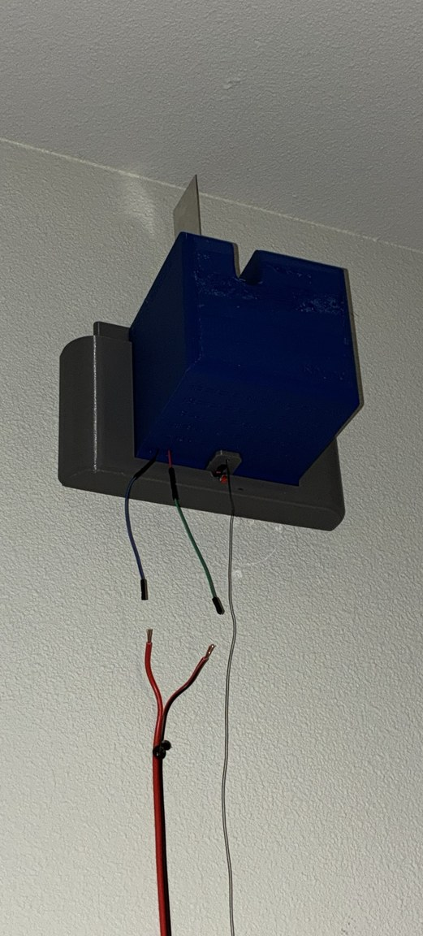
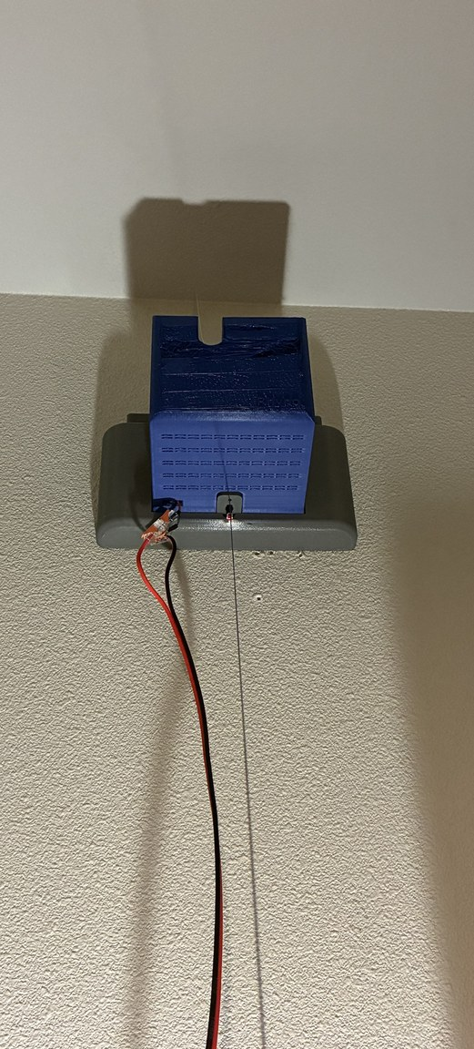
The mount assembly: fin, vents and the wall
Fin, vents, stud
The fin: aluminium on the motor face, out through a slot in the top of the shell
Motor heat P = I²R = 1.5² × 1.8 Ω = 4.05 W leaves through vents and fin (calculated)
First station in a stud on the TV wall, 12 V down the wall
The slide-in binds on insertion today; a 1° draft on the dovetail is the next iteration
On the TV wall, 12 V leads down
From below: fin through the slot
The line leaves the switch tab straight down
Notes:
Mount assembly 2. The aluminium fin bolts to the motor face and goes out through a slot in the top of the shell; the shell is vented (DECK_V9_NOTES slide 16 and 22 rows; README rows 27, 34, 36). Heat P = I^2 R = 1.5^2 x 1.8 = 4.05 W, 1.8 ohm assumed (FUNDAMENTALS section 3). The fin temperatures come from a two-node thermal network (fin_sizing_4w.py) and are not on the slide. First station in a stud on the TV wall, 12 V down the wall (slide 22 row). Load path and fuse as on the previous slide. A 1 deg draft on the dovetail is the NEXT iteration: the slide-in binds on insertion today (slide 24 row). Photos 32, 33, 44 (README rows).

Slide 14
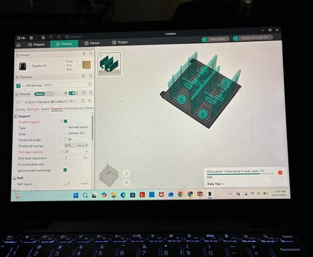
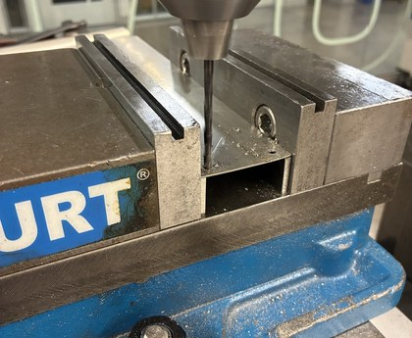
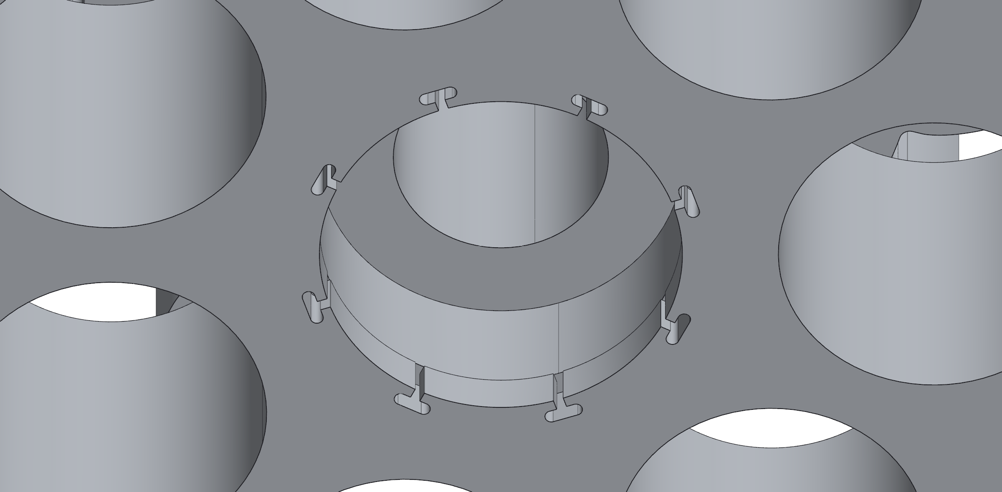
Manufacturing: in-house processes and fit control
Processes
PETG, FDM: 0.4 mm nozzle, 0.20 mm layers, supports at 30°; loads along the layers
Aluminium fin: sheared blank, five holes drilled in one mill setup
First hole is the mill zero: pattern ±0.1 mm vs ±0.5 mm sheared edges
Heat-set inserts: M3 gear housing, M2.5 encoder board
Fits
Printed holes come out undersize: every printed fit carries an allowance
Spool bore: Ø5.2 printed too tight on the Ø5.0 shaft; opened to Ø5.45
Dovetail: 0.175 mm per side, 30° flanks (CAD)
Bearing pocket Ø14.075 behind a Ø14.000 entry lip, 8 T-slots
Hole-sweep fit coupon (Ø5, Ø7, Ø14): planned
A failed layer was kept on one shell only: the shell carries no load
TPU 95A: pad trials only; none in the current build
Slicer (K1, PETG); drilling the fin
Make vs buy
Bought: steppers, drivers, boards, servo, camera, battery, encoders
Made: every printed part and the fin
Filament per station: 0.762 kg × $15/kg = $11.43 (estimated)
Robot: $210.78 parts + $37.74 filament, three stations (partly estimated)
Dovetail rib; bearing pocket and lip (CAD)
Notes:
Manufacturing. Process: PETG on a Creality K1, 0.4 mm nozzle, 0.20 mm layers, supports at 30 deg (photos 20, 26; deck_v8 'Manufacturing: Fits and Datums' printing rules: loads along the layers, mating faces off supports). Fin: blank sheared 44 x 250 mm (+/-0.5), five holes drilled in one setup on the manual mill; the edges locate only the first hole, which becomes the mill zero, so the pattern holds +/-0.1 (DECISION_STORIES.md T31/T32 line 277; photo 01). Heat-set inserts: M3 in the claw gear housing, M2.5 at the encoder board (deck_v8 fits table). TPU 95A: pad trials (DESIGN_INTENT 'The gripper'); none in the current build, the hands are PETG (COST_BREAKDOWN section 2; D32). Fits: printed holes come out undersize (FUNDAMENTALS section 12); spool bore Ø5.2 printed too tight on the Ø5.0 shaft, opened to Ø5.45 in v3 (FUNDAMENTALS section 12 supplied facts); dovetail 0.175 mm per side on 30 deg flanks, measured on Jasper's STEP files (deck_v8 fits table; PANEL_FEEDBACK_ANSWERS fits row); 687 bearing pocket Ø14.075 behind a Ø14.000 entry lip, 1.95 mm long, 8 T-slots (FUNDAMENTALS section 12; snap_gear_lip.png from make_mfg_snapshots.py). The hole-sweep fit coupon (Ø5, Ø7, Ø14, -0.10 to +0.30 mm) is PLANNED (FUNDAMENTALS section 12 evidence line). One shell kept a failed layer: a shell, not a load path (DECK_V9_NOTES slide 19 row; photo 35). Make vs buy: bought steppers, drivers, controller boards, servo, camera, battery, encoder boards (DECK_V9_NOTES slide 4 row); made: every printed part and the fin. Printed per station 762 g (estimate: CAD volume x 1.27 g/cm^3 x fill factor, COST_BREAKDOWN section 2); filament 0.762 kg x $15/kg = $11.43 per station; station-only bought parts about $23.70 per station; robot $210.78 parts + $37.74 filament for three stations, prices partly estimated (COST_BREAKDOWN headline table and section 1 note).

Slide 15
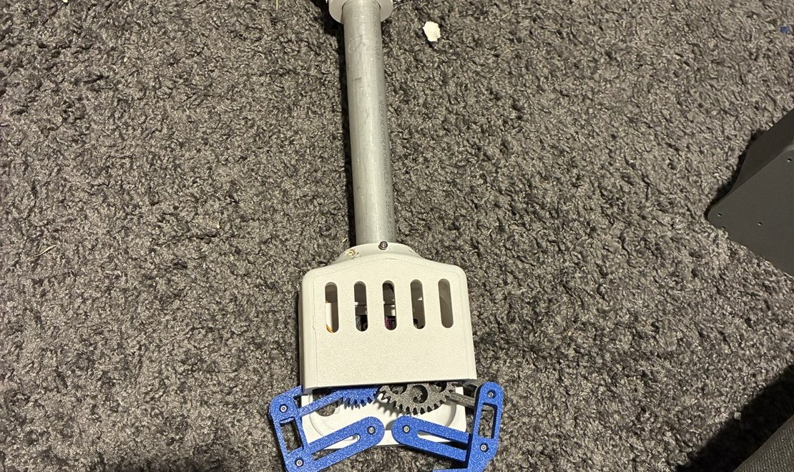


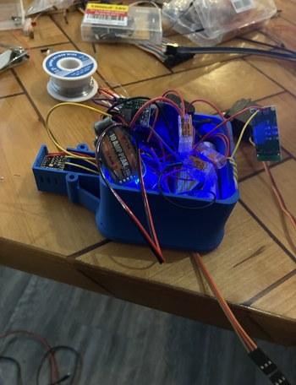
The claw, and why it is modular
The claw today
Four-bar hands on a geared crank; 53 mm opening (CAD)
A camera bay in the electronics housing; the camera looks down the tube
One 7.4 V two-cell pack: 6 V regulator for the servo, 5 V buck for the board
Weighed 0.60 kg with battery against a 0.45 kg budget
Modular, on purpose
The gripper attaches at the tube, so other grippers can be tried
A hard pinch was expected to grip better; testing showed alignment problems
The first rack-and-pinion jaws left a 2 mm gap on thin cloth (Sep 30)
TPU and other pad materials are being tried; still testing
The v6 clamp was 4.6 x its mass budget in CAD: mass is tracked per part since
Assembled; the hands (CAD); the v6 clamp (CAD); the housing open
Notes:
Claw. Four-bar hands on the gear crank, 53 mm opening (CAD; the parallelism figure is a linkage model, not shown); a camera bay on the electronics housing; one 7.4 V two-cell pack, a 6 V regulator for the servo, a 5 V buck for the board (DECK_V9_NOTES slide 18 row 'The claw'). The gripper attaches modularly at the tube, by design, a test bed for shirts (DESIGN_INTENT 'The gripper'; v9.2 slide 18 row). A hard-material pinch was expected to grip better; testing showed alignment problems: the rack-and-pinion jaws left a 2 mm gap on thin cloth, Sep 30 (v9.2 slide 18 row; no cloth-test reading logged). TPU and other pad materials being tried (DESIGN_INTENT). The v6 clamp came out at 4.6x its mass budget in CAD, Oct 20; since then mass is tracked per part; the claw weighed 0.60 kg with battery against the 0.45 kg budget (slide 11 and 17 rows). Photos 25, 40, 22; renders gripper1021_head.png, claw_v6.png.

Slide 16
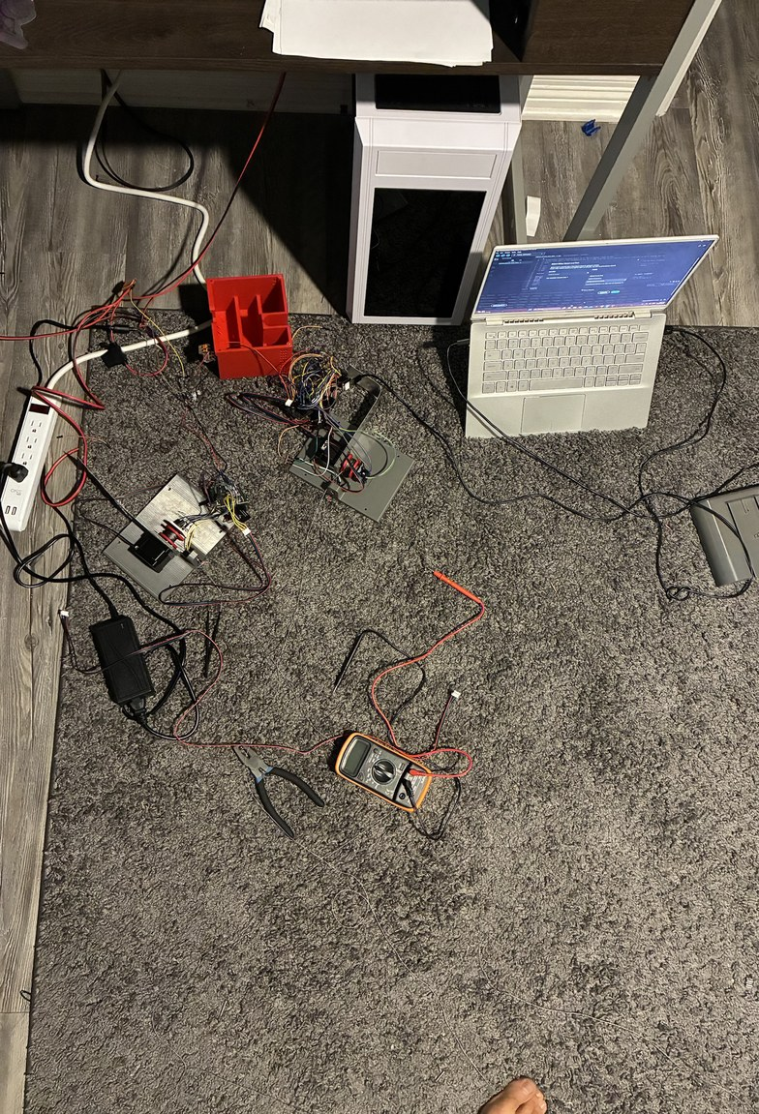
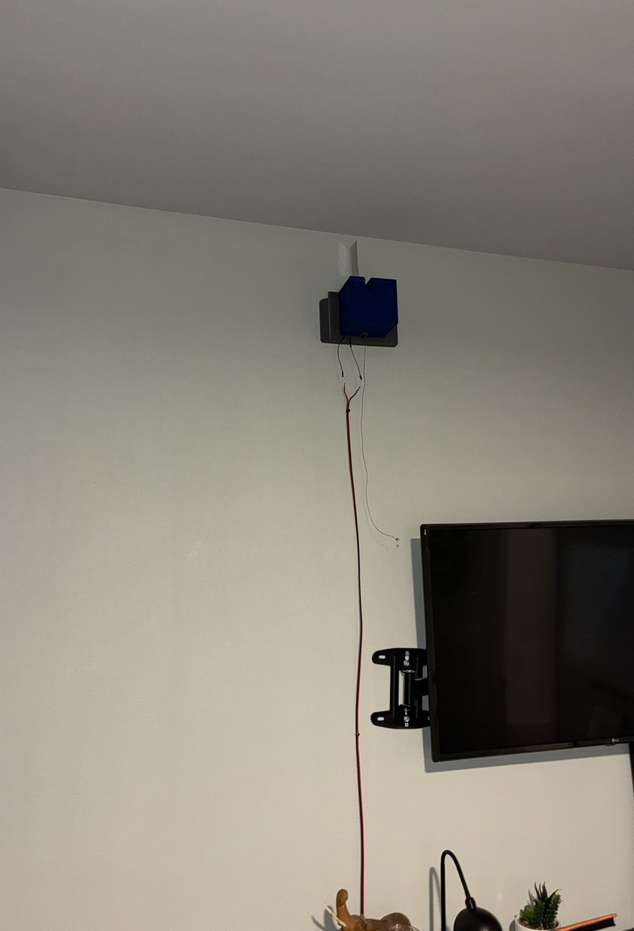
Electrical and testing: bench, then wall
Bench
Station boards: bench checklist passed on both controller boards (measured)
Claw: camera live view, battery sense and servo pass (measured)
On the wall
A boxed station boots and joins Wi-Fi by itself
Firmware updates over Wi-Fi; no USB cable after boxing
Motors stay off until the phone arms them; updates only while disarmed
Planned: pull test, hold test, first three-station lift
Bench: two stations, laptop, meter, 12 V supply
The first station on the wall
Notes:
Electrical. Station boards: the bench checklist (firmware/station_bench_test/README.md) passed on both boards, ELEGOO ESP32 and XIAO (DECK_V9_NOTES slide 20 row, 10/25-10/26). Claw Rev B: camera live view, battery sense and servo pass on the bench (DECK_V9_NOTES slide 21 row; DESIGN_STATE 10/26). On the wall: boxed stations boot and join Wi-Fi on their own; firmware updates over Wi-Fi; motors off until the phone arms them; updates accepted only while disarmed (slide 22 row). Planned: pull test at 1.5 A, 90-minute hold test, first three-station lift (slides 25, 26). Bench details in DOWN_THE_LINE.md. Photos 43, 32 (README rows).

Slide 17
Startup and self-calibration: six states before the robot is READY
1 SELF_CHECK
Claw online, battery above minimum
Camera confirms the claw upright at the known height on the floor board
Stations healthy, homing switches closed; arm
2 SLACK_TAKEUP
One cable at a time reeled in until the camera sees the claw slide or tip (onset)
Records spool position and slide bearing; backs off
Bearings checked against the anchor layout; first fit of cable lengths
3 INITIAL_LIFT
Pretension all cables; lift in small packets
Abort on lateral drift, tilt, or commanded lift exceeding observed rise (slack cable)
4 VISUAL_INITIALIZATION
Settled frame batch of the floor board
Refit cable lengths and the room-to-marker transform
5 CALIBRATION
Local → intermediate → expanded pose sets chosen by D-optimal design; refit between stages
Held-out witness poses
Accept on witness residuals, identifiability, predicted length sigma over the work volume
6 REFERENCE_VERIFICATION
Optional bead references
Trust level VERIFIED or LOCAL_ONLY from the margin check
No automatic retry; any station reboot forces the full sequence again.
Notes:
Startup sequencer, roomcleaner/cdpr/startup.py: states and bounds in the module docstring (lines 1-66), run order in StartupSequencer.run (669-690): SELF_CHECK (self_check, 693-761), SLACK_TAKEUP (slack_takeup, 763-848), INITIAL_LIFT (initial_lift, 849-930), VISUAL_INITIALIZATION (visual_init, 931-1166), CALIBRATION (calibrate, 1167-1436), REFERENCE_VERIFICATION (verify_references, 1437-1619). An abort holds motion with torque on and returns PAUSED or FAULT; nothing retries by itself (run, 673-686; CALIBRATION_SIMPLE.md rules). Trust level VERIFIED by the margin check or by beads, else LOCAL_ONLY with stated reasons (docstring REFERENCE_VERIFICATION / READY; D26). Tension is not measured in V1: the lift and calibration rely on geometric consistency checks (docstring, last paragraph). All of this is designed and simulated; it has not run on the hardware. Photo 42 (README row 42).

Slide 18
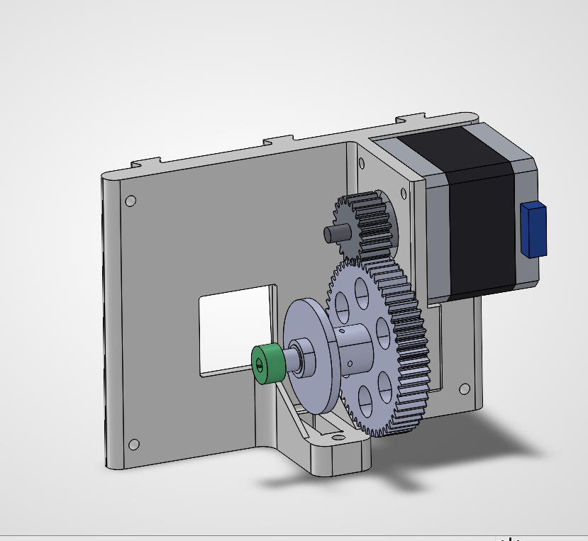
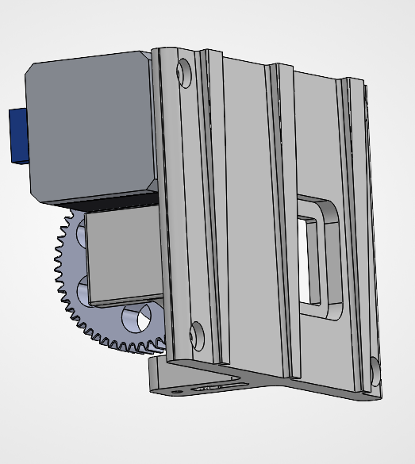
Next iteration: what was not working, and what changes
3:1 printed gear stage
18T / 54T spur, printed PETG pinion
Designed and checked in CAD; pinion printed; not fitted
Pull × 3 × 0.9 (η) = 2.7 at equal current (calculated)
At 1.0 A: heat × (1.0/1.5)² = 0.44 (calculated)
1° draft on the dovetail
Today the slide-in binds on insertion
Thicker at the top, thinning toward the bottom
The station self-locates as it slides in (planned)
Lighter back mount
Today: 597 cm³ solid, far stronger than the motor can pull
Thinner walls and ribs: about 200 cm³ (planned)
Less print time and filament
Not working yet / still planned
Pull test at 1.5 A: the measured limit goes into the planner (planned)
Hold test: 90 minutes at 1.5 A, motor below 60 °C (planned)
First three-station lift: self-check, calibration, a short move with 1 lb (planned)
Next iteration (CAD, 10/27). Front: 3:1 spur stage, spool on its own shaft, encoder magnet cap. Back: slide-in rails, window, screw holes
Notes:
Next iteration (DECK_V9_NOTES slide 24 row, Jasper 10/27). Gear stage: 18T/54T, 3:1, printed PETG pinion, CAD-verified, pinion printed, NOT fitted; the mounted stations are direct-drive spools (D40-D42; v9 'correction' update). 2.7x pull at 1.0 A with half the heat (PANEL_FEEDBACK_ANSWERS 'larger motors'). Draft: the slide-in binds on insertion; a 1 deg draft on the dovetail, thicker at the top (slide 24 row, PLANNED). Mount: 597 cm^3 solid (COST_BREAKDOWN section 2), dovetails 225x and screws in a stud 8.9x the motor (lift_chain_weakest_link.md ranking), to about 200 cm^3 (slide 24 row, PLANNED). Gear stage: ratio 3, efficiency 0.9 (winch_gear3.json ratio, eta): 3 x 0.9 = 2.7x torque at the spool at equal current; heat at 1.0 A vs 1.5 A: (1.0/1.5)^2 = 0.44 (1.8 W vs 4.05 W, winch_gear3.json heat). Still planned, no result: pull test, hold test, first three-station lift (slide 25 and 26 rows). The dashed box is for Jasper's new CAD.

Slide 19
Thank you
Jasper Buntinx | Mechanical Engineering | Texas A&M
Notes:
Thank you. Leave this slide up for questions.

