Slide 1

RoomCleaner
A cable-driven robot that picks laundry off the floor
Jasper Buntinx · Technical presentation · Oct 27, 2026
Notes:
SAMPLE — Archetype A. Dark title, full-bleed hero photo right 55%, nothing else.

Slide 2
The winch station had to survive its own motor
02
Heat, torque and a spool that kept walking off its shaft
Notes:
SAMPLE — Archetype B. Giant Signal number, one-line section claim.

Slide 3
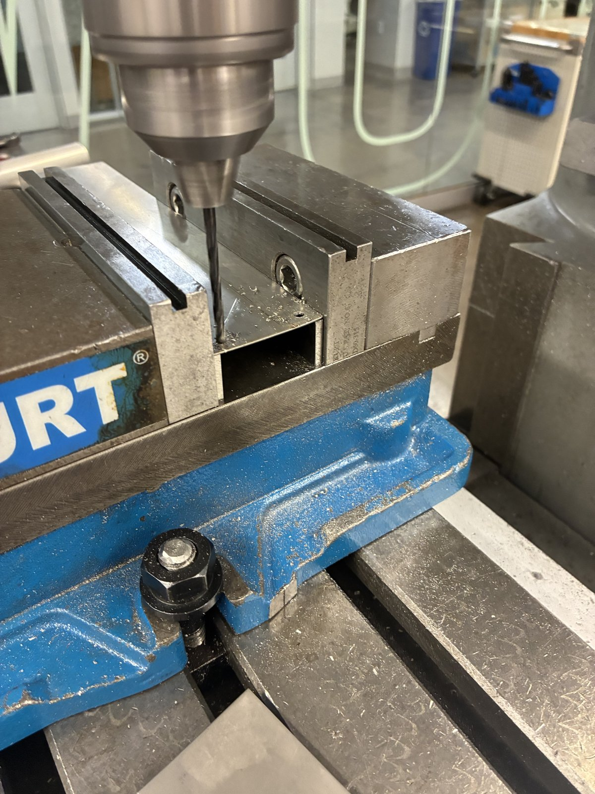
An aluminium fin pulls heat out of a sealed printed shell
DECISION 04 · HEAT
CALCULATED
TRIGGER
#29 drill · Ø3.4
Sealing the station in PETG made the motor mount its hottest, most loaded joint
OPTIONS
Seven fixes weighed: vents, a cooler driver, ASA, a thermistor, a metal fin …
CHOICE
A 1/8 in 6061 fin, narrowed to 44 × 250 mm to fit the station
1
TRIGGER
2
OPTIONS
3
CONSTRAINT
4
CHOICE
5
RESULT
Notes:
SAMPLE — Archetype C, the core slide. Photo left with one callout, three labelled lines right, decision rail at the bottom with the current step in Signal. Example numbers are placeholders until the real story is written.

Slide 4
Thicker spreads heat better, but 1/8 in was the knee
OPTIONS · FIN THICKNESS
CALCULATED
1/16 in
1/8 in
1/4 in
CHOSEN
54 %
68 %
81 %
Fin efficiency
Fin efficiency
Fin efficiency
Lightest and easiest to cut, but gives up almost half of its fin effect.
Most of the gain at half the mass of 1/4 in. The stock I sheared and drilled.
Best spreading, but twice the aluminium hanging on a printed wall mount.
Notes:
SAMPLE — Archetype D. Rejected options in Fog, chosen option in Signal tint with a Signal outline and Signal number. Numbers are the real fin-efficiency calc.

Slide 5

My first full gripper was over four times its mass budget
RESULT · CLAW MASS
CALCULATED
2.06 kg
upper-bound mass of gripper v6 against a 450 g budget
m = Σ ρ·V · ρ(PETG) = 1.27 g/cm³, 100 % infill bound
Source: CAD volume of every body in the v6 STEP, solid PETG
Notes:
SAMPLE — Archetype E. One number, its label, the equation that made it, the source, and the evidence tag.

Slide 6
Doubling the plate past 1/8 in buys only 13 more points
DATA · FIN EFFICIENCY
CALCULATED
Fin efficiency η = tanh(mL)/mL with m = √(2h/kt).
1/8 in gets 68 % for half the aluminium of 1/4 in.
That mass sits on a printed wall mount, so the knee wins.
Notes:
SAMPLE — Archetype F. Native chart, focus bar in Signal, others Steel, no legend, light gridlines; takeaways right.

Slide 7


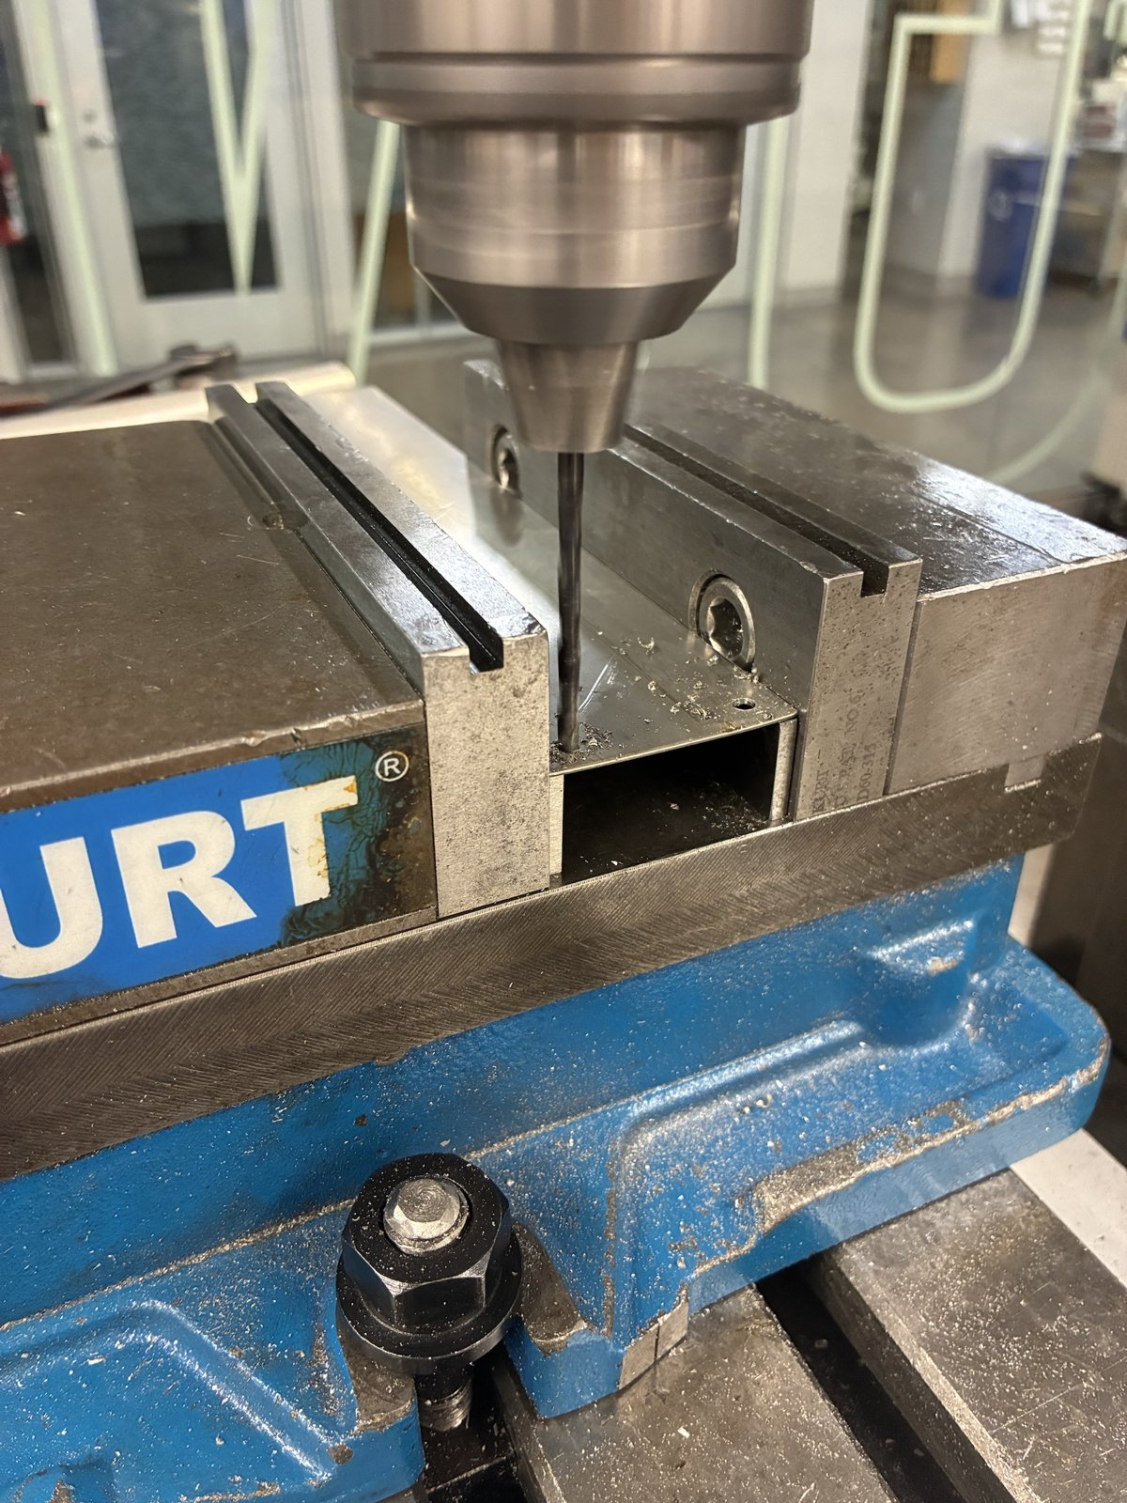
I sheared, laid out and drilled the fins myself
BUILD · HEAT FIN
MEASURED
1 Sheared blanks against the Letter drawing
2 Mill set up from the inch drawing
3 Drilling the Ø3.4 mounting holes
Notes:
SAMPLE — Archetype G. Three photos, equal size, 0.15 in gaps, numbered captions. No frames or shadows.

Slide 8
Five design snapshots in two weeks
PROJECT ARC
MEASURED
Oct 7
Oct 11
Oct 18
Oct 19
Oct 20
Oct 27
Station v1
Station v2
Station v3
v3 assembly
Gripper v6
Panel
Spool + wall mount
Slip-in mount
Shell + spool v3
Whole station in CAD
Geared jaws
Today
Notes:
SAMPLE — Archetype H. Dated nodes; the current milestone in Signal; future node hollow. Dates taken from the CAD archive folders.

Slide 9
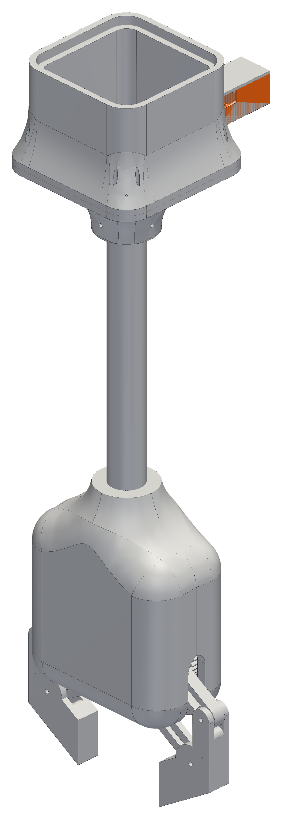
The camera rides on the narrow side so it can see the jaws' approach
DECISION · VISION
SIMULATED
Camera bay (new)
Lens 512 mm above the floor, looking straight down.
12 % of the view is blocked by the claw itself.
Lines can only touch the bay above 1.98 m at ≥ 30° yaw — so tasks are capped at 1.6 m.
Line tie-offs at fillet holes
Jaws
Notes:
SAMPLE — Render variant of archetype C. Transparent orthographic render, subject part in Signal, three callouts max.

Slide 10
Three things this robot taught me
WHAT I'D TELL MYSELF ON DAY ONE
01
02
03
Measure before you trust a margin
Every interface is a decision
Make failure visible early
Sample lesson text — one line, plain words.
Sample lesson text — one line, plain words.
Sample lesson text — one line, plain words.
jasper_buntinx@tamu.edu
Notes:
SAMPLE — Archetype I. Dark, three numbered lessons, contact line.

Slide 11
Palette, type and evidence tags
STYLE REFERENCE
Ink
Paper
Fog
Steel
Signal
Tint
0E1116 · Text, dark slides
FFFFFF · Content background
E9ECEF · Cards, mats
6B7480 · Secondary text
FF6A13 · The one thing to see
FFE6D6 · Chosen card only
Claim title — Arial Bold 32
MEASURED
EYEBROW — ARIAL BOLD 11, TRACKED
CALCULATED
Body — Calibri 16. Left aligned, ≤ 30 words a slide, units on every number.
SIMULATED
Caption / source — Calibri Italic 11
PLANNED
Notes:
Reference sheet — not part of the talk.

