Slide 1
Appendix
Fundamentals, safe state, fits, schematics

Slide 2
Safe state and failure modes
Event | What happens | Mitigation
PAUSE, or a fault the software detects | Every station holds position with torque on | Nothing moves again without approval
Wi-Fi link lost | Stations stop and hold on their own clocks | Resume needs approval
Power loss or emergency stop | Torque is lost and the claw can fall (1.5 kg from about 2 m) | Nobody underneath; claw parked low when idle; brake planned
Controller reset or brown-out | Driver disabled at boot, so torque is lost | Same as power loss
Driver over-temperature | The A4988 shuts its outputs off | Hold test watches the driver; fallback 1.35 A
Three-station run: any station fault | Every cable is needed; the claw falls | Floor clear and padded; movement and calibration only
Jasper Buntinx | RoomCleaner | Appendix
Notes:
The safe state is PAUSE: torque on, holding. Anything that removes power drops the claw, which is why nobody stands under it and why a brake or a non-backdrivable stage is on the next-steps list.

Slide 3
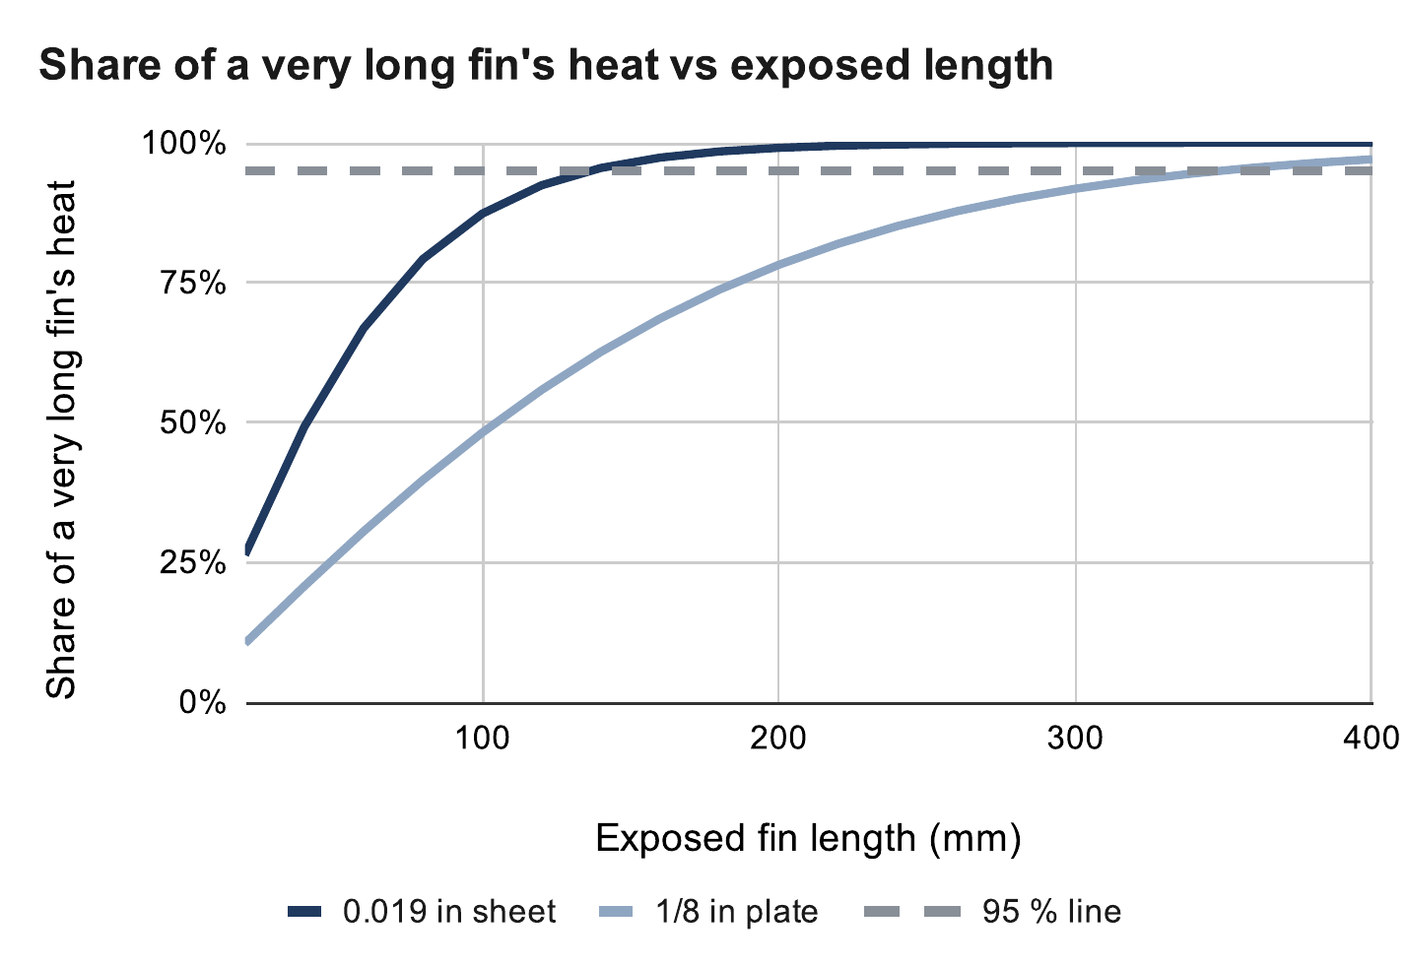
Heat fin length
CALCULATED
0.019 in prototype reaches 95 % of its capacity by 136 mm
1/8 in design keeps gaining to 349 mm
Built at 200 mm, limited by ceiling clearance
Fin length and efficiency
m = √(2h / (k t)), L₉₅ = 1.83 / m
η = tanh(mL) / (mL) = 0.74 (1/8 in)
Calculated (calc sheet: Heat fin)
Jasper Buntinx | RoomCleaner | Appendix
Notes:
L95 is where a fin carries 95 % of the heat an infinitely long one would. h = 7 W/m²·K still air, k = 160 W/m·K aluminum. Source: Incropera, ch. 3.

Slide 4
Fin sizing for 4 W
CALCULATED
Painted 6061, 44 mm wide | Mass | Shortest for ≤ 60 °C
0.019 in (prototype) | 14 g | None (2.0 W max)
1/16 in | 47 g | None (3.6 W max)
0.090 in | 68 g | 210 mm or none
1/8 in (design) | 94 g | 145–185 mm
3/16 in | 141 g | 125–140 mm
1/4 in | 189 g | 115–125 mm
If the fin alone had to carry all 4.05 W
0.019 in sheet: not possible at any length
1/8 in plate: 145–185 mm
All 4.05 W through the fin, 23 °C room, paste contact. Calculated.
Jasper Buntinx | RoomCleaner | Appendix
Notes:
The prototype works today only because the motor also sheds heat into the vented shell. Thickness beats length.

Slide 5

Floor board accuracy
SIMULATED
Camera pose error per frame, best case: 6.6 mm with one tag, 0.7 mm with four
This is the camera's view, not the cable length
After the fit, cable lengths are known to about 12–16 mm (simulated)
Calculated (calc sheet: Floor board)
Jasper Buntinx | RoomCleaner | Appendix
Notes:
Noise model: 0.3 px corner noise and a 520 px focal length (camera not yet calibrated). The four-tag figure is the best placement; realistic placements are a few times worse.

Slide 6



Operating sequence
SIMULATED
Start up: self-check, take up slack, calibrate
Find: scan from above, detect garments, choose the nearest
Pick: hover until still, grip, deliver; the camera confirms each step
Every move waits for approval on the phone; PAUSE holds position
Phone app in simulation: home, claw camera and chat
Jasper Buntinx | RoomCleaner | Appendix
Notes:
PAUSE or a detected fault stops every station on the same point of the path, still holding; nothing restarts by itself. The emergency stop is the switched power strip, and it drops the claw. Known obstacles are keep-out shapes checked against every cable before a move. Simulated end to end.

Slide 7
Control logic: Generation 1 vs. final
 | Generation 1 | Final
Where is the claw? | Assumed from the commanded cable lengths | Measured by the claw camera; refit at every startup
Room geometry | Anchors from a tape measure | Anchors and cable lengths fitted, with error bars
Motor control | One central board | A controller per station, coordinated by the laptop
Finding laundry | Ceiling camera | Claw camera
Did the grab work? | Assumed | Camera checks pickup and delivery
Faults | Emergency stop only | PAUSE keeps torque; the emergency stop cuts power and drops the claw
Jasper Buntinx | RoomCleaner | Appendix
Notes:
Generation 1 trusted its model; the final logic measures before it trusts and checks after it acts.

Slide 8
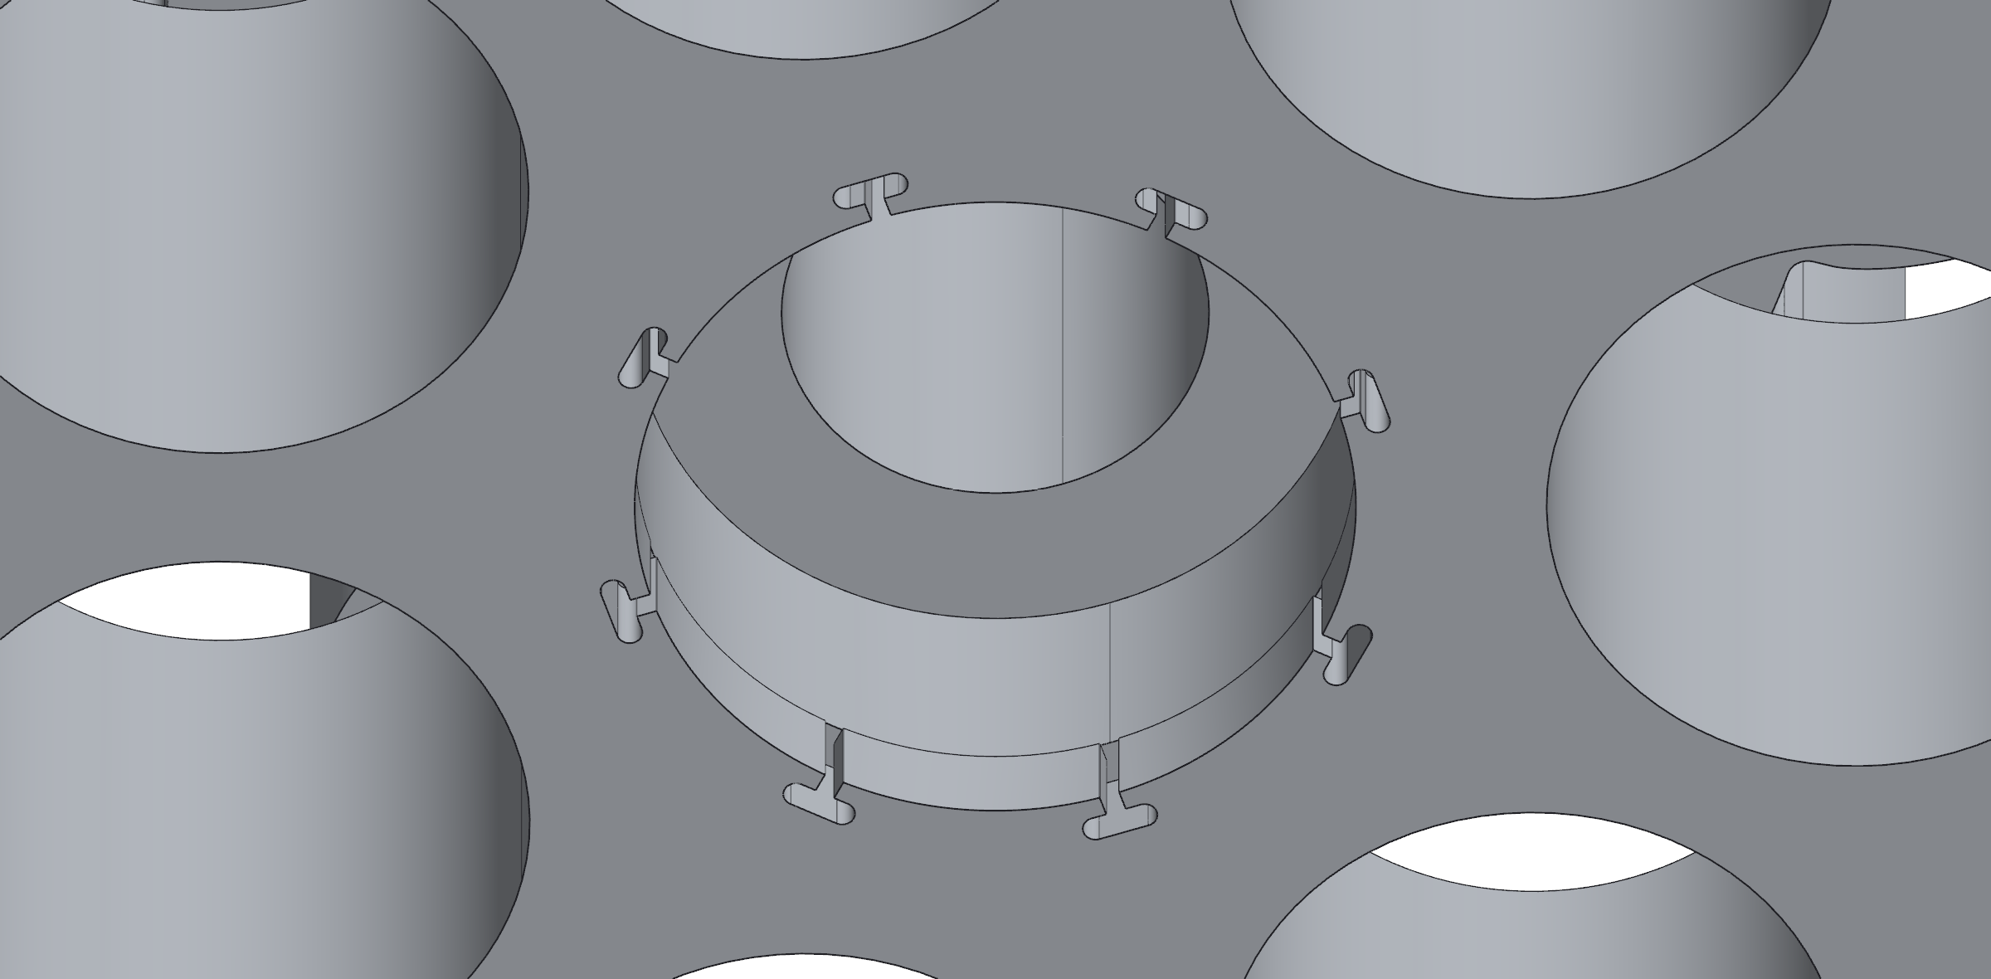
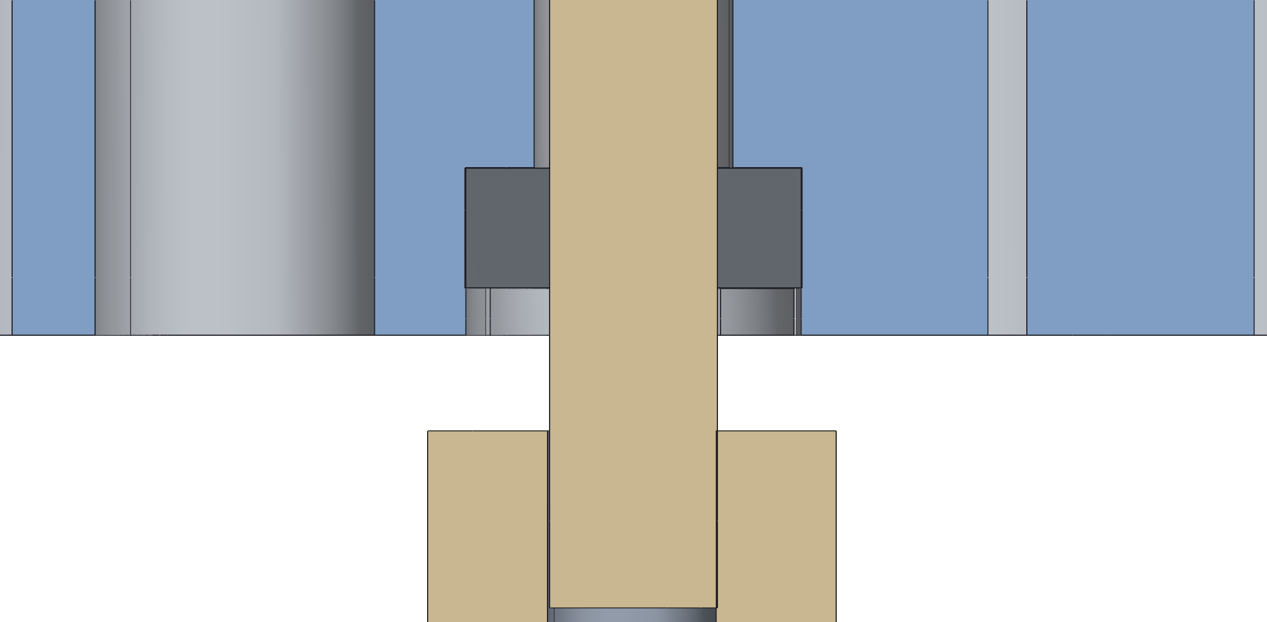
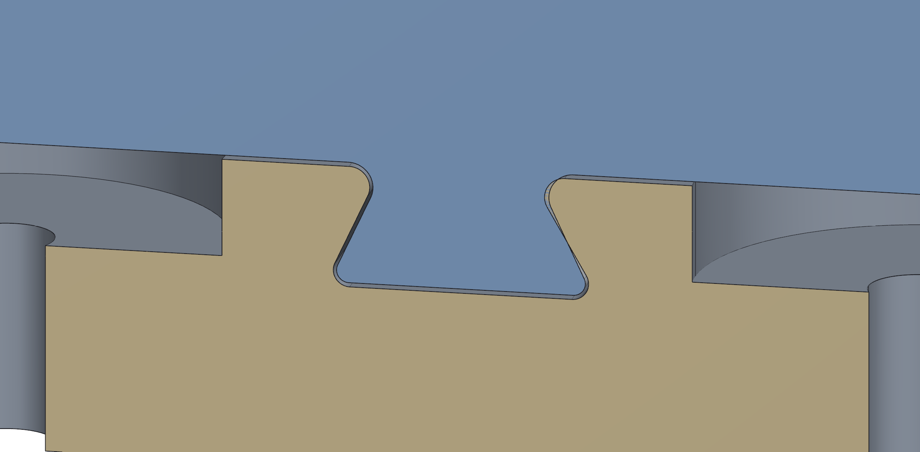
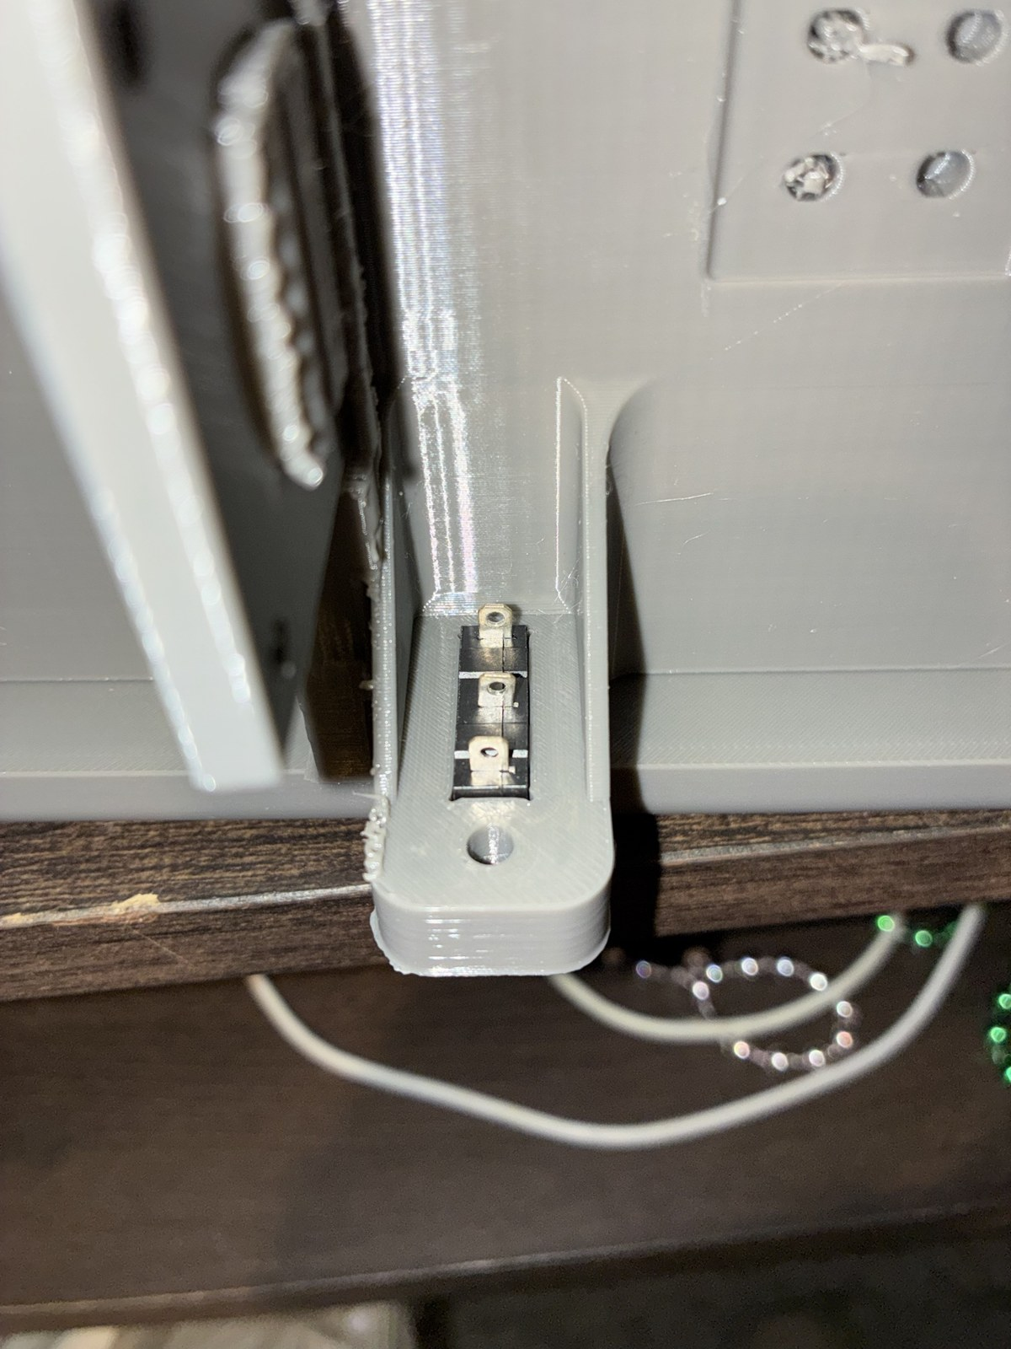
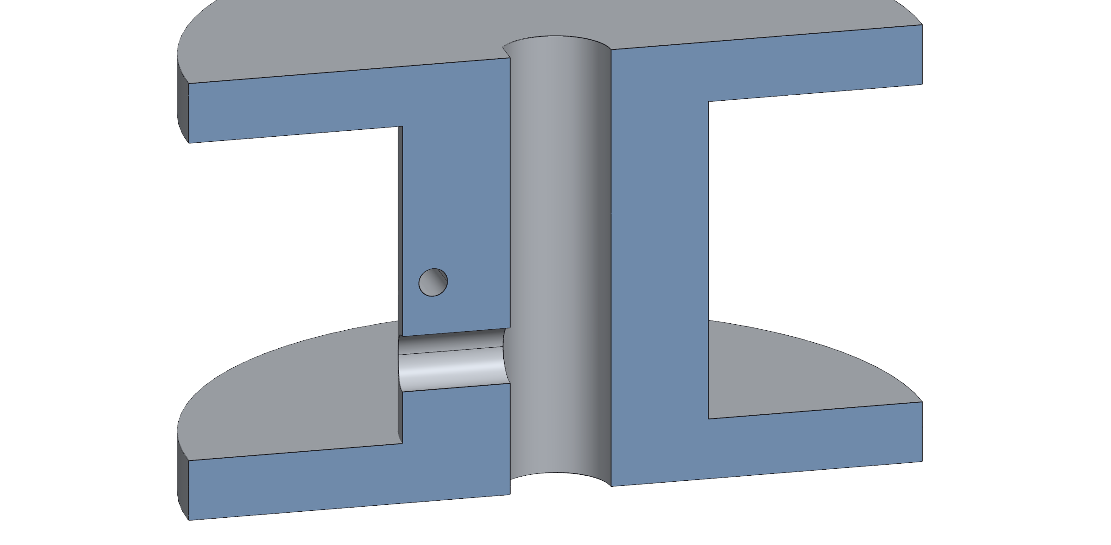
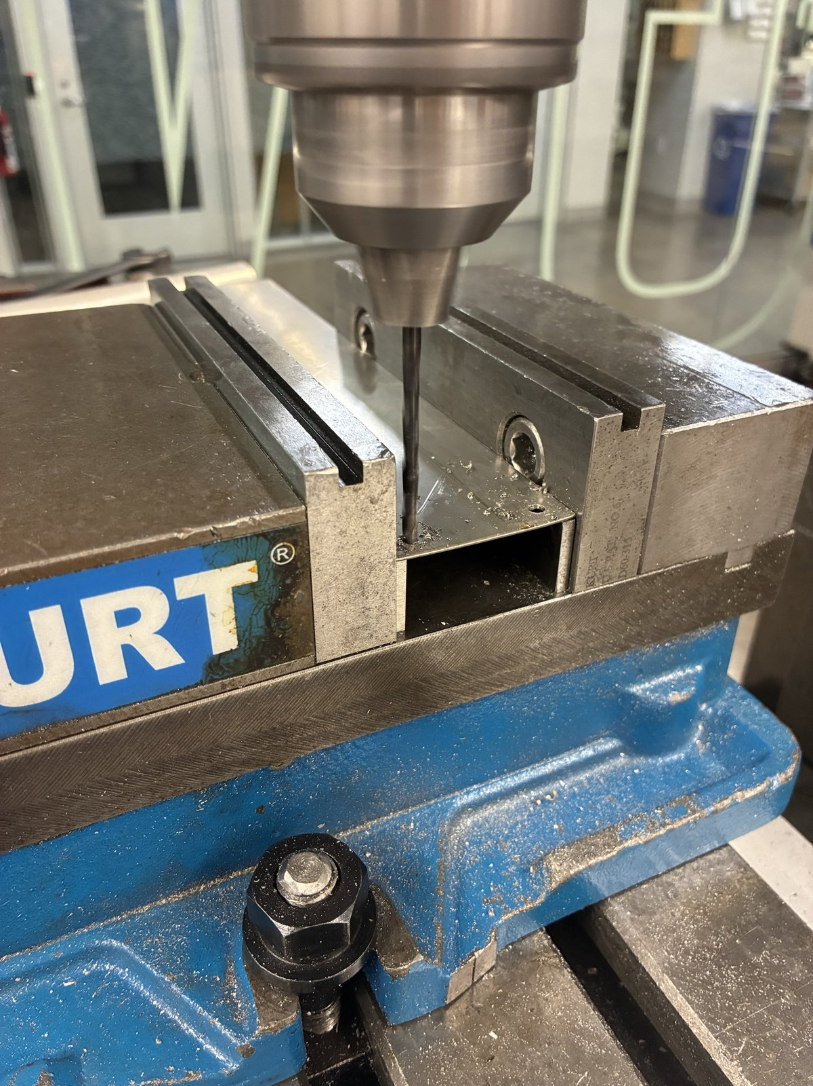
Manufacturing: fits and datums
Feature | As drawn | Fit
Gear bearings (687) | Ø14.075 pocket behind a Ø14.000 lip, 1.95 long, 8 T-slots | Snaps past the lip, +0.075 behind it
Gear pins | Printed Ø7.000 pin into a Ø7.05 socket | Line-to-line in the bearing; +0.05
Slide-in mount | 0.175 per side; 30° dovetail flanks | Slip fit, 0.14–0.21 on the flanks
Spool on Ø5 D-shaft | Ø5.30 bore (10/21), Ø5.45 in v3; 0.5 mm flat | +0.30 to +0.45: Ø5.2 printed too tight
End-stop switch | Pocket 6.65 × 20.3 × 9 on a 1 mm ledge, lever window below | Press fit, no screws
Heat-set inserts | M3: Ø4.0 × 5 gear housing; M2.5: Ø3.45 × 4 encoder | Melt-in; hole deeper than the insert
Screw clearance | M3 Ø3.5 printed, Ø3.4 drilled; wall Ø3.97 (5/32 in) | +0.5 printed, +0.4 drilled
Motor pilot, Ø22 boss | Ø22.4 printed tab, Ø22.5 drilled fin | +0.4 / +0.5
Fin hole zero | Edges locate the bottom-left hole; drilled, it is the zero for the other 4 | Pattern ±0.1, free of the ±0.5 sheared edges
Gear: Ø14.000 entry lip, 8 T-slots
Cut open: 687 bearing on the printed pin
Slide-in rib in the wall-mount dovetail
End-stop switch pressed into the slide-in
Printed holes come out small, so every printed fit carries an allowance; the drilled fin needs none
PETG on a Creality K1, 0.4 mm nozzle, 0.2 mm layers; loads along the layers, mating faces off supports
v3 spool: D-bore and set-screw hole
Fin: holes drilled from the first hole
My SolidWorks parts; blue and tan are cut faces, dark grey the bought bearing
Jasper Buntinx | RoomCleaner | Appendix
Notes:
The gear pockets: the bearing presses past a lip, the T-slots let the lip ends flex, and it then sits free in a pocket 0.075 mm larger. The slide-in runs on 0.175 mm a side. The fin's sheared edges are only good to half a millimetre, so they locate only the first hole; the rest are drilled from it. [[confirm which spool bore is printed, which holes get heat-set inserts, and the insert part number]]

Slide 9
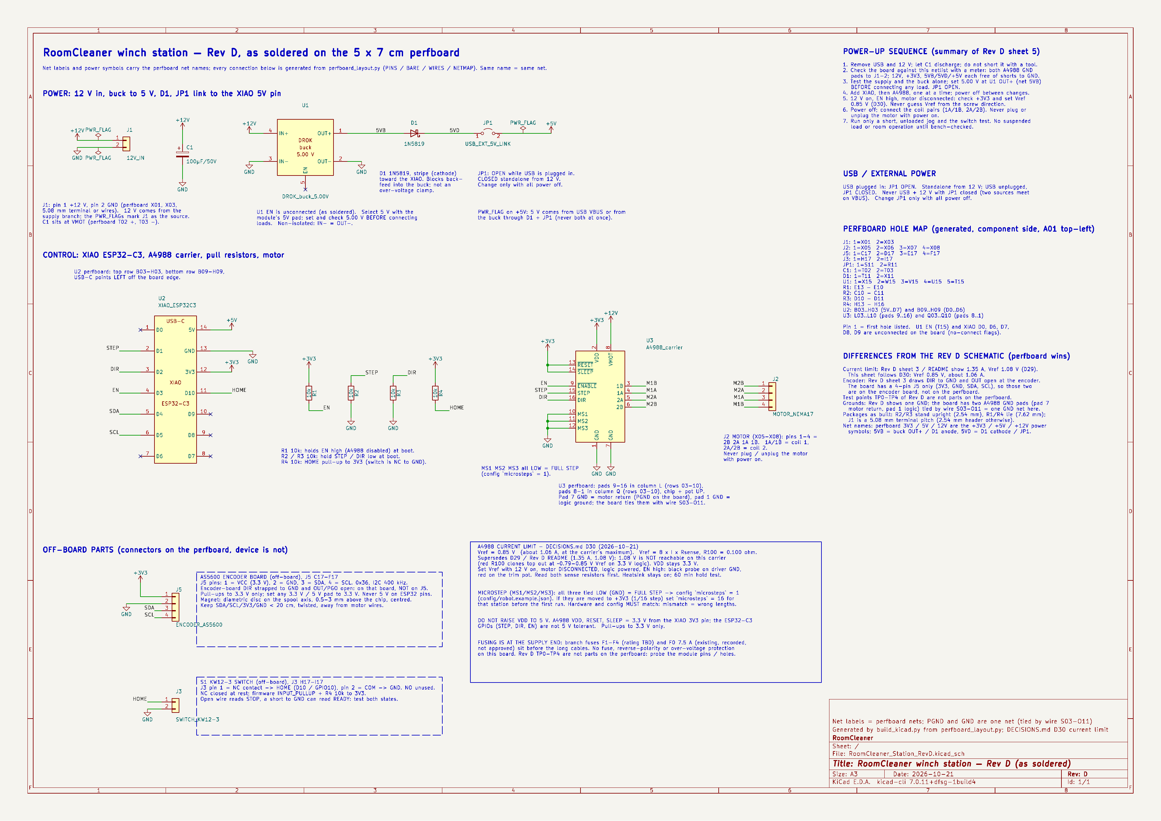
Station electronics, Rev D
One board per station: a Wi-Fi microcontroller, the A4988 driver, a 12 V to 5 V buck, the homing switch and the spool encoder
Pull-up on ENABLE keeps the driver off at boot; pull-downs on STEP and DIR; a 100 µF reservoir at the driver supply
Fuses at the source end of each 12 V branch; the buck is rated to 20 V in, so the supply stays at 12 V
Station Rev D schematic
Jasper Buntinx | RoomCleaner | Appendix
Notes:
The external 10k pull-up on ENABLE is the reason a reset cannot move a motor; it is also why disabling removes torque, so the pull-up cannot hold a suspended load. The bench script on the Act 5 slide checks each part of this board in turn.

Slide 10
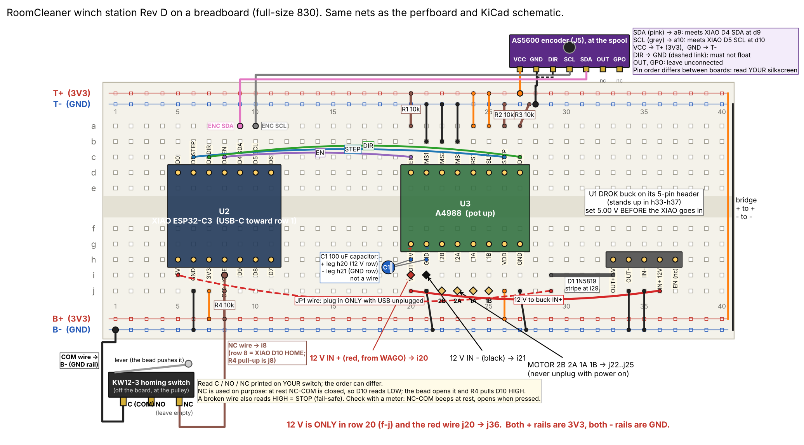
Station breadboard layout
The bench build of Rev D on a mini breadboard: the layout was net-checked against the schematic (PASS) before power
Each motor coil carries about 1 A through breadboard contacts: short leads, fully seated
The soldered perfboard and the rail board follow the same net list
Station Rev D breadboard layout, drawn and net-checked
Jasper Buntinx | RoomCleaner | Appendix
Notes:
The second bench board (the larger dev module) uses the same layout with the module off the board and nine jumpers into the holes of the small board.

Slide 11

Claw electrical, Rev B
Two-cell lithium-ion pack, 7.4 V; 5 A fuse for shorts
6 V servo rail and a separate 5 V logic rail; 200k/100k divider for battery sense
Peak draw 2.8–3.1 A, at the pack's 3 A rating
Claw Rev B schematic
Jasper Buntinx | RoomCleaner | Appendix
Notes:
Rules check 0 errors; 9 nets match the specification. Charger: 8.4 V constant current, constant voltage; charged attended, at 1 A or less. The peak sits at the pack rating, so a stall longer than a moment is the thing to watch. On the bench (10/26): live view, 7.2 V battery read, servo moves once it had its own timer.

Slide 12
Acronyms
Term | Meaning
CAD | Computer-aided design
PETG | Polyethylene terephthalate glycol (the printed plastic)
TPU | Thermoplastic polyurethane (flexible printed plastic)
NEMA 17 | National Electrical Manufacturers Association motor frame, 1.7 in square
CNC | Computer numerical control
ESP32 | A Wi-Fi microcontroller family (Espressif)
A4988 | Stepper-motor driver chip (Allegro)
YOLO | “You Only Look Once”: an object-detection model family
SF | Safety factor: allowable stress divided by actual stress
Jasper Buntinx | RoomCleaner | Appendix

Slide 13
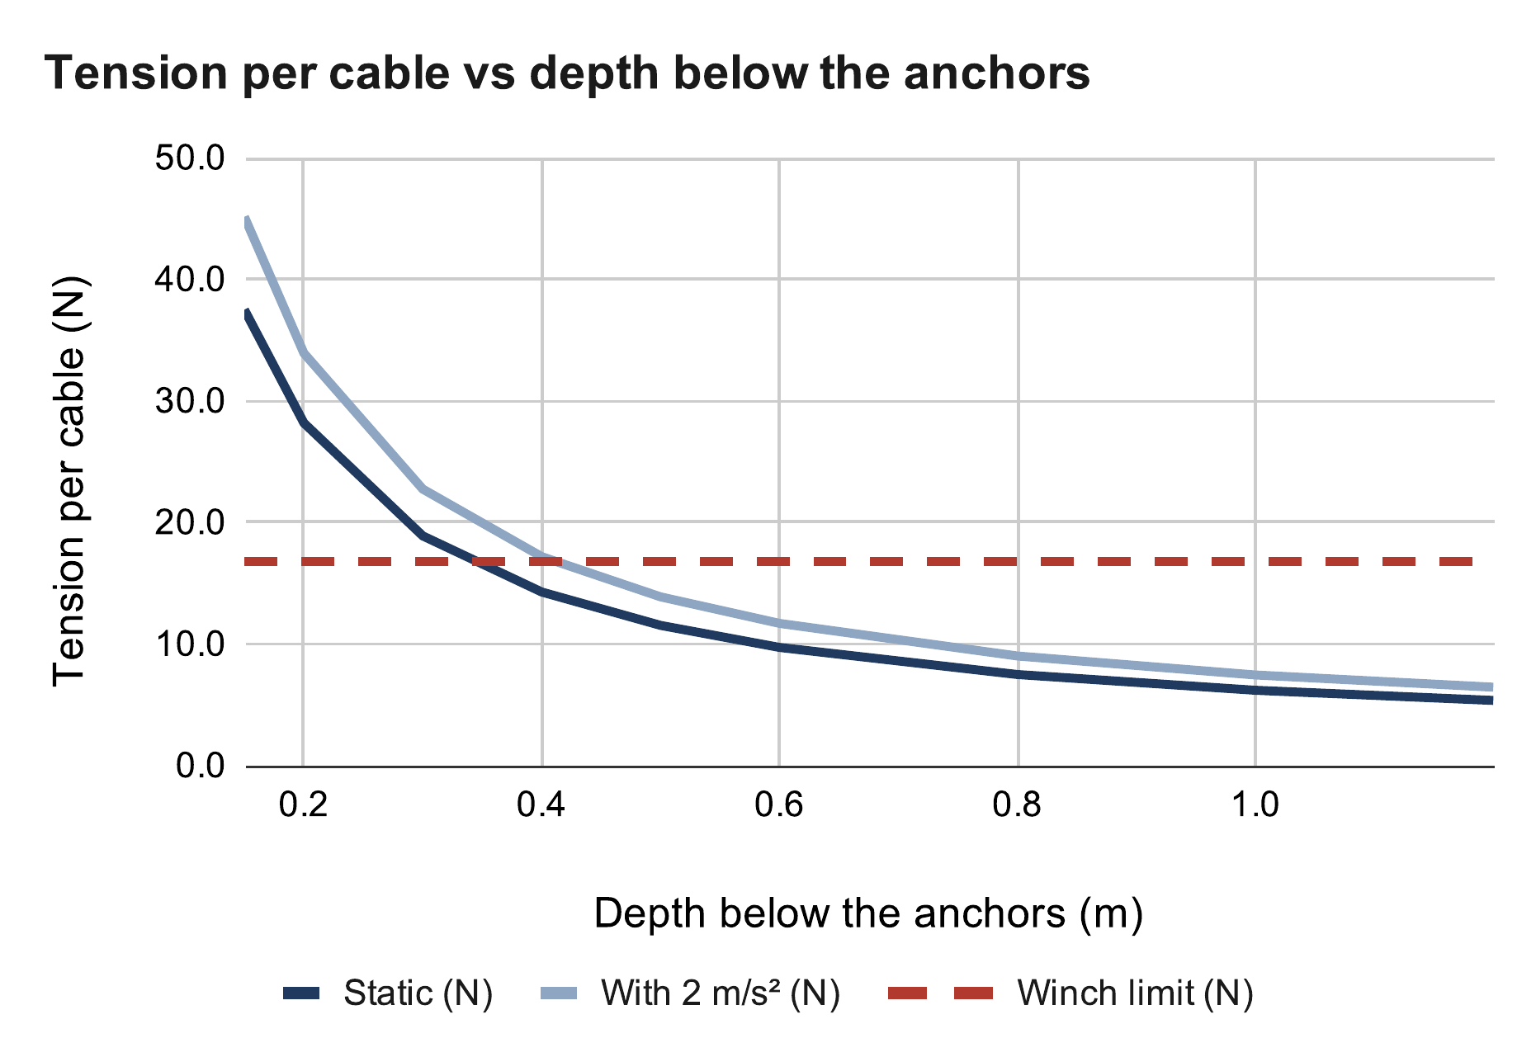
Calculations and sources
All charts come from my engineering calculation sheet
Incropera et al., Fundamentals of Heat and Mass Transfer, ch. 3
Allegro MicroSystems, A4988 datasheet
Calculated (calc sheet: Cable tension)
Jasper Buntinx | RoomCleaner | Appendix

