Slide 1

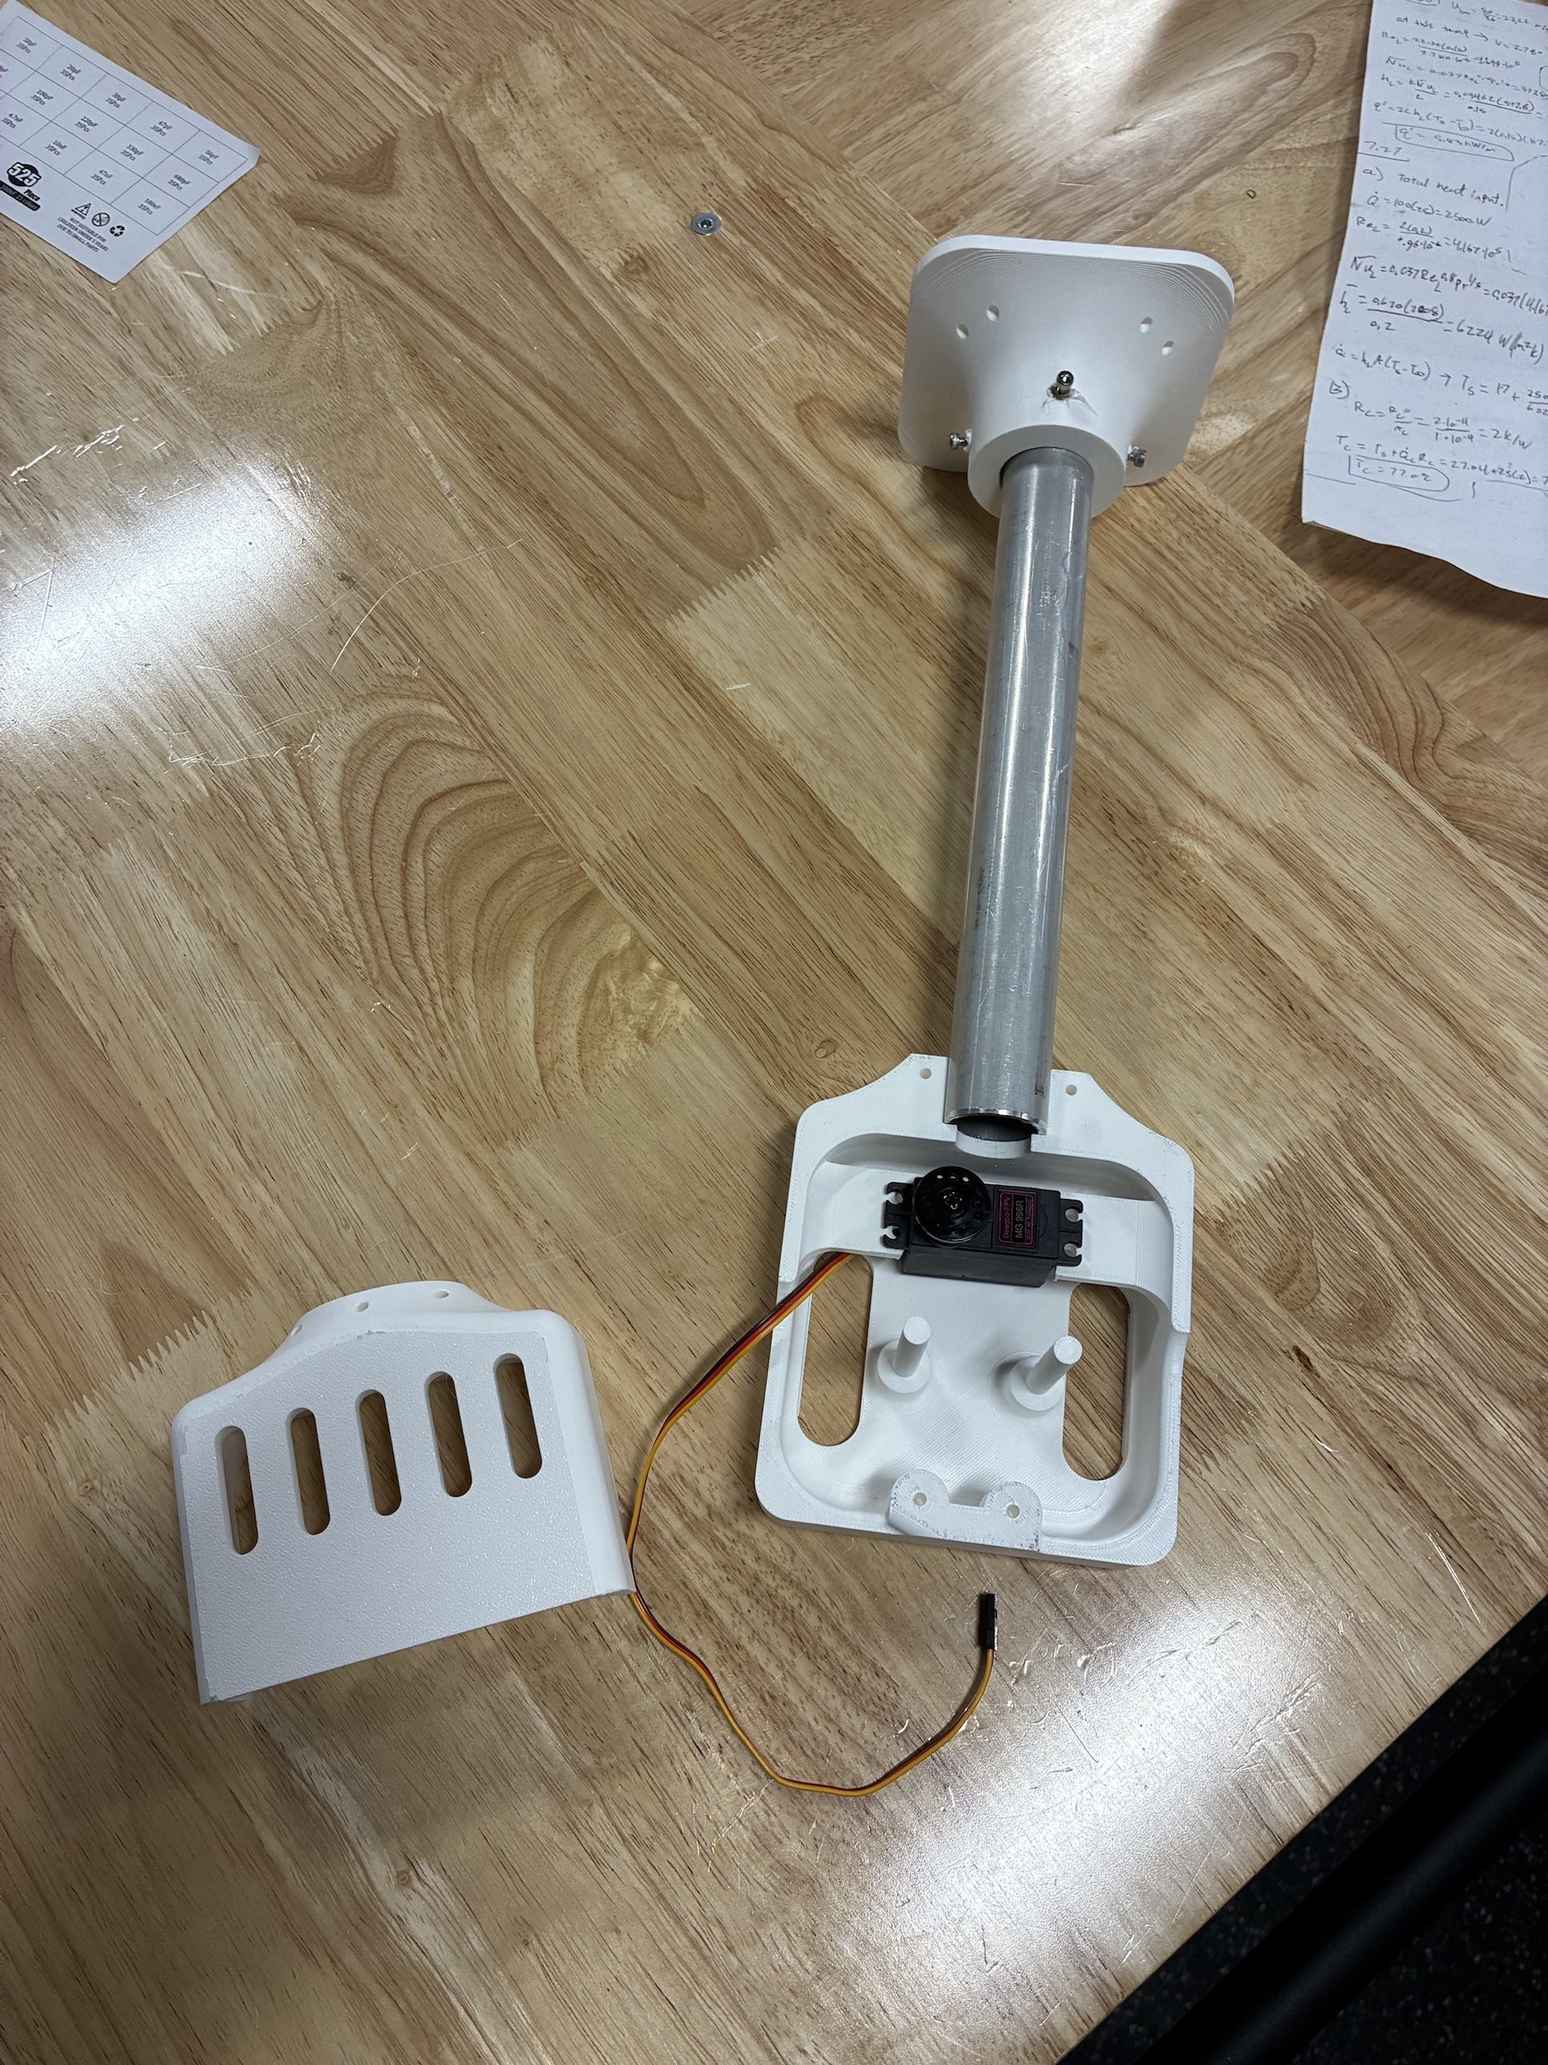
RoomCleaner
A four-cable ceiling robot designed to pick laundry off the floor
Jasper Buntinx
Mechanical Engineering, Texas A&M University
October 27, 2026
Wall station (built)
Claw body and servo (built)
Notes:
One sentence: four winches near the ceiling corners hold one claw on cables; it is designed to pick clothes off the floor and drop them in a hamper. Then who I am.

Slide 2
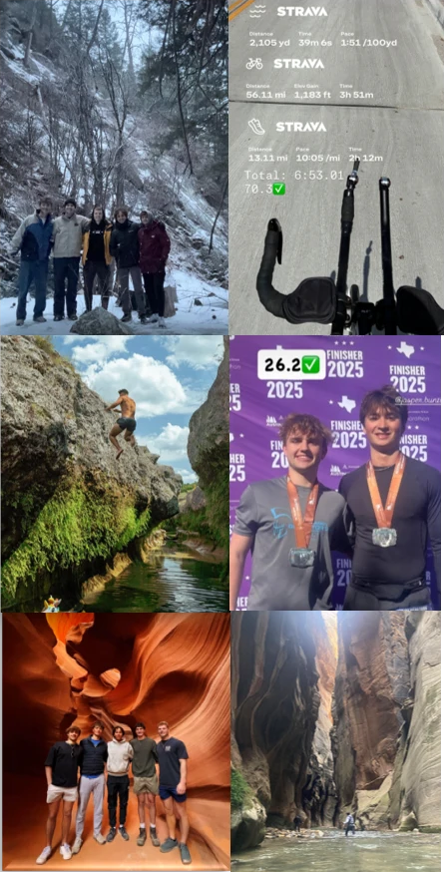
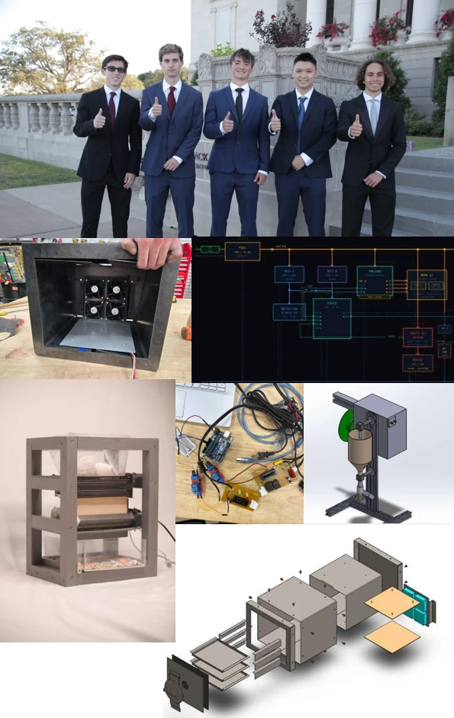
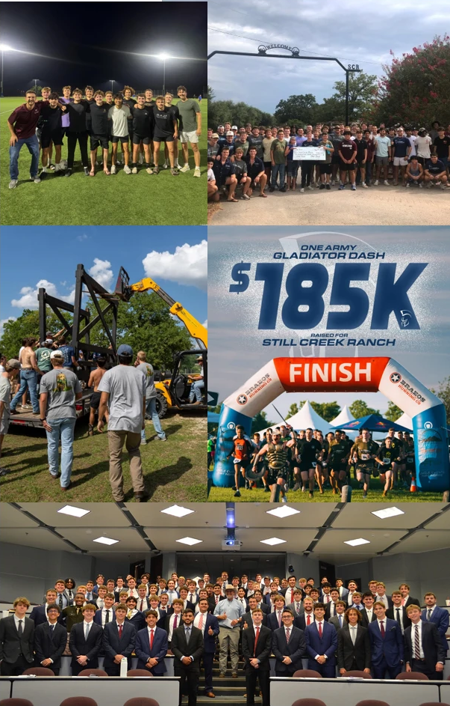
About Me
Jasper Buntinx | RoomCleaner
Notes:
Ninety seconds; the photos carry it, left to right. Mechanical Engineering at Texas A&M, class of 2027. Left: outdoors and endurance, an Ironman 70.3 in 6:53 and a marathon in 2025; I finish long things. Middle: EcoFil, a filament recycler I built with a shredder, dryer and extruder [add one number: filament diameter tolerance or throughput, and what broke]. Right: as Special Events Build Logistics Chair for the One Army Gladiator Dash I headed assembly, repairs and transport of the obstacles; the event raised $185K for Still Creek Ranch. If asked: metal sculpture for the Austin Creek Show, with fiber laser cutting and welding.

Slide 3
Project Goal
Pick up laundry in a 3.35 × 2.74 m (11 × 9 ft) room under a 2.74 m (9 ft) ceiling, and drop it in a hamper
Design load 0.9 kg (jeans); first test 0.45 kg (1 lb)
Success: one garment from floor to hamper with no human touch; I approve each move on the phone
Safe state: PAUSE holds position, and nobody stands under the robot
Anchor, 0.15 m below the ceiling
0.4 m ceiling margin
2.74 m
(9 ft)
ceiling
0.2 m wall margin
Claw
Hamper
Garment
3.35 m (11 ft) wall; room 3.35 × 2.74 m
Room elevation to scale; seen from the side, the four cables appear as two
Jasper Buntinx | RoomCleaner
Notes:
The problem in one picture: four anchors 0.15 m below the ceiling, one claw, a hamper. The shaded bands are the 0.2 m wall and 0.4 m ceiling margins the planner keeps. If asked: 0.9 kg is a screening value for a pair of jeans, not weighed. The 2 m/s² is a 1.2 times dynamic allowance for stops and snags, not the motion profile; top speed is 50 mm/s, so a diagonal move takes about a minute and a half. Where it stands: the stations, their electronics and the claw body are built; the claw is weighed (0.60 kg with battery); most other numbers in this talk are calculated or simulated, and labeled; nothing has picked up a garment yet.

Slide 4
Timeline and Scope
Phase
Dates
July
August
September
October
1. Concept
Jul 16 – Aug 5
2. Generation 1
Aug 6 – Sep 2
3. Redesign
Sep 3 – Oct 6
1
4. Final design
Oct 7 – Oct 21
2
5. Build and test
Oct 22 – Oct 27
3
1 Sep 30: first clamp's jaws cannot close on thin cloth 2 Oct 20: v6 clamp is 4.6 times its mass budget in CAD 3 Oct 22: drivers at 1.5 A; claw weighed
Mine: requirements, design decisions, the SolidWorks station and claw, printing, machining, wiring and bring-up
With Claude Code, under my direction: the control software, calculation scripts and CAD checks
Purchased: steppers, drivers, controller boards, servo, camera, battery and encoder boards
Jasper Buntinx | RoomCleaner
Notes:
About 15 weeks, alone. The numbered marks are the failures that shaped the design. I dictated the control logic and had Claude Code build it out; it also wrote calculation scripts and checked my CAD, and I can take you through any number on these slides. If asked: the garment detector is YOLO-World, an open-source model. [Fill in: hours, total cost, shop access or mentors.]

Slide 5

Why a Cable Robot
 | Floor robot | Gantry | Cable robot
Whole floor | Furniture blocks it | Yes | Yes
Floor left clear | No | Frame spans the room | Yes
Moving mass | Whole robot | Heavy beam | 0.6 kg claw
Chosen: four ceiling winches and one claw
The cost: cables only pull, so cable tension sets the working space
Cables from the ceiling anchors a₁ to a₄ to the claw at p
Jasper Buntinx | RoomCleaner | Phase 1 of 5: Concept
Notes:
A floor robot fights the clutter it is meant to clear; a gantry puts a frame across my room. A cable robot reaches the whole floor with a 0.6 kg moving mass and nothing on the floor. The price is on the next two slides. If asked: four cables on three position axes is redundant, so the tension split depends on cable-length errors; that is why the planner checks tensions and the calibration fits the cable lengths.

Slide 6
Design Trade-offs
Lever | Gain | Cost
Motor current up | Pull rises with current | Heat rises with current squared
Stronger claw | Stronger gears, firmer grip | More mass, less payload
Larger working area | More floor covered | Longer wires, more voltage drop
Closer to the ceiling | More working volume | Cable tension rises steeply
Smaller spool radius | More pull per amp | Tighter line bend, less room for the set screw
Larger safety margins | No skipped steps, no wall contact | Less usable force and floor
The chain that binds: a heavier claw needs more pull, more pull needs more current, and heat rises with the square of the current
Jasper Buntinx | RoomCleaner | Phase 1 of 5: Concept
Notes:
These are the levers I set in the concept phase and came back to in every phase after. Current bound the design, with heat right behind it. If asked: the 1.5 divisor on winch force is the margin against skipped steps.

Slide 7
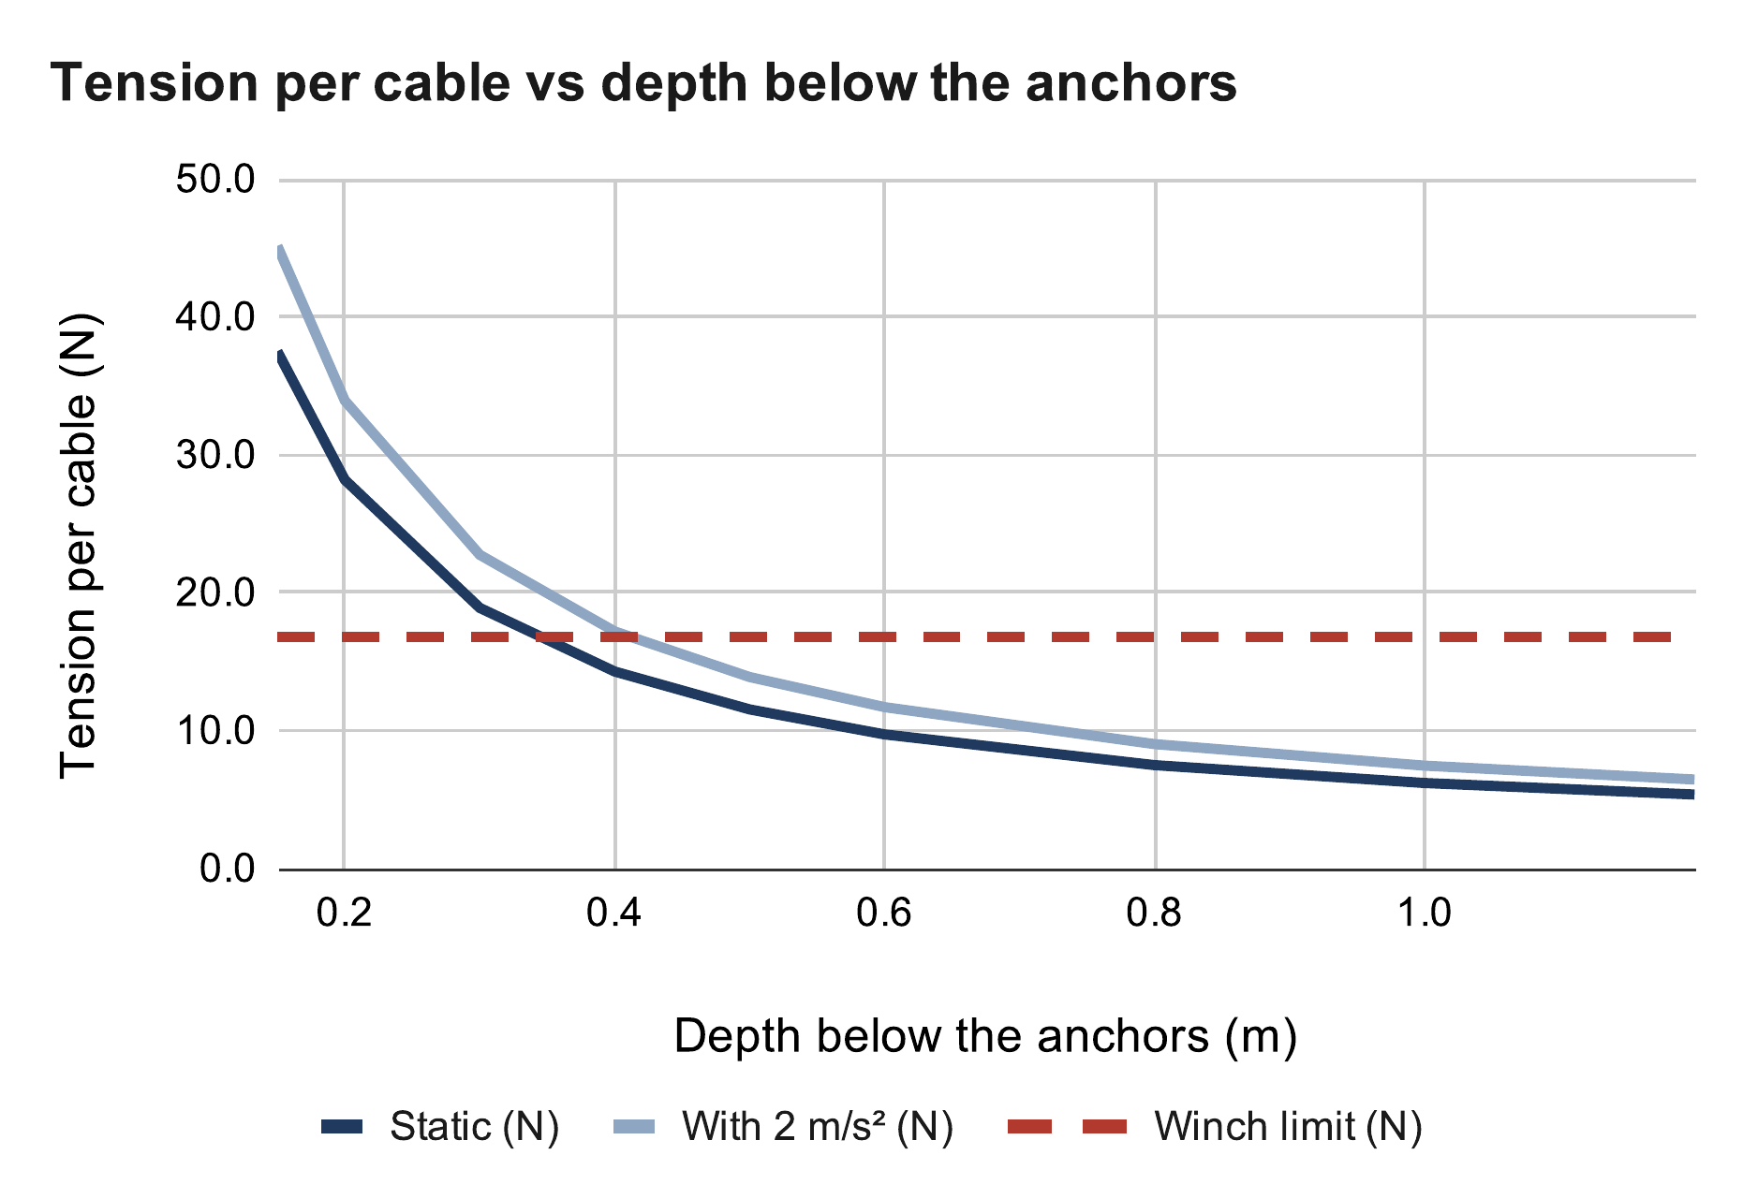
Cable Tension Sets the Ceiling Margin
Weighed claw plus 1 lb, centred 0.4 m below the anchors: 14.3 N, 17.2 N at 2 m/s²
That is at the 16.8 N winch limit; with jeans the claw must stay at least 0.6 m down
The planner checks every cable at every path point against the measured pull limit
Tension per cable, 1 lb test at 0.4 m
T = m (g + a) / (4 sin φ)
= 1.054 × 11.81 / (4 × 0.181) = 17.2 N
Winch limit: 16.8 N
Calculated (calc sheet: Cable tension)
Jasper Buntinx | RoomCleaner | Phase 1 of 5: Concept
Notes:
Cables only pull, and the shallower the cable, the more tension it carries for the same weight. 0.4 m is the margin for the empty claw (9.8 N there). With a load, the planner's tension check keeps the claw lower; it needs the measured pull limit entered first, so the pull test comes before the system test. If asked: off-centre is worse than centred; the claw rises to scan the floor from above.

Slide 8

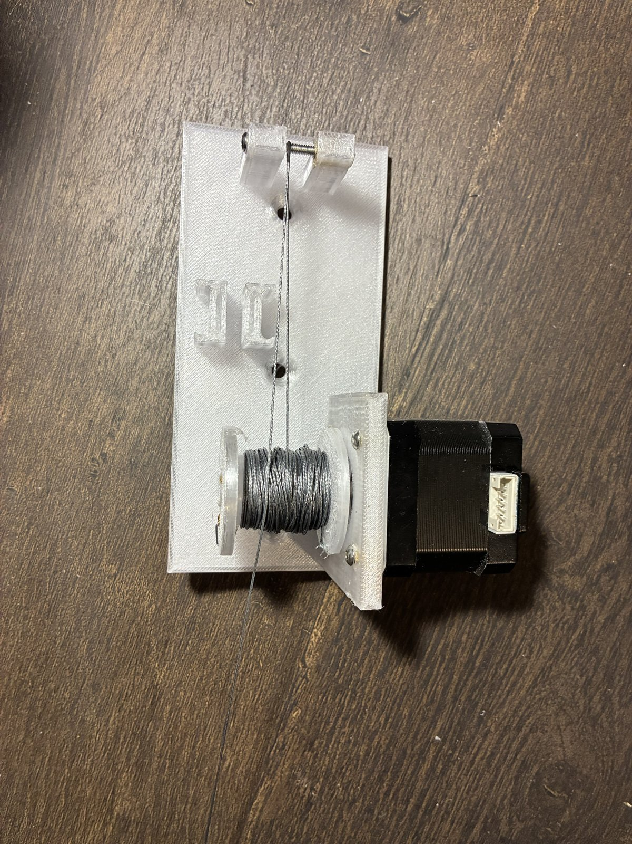

Generation 1: Bench Build and Findings
A bench station lifted a test weight; the cable math held
Bead homing would leave only 5–29 % of the room reachable, caught on paper before it was built
One central board would need 10 wires to every corner once each winch had sensors
Finger claw: designed in CAD (419 g of a 450 g budget), never built
Bench lift test, one-piece corner plate, homing switch
Jasper Buntinx | RoomCleaner | Phase 2 of 5: Generation 1
Notes:
Pause and ask: how would you home a four-cable robot without a reference pose? Then: each finding here drives one decision on the next three slides. Bead homing: a bead on each cable trips a switch at the outlet, so a cable can never be shorter than at home. [Fill in: the weight and how high it lifted.]

Slide 9


One Controller per Winch
Generation 1: one central board; with sensors it would need 250 m (820 ft) of wire
Now: a controller in each station, fed by one 12 V pair: 50 m (164 ft)
Each station can be built and tested on its own
Cost: timing moves into software; 50 ms of skew is 2.5 mm of cable error, about 7.5 N
Before: one central driver board. After: a controller in each station.
 | Generation 1 | Final
Where is the claw? | Assumed from commanded cable lengths | Measured by the claw camera at every startup
Room geometry | Anchors from a tape measure | Anchors and cable lengths fitted, with error bars
Motor control | One central board | A controller per station, coordinated by the laptop
Finding laundry | Ceiling camera | Claw camera
Did the grab work? | Assumed | Camera checks pickup and delivery
Faults | Emergency stop only | PAUSE keeps torque; the emergency stop cuts power
Jasper Buntinx | RoomCleaner | Phase 3 of 5: Redesign
Notes:
Cable routes are 6, 21, 23 and 32 ft. Generation 1 trusted its model; the final logic measures before it trusts and checks after it acts. If asked: each station runs time-stamped segments on its own clock and holds if the link drops; a 40 ms skew budget keeps the error to 2 mm. Line stiffness is about 3 N/mm over a 3 m run.

Slide 10


Camera Calibration Replaces Bead Homing
Bead homing fixes each cable's shortest length, so most of the room is out of reach
Instead the claw camera reads a printed floor board, and a fit finds the anchors and cable lengths
Camera pose per frame, best case: 6.6 mm with one tag in view, 0.7 mm with four
Simulated: cable lengths known to about 12–16 mm after the fit; the whole room opens only when the error bars allow it
Beads stay on the cables as end stops: a bead reaching its switch stops that station
Calculated (calc sheet: Bead homing)
Calculated (calc sheet: Floor board)
Jasper Buntinx | RoomCleaner | Phase 3 of 5: Redesign
Notes:
Top: why bead homing died; with home 1 m up, 5 % of the room is reachable, 2 m up, 29 %. Bottom: the floor board, per camera frame. If asked why not home each cable at its own shortest length: that drags the claw into the high-tension zone next to an anchor. The number that matters is the cable length after the fit, not the per-frame camera error; averaging tags removes noise but not bias. Simulated so far. Beads now: the startup self-check requires every switch closed; until a bead is verified the planner keeps each cable a margin longer than its bead trip length; a bead search one station at a time is optional, as a cross-check of the calibration.

Slide 11



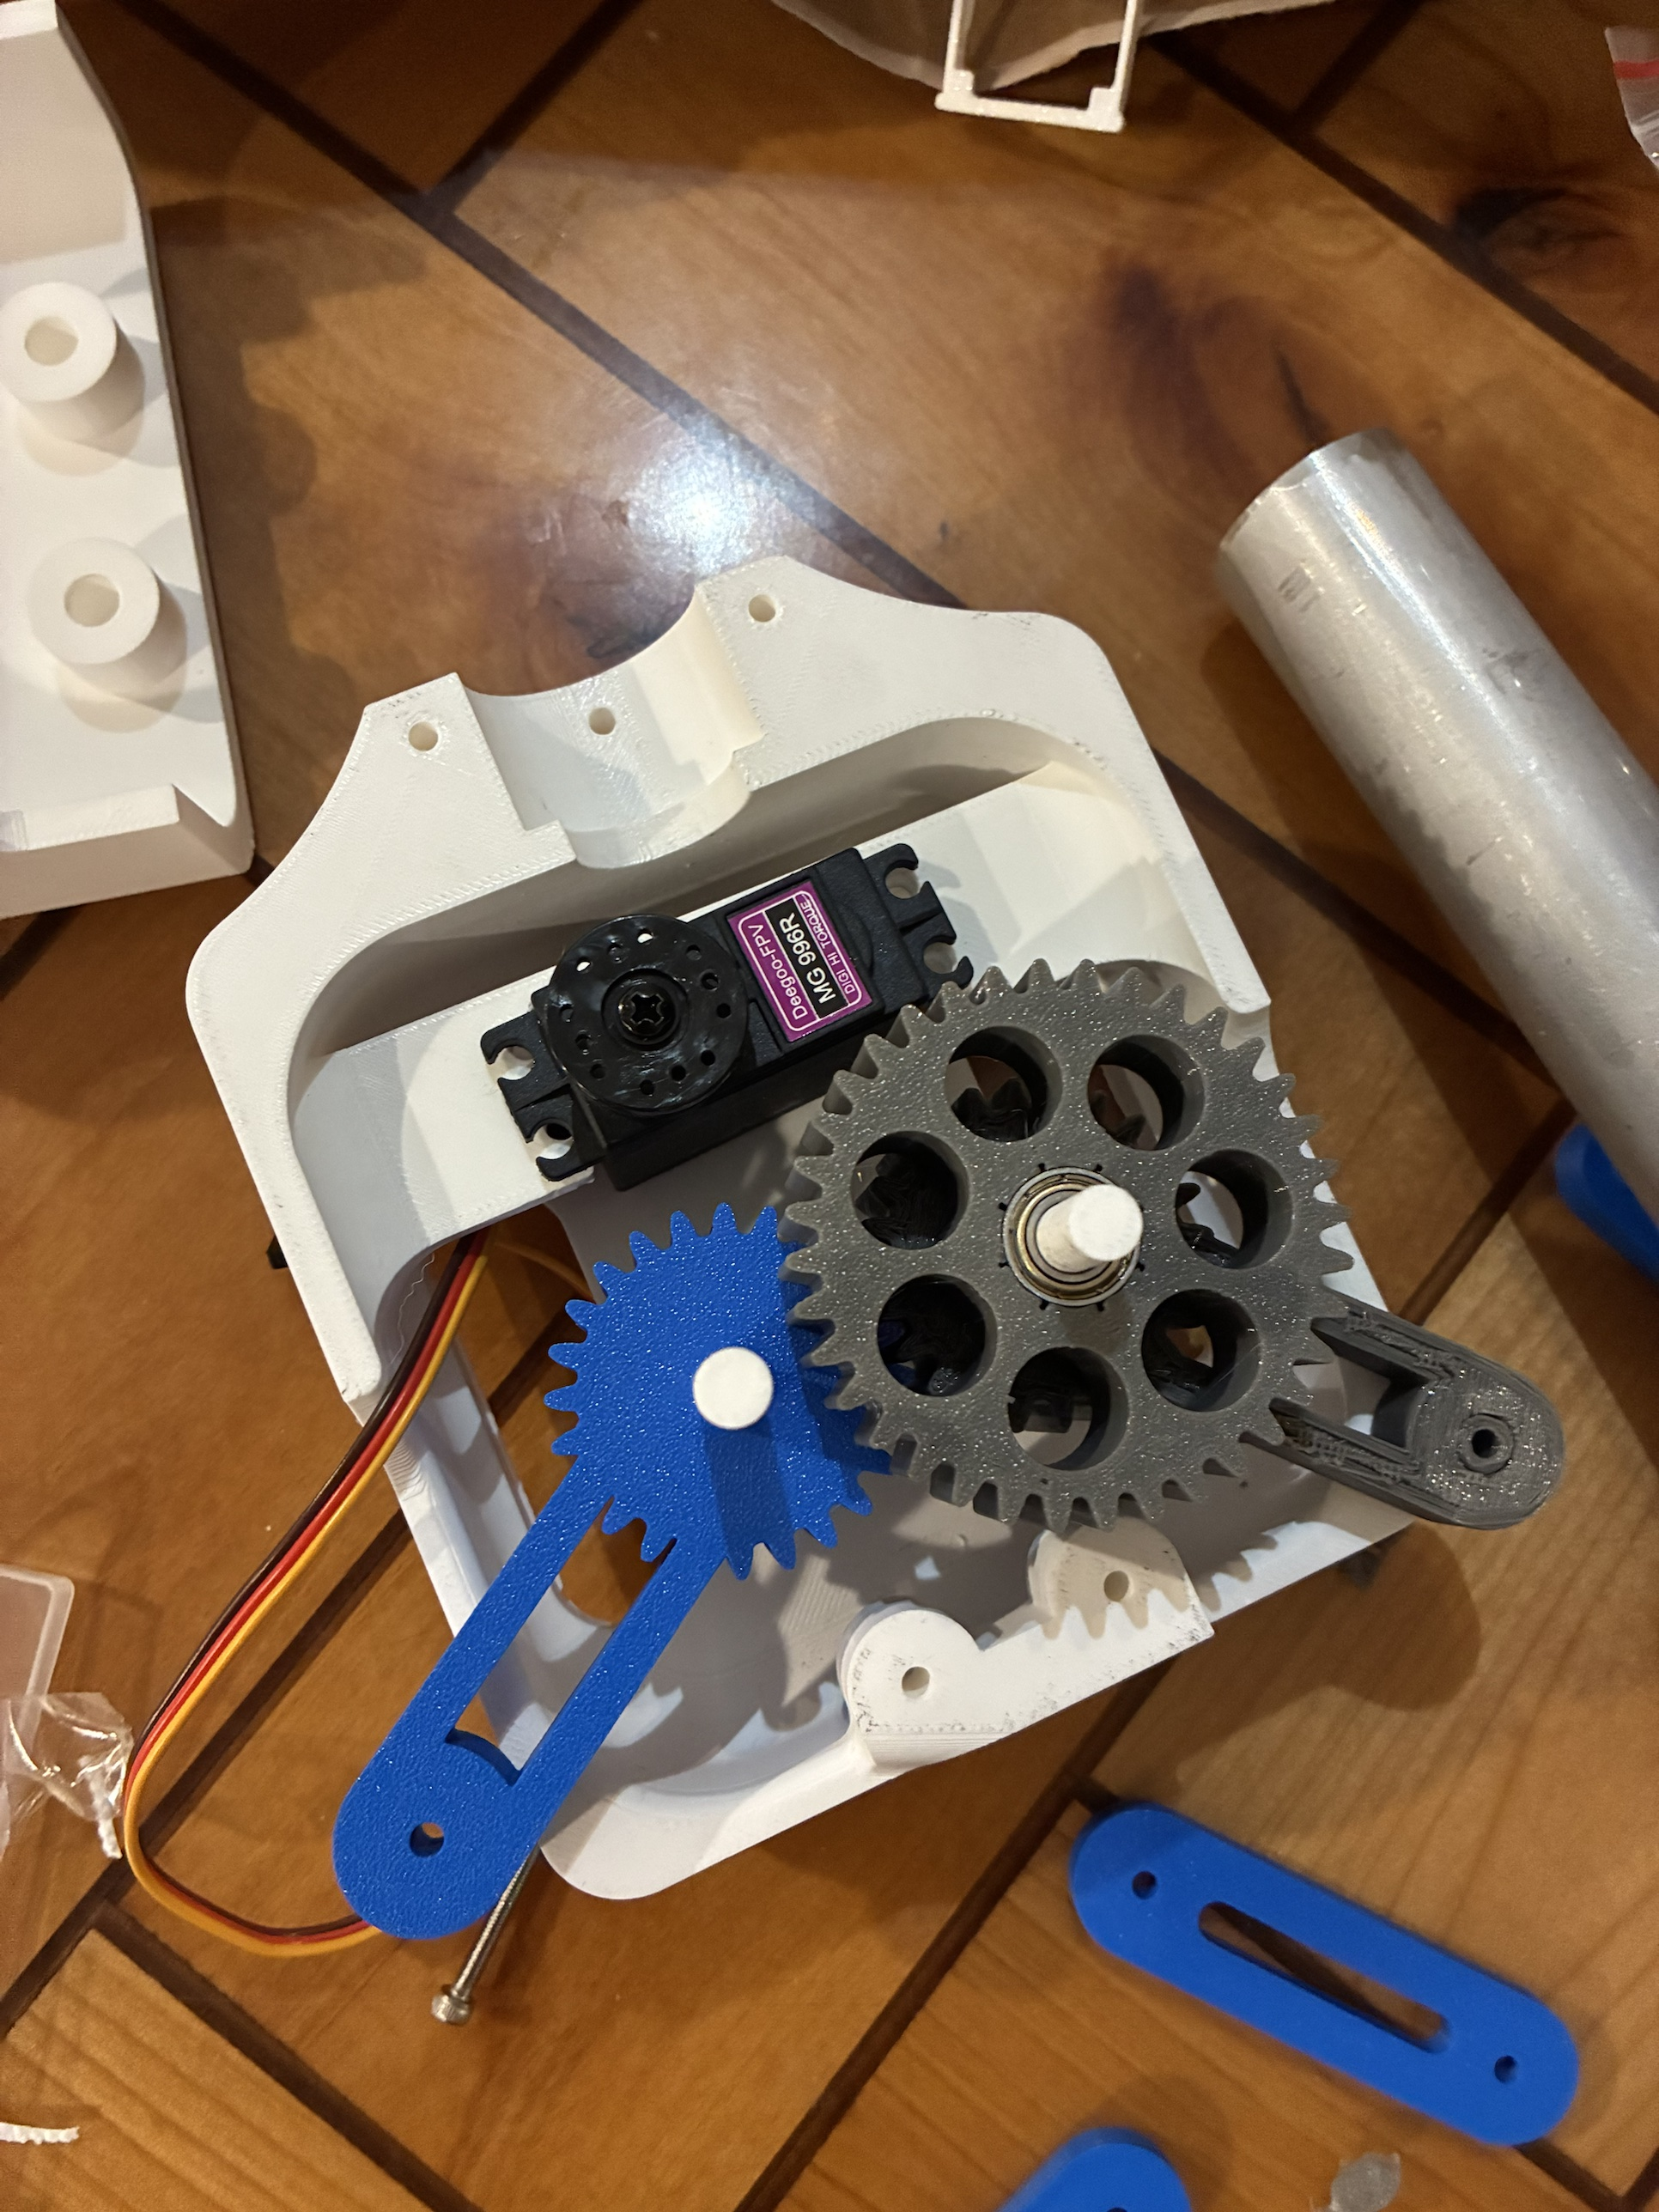
Claw: Four Versions to a Parallel Grip
Fingers (CAD only), then a clamp whose jaws could not close on thin cloth (Sep 30)
v6 clamp: 4.6 times its mass budget in CAD (Oct 20)
Final: geared four-bar, parallel jaws, 53 mm opening; gear safety factor 2.05 at servo stall
Grip for jeans is short at narrow grabs
Power: two-cell 7.4 V pack, 6 V servo rail, separate 5 V logic; peak 2.8–3.1 A at the pack's 3 A rating
Grip force per jaw, jeans
N ≥ m (g + a) / (2μ) = 0.9 × 11.81 / 0.6 = 17.7 N
Jaws: 13.3 N narrowest to 25 N at a 70 mm grab
Finger claw (CAD only), v6 clamp (CAD), final four-bar (CAD), printed gear train
Jasper Buntinx | RoomCleaner | Phase 3 of 5: Redesign
Notes:
Each version failed for a reason I can name. The first clamp's pinion travel left a 2 mm gap, so the pads never met on thin cloth. v6 was up to 2.06 kg in CAD against 0.45 kg, with no torque path from the servo. Final gears: module 1.5 with a 16 mm face (module 1 with a 6 mm face gave a safety factor of 0.35). Grip assumes friction 0.3; at 6 V the jaws give 17 % more, enough above a 22 mm grab; next are grippy pads. If asked: servo heat while holding, and claw yaw. Electrical: 5 A fuse for shorts; the claw schematic passes its rules check with 0 errors; charged attended at 1 A or less.

Slide 12
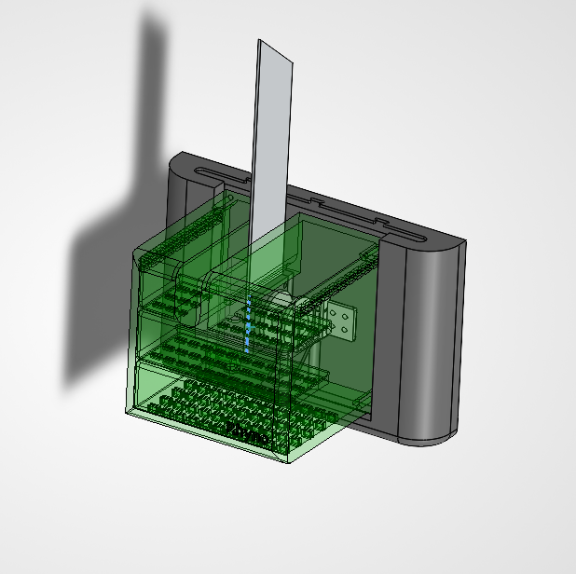
Final Wall Station
Slide-in wall mount: the station lifts off while the anchor stays in the stud
Load path: cable, spool, set screw, motor, PETG tab, slide-in, wall mount, screws, stud
Design idea: the motor is the weakest link. It slips at 34–59 N, before any part breaks, and the spool encoder reports the overload
Aluminum fin exits through a slot in the shell top
Motor slip force (the fuse)
F = τ_{h} / r = 0.36 N·m / 0.0075 m = 48 N
F_{max} = 48 N × 1.11 (motor) × 1.11 (cable angle) = 59 N
Final wall station (SolidWorks), shell shown transparent
Jasper Buntinx | RoomCleaner | Phase 4 of 5: Final design
Notes:
Walk the load from the cable to the stud. The design idea: make the motor the part that gives first. At 1.5 A it holds up to 48 N on the empty spool (59 N at most, with a 40 N·cm motor and the cable at its steepest angle); above that it skips, the encoder on the spool sees the spool fall behind the command, and the station stops and reports an overload, so nothing is damaged. Every other part has to outlast that. Elaborate: studs are far from the limit (one #6 wood screw holds about 309 N at the code design value; the same screws in drywall alone let go at about 46 N, below the motor, so studs only); as drawn, the spool's set screw in printed plastic may slip first and the warm motor tab's sharp corner is only about 1.2 times the motor; fixes are the set screw into metal (the pull test settles it) and a 6 mm tab with fillets. The rest of the station is 17 to 225 times stronger than it needs to be, which is where the lighter redesign comes from. If asked: calculation and independent check in calculations/lift_chain_weakest_link.md; the static manual was written at the old 34 N and scales linearly; the 1/8 in fin needs the shell slot about 1 mm wider on the motor side, and M3 × 12 screws.

Slide 13
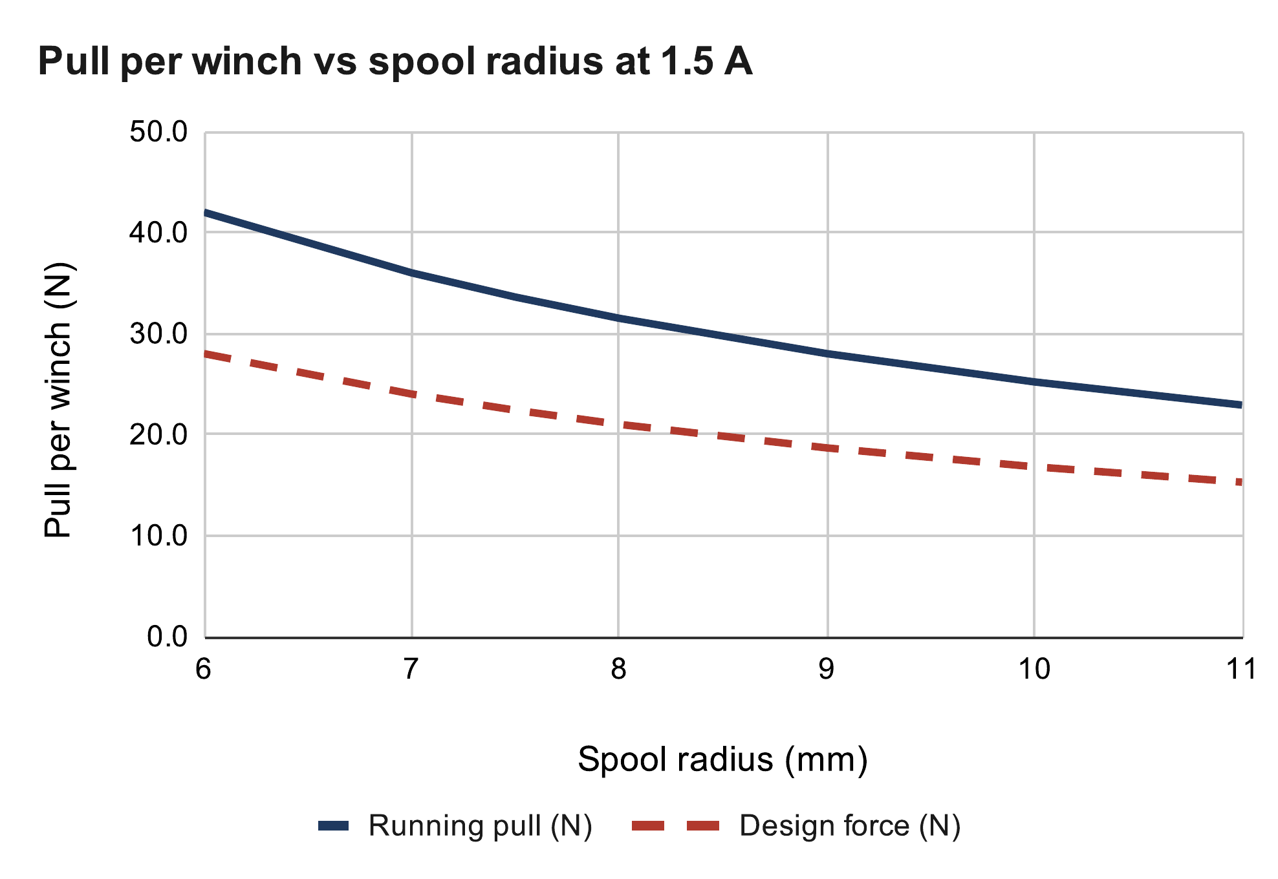
Winch Pull at 1.5 A
NEMA 17 (National Electrical Manufacturers Association) stepper at its rated 1.5 A, up from 1.06 A: 41 % more pull
Calculated pull: 34 N on an empty spool, 25 N when full
Assumes running torque of 0.7 × holding torque; the pull test measures it
Winch design force
T = τ / r = 0.252 N·m / 0.010 m = 25.2 N
F_{design} = 25.2 N / 1.5 = 16.8 N
Calculated (calc sheet: Winch pull)
Jasper Buntinx | RoomCleaner | Phase 4 of 5: Final design
Notes:
If asked how: the current is set by the driver reference voltage, I = Vref / (8 × 0.1 Ω) [fill in how you reached 1.5 A and the Vref you read]. Two torque risks: running torque could be nearer 0.5 of holding, and in microstepping the torque can be about 0.7 of the rating. The A4988 runs hot at 1.5 A; if it shuts down the winch loses torque, so the hold test watches it.

Slide 14
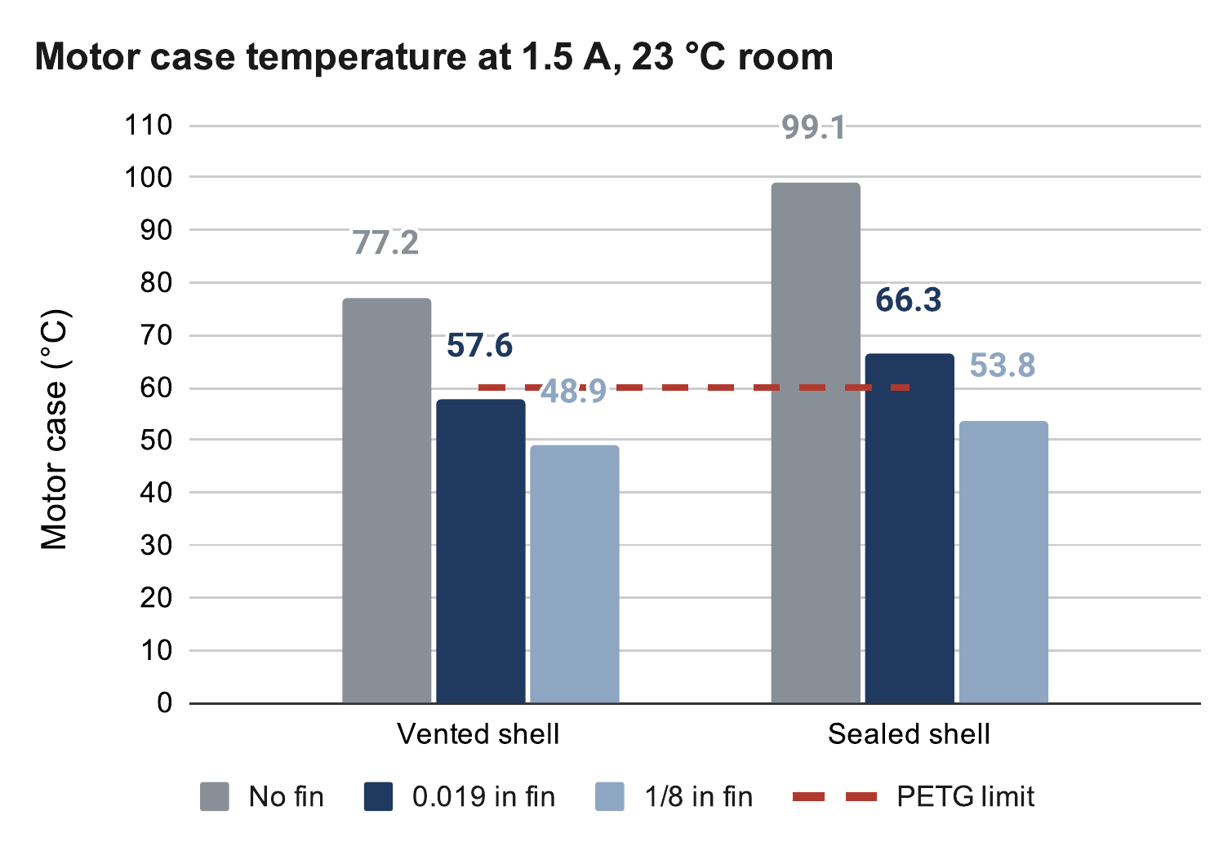
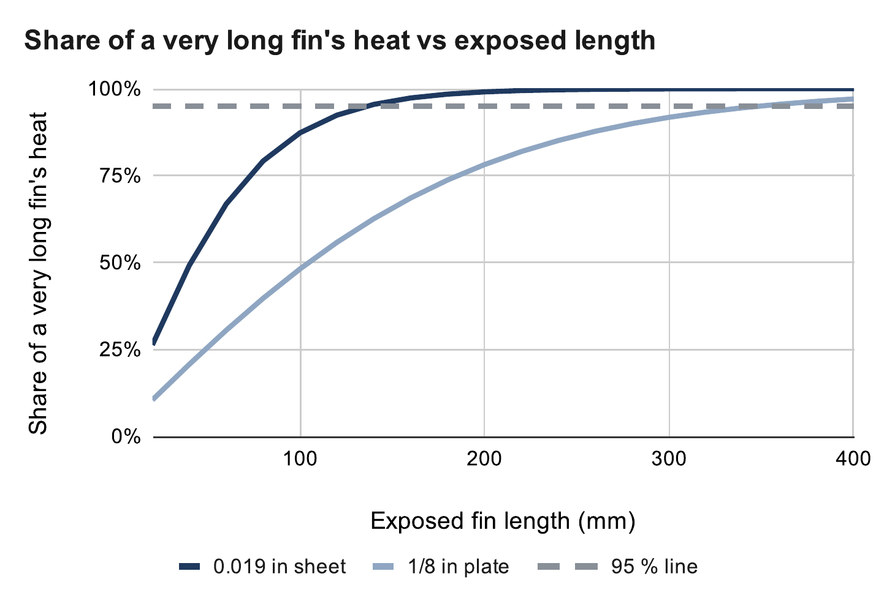
Motor Cooling
1.5 A doubles motor heat to 4.05 W; the PETG mount must stay below 60 °C
Vented shell and fin: 56–59 °C with the 0.019 in prototype, 45–49 °C with the 1/8 in design
The thin sheet stops gaining by 136 mm; the 1/8 in plate keeps gaining to 349 mm
If the fin alone carried all 4.05 W (painted 6061, 44 mm wide)
Thickness | Mass | Shortest for ≤ 60 °C
0.019 in (prototype) | 14 g | None (2.0 W max)
1/16 in | 47 g | None (3.6 W max)
0.090 in | 68 g | 210 mm or none
1/8 in (design) | 94 g | 145–185 mm
3/16 in | 141 g | 125–140 mm
1/4 in | 189 g | 115–125 mm
Calculated (calc sheet: Motor temperature; assumed 1.8 Ω coil, 23 °C room)
Motor heat, P = I² R
At 1.06 A: (1.06 A)² × 1.8 Ω = 2.0 W
At 1.5 A: (1.5 A)² × 1.8 Ω = 4.05 W
Calculated (calc sheet: Heat fin; Incropera, ch. 3)
Jasper Buntinx | RoomCleaner | Phase 4 of 5: Final design
Notes:
Top chart: motor temperature for each fin, vented and sealed; the ranges in the bullets are the simple and the refined hand model. Bottom chart: why thickness beats length; the built length is 200 mm, limited by the ceiling. The table answers what fin it would take to carry all the heat alone. This week: SolidWorks study and a 90-minute hold test; fallback 1.35 A. If asked: measuring the coil resistance takes 30 seconds; warmer air near the ceiling uses up the prototype's 1–4 K margin; the PETG next to the motor runs at about the motor temperature (independent 3-D check).

Slide 15
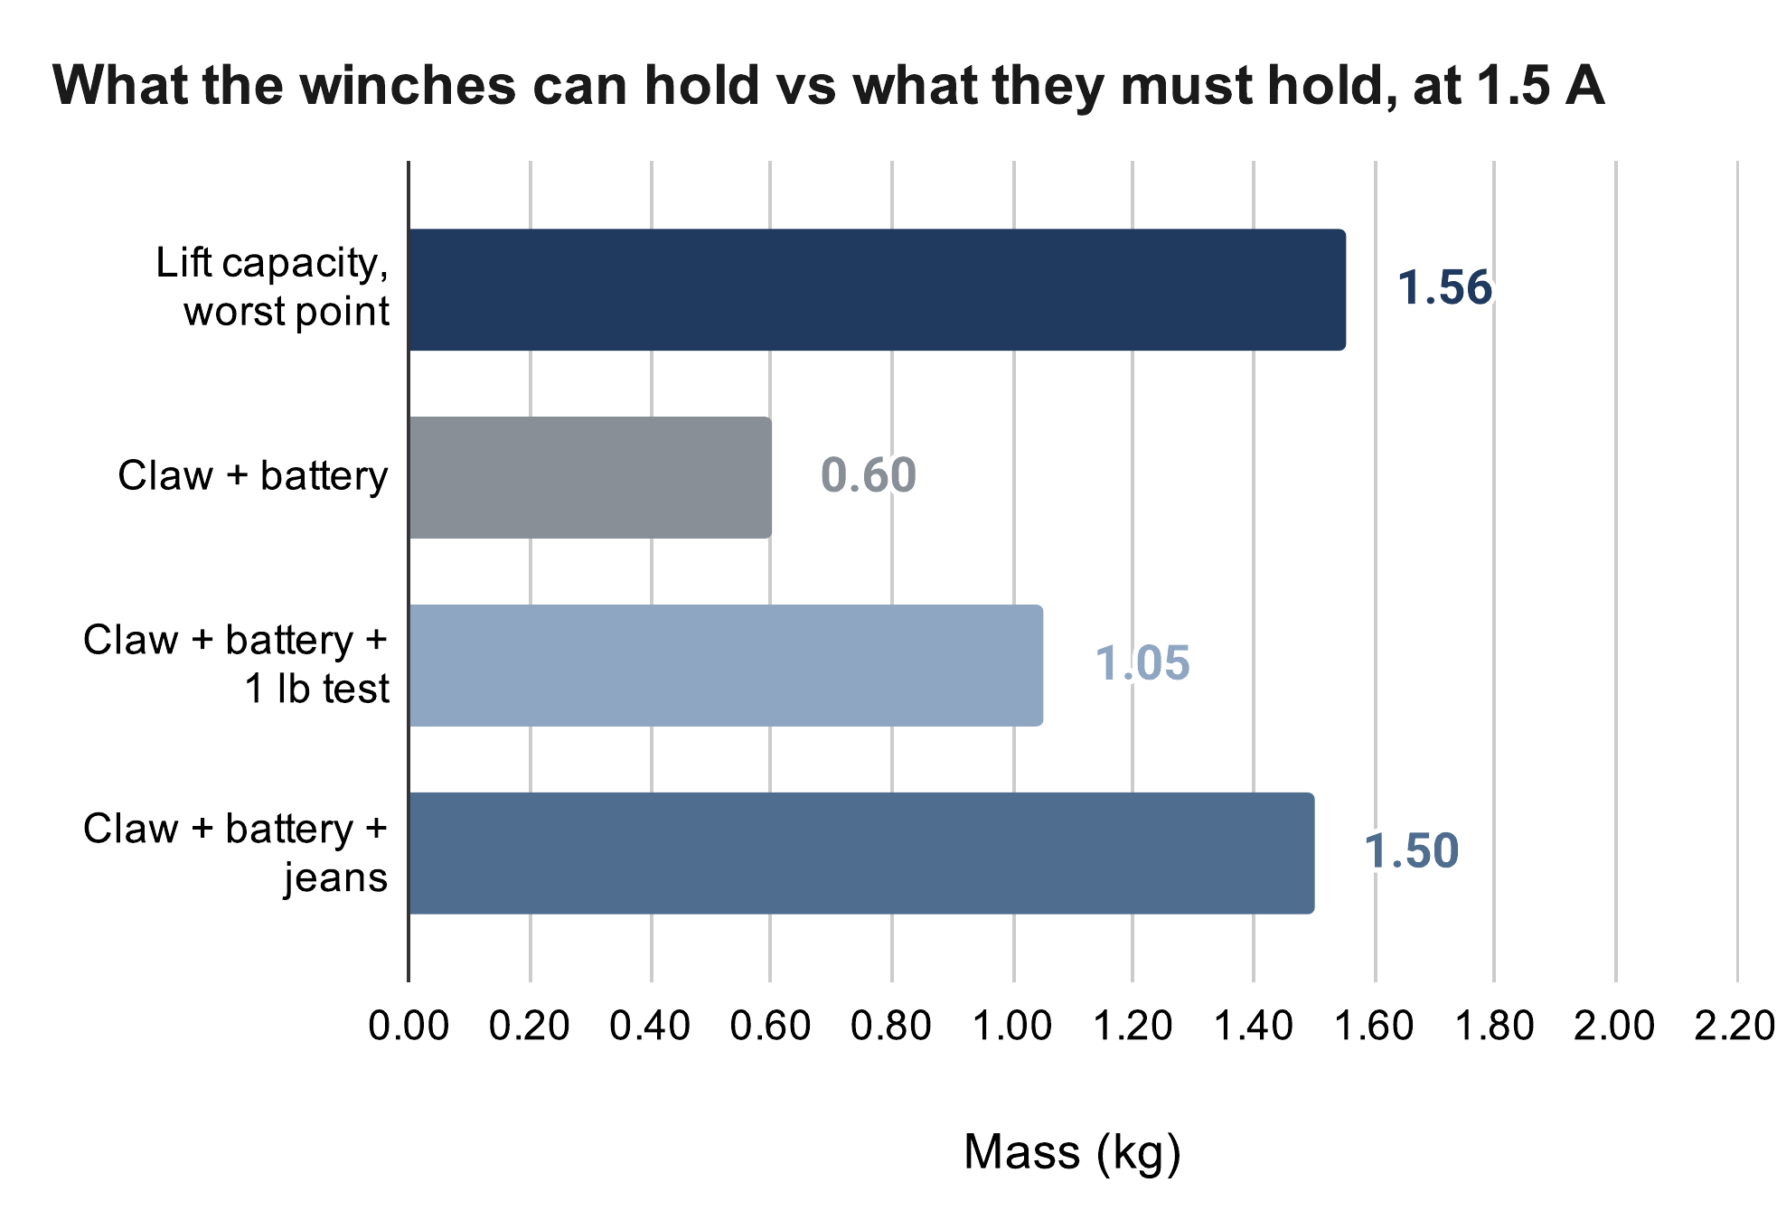
Weight Budget
Claw with battery weighed 0.60 kg (0.86 kg estimated)
Calculated capacity at task height 1.56 kg; jeans need 1.50 kg, a 4 % margin
That margin is inside the uncertainty: at 0.5 × holding torque, capacity is 1.1 kg
The pull test decides: keep 1.5 A, or add a 2:1 gear stage at each winch
Lift capacity
m_{max} = F_{design} / (k g) = 16.8 / (1.101 × 9.81)
= 1.56 kg against 0.60 + 0.90 = 1.50 kg
Calculated (calc sheet: Lift budget)
Jasper Buntinx | RoomCleaner | Phase 4 of 5: Final design
Notes:
Pause and ask: if the pull test comes in low, would you cut claw mass or add a 2:1 gear stage? My answer: the gear stage, because it also lets the current drop to about 1 A and halves the heat. If asked: task height means the claw at or below 1.6 m, and the worst point is the middle of a long wall. The claw is 0.15 kg over its 0.45 kg budget; the 198 g aluminum tube is the first place to cut.

Slide 16



Build: Printing, Machining, Bring-Up
One spool bore printed too tight (Ø5.2 on a 5 mm shaft); v3 opened it to Ø5.45
Fin drilled in one mill setup from a 1:1 drawing; the 7/8 in pilot fits the 22 mm motor boss
First motor would not turn: logic rail at 1.14 V, traced to a bad 3.3 V connection
Now: a meter on every rail before code, and fit coupons before new fits
Fin blanks and drawing, finished fin, soldered station board, mill setup
Jasper Buntinx | RoomCleaner | Phase 5 of 5: Build and test
Notes:
Two lessons from the bench: measure the hardware before trusting the software's view of it, and test a fit before printing the part. If asked: the driver stays disabled at boot so a reset cannot move a motor, which also means a reset drops a hanging claw (safe-state table on the system-test slide). [Fill in: readings and date.]

Slide 17
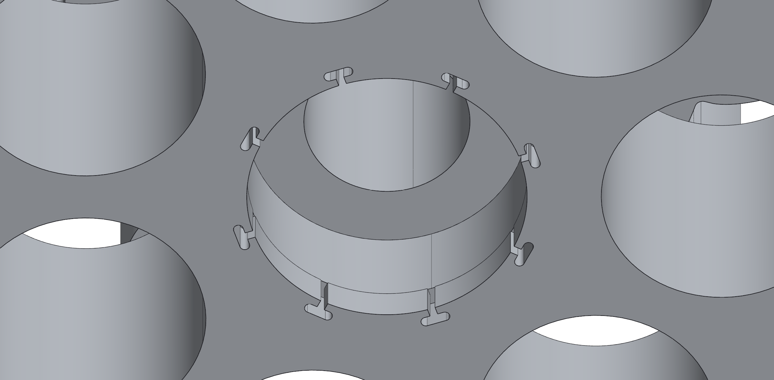
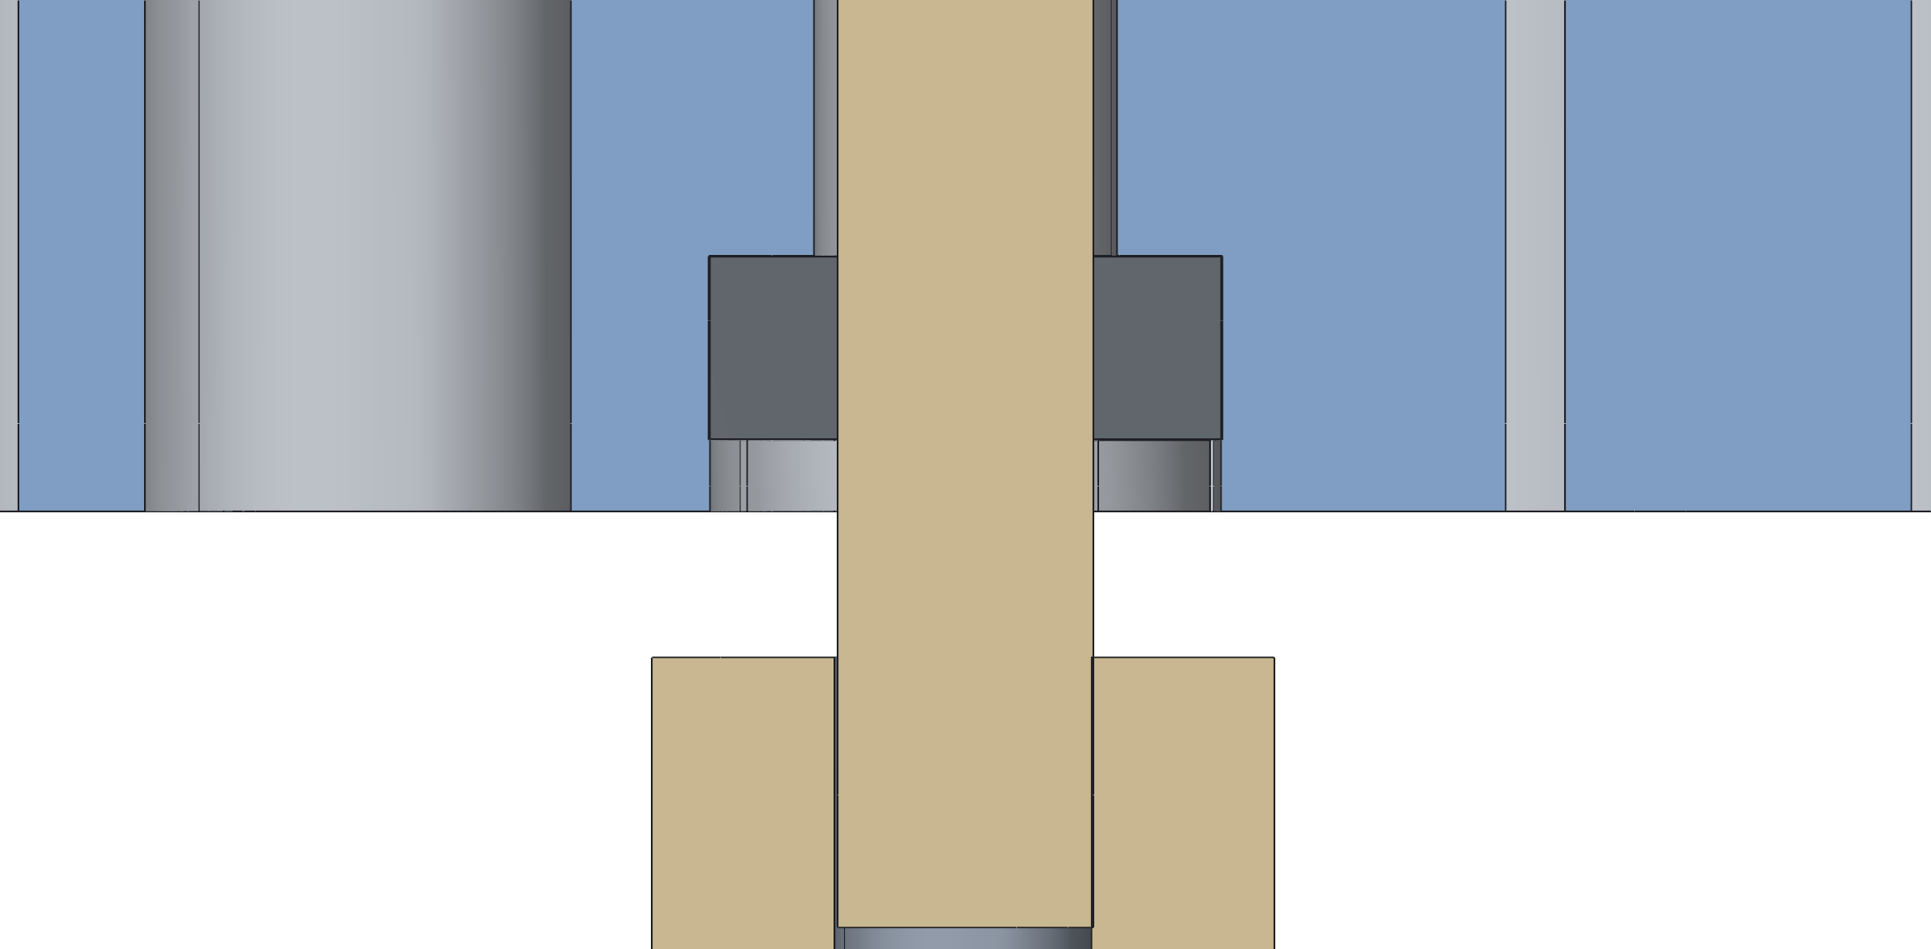
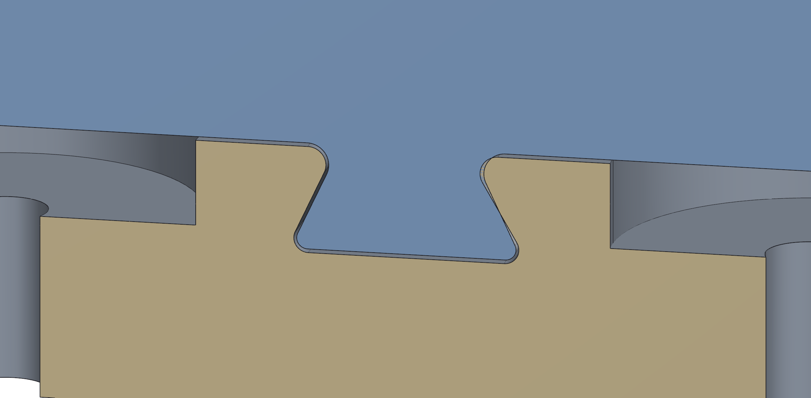
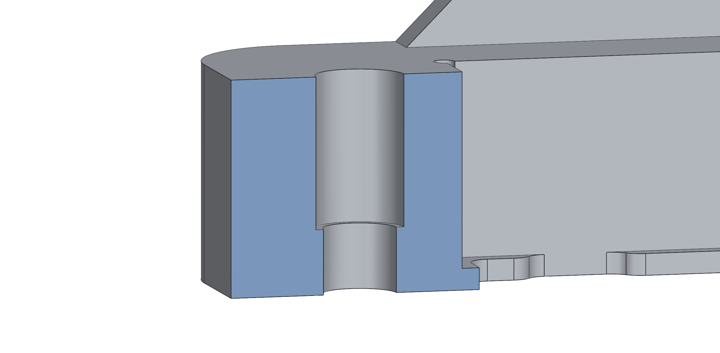
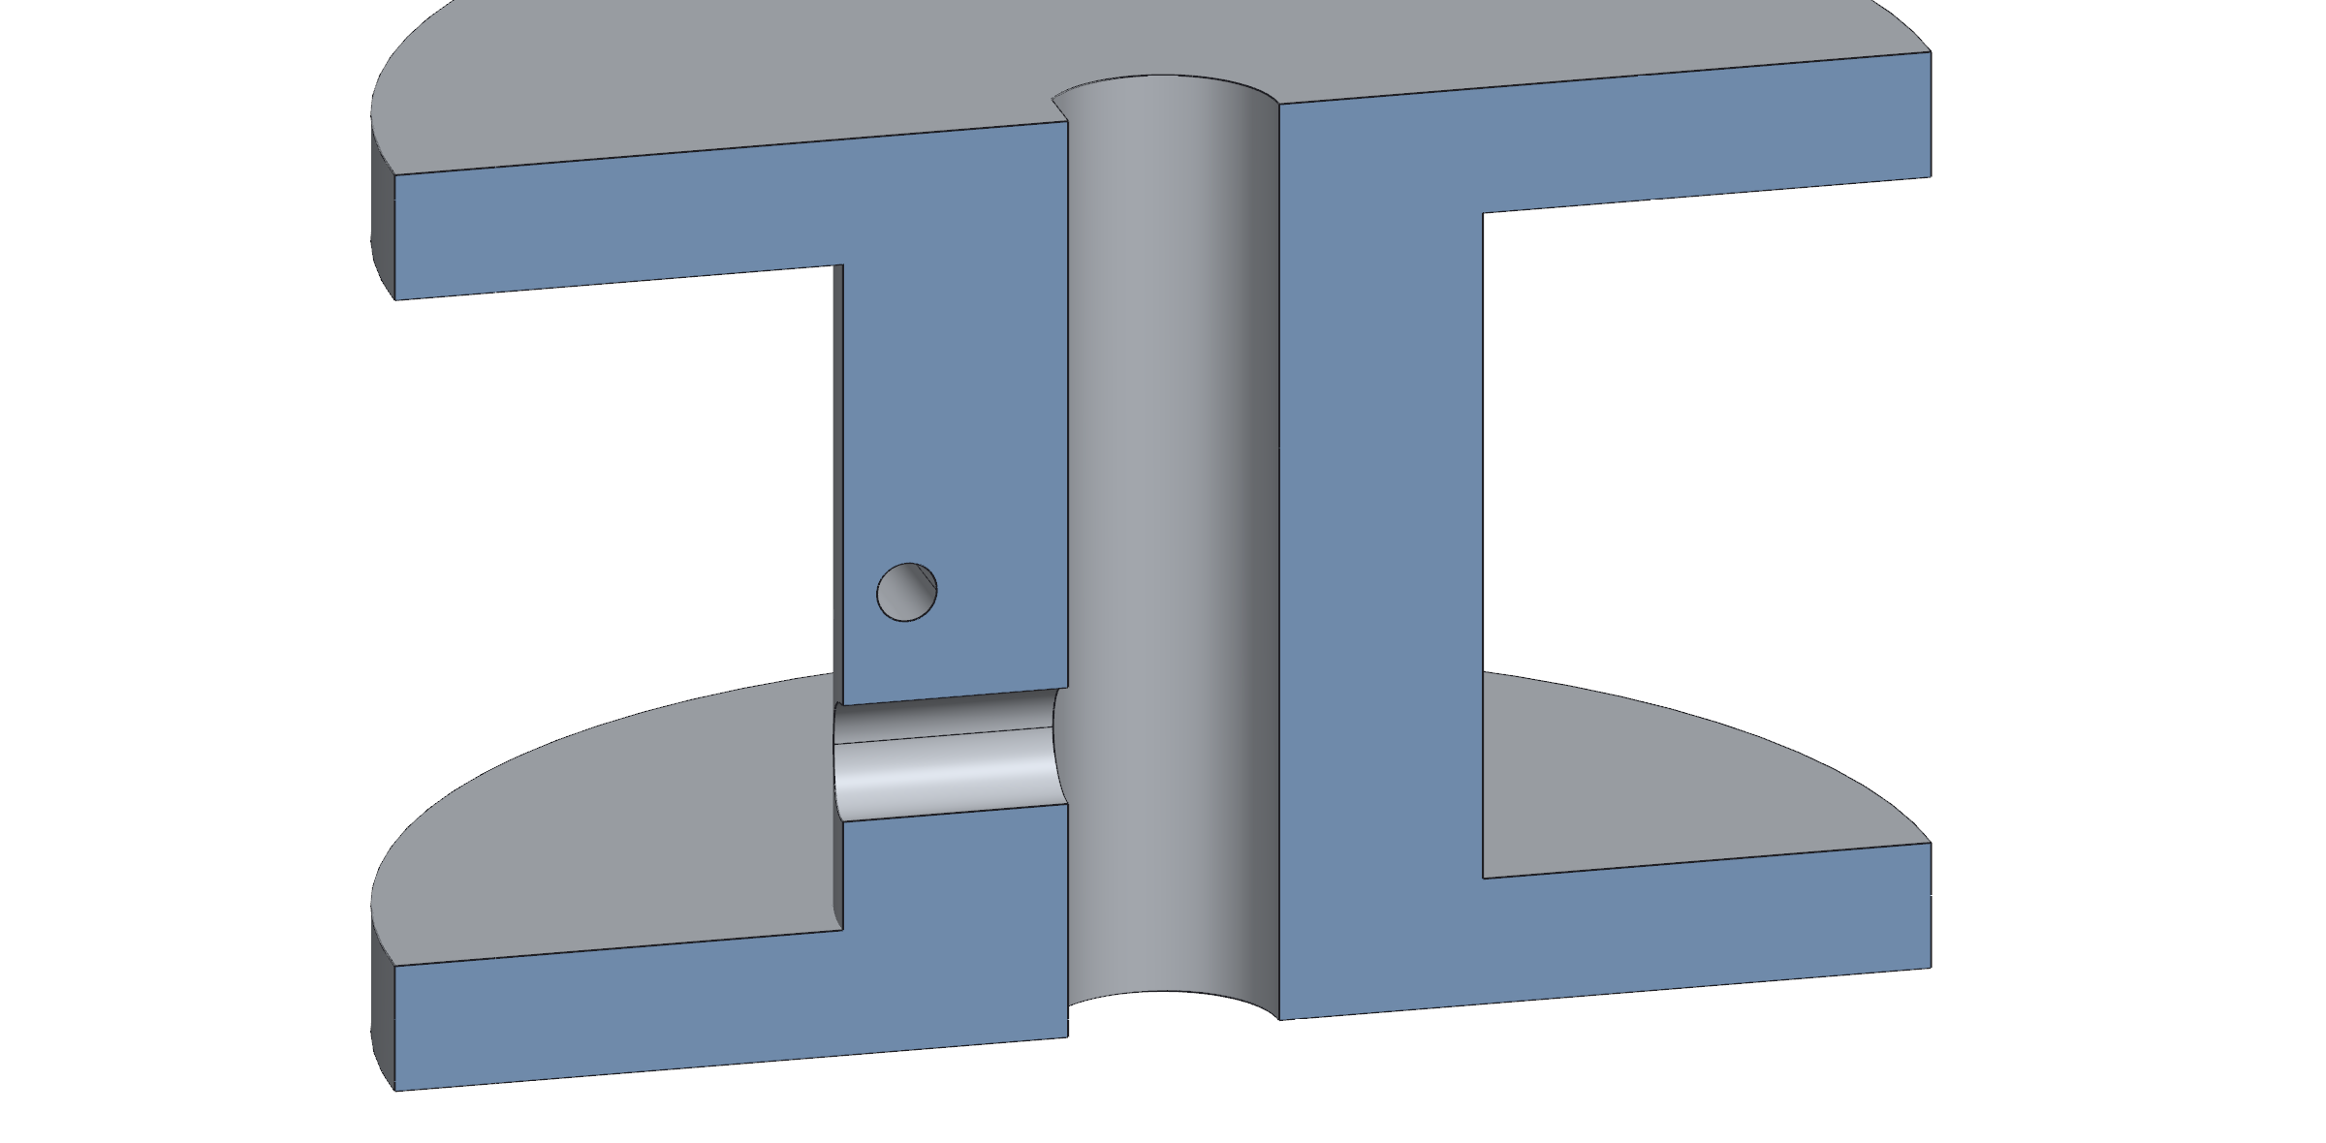
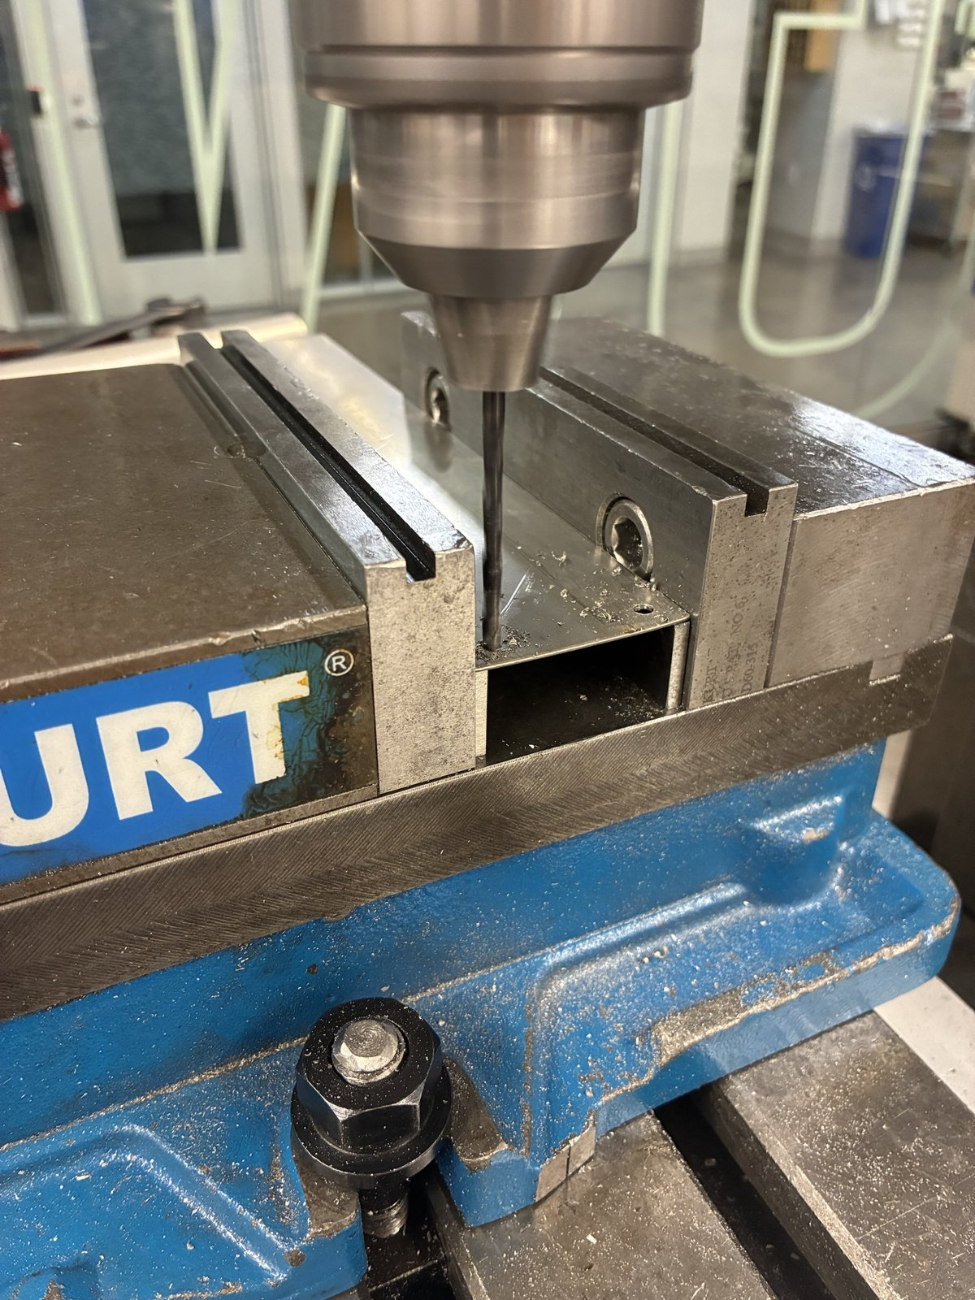
Manufacturing: Fits and Datums
Feature | As drawn | Fit
Gear bearings (687) | Ø14.075 pocket behind a Ø14.000 lip, 1.95 long, 8 T-slots | Snaps past the lip, +0.075 behind it
Gear pins | Printed Ø7.000 pin into a Ø7.05 socket | Line-to-line in the bearing; +0.05
Slide-in mount | 0.175 per side; 30° dovetail flanks | Slip fit, 0.14–0.21 on the flanks
Spool on Ø5 D-shaft | Ø5.30 bore (10/21), Ø5.45 in v3; 0.5 mm flat | +0.30 to +0.45: Ø5.2 printed too tight
Heat-set inserts | M3: Ø4.1 × 7 deck, Ø4.0 × 5 gear housing; M2.5: Ø3.45 × 4 | Melt-in; hole deeper than the insert
Screw clearance | M3 Ø3.5 printed, Ø3.4 drilled; wall Ø3.97 (5/32 in) | +0.5 printed, +0.4 drilled
Motor pilot, Ø22 boss | Ø22.4 printed tab, Ø22.5 drilled fin | +0.4 / +0.5
Fin hole zero | Edges locate the bottom-left hole; drilled, it is the zero for the other 4 | Pattern ±0.1, free of the ±0.5 sheared edges
Gear: Ø14.000 entry lip, 8 T-slots
Cut open: 687 bearing on the printed pin
Slide-in rib in the wall-mount dovetail
Heat-set pocket: Ø4.1 × 7 over Ø3.4
Printed holes come out small, so every printed fit carries an allowance; the drilled fin needs none
PETG on a Creality K1, 0.4 mm nozzle, 0.2 mm layers; loads along the layers, mating faces off supports
v3 spool: D-bore and set-screw hole
Fin: holes drilled from the first hole
My SolidWorks parts; blue and tan are cut faces, dark grey the bought bearing
Jasper Buntinx | RoomCleaner | Phase 5 of 5: Build and test
Notes:
This is what I designed into the parts so they assemble without filing. The gear pockets are the one I am proudest of: the bearing presses past a lip, the T-slots let the lip ends flex, and it then sits free in a pocket 0.075 mm larger, so the lip holds it in without squeezing the race. The slide-in runs on 0.175 mm a side, enough to lift out by hand after printing shrinkage. The fin is the one metal part. The sheared edges are only good to half a millimetre, so I used them only to find the first hole; once it was drilled I zeroed the mill on that hole and put the other four in from it, so the hole pattern carries the mill's accuracy, not the edges', and the fin bolts on without reaming. If asked: the spool bore taught me the allowance (Ø5.2 would not go on a 5 mm shaft; v3 opened it to Ø5.45 and the 10/21 CAD has Ø5.30; the set screw carries the torque). [Confirm which spool bore is printed, which holes get heat-set inserts, and the insert part number.]

Slide 18



First System Test
Three stations hold the claw under gravity over the triangle they span, about half the floor
Sequence: self-check, calibration, short move, then pickup
1 lb first, then one garment; pass limits set before the run
If something goes wrong
Phone app: home, live claw camera, chat; every move waits for approval
Event | What happens
PAUSE or a detected fault | All stations hold with torque on; nothing restarts without approval
Wi-Fi link lost | Stations stop and hold on their own clocks
Power loss or emergency stop | Torque is lost and the claw can fall, so nobody stands underneath; brake planned
Reset or brown-out | Driver off at boot: same as a power loss
Driver over-temperature | The A4988 shuts off; the hold test watches it
Check | Pass limit | Result
Self-check | All stations answer; slack taken up | Planned
Calibration | Held-out poses: cable residual ≤ 20 mm | Planned
Short move, 1 lb | 300 mm at 50 mm/s; cable mismatch ≤ 2 mm | Planned
Pickup | One garment into the hamper | Planned
Jasper Buntinx | RoomCleaner | Phase 5 of 5: Build and test
Notes:
Pause and ask: which pass limit would you tighten? Three cables give three force equations, so slack shows up directly. The app runs the sequence: start up (self-check, take up slack, calibrate), find (scan, detect, choose the nearest), pick (hover until still, grip, deliver; the camera confirms each step). The safe state is PAUSE, torque on; anything that removes power drops the claw. If the test has not run by Monday, show the rig and the dated plan. Logged: cable lengths, encoder counts, motor temperatures, the fit's error bars.

Slide 19
Results Against Targets
Target | Goal | Current | Evidence | Status
Lift capacity | 1.50 kg with jeans | 1.56 kg; 1.1 kg at 0.5 × holding torque | Calculated | Marginal; pull test
Grip for jeans | 17.7 N per jaw | 13.3–25 N | Calculated | Short at narrow grabs
Claw mass | 0.45 kg | 0.60 kg with battery | Weighed | Not met
Motor temperature | Below 60 °C | 56–59 °C prototype fin | Calculated | Marginal; hold test
Weakest link | Motor slips first | Set screw may slip first; tab at 1.2 × | Calculated | Two fixes
Working area | Floor, 0.2 m wall margin | All but 0.2 m at the walls | Calculated | Met in design
Wiring | One cable per station | One 12 V pair; 0.51 V drop | Built | Met
Accuracy | ≤ 2 mm cable mismatch | 40 ms skew budget gives 2 mm | Not measured | To be tested
Speed | 50 mm/s | Not yet run | None | To be tested
Cost | Hobby budget | Not yet totaled | Receipts | Open
Calculations: RoomCleaner engineering calculations (Google Sheets)
Jasper Buntinx | RoomCleaner
Notes:
Back to the targets, with the evidence for each. Three are not met: grip for jeans at narrow grabs, claw mass, and the weakest link (two cheap fixes). Two are marginal and this week's tests decide them: lift capacity and the prototype fin's temperature. Only the claw mass is measured so far.

Slide 20
Good and Poor Decisions
Good decision | Result
One controller per winch | Five times less wire; each station tested alone
Camera calibration instead of bead homing | Whole room reachable; caught on paper before building
Teeth checked at servo stall | A clamp stalls the servo on every grip: safety factor 2.05
Poor decision | Result
Mass not tracked through four claw versions | v6 reached 4.6 times its budget in CAD; the claw is 0.15 kg over
Prototype fin cut from scrap sheet | Only 1–4 K of thermal margin
Build and test week ends on presentation day | System results arrive at the last minute
Parts built far stronger than any load needed | Station mount 17 to 225 times the motor's pull; 1.2 L of PETG per station
Thorough where a mistake is expensive: fin holes drilled from the first hole as zero, the stall check on the teeth
Scrappy where it is cheap to undo: a jumpered ESP32 after a controller failed, a floor board printed on paper
Jasper Buntinx | RoomCleaner
Notes:
Good: each was a trade I priced first. Poor: the mass problem was not the budget but that I never re-checked it as the claw changed four times; the scrap fin saved a day and cost the thermal margin; and the schedule leaves no slack after the first test. Scrappy: when a controller board died two days before the test, I moved the same circuit to an ESP32 dev board with nine jumpers instead of redesigning it. [If true, add: several stations built before one was proven.]

Slide 21
Takeaways and Next Steps
Takeaways
  Pull-test one winch and weigh a mock claw in week 1; set the mass budget from that
  Kill ideas on paper first: bead homing and the central board failed calculations I could have run in week 1
  Prove one full station, calibration included, before copying it
  Size every part to a load number; over-building cost weight, plastic and print time
Next steps
  Pull test, then enter the measured limit in the planner
  Hold test at 1.5 A, three-station test, grip pads
  Spool set screw into metal; 6 mm motor tab with fillets on both roots
  Lighter redesign sized to the loads: about 60 % less station plastic, claw to its 0.45 kg budget
  Continuous testing: long runs logging tracking faults, temperatures and creep
  A brake or non-backdrivable stage, so a power loss cannot drop the claw
Actual
(15 weeks)
Concept
Gen 1
Redesign
Final
Build and test
Half time
(7 weeks)
Plan
One station
Copy
Clamp
Test
Same time scale. Half time: plan (pull test, mass budget), one station, copy, clamp, test.
Jasper Buntinx | RoomCleaner
Notes:
In half the time I would not build the central board, bead homing or the finger claw at all; the week-1 calculations already killed them. Next steps in order: the pull test first, because both the lift margin and the planner's tension check depend on it. The redesign uses the weakest-link numbers: the mount and dovetails are 90 to 225 times stronger than the motor can pull, so the station can lose about 60 % of its plastic while the motor tab, the one part that is short, gets thicker; a carbon tube and thinner housings bring the claw to 0.45 kg, which lifts the jeans margin from 4 % to about 16 % (docs/decisions/WEIGHT_REDESIGN_PROPOSAL_20261022.md). Continuous testing then runs the robot for hours and logs every tracking fault, temperature and any creep. Leave this slide up for questions.

