Slide 1

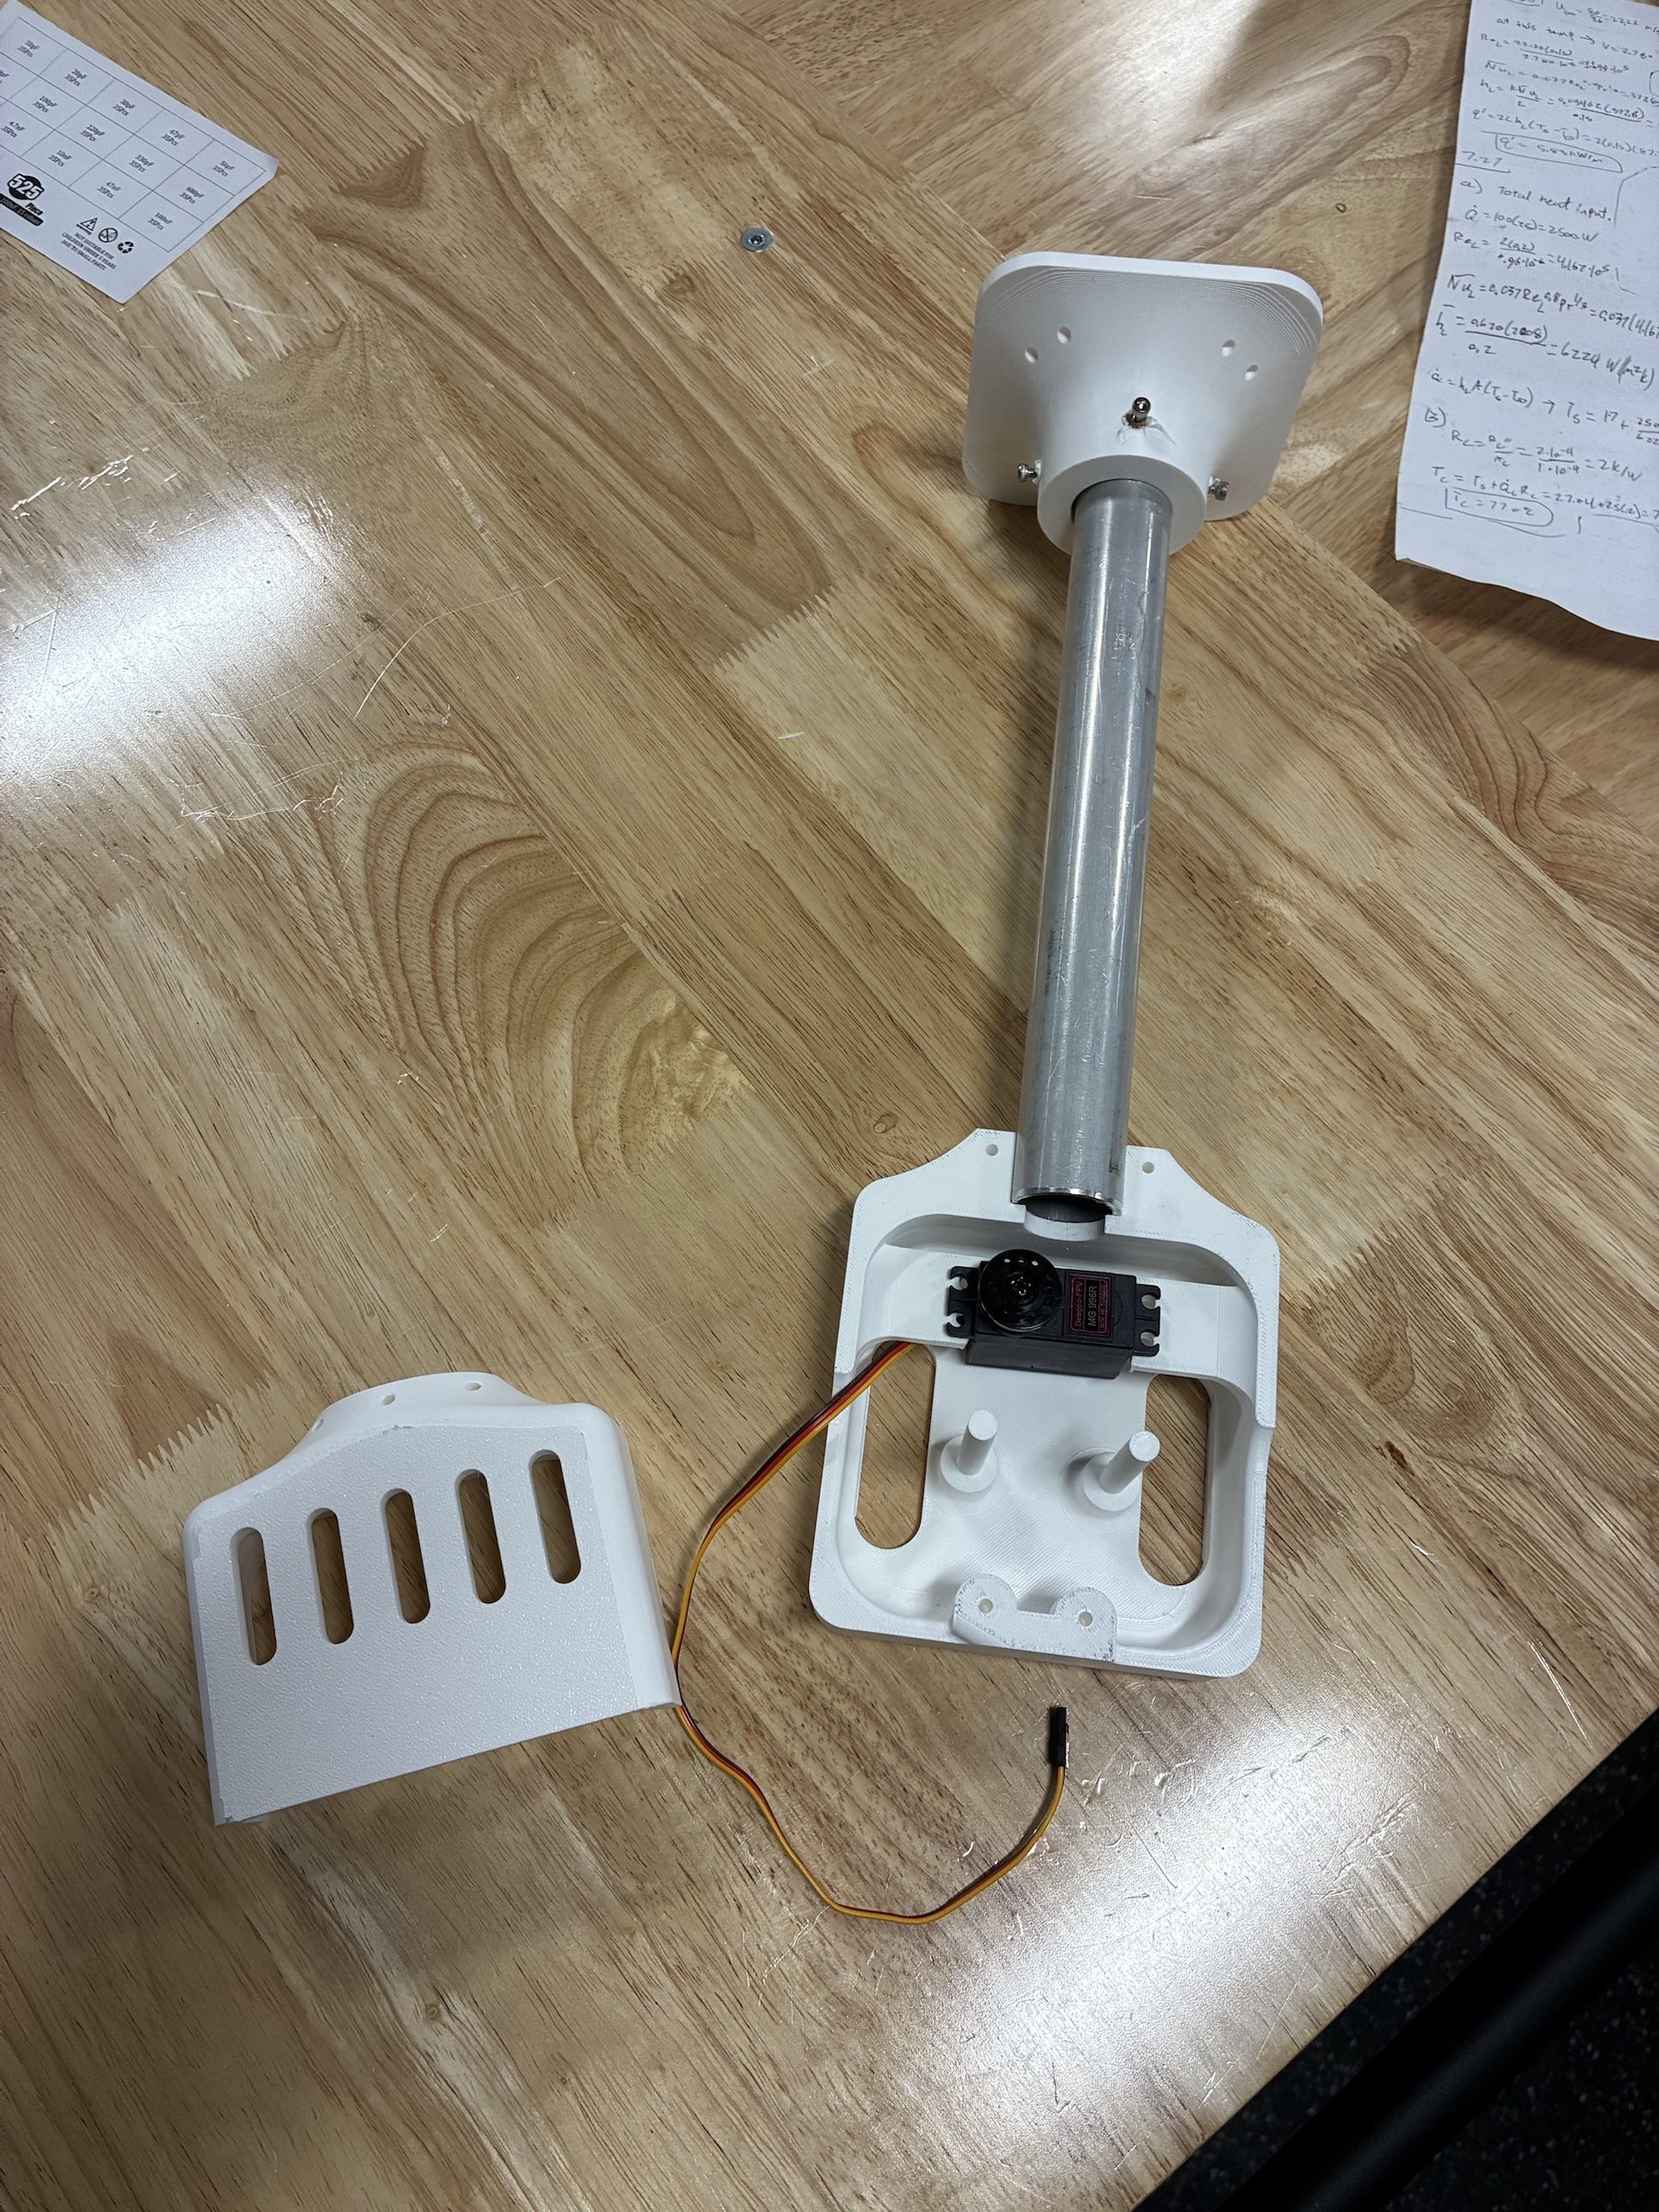
RoomCleaner
A cable-driven robot that picks laundry up off the floor
Jasper Buntinx
Mechanical Engineering, Texas A&M University
October 27, 2026
Notes:
One sentence: four winches near the ceiling corners hold one claw on cables; it picks clothes off the floor and drops them in a hamper. Then straight to who I am.

Slide 2
About Me
[Photo of you building: EcoFil, a sculpture, or the workshop]
Mechanical Engineering, Texas A&M University, [graduation year]
Built EcoFil, a filament recycler: shredder, dryer and extruder
Metal sculpture with fiber laser cutting and welding
[hobbies]
Notes:
One minute. Degree and graduation date, EcoFil (what each stage does, what you learned), the sculptures for the Austin Creek Show (fiber laser and welding: real fabrication), one hobby. Close with why a laundry robot: a problem you have, and a machine you could build end to end yourself.

Slide 3
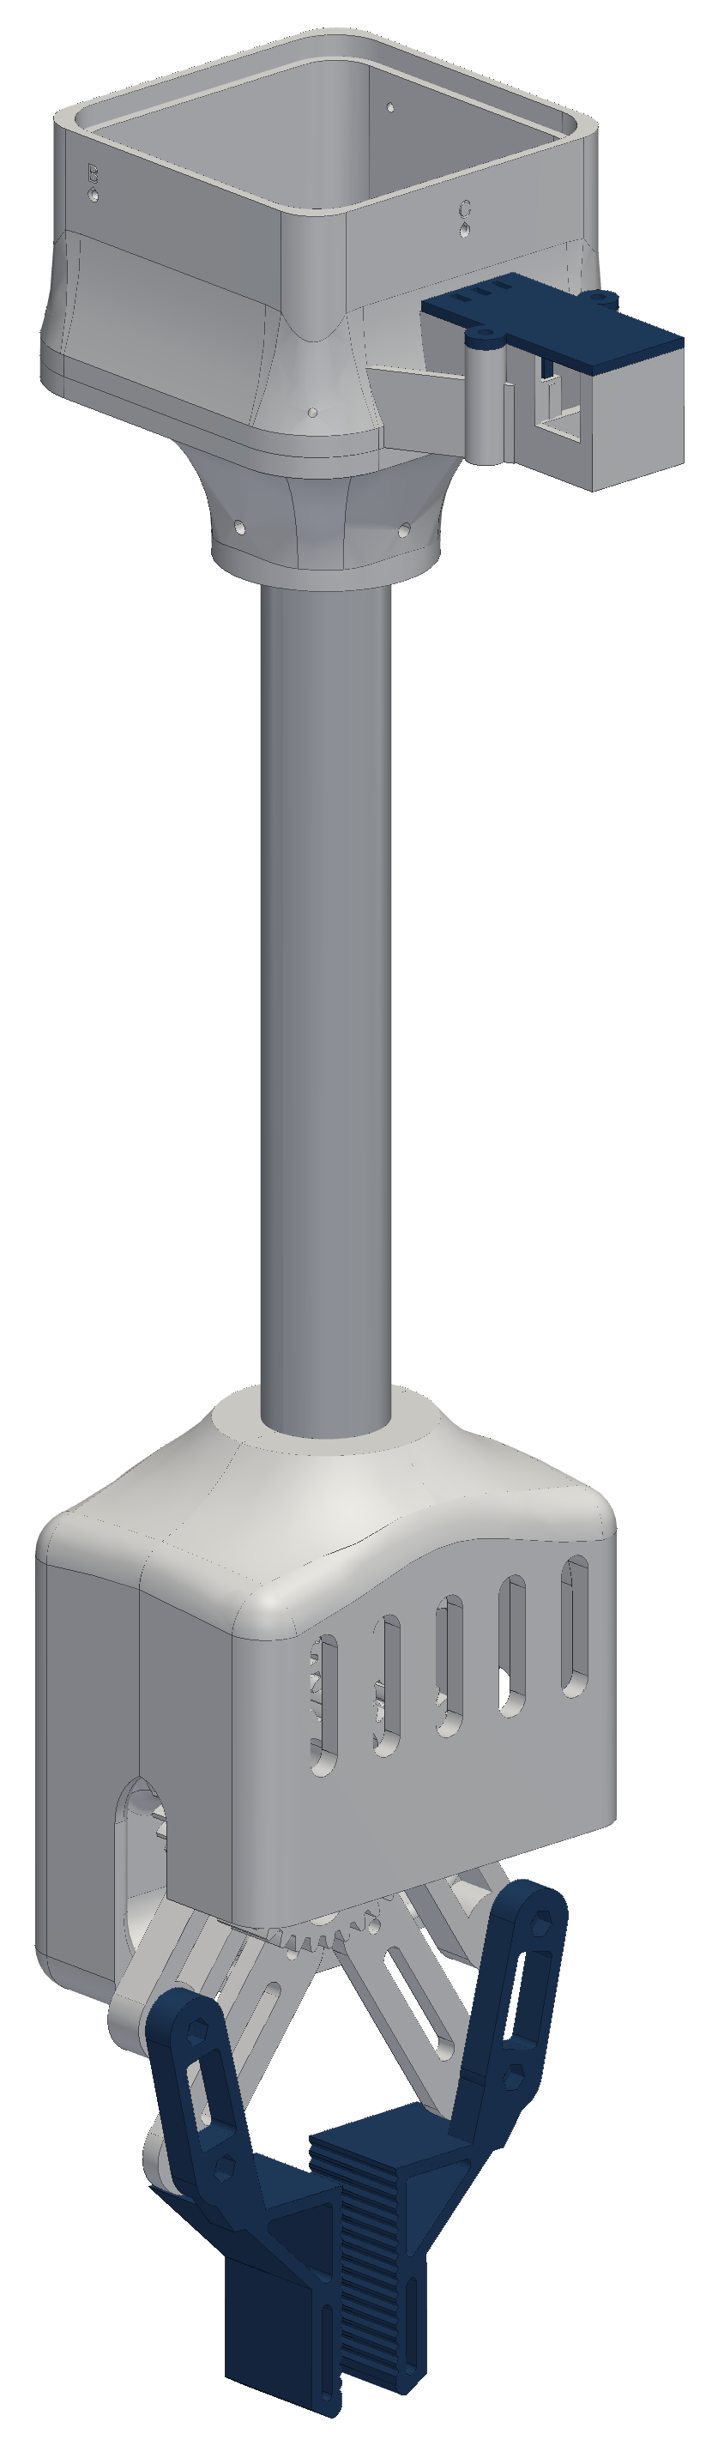
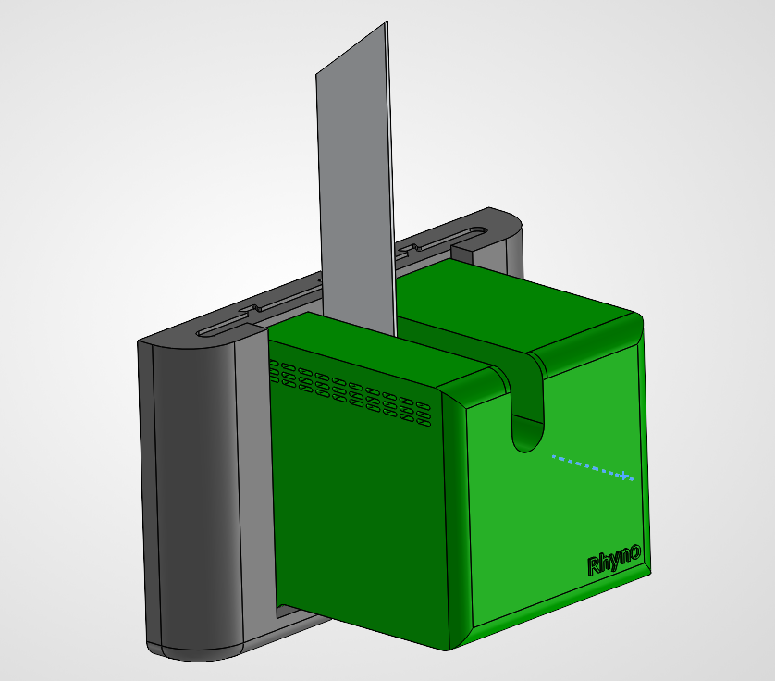
Project Goal
Pick up laundry anywhere in an 11 × 9 ft room and drop it in a hamper
Design load: jeans, 0.9 kg, at 2 m/s²; first test with 1 lb
3D-printed PETG (polyethylene terephthalate glycol) on a hobby budget
Success: one garment to the hamper with no human input
Final design (SolidWorks): wall station and claw
Notes:
Why: a real problem in my own room, and a machine I could design, build and program end to end. 0.9 kg is a screening figure for jeans; the first physical test is 1 lb. Safety rules from day one: stations anchor into studs, a switched power strip is the one hard stop, nobody stands under the robot, and any fault holds position. The talk follows the project in five phases, the same five as the timeline on the next slide.

Slide 4
Timeline and Scope
Phase
Dates
July
August
September
October
1. Concept
Jul 16 – Aug 5
2. Generation 1
Aug 6 – Sep 2
3. Redesign
Sep 3 – Oct 6
4. Final design
Oct 7 – Oct 21
5. Build and test
Oct 22 – Oct 27
Solo project: requirements, calculations, all CAD (computer-aided design), printing, machining, wiring and [software parts you wrote]
Purchased: stepper motors, drivers, controller boards, servo, camera, battery and encoder boards
Garment detection uses YOLO-World, an open-source model
Notes:
About 15 weeks, alone. Each phase that follows starts with what I set out to do and ends with what it taught me. Say plainly what is mine and what is bought. [Confirm the start date (git shows Jul 16), what happened in September, and shop access or mentors if any.]

Slide 5
Phase 1
Concept
July 16 – August 5
Choose the architecture and set the limits
Notes:
Three weeks of requirements, a simulator and the parts list, before anything was printed.

Slide 6

Why a Cable Robot
Four ceiling winches hold one claw: the whole floor is reachable and nothing stands on it
The four cable lengths set the claw position
A laptop plans every move; a phone app starts, pauses and approves it
Cables run from the ceiling anchors a₁ to a₄ to the claw at p
Notes:
Alternatives I considered: a floor robot (furniture and cords in the way, small reach) and a gantry (a rigid frame across the room). A cable robot covers the whole floor with a small moving mass and nothing on the floor. The catch: cables can only pull, which sets the limits on the next two slides. System: each wall station has its own winch, encoder and controller; the claw carries a gripper, camera and battery; the laptop checks every point of a path before anything moves, and every move waits for a yes on the phone. PAUSE holds position.

Slide 7
Design Trade-offs
Design change | Benefit | Cost | Chosen setting
Higher motor current | 41 % more pull at 1.5 A | Heat rises with current squared | 1.5 A, vented shell and heat fin
Stronger claw | Gear safety factor 0.4 to 2.0 | More claw mass, less payload | Module 1.5 gears
Larger room | More floor covered | Longer wires, more voltage drop | Only 12 V power runs to stations
Closer to the ceiling | More working volume | Cable tension 12 N to 32 N | Stay 0.4 m below the anchors
Smaller spool radius | More pull per amp | Slower line speed | 15 mm core: 25–34 N pull
Larger safety margins | No skipped steps or wall contact | Less usable force and floor | Force ÷ 1.5; 0.2 m from walls
A heavier claw needs more pull, more pull needs more current, and heat rises with the square of the current
Notes:
These are the levers I set in the concept phase and revisited in every phase after; each later slide is one of these trades. Current: pull goes with I but heat goes with I squared, so 41 % more pull costs twice the heat. Claw strength: every gram comes out of the payload. Room size: wire resistance grows with length, so only power travels; the longest 32 ft run drops 0.51 V at 2 A on 16-gauge wire. Spool: a smaller radius pulls harder but reels slower, and the radius grows as the line winds on. Margins buy safety with force and floor area.

Slide 8
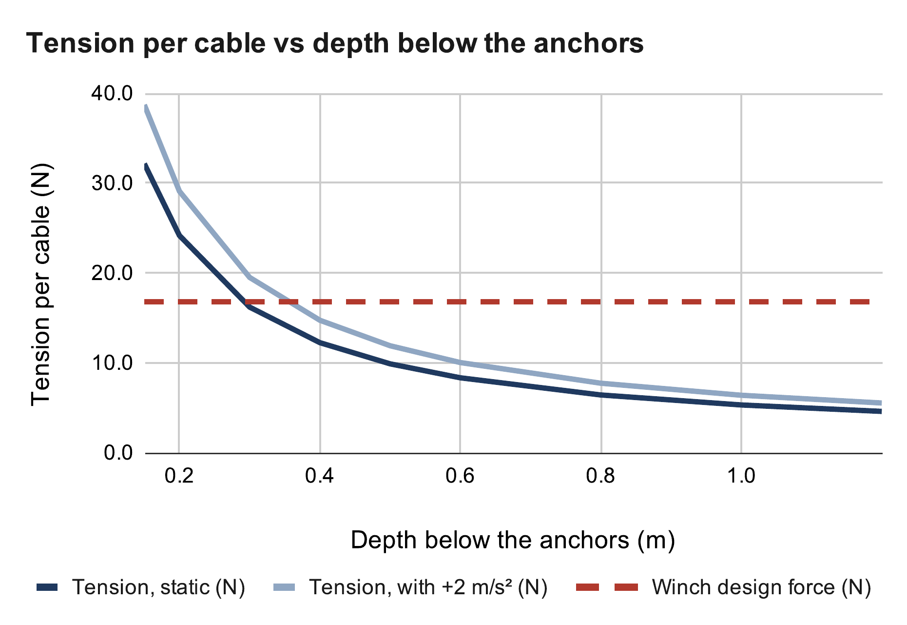
Cable Tension Limit
Tension rises sharply near the ceiling: 32 N at 0.15 m, 8.3 N at 0.6 m
Operating limit set 0.4 m below the anchors
Covers 2 m/s² acceleration within the 16.8 N winch limit
Tension per cable at 0.4 m
T = W / (4 sin φ)
= 8.87 N / (4 × 0.181) = 12.2 N
With 2 m/s²: 14.7 N < 16.8 N
Source: RoomCleaner engineering calculations, “Cable tension” (calculated)
Notes:
Force balance on the claw: the cable pulls and the weight sum to zero. Centered claw, equal shares; D_h = 2.17 m from the room center to a corner; W = (0.45 + 0.454) kg × 9.81 = 8.87 N; sin φ = 0.4 / √(0.4² + 2.17²) = 0.181. The tension doubles each time the depth halves near the ceiling, so the ceiling margin is set by tension, not by collision. 0.3 m would hold standing still (16.2 N) but not while accelerating (19.5 N), so I keep 0.4 m. Corner picks: the far cables go near-horizontal and carry little; the planner checks every cable stays inside its limits, and also refuses any path whose cables would cross a keep-out zone such as a shelf.

Slide 9
Phase 2
Generation 1
August 6 – September 2
Prove the idea on the bench
Notes:
The goal was a working station on the bench as fast as possible, to find out what I did not know.

Slide 10

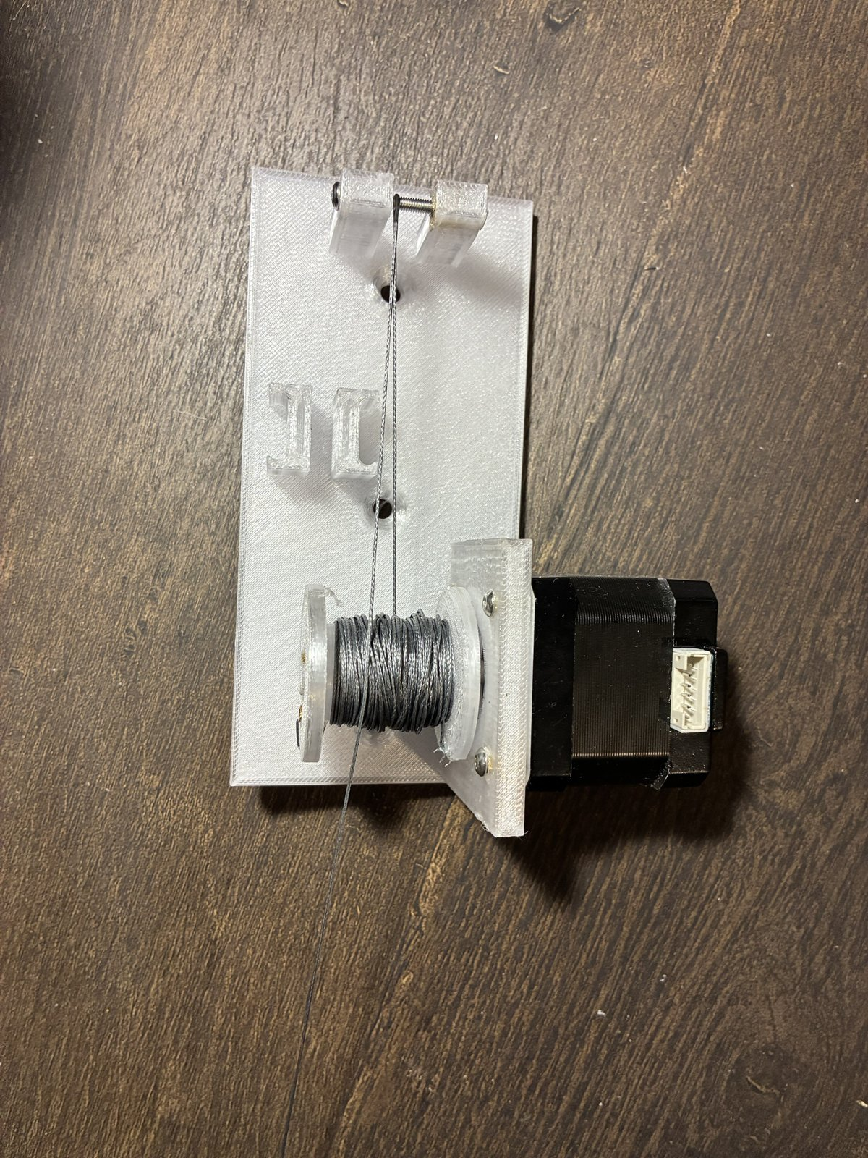


Generation 1 Build
One-piece corner plates: motor, spool, pulley and home switch
One central board drove all four motors
Five flexible TPU (thermoplastic polyurethane) fingers on the claw
A station lifted a test weight on the bench [weight]
Bench lift test, corner plate, central driver board, finger claw (CAD)
Notes:
Generation 1 worked on the bench: the winch lifted a test weight and the cable math held. The central board was a CNC shield with four A4988 drivers, which kept the first build simple. The ceiling camera mapped laundry to the floor. Each of these choices was cheap and fast, and each one showed a limit in the next slide. [Fill in: the test weight and how high it lifted.]

Slide 11

What Generation 1 Taught Me
Bead homing left only 5–29 % of the room reachable
Adding a sensor at each winch meant 10 wires per corner
Finger claw could not pinch fabric and was 4.6 times over its mass budget
Source: RoomCleaner engineering calculations, “Bead homing” (calculated)
Notes:
Homing: a bead on each cable trips a switch at the outlet. A cable can then never get shorter than its homing length, so the claw cannot reach anything closer to an anchor than home. With home 1 m up, 5 % of the room is reachable; 2 m up, 29 %. This was caught on paper, before it was built. Wiring: once every winch needed an encoder and a switch, the central board needed 10 conductors run to every corner. Claw: soft fingers wrap round objects but cannot pinch a flat T-shirt, and the finger claw was far over its mass budget. These three findings drove the redesign.

Slide 12
Phase 3
Redesign
September 3 – October 6
Fix what generation 1 exposed
Notes:
Three decisions, one for each finding: distributed control, camera calibration, and a rigid claw.

Slide 13
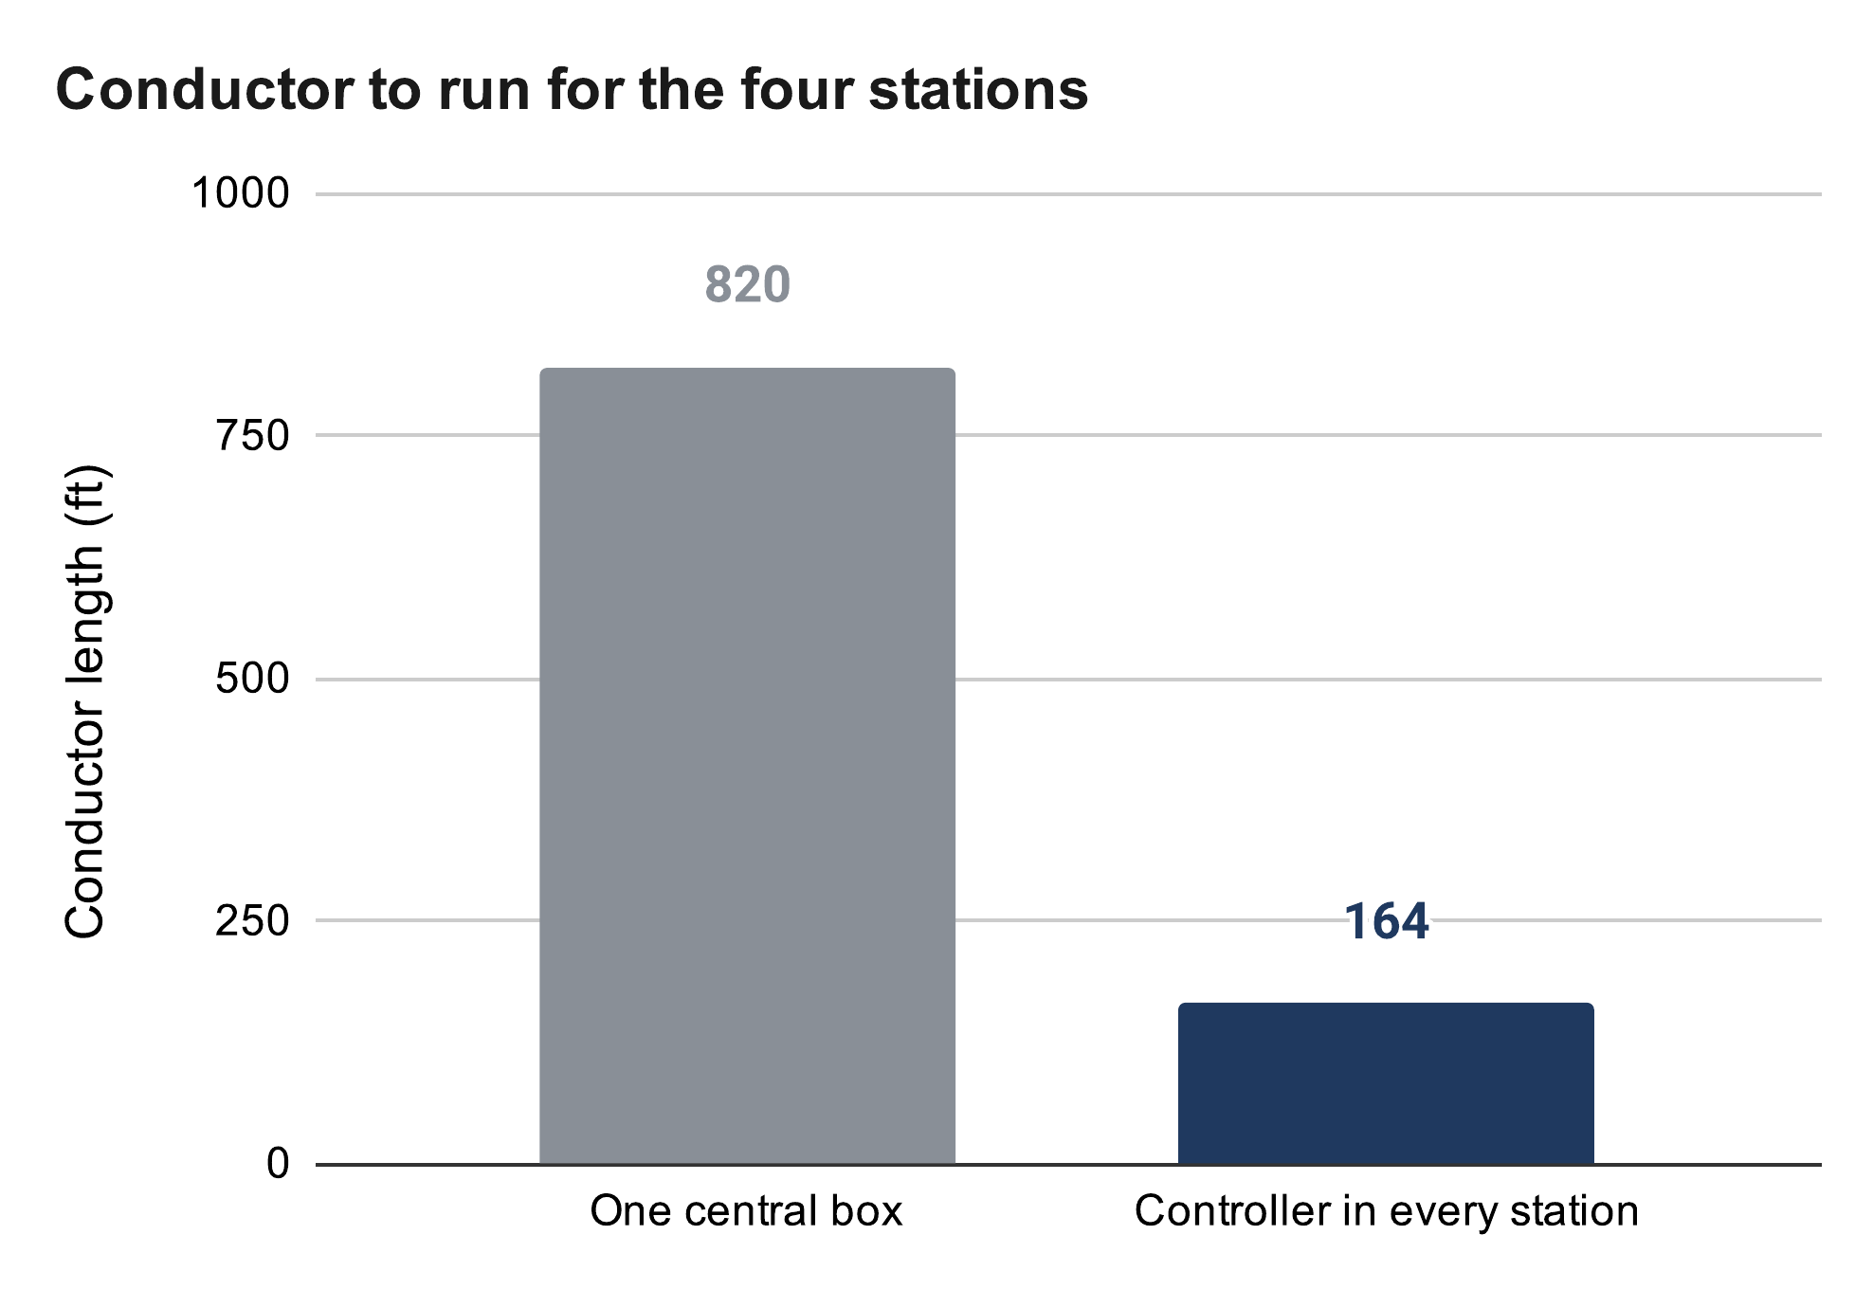
One Controller per Winch
A controller in each station instead of one central board
Only a 12 V pair runs to each station: five times less wire
Cost: synchronization moves into software
Wire to the four stations
Central board: 10 × 82 ft = 820 ft
Per station: 2 × 82 ft = 164 ft
Source: RoomCleaner engineering calculations, “Wiring” (calculated)
Notes:
Real cable routes are 6, 21, 23 and 32 ft (82 ft). 10 conductors per corner (motor 4, switch 2, encoder 4) × 82 ft = 820 ft against 2 × 82 ft = 164 ft for one power pair. Each station runs time-stamped segments on its own clock; a lost link means hold. Timing skew becomes cable mismatch: 50 mm/s × 50 ms = 2.5 mm, which is why every segment carries a time stamp. Each station can also be tested on its own.

Slide 14

Camera Calibration Replaces Homing
The claw camera reads a printed floor board from several poses
A fit finds the anchor positions and cable lengths: no tape measure
Position error: 6.6 mm with one tag in view, 0.7 mm with four
Whole room reachable; the beads stay as end stops
Source: RoomCleaner engineering calculations, “Floor board” (calculated)
Notes:
Startup: take up slack one cable at a time, lift the claw, look at the floor board from several poses, least-squares fit of the anchors and cable zero lengths, then check the fit on poses it did not use. Error = angle error × camera height: 12.9 mrad × 0.51 m = 6.6 mm with one tag; averaging tags removes noise but not bias. Safety comes from margins (0.4 m below the anchors, 0.2 m inside the walls), not precision; the full room opens only when the fit's error bars allow it. Simulated end to end so far; the first hardware run is this week.

Slide 15


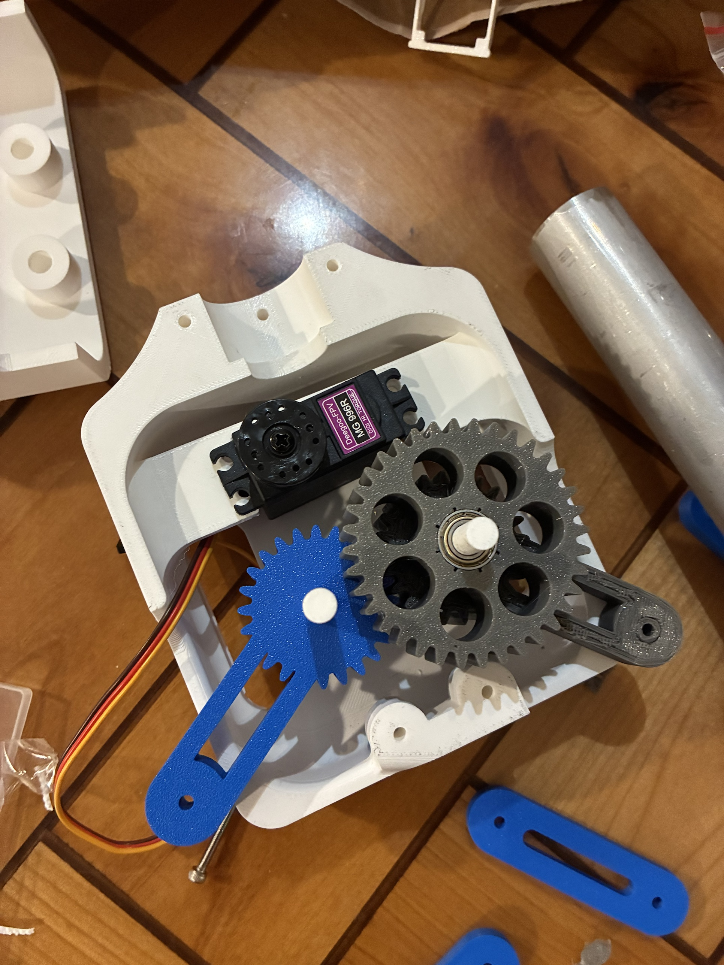
Geared Four-Bar Claw
Parallel jaws pinch thin fabric; 53 mm opening
Camera moved into the claw to see each grasp
Stall check moved the gears from module 1 to 1.5
Gear stress at servo stall
σ = F_{t} / (b m Y) = 11.0 MPa
SF = 22.5 MPa / 11.0 MPa = 2.05
v6 clamp, final four-bar (CAD), printed claw body and gear train
Notes:
Four-bar: ground 36.5, crank 53, rocker 50, coupler 34.7 mm; jaws stay parallel within about 1 degree, and closing drops the tips about 38 mm, a scoop. Gear train: MG996R servo, 18-tooth pinion, 36/24-tooth compound, 24-tooth sync gear. Lewis bending check at servo stall: with module 1 the safety factor was 0.35 to 0.41, so the module went to 1.5: pinion 2.05, compound 2.50, sync gear 2.00. Stall torque 1.078 N·m is the servo rating, not measured. Electrical: a two-cell lithium-ion pack with a 5 A fuse, a 6 V servo rail and a separate 5 V logic rail (appendix).

Slide 16
Phase 4
Final Design
October 7 – October 21
Size the winch, the cooling and the weight in SolidWorks
Notes:
Three station versions and three spool versions in SolidWorks, ending with the final design on October 21.

Slide 17
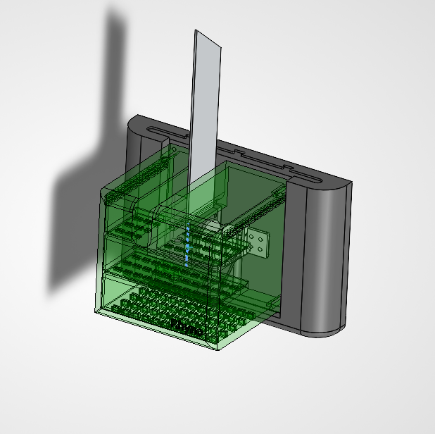
Final Wall Station
Slide-in wall mount: the station lifts off while the anchor stays in the wall
Vented shell around the motor, spool, encoder and controller
Aluminum fin leaves through a slot in the shell top
Three station and three spool versions in SolidWorks
Final wall station (SolidWorks), shell shown transparent
Notes:
Walk through the station from the wall out: the slide-in mount anchors into a stud and the station slides onto it, so a station can come off for rework without moving the anchor. The motor sits on a 5 mm PETG tab with the fin clamped between them; the spool is on the motor shaft and the encoder reads a magnet on the spool's end. The shell carries the vents, and the fin exits through the slot in its top into room air. The 1/8 in production fin needs that slot about 1 mm wider on the motor side, and M3 × 12 screws. Each version fixed a fit or assembly problem from the one before.

Slide 18
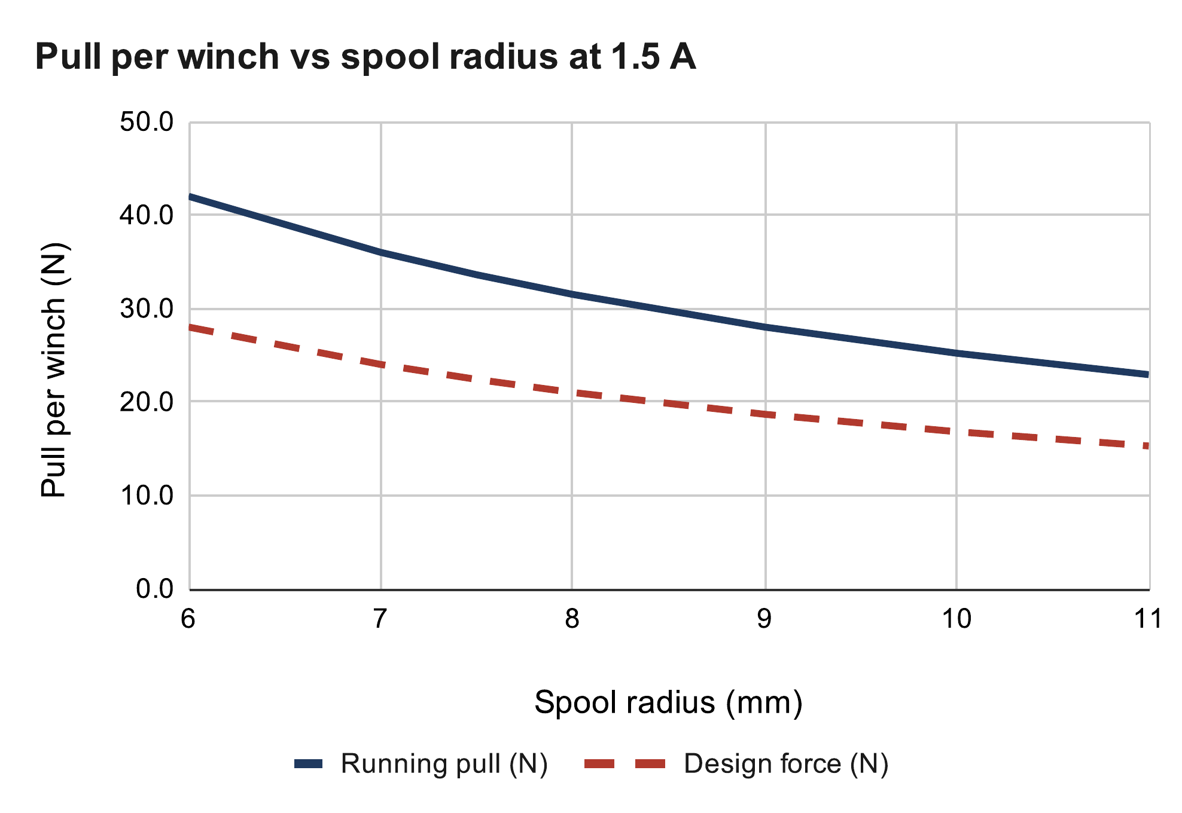
Winch Pull at 1.5 A
NEMA 17 (National Electrical Manufacturers Association) stepper on a printed spool
Driver current raised from 1.06 A to the rated 1.5 A: 41 % more pull
34 N with an empty spool, 25 N when full
Winch design force
T = τ / r = 0.252 N·m / 0.010 m = 25.2 N
F_{design} = 25.2 N / 1.5 = 16.8 N
Source: RoomCleaner engineering calculations, “Winch pull” (calculated)
Notes:
Current limit from the driver's reference voltage (A4988 datasheet): I = Vref / (8 × 0.1 Ω). The first boards topped out at 0.85 V, which is 1.06 A; I got them to 1.2 V, 1.5 A, the motor's rated current. [Fill in: how, and the Vref you read.] Running torque assumed 0.7 of the 0.36 N·m holding torque; the luggage-scale pull test measures it. The 1.5 divisor is the margin against skipped steps. The cost of the extra pull is heat, next slide.

Slide 19
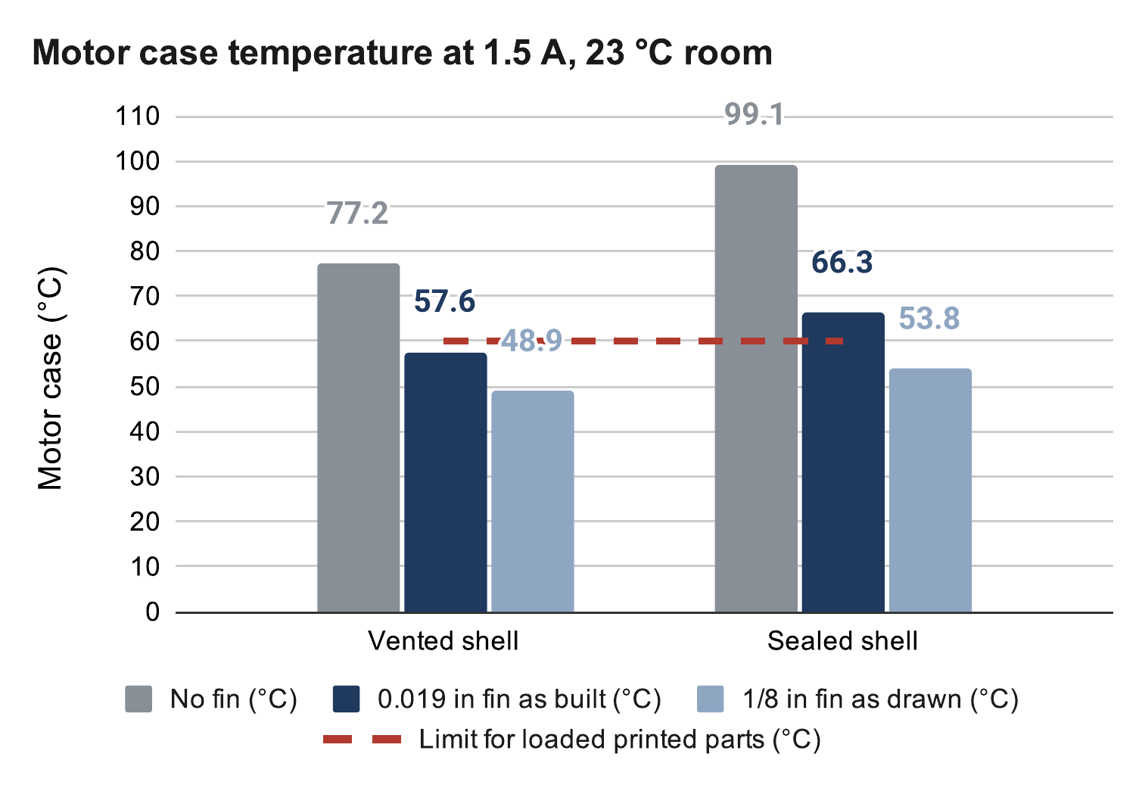
Motor Cooling
1.5 A doubles motor heat to 4.05 W
PETG creeps above 60 °C, so the shell is vented and finned
Motor at 45–49 °C with the 1/8 in fin, 56–59 °C with the 0.019 in prototype
Motor heat, P = I² R
At 1.06 A: (1.06 A)² × 1.8 Ω = 2.0 W
At 1.5 A: (1.5 A)² × 1.8 Ω = 4.05 W
Source: RoomCleaner engineering calculations, “Motor temperature” (calculated)
Notes:
Model: motor to shell air to room, with an aluminum fin through the top of the shell as a second path out. Sealed, the motor would reach 99 °C with no fin, so the shell stays vented. Fin sizing: the 0.019 in prototype sheet reaches 95 % of its capacity by 136 mm, so most of its length does little; the 1/8 in plate keeps gaining to 349 mm and is 74 % efficient at the 200 mm the ceiling allows (appendix). The PETG next to the motor runs at about the motor temperature, within 1 K. Next: a SolidWorks thermal study and a 90-minute hold test at 1.5 A. Fallback: 1.35 A.

Slide 20
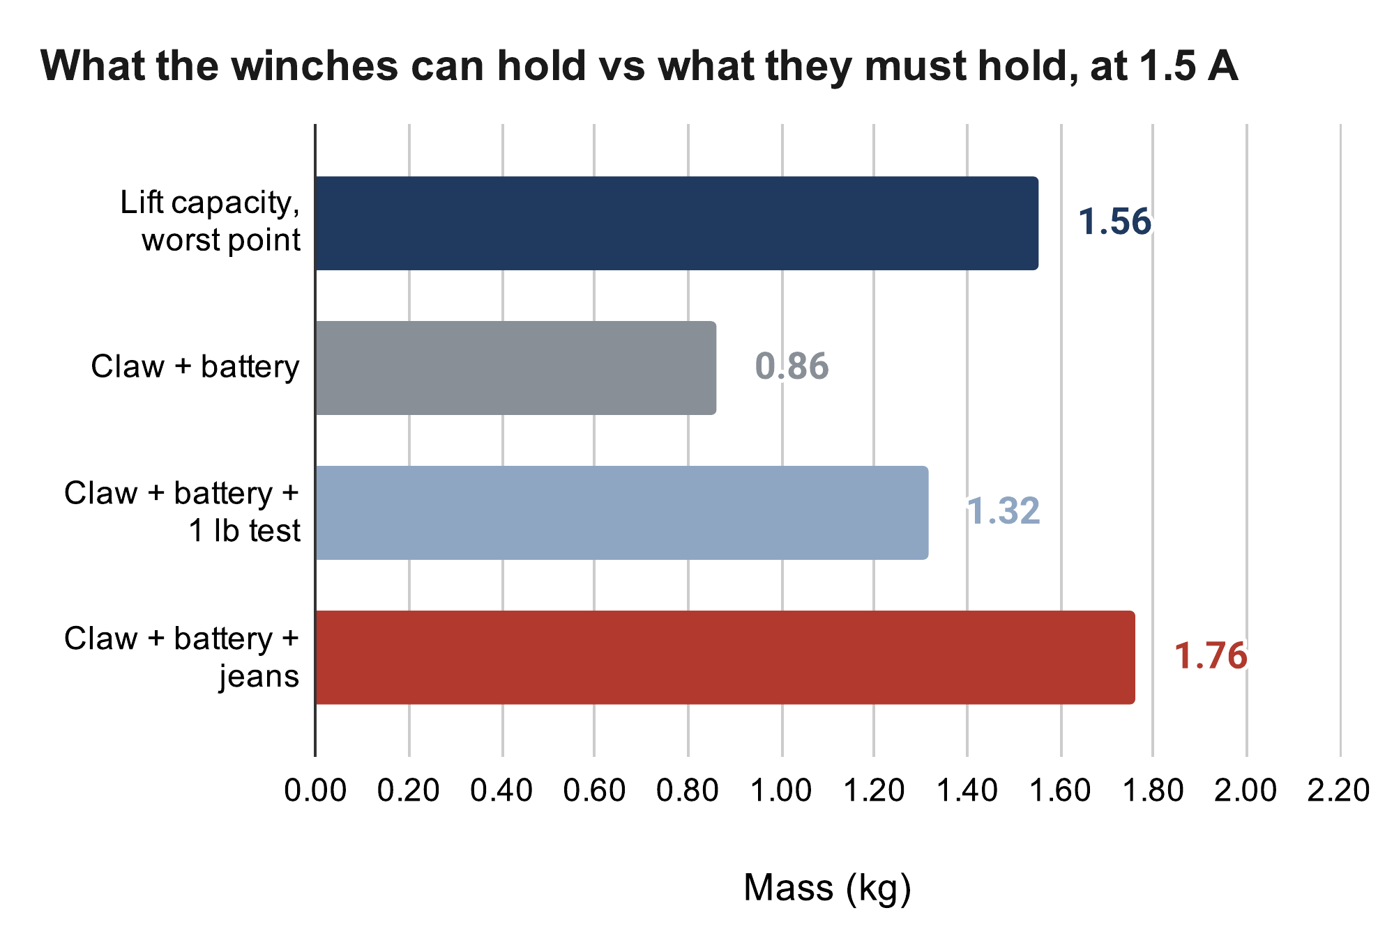
Weight Budget: Open Issue
Lift capacity at 1.5 A: 1.56 kg
Claw with battery estimated at 0.86 kg [weighed]
1 lb test fits; jeans are 0.2 kg over
Next: a lighter claw or a gear reduction at each winch
Lift capacity
m_{max} = F_{design} / (k g)
= 16.8 / (1.101 × 9.81) = 1.56 kg
Needed with jeans: 1.76 kg
Source: RoomCleaner engineering calculations, “Lift budget” (calculated)
Notes:
Be upfront: even at 1.5 A the claw plus jeans is too heavy, by about 0.2 kg (it was 0.66 kg at 1.06 A). Root cause: I set the mass budget late, after the claw grew. k = 1.101 is the worst cable tension per unit weight over the room with 2 m/s²: the middle of a long wall at task height. Claw estimate: 0.55 fill × 927 g solid + 198 g tube + 55 g servo ≈ 0.76 kg, plus 0.10 kg battery. A 2:1 or 3:1 gear stage at each winch clears it with margin and lets the current drop back to about 1 A, which also halves the heat; the pull test result picks the fix.

Slide 21
Phase 5
Build and Test
October 22 – October 27
Build the stations and run the first system test
Notes:
This week: print, machine, wire, then the three-station test.

Slide 22




Printing and Machining
Printed holes come out at least 0.2 mm undersize: the spool took three prints
Fit coupons are now printed before full parts
Fin holes drilled in one mill setup to ±0.1 mm
Spool v2 (bore too tight) and v3, fin mill setup, finished fin
Notes:
PETG on a Creality K1 at 0.2 mm layers; flat face on the bed, loads along the layers, heat-set M3 inserts where screws are reused. Spool: v1 was longer than the shaft could engage; v2's Ø5.2 bore printed too tight on the 5 mm shaft; v3 opened it to Ø5.45 (0.25 mm clearance) with a D-flat. Fin: a 1:1 shop drawing used as the hole template; a 7/8 in pilot for the motor boss and four Ø3.4 holes on the 31 mm square, all from the same two edges so errors do not stack. The prototype is 0.019 in sheet I had; the design is 1/8 in plate. [Fill in: time per fin, how many made.]

Slide 23


Electronics Bring-Up
Driver stays off at boot, so a reset cannot move a motor
First motor failed to turn: logic rail at 1.14 V, not 3.3 V
Supply rails are now checked with a meter before any code
Soldered station board and bench bring-up
Notes:
Boot-safe: a 10k pull-up holds the driver's enable pin off until the firmware arms it. USB and the 5 V buck cannot back-feed each other (link jumper plus a Schottky diode). The schematic is generated from the soldered board's net list (16 nets), so the two cannot disagree. The 1.14 V story: measure the hardware before trusting the software's view of it. [Fill in: exact readings, date, what you tried first.]

Slide 24
First System Test
[Photo or video from the three-station test]
Three stations: the fewest cables that fully hold the claw
Self-check, calibration, short move, then pickup
1 lb first, then one garment; pass limits set before the run
Check | Pass limit | Result
Self-check | All stations answer; slack taken up | [fill in]
Calibration | Held-out poses inside the margin | [fill in]
Short move, 1 lb | 300 mm at 50 mm/s, ≤ 2 mm per cable | [fill in]
Pickup | One garment into the hamper | [fill in]
Notes:
Three cables, three unknown tensions, three force equations: statically determinate, so slack shows up directly. It is the simplest real test of calibration and coordinated motion. Logged: cable lengths, encoder counts, motor temperatures, the fit's error bars. Fill in the results after the test, including any that fail.

Slide 25
Thermal Verification
[SolidWorks temperature plot: motor, fin, screws and mount]
PETG mount must stay below 60 °C
Hand calculation, SolidWorks study, then a 90-minute hold test
The PETG runs at about the motor temperature
Method | 0.019 in fin | 1/8 in fin
Hand calculation | 56–59 °C | 45–49 °C
SolidWorks | [fill in] | [fill in]
Hold test | [fill in] | [fill in]
Notes:
The 60 °C limit is for the loaded PETG. The SolidWorks study uses my 10/21 assembly with a detailed NEMA 17 (aluminum end caps, black steel stator, copper windings as the 4.05 W source), the fin, the four M3 screws and the PETG mount. An independent 3-D check showed the PETG next to the motor runs at about the motor temperature, within 1 K. If the calculation, simulation and test disagree, I fit the convection coefficient and the coil resistance, not the physics.

Slide 26
Results Against Targets
Target | Goal | Current | Status
Lift capacity | 1.76 kg with jeans | 1.56 kg (calculated) | Not met
Claw mass | 0.45 kg | 0.86 kg with battery; [weighed] | Not met
Motor temperature | Below 60 °C | 45–49 °C with the 1/8 in fin | Met in design
Working area | Full 11 × 9 ft floor | All but 0.2 m along the walls | Met in design
Wiring | One cable per station | One 12 V pair; 0.51 V drop | Met
Accuracy | 2 mm per cable | 0.7 mm (calculated) | To be tested
Speed | 50 mm/s at 2 m/s² | Not yet run | To be tested
Cost | Hobby budget | [total cost] | [fill in]
Notes:
Back to the targets from the start. Two are not met, and they are the same problem: lift capacity and claw mass. Motor temperature and working area are met by the design and wait on the hold test; accuracy and speed wait on the system test.

Slide 27
Good and Poor Decisions
Good decision | Result
One controller per winch | Five times less wire; each station tested alone
Camera calibration instead of bead homing | Whole room reachable
Gear strength checked at servo stall | Failure caught in CAD, before printing
Poor decision | Result
Mass budget set late | 0.2 kg over capacity with jeans
Bead homing as the first plan | Under a third of the room reachable
Several stations built before one was proven | Every fix repeated on each station [confirm]
Notes:
Good: each was a trade I priced first. Distributed control cost software synchronization but saved five times the wire. Calibration by camera replaced a plan that physically limited the motion. The stall check caught gears that would have sheared. Poor: the mass budget came after the claw grew, which is the open issue today. Bead homing looked cheap until I computed what it cost. Building several stations before one was fully proven meant repeating each fix. Also the spool printed before a fit coupon: three prints. [Confirm the stations one.]

Slide 28
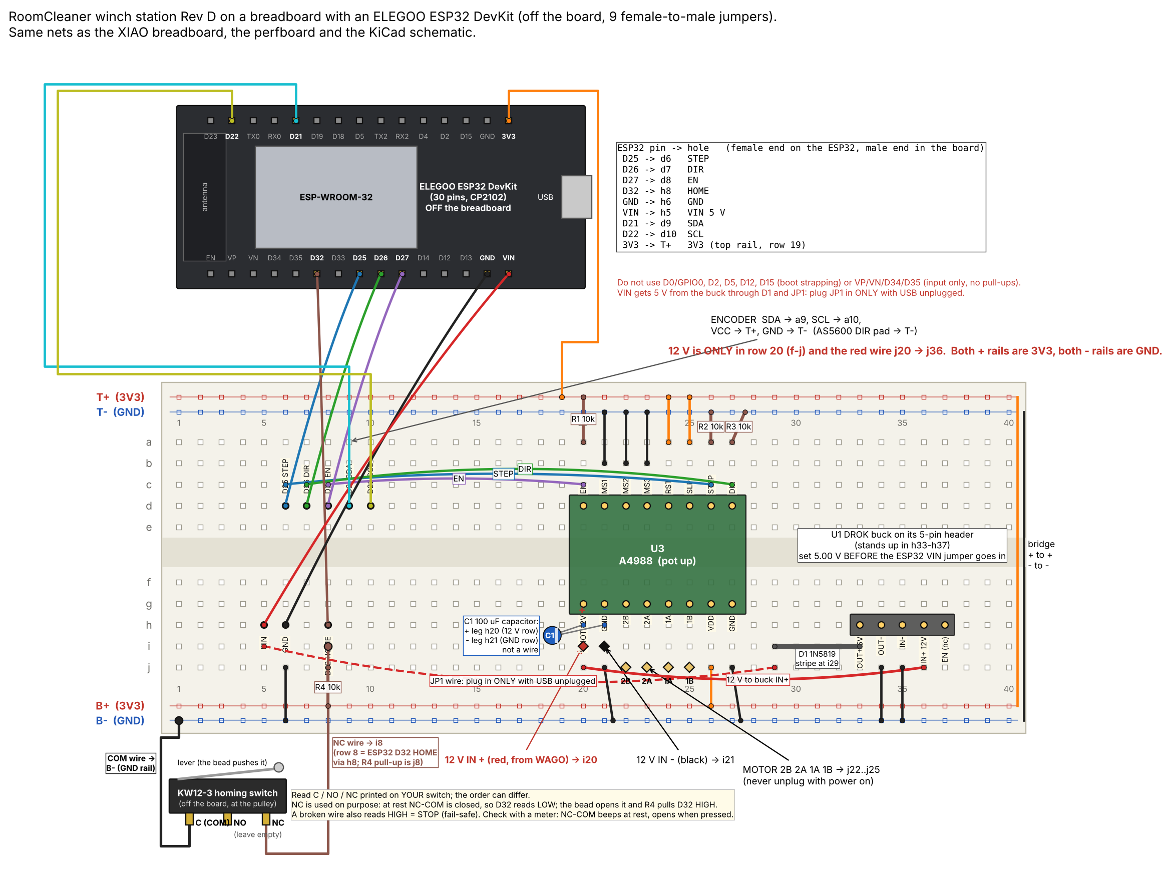
Thorough vs. Scrappy
Thorough where a mistake is expensive or unsafe
  Heat fin: one mill setup, ±0.1 mm
  Gears: strength checked before printing
Scrappy where it is cheap to undo
  Failed controller replaced by a jumpered ESP32 board
  Floor board printed on paper
Thorough: fin mill setup. Scrappy: jumpered ESP32 controller board.
Notes:
Thorough: the fin is machined once, so the hole pattern had to be right before the first cut; the board schematic is generated from the soldered net list; the gear check happened in CAD because a sheared gear costs a print and a jammed claw. Scrappy: when a controller board died two days before the test, I moved the same circuit to an ESP32 dev board with nine jumpers and a compile-time pin map instead of redesigning the board. The floor board is paper because accuracy comes from seeing several tags, not from the board. The prototype fin is the 0.019 in sheet I already had.

Slide 29
Lessons Learned
Set the mass budget first, from the measured winch pull
Prove one station before building the rest
Print fit coupons before full parts
In half the time: freeze requirements in week 1 and order long-lead parts on day 1
Actual
(15 weeks)
Concept
Gen 1
Redesign
Final
Build and test
Half time
(7 weeks)
Plan
One station
Copy
Claw
Test
Same time scale. Half-time plan: prove one station, then copy it.
Notes:
What I would do differently: weigh the claw and set its budget from the measured pull before designing it; one complete station tested end to end before building more; coupons before every new fit; a meter on every rail before debugging code. Half the time: most lost time was the redesign and the generations a frozen requirement and an early test would have avoided. Three stations are statically determinate and need fewer parts for the first test.

Slide 30
Questions
Jasper Buntinx | jasper_buntinx@tamu.edu
Notes:
The appendix covers fin sizing, the operating sequence and phone app, control logic, claw electrical, acronyms and the calculation sources.

Slide 31
Appendix

Slide 32
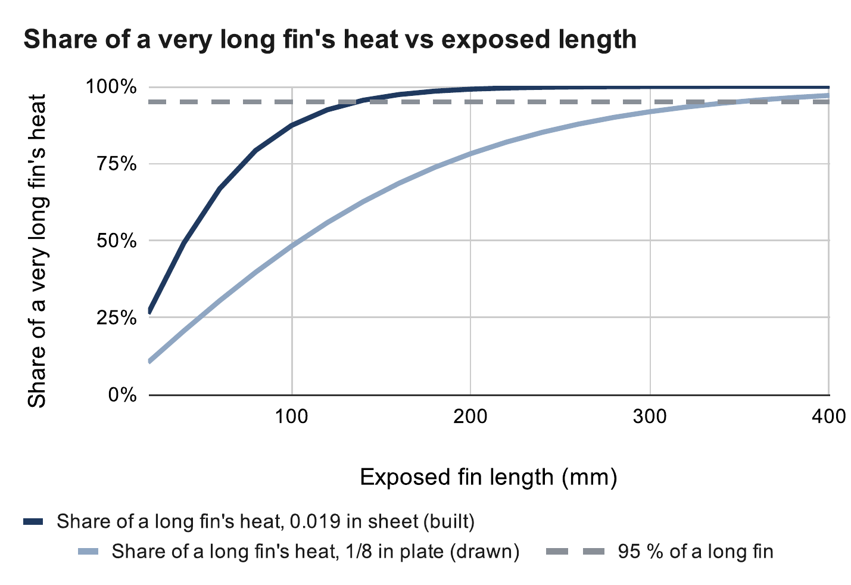
Heat Fin Length
0.019 in prototype reaches 95 % of its capacity by 136 mm
1/8 in design keeps gaining to 349 mm
Built at 200 mm, limited by ceiling clearance
Fin length and efficiency
m = √(2h / (k t)), L₉₅ = 1.83 / m
η = tanh(mL) / (mL) = 0.74 (1/8 in)
Source: RoomCleaner engineering calculations, “Heat fin” (calculated)
Notes:
L95 is where a fin carries 95 % of the heat an infinitely long one would. h = 7 W/m²·K still air, k = 160 W/m·K aluminum. At 200 mm: sheet 37 % efficient and 22.1 K/W; 1/8 in plate 74 % and 10.9 K/W. Source: Incropera, Fundamentals of Heat and Mass Transfer, ch. 3.

Slide 33
Fin Sizing for 4 W
Painted 6061, 44 mm wide | Mass | Shortest for ≤ 60 °C
0.019 in (prototype) | 14 g | None (2.0 W max)
1/16 in | 47 g | None (3.6 W max)
0.090 in | 68 g | 210 mm or none
1/8 in (design) | 94 g | 145–185 mm
3/16 in | 141 g | 125–140 mm
1/4 in | 189 g | 115–125 mm
If the fin alone had to carry all 4.05 W
0.019 in sheet: not possible at any length
1/8 in plate: 145–185 mm
All 4.05 W through the fin, 23 °C room, paste contact. Calculated.
Notes:
The prototype works today only because the motor also sheds heat into the vented shell. A thin sheet's far end does almost nothing: the most heat any length can carry is w √(2hkt) θ_b, about 2 W for 0.019 in at a 60 °C base (approximate, about 10 % low). Thickness beats length.

Slide 34



Operating Sequence
Start up: self-check, take up slack, calibrate
Find: scan from above, detect garments, choose the nearest
Pick: hover until still, grip, deliver; the camera confirms each step
Every move waits for approval on the phone; PAUSE holds position
Phone app: home, live claw camera and chat
Notes:
A fault or PAUSE stops every station at the same point on the path, still holding; nothing restarts by itself, and a reboot never resumes a task. Known obstacles are keep-out cylinders and every cable is checked against them before a move. People are not detected, so nobody stands underneath. Three failures in a row pause for the operator. Disarm needs a typed confirmation because releasing torque drops a hanging claw. Simulated end to end.

Slide 35
Control Logic: Generation 1 vs. Final
 | Generation 1 | Final
Where is the claw? | Assumed from the commanded cable lengths | Measured by the claw camera; refit at every startup
Room geometry | Anchors from a tape measure | Anchors and cable lengths fitted, with error bars
Motor control | One central board | A controller per station, coordinated by the laptop
Finding laundry | Ceiling camera | Claw camera
Did the grab work? | Assumed | Camera checks pickup and delivery
Faults | Emergency stop only | A stop keeps torque; nothing restarts by itself
Notes:
Generation 1 trusted its model; the final logic measures before it trusts and checks after it acts. Kept from generation 1: the cable math, the state-machine idea and the YOLO-World detector.

Slide 36

Claw Electrical
Two-cell lithium-ion pack: 7.4 V with a 5 A fuse
6 V servo rail and a separate 5 V logic rail
Peak 2.8–3.1 A against a 3 A pack rating
Claw schematic
Notes:
Rules check 0 errors; 9 nets match the specification. Charger: 8.4 V constant current, constant voltage; charged with the switch off, attended, at 1 A or less.

Slide 37
Acronyms
Term | Meaning
CAD | Computer-aided design
PETG | Polyethylene terephthalate glycol (the printed plastic)
TPU | Thermoplastic polyurethane (flexible printed plastic)
NEMA 17 | National Electrical Manufacturers Association motor frame, 1.7 in square
CNC | Computer numerical control
ESP32 | A Wi-Fi microcontroller family (Espressif)
A4988 | Stepper-motor driver chip (Allegro)
YOLO | “You Only Look Once”: an object-detection model family
SF | Safety factor: allowable stress divided by actual stress

Slide 38
Calculations and Sources
All charts come from my engineering calculation sheet
Incropera et al., Fundamentals of Heat and Mass Transfer, ch. 3
Allegro MicroSystems, A4988 datasheet
RoomCleaner engineering calculations (Google Sheets)
Source: RoomCleaner engineering calculations, “Cable tension” (calculated)

