Slide 1
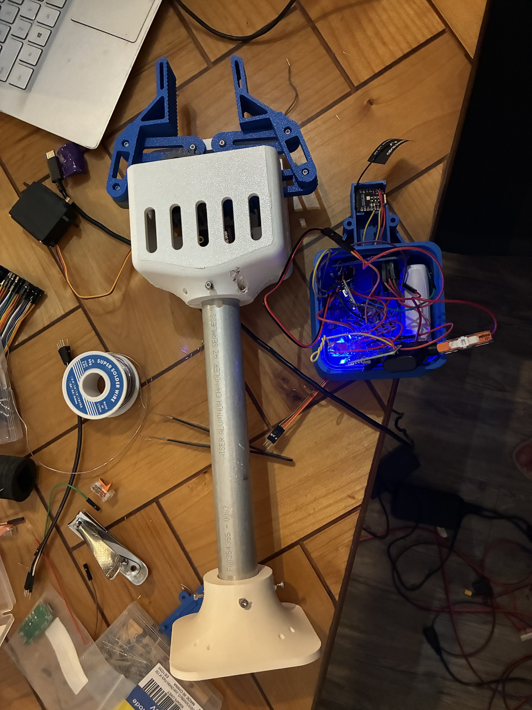
RoomCleaner
A four-cable ceiling robot that picks laundry off the floor
Jasper Buntinx
Mechanical Engineering, Texas A&M University
Built July to October 2026
Notes:
Talk track (45 s): This is RoomCleaner. Four winches near the ceiling corners of my room hold one claw on cables; the claw descends on a garment, grips it, and drops it in a hamper. The photo is the claw as it sat on my bench yesterday. I built it between July and October, alone, and this talk goes through it in the order it happened: the concept, a first generation that taught me what the drawings could not, the redesign, the final design, and the build and bring-up week. Every number carries a tag: measured, calculated, simulated or planned. If asked: it has not picked up a garment yet; the first three-station lift is the next milestone.

Slide 2
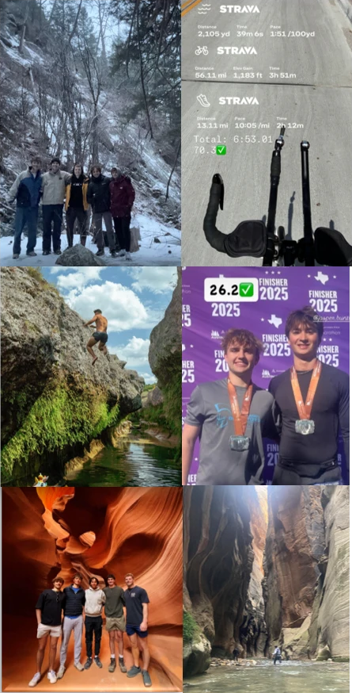
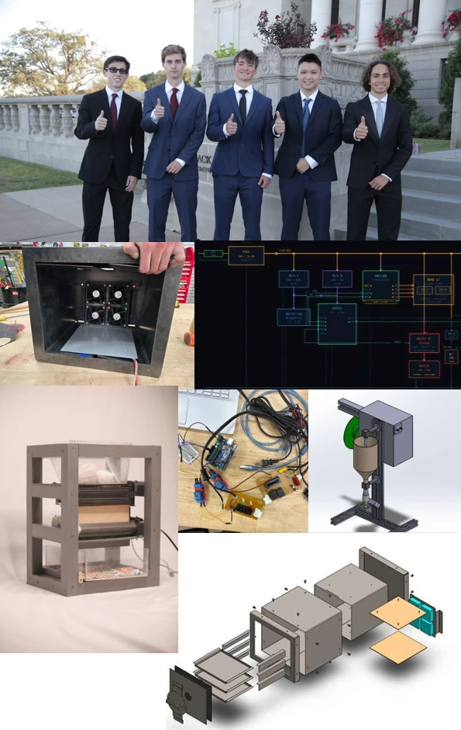
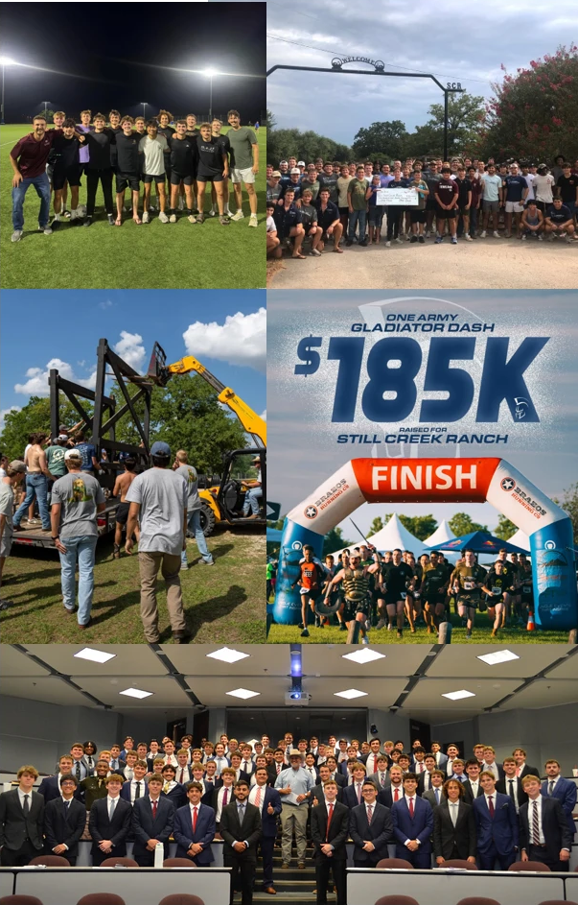
About me
Jasper Buntinx | RoomCleaner
Notes:
Talk track (45 s): the photos carry it, left to right. Mechanical Engineering at Texas A&M, class of 2027. Left: outdoors and endurance, an Ironman 70.3 in 6:53 and a marathon in 2025; I finish long things. Middle: EcoFil, a filament recycler I built with a shredder, dryer and extruder [[one EcoFil number: diameter tolerance or throughput, and what broke]]. Right: as Special Events Build Logistics Chair for the One Army Gladiator Dash I headed assembly, repairs and transport of the obstacles; the event raised $185K for Still Creek Ranch. If asked: metal sculpture for the Austin Creek Show, with fiber laser cutting and welding.

Slide 3
The goal: jeans from anywhere on the floor into the hamper, nobody touching it
Pick up laundry in a 3.35 × 2.74 m (11 × 9 ft) room under a 2.74 m (9 ft) ceiling; design load 0.9 kg (jeans) plus a 2 m/s² dynamic allowance
Four winches screwed into the studs near the ceiling corners, one claw on four cables, nothing on the floor
PAUSE holds position with torque on; the switched power strip is the emergency stop, and it drops the claw
Success: one garment from floor to hamper with no human touch; I approve each move on the phone
Anchor, 0.15 m below the ceiling
0.4 m ceiling margin
2.74 m
(9 ft)
ceiling
0.2 m wall margin
Claw
Hamper
Garment
3.35 m (11 ft) wall; room 3.35 × 2.74 m
Room elevation to scale; seen from the side, the four cables appear as two
Jasper Buntinx | RoomCleaner
Notes:
Talk track (50 s): The problem in one picture. Four anchors 0.15 m below the ceiling, one claw, a hamper. The shaded bands are the margins the planner keeps: 0.2 m from the walls, 0.4 m below the anchors. The load case is a pair of jeans, 0.9 kg, with a 2 m/s² allowance for stops and snags. The safe state is PAUSE: every station holds with torque on. The emergency stop is the power strip, and because steppers hold only while powered, it drops the claw; nobody stands under the robot. Success means one garment from floor to hamper with no human touch; I approve each move on the phone. If asked: 0.9 kg is a screening value, not weighed. Top speed is 50 mm/s, so a diagonal move takes about a minute and a half. Where it stands today: the stations, their electronics and the claw are built and bench-tested; nothing has picked up a garment yet.

Slide 4
Five phases in fifteen weeks
Act
Dates
July
August
September
October
1. Concept
Jul 16 – Aug 5
2. Generation 1
Aug 6 – Sep 2
3. Redesign
Sep 3 – Oct 6
1
4. Final design
Oct 7 – Oct 21
2
5. Build and test
Oct 22 – Oct 27
3
1 Sep 30: first clamp's jaws cannot close on thin cloth 2 Oct 20: v6 clamp is 4.6 times its mass budget in CAD 3 Oct 22: drivers at 1.5 A; claw weighed
Mine: requirements, design decisions, the SolidWorks station and claw, printing, machining, wiring and bring-up
With Claude Code, under my direction: the control software, calculation scripts and CAD checks
Purchased: steppers, drivers, controller boards, servo, camera, battery and encoder boards
Jasper Buntinx | RoomCleaner
Notes:
Talk track (45 s): About fifteen weeks, alone, in five acts: concept in July, a first generation in August, the redesign through September, the final design in the first three weeks of October, and the build and test week that ends on presentation day. The three red marks are the failures that shaped the design, and each gets its own slide. Scope: the requirements, the decisions, the SolidWorks parts, the printing, machining, wiring and bring-up are mine. I dictated the control logic and had Claude Code build it out; it also wrote the calculation scripts and checked my CAD, and I can take you through any number on these slides. The motors, drivers, boards, servo, camera, battery and encoders are bought. If asked: the garment detector is YOLO-World, an open-source model. [[hours spent, total cost, shop access or mentors]]

Slide 5

Why a cable robot: four winches cover the whole floor with nothing in the room
 | Floor robot | Gantry | Cable robot
Whole floor | Furniture blocks it | Yes | Yes
Floor left clear | No | Frame spans the room | Yes
Moving mass | Whole robot | Heavy beam | 0.6 kg claw
Chosen: four ceiling winches and one claw
The cost: cables only pull, so cable tension sets the working space
Cables from the ceiling anchors a₁ to a₄ to the claw at p
Jasper Buntinx | RoomCleaner | Act 1 of 5: Concept (July)
Notes:
Talk track (45 s): Three ways to reach a floor. A floor robot fights the clutter it is meant to clear. A gantry puts a frame across my room. A cable robot reaches the whole floor with a 0.6 kg moving mass and nothing on the floor; the room is the frame. So: four ceiling winches and one claw. The price is in the geometry: a cable can only pull, so the tension split sets where the claw can go, and that is the next slide. If asked: four cables on three position axes is redundant, so the tension split depends on cable-length errors; that is why the planner checks tensions and the calibration fits the cable lengths.

Slide 6
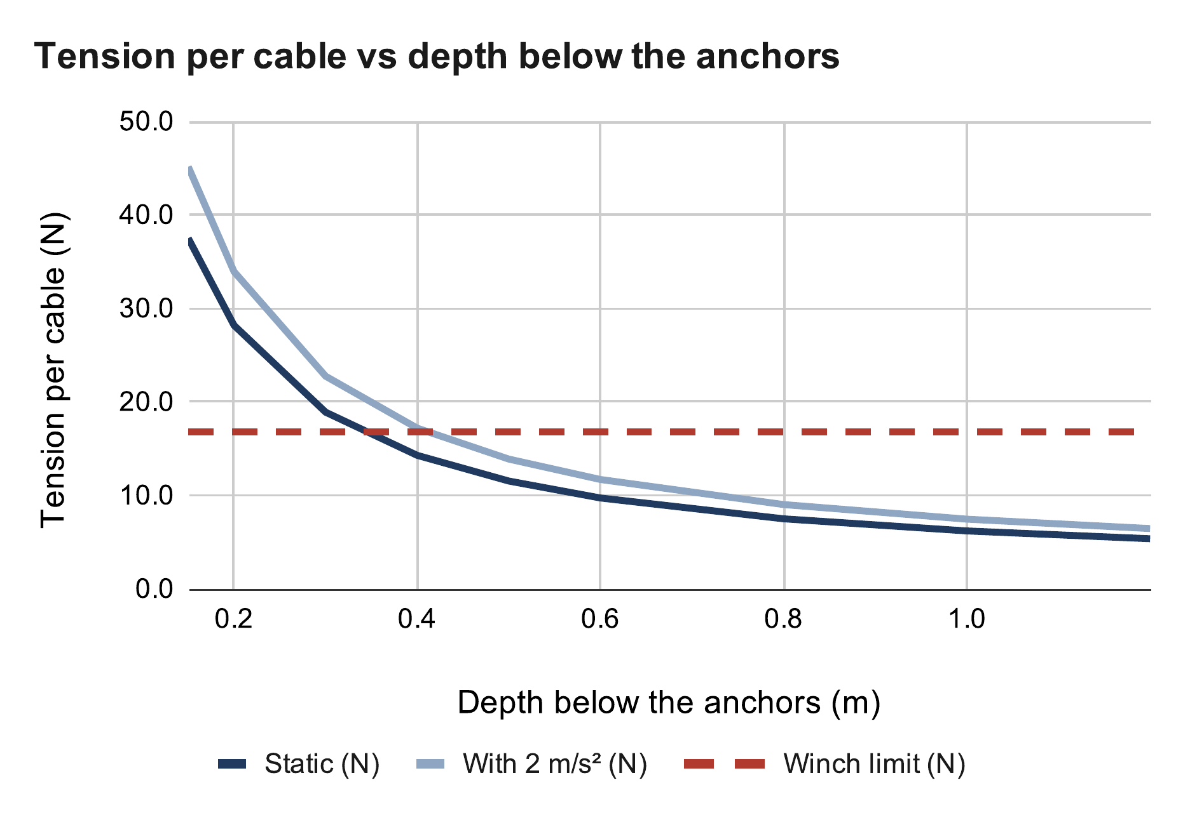
The first physics: cable tension climbs toward the ceiling
CALCULATED
Weighed claw plus 1 lb, centred 0.4 m below the anchors: 14.3 N static, 17.2 N at 2 m/s²
That is at the 16.8 N winch limit; with jeans the claw must stay at least 0.6 m below the anchors
The planner checks every cable at every path point against the measured pull limit
Tension per cable, 1 lb test at 0.4 m
T = m (g + a) / (4 sin φ)
= 1.054 × 11.81 / (4 × 0.181) = 17.2 N
Winch limit: 16.8 N
Calculated (calc sheet: Cable tension)
Jasper Buntinx | RoomCleaner | Act 1 of 5: Concept (July)
Notes:
Talk track (50 s): The first calculation I ran, redone here with the claw as weighed. Tension per cable is the weight over four times the sine of the cable angle, so the shallower the cable, the more it carries. Centred 0.4 m below the anchors with the 1 lb test weight, each cable sees 14.3 N static and 17.2 N with the 2 m/s² allowance, which is right at the 16.8 N design limit of a winch. With jeans the claw has to stay 0.6 m down. The planner does this check on every cable at every point of a path, against the pull limit that the pull test will measure. If asked: off-centre is worse than centred; the claw rises only to scan the floor from above, empty. The 1.5 divisor in the winch limit is the margin against skipped steps.

Slide 7
July's choices, and what each one cost later
WINCH MOTOR
GRIPPER
EMERGENCY STOP
NEMA 17 steppers
Five tendon fingers
The power strip
CHOSEN BECAUSE
CHOSEN BECAUSE
CHOSEN BECAUSE
Cheap, and one shield drives all four
Holds position without a feedback loop
Gathers crumpled cloth with one servo
Printable in flexible TPU
A guaranteed stop with no extra part
The only stop that cannot be overridden by software
WHAT IT COST LATER
WHAT IT COST LATER
WHAT IT COST LATER
No brake: it holds only while powered, so a power loss drops the claw
Runs hot: holding current is heat, 4.05 W per motor at 1.5 A
Designed in CAD only, 419 g of a 450 g budget, never built
Replaced by a clamp, then by the geared four-bar (Act 3)
Cutting power drops the claw
Nobody stands under the robot; a brake is on the next-steps list
Jasper Buntinx | RoomCleaner | Act 1 of 5: Concept (July)
Notes:
Talk track (55 s): Three July choices that each came back later. Steppers: cheap, one shield drives four, and they hold position without a loop. The cost: no brake, so they hold only while powered, and holding current is heat, which becomes the thermal story in Act 4. The gripper: five tendon fingers in flexible TPU, pulled by one servo, meant to gather crumpled cloth. It stayed in CAD at 419 g of a 450 g budget and was never built. The emergency stop: the switched power strip, the one stop software cannot override; the cost is that it drops the claw, so the rule is nobody under the robot. If asked: a worm-gear DC motor would self-lock and hold with zero current, at about $32 each and with a control loop per motor; I chose the stepper for cost and simplicity and accepted the drop.

Slide 8
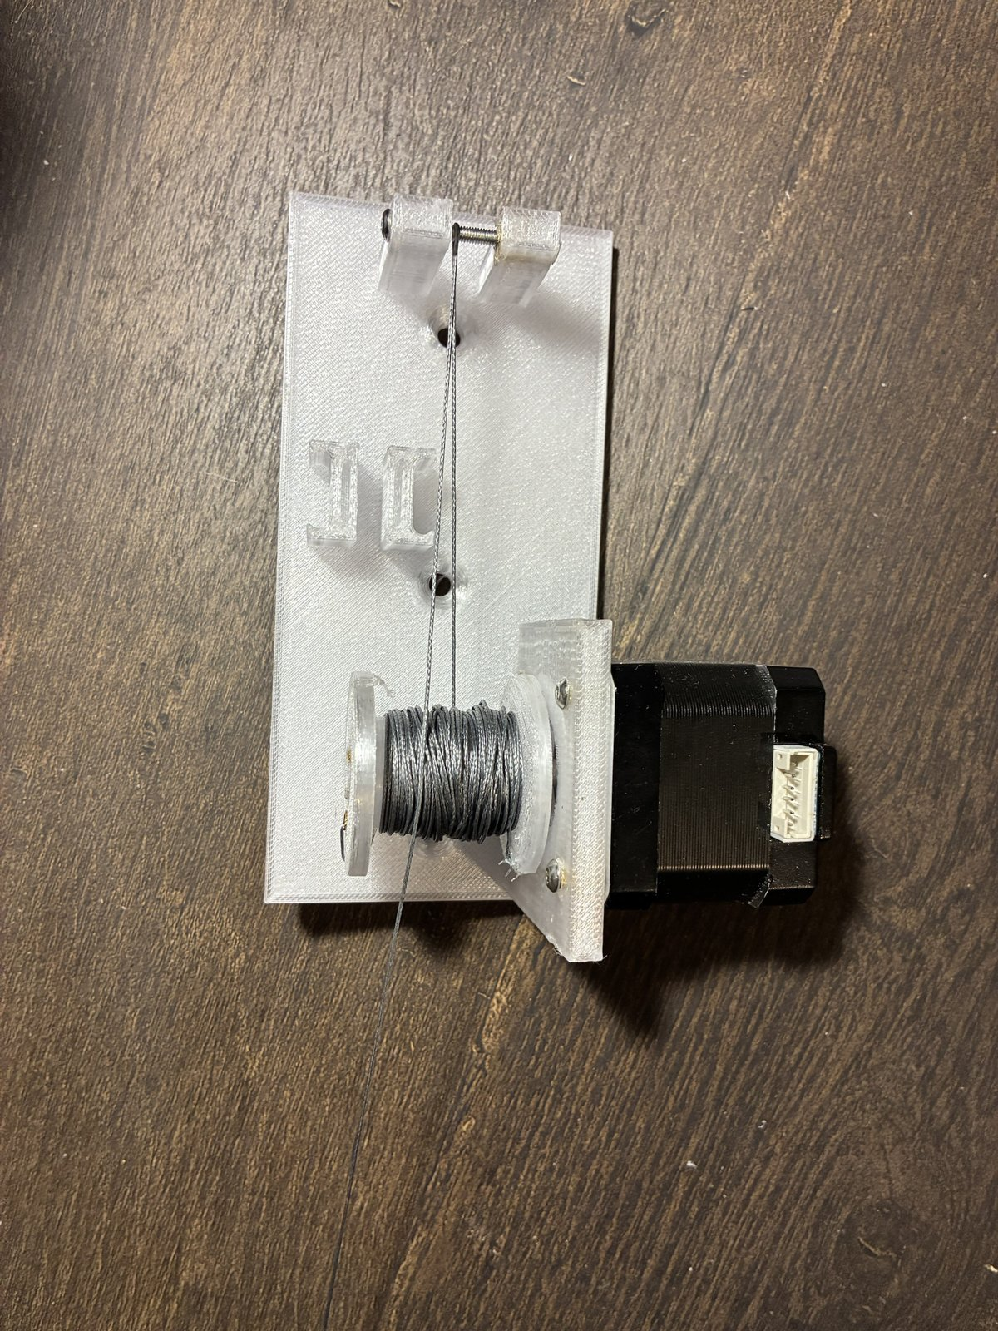

Generation 1: one Uno, one shield, four corner mounts
MEASURED
A printed corner plate screwed into a joist replaced hanging hooks: a hook is a pivot, and about 1:1 of anchor error becomes claw position error
One Uno and one CNC shield drove all four motors from one board
Bench: the station lifted a test weight; the cable math held
1 Gen-1 corner plate: motor, spool, pulley, switch
2 Gen-1 station lifting a test weight
Jasper Buntinx | RoomCleaner | Act 2 of 5: Generation 1 (August)
Notes:
Talk track (50 s): Generation 1 was built to find out what I did not know. Each corner got a one-piece printed plate with the motor, spool, pulley and homing switch, screwed into a joist. That replaced the closed-eye hooks of the first order, because a hook is a pivot: the anchor moves, and the calibration study shows about one-to-one transfer from anchor error to claw position error; an anchor has to be fixed to be calibratable. One Uno with a CNC shield drove all four motors. On the bench a station lifted a test weight, and the cable tension numbers from the previous slide held. Pause and ask: how would you home a four-cable robot with no reference pose? [[the test weight and how high it lifted]] If asked: the plate's ears see 5.5 MPa worst case at 40 N, about five times under PETG's layer-adhesion limit.

Slide 9
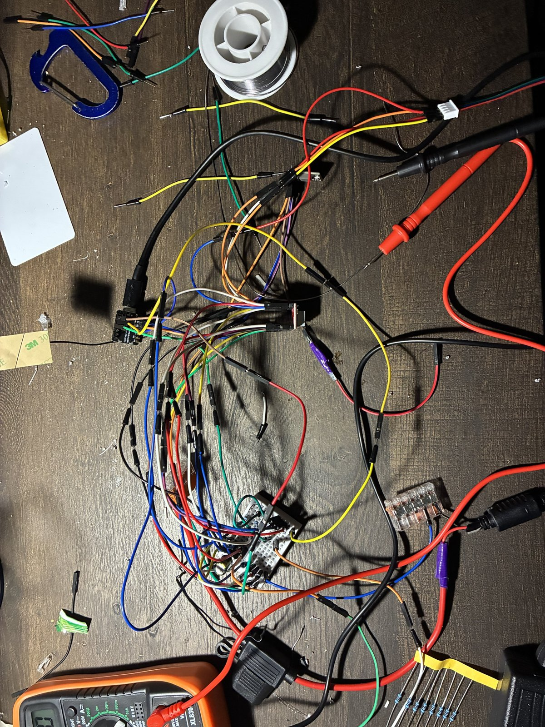


Bench week found what the drawings could not
MEASURED
18 V on the meter from a supply labelled 12 V
A homing switch that would have zeroed without moving: fail-safe wiring reads LOW at rest, and the firmware took LOW as pressed; logic inverted
The switch had to move below the pulley, onto a drop arm beside the line; the first arm design failed a CAD check before it was printed
2 Homing switch
1 Bench wiring during bring-up
3 Bench laptop
Jasper Buntinx | RoomCleaner | Act 2 of 5: Generation 1 (August)
Notes:
Talk track (55 s): Three things the bench found that no drawing would have. First, the meter: with the plug cut off the supply brick and a fuse fitted, the shield terminal read 18 V, not the nominal 12. Second, the homing switch: I wired it fail-safe, common and normally-closed, so it reads LOW at rest and HIGH when pressed or when a wire breaks; the firmware took LOW as pressed, so homing would have zeroed instantly without moving. The fix was to invert the logic and add a command that reports all four switches. Third, the switch position: it had to sit below the pulley, beside the vertical line, on a drop arm; the first arm design failed an independent CAD check before it was printed. The lesson for the rest of the project: a meter on every rail before code. If asked: whether the 18 V was an open-circuit reading is not recorded; the supply was later identified as 12 V, 6 A, and the station buck accepts up to 20 V.

Slide 10

Why Generation 1 could not be the final design
CALCULATED
Bead homing left 5–29 % of the room reachable: with home 1 m up, 5 %; 2 m up, 29 %. Caught on paper before it was built
One central board would need 10 wires to every corner once each winch had sensors: 250 m (820 ft) of wire
A central board also skews the winches: 50 ms of skew is 2.5 mm of cable error, about 7.5 N
Calculated (calc sheet: Bead homing)
Jasper Buntinx | RoomCleaner | Act 2 of 5: Generation 1 (August)
Notes:
Talk track (55 s): Three calculations killed Generation 1 on paper. Homing: a bead on each cable trips a switch at the outlet, so a cable can never be shorter than at home. The chart shows what that costs: with home one metre up, 5 % of the room is reachable; two metres up, 29 %. Wiring: once each winch has a switch and an encoder, a central board needs ten wires to every corner, and with the supply on a stand and the runs down the wall and back up, that is 250 metres of wire. Timing: one board stepping four motors from one loop skews them; 50 ms of skew is 2.5 mm of cable error, about 7.5 N on a 3 N/mm line. Each of these drives one decision in Act 3. If asked why not home each cable at its own shortest length: that drags the claw into the high-tension zone next to an anchor.

Slide 11



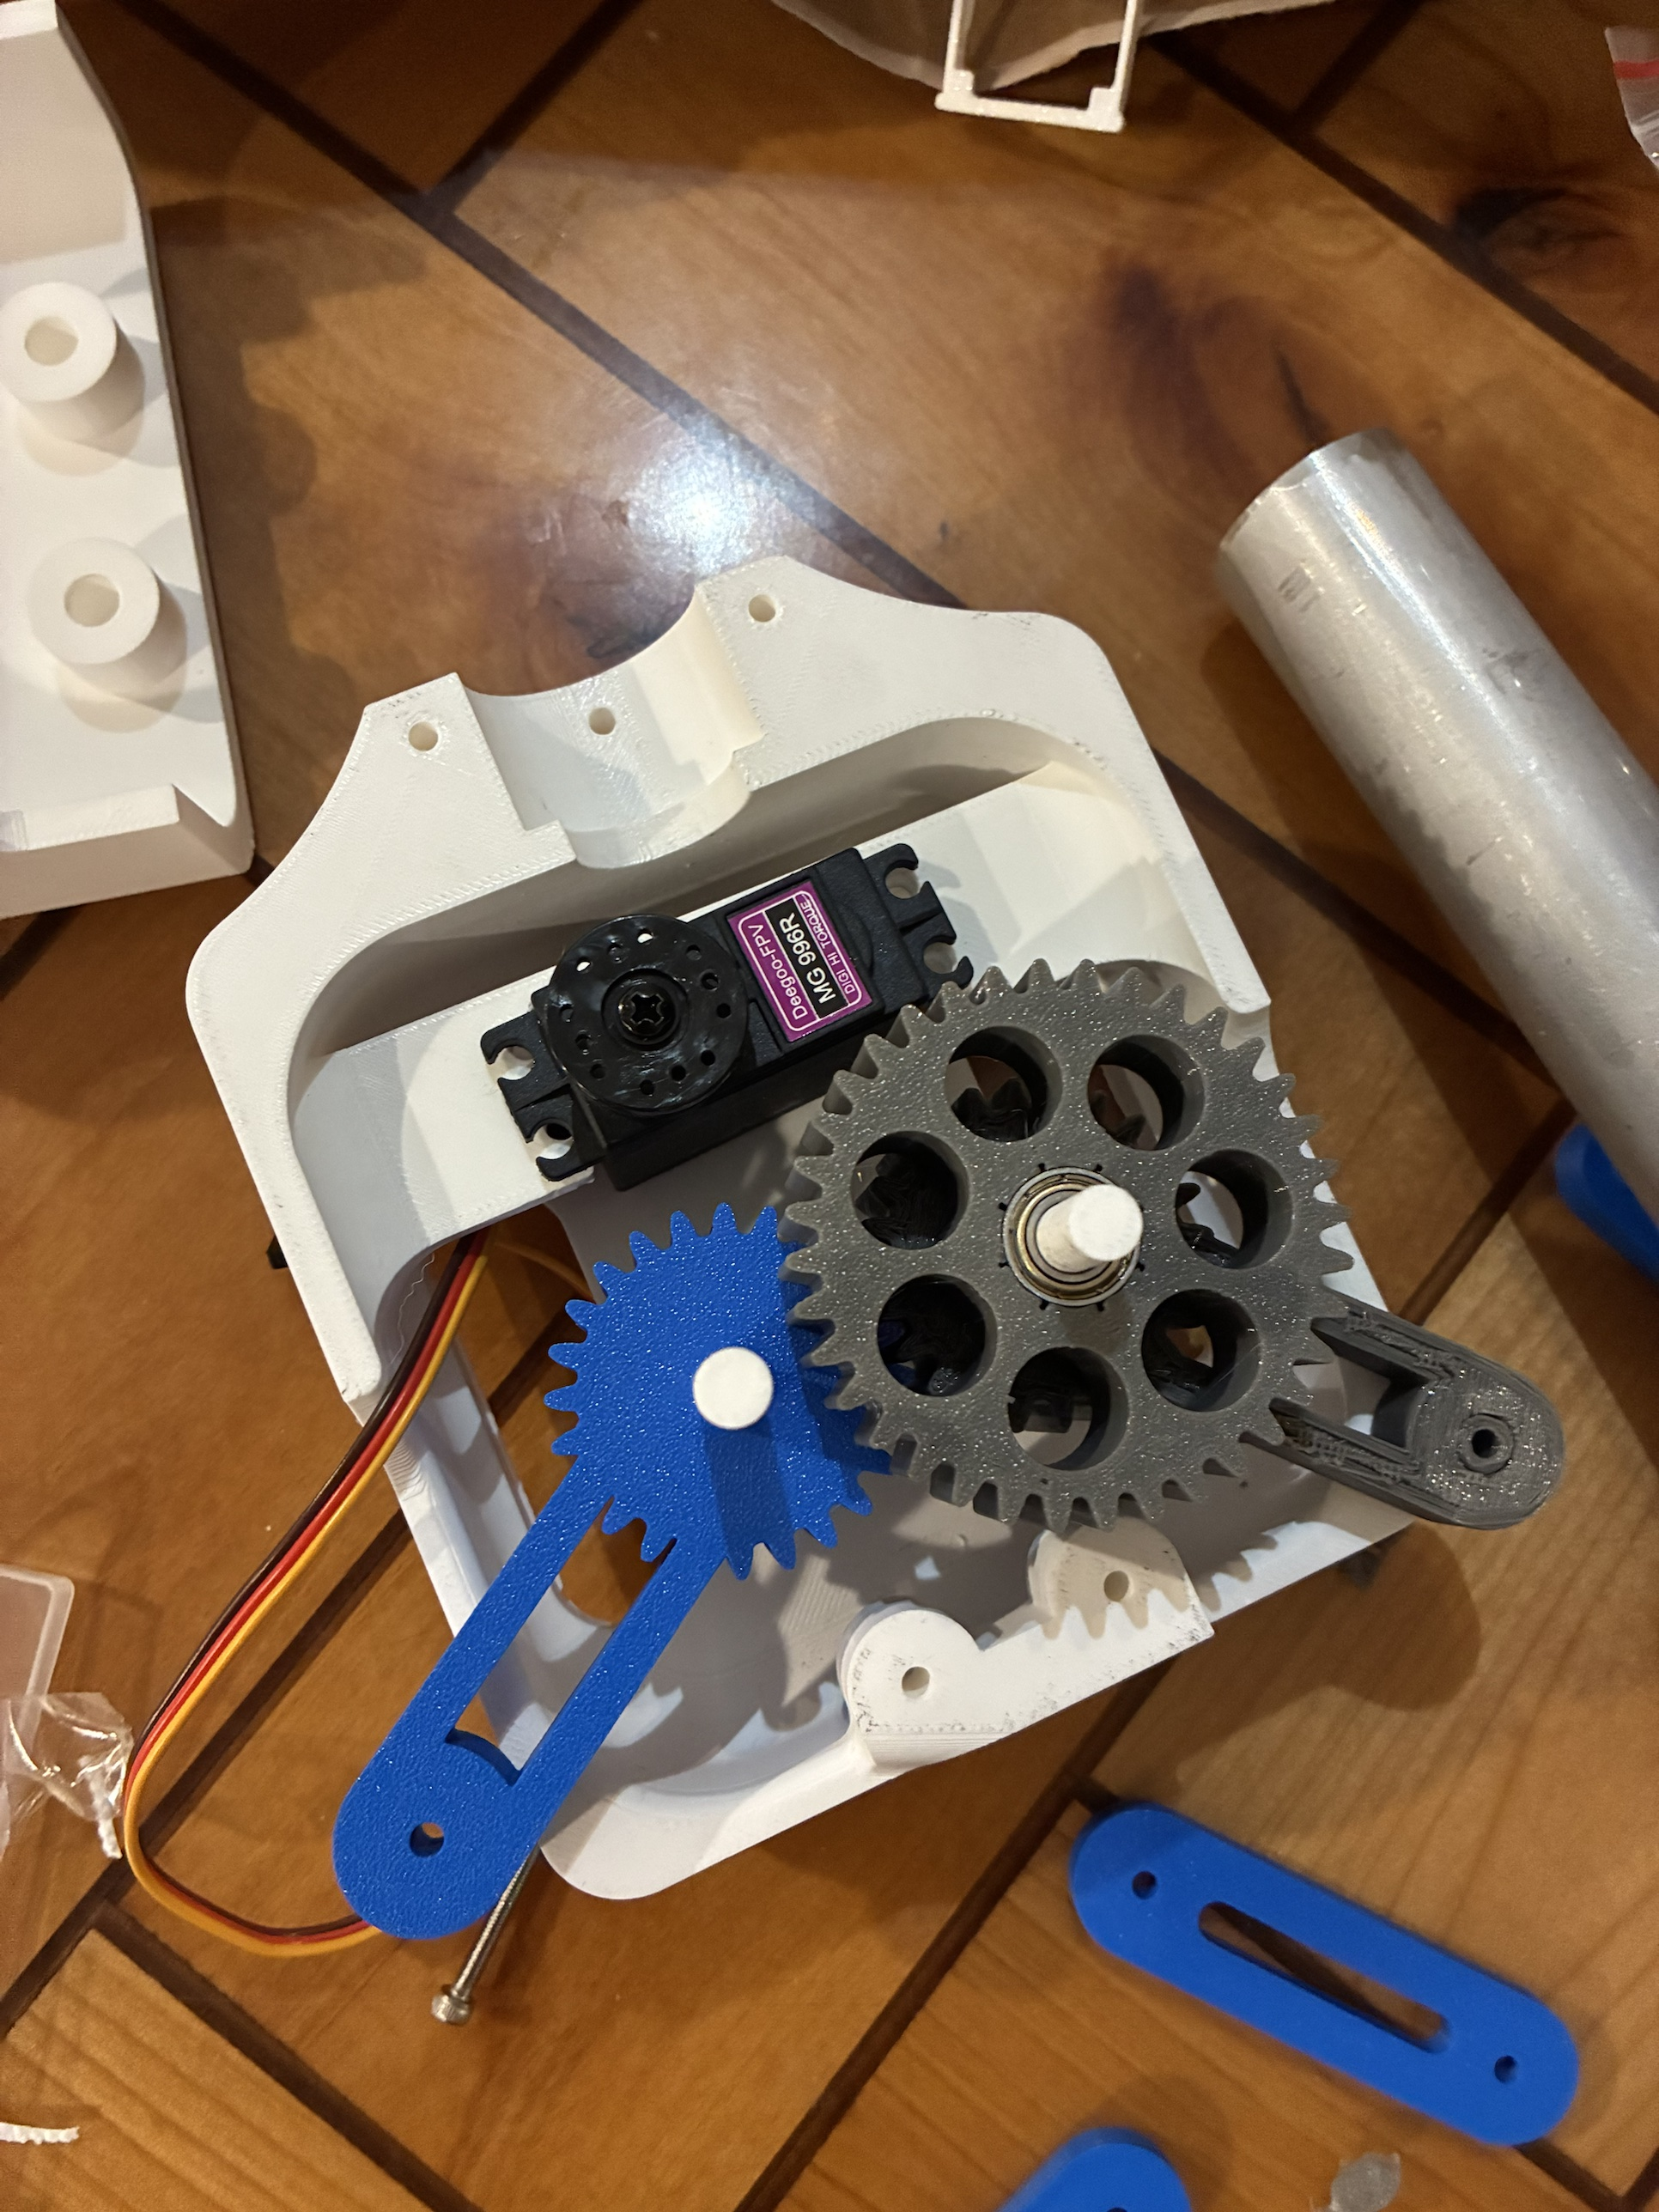
The clamp that could not close on thin cloth (Sep 30)
CAD
Rack-and-pinion jaws could not pinch thin fabric: the pinion travel left a 2 mm gap, so the pads never met
The v6 clamp came out at 4.6 times its mass budget in CAD (Oct 20), with no torque path from the servo
Lesson: mass tracked through every version from then on; the final claw was weighed on Oct 22
Final: a geared four-bar with parallel jaws (Act 4)
Finger claw (CAD only), v6 clamp (CAD), final four-bar (CAD), printed gear train
Jasper Buntinx | RoomCleaner | Act 3 of 5: Redesign (September to early October)
Notes:
Talk track (55 s): The claw went through four versions, and each failed for a reason I can name. The fingers never left CAD. The first clamp, September 30: rack-and-pinion jaws whose pinion travel left a 2 mm gap, so on thin cloth on a hard floor the pads never met. The v6 clamp, October 20: in CAD it came out at 4.6 times its mass budget, up to 2.06 kg against 0.45, and with no torque path from the servo to the jaws. That was the moment I started tracking mass through every version, and the final claw was weighed two days later. The final design is the geared four-bar with parallel jaws, in Act 4. If asked: the mass problem was never the budget; it was that I did not re-check the budget as the claw changed.

Slide 12
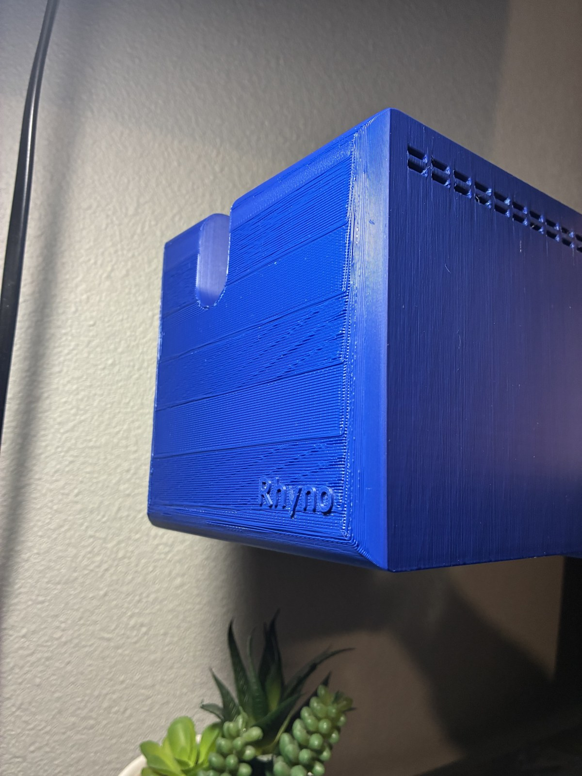
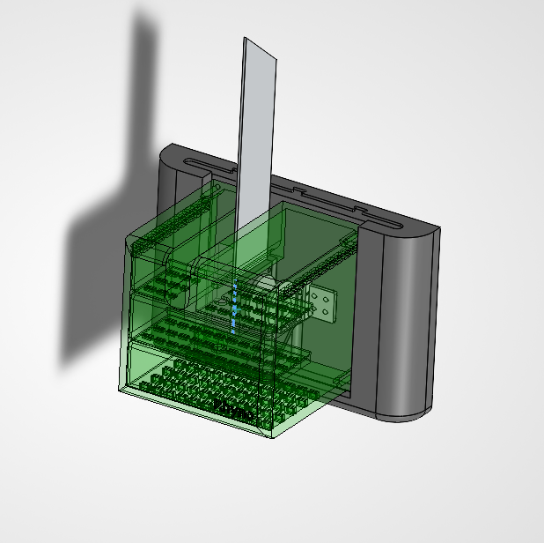
One plug per station: the station lifts off while the anchor stays in the stud
CALCULATED
Slide-in wall mount: the station lifts off its dovetail; the wall mount and its screws stay in the stud
Load path: cable, spool, set screw, motor, PETG tab, slide-in, wall mount, screws, stud
The motor is the weakest link: it slips at 34–59 N before anything breaks, and the spool encoder reports the overload
Motor slip force (the fuse)
F = τ_{h} / r = 0.36 N·m / 0.0075 m = 48 N
F_{max} = 48 N × 1.11 (motor) × 1.11 (cable angle) = 59 N
SolidWorks, shell transparent (left); the printed shell on the wall, Oct 22 (right)
Jasper Buntinx | RoomCleaner | Act 3 of 5: Redesign (September to early October)
Notes:
Talk track (55 s): The station that came out of the redesign. One plug per station: the wall mount is screwed into a stud, and the station slides onto it on a dovetail, so it lifts off for service while the anchor stays put. Walk the load from the cable to the stud: cable, spool, set screw, motor shaft, the printed motor tab, the slide-in, the wall mount, the screws, the stud. The design idea is to make the motor the part that gives first. At 1.5 A it slips at 34 to 59 N, depending on the spool fill and the cable angle, before any part breaks; the encoder on the spool sees the spool fall behind the command and the station stops and reports an overload. Every other part has to outlast that. If asked: as drawn, the spool's set screw in printed plastic may slip first and the warm motor tab's sharp corner is only about 1.2 times the motor; the fixes are the set screw into metal and a 6 mm tab with fillets. A #6 wood screw in a stud holds about 309 N; in drywall alone about 46 N, so studs only.

Slide 13


One controller per winch
Generation 1: one central board; with sensors it would need 250 m (820 ft) of wire
Now: a controller in each station, fed by one 12 V pair: 50 m (164 ft)
Each station is built and tested on its own
The cost: timing moves into software; 50 ms of skew is 2.5 mm of cable error
Before: one central driver board. After: a controller in each station.
 | Generation 1 | Final
Where is the claw? | Assumed from commanded cable lengths | Measured by the claw camera at every startup
Room geometry | Anchors from a tape measure | Anchors and cable lengths fitted, with error bars
Motor control | One central board | A controller per station, coordinated by the laptop
Finding laundry | Ceiling camera | Claw camera
Did the grab work? | Assumed | Camera checks pickup and delivery
Faults | Emergency stop only | PAUSE keeps torque; the emergency stop cuts power
Jasper Buntinx | RoomCleaner | Act 3 of 5: Redesign (September to early October)
Notes:
Talk track (50 s): The wiring calculation became this decision: a controller in each station instead of one central board. Each station gets one 12 V pair, 50 metres of wire in total instead of 250, and it can be built and tested on its own, which is exactly how the bench week in Act 5 went. The cost is that the four winches now have to agree on time in software: each station runs time-stamped segments on its own clock and holds if the link drops, with a 40 ms skew budget that keeps the error to 2 mm. The table is the wider change: Generation 1 trusted its model; the final logic measures before it trusts and checks after it acts. If asked: cable routes are 6, 21, 23 and 32 ft; line stiffness is about 3 N/mm over a 3 m run.

Slide 14

The claw camera replaces bead homing
SIMULATED
The claw camera reads a printed floor board, and a fit finds the anchors and cable lengths: the whole room is reachable
Camera pose per frame, best case: 6.6 mm with one tag in view, 0.7 mm with four
After the fit, cable lengths are known to about 12–16 mm (simulated); the room opens only when the error bars allow it
Beads stay on the cables as end stops: a bead reaching its switch stops that station
Calculated (calc sheet: Floor board)
Jasper Buntinx | RoomCleaner | Act 3 of 5: Redesign (September to early October)
Notes:
Talk track (55 s): Bead homing died on the reachability chart, so the claw camera does the homing instead. At startup the claw looks down at a printed floor board; from the tags it sees, a fit finds the anchor positions and the cable lengths, with error bars, and the whole room becomes reachable. The chart is the camera's per-frame accuracy, best case: 6.6 mm with one tag in view, 0.7 mm with four. That is not the number that matters. The number that matters is the cable length after the fit, about 12 to 16 mm in simulation; averaging frames removes noise but not bias, and the planner opens the room only as far as the error bars allow. The beads stay on the cables as end stops. If asked: noise model 0.3 px corner noise and a 520 px focal length, camera not yet calibrated; realistic tag placements are a few times worse than the four-tag best case.

Slide 15
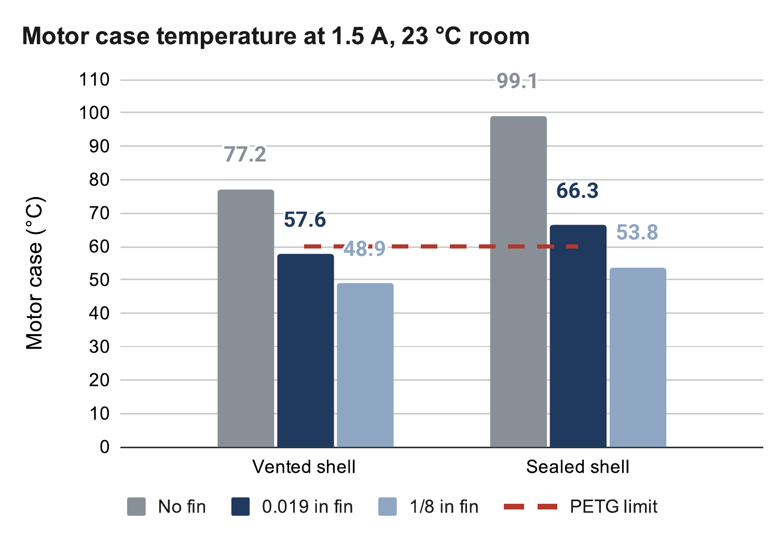
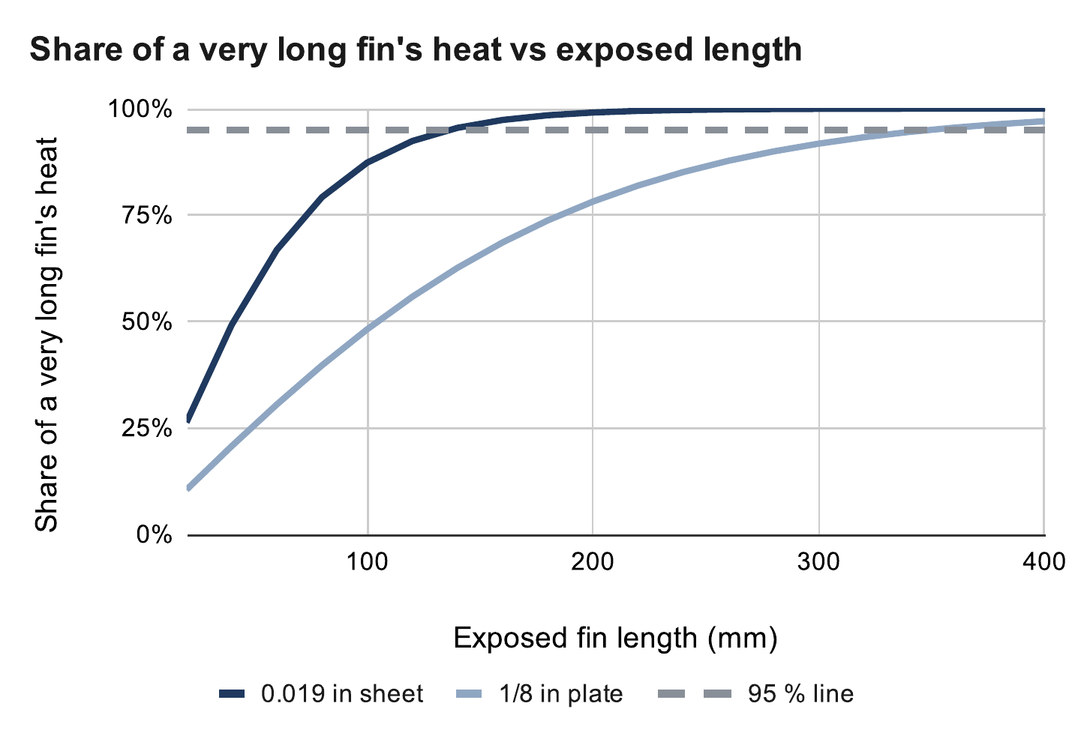
Heat: a sealed PETG box would cook its own motor mount
CALCULATED
1.5 A doubles motor heat to 4.05 W; the PETG mount must stay below 60 °C
Vented shell and fin: 56–59 °C with the 0.019 in prototype, 45–49 °C with the 1/8 in design
The thin sheet stops gaining by 136 mm; the 1/8 in plate keeps gaining to 349 mm
If the fin alone carried all 4.05 W (painted 6061, 44 mm wide)
Thickness | Mass | Shortest for ≤ 60 °C
0.019 in (prototype) | 14 g | None (2.0 W max)
1/16 in | 47 g | None (3.6 W max)
0.090 in | 68 g | 210 mm or none
1/8 in (design) | 94 g | 145–185 mm
3/16 in | 141 g | 125–140 mm
1/4 in | 189 g | 115–125 mm
Calculated (calc sheet: Motor temperature; assumed 1.8 Ω coil, 23 °C room)
Motor heat, P = I² R
At 1.06 A: (1.06 A)² × 1.8 Ω = 2.0 W
At 1.5 A: (1.5 A)² × 1.8 Ω = 4.05 W
Calculated (calc sheet: Heat fin; Incropera, ch. 3)
Jasper Buntinx | RoomCleaner | Act 4 of 5: Final design (October 7-21)
Notes:
Talk track (55 s): Raising the drivers to the motor's rated 1.5 A doubles the heat to 4.05 W per motor, and the motor sits in a printed PETG mount that softens at 60 °C. A sealed shell would cook it. The answer is a vented shell and an aluminium fin bolted to the motor face and out through a slot in the top. Top chart: motor temperature for each fin, vented and sealed; the prototype fin, 0.019 in scrap sheet, lands at 56 to 59 °C, one to four degrees of margin; the 1/8 in design fin at 45 to 49. Bottom chart: why thickness beats length; the thin sheet stops gaining by 136 mm, the plate keeps gaining to 349. The table answers what fin it would take to carry all the heat alone. If asked: built length is 200 mm, limited by the ceiling; the fallback is 1.35 A; warmer air near the ceiling eats the prototype's margin; a 90-minute hold test is planned.

Slide 16
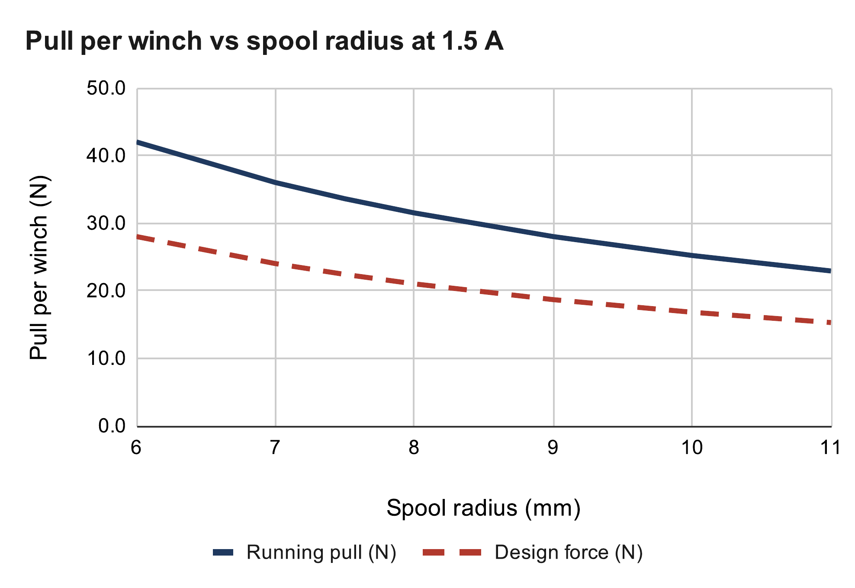
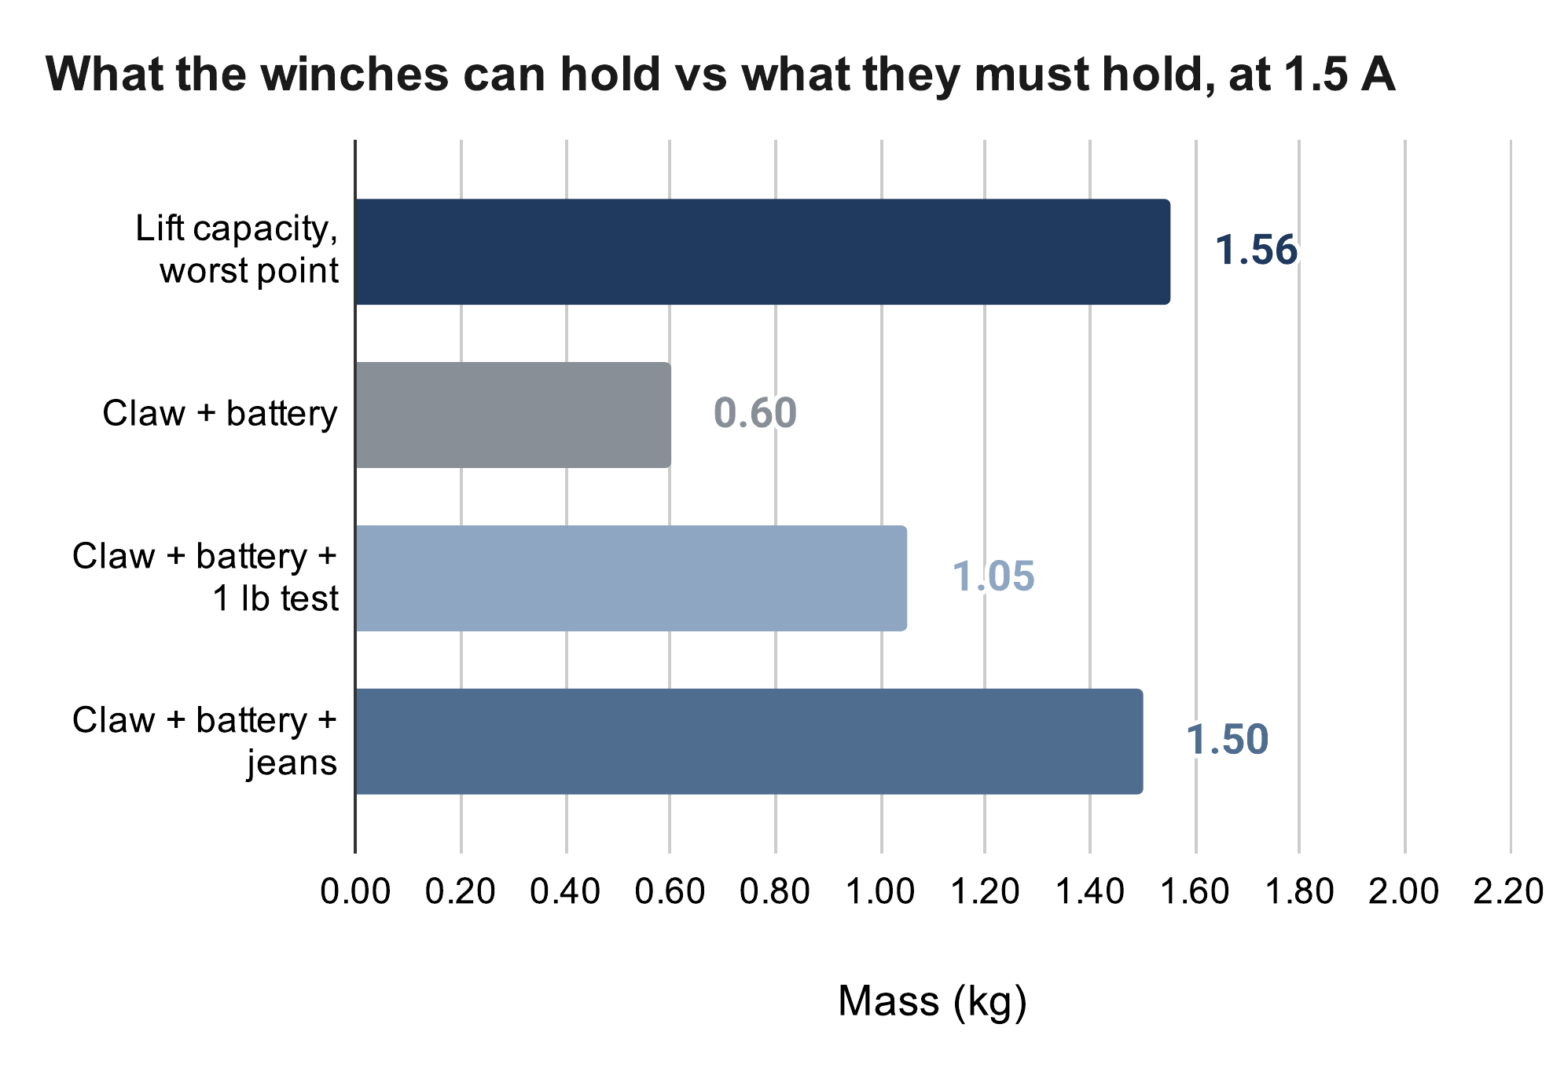
Winch pull and what the four winches can lift
MEASURED
CALCULATED
Calculated pull at 1.5 A: 34 N on an empty spool, 25 N when full; running torque assumed 0.7 × holding
Claw with battery weighed 0.60 kg (0.86 kg estimated)
Jeans: 1.50 kg against 1.56 kg capacity, a 4 % margin, inside the uncertainty (1.1 kg at 0.5 × holding torque)
The pull test decides: keep 1.5 A, or add a gear stage at each winch
Calculated (calc sheet: Winch pull)
Lift capacity
m_{max} = F_{design} / (k g) = 16.8 / (1.101 × 9.81)
= 1.56 kg against 0.60 + 0.90 = 1.50 kg
Calculated (calc sheet: Lift budget)
Jasper Buntinx | RoomCleaner | Act 4 of 5: Final design (October 7-21)
Notes:
Talk track (55 s): Top chart: what one winch pulls at 1.5 A as the spool fills: 34 N on the empty core, 25 N full, assuming running torque is 0.7 of holding torque. Divided by 1.5 against skipped steps, that is the 16.8 N design force. Bottom chart: what the four winches hold at task height against what they must hold. The claw weighed 0.60 kg with its battery, against 0.86 estimated. With jeans that is 1.50 kg against a capacity of 1.56: a 4 % margin, which is inside the uncertainty, because at 0.5 times holding torque the capacity is 1.1 kg. The pull test decides whether 1.5 A is enough; the alternative is a gear stage at each winch, which is the next slide. Pause and ask: cut claw mass or add the gear stage? If asked: the current is set by the driver reference voltage, I = Vref / (8 × 0.1 Ω) [[how 1.5 A was reached and the Vref read]]; the A4988 runs hot at 1.5 A and shuts down if it overheats, so the hold test watches it.

Slide 17
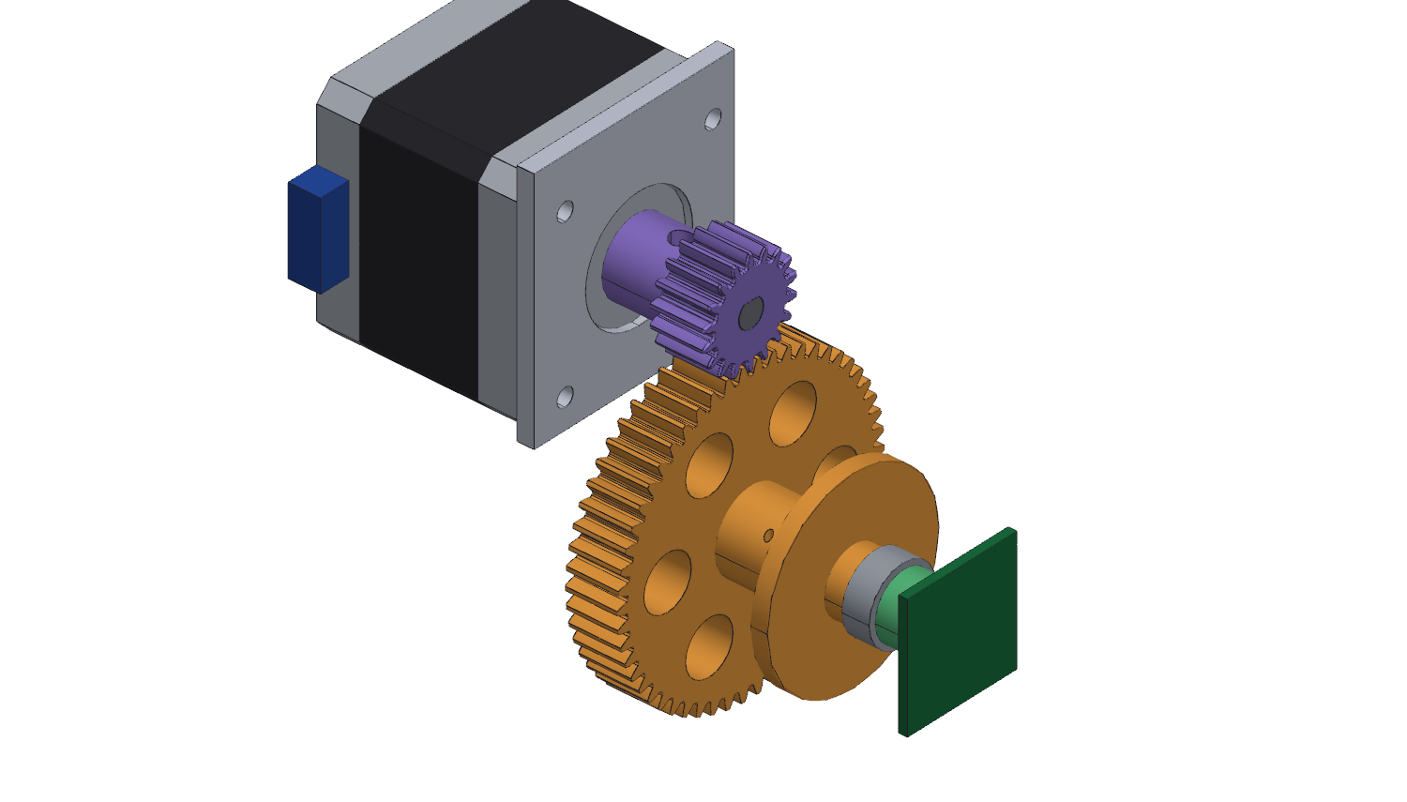
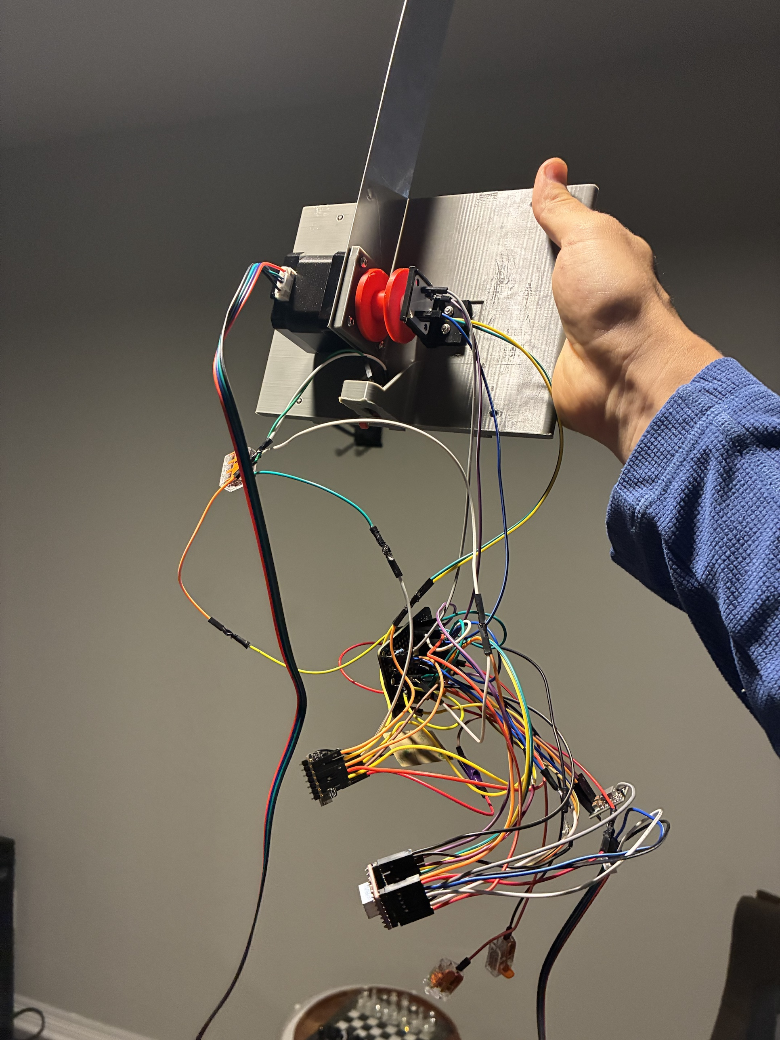
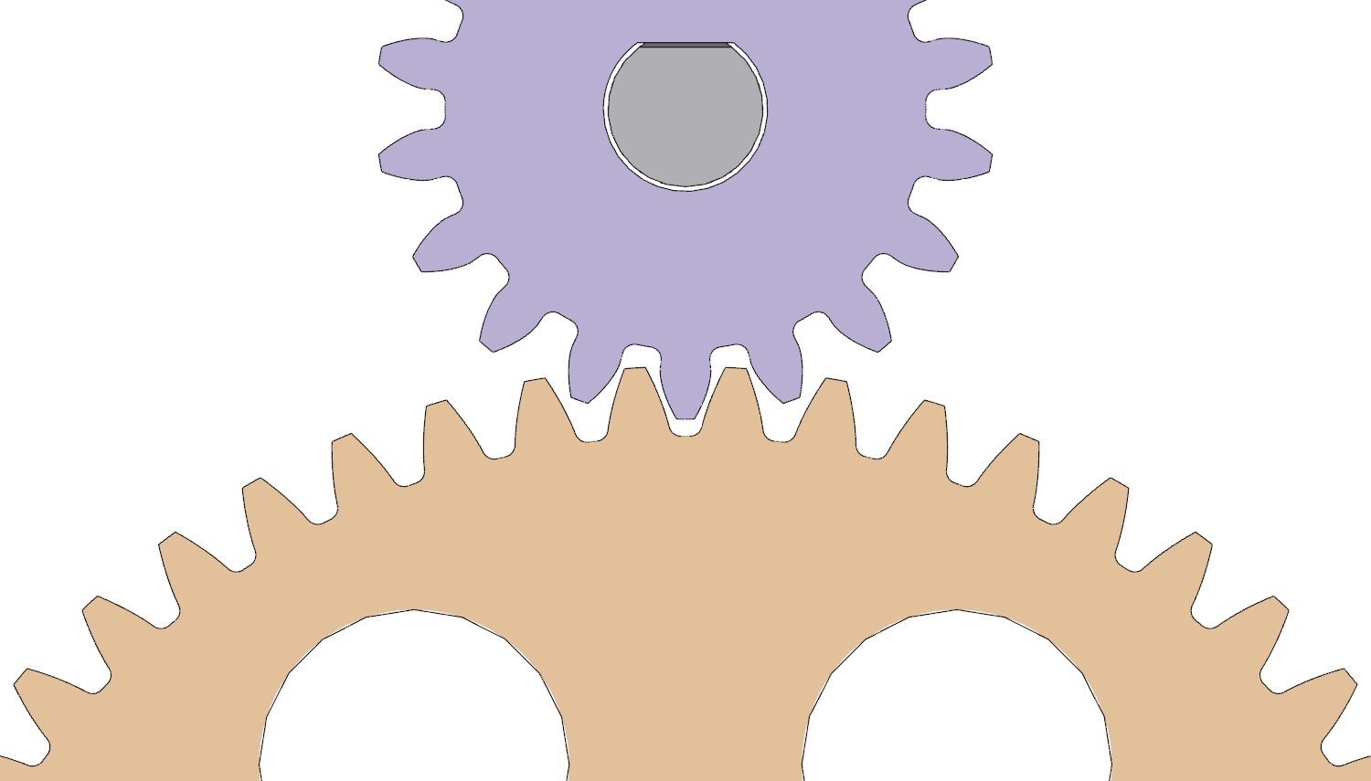
A 3:1 gear stage, all printed, with the encoder on the spool shaft
CALCULATED
CAD
18T pinion, 54T gear, module 1: 3:1 at the spool. Lift capacity 1.98–2.80 kg at 1.0 A (was 1.10–1.56 kg), motor heat 1.8 W (was 4.05)
Printed PETG pinion: its teeth hold 1.75 × the motor's slip force at 1.0 A
Backlash 0.42 mm at the pitch circle: 10 encoder counts of the 60-count tracking tolerance
The encoder magnet moves to the end of the spool shaft; measured Ø4.0, not the Ø6 the spec had assumed
1 Pinion on the motor; gear and spool in one part
2 Mesh: module 1, 36.3 mm centres
3 Slide-in: motor, spool, end stop, harness (Oct 26)
Jasper Buntinx | RoomCleaner | Act 4 of 5: Final design (October 7-21)
Notes:
Talk track (55 s): The gear stage that takes the lift margin from 4 % to a real one. An 18-tooth pinion on the motor drives a 54-tooth gear printed in one piece with the spool, module 1, 3:1. At 1.0 A the capacity goes from 1.10 to 1.56 kg up to 1.98 to 2.80 kg, and the motor heat drops from 4.05 W to 1.8, which also relaxes the fin. I printed the pinion too: its teeth are the weakest tooth in the train, at 1.75 times the most the motor can pull before it slips, so the motor still gives first. Backlash is 0.42 mm, ten encoder counts out of the sixty the tracking fault allows. The encoder magnet moves to the end of the spool shaft, and when I measured it, it was 4 mm, not the 6 the spec had assumed, so the cap was redrawn. If asked: at 1.5 A the pinion teeth drop to 1.17 and the set screw to 1.00, so the recommendation is 1.0 A; the spool shaft is Ø7 steel in two 687 bearings; the stage is verified in CAD, not yet pull-tested.

Slide 18
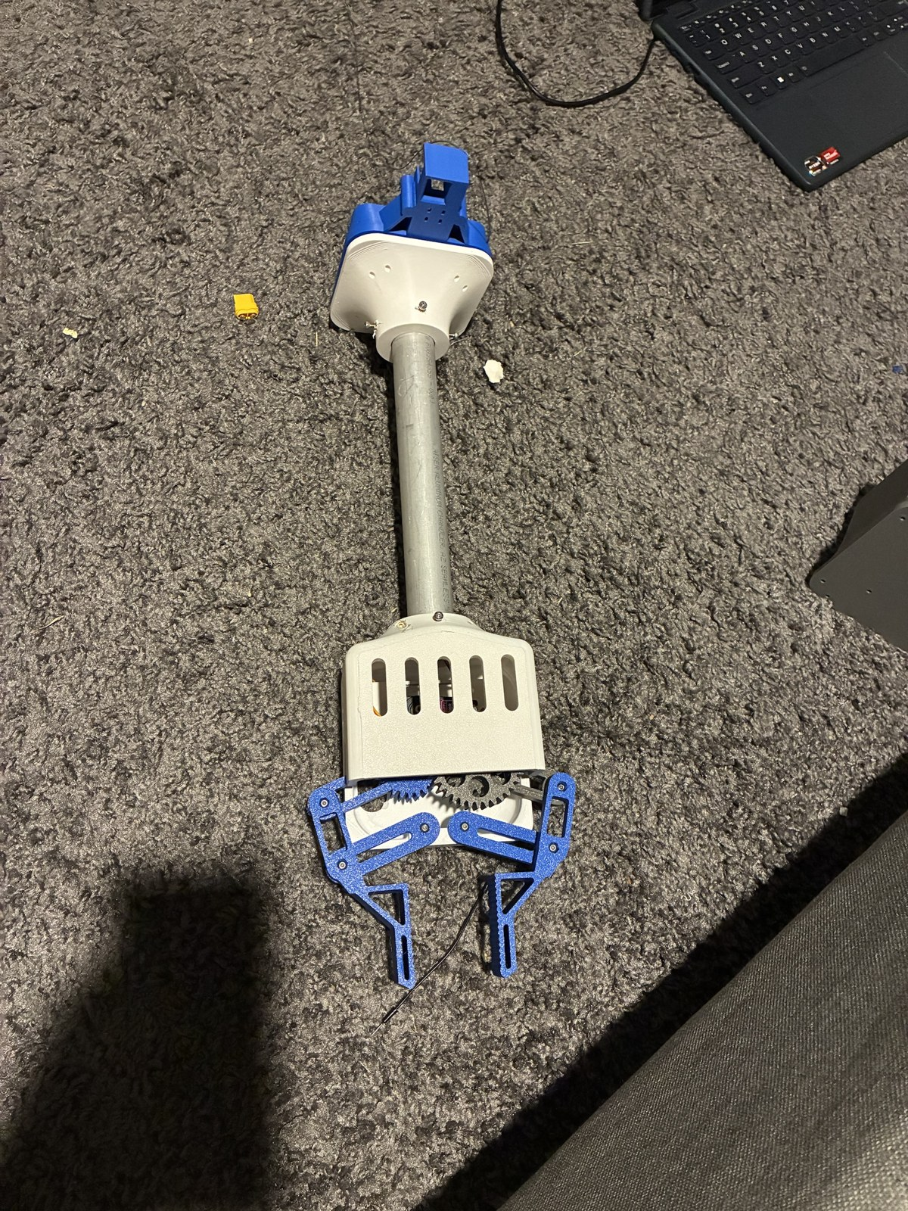
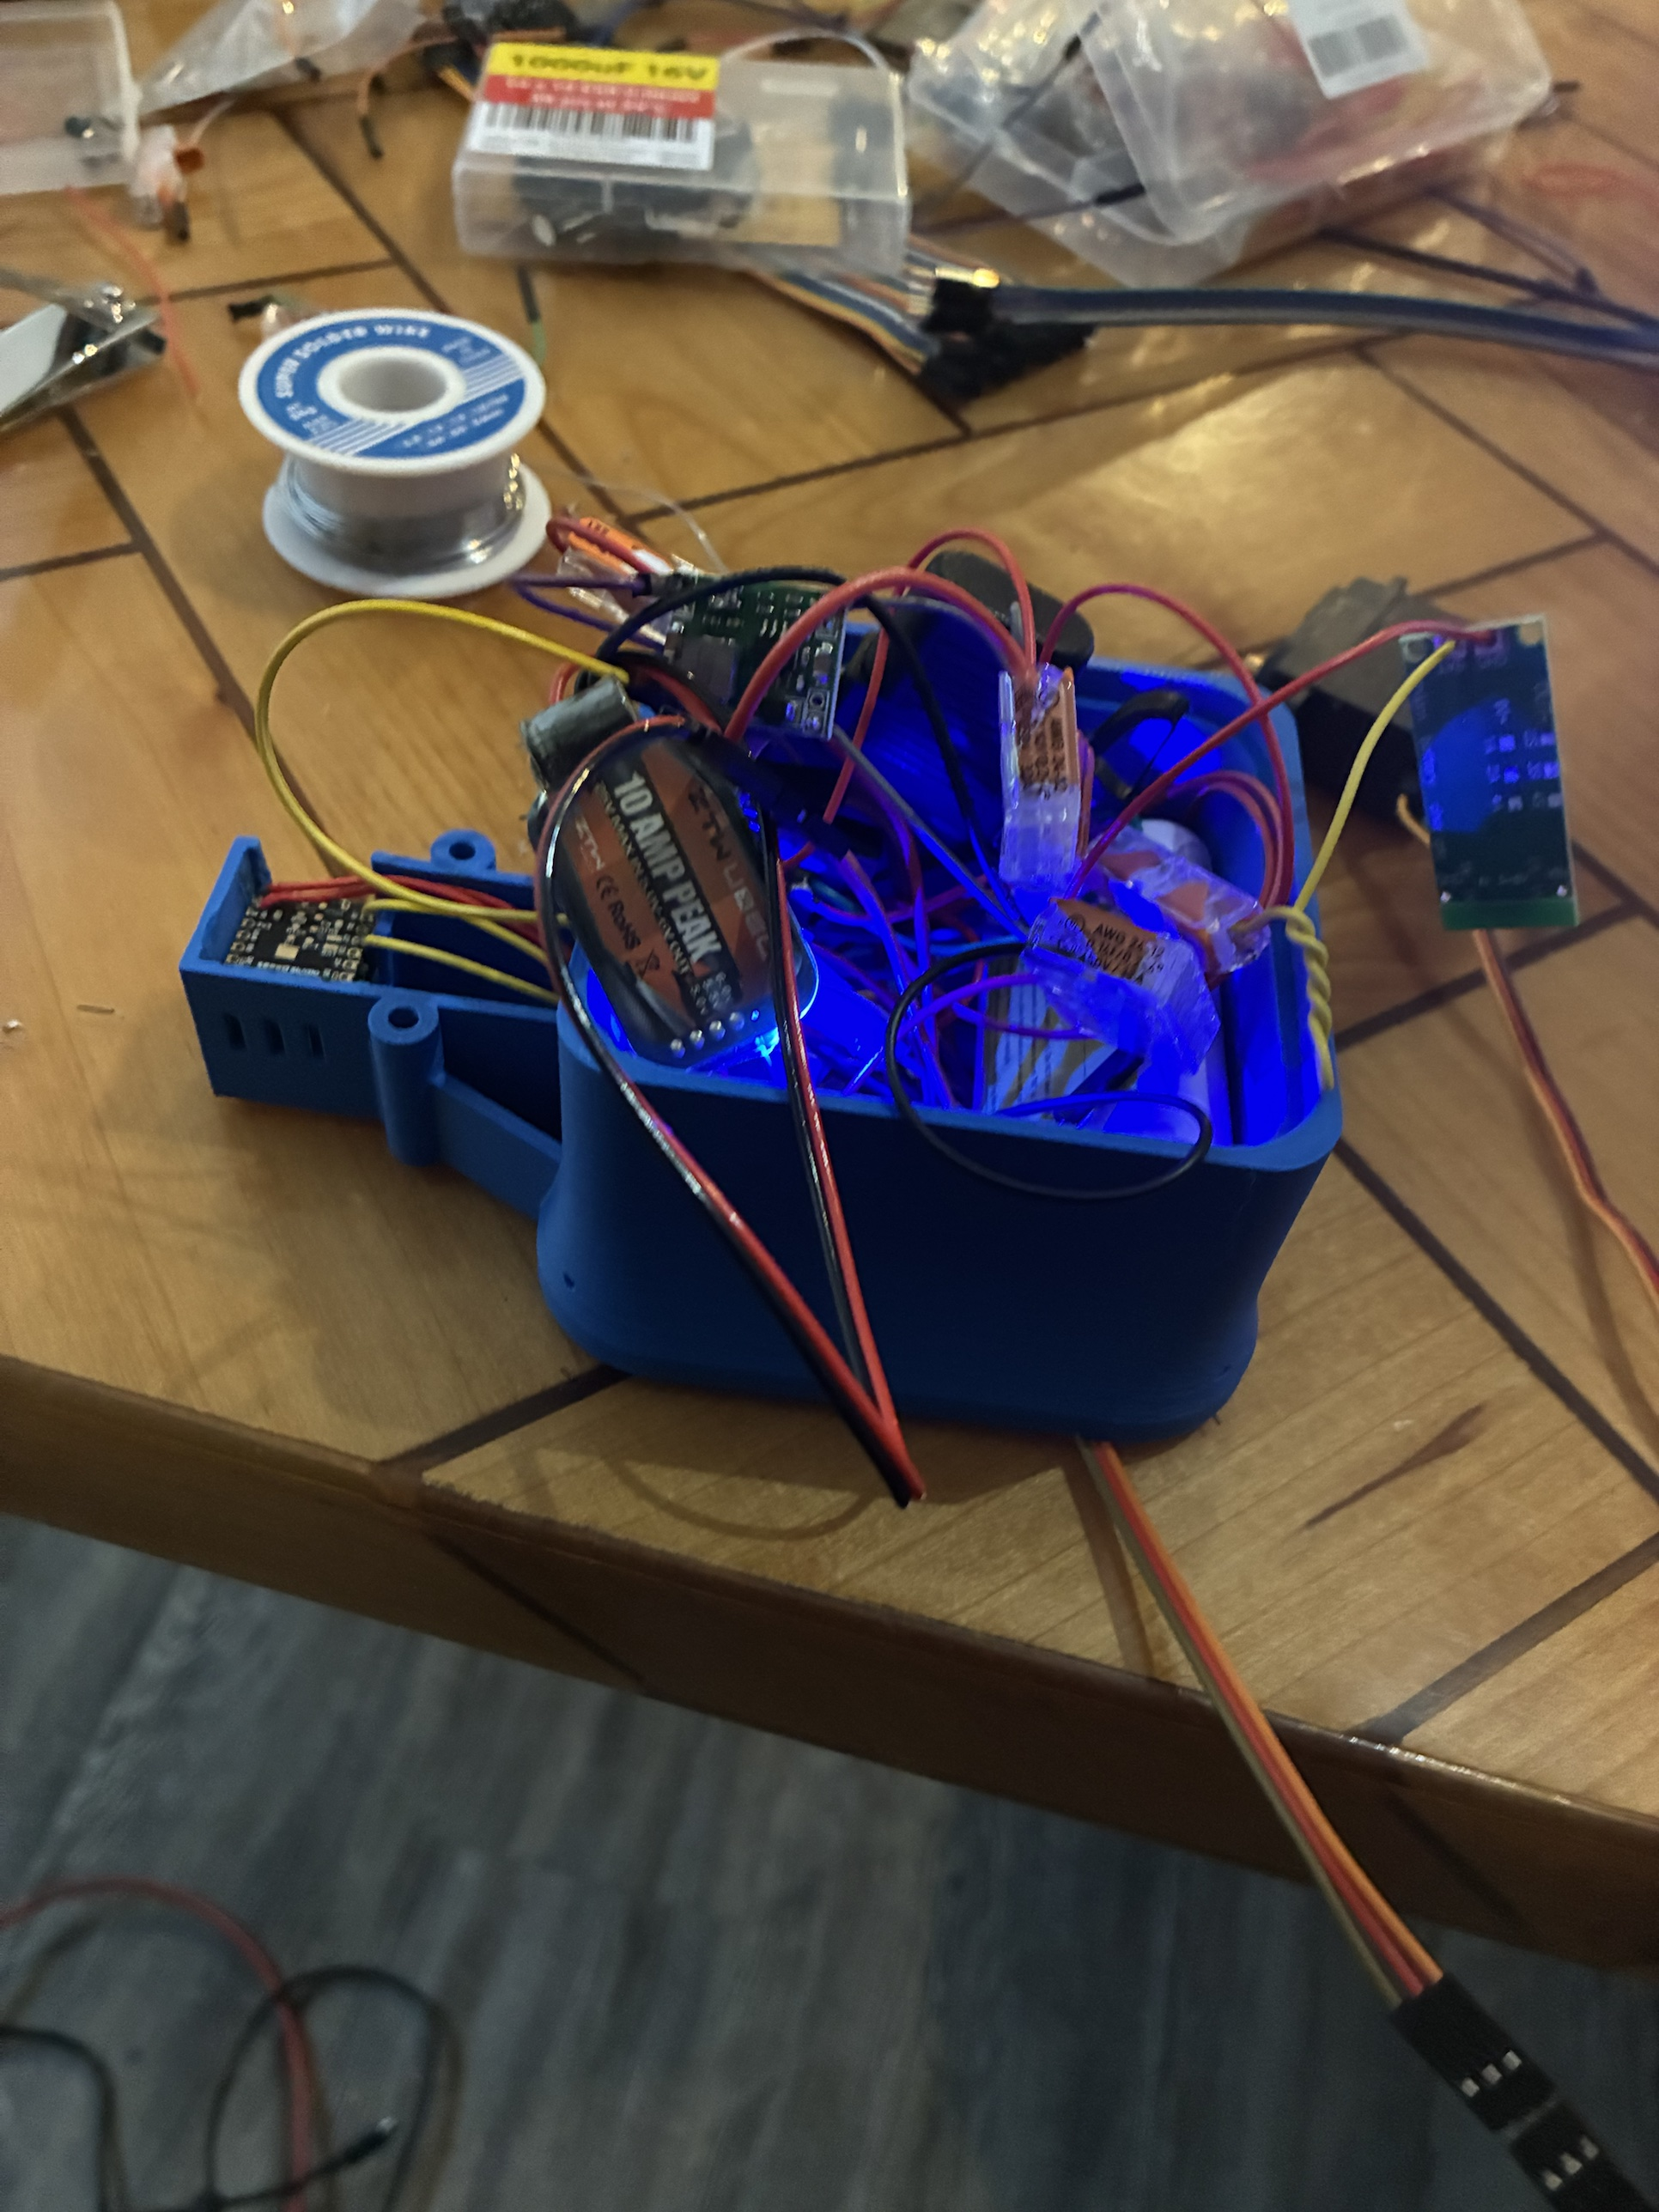
The claw: geared four-bar hands, camera bay, one 2S pack
CALCULATED
The hands are four-bar couplers: they stay within 1° of parallel over the 53 mm opening
Grip 13.3–25 N per jaw against 17.7 N for jeans: short at the narrowest grab, enough above a 22 mm grab
One 7.4 V two-cell pack: a 6 V regulator for the servo, a 5 V buck for the board, a 200k/100k divider for battery sense
Grip force per jaw, jeans
N ≥ m (g + a) / (2μ) = 0.9 × 11.81 / 0.6 = 17.7 N
Jaws: 13.3 N narrowest, 25 N at a 70 mm grab
1 Claw assembled (Oct 22)
2 Electronics housing open (Oct 26)
Jasper Buntinx | RoomCleaner | Act 4 of 5: Final design (October 7-21)
Notes:
Talk track (55 s): The final claw. The servo drives an 18-tooth pinion into a 54-tooth gear, 3:1, and each hand is a four-bar coupler on the gear's crank and the arm, a near-parallelogram, so the hands stay within a degree of parallel across the 53 mm opening. Grip: jeans need 17.7 N per jaw at a friction of 0.3; the jaws give 13.3 N at the narrowest grab and 25 N at a 70 mm grab, so narrow grabs are short and grippy pads are next. Power: one two-cell 7.4 V pack, a 6 V regulator for the servo, a 5 V buck for the camera board, a 200k over 100k divider so the board reads its own battery. The right photo is the housing open on the bench. If asked: gear safety factor 2.05 at servo stall; peak draw 2.8 to 3.1 A at the pack's 3 A rating; 5 A fuse; charged attended at 1 A or less; the tips drop about 38 mm while closing, so the claw closes from 35 to 40 mm above the floor.

Slide 19
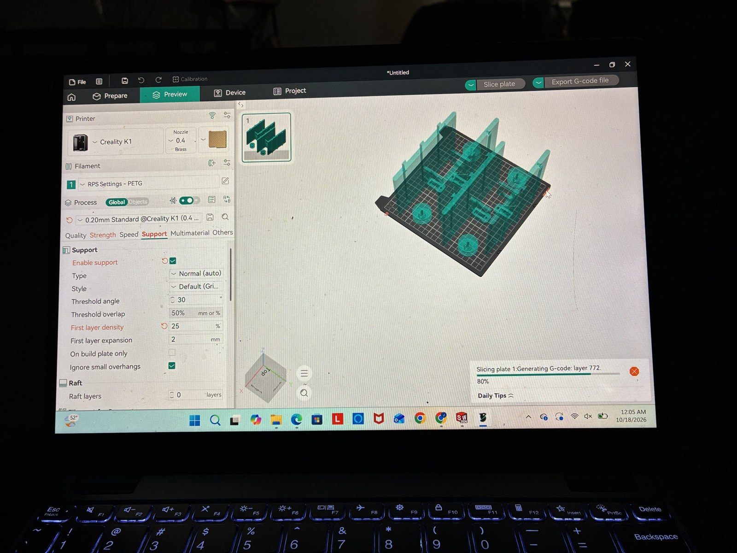
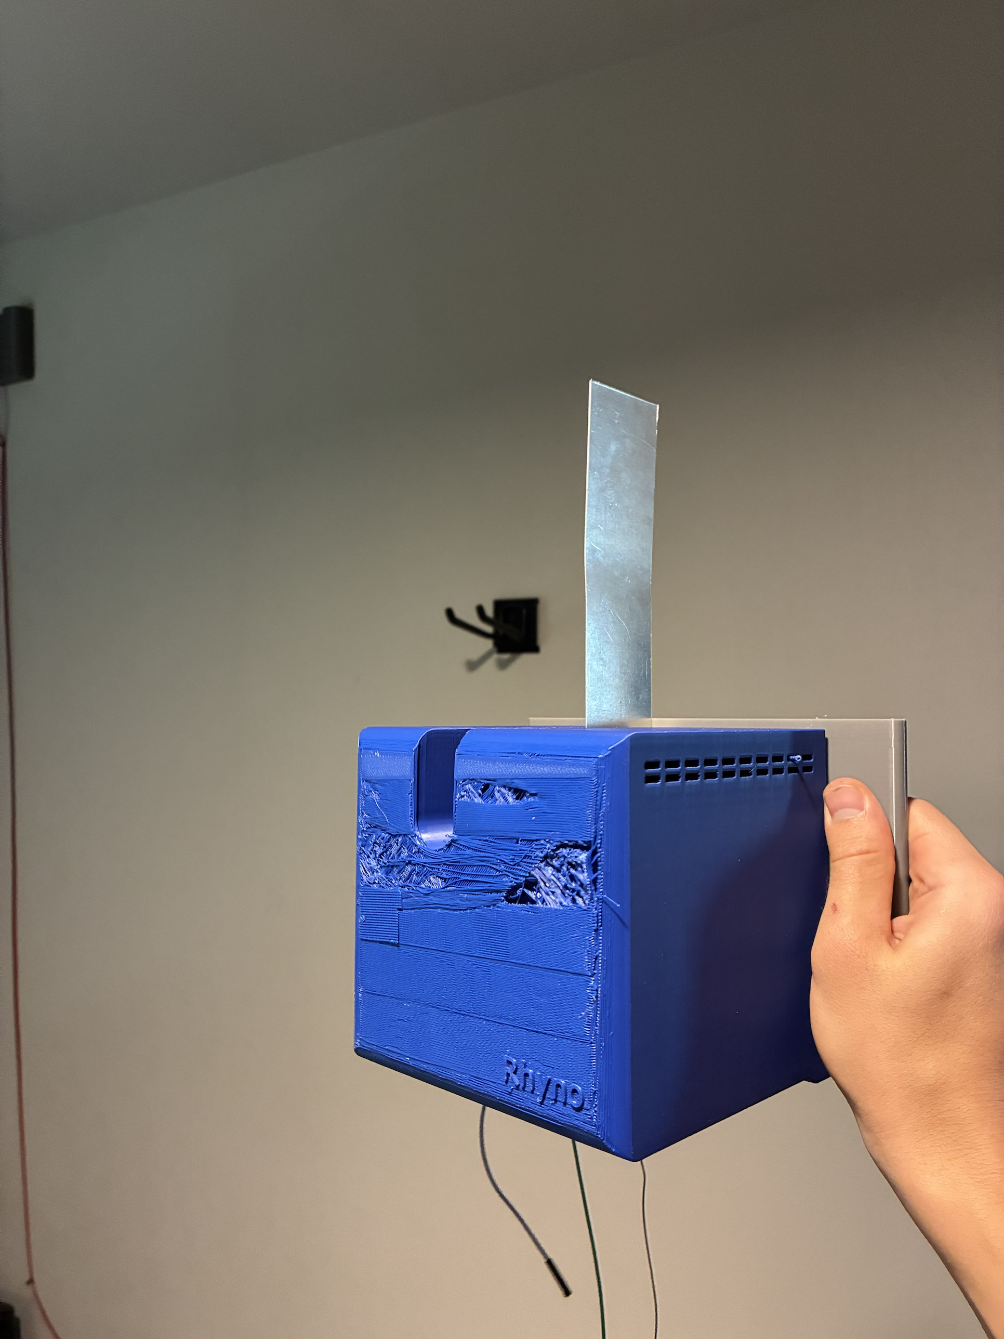
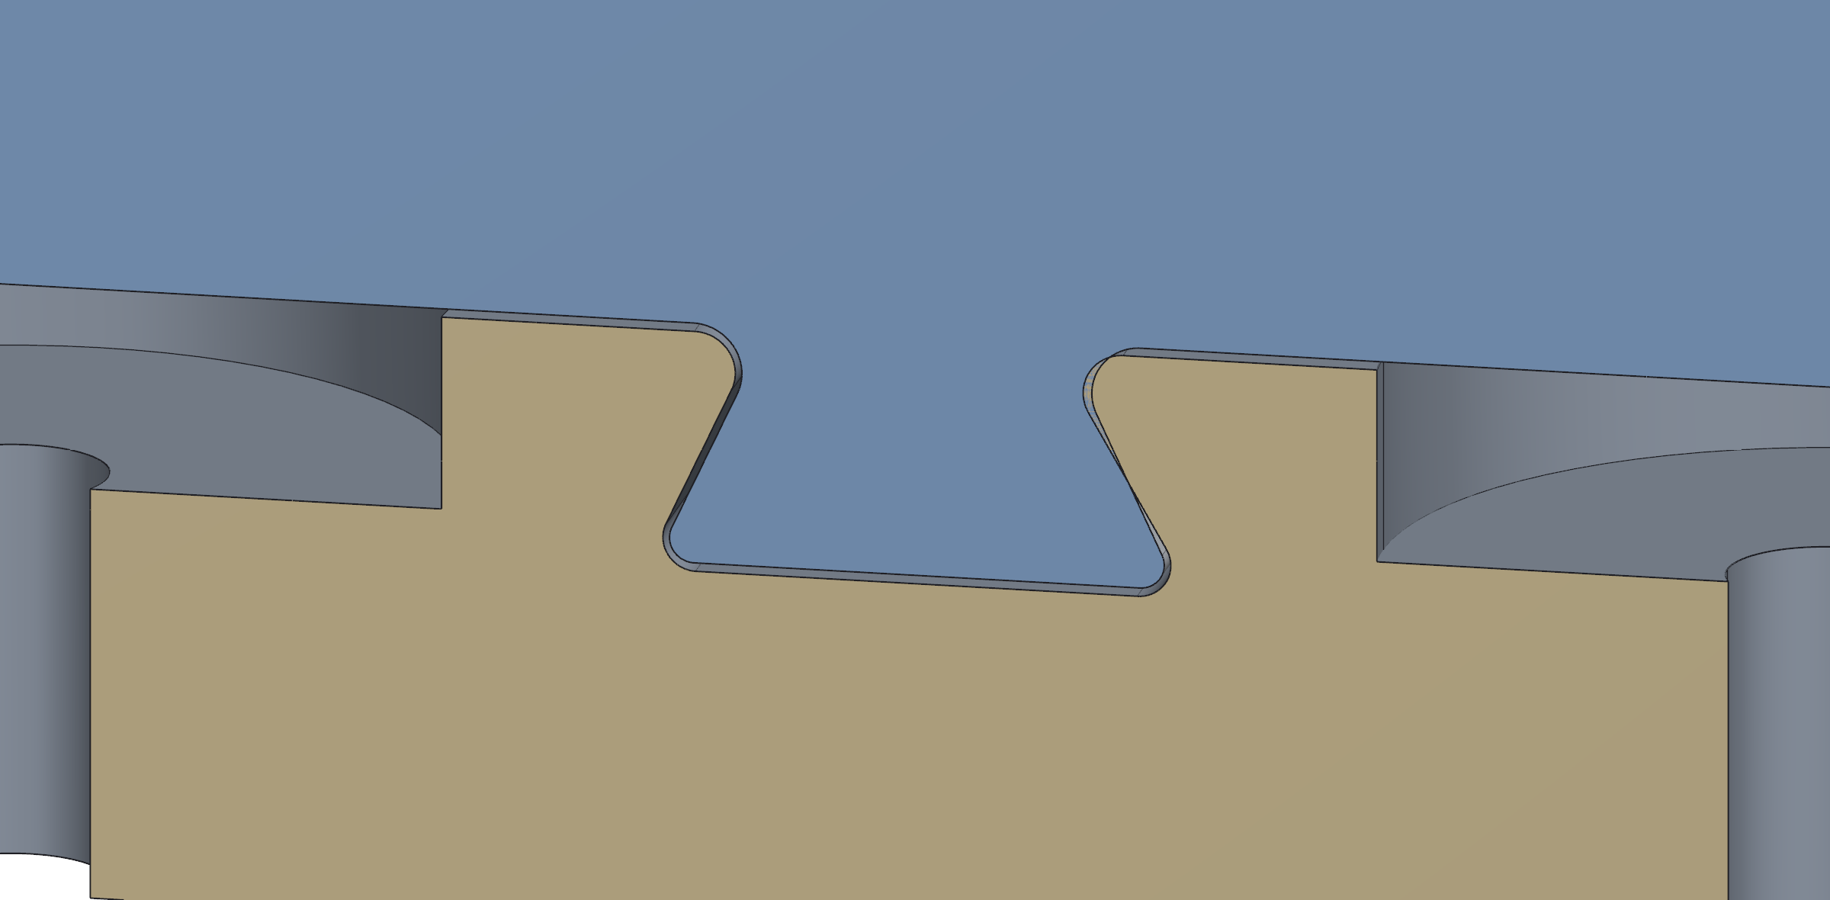
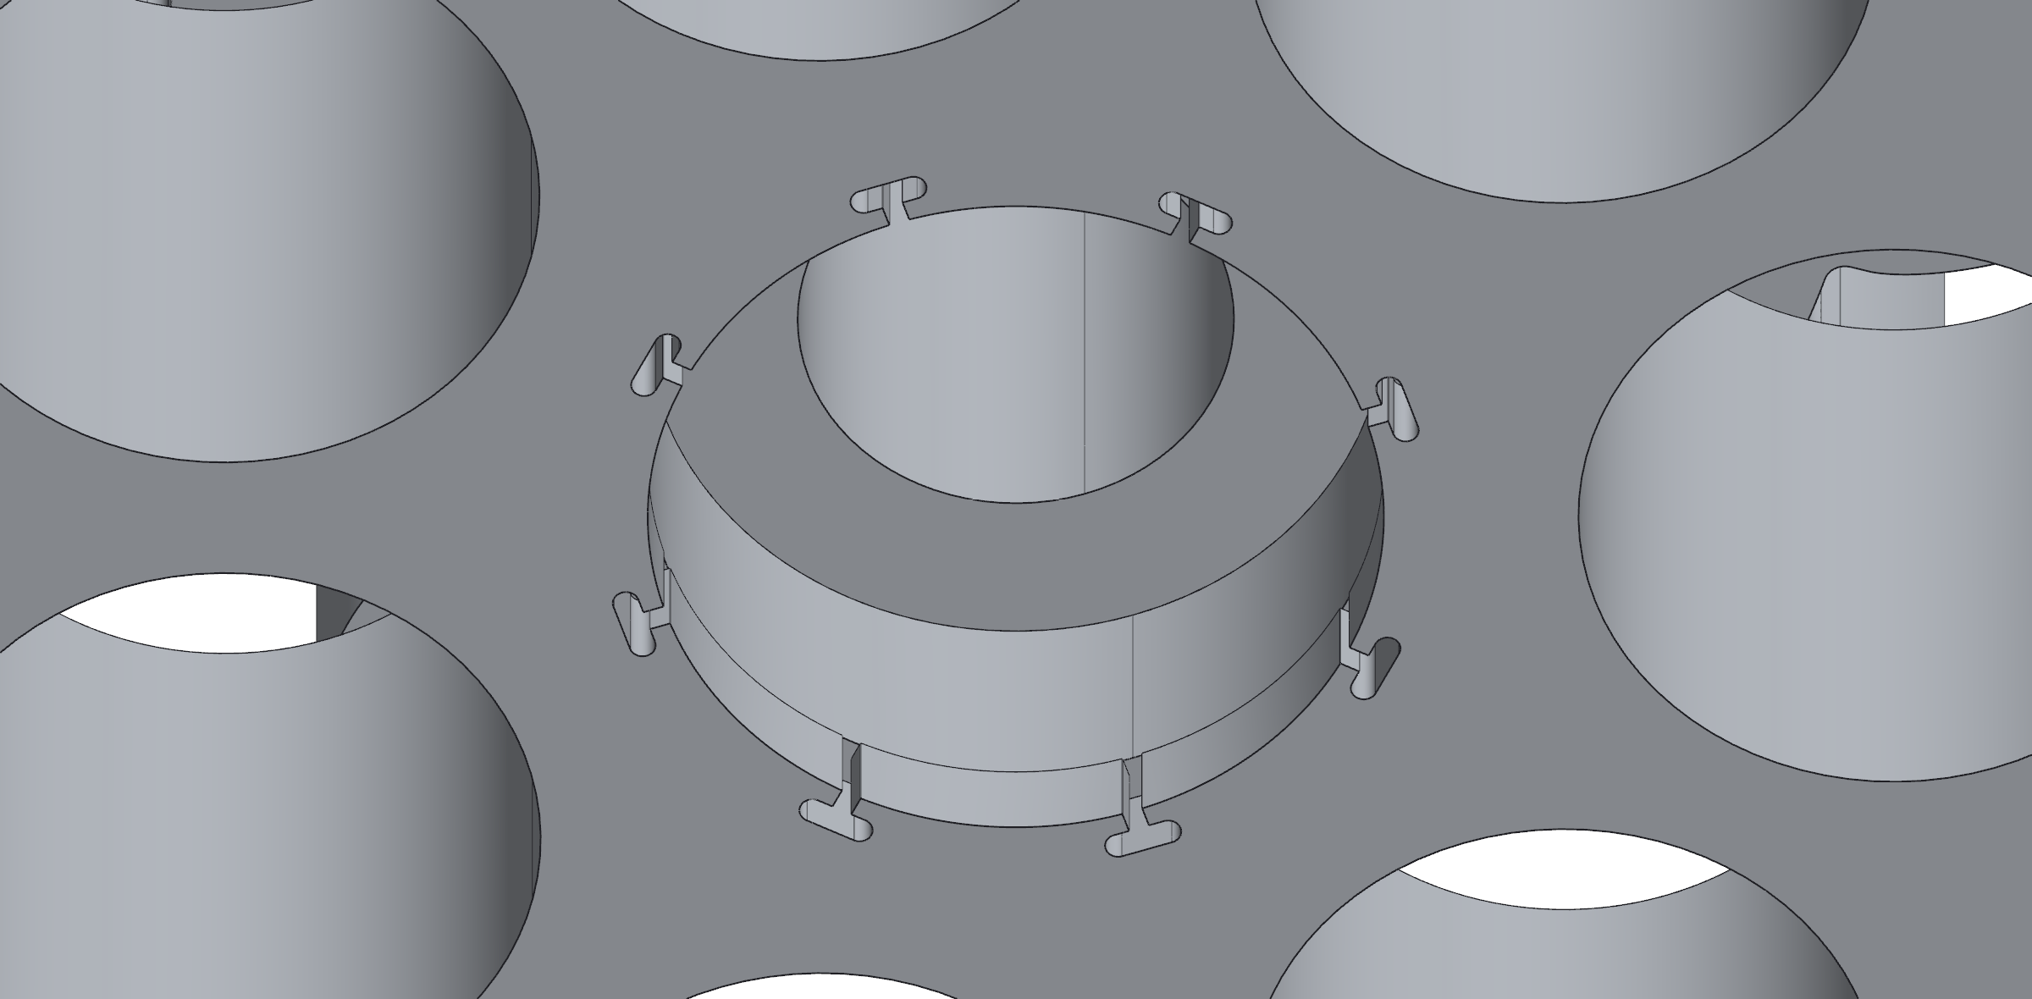
Printing and machining: fits came from coupons, not guesses
MEASURED
The spool bore printed too tight (Ø5.2 on a 5 mm shaft): opened to Ø5.45 after a fit coupon
Fin holes drilled in one setup: the first hole became the mill's zero, so the pattern carries ±0.1 mm, not the sheared edges' ±0.5
One shell kept a failed layer: it is a shell, not a load path
Printed holes come out small, so every printed fit carries an allowance; the drilled fin needs none
1 Slicing PETG, 0.2 mm layers
2 Slide-in rib in the dovetail
3 Gear: Ø14.000 entry lip, 8 T-slots
4 Blue shell and fin; the failed layer near the top was kept
Jasper Buntinx | RoomCleaner | Act 5 of 5: Build and bring-up (October 22-26)
Notes:
Talk track (55 s): Build week, starting with the parts. Everything structural is PETG on a Creality K1, 0.4 mm nozzle, 0.2 mm layers, loads along the layers, mating faces away from supports. The fits came from coupons: the first spool bore, 5.2 mm on a 5 mm shaft, would not go on; v3 opened it to 5.45 and now every printed fit carries an allowance. The gear bearing pockets are the ones I am proudest of: the bearing presses past a lip, the T-slots let the lip flex, and it sits free in a pocket 0.075 mm larger. The fin is the one machined part: the sheared edges are only good to half a millimetre, so I used them to find the first hole, zeroed the mill on it and put the other four in from there. And one shell kept a failed layer near the top: it is a shell, not in the load path, so it went on the wall. If asked: the spool's set screw carries the torque; which holes get heat-set inserts: M3 in the gear housing, M2.5 at the encoder. [[confirm which spool bore is printed and the insert part number]]

Slide 20
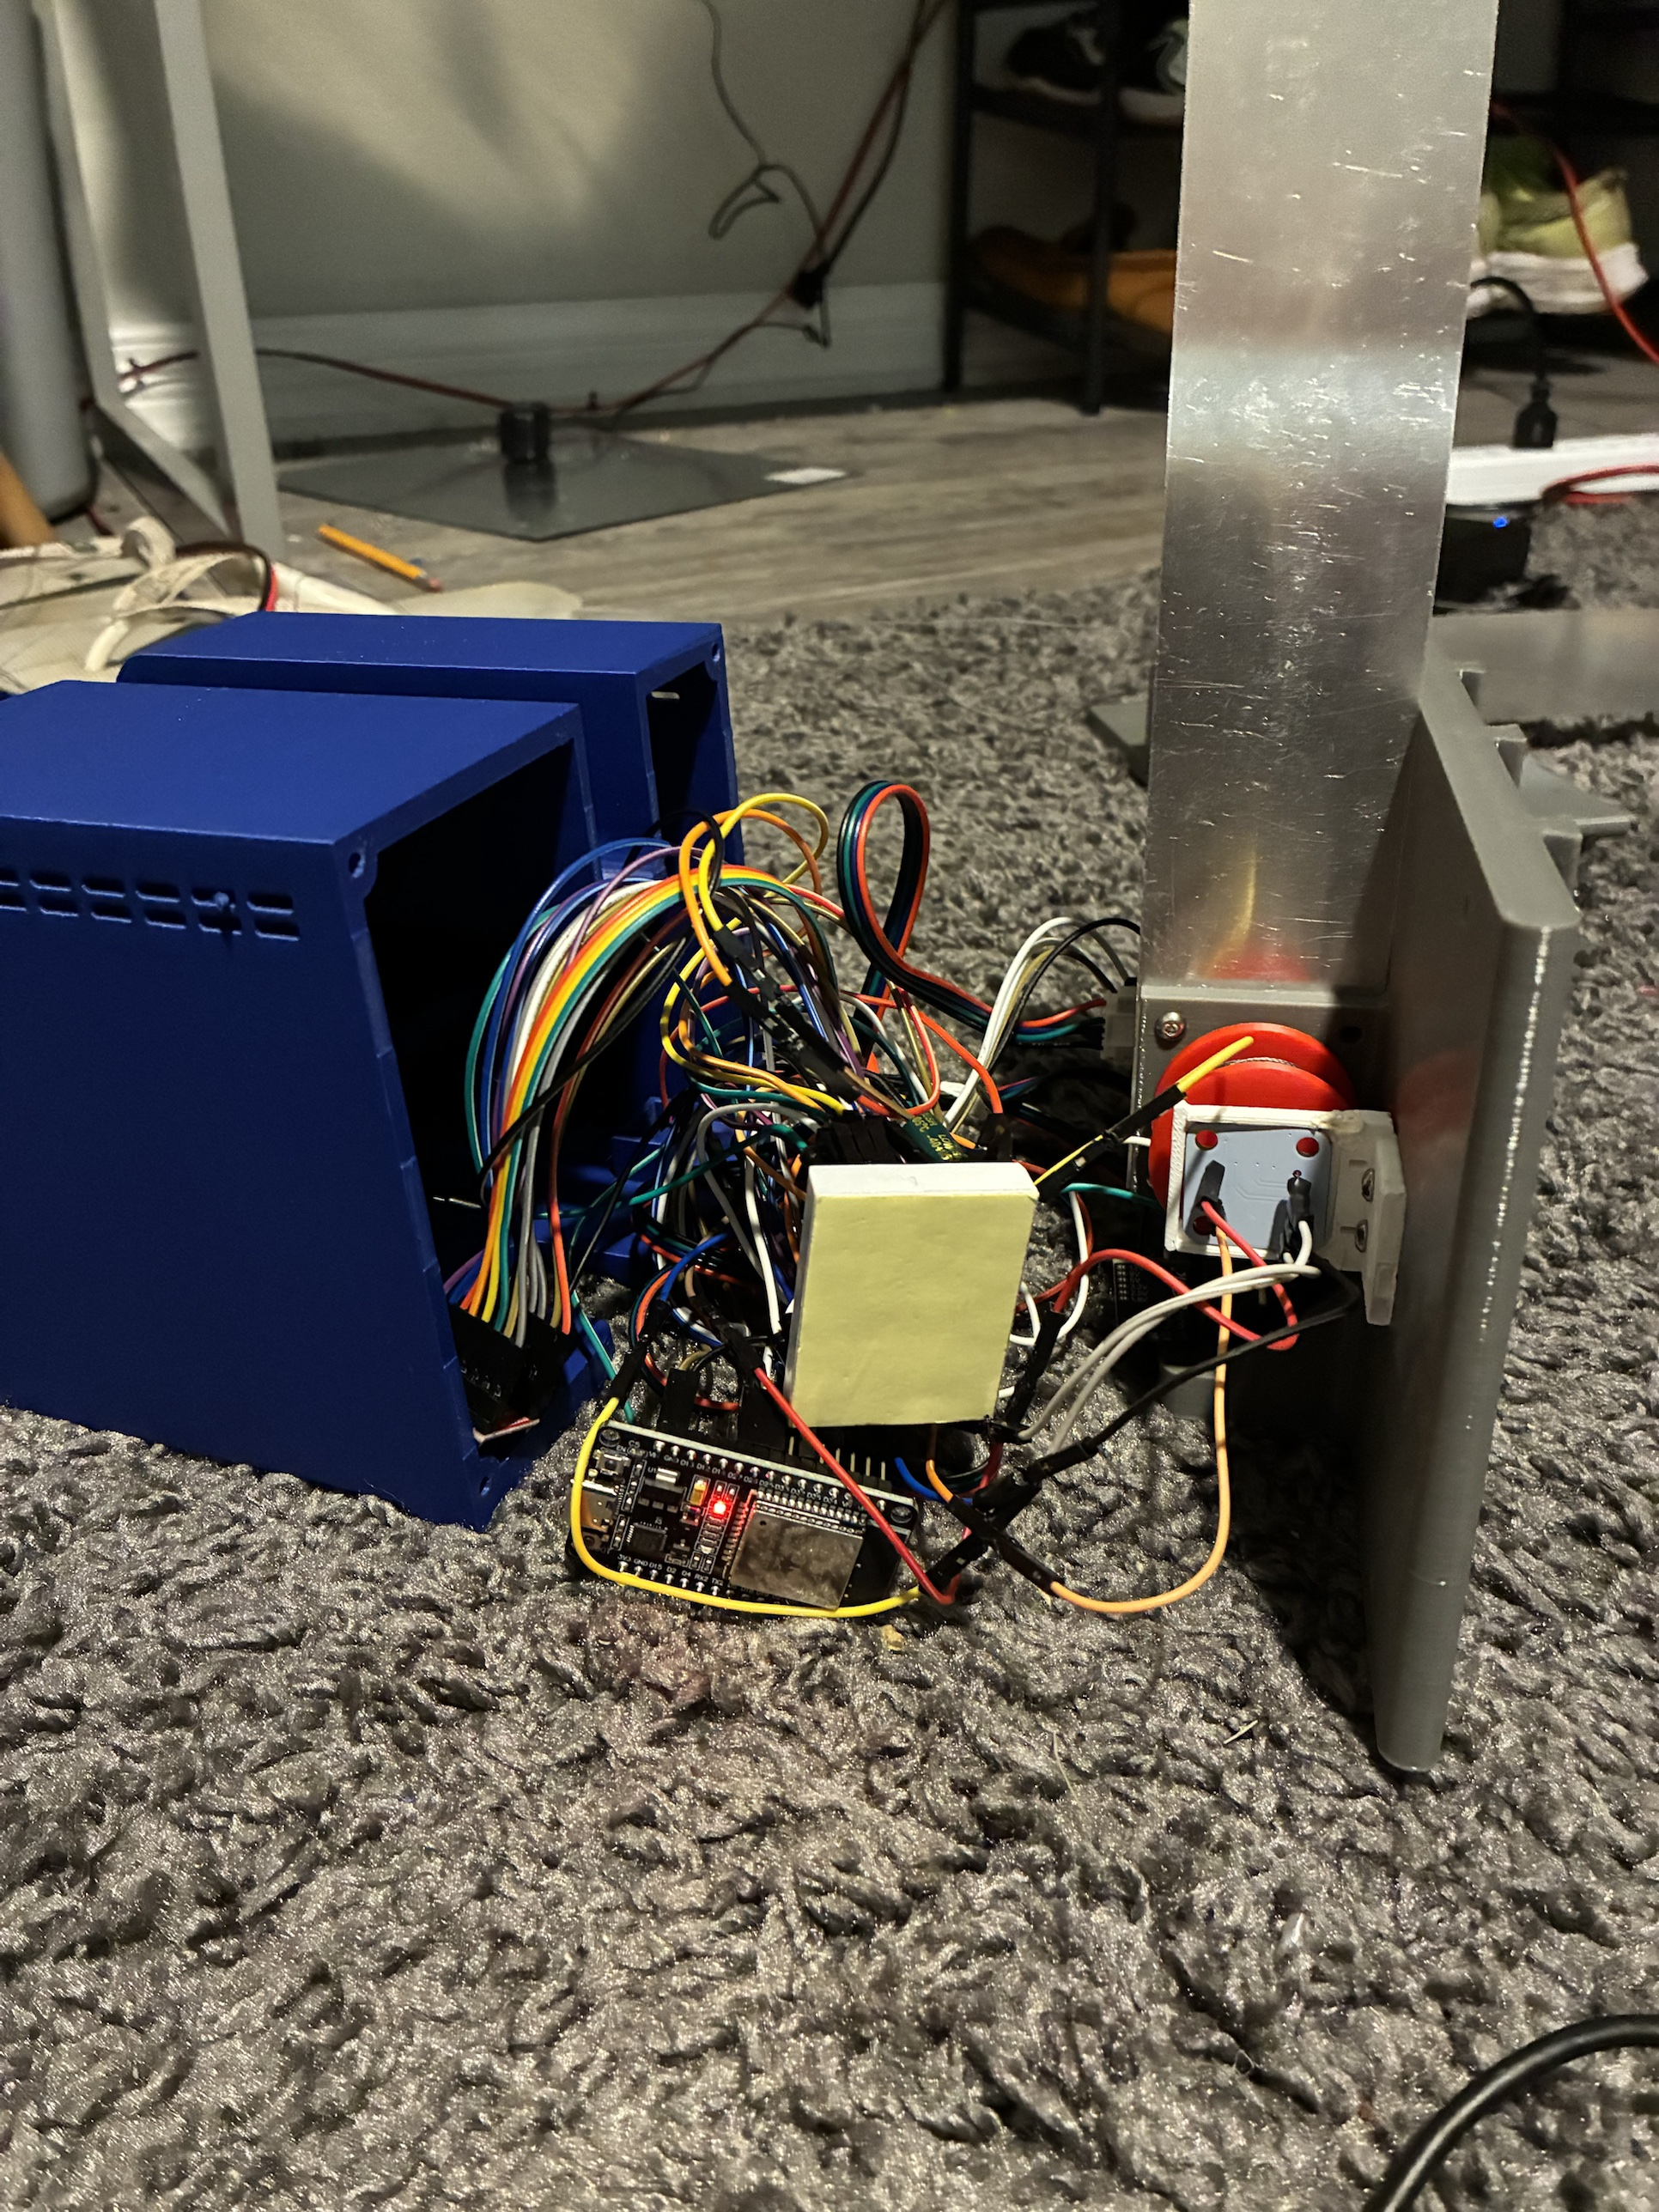
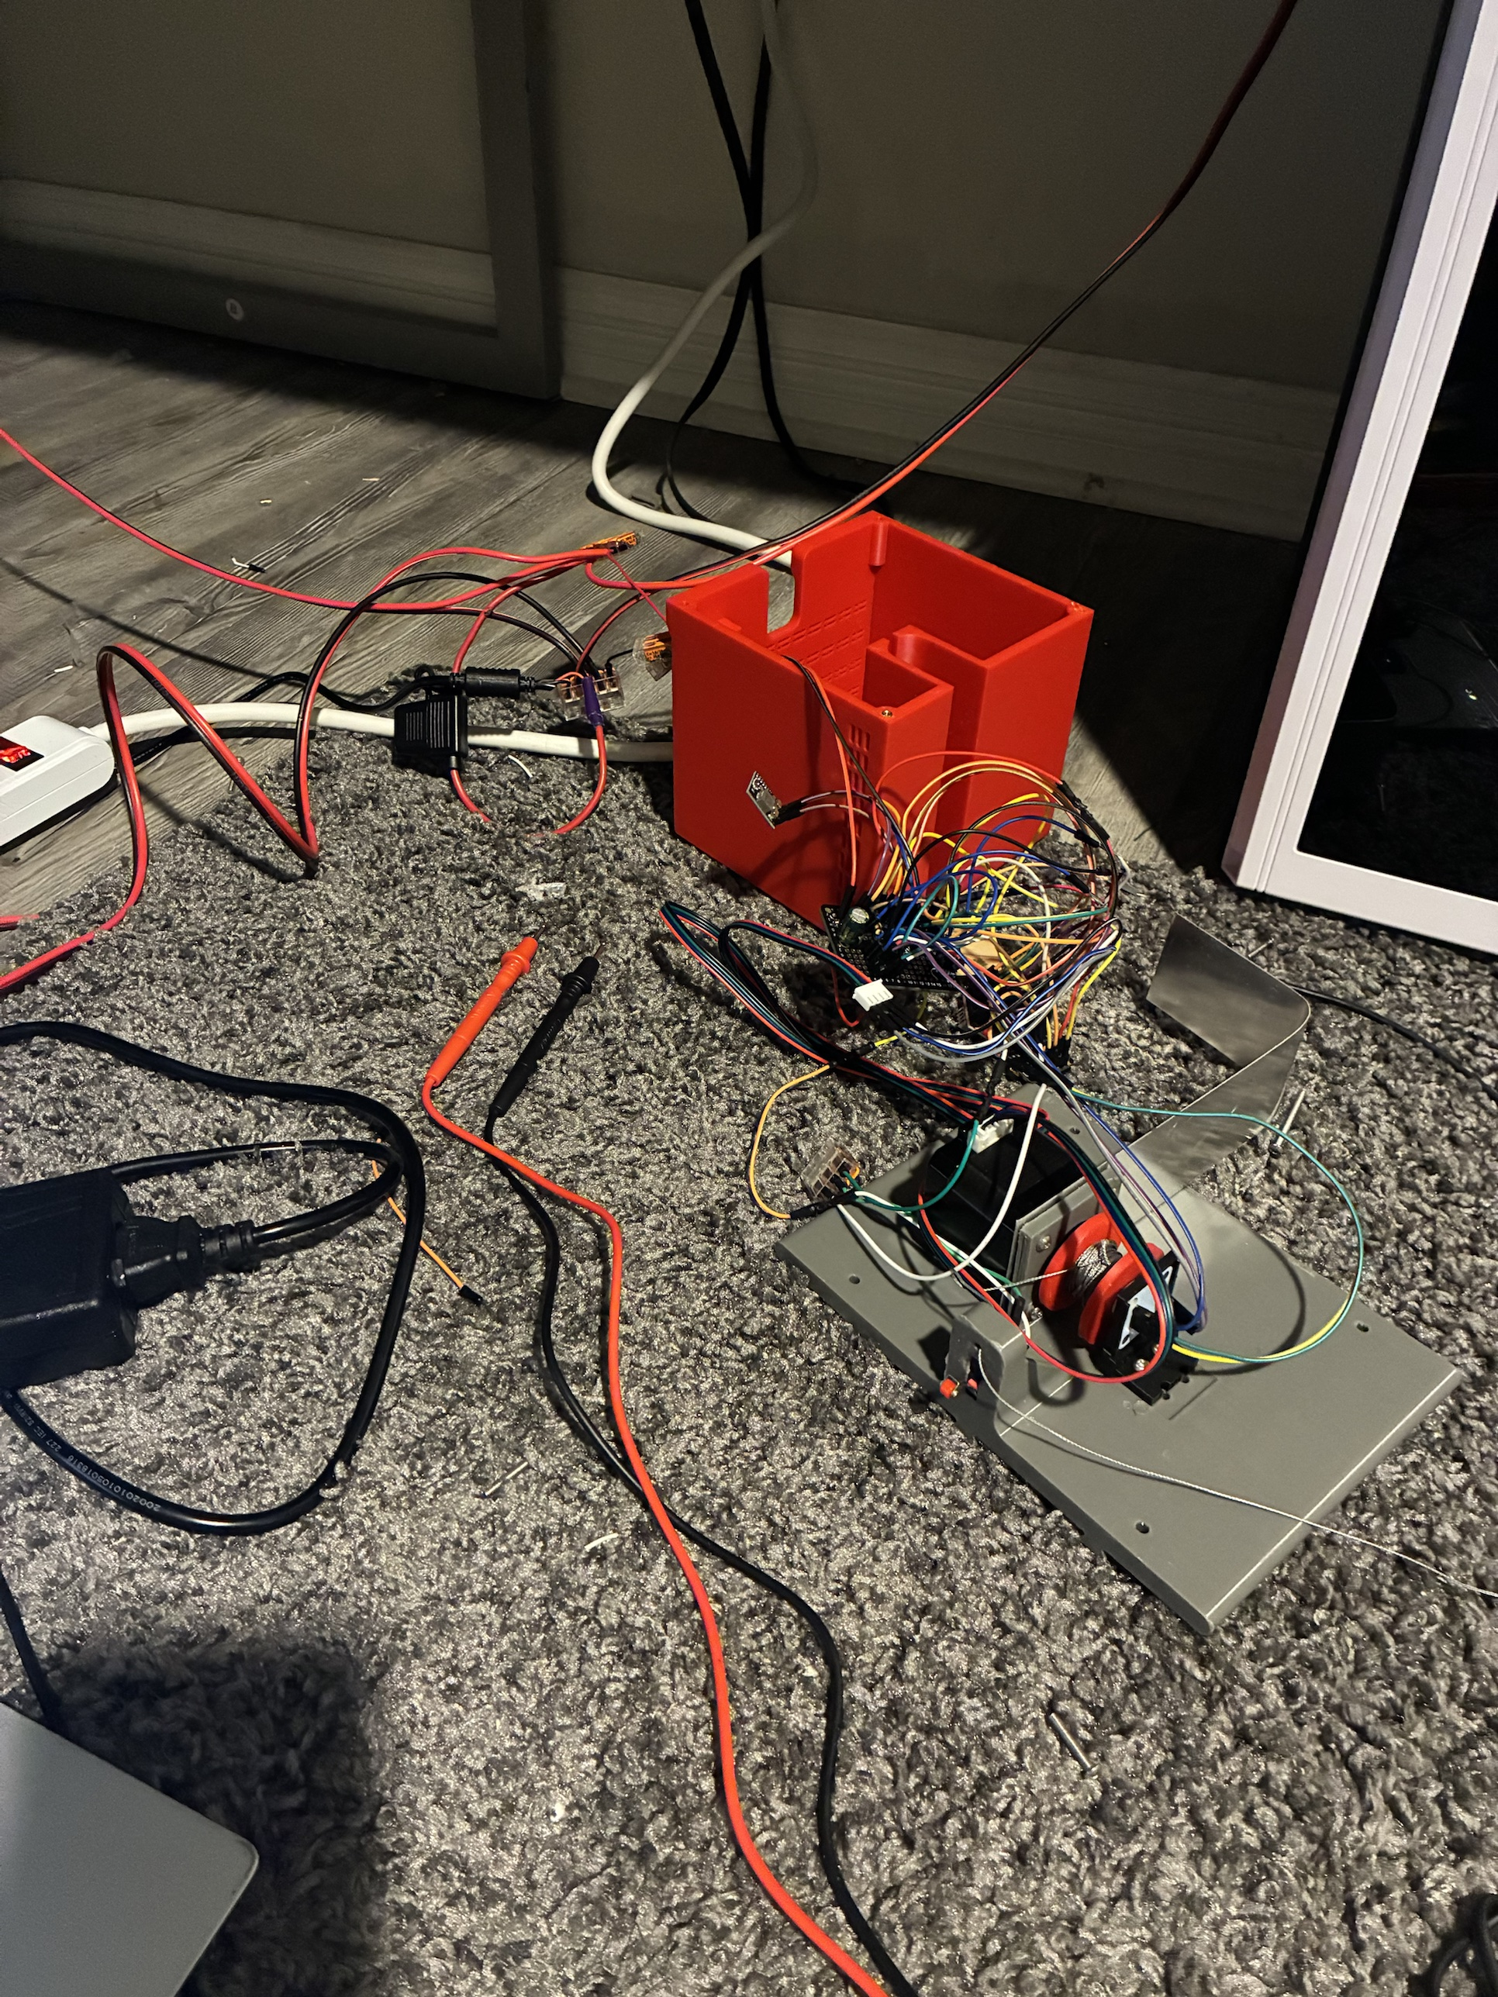
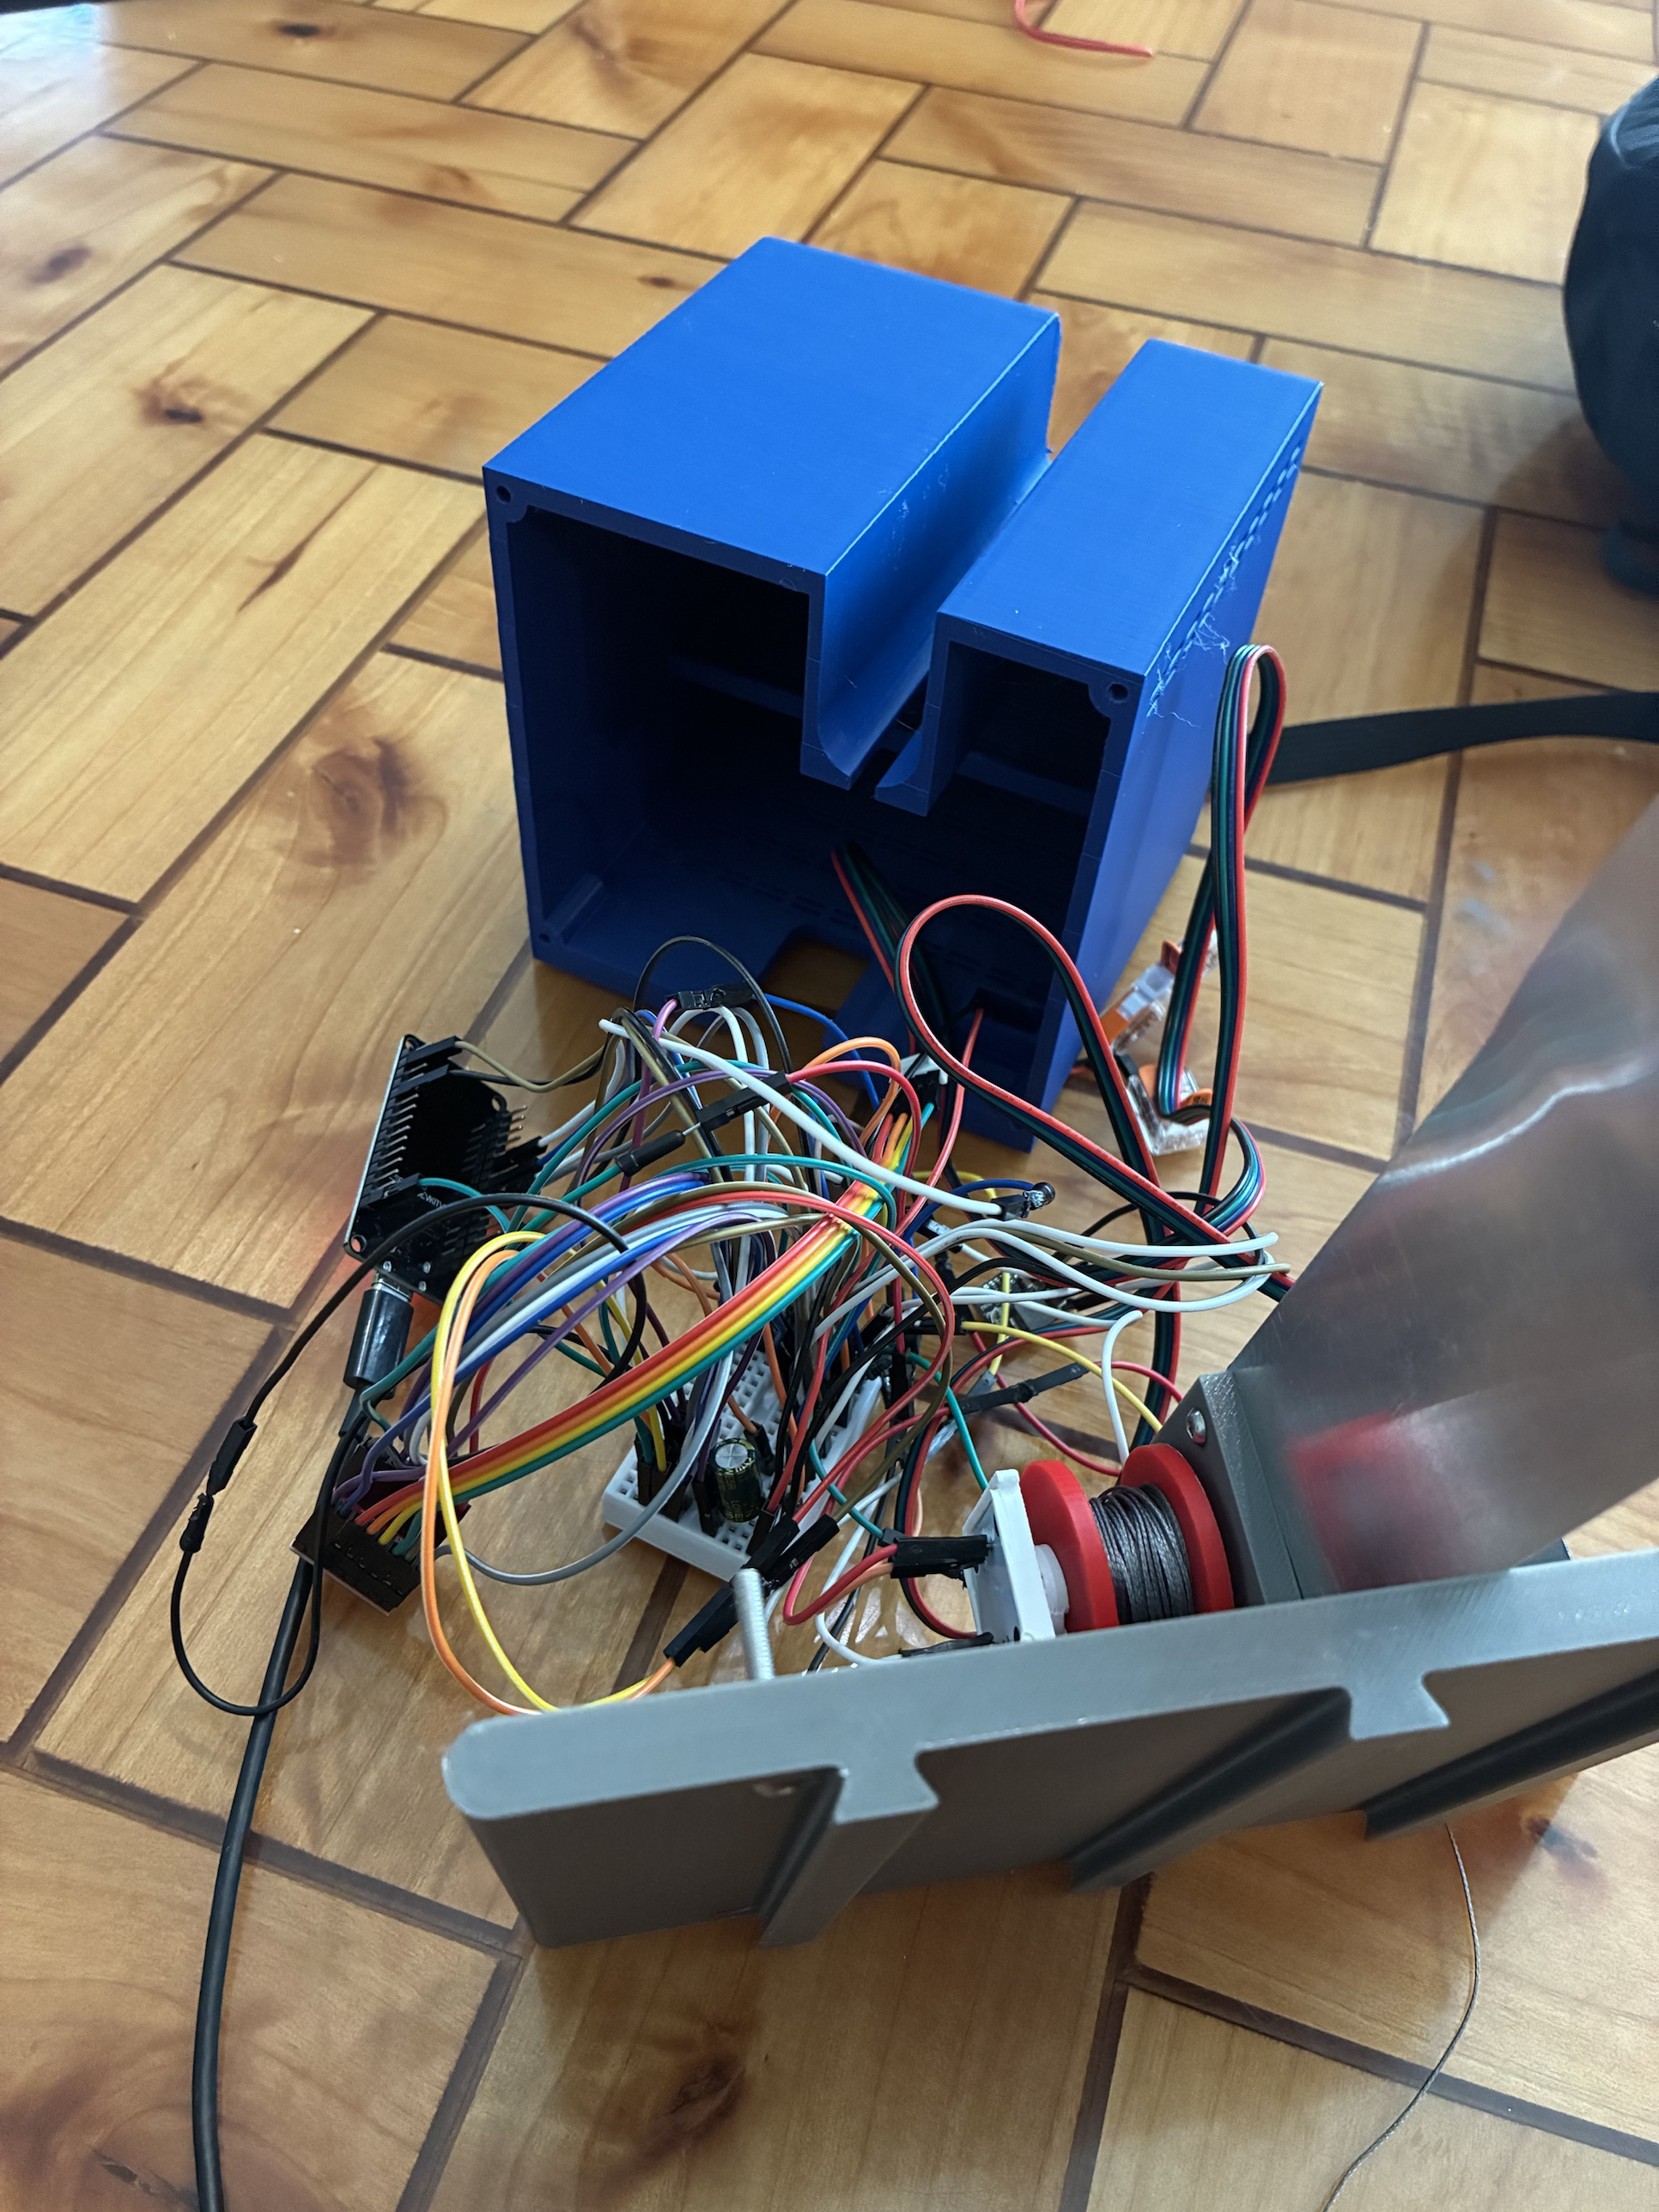
Station electronics on the bench: every check before the motor turns
MEASURED
Driver off at boot: a reset cannot move a motor
Homing switch LOW at rest, HIGH pressed or with a broken wire; the encoder answers at its address with the magnet detected
One spool turn within 60 encoder counts: PASS on both boards
A short found by the board's LED going out, traced to the switch pull-up
2 Red shell, fused 12 V lead
1 Station bench: dev board, driver, spool and end stop
3 Second board, shell open
Jasper Buntinx | RoomCleaner | Act 5 of 5: Build and bring-up (October 22-26)
Notes:
Talk track (55 s): The station electronics went through a bench script one part at a time, before the station firmware went on. Boot on USB alone with 12 V off: the board's LED on, the board cool. The homing switch reads LOW at rest and HIGH when pressed or when a wire breaks, the fail-safe wiring from Act 2. The encoder answers at its address and reports the magnet detected. Then 12 V on: the driver must stay off at boot, so a reset can never move a motor. Enable, jog a quarter turn each way, then one full spool turn, which must land within 60 encoder counts of a revolution: PASS on both boards, the dev board and the smaller one. One short announced itself by the LED going out; it traced to the switch pull-up. If asked: the sign the one-turn test prints is what the step and encoder signs in the config must agree on; 60 counts is 0.69 mm of line, about twice the error budget; the magnet reported detected with the Ø4 magnet.

Slide 21
Claw electronics on the bench: camera, battery, servo
MEASURED
[Jasper: screenshot of the live view on the phone]
Live video from the claw camera on the phone
Battery 7.2 V read through the divider, matching the meter
The servo only moved once it had its own hardware timer; the camera owned the first one
Still open: servo end points unmeasured; camera not yet calibrated
1 Housing open: regulators, battery, camera board
2 Live view from the claw camera
Jasper Buntinx | RoomCleaner | Act 5 of 5: Build and bring-up (October 22-26)
Notes:
Talk track (50 s): The claw electronics on the bench, Rev B. Three passes: the camera streams live video to the phone; the board reads its battery through the divider at 7.2 V, matching the meter; and the servo moves. The servo was the find: with the camera running it got no pulses at all. The camera's clock generator and the servo's PWM were sharing one hardware timer; the servo now drives from its own timer and the camera keeps the first. That is the kind of fault the schematic cannot show. Still open: the servo's open and closed end points are not measured, and the camera is not calibrated yet. If asked: the 5 V buck is set to 5.16 V and the board sees about 4.9 V after its diode; an earlier 4.33 V reading was a meter mis-read, not the pack; the board and the wiring were net-checked against the spec before any power went on.

Slide 22
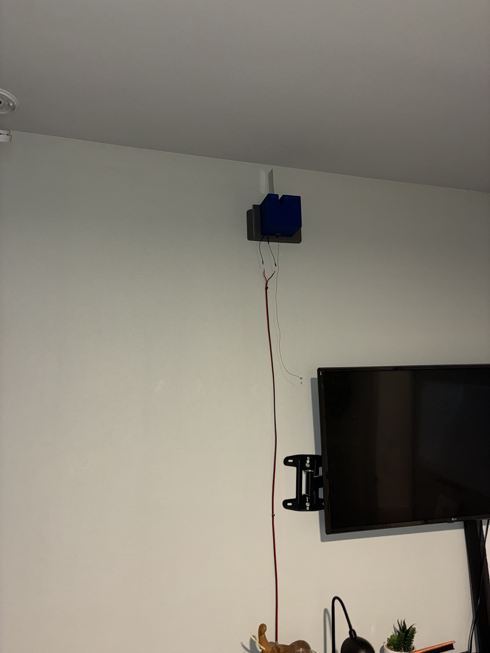
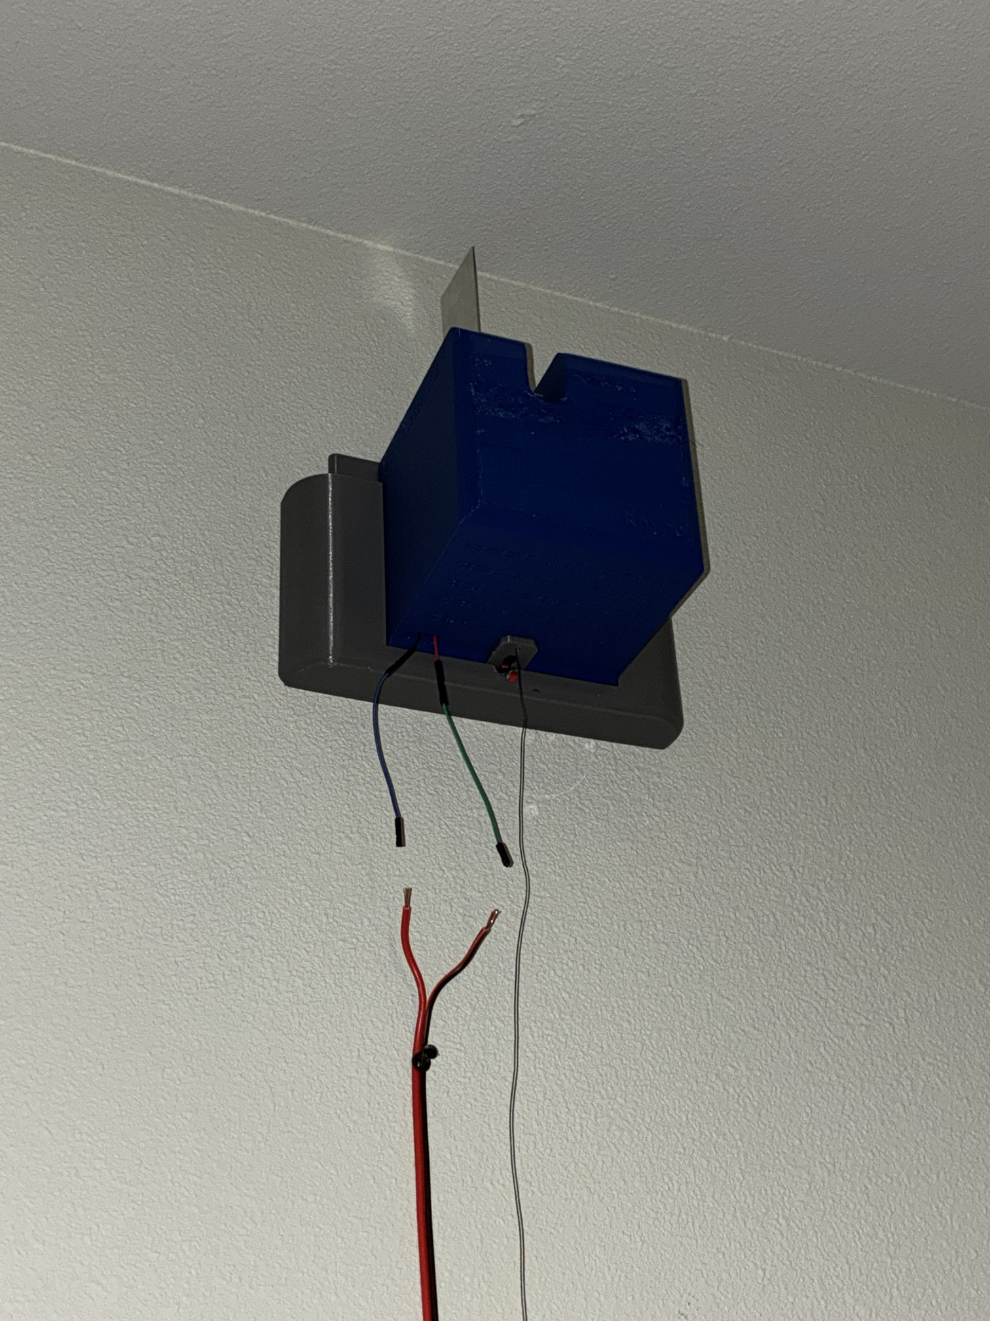
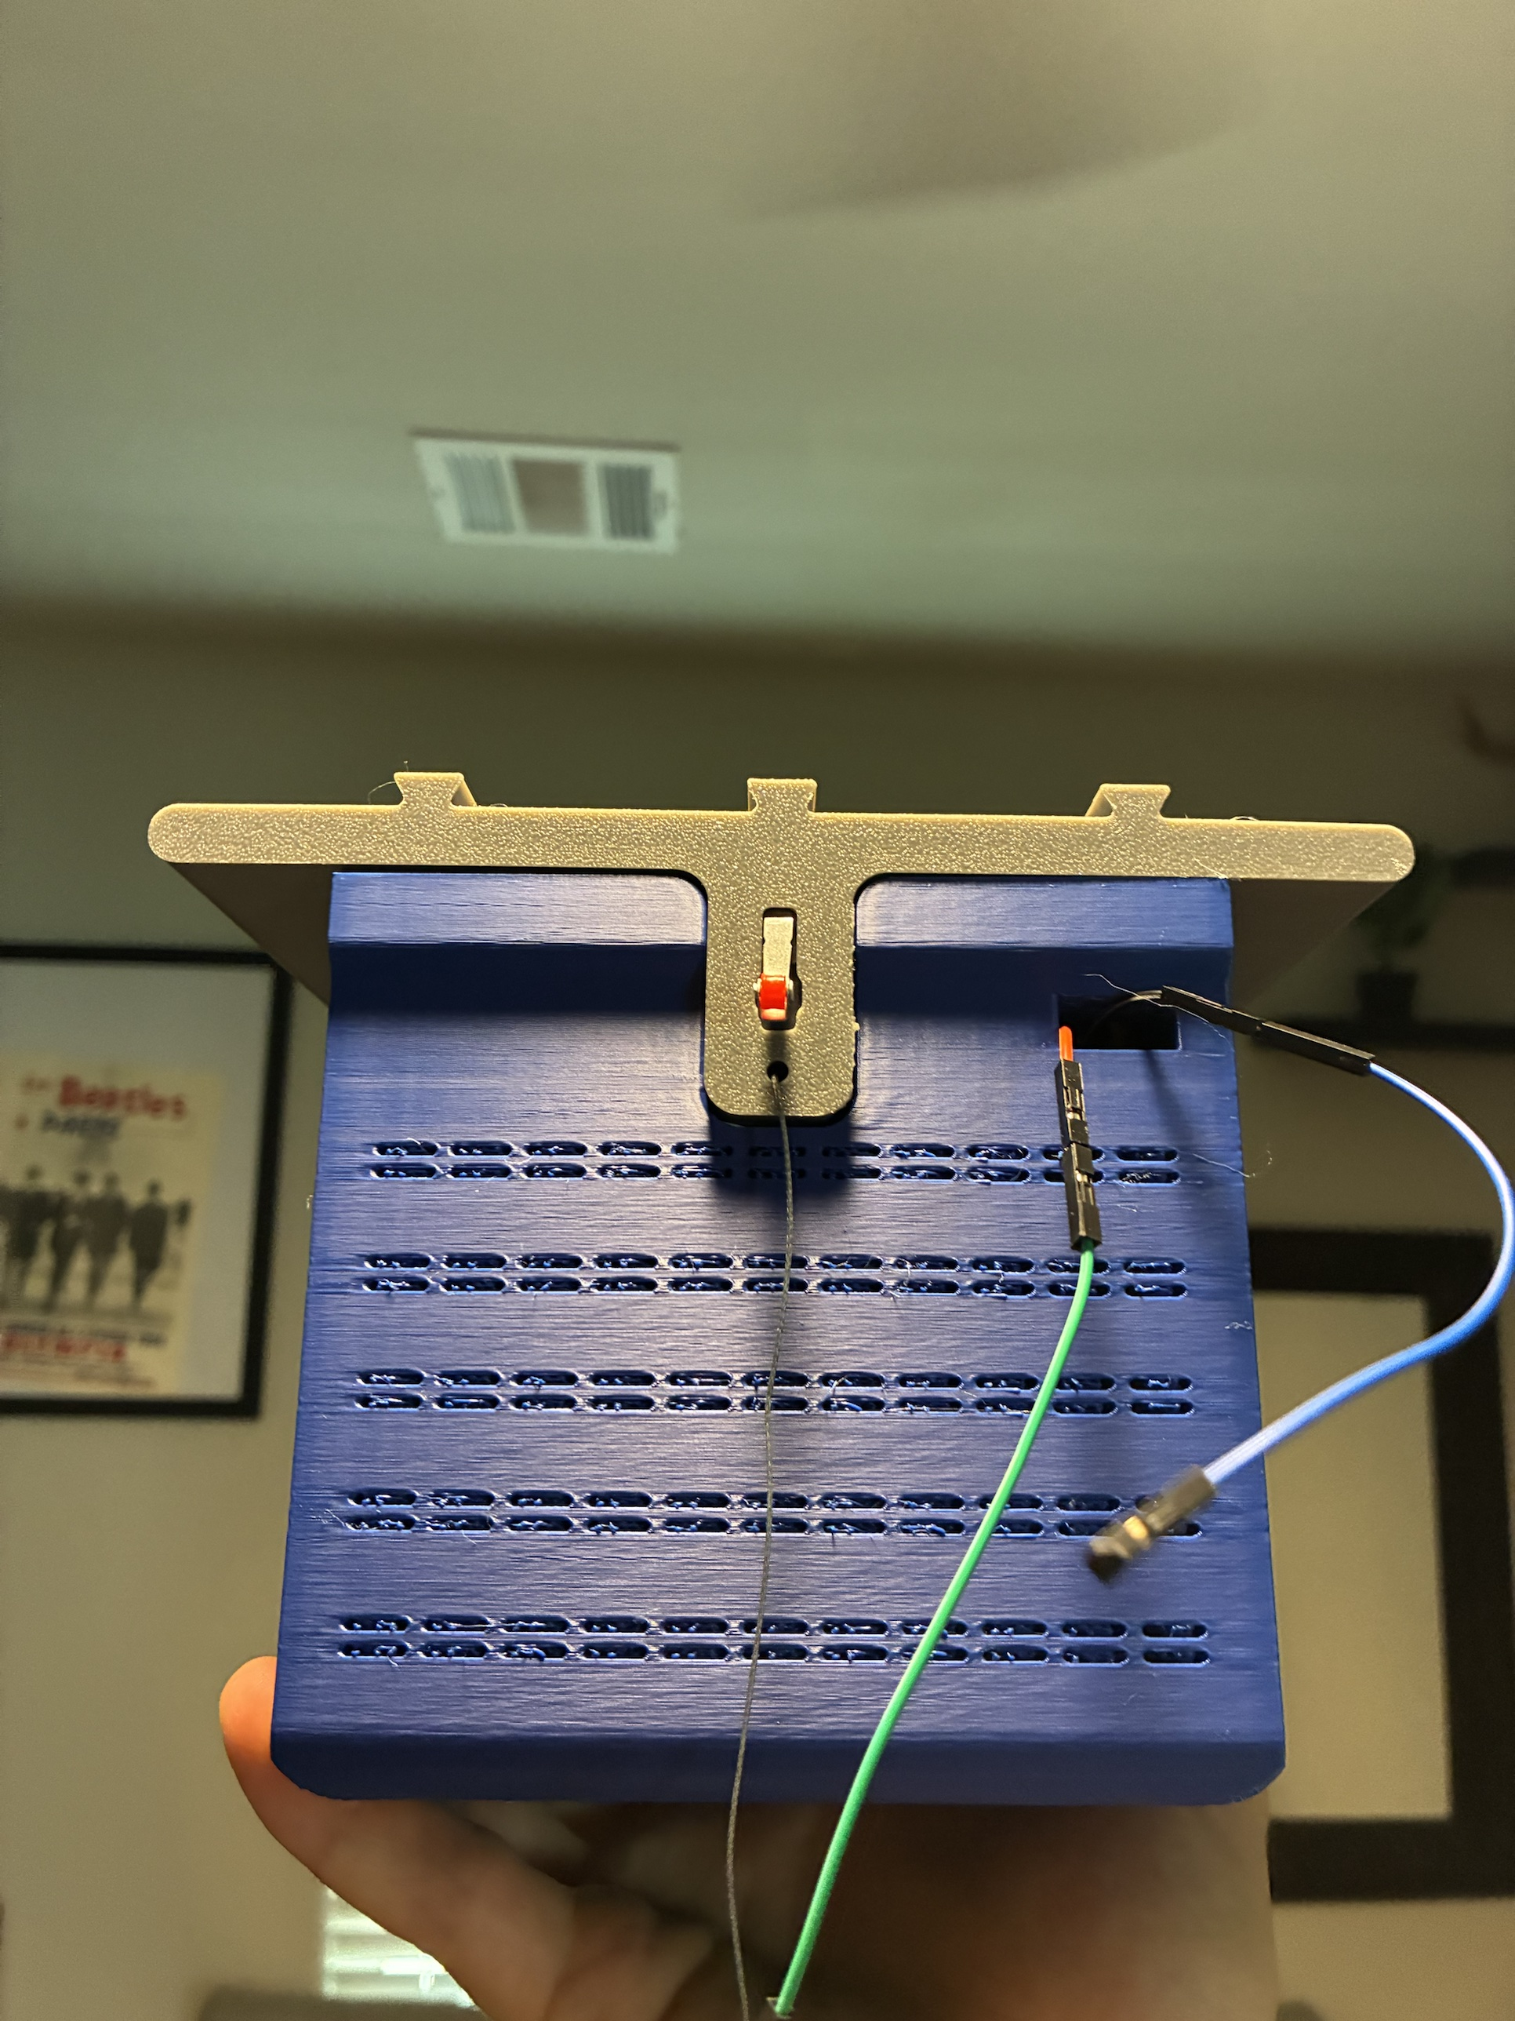
On the wall
First station in a stud on the TV wall: 12 V down the wall, the fin out through the slot in the top
Boxed stations boot and join Wi-Fi on their own; firmware updates arrive over Wi-Fi, so a boxed station never needs a USB cable again
The motor stays off until the phone arms it; a station accepts an update only while disarmed
2 From below: fin in its slot
1 Station mounted high on the TV wall, 12 V leads down
3 Shell front: vents, fin tab
Jasper Buntinx | RoomCleaner | Act 5 of 5: Build and bring-up (October 22-26)
Notes:
Talk track (50 s): The first station on the wall, in a stud on the TV wall, with the 12 V pair running down the wall and the fin out through the slot in the top of the shell. From below you can see the shell sitting on its grey wall mount, the slide-in from Act 3. Because a station is a sealed box up at the ceiling, it has to look after itself: it boots, joins Wi-Fi at a fixed address and keeps retrying until the router is up, and firmware updates arrive over Wi-Fi, so a boxed station never needs a USB cable again. The motor stays off until the phone arms it, and a station only accepts an update while it is disarmed, so an update can never drop a load. If asked: the one USB flash happens on the bench before boxing; the claw accepts updates only while its grip is open, for the same reason; the three stations are not on the network yet.

Slide 23
Three stations first: the triangle, the tilt, and no spare cable
SIMULATED
D: not mounted
C (1.68, 2.69), mid-wall
A and B in two corners of one wall, C mid-wall opposite: a 3.25 / 3.10 / 3.10 m triangle, nearly equilateral
Hanging from three of the four corner holes tilts the claw 5.5° at the start point; the lift aborts at 8°
Grips (5° limit) would be refused over 78 % of the floor; a three-hole housing at 120° brings the start tilt to 0.8°
No spare cable: a station fault drops the claw, so the floor under it stays clear and padded
2.74 m
(9 ft)
3.10 m
3.10 m
Start (1.68, 0.93), the centroid
3.25 m
A (0.05, 0.05)
3.35 m (11 ft) wall
B (3.30, 0.05)
Top view to scale; anchors at one height, 2.59 m; shaded: where three cables hold the claw
Jasper Buntinx | RoomCleaner | Act 5 of 5: Build and bring-up (October 22-26)
Notes:
Talk track (55 s): The first system test runs on three stations, not four. A and B sit in the two corners of one wall, C on the stud nearest the middle of the opposite wall, all at the same height, so the triangle is nearly equilateral and the usable area is as large as it can be; the claw starts at the centroid. Two costs. Tilt: the claw hangs from three of its four corner holes, so its centre of mass is off the centroid of the holes and it hangs 5.5° over at the start; the lift aborts at 8°, and the grip check refuses above 5°, which would refuse grips over 78 % of the floor. A housing with three holes at 120° brings the start tilt to 0.8°; until then, three-station runs are for movement and calibration, not pickups. Redundancy: with four cables a failed station leaves three; with three, a station fault drops the claw, so the floor is clear and padded. If asked: the entries only seed the calibration, which fits the geometry itself; a stud 0.2 m off the midpoint leaves about 0.12 m after the fit; all simulated, not yet run.

Slide 24
Results against targets, and what is still planned
MEASURED
CALCULATED
PLANNED
Target | Goal | Current | Evidence | Status
Lift capacity | 1.50 kg with jeans | 1.56 kg; 1.1 kg at 0.5 × holding torque; 1.98–2.80 kg with the 3:1 stage | Calculated | Marginal; pull test
Grip for jeans | 17.7 N per jaw | 13.3–25 N | Calculated | Short at narrow grabs
Claw mass | 0.45 kg | 0.60 kg with battery | Weighed | Not met
Motor temperature | Below 60 °C | 56–59 °C prototype fin | Calculated | Marginal; hold test
Weakest link | Motor slips first | Set screw may slip first; tab at 1.2 × | Calculated | Two fixes
Working area | Floor, 0.2 m wall margin | All but 0.2 m at the walls | Calculated | Met in design
Wiring | One cable per station | One 12 V pair; 0.51 V drop | Built | Met (bench PASS)
Station bench test | Switch, encoder, driver, one turn | PASS on both boards | Measured | Met
Claw bench test | Camera, battery, servo | Live view; 7.2 V; servo moves | Measured | Met
Accuracy | ≤ 2 mm cable mismatch | 40 ms skew budget gives 2 mm | Not measured | To be tested
Obstacle map in the app | Drawn shapes kept out of every path | Built; two findings being fixed | Simulated | Planned
First three-station lift | Self-check, calibration, short move | Not yet run | None | Planned
Cost | Hobby budget | [total] | Receipts | Open
Jasper Buntinx | RoomCleaner
Notes:
Talk track (55 s): Back to the targets, with the evidence for each. Measured so far: the claw mass, the two bench tests and the wiring. Three are not met: grip for jeans at narrow grabs, claw mass at 0.60 against 0.45, and the weakest link, which has two cheap fixes. Two are marginal and the next tests decide them: lift capacity, where the gear stage is the answer if the pull test comes in low, and the prototype fin's temperature. Planned: the map of obstacles in the phone app is built and under independent verification, with two findings being fixed before it runs on hardware; and the first three-station lift, which is the next milestone. If asked about the map: the user draws shapes on a top view of the room and every cable and the claw body are checked against them before a move; the two findings are a descent that could enter a refused shape and a calibration detour that strands the claw at the top of the workspace. [[total cost]]

Slide 25
What I would do first next time, and what happens next
Good decision | Result
One controller per winch | Five times less wire; each station tested alone
Camera calibration instead of bead homing | Whole room reachable; caught on paper before building
A mass budget per part | The claw was weighed; the gear stage sized to the lift margin
Next
Flash and commission the three stations on the wall
Pull test at 1.5 A; enter the measured limit in the planner
First lift: self-check, calibration, a short move with 1 lb
Then the robot scans its own room: height map and obstacle proposals in the app
A brake or non-backdrivable stage, so a power loss cannot drop the claw
Poor decision | Result
Mass not tracked through four claw versions | v6 reached 4.6 times its budget in CAD; the claw is 0.15 kg over
Prototype fin cut from scrap sheet | Only 1–4 K of thermal margin
Build and test week ending on presentation day | System results arrive at the last minute
Half the time: pull-test one winch and weigh a mock claw in week 1; kill the central board, bead homing and the fingers on paper; prove one station first
Jasper Buntinx | RoomCleaner
Notes:
Talk track (55 s): Three decisions I would make again: a controller in every station, which is why the bench week worked station by station; the camera calibration instead of bead homing, killed on paper before anything was built; and a mass budget per part, late, but it is why the claw got weighed and the gear stage got sized. Three I would not: not re-checking the claw's mass through four versions; cutting the prototype fin from scrap sheet, which left one to four degrees of margin; and a build week that ends on presentation day. In half the time I would pull-test one winch and weigh a mock claw in week one and prove one full station before copying it. Next, in order: flash and commission the three stations, the pull test, the first lift with a pound, and then the robot scans its own room and proposes the obstacles in the app. Leave this slide up for questions. If asked: the lighter redesign takes about 60 % of the plastic out of the station and brings the claw to its 0.45 kg budget, lifting the jeans margin from 4 % to about 16 %.

