Slide 1


Chinese BERT Sentiment analysis
A closer look at the Taiwanese local elections
Jasper Hewitt S111926019

Slide 2

Problem statement
ICI capstone project students came to us for help
Create a Chinese BERT model for sentiment analysis on Weibo
But how?
Because the capstone project is already looking at Weibo, I decided to look at Twitter

Slide 3
Research question
Research question: How to best fine-tune a Chinese BERT model to do sentiment analysis about the Taiwanese local elections on Twitter?
create a table with the accuracy of different training possibilities to find the most accurate option.
Use this accurate model to do the sentiment analysis on Twitter.

Slide 4
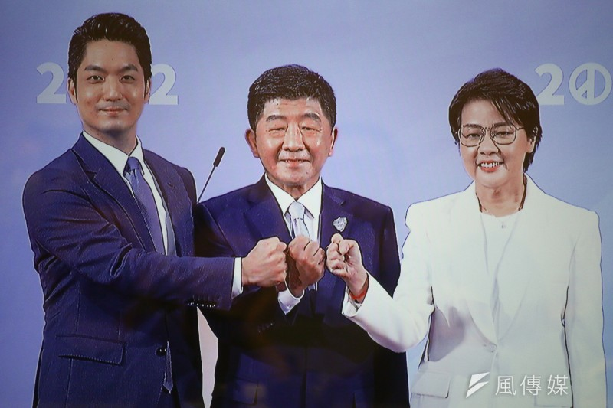
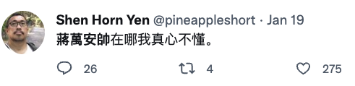
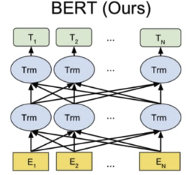

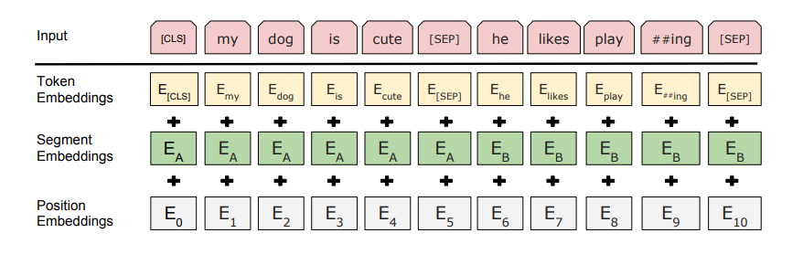
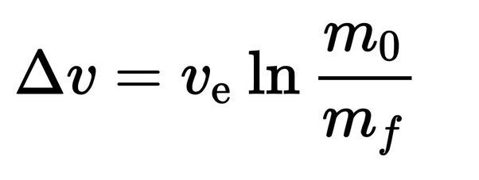


The power of BERT
Negative!!!!

Slide 5



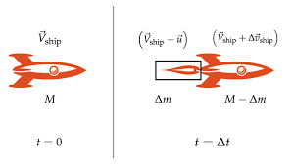
literature review
Legal Bert
BIObert
SCIBERT
BERTweet

Slide 6
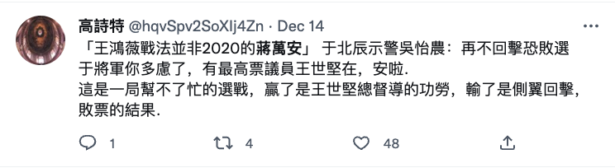





BERTweet! (Nguyen et a. 2020)
Problem solved!!!
Negative, positive
Positive, negative

Slide 7




BERTweet! (Nguyen et a. 2020)
NOT!!
I don’t speak Chinese!

Slide 8

Chinese BERT models
- This repository contains several Chinese
models.
- But none of them have been fine-tuned for sentiment analysis yet. So that it the part I will have to do myself
https://github.com/ymcui/Chinese-BERT-wwm

Slide 9

Fine-tuning: Sentiment analysis challenges
Luckily, there have been several challenges in Chinese sentiment analysis on Weibo, so I can easily access big databases (33000 posts) with manually labelled data (https://smp2020ewect.github.io/). I will play around with different datasets and different models to find the highest possible accuracy for my project.

Slide 10
Methodology
Step 1: Pick a model
hfl/chinese-bert-wwm vs hfl/chinese-roberta-wwm-ext
Step 2: fine-tune the model
Find a solution for our unbalanced training data
More data, add class weights, upsampling, and downsampling,
Step 3: data collection
Find a twitter scraper
Step 4: data visualization
Pie charts, day-by-day plot.

Slide 11
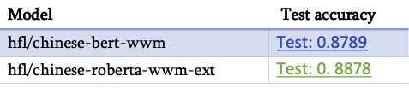
Picking a model
As expected. Roberta performs better than BERT

Slide 12
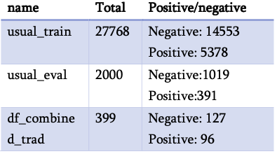
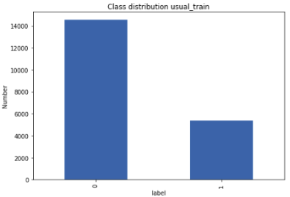
Step 2: fine-tune the model
Unbalanced training data
Datasets originally had 6 classes, which we converted into 2 (pos/neg)
See paper for more info

Slide 13
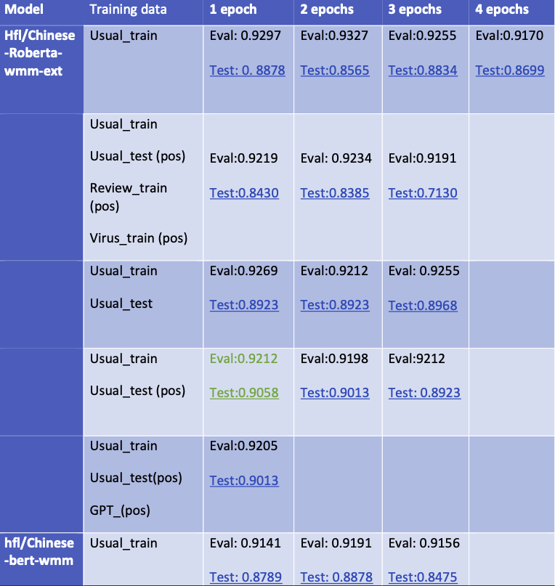
Step 2 fine-tune the model
Step 2.1, find additional positive data and explore different combinations of training data to see what yields the best results
Additional datasets (virus, usual_test, review_train)
ChatGPT?

Slide 14


Getting training data from ChatGPT?
Would it be possible to extract positive sentences
From ChatGPT?

Slide 15
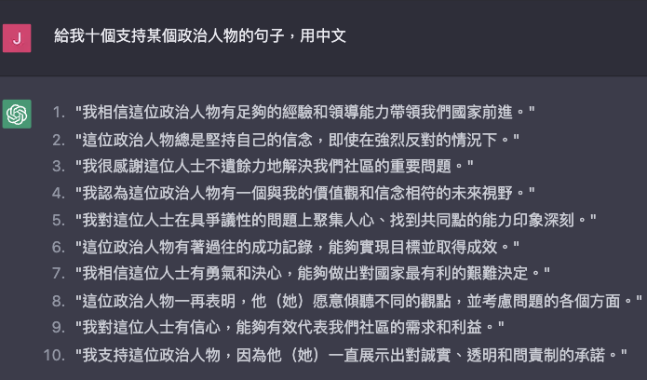
It’s looking promising

Slide 16
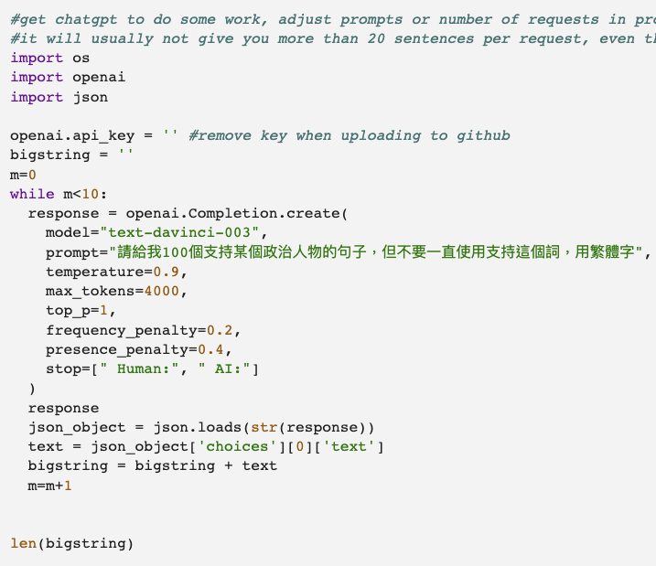
one big while loop in

