Slide 1
NOVABANK | PROJECT 4
Predictive Retention via Targeted Engagement Campaigns
Under a fixed contact budget, target the customers most likely to engage — capturing retention value while wasting fewer calls.
Quantic MSBA | Analytics Methods & Frameworks
Team: Jasper Gelten • Partner
Notes:
Project reframes the assignment from a literal churn flag (not present in the data) to Predictive Retention via Targeted Engagement Campaigns on the UCI Bank Marketing dataset, preserving real labels.

Slide 2
Problem framing and chosen KPIs
• Margins are under pressure; outbound campaign calls deepen relationships but each call has a cost.
• Goal: under a fixed contact budget, predict who is most likely to engage so fewer calls are wasted and more retention value is captured.
• Subscription is treated as a retention signal — real labels, no synthetic target (UCI Bank Marketing, ~41k customers, 11.3% base rate).
• KPI 1 — PR-AUC: primary metric under ~11% class imbalance; ROC alone overstates performance in the imbalanced regime.
• KPI 2 — Expected Value at top-K contacts: ties model output directly to the campaign budget and the FP/FN cost trade-off.
Source: notebooks/01_problem_framing.ipynb
Notes:
Two KPIs chosen deliberately: PR-AUC handles the 11% imbalance; EV at top-K connects the model to the business decision. Both appear on every downstream slide.

Slide 3
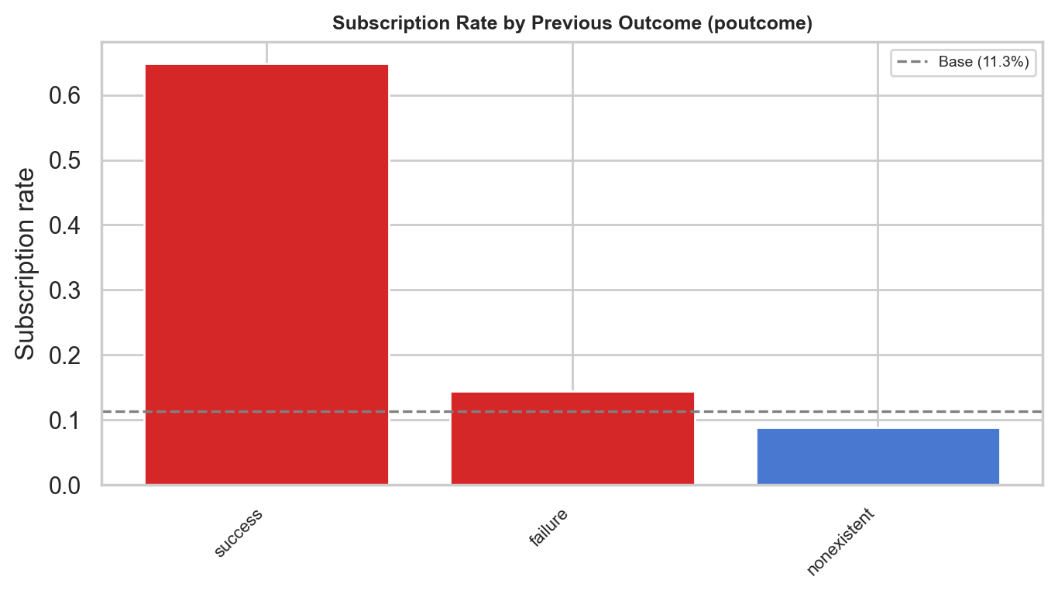
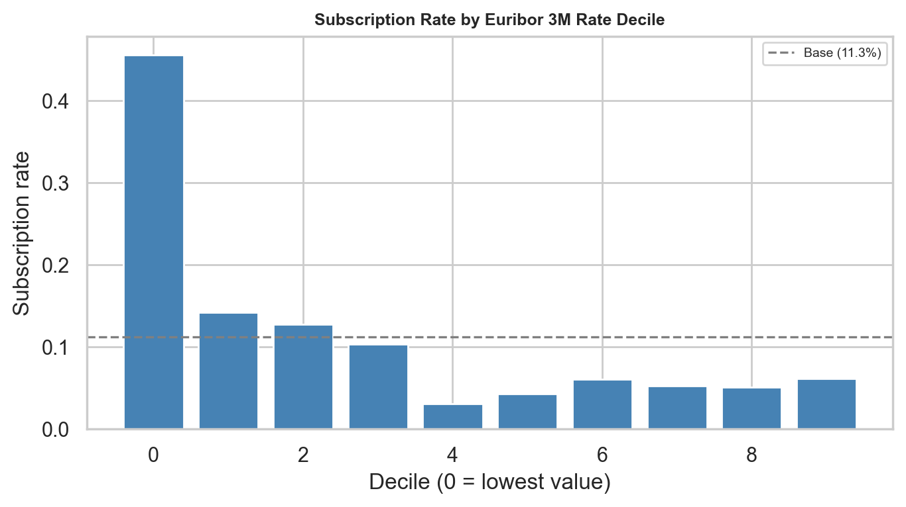
Data and EDA — strongest signal: prior campaign success
• Prior campaign success (poutcome=success) is the single strongest lift signal — a customer who said yes before is the best prospect.
• Macro context matters: low euribor3m periods coincide with higher deposit conversion (deciles 1–3 carry most of the positives).
• Train-only EDA; test parquet untouched. 12 figures saved with 03_eda_* prefix support the full narrative.
Source: notebooks/03_eda.ipynb
Notes:
EDA findings hold across the train set only — test data is held out for modelling. Macro and prior-outcome signals together motivate the feature set carried into the baseline and improved models.

Slide 4
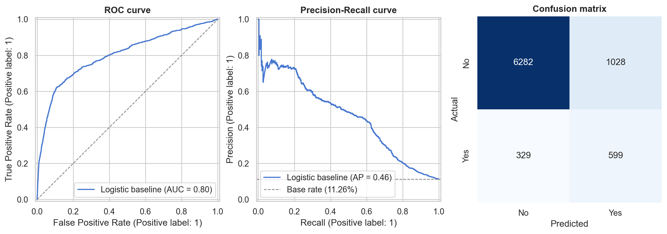
Modelling approach — leakage discipline first
• Two models built deliberately: a leaky benchmark (uses call duration, known only post-call) and a deployable model (no leak).
• Leaky ROC 0.944 vs. deployable ROC 0.801 — a 0.143 gap that quantifies the cost of using a feature you cannot have at decision time.
• Deployable line is the production baseline; LightGBM is then introduced to clear that bar via Optuna tuning and isotonic calibration.
• Calibration is non-negotiable: every downstream EV figure multiplies probability by money — miscalibrated scores distort the recommendation.
Source: notebooks/04_baseline_model.ipynb
Notes:
The leaky-vs-deployable contrast is the headline methodological signal. It shows we know what should not be in the model and why, and it gives the LightGBM step a concrete bar to clear.

Slide 5
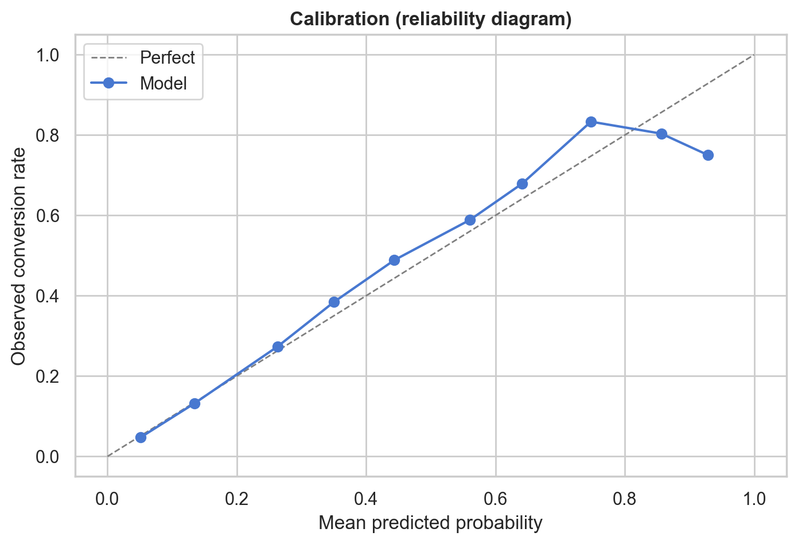
Model performance — calibrated LightGBM clears the bar
Model | PR-AUC | ROC-AUC | Brier
Logistic baseline | 0.460 | 0.801 | 0.162
LightGBM (calibrated) | 0.495 | 0.817 | 0.074
• LightGBM lifts PR-AUC from 0.460 to 0.495 over the logistic baseline and cuts Brier score by 54% (0.162 → 0.074).
• Reliability diagram (right) confirms predicted probabilities track observed frequencies across the score range.
• Calibrated probabilities make the €/contact EV math defensible for the decision rule on the next slide.
Source: notebooks/05_improved_model.ipynb
Notes:
Brier score is the load-bearing improvement: the EV calculation in the decision framework multiplies probabilities by € values, so a 54% improvement in calibration directly improves trust in the EV figure.

Slide 6
Customer segmentation — three structural cohorts
Segment (campaign tier) | N | Conversion rate | Avg age | Dominant channel | Mean euribor3m
warm_returners | 1,243 | 62.9% | 41.8 | cellular | 0.98
engaged_cellular | 9,613 | 19.2% | 39.4 | cellular | 1.20
cold_pool | 22,094 | 4.9% | 40.2 | cellular | 4.82
• warm_returners (n=1,243, 63% conversion): prior-success base; the first call list — almost guaranteed wins.
• engaged_cellular (n=9,613, 19% conversion): mid-tier mobile-reachable customers; the volume slice that the LightGBM ranks within.
• cold_pool (n=22,094, 5% conversion): low-probability mass; split deterministically by channel into cold_cellular and cold_telephone.
• k=3 chosen via silhouette + elbow; the channel split is an explicit operational rule, not a fourth cluster — methodology is openly hybrid.
Source: notebooks/06_segmentation.ipynb
Notes:
An earlier k=4 result was overridden after review: the fourth split was just a contact-channel rule, not a structurally distinct cluster. k=3 plus an explicit channel rule is the honest framing.

Slide 7
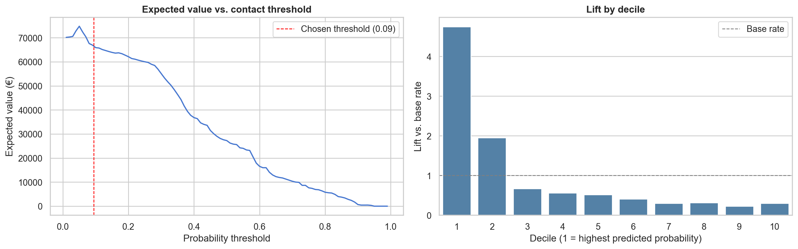
Decision rule — top-20% contact policy
• Threshold: probability ≥ 0.094 (top 20% of scored customers).
• Contacts: 1,648. Successful: 622. Wasted: 1,026.
• Expected value: €66,400 at €5/contact, €120/conversion.
• Top decile lift: 4.75× vs. base — 47% of converters captured in 10% of contacts.
• Budget-constrained rule chosen over EV-max: predictable capacity planning across scoring cycles, even as the score distribution shifts.
Source: notebooks/07_decision_framework.ipynb
Notes:
Memo number: €66,400 EV on a single top-20% contact list. A pilot RCT with a 50/50 within-decile control split is required before scaling — rollout decision criteria are documented in notebook 07.

Slide 8
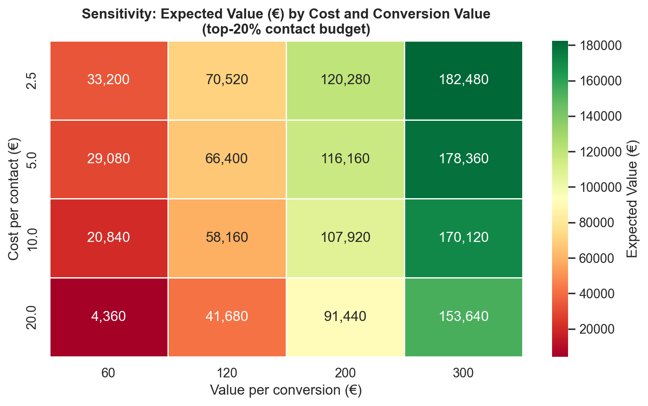
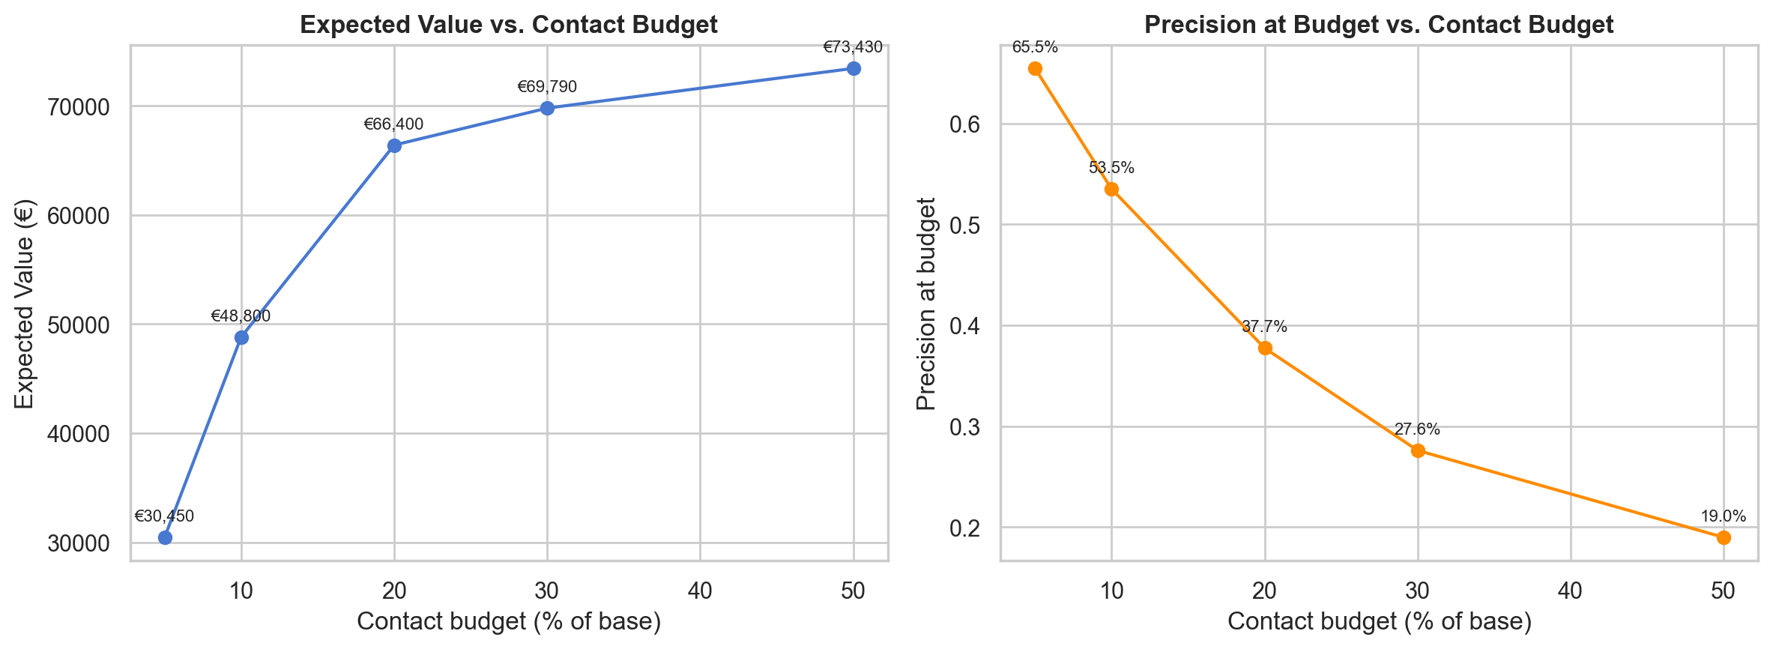
Sensitivity — what holds and what shifts
• Holds: every cell of the 4×4 cost/value grid (€2.5–€20/call × €60–€300/conversion) returns positive EV — recommendation direction is robust to plausible business-assumption changes.
• Shifts: a recession scenario (base rate halved 11.3% → 5.9%) cuts EV to €30,855 — still positive but ~54% lower.
• Risk to flag: campaign economics depend on macro stability; revisit the threshold if observed base rate moves more than 2 percentage points.
Source: notebooks/08_sensitivity_analysis.ipynb
Notes:
Sensitivity confirms the recommendation under cost/value uncertainty but flags genuine macro risk. The recession case is the dominant stress factor and the trigger for re-tuning the threshold.

Slide 9
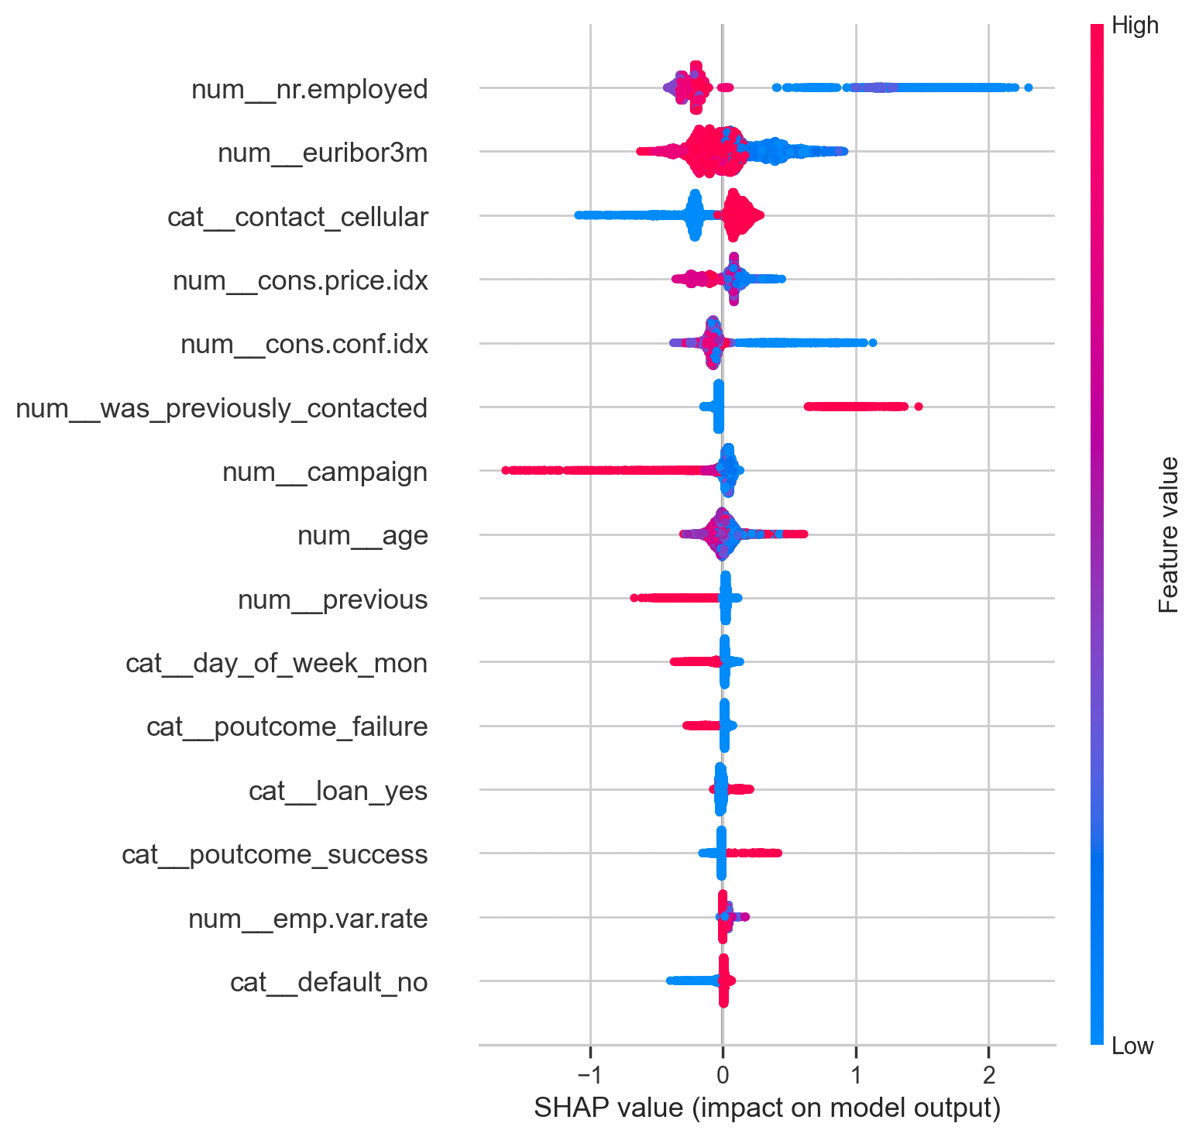
Explainability and fairness — defensible to compliance
• Top SHAP drivers: nr.employed, was_previously_contacted, euribor3m — macro state plus prior engagement, no proxy variables.
• Fairness: 60+ band converts at 45.7% vs. ~10% for working-age — a structural signal, not bias. Model mean_predicted 46.7% matches actual within 1pp.
• Top-20% contact rate by age band is reported as observation, not verdict; small subgroups (illiterate n=2) flagged with caveats.
• Surrogate fallback: depth-3 decision tree, 8 leaves, R² 0.877 vs. LightGBM scores — usable as a documented manual ruleset if the model is unavailable.
Source: notebooks/09_explainability_and_fairness.ipynb
Notes:
Compliance has three artefacts: per-customer SHAP explanations, group-level fairness tables across age and education, and a depth-3 surrogate that can be read off as an 8-rule fallback policy.

Slide 10
AI usage and limitations
How AI was used
Limitations of the analysis
• Claude Code used for notebook scaffolding, code generation, debugging loops, and figure/table drafting — never for the final numeric claims.
• Every numerical claim on the deck traces to a CSV under outputs/tables/ and was re-verified after each notebook re-run.
• Human review caught two material errors AI made: a silent duration leakage bug in the preprocessor, and an incorrect k=4 segmentation choice that was overridden to k=3 plus an explicit channel rule.
• Dataset is the 2008–2010 Portuguese bank campaign; macro features (euribor3m, nr.employed) reflect that rate regime and may not generalise to current conditions.
• No concurrent control group exists in the historical data — the 60/30/30-day pilot RCT in notebook 07 is required before scaling.
Source: notebooks/../ai_usage_log.md
Notes:
AI accelerated scaffolding and verification but did not own correctness. Two material AI errors were caught and corrected during the project; both are documented in the AI usage log.

