Slide 1
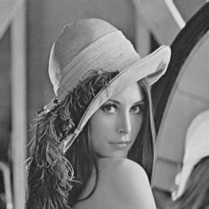
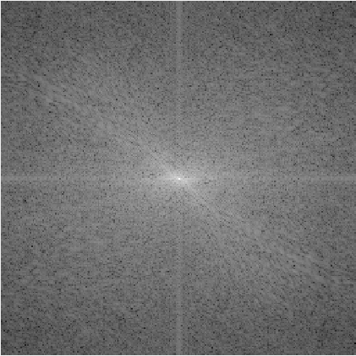
Homework-4 Fourier Transformation
For Lena.png and Sample.png.(gray, 8bits/pixels, 256*256 pixels)
Show the two-dimensional discrete Fourier transformation results and try to explain them. (You can use log transformation for better visualization)
Show the inverse Fourier transformation results and compare them with the original image.

Slide 2


Homework-4 Lowpass Filtering
For Sample.png, perform Ideal & Gaussian lowpass filtering on both images with D0=10, 20, 40 and analyse their ringing effects.

