Slide 1

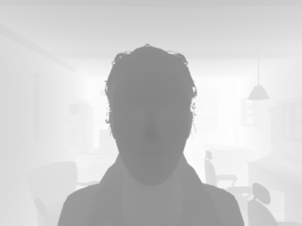
Homework-1 Interpolation
For depth_4x.png(gray, 8bits/pixels, 80*60 pixels), and depth_2x.png(gray, 8bits/pixels, 160*120 pixels)
Do bilinear interpolation into 320*240 pixels.
Do bicubic interpolation into 320*240 pixels.
depth_4x.png
depth.png

Slide 2
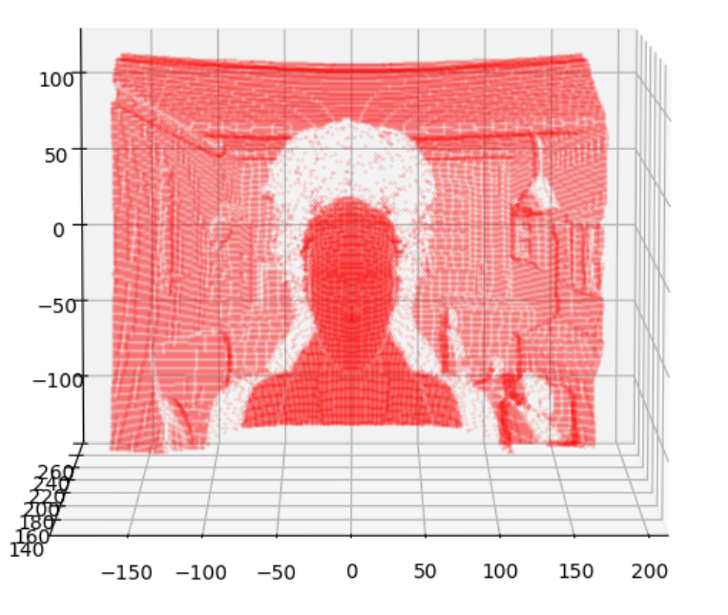
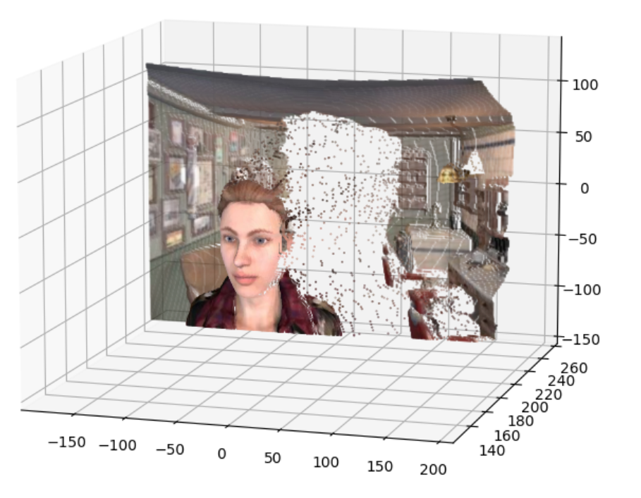
Homework-1 3D Visualization
Visualize the depth results together with the RGB image (rgb.jpg) in a 3D pattern.
Using C++ / Matlab / Python
Here is a simple demonstration using matplotlib.
If available, you can try with the images in the ‘original’ folder (640*480 pixels) to generate more satisfying results.
Upload a zip/rar with a brief report, source codes and results.

Slide 3

Homework-1 Hints
While visualizing your results, you may be confused about the intrinsic parameters of our camera. You can take:
$$f_{x}=f_{y}=200$$
$$c_{x}=160, c_{y}=120$$
Limited by the course schedule, we do not provide accurate settings of our camera.
So please feel free to make your own assumptions of the experimental settings for a better visualization.

