Slide 1

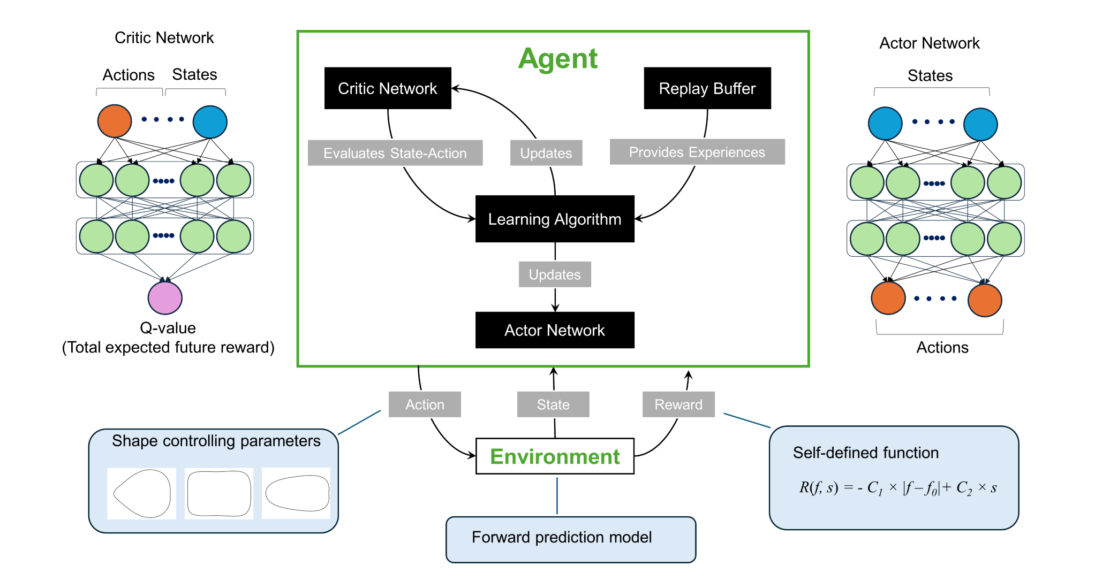
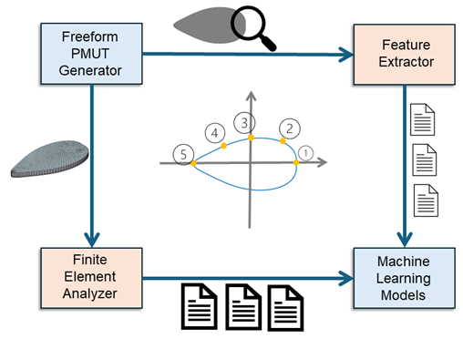
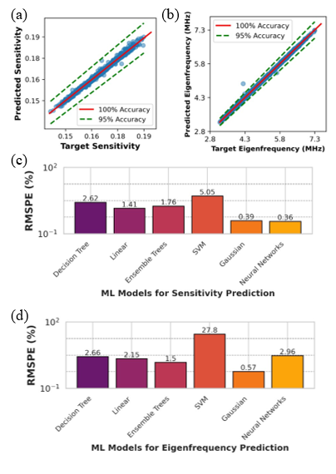
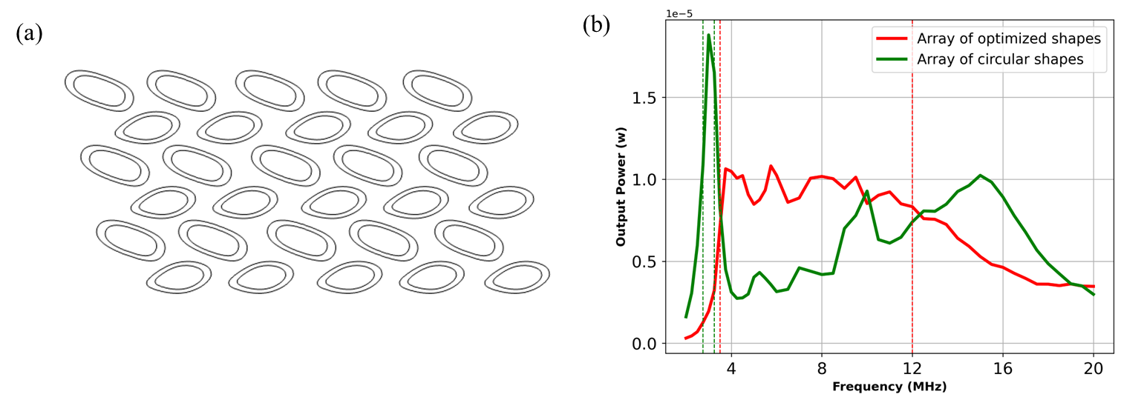
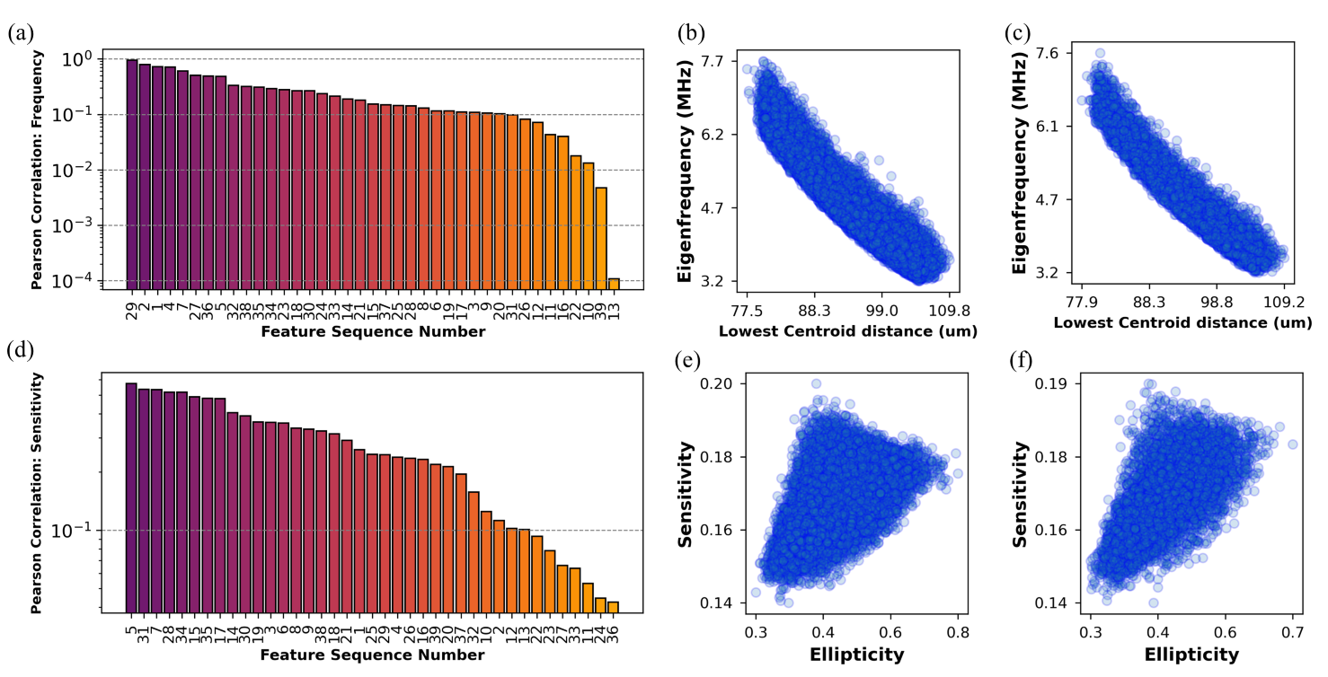
Machine Learning Strategies for Freeform PMUTs Design
Jiapeng Xu^{1,2}, Gabriele Schrag², Zongru (Doris) Shao³, Rodrigo Tumolin Rocha¹, Tingzhong Xu*¹
¹Piezoelectric Microsystem Technologies, Silicon Austria Labs,
Villach, Austria
²Professorship of Microsensors and Actuators, Technical University of Munich, Munich, Germany
³Embedded AI (eAI), Silicon Austria Labs, Linz, Austria
Abstract
We present a four-stage framework (Fig. 1) for PMUT performance forward prediction and a deep reinforcement learning model (Fig. 2) for inverse PMUT design optimization. Through comparative analysis of ML models (Fig. 3), we identify those with superior prediction accuracy. By combining these optimized forward and inverse models, we achieve a PMUT array with expanded bandwidth (Fig. 4). Additionally, Pearson Correlation feature analysis (Fig. 5) provides insights into effective ML techniques, advancing intelligent MEMS design optimization.
1. Forward Prediction: Architecture
2. Inverse Optimization Using Deep Reinforcement Learning
3. Model Comparison
4. PMUT Array Simulation Verification by Comsol Mutiphysics
5. Feature Analysis by Pearson Correlation
7330

