Slide 1
Xamarin
A Presentation by Jasper Bröker

Slide 2
Agenda
What is Xamarin?
Xamarin Studio
iOS-App Development
Android-App Development
Cross-Platform Development
Xamarin.Forms
Hands-On

Slide 3
What is Xamarin?
Founded in May 2011
Microsoft acquired Xamarin in 2016
Develop native Android, iOS and Windows-Phone applications
C#-shared codebase
Native User-Interfaces
Xamarin IDE: Xamarin Studio

Slide 4
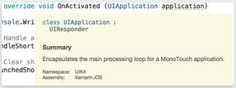
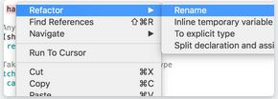
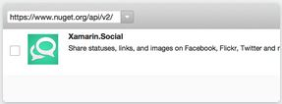
Xamarin Studio
Contextual Highlights
Refactoring
Version Control
NuGet
Syntax Highlighting

Slide 5
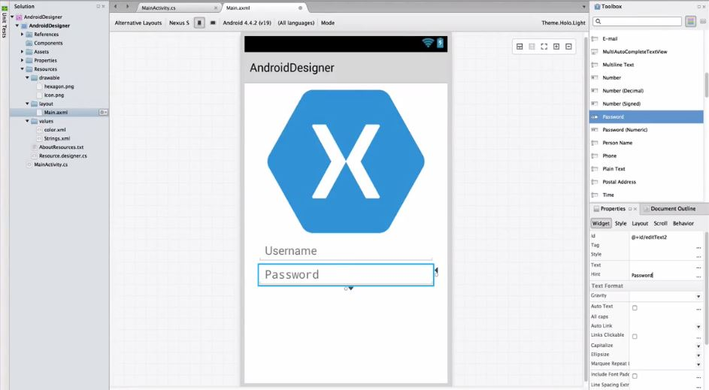
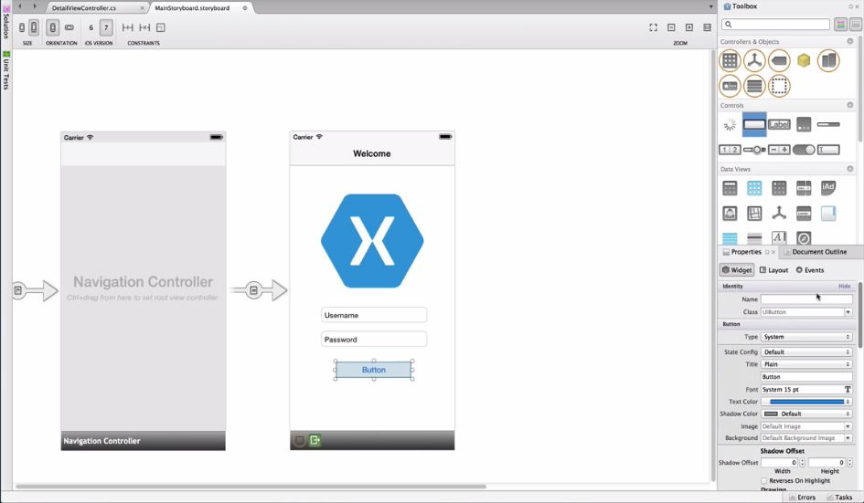
Xamarin Studio
Native User-Interfaces for Android and iOS
Android Designer iOS Designer

Slide 6
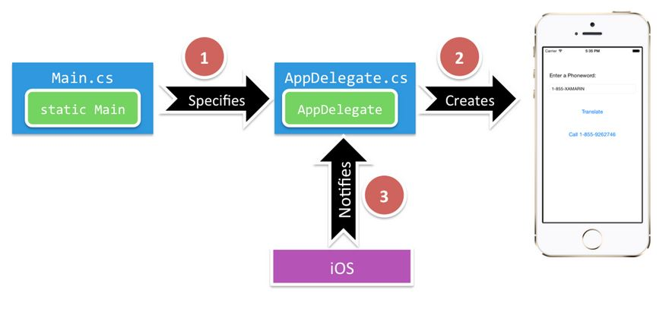
iOS-App Development
Architecture

Slide 7
iOS-App Development
Main.cs
Main entry point of the application
Contains the static main method
Creates Xamarin.iOS instance
Passes name of application delegate class that will handle OS events

Slide 8
iOS-App Development
Application Delegate
Lives in AppDelegate.cs
Handles system events
Class manages the application Window
Subscribing to important system updates about important application events

Slide 9
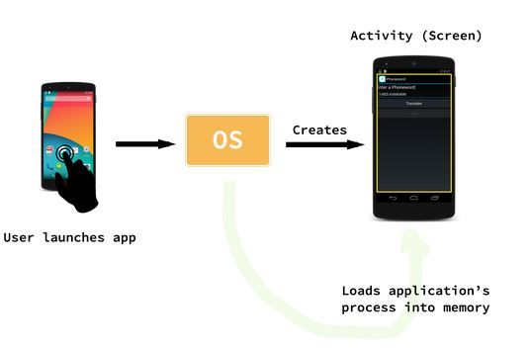
Android-App Development
Architecture

Slide 10
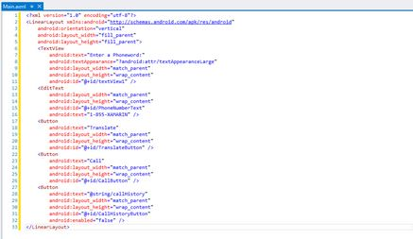
Android-App Development
Main.axml
User-Interface layout file for first screen
When open it in Xamarin Studio the Android Designer opened

Slide 11
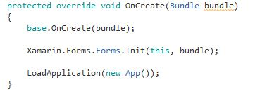
Android-App Development
MainActivity.cs
Contains code that powers the User-Interface

Slide 12
Cross-Platform Development
Platform SDK-Access
iOS: Apple‘s CocoaTouch Framework be used as namespace
Android: Google‘s Android SDK can be used as namespace
Windows Phone: SDK is implicity available, because WP-Apps are anyway developed in C#

Slide 13
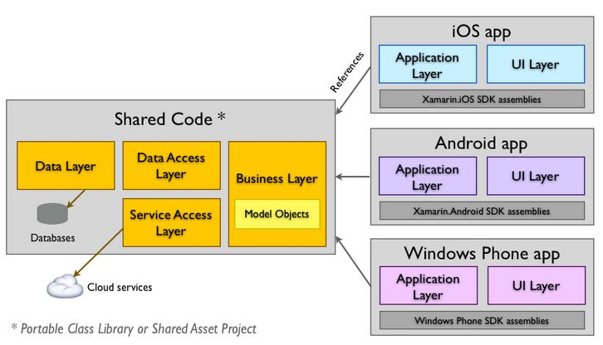
Cross-Platform Development
Architecture

Slide 14
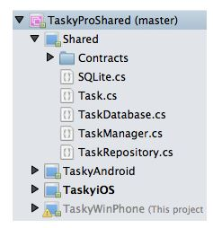
Cross-Platform Development
Example Project Structure

Slide 15
Cross-Platform Development
Possible Platform Divergences
Screen-Sizes
„Back“-Buttons
Keyboards ( Physical and Software)
Push-Notifications
Dealing with that Divergences
Implementations via interfaces and inheritance
Conditional compilation

Slide 16


Cross-Platform Development
Conditional Compilation

Slide 17
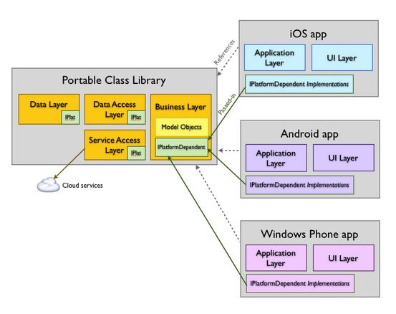
Cross-Platform Development
Portable Class Libraries
Allows you to write code and produce libraries, which can be used in other projects

Slide 18
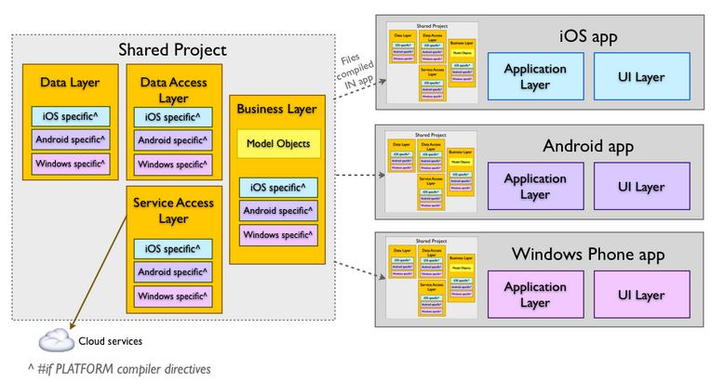
Cross-Platform Development
Shared Project
Written code can be shared between different projects

Slide 19
Xamarin.Forms
Framework to create cross platform user interfaces
Using native controls for rendering
A Xamarin.Forms application has shared code in a portable class Library
Platform-specific applications consume the shared code

Slide 20
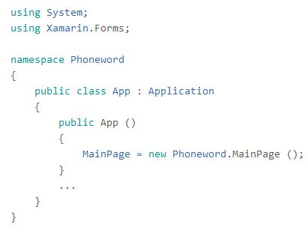
Xamarin.Forms
Example of shared code

Slide 21
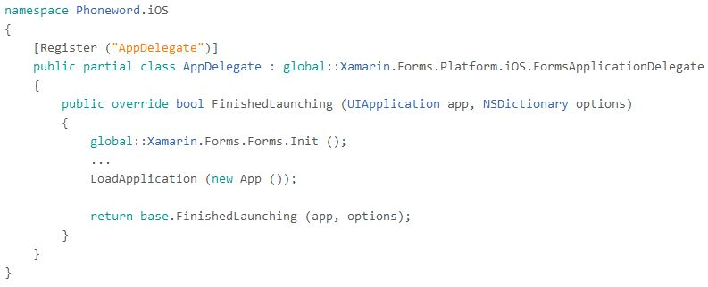
Xamarin.Forms
Call shared code on iOS

Slide 22
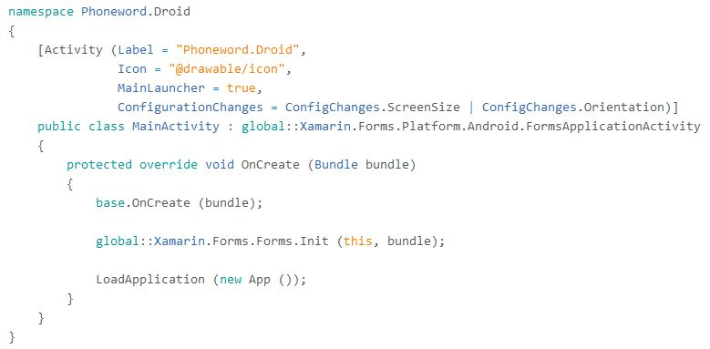
Call shared code on Android

Slide 23
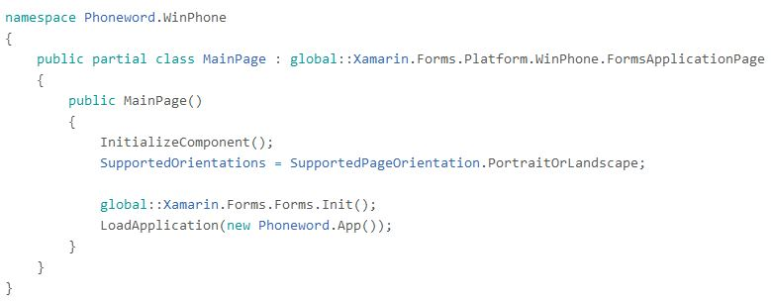
Xamarin.Forms
Call shared code on Windows Phone

Slide 24
Hands-On
You can find everything you need on:
https://github.com/JasperBroeker/ePortfolio

