Slide 1
Corpus-based example sentence selection for L2 Spanish: from framework to practice
department of translation, interpreting and communication
research groupS LT³ and MULTIPLES
Jasper Degraeuwe – TaLC 2024 – 10 June 2024
Notes:
Hello everyone, I’m Jasper Degraeuwe from Ghent University in Belgium. I’ll be presenting a framework to select example sentences from corpora for L2 Spanish. And also a little bit about generative AI, but that’s for later. Ok, framework contains the word frame, and when you say frame, you say …

Slide 2






Let’s go for a ride
Bike graphics © Amethyst Studio and fauzan akbar (Noun Project)
Notes:
That’s right, bike! This bike is going to be the recurring theme throughout the presentation. By the way, a small disclaimer before we start: as far as visuals and graphic design is concerned, this is as good as it’s going to get today. My limit really is at assembling separate images and combining them with pictograms in Microsoft Powerpoint.

Slide 3
Goal: language learning materials
Bike graphics © Amethyst Studio and fauzan akbar (Noun Project)
Notes:
Right, so first up: the direction we’re heading into with our bike: example sentences for language learning materials.

Slide 4
Goal: language learning materials
Vocabulary item | POS
Creative | ADJ
Edit | VERB
Font | NOUN
Infographic | NOUN
Logo | NOUN
Typography | NOUN
User experience design | NOUN
Notes:
Let’s make that a little bit more concrete. Here, we see a basic vocabulary list containing isolated words. I’ve chosen the topic of graphic design, since there’s still a lot to learn for me in that particular domain.

Slide 5
Goal: language learning materials
Vocabulary item | POS | Example sentence
Creative | ADJ | An interesting view can stimulate creative thinking.
Edit | VERB | The recorded interview was edited for broadcast.
Font | NOUN | The font size should be 12 pt.
Infographic | NOUN | Below is an infographic that highlights clinic activities.
Logo | NOUN | The finely detailed interior woodwork also includes company logos.
Typography | NOUN | Computer technology revolutionized typography in the 20th century.
User experience design | NOUN | Finally, there are user interface and user experience design issues that must be addressed.
Sentences © SKELL
Notes:
Now, we see the exact same list, but enriched with example sentences.

Slide 6
banco
bank; bench
Notes:
Here we have a flash card for the Spanish word banco, with its translation to English at the back of the card.

Slide 7
banco
banco
Voy al banco para abrir una cuenta.
bank; bench
bank
Notes:
And on the right-hand side we have another flash card for banco, but now with an example sentence. Thanks to the example sentence, the flash cards can be made meaning-based instead of form-based. So one card for banco as a financial institution, […]

Slide 8
banco
Al llegar al parque, me senté en un banco.
bench
Notes:
[…] and one for banco as bench.

Slide 9
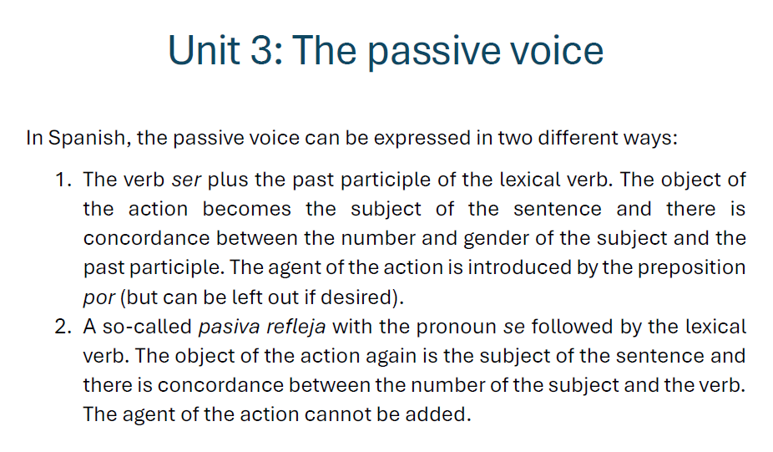
Notes:
On to the next example. Here, we see the explanation of how the passive voice can be formed in Spanish.

Slide 10
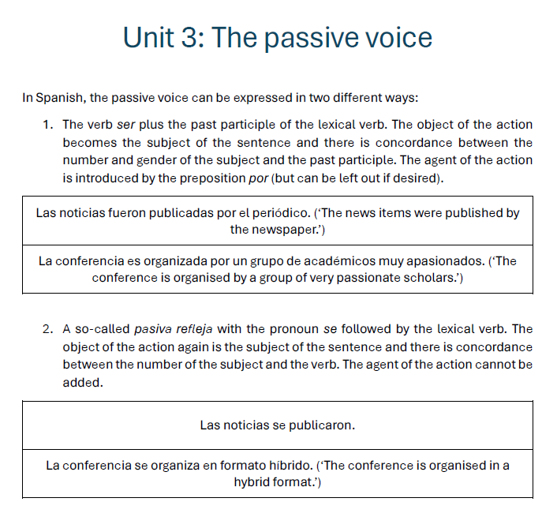
Notes:
And here, we see the same explanation but now with a few examples illustrating each of the two possible ways in which the passive voice can be expressed.

Slide 11
Intermediate conclusion
Example sentences are important

Slide 12
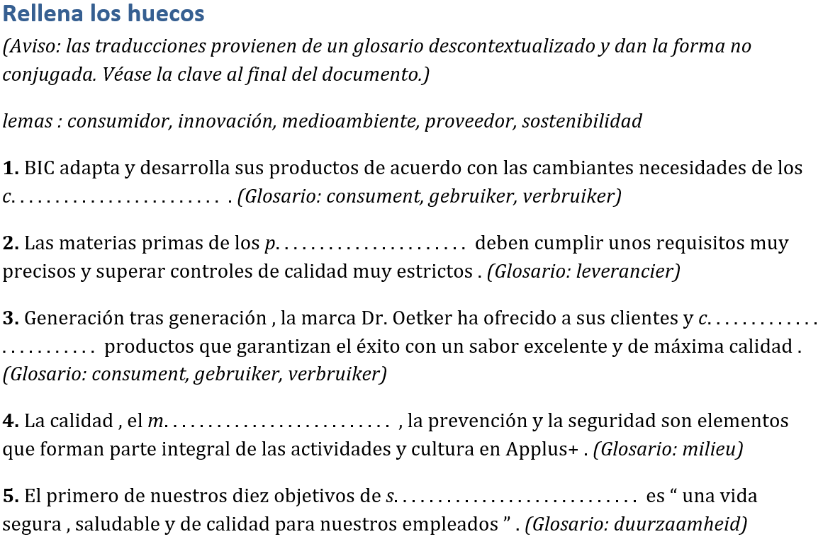
Goal: language learning materials
Notes:
Some types of language learning exercises even depend entirely on example sentences, such as fill-in-the-blanks exercises.

Slide 13
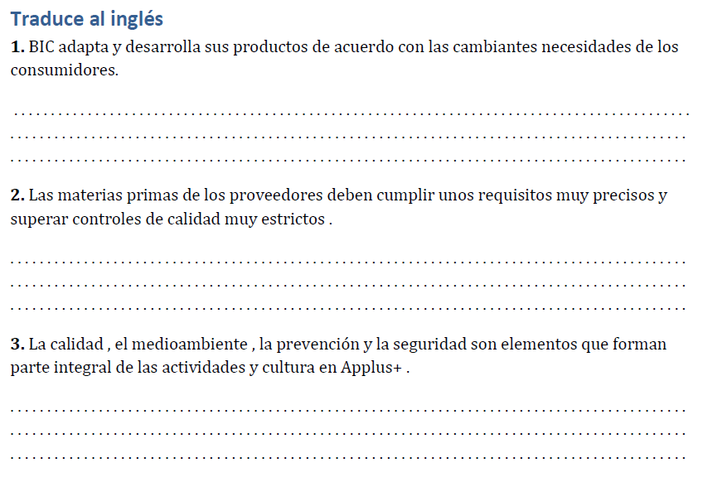
Goal: language learning materials
Notes:
And in-context translation exercises.

Slide 14
Full conclusion
Need for “good” example sentences and/or authentic contexts
Notes:
So, as a full conclusion, we can say that there’s a need for “good” example sentences in language learning.

Slide 15
Full conclusion
Need for “good” example sentences and/or authentic contexts
Strengthens word form-word meaning associations (Laufer & Shmueli, 1997)
Fosters both language comprehension and production (Frankenberg-Garcia, 2014)
Notes:
For the record, this is not just me thinking this, the importance of practising vocabulary in example sentences is also backed by research.

Slide 16
Let’s go for a ride
Bike graphics © Amethyst Studio and fauzan akbar (Noun Project)
Notes:
Right, but which road are we going to take to get there? Let’s have a look at some more related research.

Slide 17
Related research

Slide 18
Methods to obtain example sentences
Intuited / invented examples
Notes:
Obtaining example sentences to use in language learning context has a long tradition in so-called intuited or invented examples. So basically language experts such as lexicographers or L2 teachers following their intuitions to create what they think are relevant examples. But this method came with a lot of limitations. Coverage, for example. Because while coming up with examples for a set of ten vocabulary items is perfectly doable, if you have to provide examples for a keyword list of a hundred items, that’s a completely different ball game.

Slide 19
Invented examples
Long tradition (since grammar-translation method)
Pros
Cons
Notes:
The tradition goes back to the grammar-translation method in the 19th century, and has both pros and cons.

Slide 20
Invented examples
Long tradition (since grammar-translation method)
Pros
Customisable
Promote noticing and foster remembering (“mnemonics”; Cook, 2001)
Notes:
As for the pros, they are customisable and can be written in such a way that they promote noticing and stimulate remembering.

Slide 21
Invented examples
Long tradition (since grammar-translation method)
Pros
Cons
Form-driven → meaningless
Unauthentic
Bizarre (“The cat of my aunt is more treacherous than the dog of my uncle.”; Sweet, 1899)
Time-consuming
Notes:
Regarding the cons, invented examples have been criticised for being form-driven and therefore meaningless. For being unauthentic. For being bizarre, with a famous example from Sweet being shown here. And finally also for being time consuming. Coming up with examples for a set of ten vocabulary items is perfectly doable. But if you have to provide examples for a keyword list of a hundred items, that’s a different ball game.

Slide 22
Methods to obtain example sentences
Intuited / invented examples
Corpus-based example selection
Notes:
That lack of efficiency brings us to the second selection method: corpus-based examples.

Slide 23
Corpus-based examples
Towards end of 1980s
Rise of online accessible corpora
Advances in corpus query tools
With posterior human revision or without (COBUILD)
Specific selection algorithms (e.g., GDEX; Kilgarriff et al., 2008)
Notes:
Because towards the end of the 1980s, the rise of online accessible corpora together with advances in the technological tools to process those corpora, opened a whole new range of perspectives. Because in a few clicks, it became possible to extract a set of examples for a given target word based on a corpus query. Some argued that it was best to still revise the sentences afterwards, but some also radically rejected each form of revision, to ensure the authenticity, as was the case in the COBUILD project. And then also specific selection algorithms started to arise, with GDEX arguably being the most well-known one. But although GDEX has also been used for pedagogical purposes, like in the SKELL tool, the problem is that it’s still primarily a method for lexicographic purposes, which do not necessarily take into account pedagogical considerations.

Slide 24
Methods to obtain example sentences
Intuited / invented examples
Corpus-based example selection
Generative Artificial Intelligence
Notes:
All right. On to the third and final way in which we can obtain example sentences: GenAI.

Slide 25
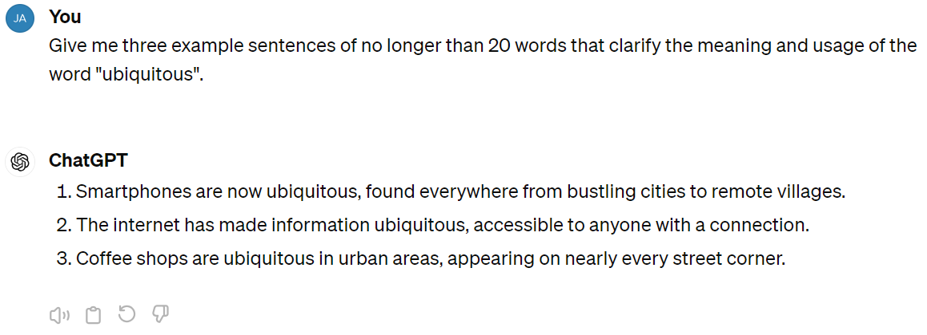
GenAI-based examples
Notes:
Thanks to the recent advances in language technology, we can simply ask a large language model such as GPT – here in the ChatGPT interface – to give us a list of usage examples for a given word.

Slide 26
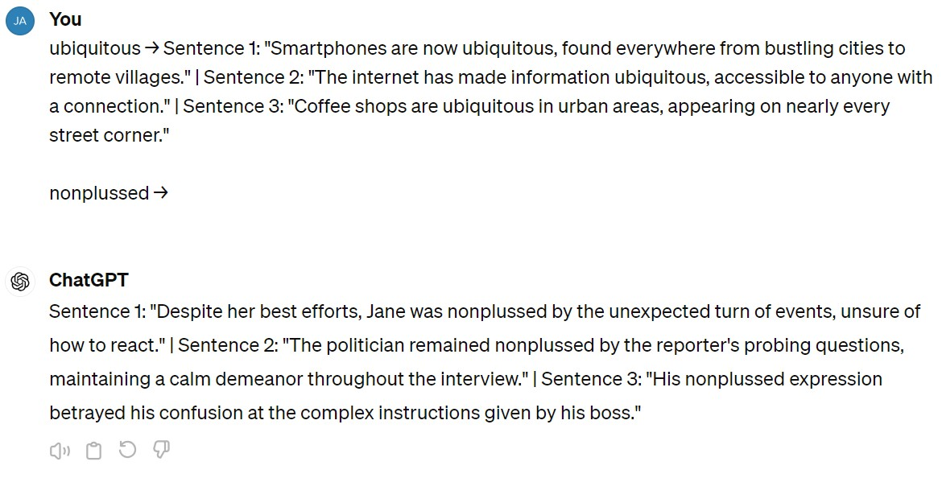
GenAI-based examples
Notes:
Or we can give it a few examples ourselves and then prompt the model to do the same for another word. This strategy is called few-shot prompting, the previous one zero-shot prompting.

Slide 27
GenAI-based examples
Few-shot prompting
Notes:
Or we can give it a few examples ourselves and then prompt the model to do the same for another word. This strategy is called few-shot prompting, the previous one zero-shot prompting.

Slide 28
GenAI-based examples
Zero-shot prompting
Notes:
Thanks to the recent advances in language technology, we can simply ask a large language model such as GPT – here in the ChatGPT interface – to give us a list of usage examples for a given word.

Slide 29
Let’s go for a ride
Bike graphics © Amethyst Studio and fauzan akbar (Noun Project)
Notes:
So now we know which are the roads we can take, but …

Slide 30

Notes:
To be able to arrive there we will need to fill some gaps in that road.

Slide 31
Research gaps
Frameworks to select pedagogically suitable example sentences from corpora
Evaluate pedagogical usability and validity of GenAI-based example sentences
Languages other than English
Notes:
Aka research gaps. Selecting examples from corpora has become more or less the go-to method in the creation of language learning resources and exercises. But as mentioned before, this selection is mostly performed from a lexicographic point of view. So we first of all we need more research into frameworks that select sentences specifically for pedagogical purposes. Secondly, if we want to make use of GenAI to create example sentences, we need to know if its output is actually useful and valid for pedagogical purposes. And finally, compared to English there’s a lot more work to be done for other languages.

Slide 32
Methodology
Notes:
So, that’s exactly what I did for my study.

Slide 33
Methodology
Build framework to select examples from corpora for L2 Spanish
Define set of target vocabulary items
Use framework to select pedagogically suitable examples for those items
Use GenAI model to create examples for those items
Compare both types in experiment with L2 learners
Notes:
I built a framework to select examples from corpora, for L2 Spanish as the target language. I defined a set of target items to work with. For each of those target sentences, I gathered a set of corpus concordances and applied the framework to those sentences to select the pedagogically most suitable ones. Then I also created artificial examples for that same set of target words. And finally, I compared the corpus-based examples with the GenAI-based examples in an experiment with L2 learners.

Slide 34
Methodology
Build framework to select examples from corpora for L2 Spanish
Define set of target vocabulary items
Use framework to select pedagogically suitable examples for those items
Use GenAI model to create examples for those items
Compare both types in experiment with L2 learners
Notes:
First, a few words about the framework.

Slide 35
Framework for L2 Spanish
Foundational work: HitEx for L2 Swedish (Pilán et al., 2016)
Notes:
I didn’t have to start from scratch, luckily, because Pilán and colleagues launched the HitEx sentence selection framework a few years ago, for L2 Swedish.

Slide 36
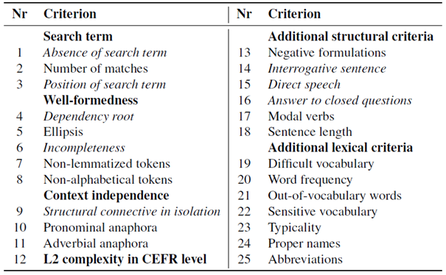
HitEx (Pilán et al., 2016)
Notes:
Which looks like this. So the idea is that the better a given sentence scores on these criteria, the more suitable it is from a pedagogical perspective. [discuss some criteria]

Slide 37
Framework for L2 Spanish
Foundational work: HitEx for L2 Swedish
Our work
Convert HitEx into Spanish (e.g., take into account pronoun dropping)
Expand (personalised difficulty classifier; more importance attributed to typicality criterion)
→ SelEjemCor framework (Selección de Ejemplos de Corpus)
Notes:
So basically, I first converted this set of criteria from Swedish into Spanish, and then – based on SLA research – made some improvements. Such as the inclusion of personalised estimations of word difficulty, and dedicating more importance to the presence of collocations and colligations in the typicality criterion. As I told you before, creativity is not my forte so I gave the framework a very boring name. Selection of examples from corpora.

Slide 38
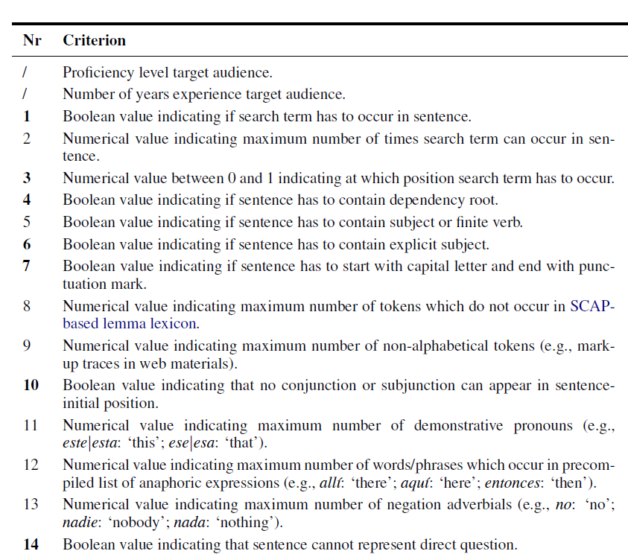
Notes:
And this is what it basically looks like.

Slide 39
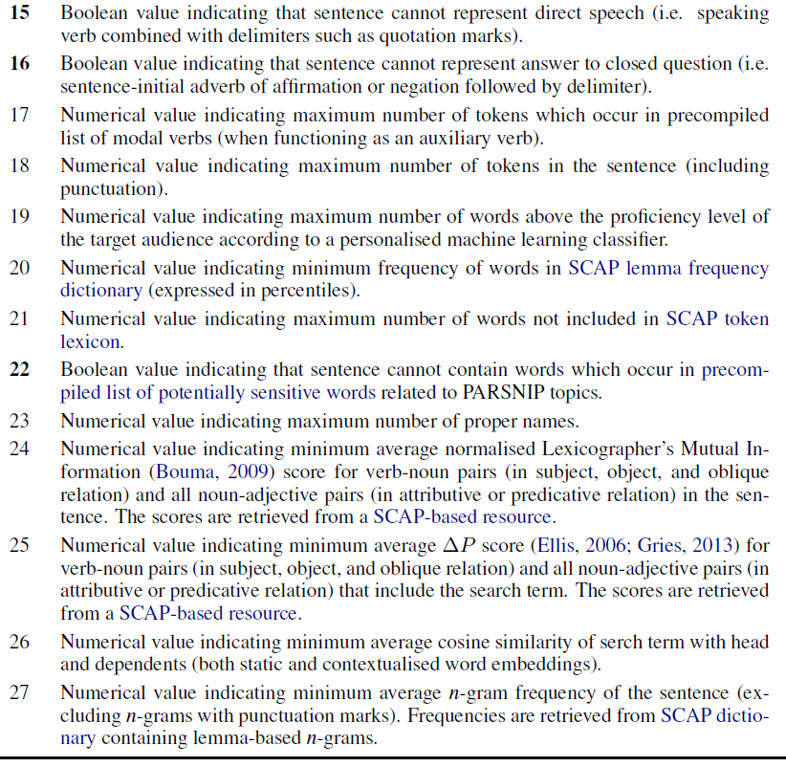
Notes:
I can come back to the individual criteria during the Q&A if you want to.

Slide 40
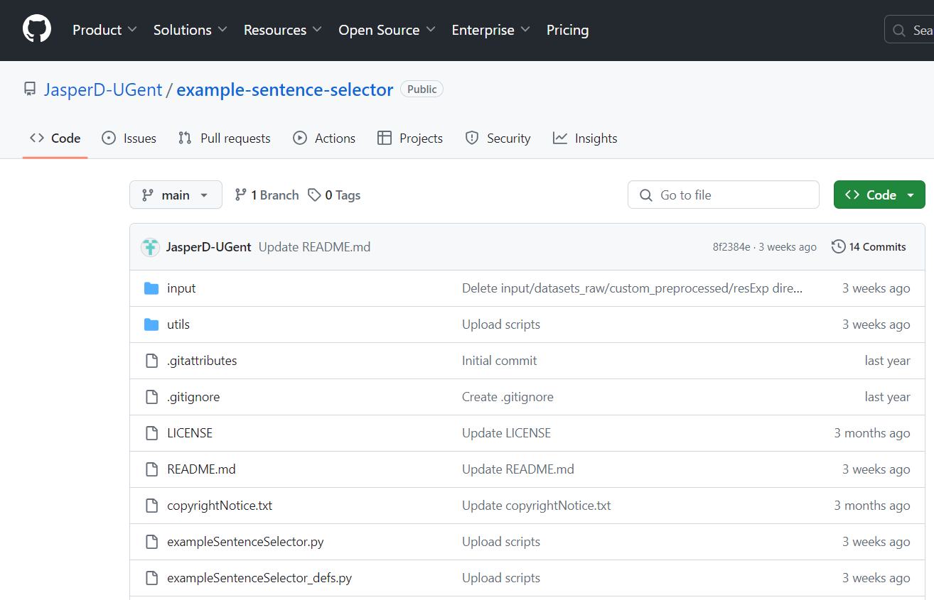

Notes:
And then I wrote the Python code to be able to apply the framework to actual sets of sentences. Which is all open source.

Slide 41
Methodology
Build framework to select examples from corpora for L2 Spanish
Define set of target vocabulary items
Use framework to select pedagogically suitable examples for those items
Use GenAI model to create examples for those items
Compare both types in experiment with L2 learners
Notes:
So, we have the framework ánd we can apply it. Time for step 2, gathering a representative set of target vocabulary items.

Slide 42
Define set of target items
250 items for beginner learners
250 items for advanced learners

Slide 43
Define set of target items
250 items for beginner learners
1,001 – 2,000 range in Davies and Hayward Davies (2018) frequency list
150 NOUN, 50 VERB, 50 ADJ
250 items for advanced learners

Slide 44
Define set of target items
250 items for beginner learners
250 items for advanced learners
25M domain-specific corpus containing newspaper articles on legal topics ranked based on keyness (Odds Ratio effect size metric)
150 NOUN, 50 VERB, 50 ADJ

Slide 45
Define set of target items
250 items for beginner learners
250 items for advanced learners

Slide 46
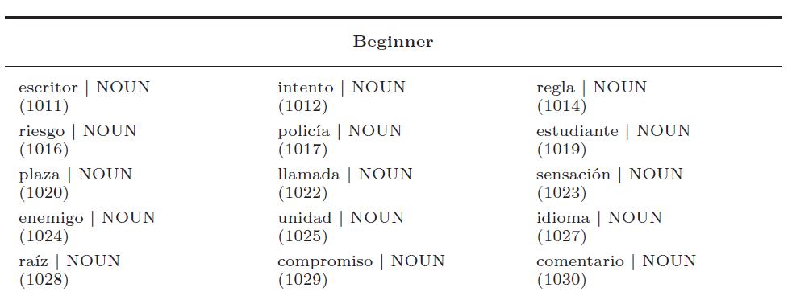
Define set of target items
250 items for beginner learners
250 items for advanced learners

Slide 47
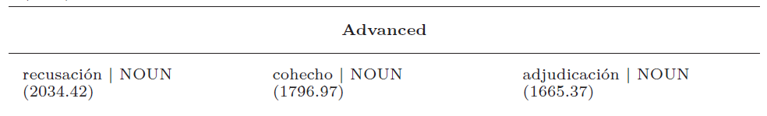
Define set of target items
250 items for beginner learners
250 items for advanced learners

Slide 48
Methodology
Build framework to select examples from corpora for L2 Spanish
Define set of target vocabulary items
Use framework to select pedagogically suitable examples for those items
Use GenAI model to create examples for those items
Compare both types in experiment with L2 learners

Slide 49
Select corpus sentences
Beginner group: 7.5M corpus containing accessible reportages about tourist destinations
Advanced group: 25M domain-specific corpus containing newspaper articles on legal topics
Select top-ranked sentence according to framework

Slide 50
Select corpus sentences: illustration
Target vocabulary item = complaint
ID | Rank | Sentence
1 | ? | When asked if I had any complaints about the TaLC conference, I could only say that
2 | ? | Investigators said 170 complaints were made, with 39 of the complaints resulting in prosecutions.
3 | ? | She attended the local police station to file a complaint after being denied access to her granddaughter.

Slide 51
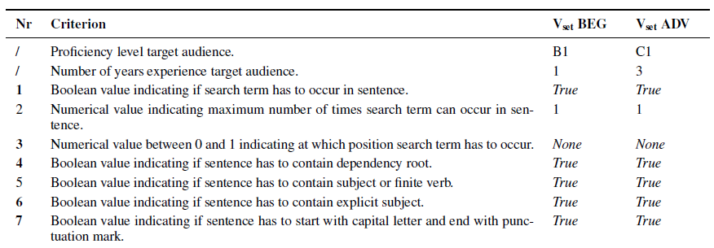
Select corpus sentences: illustration
ID | Rank | 1 | 2 | 3 | … | 7 | … | 25 | 26 | 27
1 | ? | True | 1 | 0.24 | … | False
2 | ? | True | 2 | 0.11 | … | True
3 | ? | True | 1 | 0.5 | … | True

Slide 52
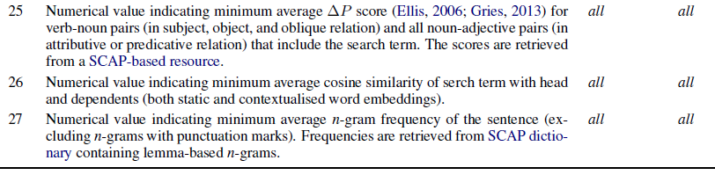
Select corpus sentences: illustration
ID | Rank | 1 | 2 | 3 | … | 7 | … | 25 | 26 | 27
1 | ? | True | 1 |  | … | False |  | 0.1 | 0.5 | 0
2 | ? | True | 2 |  | … | True |  | 0.05 | 0.61 | 18
3 | ? | True | 1 |  | … | True |  | 0.32 | 0.58 | 85.3

Slide 53
Select corpus sentences: illustration
ID | Rank | 1 | 2 | 3 | … | 7 | … | 25 | 26 | 27
1 | EXCL | True | 1 |  | … | False |  | 0.1 | 0.5 | 0
2 | 2 | True | 2 |  | … | True |  | 0.05 | 0.61 | 18
3 | 1 | True | 1 |  | … | True |  | 0.32 | 0.58 | 85.3

Slide 54
Methodology
Build framework to select examples from corpora for L2 Spanish
Define set of target vocabulary items
Use framework to select pedagogically suitable examples for those items
Use GenAI model to create examples for those items
Compare both types in experiment with L2 learners

Slide 55
Create GenAI-based sentences
Different system prompts
Different user prompts

Slide 56
Create GenAI-based sentences
Zero shot
General
General + target audience
General + target audience + criteria
Few-shot

Slide 57
Create GenAI-based sentences
Zero-shot, general
System prompt: You are a teacher of Spanish as a foreign language.
User prompt: Write a sentence between 15 and 30 words in Spanish that presents an authentic usage of the Spanish [POS] ’[WORD]’, a vocabulary item that has to be learnt by your students. The sentence should not be a definition of the word.

Slide 58
Create GenAI-based sentences
Zero-shot, general + target audience
System prompt (beginner): You are a teacher of Spanish as a foreign language to a beginner/lower-intermediate group of university students who have been studying Spanish for one year.
System prompt (advanced): You are a teacher of Spanish as a foreign language to an upper-intermediate/advanced group of university students who have been studying Spanish for three years.
User prompt: Write a sentence between 15 and 30 words in Spanish that presents an authentic usage of the Spanish [POS] ’[WORD]’, a vocabulary item that has to be learnt by your students. The sentence should not be a definition of the word.

Slide 59
Create GenAI-based sentences
Subset | POS | Prompt type
1 | 30 NOUN 10 VERB 10 ADJ | General
2 |  | General + target audience
3 |  | General + target audience + criteria
4 |  | Few shot
5 |  | General General + target audience General + target audience + criteria Few shot

Slide 60
Methodology
Build framework to select examples from corpora for L2 Spanish
Define set of target vocabulary items
Use framework to select pedagogically suitable examples for those items
Use GenAI model to create examples for those items
Compare both types in experiment with L2 learners

Slide 61
corpus-based versus Gen-AI
Beginner group: 3 ≈ B1 Spanish L2 learners (L1 = Dutch)
Advanced group: 4 ≈ C1 Spanish L2 learners (L1 = Dutch)
Evaluate all subsets

Slide 62
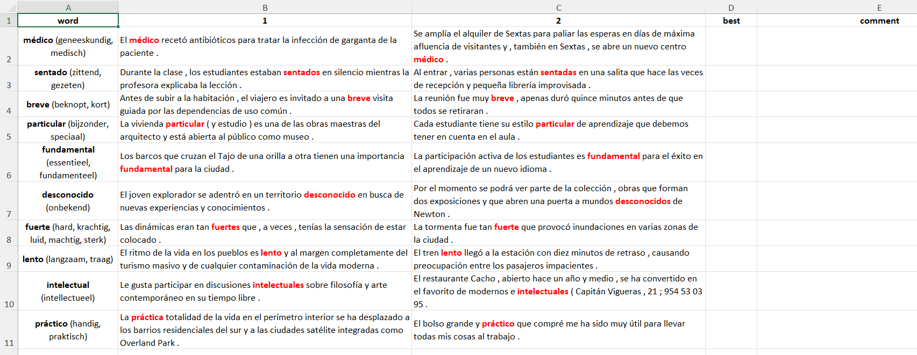

Slide 63
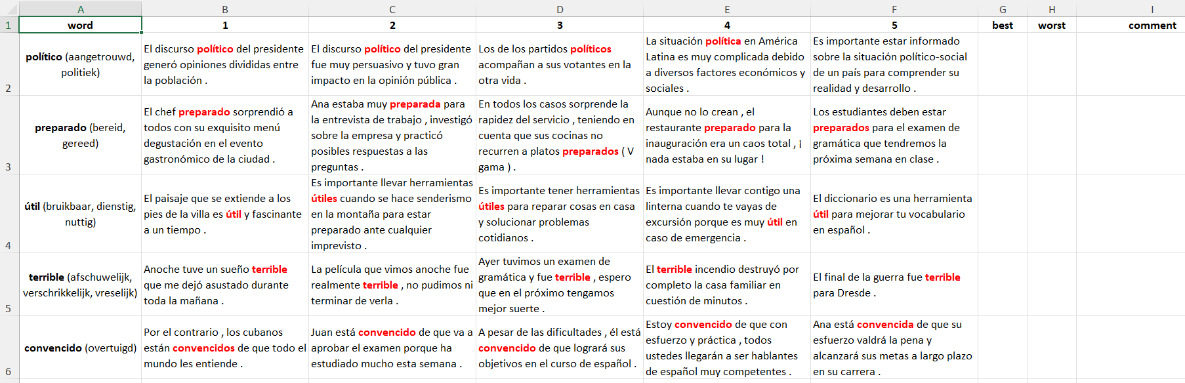

Slide 64
corpus-based versus Gen-AI
Evaluation criteria students
Sentence is more definition than usage example
Sentence is context-dependent
Sentence is too difficult
If all criteria met → base evaluation on needs as L2 learner
Pairwise: indicate “best” (subset 1 to 4)
Best-worst scaling: indicate “best” and “worst” (subset 5)

Slide 65
corpus-based versus Gen-AI
Formality check
Target item occurs in sentence (no “hallucination”)
Target item occurs in correct part of speech
Sentence is complete

Slide 66
Results
Notes:
Great, time for the results now.

Slide 68
Pairwise comparisons
Beginner group (full agreement)
Subset | Corpus-based = best | GenAI-based = best
1 | 1 | 38
2 | 1 | 39
3 | 0 | 36
4 | 2 | 35
Total | 4 / 200 | 148 / 200
Advanced group (full agreement)
Subset | Corpus-based = best | GenAI-based = best
1 | 1 | 28
2 | 1 | 28
3 | 0 | 33
4 | 1 | 28
Total | 6 / 200 | 117 / 200

Slide 69
Pairwise comparisons
Beginner group (corpus-based, / 50)
Subset | No target item | Wrong POS | Incomplete | Definition | Context-dependent | Too difficult
1 | 0 | 1 | 2 | 0 | 16 | 11
2 | 0 | 1 | 2 | 0 | 13 | 12
3 | 0 | 0 | 0 | 0 | 15 | 11
4 | 0 | 0 | 1 | 0 | 14 | 9
Beginner group (GenAI-based, / 50)
Subset | No target item | Wrong POS | Incomplete | Definition | Context-dependent | Too difficult
1 | 0 | 1 | 0 | 0 | 0 | 1
2 | 1 | 1 | 0 | 0 | 0 | 1
3 | 0 | 0 | 0 | 0 | 0 | 0
4 | 0 | 1 | 0 | 0 | 0 | 0

Slide 70
Pairwise comparisons
Advanced group (corpus-based, / 50)
Subset | No target item | Wrong POS | Incomplete | Definition | Context-dependent | Too difficult
1 | 0 | 3 | 0 | 0 | 14 | 23
2 | 0 | 1 | 0 | 1 | 16 | 21
3 | 0 | 1 | 0 | 0 | 15 | 19
4 | 0 | 0 | 0 | 0 | 14 | 23
Advanced group (GenAI-based, / 50)
Subset | No target item | Wrong POS | Incomplete | Definition | Context-dependent | Too difficult
1 | 0 | 2 | 0 | 3 | 1 | 3
2 | 0 | 2 | 0 | 1 | 0 | 0
3 | 0 | 3 | 0 | 5 | 1 | 0
4 | 0 | 0 | 0 | 3 | 1 | 2

Slide 72
Best-worst scaling
Beginner group (full agreement, / 50)
Subset | Corpus-based | General | General + target aud | General + target aud + criteria | Few shot
5_{best} | 0 | 0 | 6 | 3 | 4
5_{worst} | 28 | 0 | 0 | 0 | 2
Beginner group (≥ 1 agreement, / 50)
Subset | Corpus-based | General | General + target aud | General + target aud + criteria | Few shot
5_{best} | 3 | 23 | 24 | 24 | 24
5_{worst} | 47 | 5 | 6 | 6 | 10

Slide 73
Best-worst scaling
Advanced group (full agreement, / 50)
Subset | Corpus-based | General | General + target aud | General + target aud + criteria | Few shot
5_{best} | 1 | 2 | 0 | 3 | 2
5_{worst} | 26 | 0 | 1 | 0 | 1
Advanced group (≥ 1 agreement, / 50)
Subset | Corpus-based | General | General + target aud | General + target aud + criteria | Few shot
5_{best} | 4 | 32 | 26 | 31 | 28
5_{worst} | 45 | 6 | 9 | 2 | 8

Slide 74
Conclusion
Notes:
Great, $ for the results now.

Slide 75
Conclusion
Novel framework to select pedagogically suitable sentences from corpora for L2 Spanish
GenAI more suitable source of example sentences than corpus-based examples
BUT: not always
→ “hybrid” approach as combination of best of both worlds?

Slide 76
Let’s go for a ride
Bike graphics © Amethyst Studio and fauzan akbar (Noun Project)

Slide 77
REferences
Cook, G. (2001). ‘The philosopher pulled the lower jaw of the hen’. Ludicrous invented sentences in language teaching. Applied Linguistics, 22(3), 366–387. https://doi.org/10.1093/applin/22.3.366
Davies, M., & Hayward Davies, K. (2018). A frequency dictionary of Spanish: Core vocabulary for learners (2nd ed.). Routledge.
Frankenberg-Garcia, A. (2012). Learners’ Use of Corpus Examples. International Journal of Lexicography, 25(3), 273–296. https://doi.org/10.1093/ijl/ecs011
Kilgarriff, A., Husák, M., McAdam, K., Rundell, M., & Rychlỳ, P. (2008). GDEX: Automatically finding good dictionary examples in a corpus. Proceedings of the XIII EURALEX International Congress, 1, 425–432.
Laufer, B., & Shmueli, K. (1997). Memorizing New Words: Does Teaching Have Anything To Do With It? RELC Journal, 28(1), 89–108. https://doi.org/10.1177/003368829702800106
Pilán, I., Volodina, E., & Borin, L. (2016). Candidate sentence selection for language learning exercises: From a comprehensive framework to an empirical evaluation. Revue Traitement Automatique Des Langues, 57(3), 67–91.
Notes:
And the references.

Slide 78



Jasper Degraeuwe PhD researcher Department of translation, interpreting and communication E Jasper.Degraeuwe@UGent.be www.ugent.be
Universiteit Gent @ugent
@ugent Ghent University
Notes:
And then I just want to thank you very much for your attention, and if you want to know more about the dataset, don’t hesitate to send me an email!

Slide 79
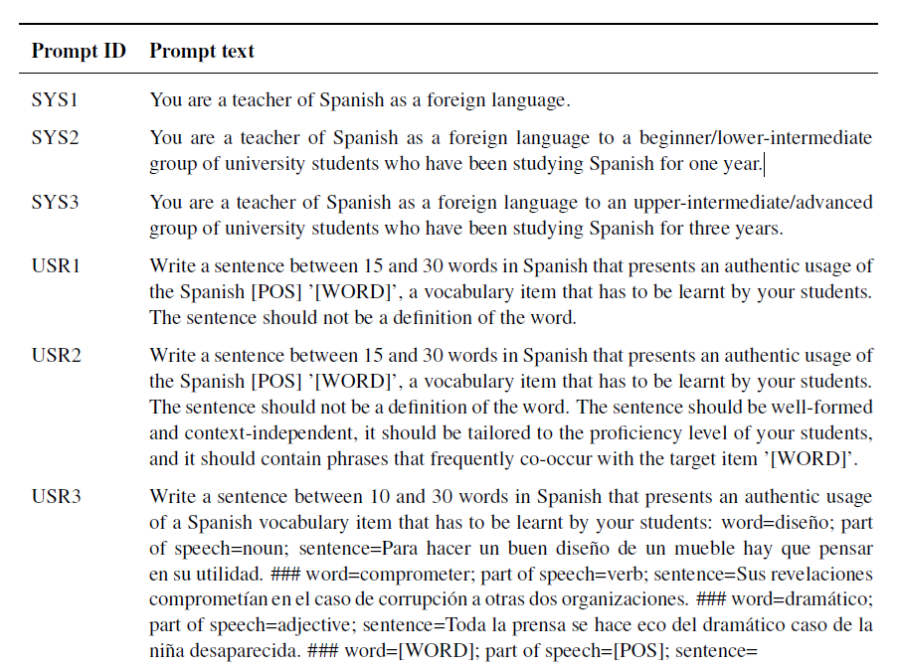
Prompt types (1)

Slide 80
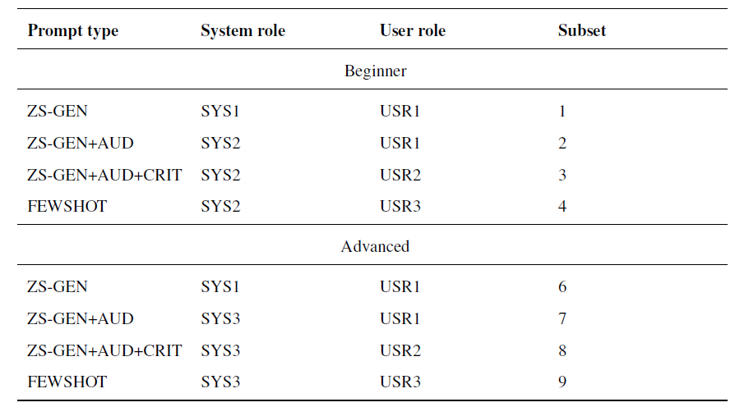
Prompt types (2)

Slide 81
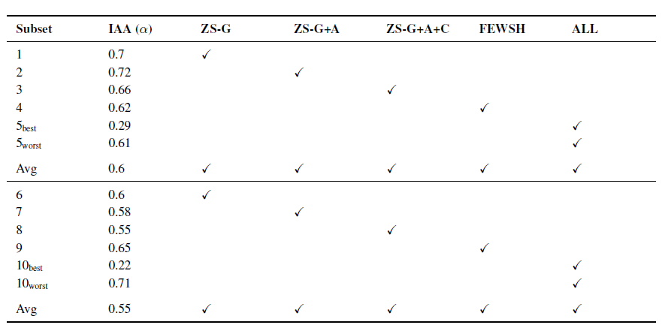
IAA

