Slide 1
Phonetic Normalization
Jasper Ginn

Slide 2
Overview

Slide 3
At a glance

Slide 4
Neural Network Refresher

Slide 5
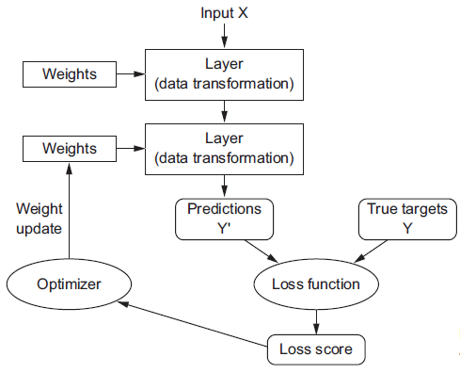
Vanilla Neural Network
From: Cholet, F. “Deep Learning with Python” (Manning), p.11
But … textual data is not i.i.d

Slide 6
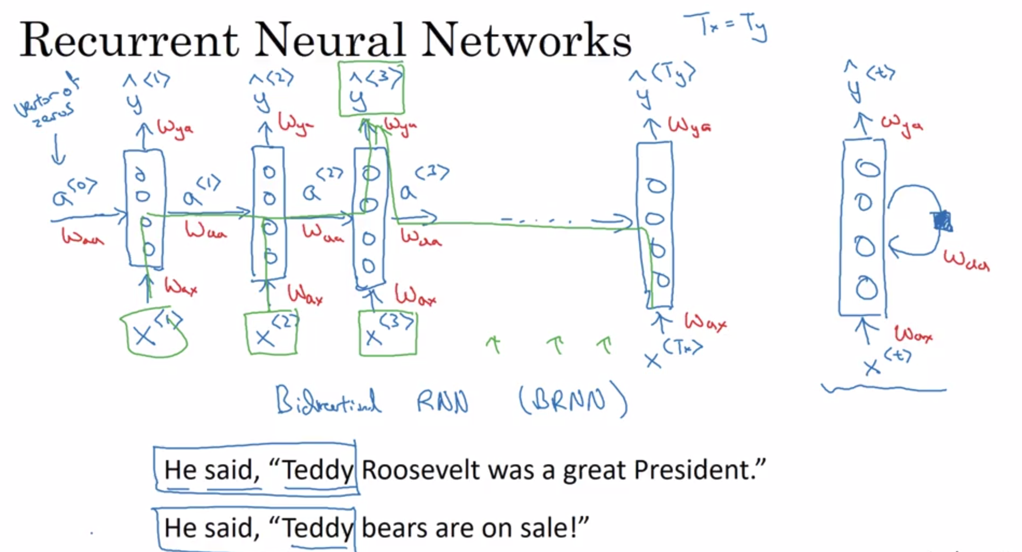
Recurrent Neural Network
“Th . c . t jum . ed on th . fe . nce”
Andrew Ng, “Sequence Models” (week 1) on Coursera

Slide 7
RNN, LSTM, GRU
RNN bad at capturing long-term dependencies
”Boaz, who was … … … …, went to work”
Who does the verb refer to?
‘Vanishing gradients’
Introduce memory cell

Slide 8
Attention mechanism
How would you translate a piece of text?
Attention allows ‘reading in parts’
{Boaz, Arvid & Aaron went climbing together in The Hague. Boaz, being the best climber, taught Arvid and Aaron how to climb the wall. Arvid was distracted by some beautiful ….} → [Boaz, Arvid et Aaron sont montés ensemble à La Haye. Boaz, étant le meilleur grimpeur, a enseigné à Arvid et Aaron comment escalader le mur. Arvid était distrait par une belle ….]
{{Boaz, Arvid & Aaron went climbing} {together in The Hague.} {Boaz, being the best climber, taught Arvid and Aaron how to climb the wall}. {Arvid was distracted by some beautiful} ….} → [{Boaz, Arvid et Aaron sont montés} {ensemble à La Haye.} {Boaz, étant le meilleur grimpeur, a enseigné à Arvid et Aaron comment escalader le mur}. {Arvid était distrait par une belle} ….]

Slide 9
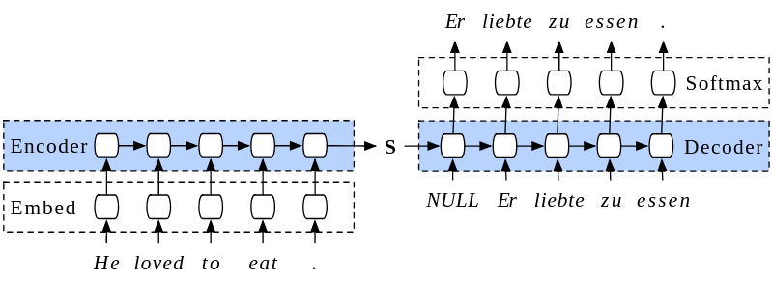
Encoder/Decoder Architecture
Source: https://tinyurl.com/ydcdlbun

Slide 10

‘Teacher Forcing’

Slide 11
Problem Context

Slide 12
Spoken v. Written Word
{‘owpen’ = ‘open’} → [OW P AH N]
{‘bard’ = ‘barred’} → [B AA R D]
{‘aksiom’ = ‘axiom’} → [AE K S IY AH M]
{‘effekt’ = ‘effect’} → [IH F EH K T]
{‘prophet’ = ‘profit’} → [P R AA F AH T]
{‘raise’ = ‘raze’} → [R EY Z]
...

Slide 13
Goal
Similar-sounding words should map to the same output
Non similar-sounding words should not map to the same output

Slide 14
Translation
Input: English (written)
Output: English {dialect} (IPA|XSAMPA)
  Or Carnegie Mellon dialect

Slide 15
Data Collection

Slide 16
Sources
Wikipedia
  Extracted using the wikt2pron module
  Unreliable (many pronunciations, we don’t know which belong to which dialect)
Carnegie Mellon dataset
  ‘Gold Standard’

Slide 17
Evaluation

Slide 18
Defining ‘skill’
BLEU score
  1-gram
  2-gram
  3-gram
  4-gram

Slide 19
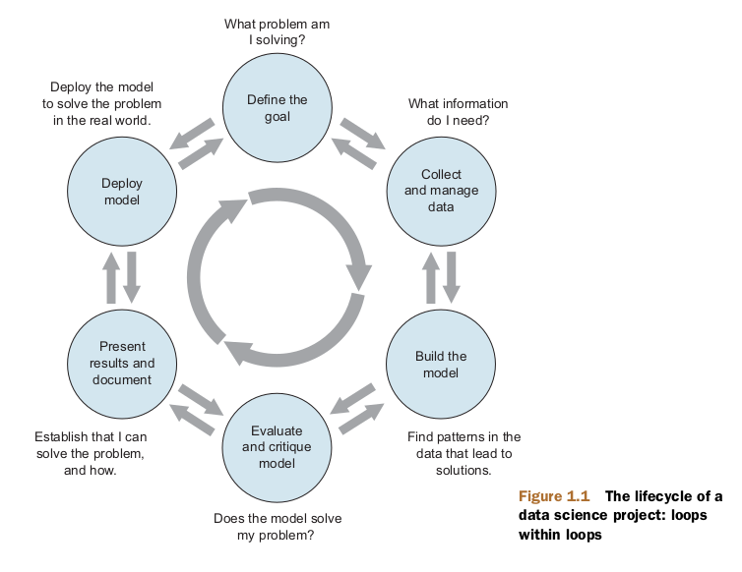
How does model perform?
BLEU / model accuracy
Do models map homophones and non-homophones?
Practical value
  …
Zumel, N. and Mount, J.
“Practical Data Science with R”,
p.6

Slide 20
Performance
General performance (dev/test 1)
Performance on homonyms (dev/test 2)
Made-up words that should sound similar (dev/test 3)

Slide 21
Modeling

Slide 22
Two models, two datasets

Slide 23
Model performance

Slide 24
Which framework to use?
Keras:
  Abundance of documentation
  Can be used in R/Python
PyTorch:
  Flexible + Pythonic

Slide 25
Lessons Learned
PyTorch > Keras
  Interpretability, pythonic code etc.
Wikipedia data is noisy
Breaking into deep learning takes > 12 days

Slide 26
