Slide 1
Incorporating phenotype heterogeneity in disease GWAS improves power while maintaining specificity
  Jasper Hof¹, Chao Ning¹, Liam Quinn², and Doug Speed¹
  ¹Center for Quantitative Genetics and Genomics, Aarhus University, Denmark
  ²Department of Clinical Immunology, Zealand University Hospital, Denmark

Slide 2
I have nothing to disclose

Slide 3
A hypothetical scenario (?)
You are conducting a GWAS on major depressive disorder and observe two cases
- Case A: self-diagnosed, low symptom score, late onset
- Case B: clinically diagnosed, high symptom score, early onset
Should these cases be treated equally in a GWAS?
- Case A: a “proxy-case”: an individual likely to be case from data, but not phenotyped
- Case B: a hard phenotyped case
Should these cases be treated equally in a GWAS?

Slide 4
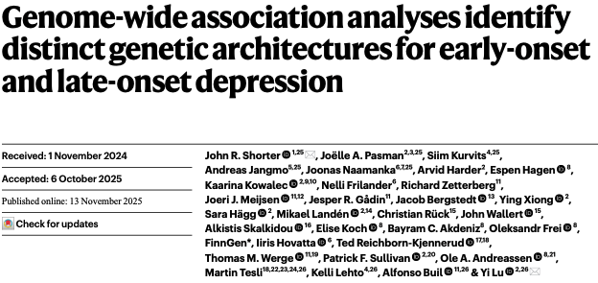
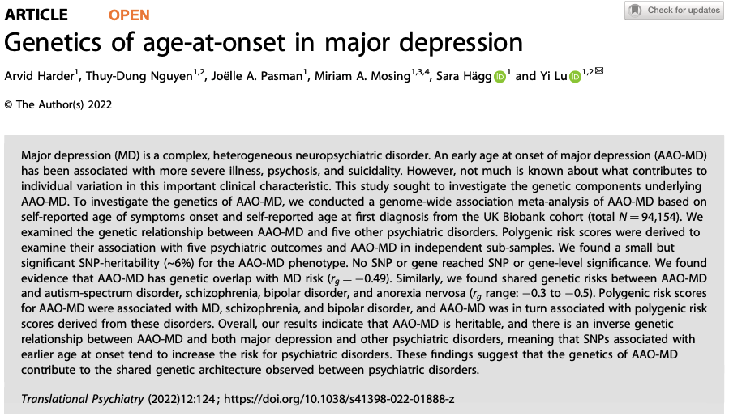
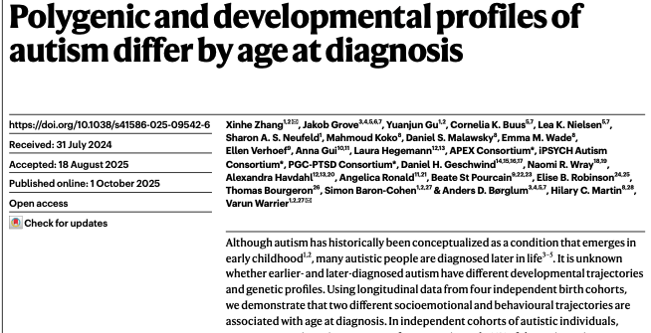
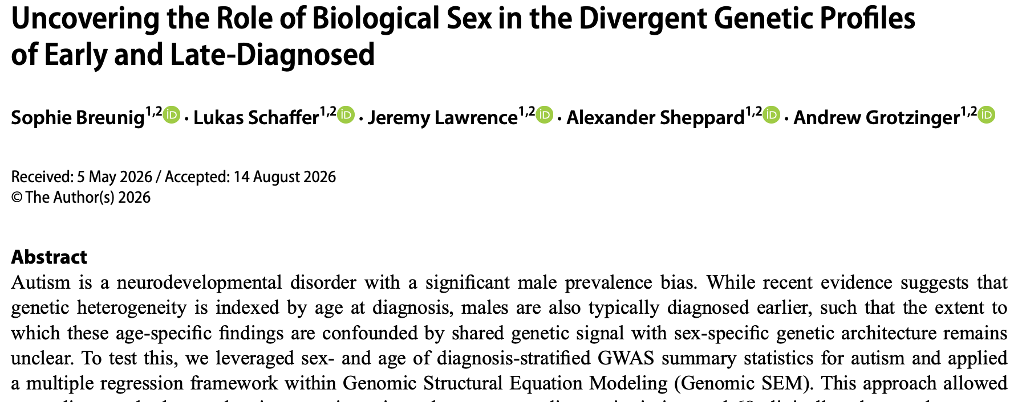
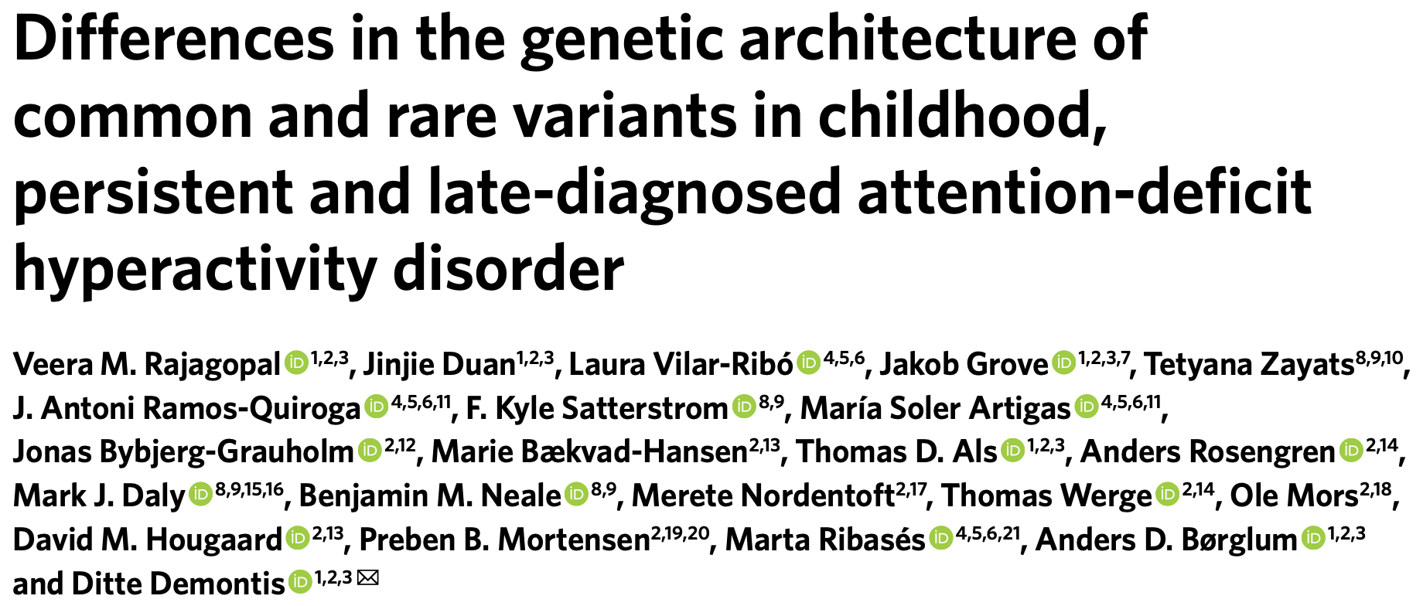
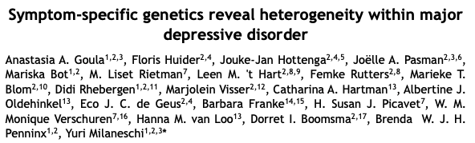
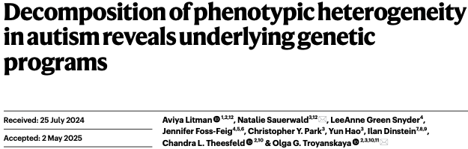
Current GWAS stratify cases to study the genetics of subgroups
Many recent GWAS perform stratified analyses to study differences in genetic architecture of subgroups
Examples:
Early vs. late onset of depression^{1,2}
Early vs. late onset of autism^{3,4}
Early vs. late onset of ADHD⁵
Symptom-based subgroups of depression⁶
Symptom-based subgroups of autism⁷
Although these point to genetic differences among cases, there is no optimal way of performing a pooled GWAS
¹ Shorter et al. Nature Genetics 2025
² Harder et al. Translational Psychiatry 2022
³ Breunig et al. Behavior Genetics 2026
⁴ Zhan et al. Nature 2025
⁵ Rajagopal et al. Nature Genetics 2025
⁶ Goula et al. medRxiv 2026
⁷ Litman et al. Nature Genetics 2025

Slide 5
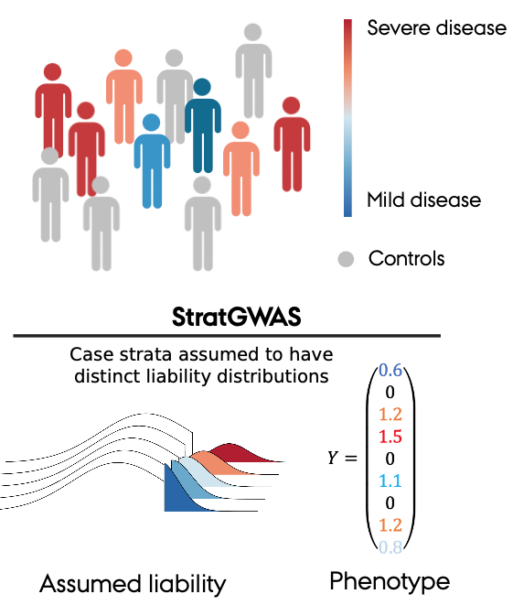
StratGWAS exploits clinical heterogeneity
We introduce StratGWAS, a new GWAS tool that uses heterogeneity information to improve the statistical power of GWAS
Three sources of input data are required:
  “Target binary trait”
  “Stratification variables” (age-at-onset, symptom score, …)
  Genotype data (.bed format)
StratGWAS computed a “transformed phenotype” that assigns weights to individuals based on disease subgroups membership

Slide 6
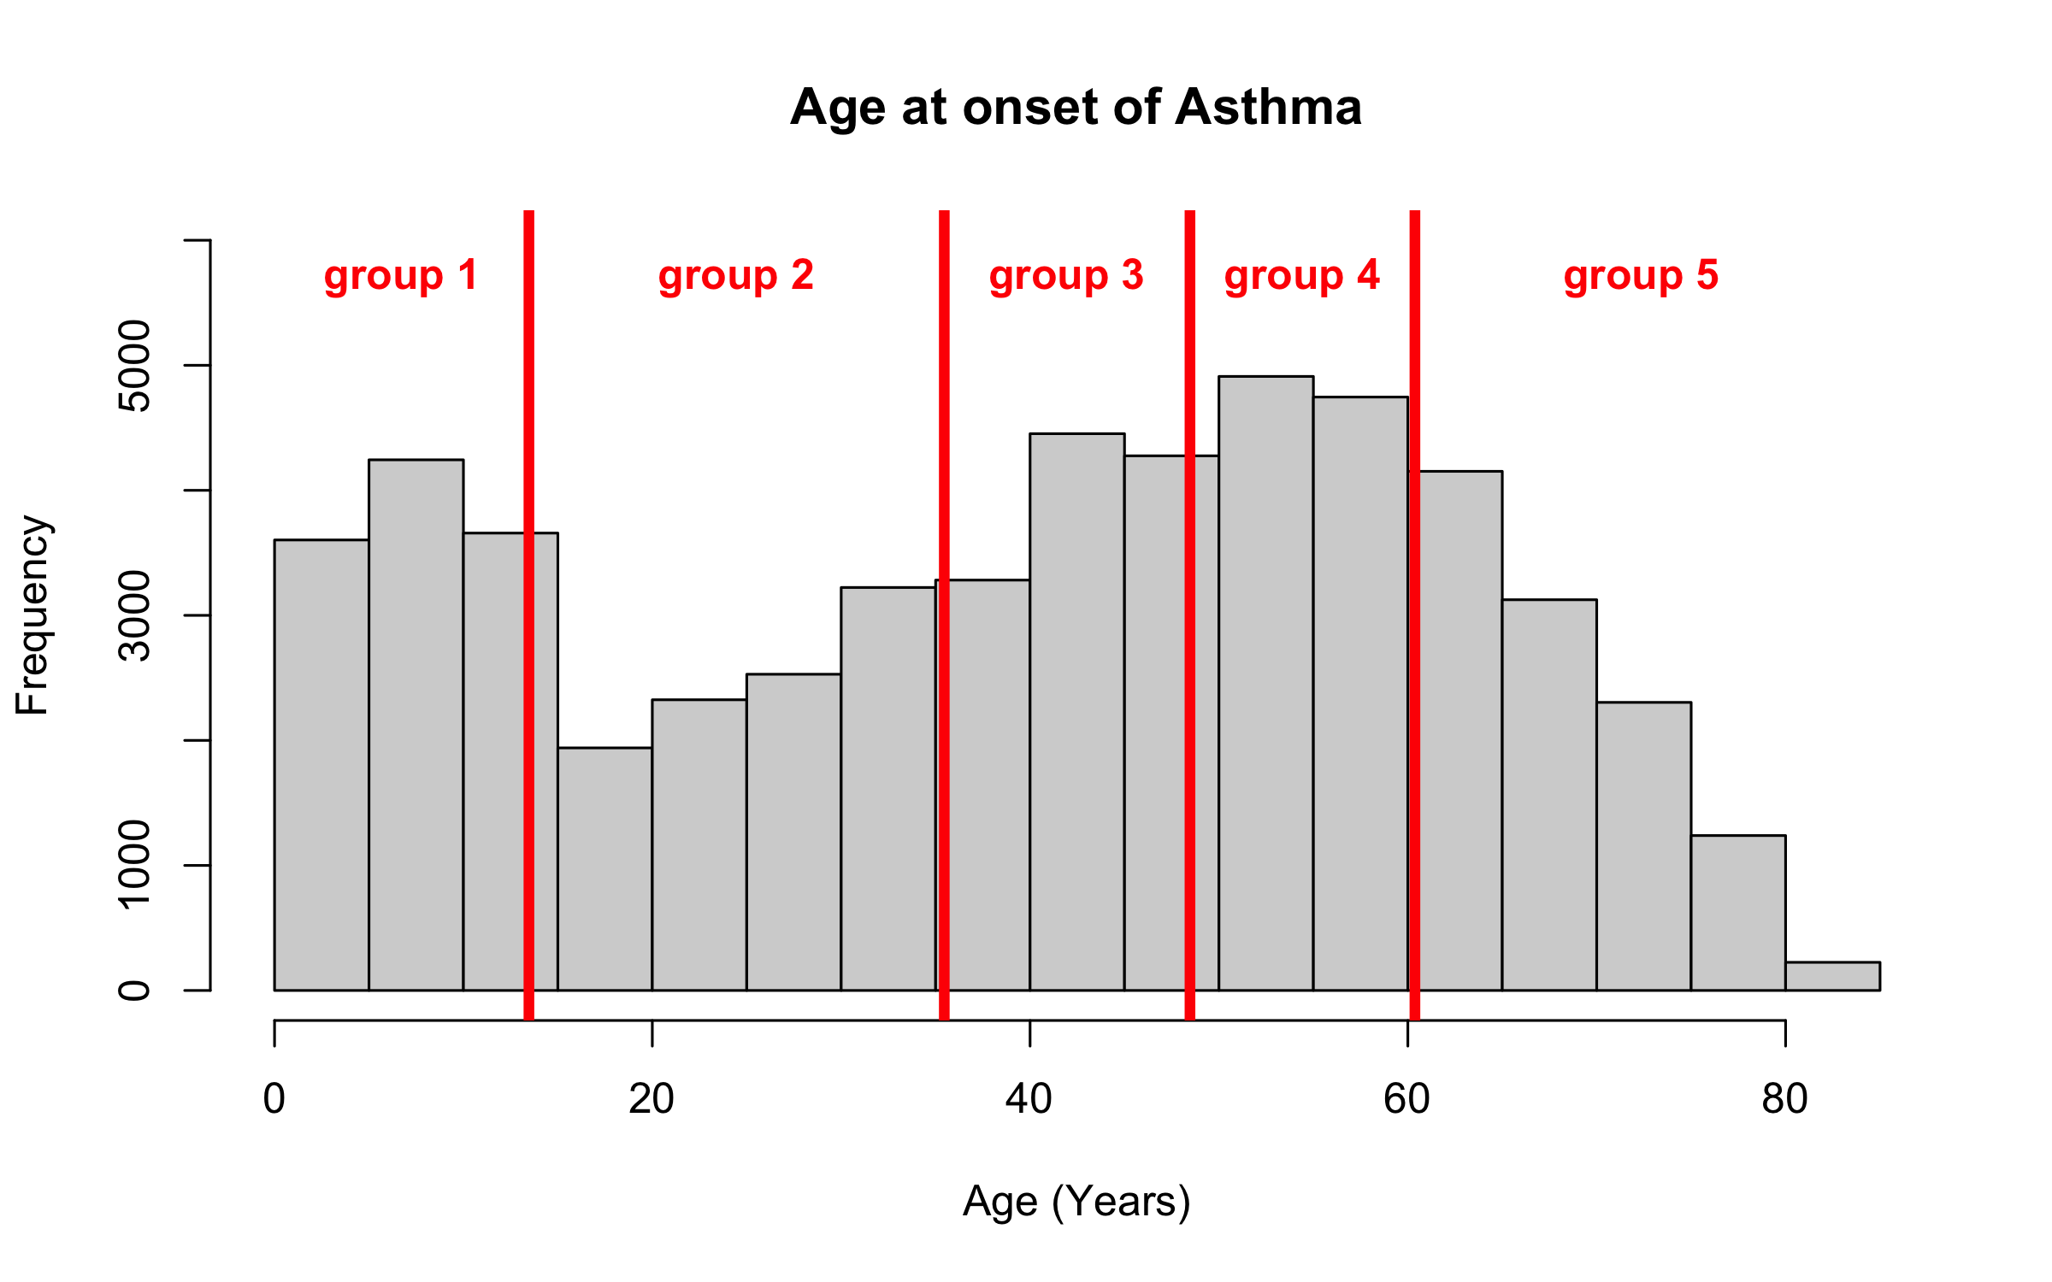
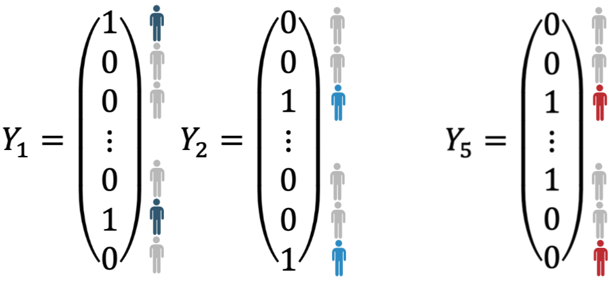





StratGWAS overview
Cases are partitioned into subgroups using “stratification variables”
Continuous stratification variable (e.g., age at diagnosis, medication uptake, …)
Categorical stratification variable (e.g., subtypes, comorbidities, questionnaire data, …)
StratGWAS constructs new phenotypes based on these subgroups, with shared controls
then runs a simple linear regression GWAS for each phenotype
the next slides assume analysis of one stratification variable, but there can be many!

Slide 7
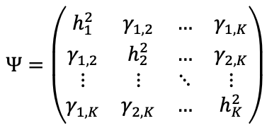
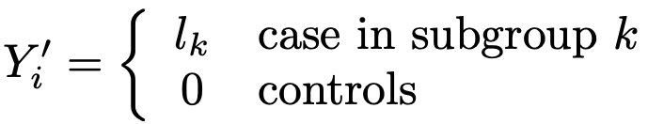

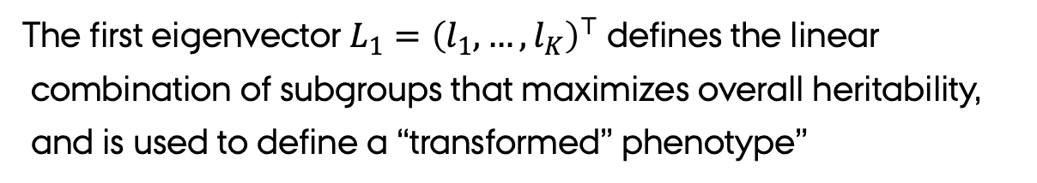
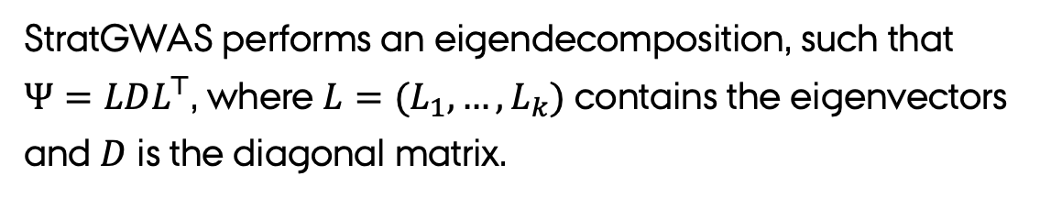
StratGWAS overview
Next, StratGWAS computes the matrix $Ψ$, whose entries are
estimates of genetic coheritability between disease subgroups
StratGWAS performs an eigendecomposition, such that
$Ψ=LDL^{⊤}$, where $L=(L_{1},…, L_{k})$ contains the eigenvectors
and $D$ is the diagonal matrix.
The first eigenvector $L_{1}={\left(l_{1}, …, l_{K}\right)}^{⊤}$ defines the linear
combination of subgroups that maximizes overall heritability,
and is used to define a “transformed” phenotype”

Slide 8
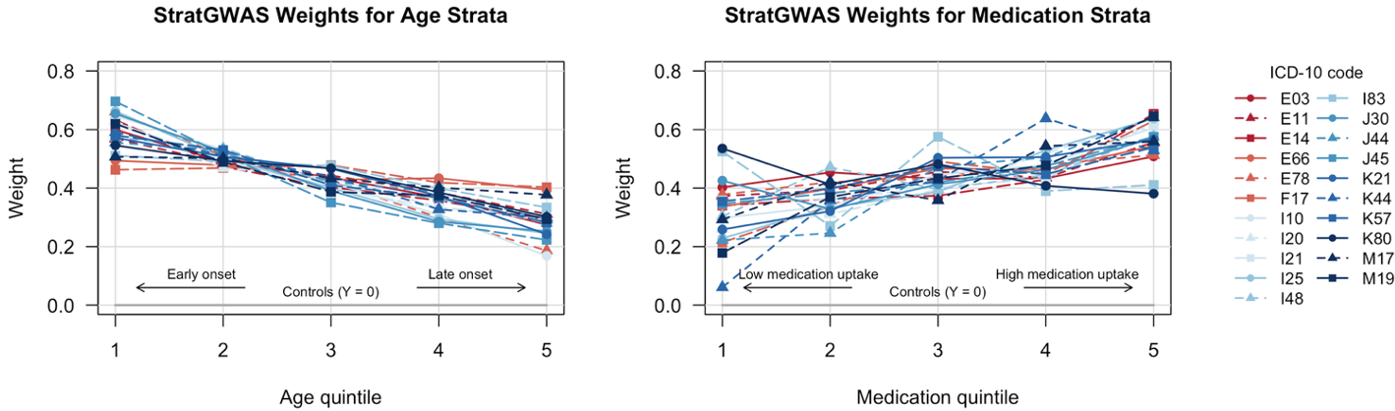
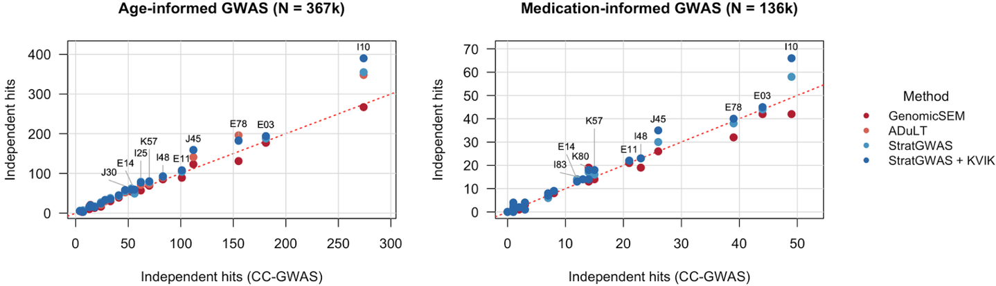
StratGWAS increases statistical power
We next applied StratGWAS to 21 binary traits in the UK Biobank, recorded as ICD-10 codes
Age-at-onset as stratification variable
Medication burden as stratification variable
Individuals with earlier onset or higher medication
burden were assigned higher weights
This translated in improved statistical power:
17% more independent loci for age
4% more independent loci for medication

Slide 9
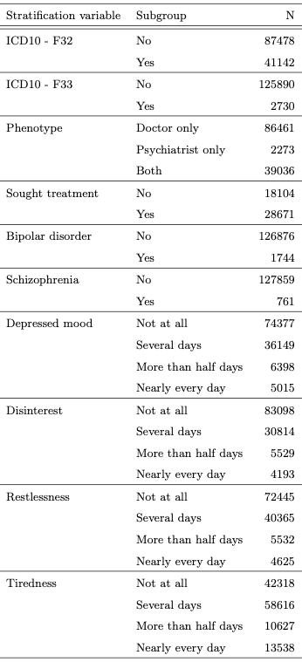
StratGWAS application to depression in UK Biobank
We applied StratGWAS to depression in the UK Biobank, using different stratification variables:
Diagnoses types
  ICD-10 codes F32 and F33
  Diagnosed by doctor only, psychiatrist only, or both
Indicator variable for seeking depression treatment
“Comorbidities”
  Bipolar disorder
  Schizophrenia
Self-reported depressive symptoms (from PHQ-9 questionnaire)

Slide 10
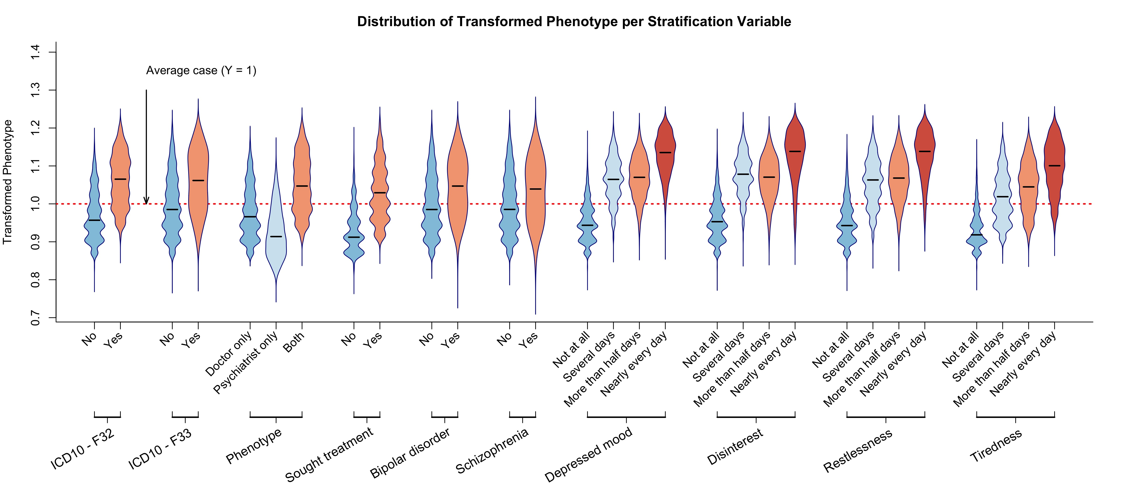
StratGWAS upweights severe cases of depression

Slide 11
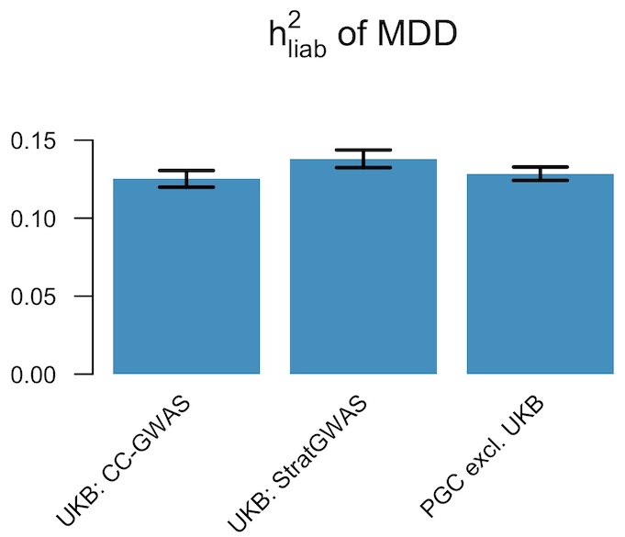

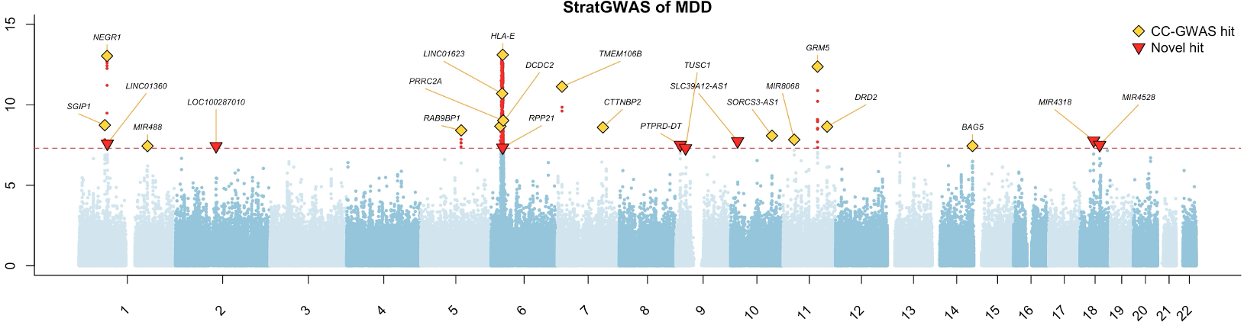
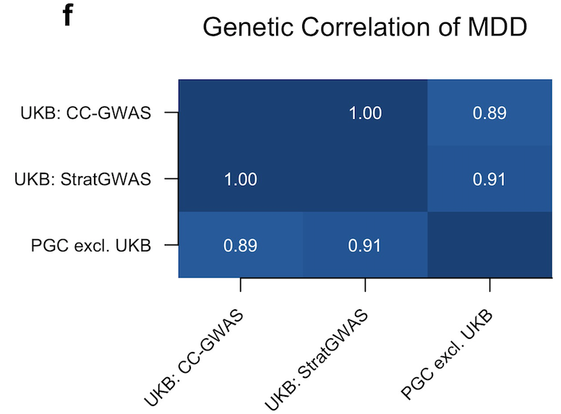
StratGWAS finds additional depression loci
StratGWAS identified 23 loci, versus 15 from case-control GWAS
7 / 8 new loci were replicated in PGC summary statistics
Heritability estimates were higher for StratGWAS summary statistics
Genetic correlation analysis suggests that the transformed phenotype preserves specificity
Notes:
Have the figures pop up along with the text (also consider this for other slides)

Slide 12
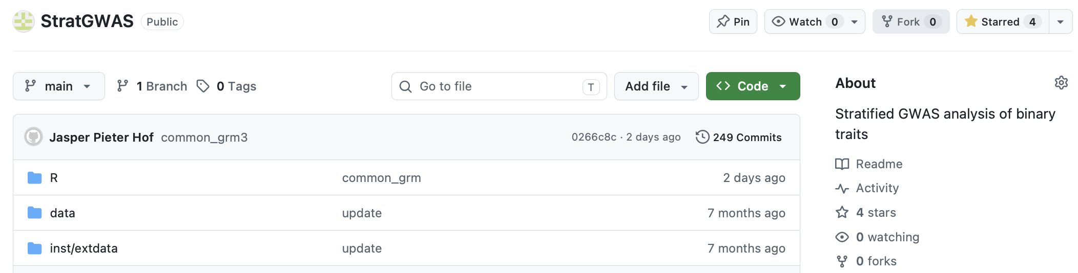
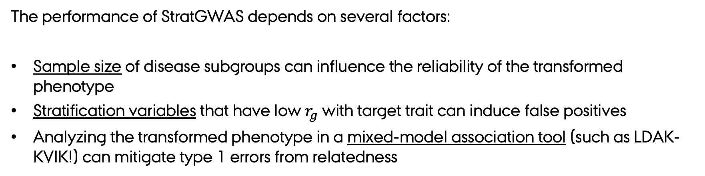
StratGWAS considerations
The performance of StratGWAS depends on several factors:
Sample size of disease subgroups can influence the reliability of the transformed phenotype
Stratification variables that have low $r_{g}$ with target trait can induce false positives
Analyzing the transformed phenotype in a mixed-model association tool (such as LDAK-KVIK!) can mitigate type 1 errors from relatedness
R package on GitHub →

Slide 13
A hypothetical scenario (?)
You are conducting a GWAS on major depressive disorder and observe two cases
- Case A: self-diagnosed, low symptom score, late onset
- Case B: clinically diagnosed, high symptom score, early onset
To improve power, likely better to assign higher weight to Case B
- Case A: a “proxy-case”: an individual likely to be case from data, but not phenotyped
- Case B: a hard phenotyped case
To improve power, likely better to assign higher weight to Case B

Slide 14
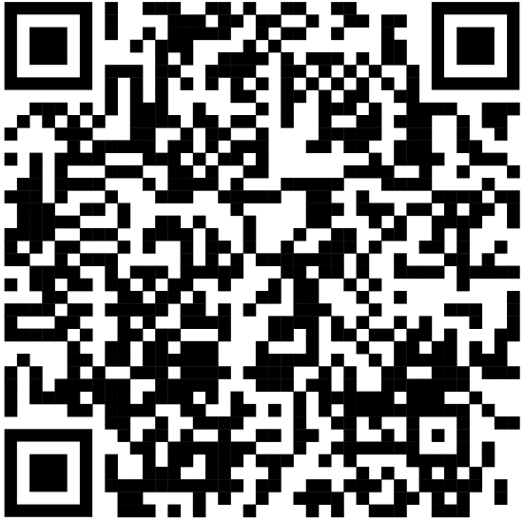
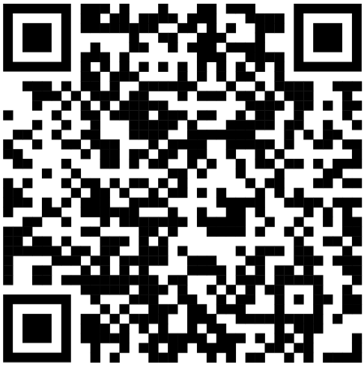
Summary
StratGWAS can leverage clinical heterogeneity to study genetic architecture of subgroups and compute a “transformed phenotype” for GWAS analysis
This boosts statistical power while preserving the specificity of the target binary trait
As biobanks expand their depth of clinical characterization, more possible applications of StratGWAS might arise
Medrxiv GitHub

