Slide 1

Rainfall Insights Platform
Spring Cloud on Kubernetes
Jasper Jiang
Notes:
Hello Everyone, Welcome to this talk on spring cloud on Kubernetes. I am appreciated you guys coming.
I’m Jasper Jiang. Currently I am working as a backend developer in Insights Platform team.
Before we start this talk, I want to know, how many of you guys attended the last microservice session which was presented by Joe?
That was a very good session which help us walked through from monolithic application to microservice application and gave us a brief understand of what is microservice.
I guess a lot of you guys may have interested in how does microservice looks like in the real world and how does microservice work in the real project.
Today I will take a little bit further to introduce how is our Insights Platform using microservice.

Slide 2
Agenda
Brief introduction about Cloud Native
What is Spring Cloud
What is Kubernetes
Spring Cloud on Kubernetes
Demo Time!!
Notes:
Here is the Agenda of today’s sharing. First I will have a Brief introduction about the Cloud Native. And I will introduce Spring Cloud and Kubernetes. At last I will show you some demo.
Ok, let’s start today’s sharing.

Slide 3
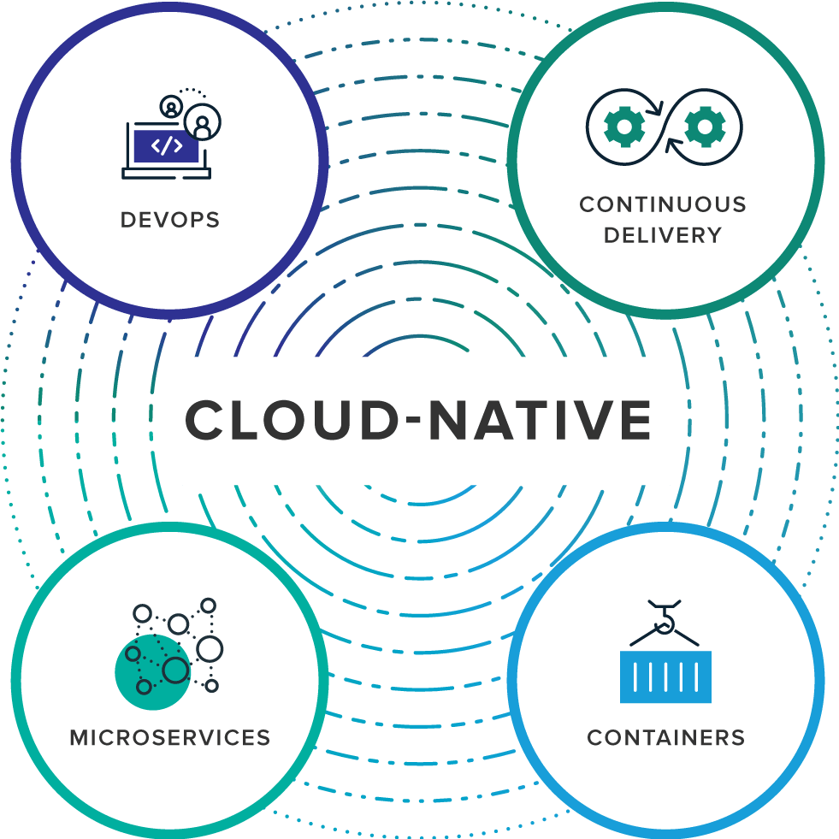
What is Cloud Native
Cloud Native is an approach to building and running applications that exploits the advantages of the cloud computing delivery model.
Notes:
Before we start talking about the spring cloud, I want to talk something about the Cloud Native first.
What is Cloud Native?
Cloud Native is not a specific technology. it is an approach to building and running the applications, which will use the advantages of the cloud computing delivery model.
Cloud Native contains 4 key components.
1. DevOps: is the collaboration between application developers and IT operations with the goal of constantly delivering high-quality application that solves customer challenges
2. Continuous Delivery: is about shipping small batches of application to production constantly
3. Microservices: is an architectural approach to developing an application as a collection of small services
4. Containers: Using operating system (OS)-level virtualization to offer both efficiency and portable

Slide 4
Advantages of Cloud Native
Modular
Quick Deployment
OS Abstraction
Continuous Delivery
Right Sized Capacity & Auto Scaling
Rapid Recovery
etc.
Notes:
Why do we need the Cloud Native, we can directly design our applications like how we used to do pretty soon. So why we need those
1. Cloud Native can make our applications Modular which means we can create a bunch of microservices which can reduce the effort in delivery and testing in production
2. Because each microservices are small enough, it can bring us a quick deployment.
3. With Cloud Native you don’t need to worry about which Operating System you will use, what are the settings, how we maintain them, you don’t need to worry about them.
4. Cloud Native is friendly for Continuous Delivery which can give us a good feedback from the users
5. We can easily size the capacity according to the requirement and enable the auto scaling if we needed.
6. Because each module is isolated it is very easy to recovery the system.

Slide 5
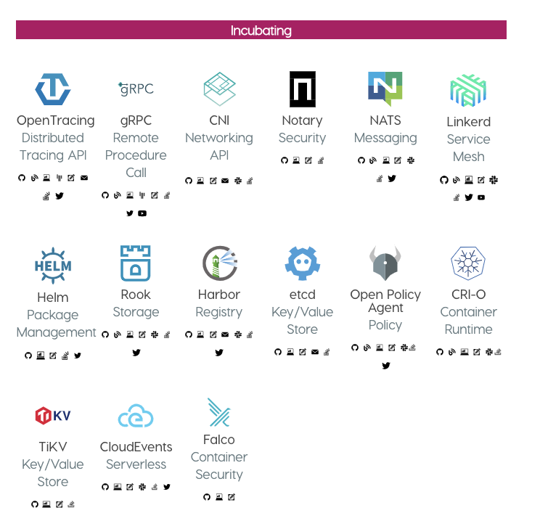
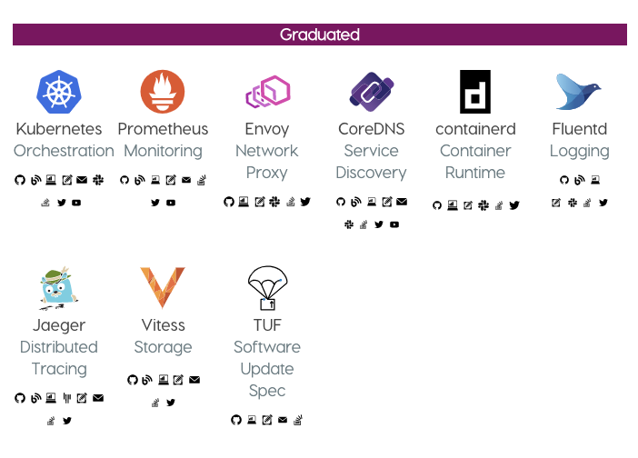
Cloud Native Computing Foundation
https://www.cncf.io/

Slide 6
Why Spring Cloud
Cloud native apps are a good thing, just not easy
Don’t need to reinvent the wheel each time
Providing useful defaults
Cloud Agnostic
Saving time!!
Notes:
So we know about the Cloud Native, why we need Spring Cloud. What spring cloud can help us?
1. We can all agree that Cloud Native applications are a good thing, but is just not easy to do right?
2. To build a Cloud Native applications you need a lot of resources like time, people and money. And they can do a lot and get a lot of achievement pretty fast right? But you are not someone with that types of resources what you gonna do? you need to produce the same speed as them, but you don’t have resources.
3. Actually the big company like Google, Netflix they have done a lot of works to build the open source libraries that can help us to build the cloud native applications. So why we have to reinvent the wheel every time without use these things.
4. So flowing the Spring Boot model of doing things, the spring cloud provide an opinionated way of building the cloud native applications with bunch of useful defaults.
5. And Spring Cloud is Cloud Agnostic, so it don’t care were we run the applications.

Slide 7

Spring Cloud Components
Service registration and discovery
Eureka
Service load balance
Ribbon
Circuit breaker
Hystrix
API Gateway
Zuul
Centralized configuration management
Config
Invoke path tracing
Sleuth
Notes:
So let’s take a look of some of the components of Spring Cloud.
1. The first one is Service registration and discovery: You have a bunch of microservices that are make up your cloud native applications. They need to talk to each other, and they need to know where they live because that might change from time to time. Because the dynamic nature of cloud native
2. Service Load Balancer: which can reduce the pressure from a single instance
3. Circuit breaker: can help protect your applications in your users from failure
4. API Gateway: is quit important for your front-end client to talk to the back-end services, it’s going to route requests from your clients to the various micro services.
5. Centralized configuration management: When developing a cloud application, one issue is maintaining and distributing configuration to our services. To solve this, we will collect all our configurations into a single Git repository and connect that to one application that manages a configuration for all our services.
6. Tracing: Debugging a Micro Service application is a headache, because you have a lot of microservices that you don’t know which one is having the issue. so you need a tracing system to help you locate the issue.

Slide 8
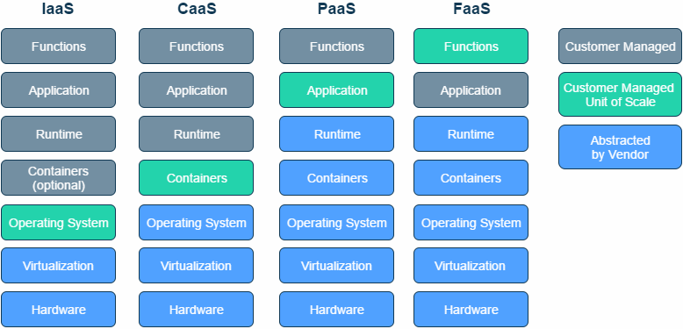
Where to Deploy
I DON’T CARE
Notes:
After we know something about the Spring Cloud. Let’s take about where to deploy our applications.
As a developer we need to choose where we gonna deploy our applications. Like these picture.
1. The type of platform we choose the only difference is the level of control we are giving up to the platform and what we control by ourselves.
2. Like the Infrastructure as a Service the platform just provide the hardware and virtualization and we will control everything from the operating system.
3. And The Function as a service we just need to provide piece of code and the platform will control everything below that.
4. So it about what you want to control and what you don’t want to control.
5. But besides IaaS we have container as a service it have a lot of advantages like we want a little bit more control of our environment we can use it. and it is portable, so that we can easily move it from one environment to the next.
6.but from the spring cloud perspective, it don’t care. you can run your spring cloud applications in your local machine, it doesn’t matter.

Slide 9
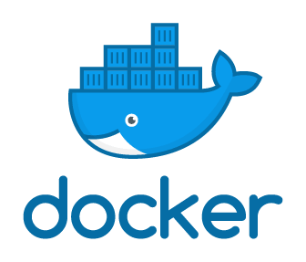
Containers
Notes:
When we talk about the containers there is a thing called docker. Which can Allow us the build the containers very easy

Slide 10

Spring Application in Container
FROM openjdk:8-jre-alpine
COPY ${JAR_FILE} app.jar
ENV JAVA_OPTS=""
ENTRYPOINT [ "sh", "-c", ”java -Djava.security.egd=file:/dev/./urandom -jar /app.jar" ]
Notes:
And it is Also very easy to get the spring boot applications running inside the docker. We just need to use this Docker File.
First, we are setting the base images ………….
But in the cloud architecture we are not only have one container or two of these containers we will have hundreds of these containers. How do you manage these containers ? How do you make sure they are all running properly? How do you make sure they are all healthy?
The docker will not solve these it just provide you a container right? so what we gonna do?

Slide 11
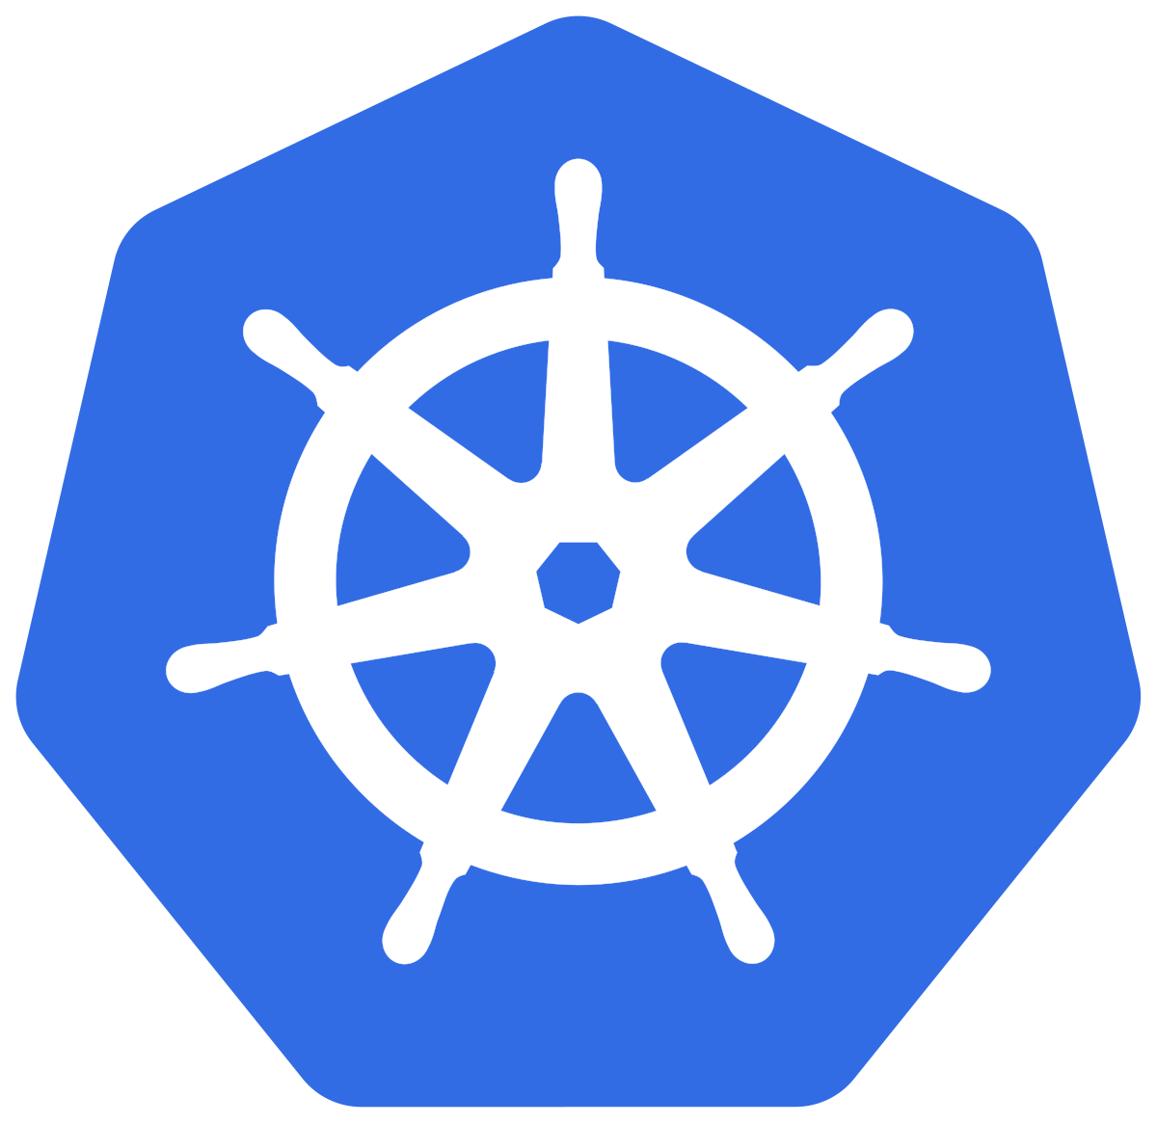
Kubernetes
What about Kubernetes?
Notes:
So what about the Kubernetes?
Kubernetes is an open-source system for management of containerized applications. So you don’t need to worry about those headaches.

Slide 12
Spring Cloud Components
Service registration and discovery
Eureka
Service load balance
Ribbon
Circuit breaker
Hystrix
API Gateway
Zuul
Centralized configuration management
Config
Invoke path tracing
Sleuth
Notes:
Do you remember this slide?
So with Kubernetes we can replace few of them by the feature which Kubernetes provided

Slide 13
Spring Cloud On Kubernetes
Service registration and discovery
Kubernetes
Service load balance
Kubernetes
Circuit breaker
Hystrix
API Gateway
Zuul
Centralized configuration management
Config
Invoke path tracing
Sleuth
Notes:
Like Service Discovery and load balancer, we can use services Component to achieve.
Not only these we can get from spring cloud on Kubernetes.

Slide 14
Spring Cloud On Kubernetes
Service registration and discovery
Service load balance
Circuit breaker
API Gateway
Centralized configuration management
Invoke path tracing
High Availability
Scalability
Health Check
Rolling Update
Service Mesh
Kubernetes
Kubernetes
Hystrix
Zuul
Config
Sleuth
Kubernetes
Kubernetes
Kubernetes
Kubernetes
Istio
Notes:
actually we can get more.
We can get High Availability, Scalability, Health Check, Rolling Update and more of them.
I will introduce and demo some of these features today.
Let get deeper

Slide 15
High Availability
Node 1
Node 2
Node 3
Service 1
Service 3
Service 4
Service 2
Notes:
What is High Availability?
let’s imagine you have 3 nodes in your cluster. and servel services are running in these nodes

Slide 16
High Availability
Node 1
Node 2
Node 3
Service 1
Service 3
Service 4
Service 2
Notes:
one day one of your node down.
how about the services which are on this node? They will not be able go access right?
it is a disaster

Slide 17
High Availability
Node 1
Node 2
Node 3
Service 3
Service 4
Service 1
Service 2
Notes:
Kubernetes will help you to move these services to the other working nodes. So your system won’t down. And once the Node up and running again it will automatically be joined back to the cluster as a worker node and waiting for the assignment.

Slide 18
Scalability
Request
Instance 1
Notes:
Then let’s talk about the Scalability.
Imaging you have 1 request going to one instance. And it is working very well. but how about this?

Slide 19
Scalability
Requests
HELP !!!!!!
Instance 1
Notes:
you have bunch of requests going to the single instance at the same time, and your instance will have a very big pressure to handle these requests.

Slide 20
Scalability
Requests
Instance 1
Instance 2
Notes:
In Kubernetes you can easily scale up your service into multiple instance that can balance the pressure. And you can enable the Auto Scale ability to make your service automatically scale up or down according the cup and memory usage. Which can solve the problem and save the money as well.

Slide 21
Health Check
Instance 1
Instance 2
Requests
Notes:
now let’s talk about the Health Check, what is health check?
For a cloud system the network and applications are very complicated.
For small part breaks, the system should detect it, route around it, and fix it, and it should be all automatically.
If your one of your Instance goes down, other services should not access it.
Instead the request should be sent to another instance which is ready. The system should also bring your service back to the healthy status

Slide 22
Health Check
Instance 1
Instance 2
Requests
Notes:
Instead the request should be sent to another instance which is ready. The system should also bring your instance back to the healthy status

Slide 23
Types of Health Check
Readiness
Liveness
Notes:
Kubernetes provide 2 Types of Health Check. Readiness and Liveness

Slide 24
Readiness
Requests
Ready
Loading: 30%
Readiness Pass
Readiness Fail
Notes:
Readiness is designed for letting Kubernetes know when your instance is ready to traffic. Kubernetes will make sure that readiness check passes before it send request to the instance. if the readiness check start to fail Kubernetes will stop sending request to the instance.
Imaging your service will need time to boot up. And your request will not go to the booting instance. until your instance fully start

Slide 25
Readiness
Requests
Ready
Ready
Readiness Pass
Readiness Pass

Slide 26
Liveness
Requests
Ready
Ready
Liveness Pass
Liveness Pass
Notes:
Liveness let kubernetes know your instance is live or dead. If your instance is dead, kubernetes will remove the instance and start a new one to replace it.
Imaging your app is having the deadlock or the memory issue. by default kubernetes will consider your pod is still ready and continue sending request to that.

Slide 27
Liveness
Requests
Ready
Pod Restarting
Liveness Pass
Liveness Fail
Notes:
but with Liveness setting, Kubernetes will know this pod is not ready , stop the request., restart it.

Slide 28
Liveness
Requests
Ready
Ready
Liveness Pass
Liveness Pass
Notes:
kubernetes will start the request to the instance until it is ready

Slide 29
Kubernetes
Service registration and discovery
Service load balance
High Availability
Scalability
Health Check
Notes:
Ok, we told pretty much about the Kubernetes future. Let’s have a Demo time

Slide 30
Demo Time!!

Slide 31
Thank You!

