Slide 1
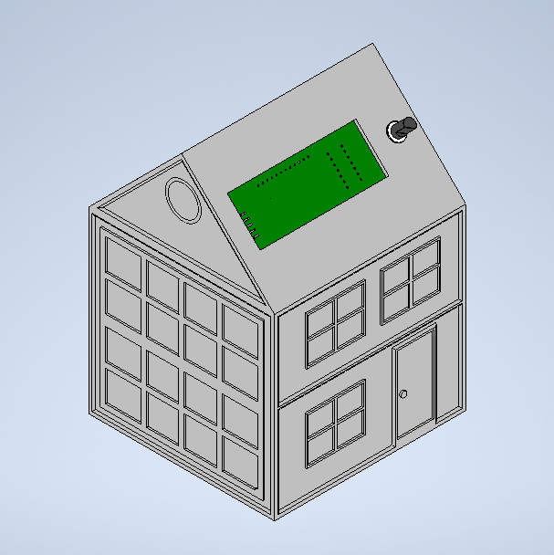
Project design - Soldering station
Jasper Maes
1EAI

Slide 2
Table of contents
Goal of this project
Schematic design
PCB design
Components
Errors
3D case design
Reflection

Slide 3
Goal of this project
Learning to:
Design in Altium designer
Design in Inventor/Fusion 360
Mount PCBs
Troubleshoot

Slide 4
Schematic design
Altium Designer
Consists of 5 parts
Soldering iron controller
Power supply (2 X 12 V inlet)
Temperature measurement
Main IC schematic
Display board
Notes:
Controller == power is sent to the soldering iron
ATMEG placed on main IC = ATMEG = main microcontroller

Slide 5
PCB design
Altium
Based on schematic
Autorouting (still some errors)
Ordered at JLC
35,36 euros (shipping included)

Slide 6
Components
BOM (see GitHub)
Mostly ordered at Farnell
Total price (all components) = 99,28 euros
Notes:
Brings the total of the project to: 134,64 euros

Slide 7
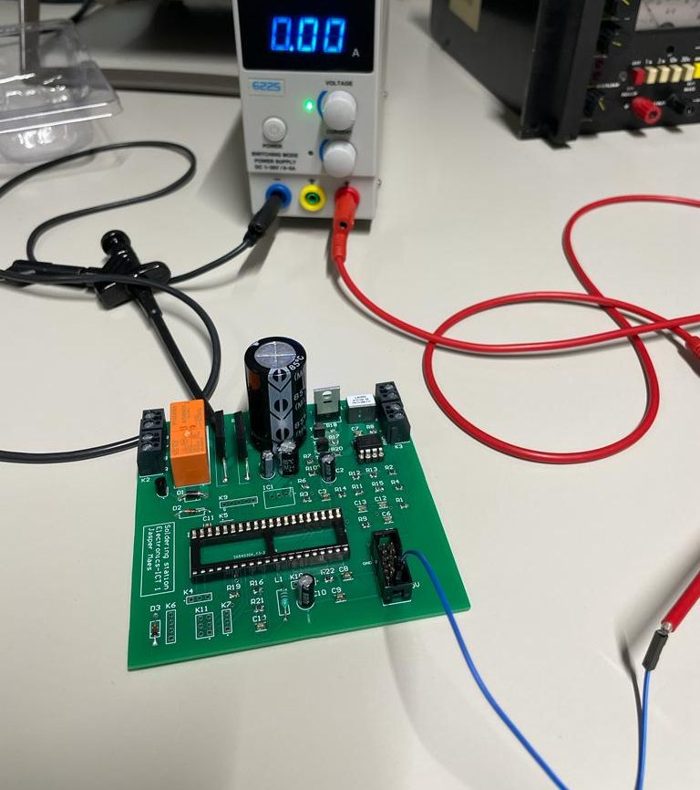
Errors
Errors in the schematics
Lane not drawn (autorouting bug)
Wrong footprints
Some other unknow bug
Notes:
Footprints of: display IC, Bridge rectifiers, capacitor and transistors where wrong

Slide 8
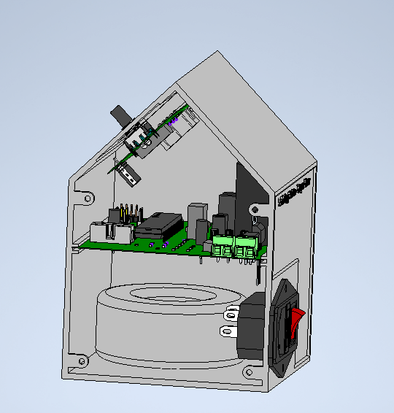
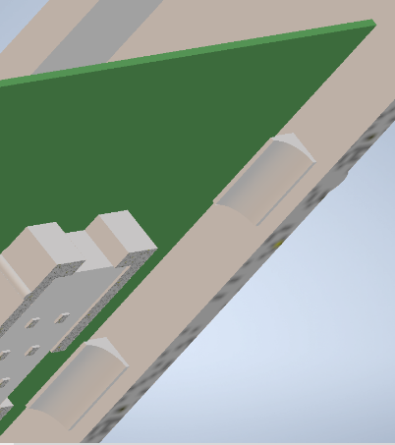
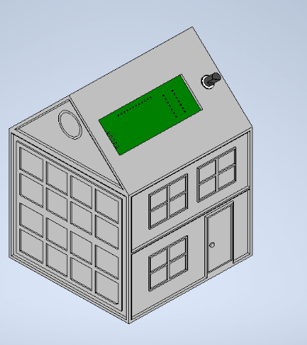
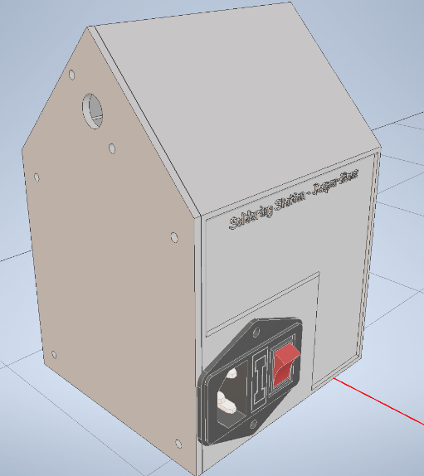
3D case design
Not printed
No PCB screws
Closure provided
Notes:
First: guitar amp
Then, house (not enough time for amp)
the main print is slid into a slot

Slide 9
Reflection
Interesting project
Still bugs on the PCB
Notes:
If the bugs are fixed, the project should work perfectly

Slide 10
Any questions?
Thanks for listening

