Slide 1
Procedural Programming
Procedure
Data
Object-Oriented Programming
Data
How to describe the object by data
What operations the object contains
How data is stored

Slide 2
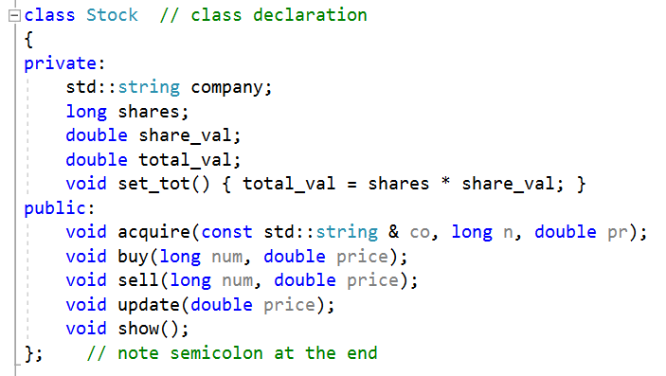
data type just like int, float…
information to describe an object
public interfaces for operating object

