Slide 1
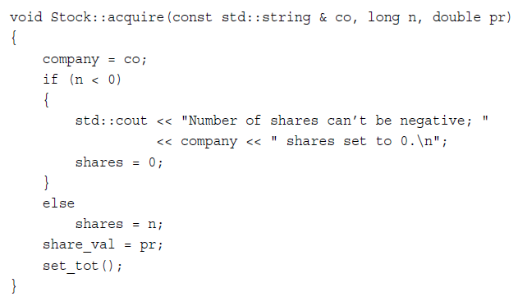
scope-resolution operator
acquire() is a member function for class Stock
acquire can be used for member function for other classes

