Slide 1
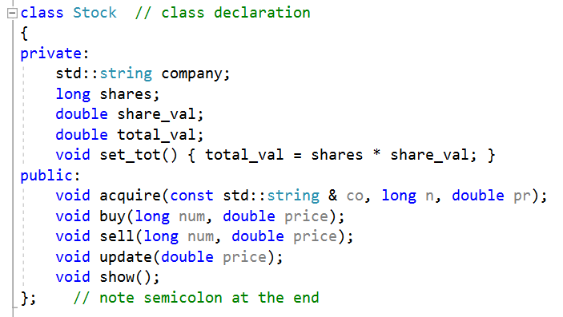
data type just like int, float…
information to describe an object
public interfaces for operating object

