Slide 1
Architecture of Distributed Systems
2015-2016
Homework assignment 2
TU/e Parking System
Jasper Selman, 0741516
Ramon de Vaan, 0758873

Slide 2
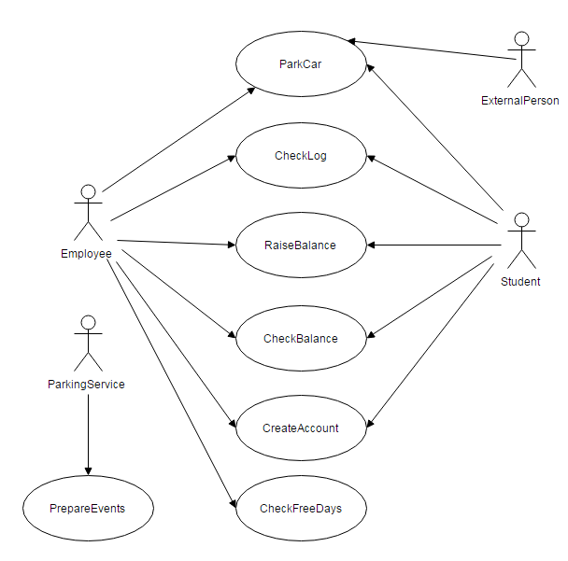
Use Case Diagram

Slide 3
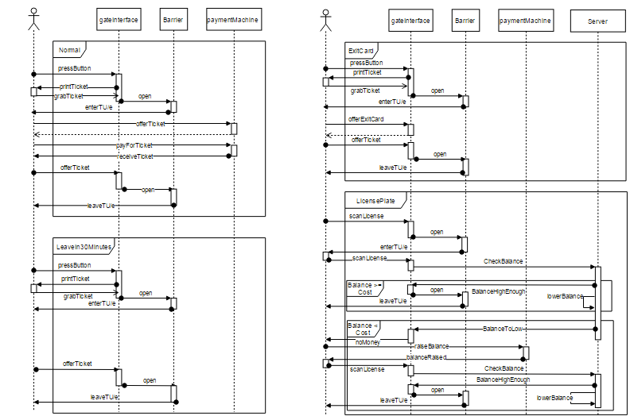
Message Sequence Chart
Notes:
Building blocks:
Connectors:
View – concern – stakeholder (1..*):
Extra-functional requirements (Y + motivation) /N :
Security:
Availability & reliability:
Maintainability:
Performance and scalability:
Distribution (Y + motivation) /N :
Clarity/Semantics ( ☺ | 😐 | ☹) + motivation:

Slide 4
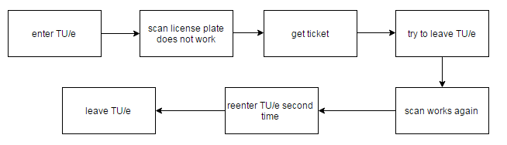
Worst Case Scenario

