Slide 1
Architecture of Distributed Systems 2015-2016
Homework assignment 2
TU/e Parking System
Jasper Selman, 0741516
Ramon de Vaan, 0758873

Slide 2
Architectural Style(s)
Client-Server
We have adopted the client-server architectural style, due to the independent nature of the system.
On one hand, the system consists out of a database, which allows users to register using their campus card. In this part, the user can register cars, check and increase balance, and enter the campus with either automatic license plate recognition, or campus card scanning. Upon leaving, the cost of parking is automatically deducted from the user’s balance. Of course all users can only access and alter their own data.
This situation can be easily modeled via a client-server architecture, where we keep a database of users, balances, etc. which the users can access and alter via requests via either the web client, or the payment machines at the campus.
One the other hand, part of the system does not interact with the server at all. Users are also allowed to enter the campus with a ticket containing a timestamp. Upon leaving the campus, a ticket has to be fed into the machine at the barrier, which verifies that the timestamp was within 30 minutes ago. Users can get a new ticket via the payment machine by paying an amount dependent on the last ticket.
This shows the independent nature of the system. The server is not needed at all times, and is request based instead. Thus reinforcing the need for a client-server style.

Slide 3
Interaction Style(s)
Request- Reply / Remote Procedure Call:
We think that the most important interaction style used is the request- reply style or remote procedure style. This
style is used because of the client server connection. Users log in on their account (client) and make requests about
their accounts to the server. This style is very common for Remote procedure calls, it has good portability of code, it
reduces the language and operating system dependence and accesses transparency. Especially the dependence on
OS is important since users might log in on their account using different browsers and/or OS. It is important that this
works.
Problems that need to addressed though, are scalability and reliability. You do not want that when a lot of
employees/students login on the system, that the system fails or that transactions to you account are missing.
The communication between the server and the client need to be synchronous because of the issues just mentioned.
When you make a change to your account you want the server to reply if the action is confirmed or not. If you make it
asynchronous weird things can happen, since the client can continue while it is in an error state.

Slide 4
Extra Functional Requirements
Security:
There are accounts at stake and these accounts contain personal data, which the employees do not want to be
available for everyone (think of license plates). This is why this system needs to have a certain level of security to
make sure that this information stays classified.
Availability:
It is important that at every moment of the day the system works (especially the gate system). If that that part does
not work, people are not able to go to their work. Next to that if the online account system fails, then people are not
able to change their balance and therefore might not be able to leave campus.
Maintainability:
You want a system that is easy to maintain. There are several systems build on each other (the old ticket system and
the new license plate system).You should be able to maintain these parts separately.
Usability:
Since there are a lot of users who use the system and the system need to work fast (for the gate part), since
the gates to the university will be blocked, the system need to be easy to use. The part regarding the gates should
only require a few actions. The online system may be somewhat more complex, but should still be easy to use and
clear.

Slide 5
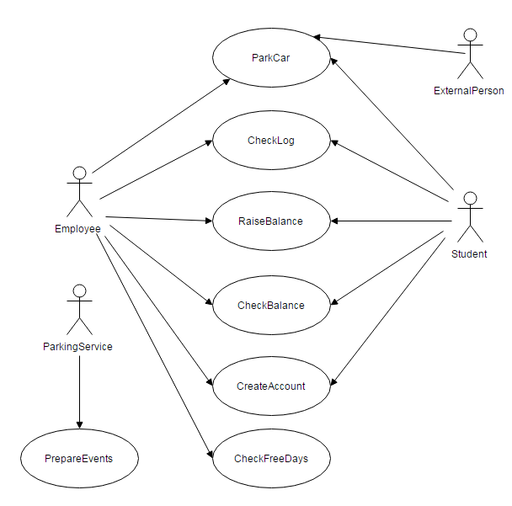
Use Case Diagram
Stakeholders:
There are some stakeholders that we can easily define.
These are the people who will use the system the most.
These are obviously employees and students. They part at
the TU/e, but also need to maintain their accounts such
that there balances are high enough to keep on parking at
the TU/e.
The parking service has to make sure that the system
keeps working and every now and a while need to prepare
for events for which may or may not free parking is
available.
At last we also have external persons. For this you can think
of people who are involved in events, business people but
also guest lecturers and many others. They also need to be
able to park their car on the TU/e campus.

Slide 6
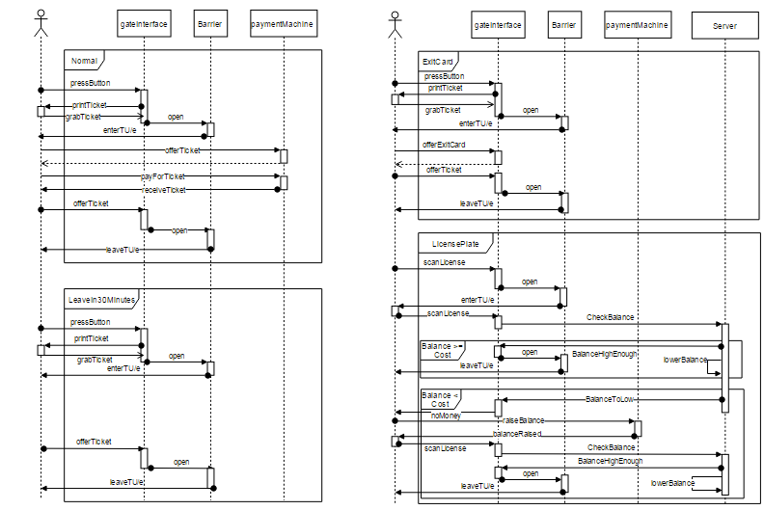
Message Sequence Chart
Notes:
Building blocks:
Connectors:
View – concern – stakeholder (1..*):
Extra-functional requirements (Y + motivation) /N :
Security:
Availability & reliability:
Maintainability:
Performance and scalability:
Distribution (Y + motivation) /N :
Clarity/Semantics ( ☺ | 😐 | ☹) + motivation:

Slide 7
Stakeholders & Viewpoints
Use Case Diagram:
Information: This is a very simple diagram which describes the most common scenario’s which need to be executed on the parking system. This involves parking at the TU/e, checking accounts and changing balances. When a certain actor is involved in a use case, an arrow is drawn to that use case.
Stakeholders: As described before the stakeholders in this diagram are employees, students, external persons and the parking service.
Viewpoints: This diagram has two viewpoints. The scenario and logical viewpoints where the users can see what they can do using this system.
Message Sequence Chart:
Information: This chart shows the interaction of the users to the parking system for the most important (in our opinion) scenarios. The actors in the scenario’s could be employees/students/external persons. The most important parts with which the user needs to interact are modeled in the charts. The chart shows how the interaction between the parts happens and in what order. The arrows between parts are labeled such that it is clear what they do.
Stakeholders: The stakeholders of the former use case diagram are now also involved. On top of that other people who benefit from this chart are programmers and testers. They know how components have to interact and what has to happen.
Viewpoints: This diagram also has two viewpoints, namely the process view and the scenario view. Programmers and testers see how the various parts interact and how they should be tested. The implementation details can be determined by the programmers.

Slide 8
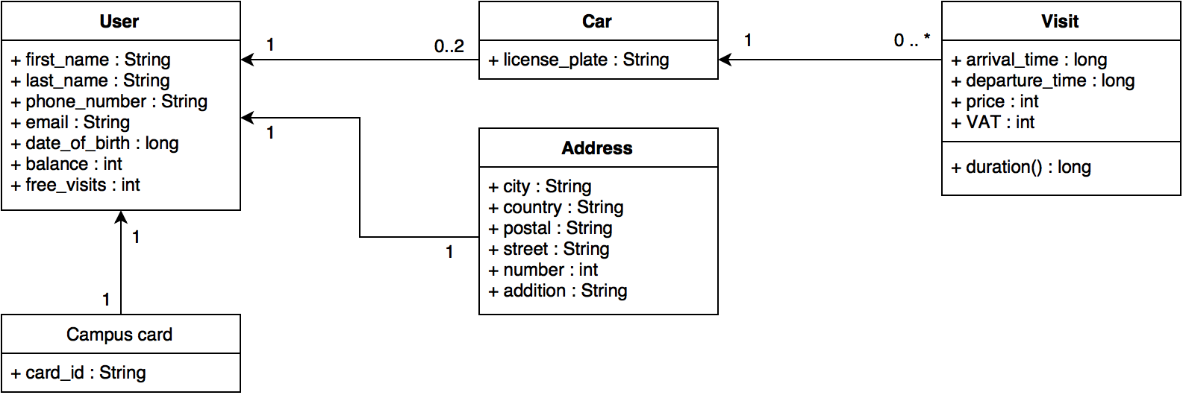
Class Diagram
Information: This is the class diagram that may be used in the online part of the TU/e parking system. It shows the relations between different classes, along with variables needed.
The model shows that a user can have up to two cars associated to their account. Additionally, each of those cars can have any number of visits.
Stakeholders: This class structure will be of interest to the programmers who have to implement the system.
Views: The model is part of the logical view, as it shows important aspects of the system and their relationships, while still leaving some room for interpretation, for example, the timeline is missing. Additionally, the model is part of the development view, as it shows how a certain aspect of the system is to be implemented.

Slide 9
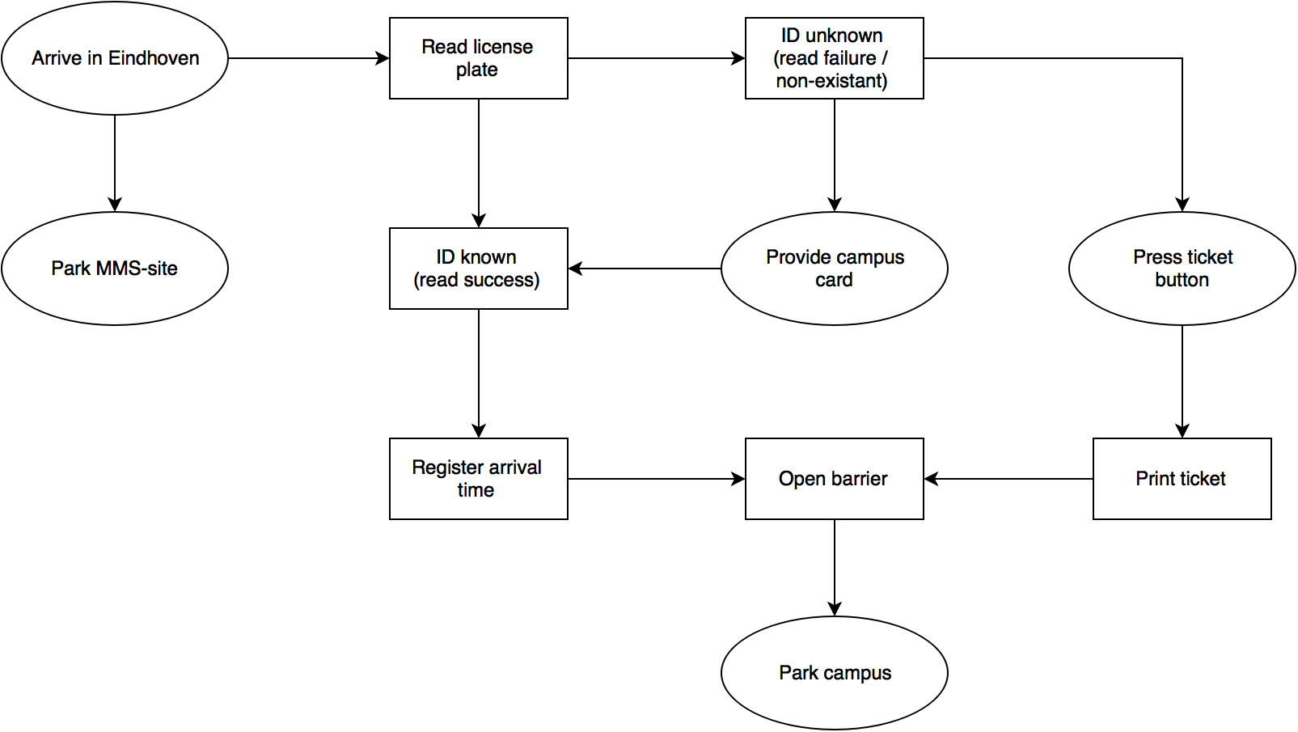
System overview (entry)

Slide 10
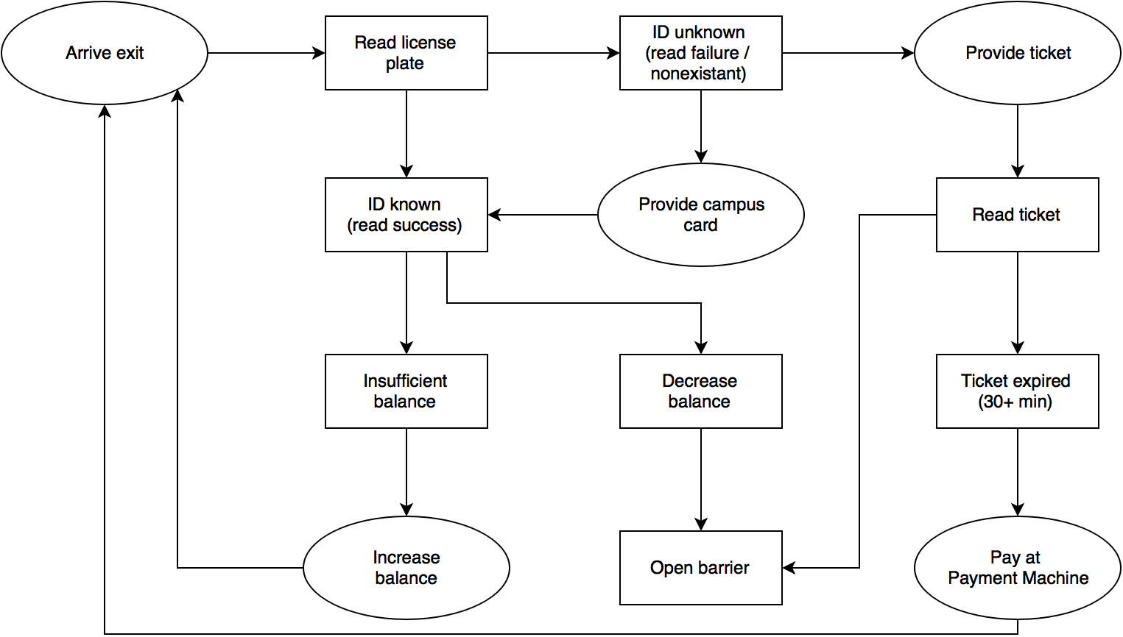
System overview (exit)

Slide 11
System overview
Information: The system overview models given above visualize the interaction between the system and the user, along with the most general actions the both of them perform in the interaction. The actual implementation with function calls and database checks are left out, it is simply an abstract overview.
Actions taken by the user of the system are displayed in ellipses, while actions taken by the system are given in rectangles.
Stakeholders: The models are useful to system acquirers, as it gives a clear overview of what the system is supposed to do, where many other models are often far too detailed. This is also useful to system developers to refer to when the internal system development becomes to complex.
Views: The models mostly concern the logical view. The main aspects of interaction with the system are shown, without actually showing implementation details.

Slide 12
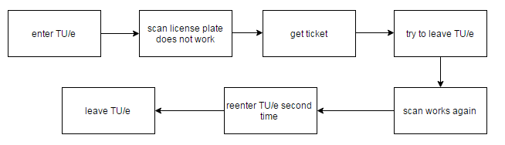
Worst Case Scenario
We have created a scenario, where it is hard for the system to decide what has to happen next. This scenario is shown
with blocks, which represent which action happens after the other action.
First an employee/student arrives at the TU/e. His license plate cannot be scanned and he forgot his TU/e employee /
student card. The only option left is to take a ticket from the machine so he does that. Now after a long day the person
wants to leave the TU/e again. He forgot that he had taken a ticket, because his license plate was registered. He drives
up to the gates and this time the license plate scanner works. Only there is a problem. It never registered the car arriving
at the TU/e, so it does not know whether it should open the gate or not and what price should be accounted. For all the
machine knows the vehicle was already 5 days on the TU/e.
This example shows us that there are scenario’s which gives problems when the old and the new parking system
intervene.

