Slide 1
Architecture of Distributed Systems
2015-2016
Homework assignment 1
Jasper Selman, 0741516
Ramon de Vaan, TODO
Rudolf Mak TU/e Computer Science
Rudolf Mak TU/e Computer Science

Slide 2
Exercise
Consider the models on the following slides and answer the
following questions. Each model is provided with a hyperlink
to acknowledge its source and for additional information.
  What building blocks do you see? What do they represent? Are they conceptual or physical?
  Same questions as 1, but now for connectors?
  To which views (1..*) does the model belong?
    Motivate why, and identify corresponding stakeholders and their concerns.
  Which of the following EFRs are addressed (Y + motivation | N)?
    Performance/scalability, availability/reliability, security, maintainability, other?
  Is there a concept of distribution (Y + motivation | N)?
  Comment on the clarity/semantics of the diagram
    ☺ | 😐 | ☹ , plus motivation
Keep you answers crisp!
Notes:
Building blocks:
Connectors:
View – concern – stakeholder (1..*):
Extra-functional requirements (Y + motivation) /N :
Security:
Availability & reliability:
Maintainability:
Performance and scalability:
Distribution (Y + motivation) /N :
Clarity/Semantics ( ☺ | 😐 | ☹) + motivation:

Slide 3
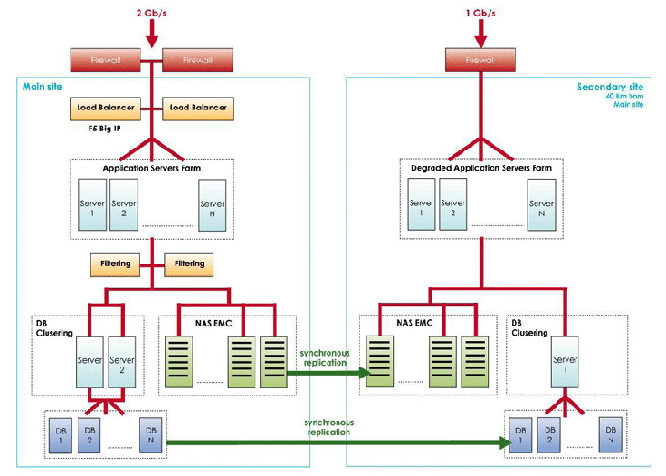
Taken from: http://en.oodrive.com/en/hosting/saas-mode (no longer available?)
Notes:
Building blocks:
Connectors:
View – concern – stakeholder (1..*):
Extra-functional requirements (Y + motivation) /N :
Security:
Availability & reliability:
Maintainability:
Performance and scalability:
Distribution (Y + motivation) /N :
Clarity/Semantics ( ☺ | 😐 | ☹) + motivation:

Slide 4
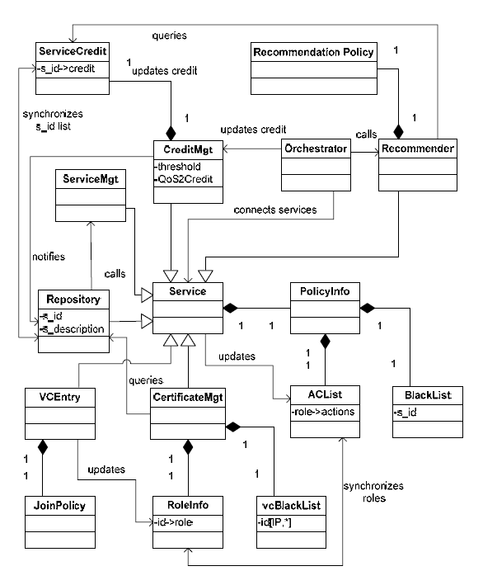
Taken from:
VICSDA: using virtual communities to secure service discovery and access
Notes:
Building blocks:
Connectors:
View – concern – stakeholder (1..*):
Extra-functional requirements (Y + motivation) /N :
Security:
Availability & reliability:
Maintainability:
Performance and scalability:
Distribution (Y + motivation) /N :
Clarity/Semantics ( ☺ | 😐 | ☹) + motivation:

Slide 5
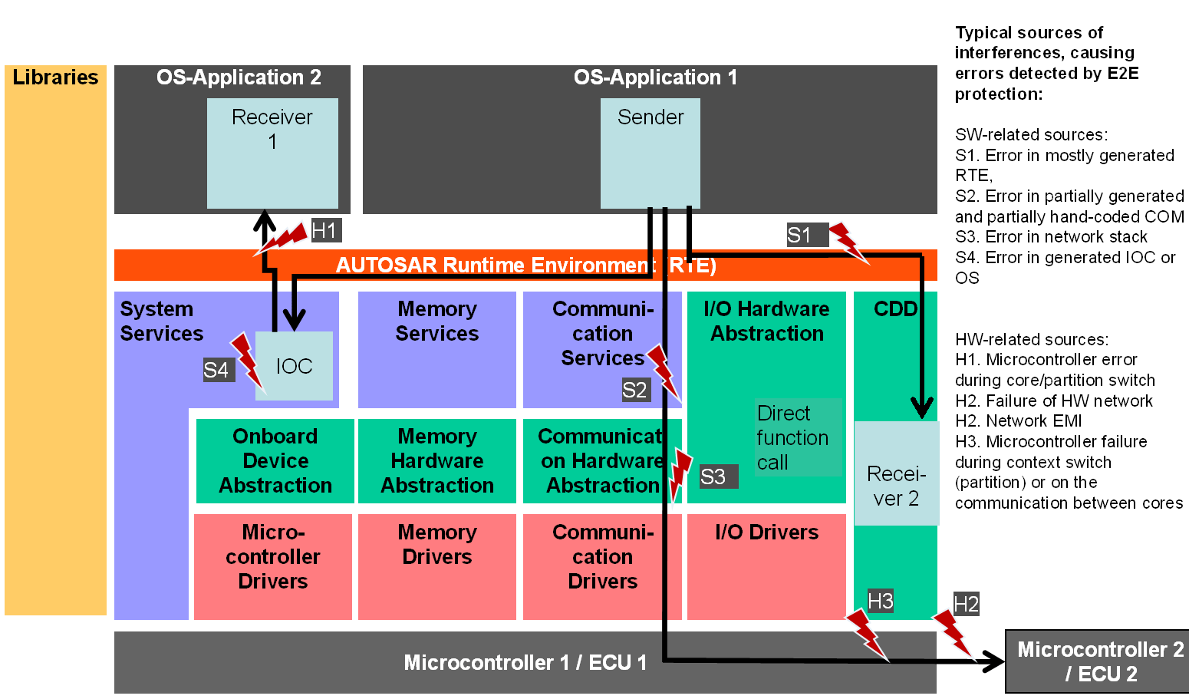
Taken from: http://www.eetimes.com/document.asp?doc_id=1278566
Notes:
Building blocks:
Connectors:
View – concern – stakeholder (1..*):
Extra-functional requirements (Y + motivation) /N :
Security:
Availability & reliability:
Maintainability:
Performance and scalability:
Distribution (Y + motivation) /N :
Clarity/Semantics ( ☺ | 😐 | ☹) + motivation:

Slide 6
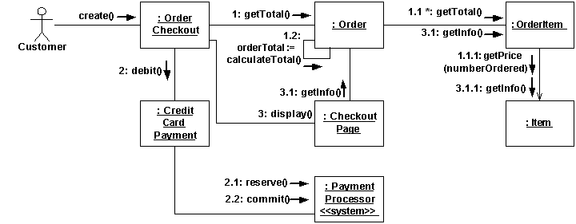
Taken from: http://www.agilemodeling.com/style/collaborationDiagram.htm
Notes:
Building blocks:
Connectors:
View – concern – stakeholder (1..*):
Extra-functional requirements (Y + motivation) /N :
Security:
Availability & reliability:
Maintainability:
Performance and scalability:
Distribution (Y + motivation) /N :
Clarity/Semantics ( ☺ | 😐 | ☹) + motivation:

Slide 7
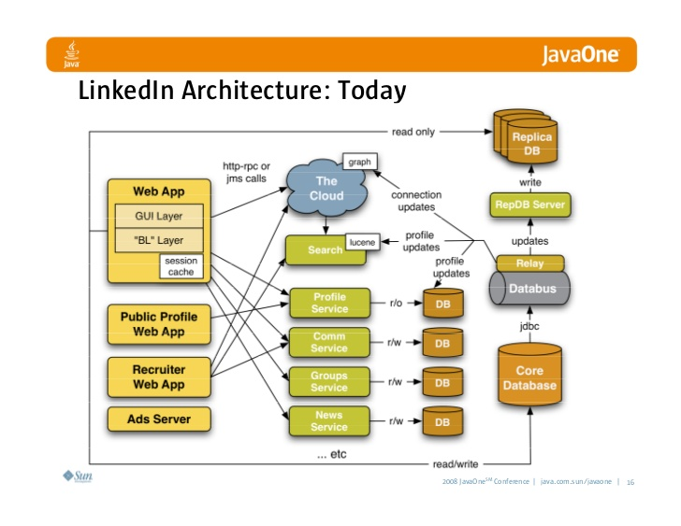
Taken from: http://www.slideshare.net/linkedin/linkedins-communication-architecture
Notes:
Building blocks:
Connectors:
View – concern – stakeholder (1..*):
Extra-functional requirements (Y + motivation) /N :
Security:
Availability & reliability:
Maintainability:
Performance and scalability:
Distribution (Y + motivation) /N :
Clarity/Semantics ( ☺ | 😐 | ☹) + motivation:

Slide 8
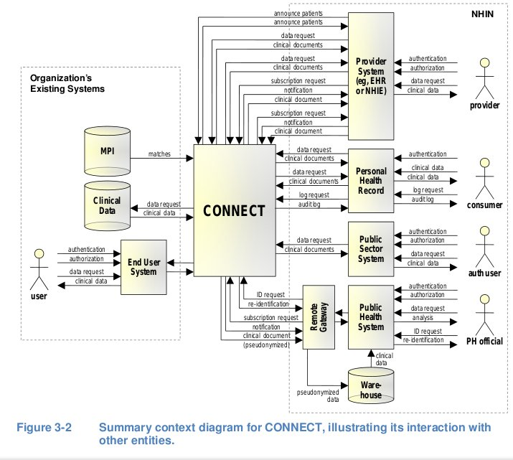
Taken from: http://www.ehrdoctors.com/medibridgenet/nwhin-connect/architecture/
Notes:
Building blocks:
Connectors:
View – concern – stakeholder (1..*):
Extra-functional requirements (Y + motivation) /N :
Security:
Availability & reliability:
Maintainability:
Performance and scalability:
Distribution (Y + motivation) /N :
Clarity/Semantics ( ☺ | 😐 | ☹) + motivation:

Slide 9
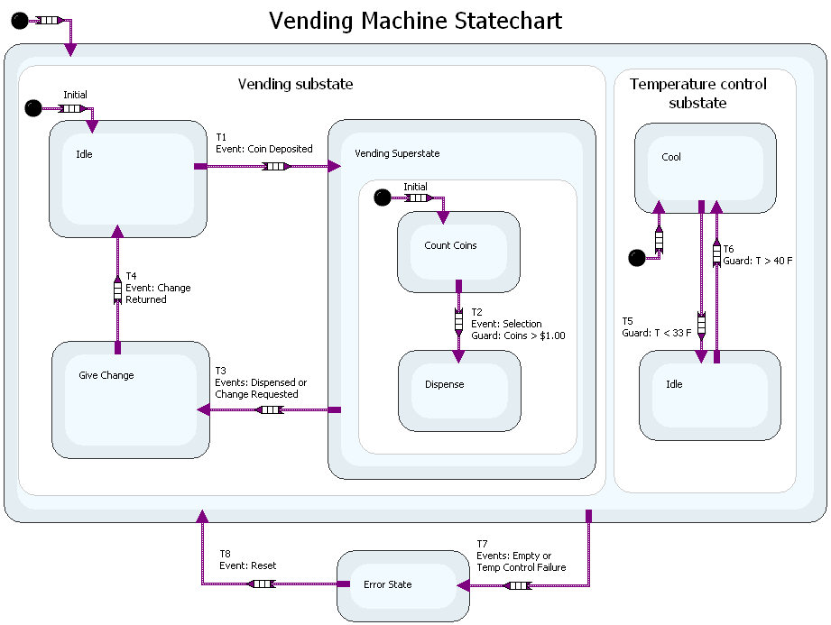
Taken from: http://www.ni.com/white-paper/6194/en/
Notes:
Building blocks:
Connectors:
View – concern – stakeholder (1..*):
Extra-functional requirements (Y + motivation) /N :
Security:
Availability & reliability:
Maintainability:
Performance and scalability:
Distribution (Y + motivation) /N :
Clarity/Semantics ( ☺ | 😐 | ☹) + motivation:

Slide 10
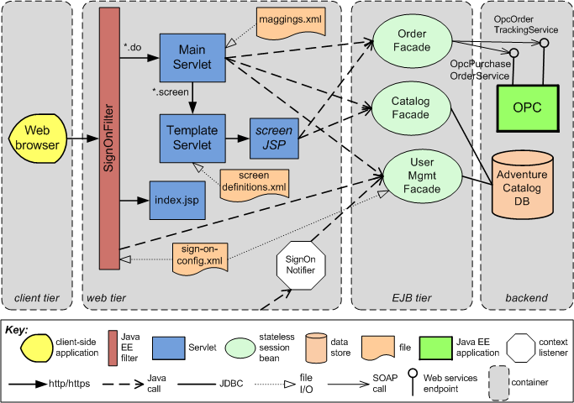
Taken from: https://wiki.sei.cmu.edu/sad/images/5/54/ConsumerWebsiteC%26CRefinementUsingInformal_PP.png
Notes:
Building blocks:
Connectors:
View – concern – stakeholder (1..*):
Extra-functional requirements (Y + motivation) /N :
Security:
Availability & reliability:
Maintainability:
Performance and scalability:
Distribution (Y + motivation) /N :
Clarity/Semantics ( ☺ | 😐 | ☹) + motivation:

