Slide 1
SMOOTHSCAN: ONE PATH TO RULE THEM ALL
By:
Sander Breukink 0741209
Rianne Conijn 0740635
Harm van Schaaijk 0873871
Jasper Selman 0741516
Tom Vogels 0871231

Slide 2
CONTENTS
Paper
Set-up
Results compared
Questions

Slide 3
PAPER
Describes algorithms for optimizing I-O usage for database queries.
Increasing problem: more data, current optimizers no longer optimal, continuous adaptation and morphing of physical operators.

Slide 4
PAPER
Describes 2 basic algorithms which are relatively simple:
Index scan
Full scan .
and 2 advanced algorithms which are more complex:
Switch scan .
Smooth scan

Slide 5
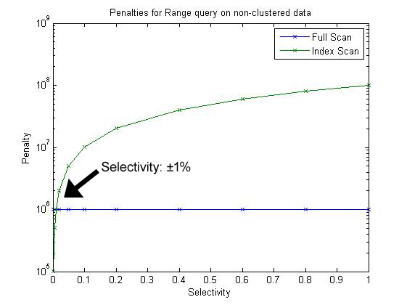
PAPER
Index scan and full scan:

Slide 6
PAPER
Switch scan and Smooth scan:
Combine the 2 previous algorithms for optimal results

Slide 7
SET UP
Progress:
Authors wouldn’t give us the source code
Recreated algorithms

Slide 8
SET UP
Steps:
First created index scan and full scan
Then created switch scan based on the previous 2
Lastly created smooth scan using our exisiting algorithms

Slide 9
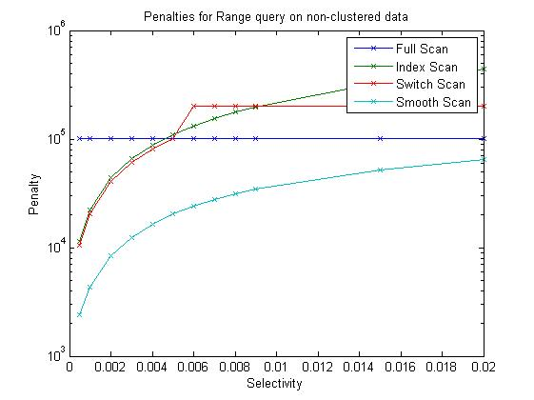
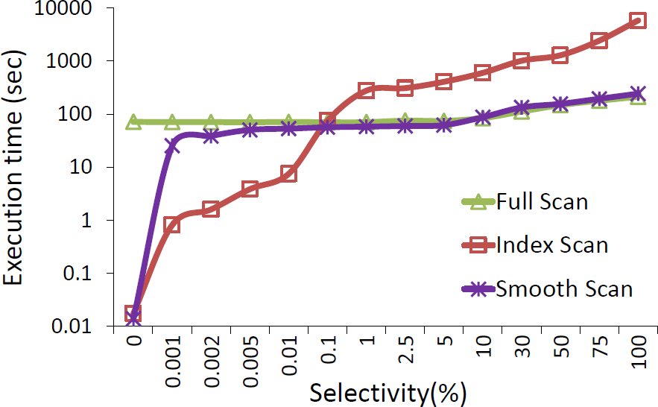
RESULTS COMPARED
Our results Their results

Slide 10
CONCLUSION

Slide 11
QUESTIONS?

