Slide 1
Basic Provisioning: Lab Wrap-up
DevOps Technical Workshop

Slide 2
Re-open your Virtual Machine (VM) and work through lab instructions
In this lab you will:
  Install Liberty Profile (part of WAS)
  Install and configure Jenkins—the tool you will use to run Continuous Integration (CI) and control other DevOps jobs
  Install Jenkins plugins that needs to be enabled
  Create our first Jenkins job
  Use Puppet to apply / create a new Worklight server environment
  Create a useful Jenkins job
Follow the instructions in the provided lab instructions
If you hit any problems, try watching the ‘show-me’ video or raise with one of the course instructors
Basic Provisioning: Lab Wrap-up

Slide 3
Lab 1 wrap-up
Did you manage to complete all steps in the lab?
Did you encounter any problems?
How long did it take to provision a new server once you had the Puppet script executing?
How long would this have taken if you were dependent on a third party operations team?
What other automation could we include in such scripts?
Think about your own projects, past and present. Can you think of server infrastructure that would benefit from automation like this?
Basic Provisioning: Lab Wrap-up

Slide 4
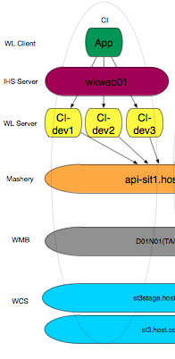
Client example
This is an example from a mobile delivery project where three separate CI servers were quickly provisioned.
CI-dev1 was used for CI (built upon any code check-in).
CI-dev2 was used for Continuous Testing of defined levels of code.
CI-dev3 was used for building of fix-stream code.
More CI environments could be built quickly.
Basic Provisioning: Lab Wrap-up

Slide 5
Basic Provisioning: Lab Wrap-up

