Slide 1
Extended Provisioning: Lab Wrap-up
DevOps Technical Workshop

Slide 2
Re-open your Virtual Machine (VM) and work through lab instructions
In this lab exercise, you will:
Use Puppet to build new environment
Create a second Jenkins job to built downstream test environments, such as SI and User Acceptance Testing (UAT)
Use Jenkins to create additional server operational jobs, such as server restart and stop / logs, and so on
Follow the instructions in the lab exercises provided in the wiki.
If you have any problems, try watching the show-me videos or raise a question in the discussion forum with one of the course instructors.
Extended Provisioning: Lab Wrap-up
Notes:
Instructor Notes:
Use the following link to the wiki for lab instructions and videos, and to access the discussion forums:
https://w3-connections.ibm.com/wikis/home?lang=en-us#!/wiki/W06bca027ecc0_44df_ae17_504b0abb6339/page/Welcome%20to%20DevOps%20Hands-On%20Case%20Study%20Technical%20Workshop

Slide 3
Wrap-up
Did you manage to complete all steps in the lab?
Did you encounter any problems?
How long did it take to provision your second server compared to the time it took you to get your first Puppet script running?
How long would this have taken if you were dependent on a third party operations team?
How many times do you think you might run this on a client project?
Think about your own recent projects. Can you think of how you might build a release train like this?
Extended Provisioning: Lab Wrap-up

Slide 4
Client example
Nine server environments are built using repeatable executable steps.
As solutions evolve, more environments may be created to enable parallel development / testing to take place on different features and releases.
This facilitates a try it out and see approach to feature development.
Extended Provisioning: Lab Wrap-up

Slide 5
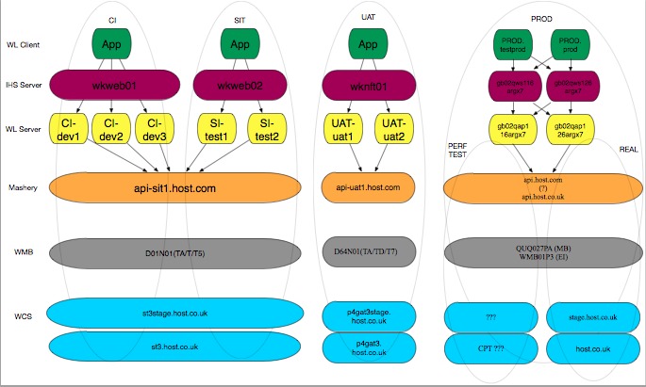
Client example (continued)
Extended Provisioning: Lab Wrap-up

Slide 6
Extended Provisioning: Lab Wrap-up

