Slide 1

Control by Shaping Delay Distributions
Jasper Visterin, Wim Michiels
NUMA Research Unit

Slide 2
Control by Shaping Delay Distributions
Distributed Delays
Time-Delay Systems

Slide 3
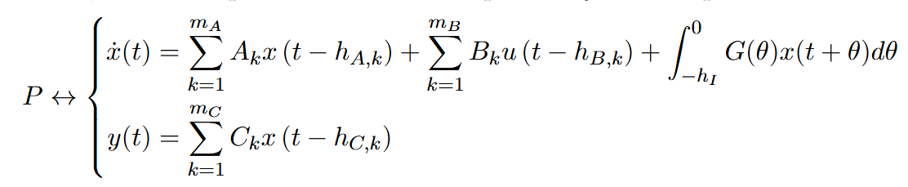



Time-Delay Systems
$$u\left(t\right)$$
$P$
$$y\left(t\right)$$
Broad class of infinite-dimensional systems
Inherently difficult to control
Specialized computational methods needed
In this work: LTI systems of retarded type
Piecewise continuous

Slide 4
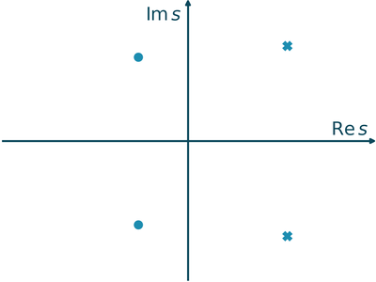
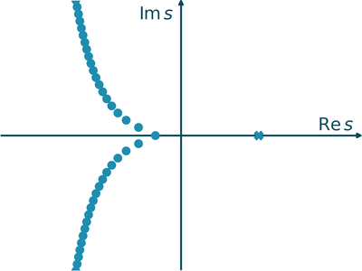
Retarded Time-Delay Systems
Delay-Free Linear systems
Images from: https://wms.cs.kuleuven.be/groups/NUMA/research/outreach-delay#2.1.

Slide 5
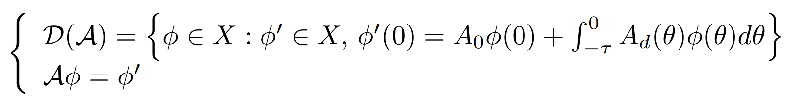



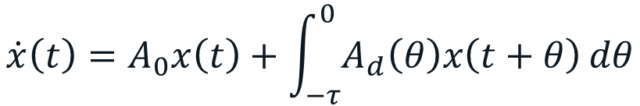










$$\dot{x}\left(t\right)=A_{0}x\left(t\right)+\int_{−τ}^{0}{A_{d}\left(θ\right)x\left(t+θ\right)}dθ$$
$$x(t)$$
$$−τ$$
$$0$$
$$t_{1}−τ$$
$$t_{1}$$
$$t$$
$$t=−τ$$
$$t=t1$$
$$t=t_{1}−τ$$
$$t=0$$
$$−τ$$
$$0$$
$$θ$$
Abstract ordinary differential equation over the function space $X$

Slide 6
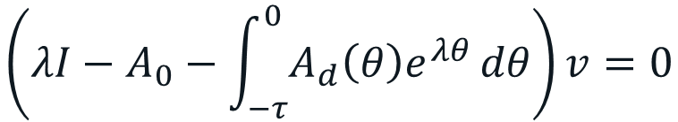
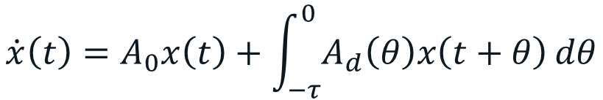

Stability Analysis: Spectrum Approximation
$$\dot{x}\left(t\right)=A_{0}x\left(t\right)+\int_{−τ}^{0}{A_{d}\left(θ\right)x\left(t+θ\right)}dθ$$
$$x\left(t\right)=e^{λt}v$$
$$\left(λI−A_{0}−\int_{−τ}^{0}{A_{d}\left(θ\right)e^{λθ}}dθ\right)v=0$$
Nonlinear eigenvalue problem
Finite dimensional
Linear eigenvalue problem
Infinite dimensional

Slide 7


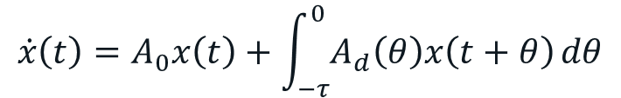

Stability Analysis: Spectrum Approximation
$$\dot{x}\left(t\right)=A_{0}x\left(t\right)+\int_{−τ}^{0}{A_{d}\left(θ\right)x\left(t+θ\right)}dθ$$
$$↔$$
Discretize infinitesimal generator
compute eigenvalues of resulting matrix
3. Get better characteristic root approximations using the nonlinear equation
$$→ A_{N} w=\hat{λ} w$$
$$\left(λI−A_{0}−\int_{−τ}^{0}{A_{d}\left(θ\right)e^{λθ}}dθ\right)v=0$$

Slide 8


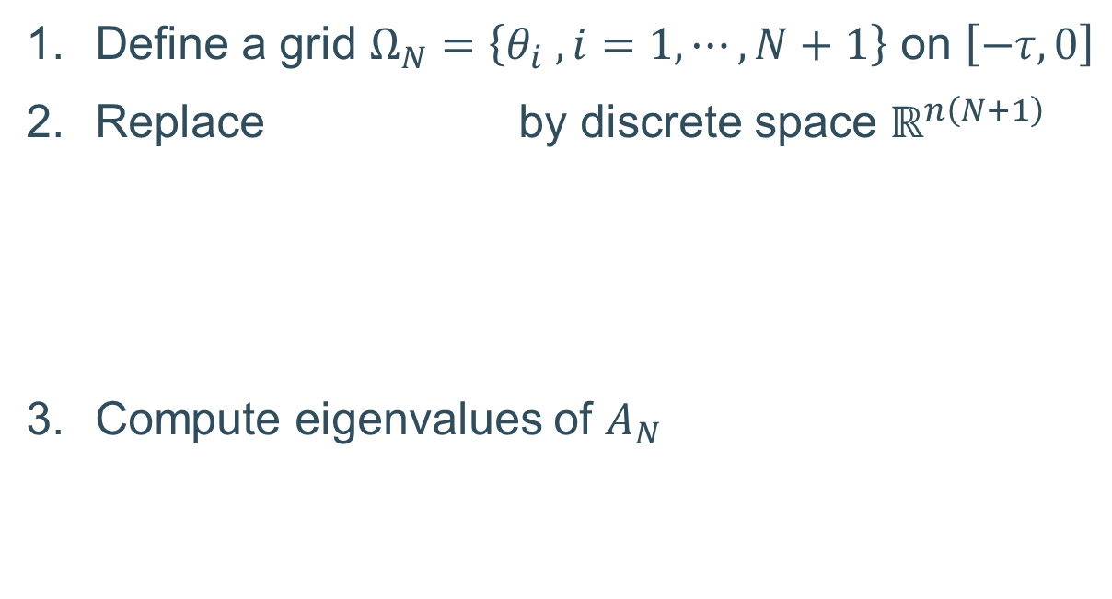
Spectral discretization
$$\dot{x}\left(t\right)=A_{0}x\left(t\right)+\int_{−τ}^{0}{A_{d}\left(θ\right)x\left(t+θ\right)}dθ$$
$$↔$$
Define a grid $Ω_{N}=\left\{θ_{i} , i=1,⋯,N+1\right\}$ on $\left[−τ,0\right]$
Replace by discrete space $ℝ^{n\left(N+1\right)}$
Compute eigenvalues of $A_{N}$
$$→$$
Interpolating polynomial in
$$−τ$$
Illustration from: Phd course on Analysis and Design Methods for Time-Delay Systems, organized by the European Embedded Control Institute (EECI)

Slide 9
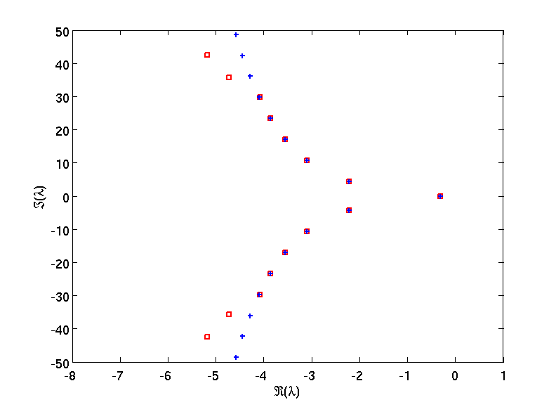
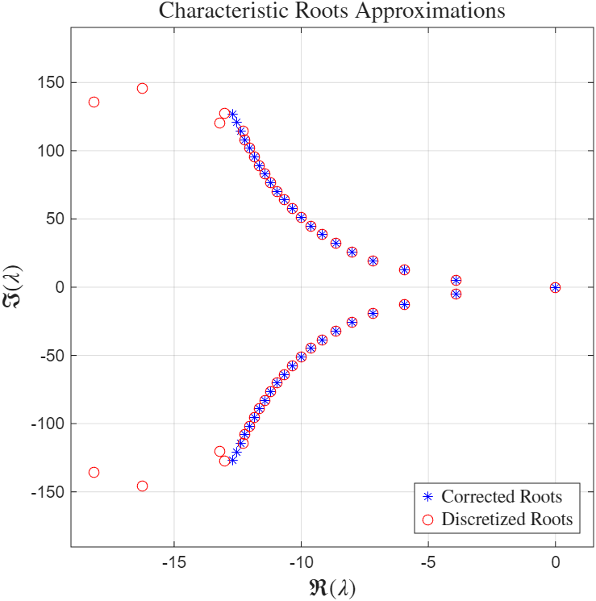
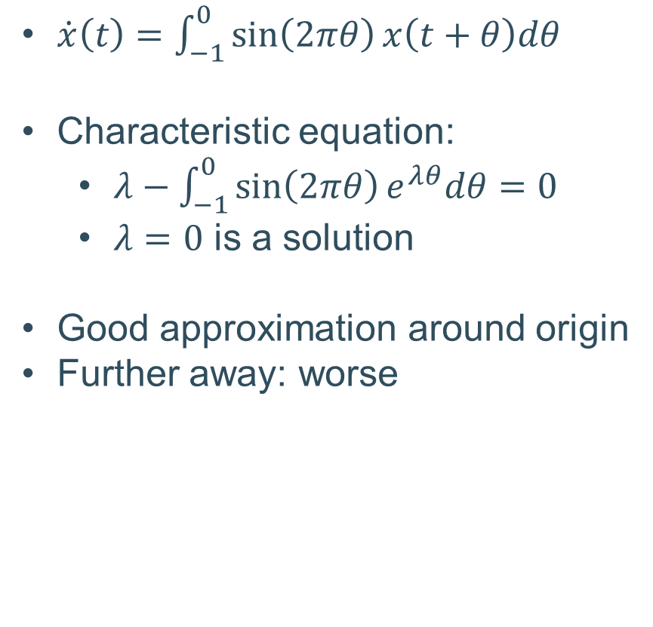
Example
$\dot{x}\left(t\right)=\int_{−1}^{0}{\sin\left(2πθ\right)x\left(t+θ\right)dθ}$
Characteristic equation:
  $λ−\int_{−1}^{0}{\sin\left(2πθ\right)e^{λθ}dθ}=0$
  $λ=0$ is a solution
Good approximation around origin
Further away: worse
Illustration from: Phd course on Analysis and Design Methods for Time-Delay Systems, organized by the European Embedded Control Institute (EECI)

Slide 10
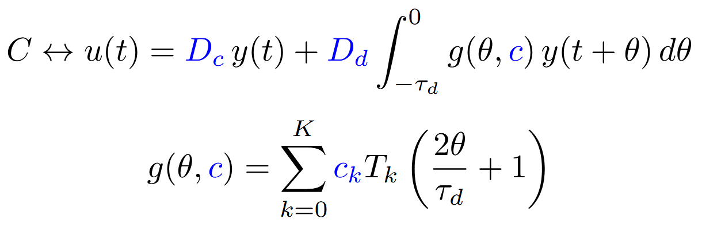
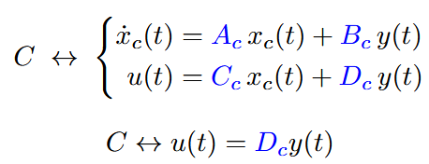

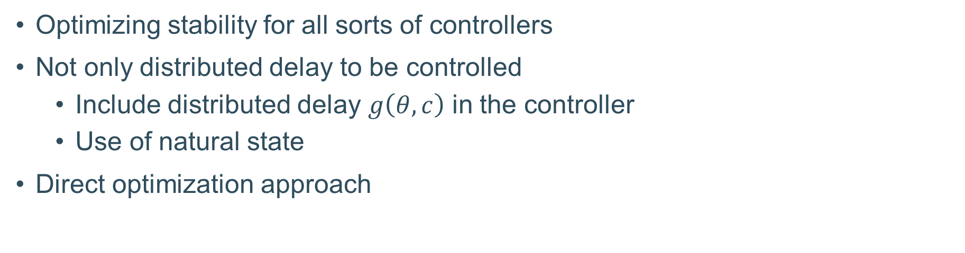





Stabilization by output feedback
Optimizing stability for all sorts of controllers
Not only distributed delay to be controlled
  Include distributed delay $g\left(θ,c\right)$ in the controller
  Use of natural state
Direct optimization approach
$P$
$$u\left(t\right)$$
$$y\left(t\right)$$
$C$
$$CL$$
Optimization variables $p$

Slide 11
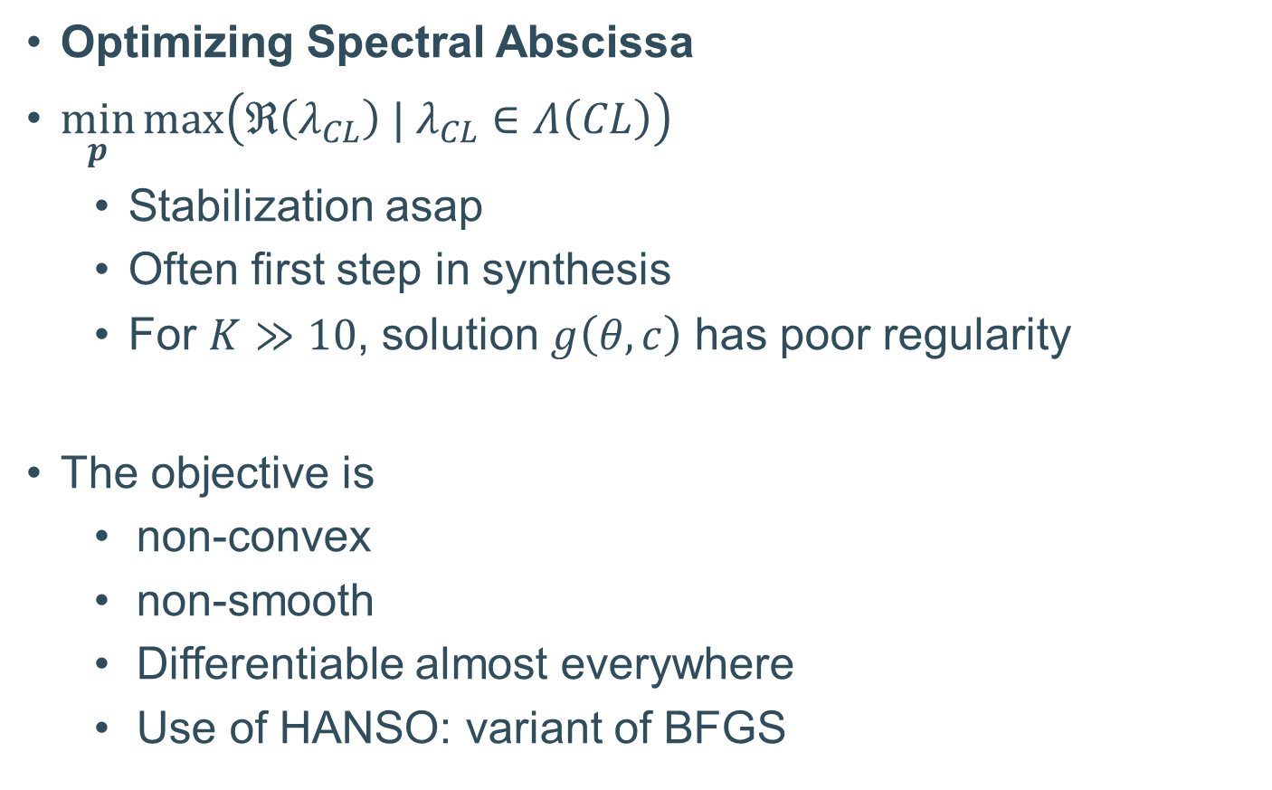

Controller Synthesis
Optimizing Spectral Abscissa
$\min_{p}{\max\left(ℜ\left(λ_{CL}\right) | λ_{CL}∈Λ\left(CL\right)\right)}$
  Stabilization asap
  Often first step in synthesis
  For $K≫10$, solution $g\left(θ,c\right)$ has poor regularity
The objective is
  non-convex
  non-smooth
  Differentiable almost everywhere
  Use of HANSO: variant of BFGS
$P$
$$u\left(t\right)$$
$$y\left(t\right)$$
$C$
$$CL$$

Slide 12
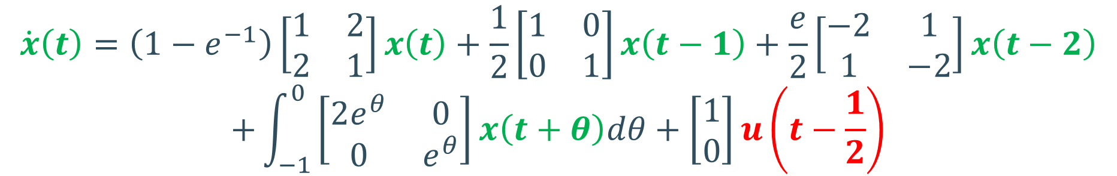
Preliminary results: spectral abscissa
It is possible to shape the delay distribution for control
  Highly useful from a practical point of view
  Significant improvement in the objective
Example:
$$\dot{x}\left(t\right)=\left(1−e^{−1}\right)\left[\begin{matrix}1 & 2 \\ 2 & 1\end{matrix}\right]x\left(t\right)+\frac{1}{2}\left[\begin{matrix}1 & 0 \\ 0 & 1\end{matrix}\right]x\left(t−1\right)+\frac{e}{2}\left[\begin{matrix}−2 & 1 \\ 1 & −2\end{matrix}\right]x\left(t−2\right)$$
$$+\int_{−1}^{0}{\left[\begin{matrix}2e^{θ} & 0 \\ 0 & e^{θ}\end{matrix}\right]x\left(t+θ\right)dθ}+\left[\begin{aligned}1 \\ 0\end{aligned}\right]u\left(t−\frac{1}{2}\right)$$
$$u\left(t\right)=D_{c}x\left(t\right)+D_{d}\int_{−τ_{d}}^{0}{g\left(θ,c\right) x\left(t+θ\right)dθ}, τ_{d}=2$$

Slide 13
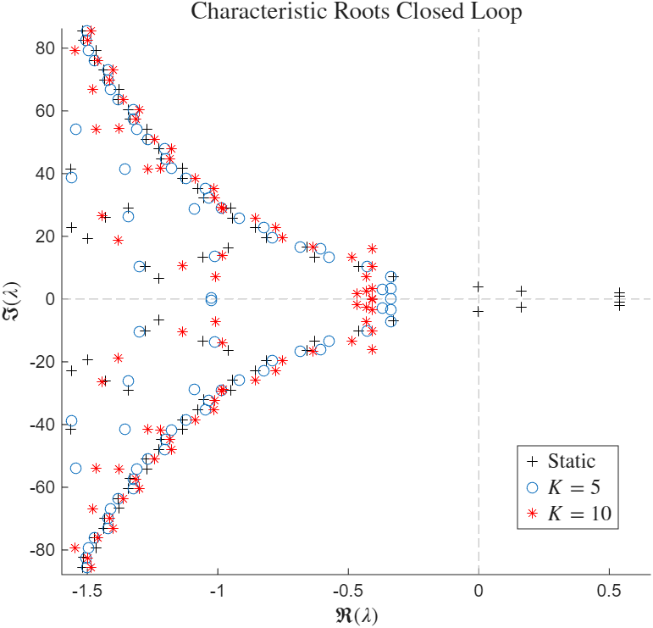
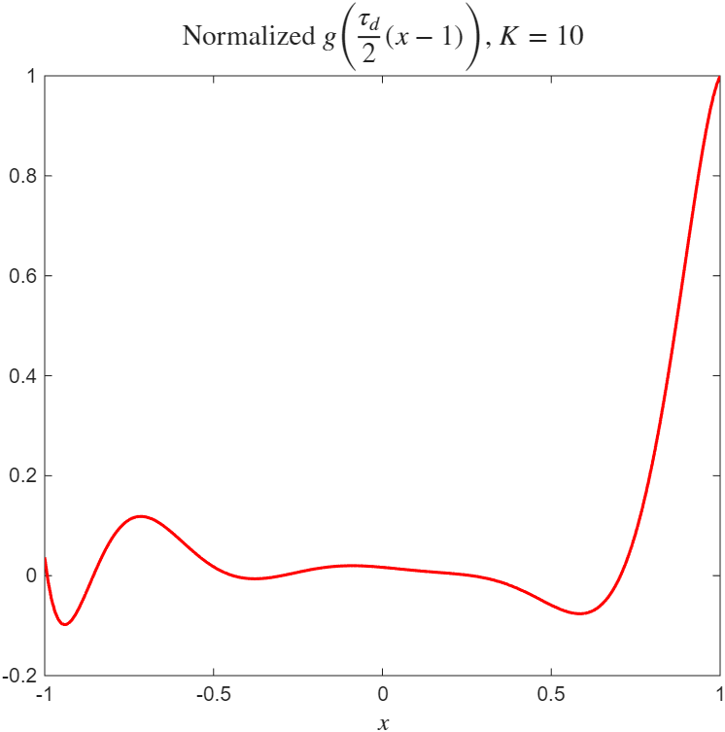
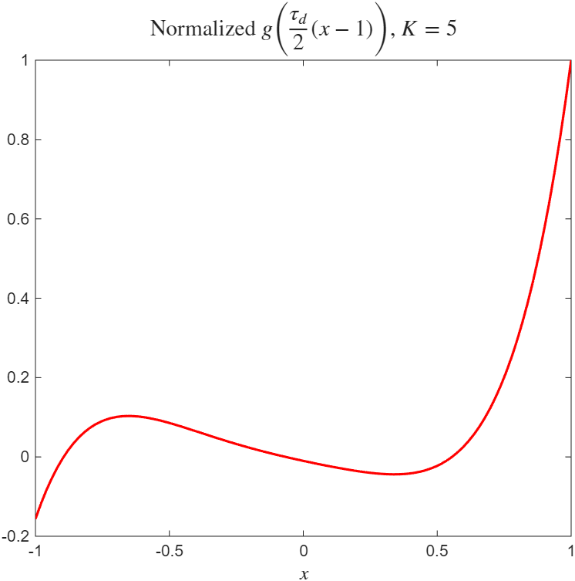
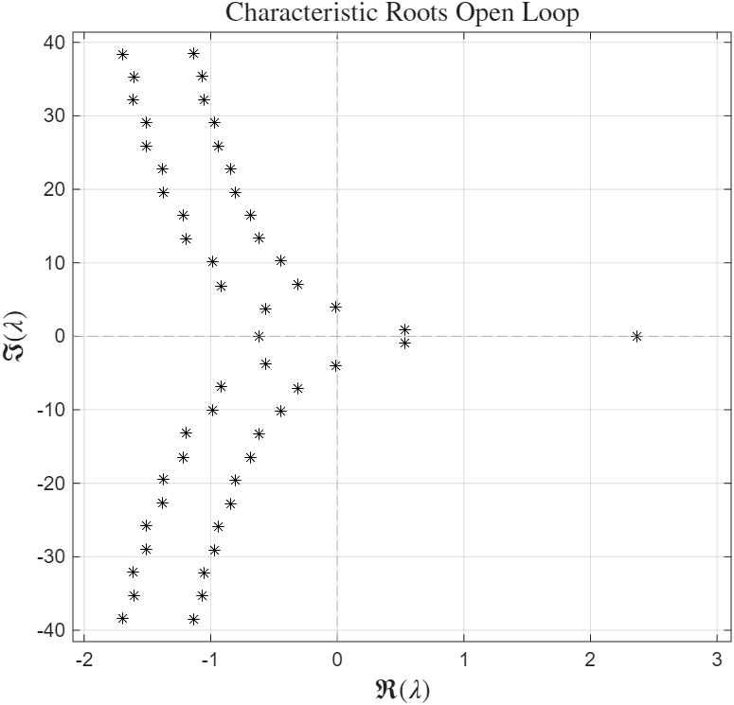

$x∈\left[−1,1\right]$, $θ∈\left[−τ_{d},0\right]$

Slide 14
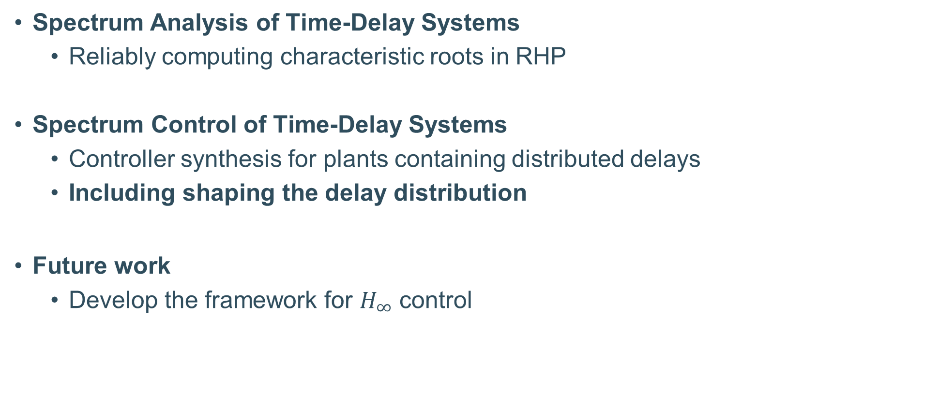
Conclusions
Spectrum Analysis of Time-Delay Systems
  Reliably computing characteristic roots in RHP
Spectrum Control of Time-Delay Systems
  Controller synthesis for plants containing distributed delays
  Including shaping the delay distribution
Future work
  Develop the framework for $H_{∞}$ control

Slide 16
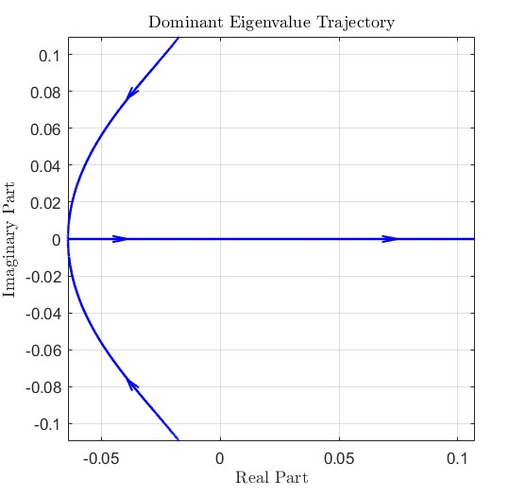
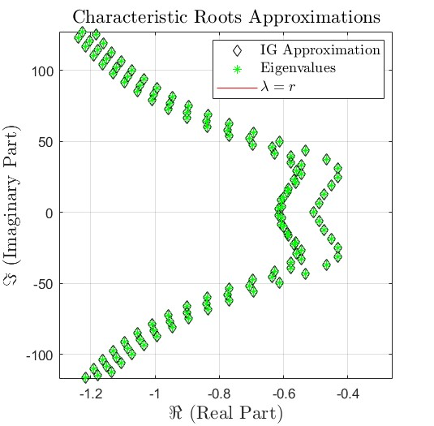
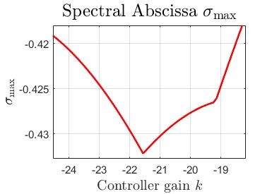
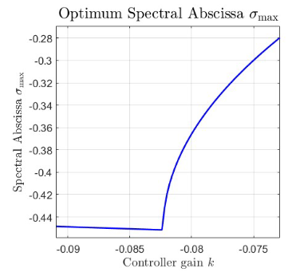

Details on Control
Why non-smooth?
  Multiple defective roots exhibit non-Lipschitz behaviour
  Earlier Framework used with caution
    Newton corrections!
  Roots may have the same real part → gradient of rightmost root undefined
  Often non-smooth in optimum
Spectral abscissa = differentiable almost everywhere
  assumption used in HANSO
  Important for all considered controllers
  Still need to ensure regularity for $g\left(θ,c\right)!$

Slide 17
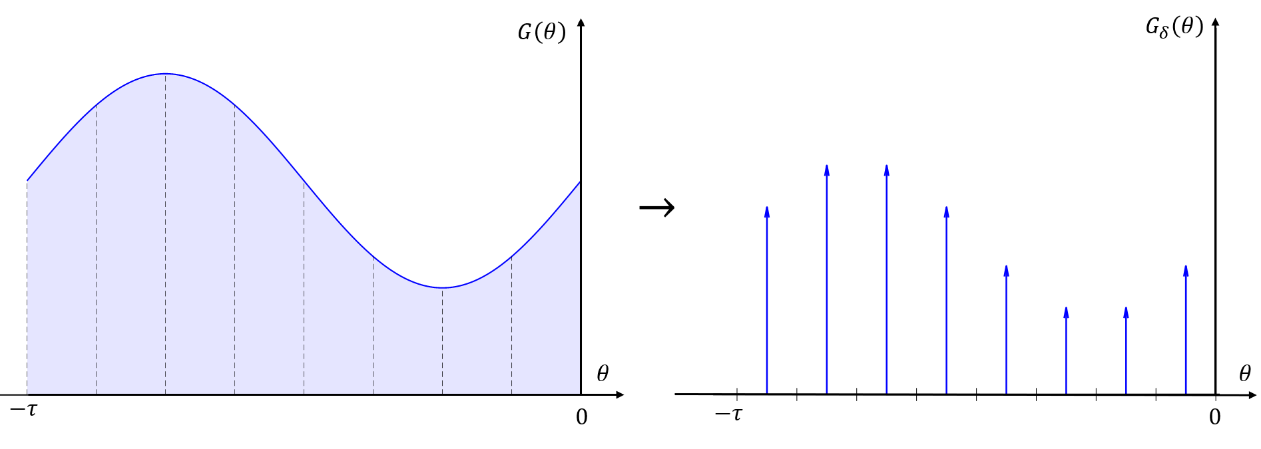

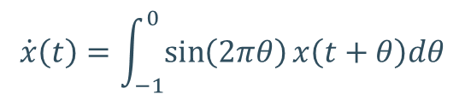
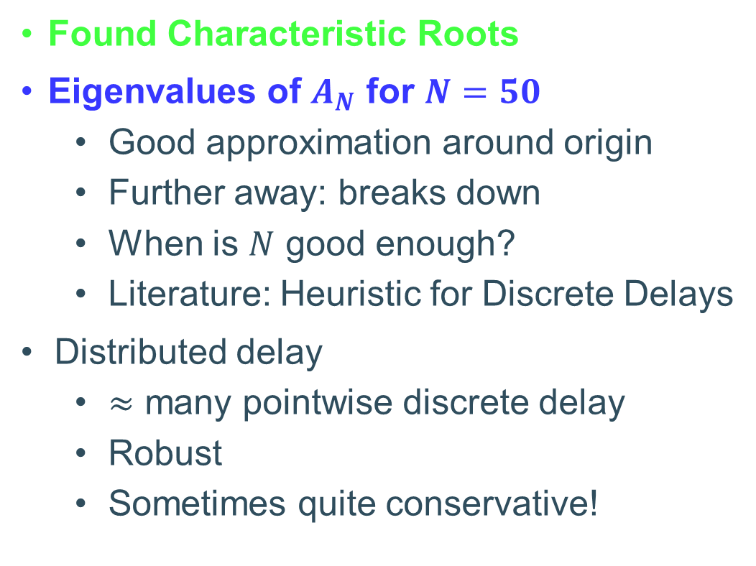
Choice of $N$
$$\dot{x}\left(t\right)=\int_{−1}^{0}{\sin\left(2πθ\right)x\left(t+θ\right)dθ}$$
Found Characteristic Roots
Eigenvalues of $A_{N}$ for $N=50$
  Good approximation around origin
  Further away: breaks down
  When is $N$ good enough?
  Literature: Heuristic for Discrete Delays
Distributed delay
  $≈$ many pointwise discrete delay
  Robust
  Sometimes quite conservative!
Illustration from: Phd course on Analysis and Design Methods for Time-Delay Systems, organized by the European Embedded Control Institute (EECI)

Slide 18
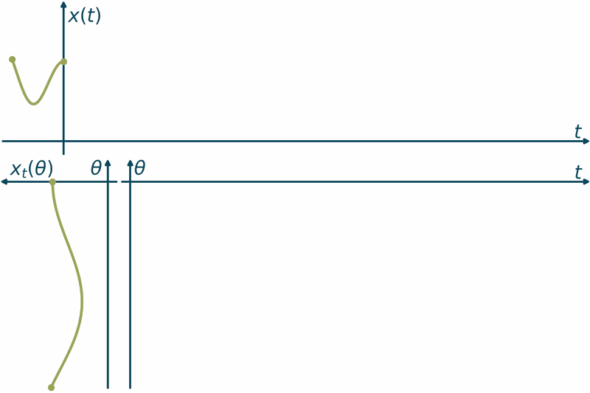



Window interpretation
$$u\left(θ,t\right)=x_{t}\left(θ;φ\right) =x\left(t+θ;φ\right)$$
$$\frac{∂u\left(θ,t\right)}{∂t}=\frac{∂u\left(θ,t\right)}{∂θ}, θ∈\left[−τ,0\right],t>0$$
$$\frac{∂u\left(θ,t\right)}{∂θ}{\left.​\right|}_{θ=0}=A_{0}u\left(0,t\right)+A_{1} u\left(−τ,t\right)$$
$$\dot{x}\left(t\right)=A_{0}x\left(t\right)+A_{1}x\left(t−τ\right)$$
$$φ\left(θ\right)$$
Animation from: https://wms.cs.kuleuven.be/groups/NUMA/research/outreach-delay#2.1.

Slide 19

Window interpretation
Animation from: https://wms.cs.kuleuven.be/groups/NUMA/research/outreach-delay#2.1.

Slide 20
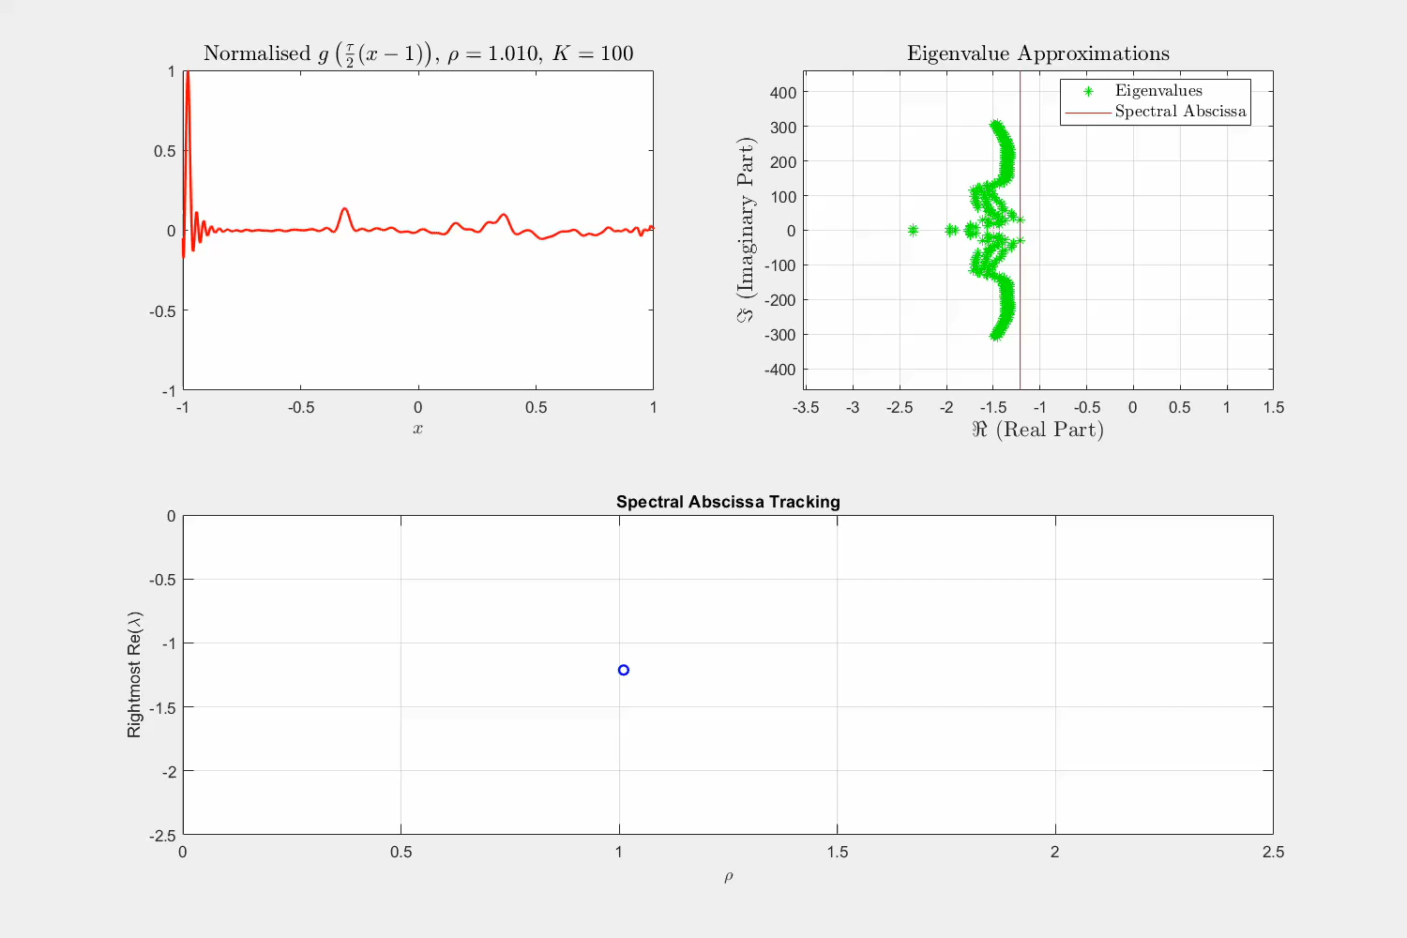
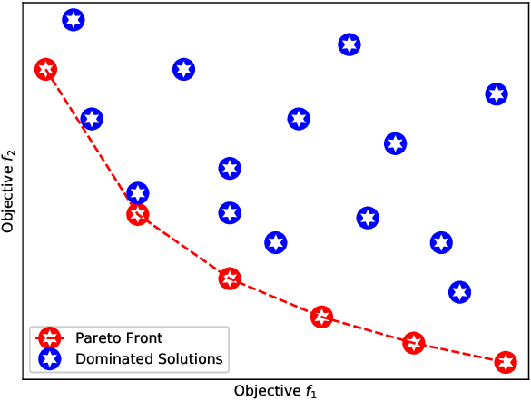
Details on Regularization
Bi-objective optimization → Tracing Pareto Front?
Non-convex objective → jumps occur regularly
Strict idea of Pareto Front holds for penalty-term
  Shape can also be found for Damping Heuristic!

