Slide 1
TSP Project - Presentation
group: m
Names: joy kimmel, m.s. sUraj,
peijun wu, hansen zhao

Slide 2
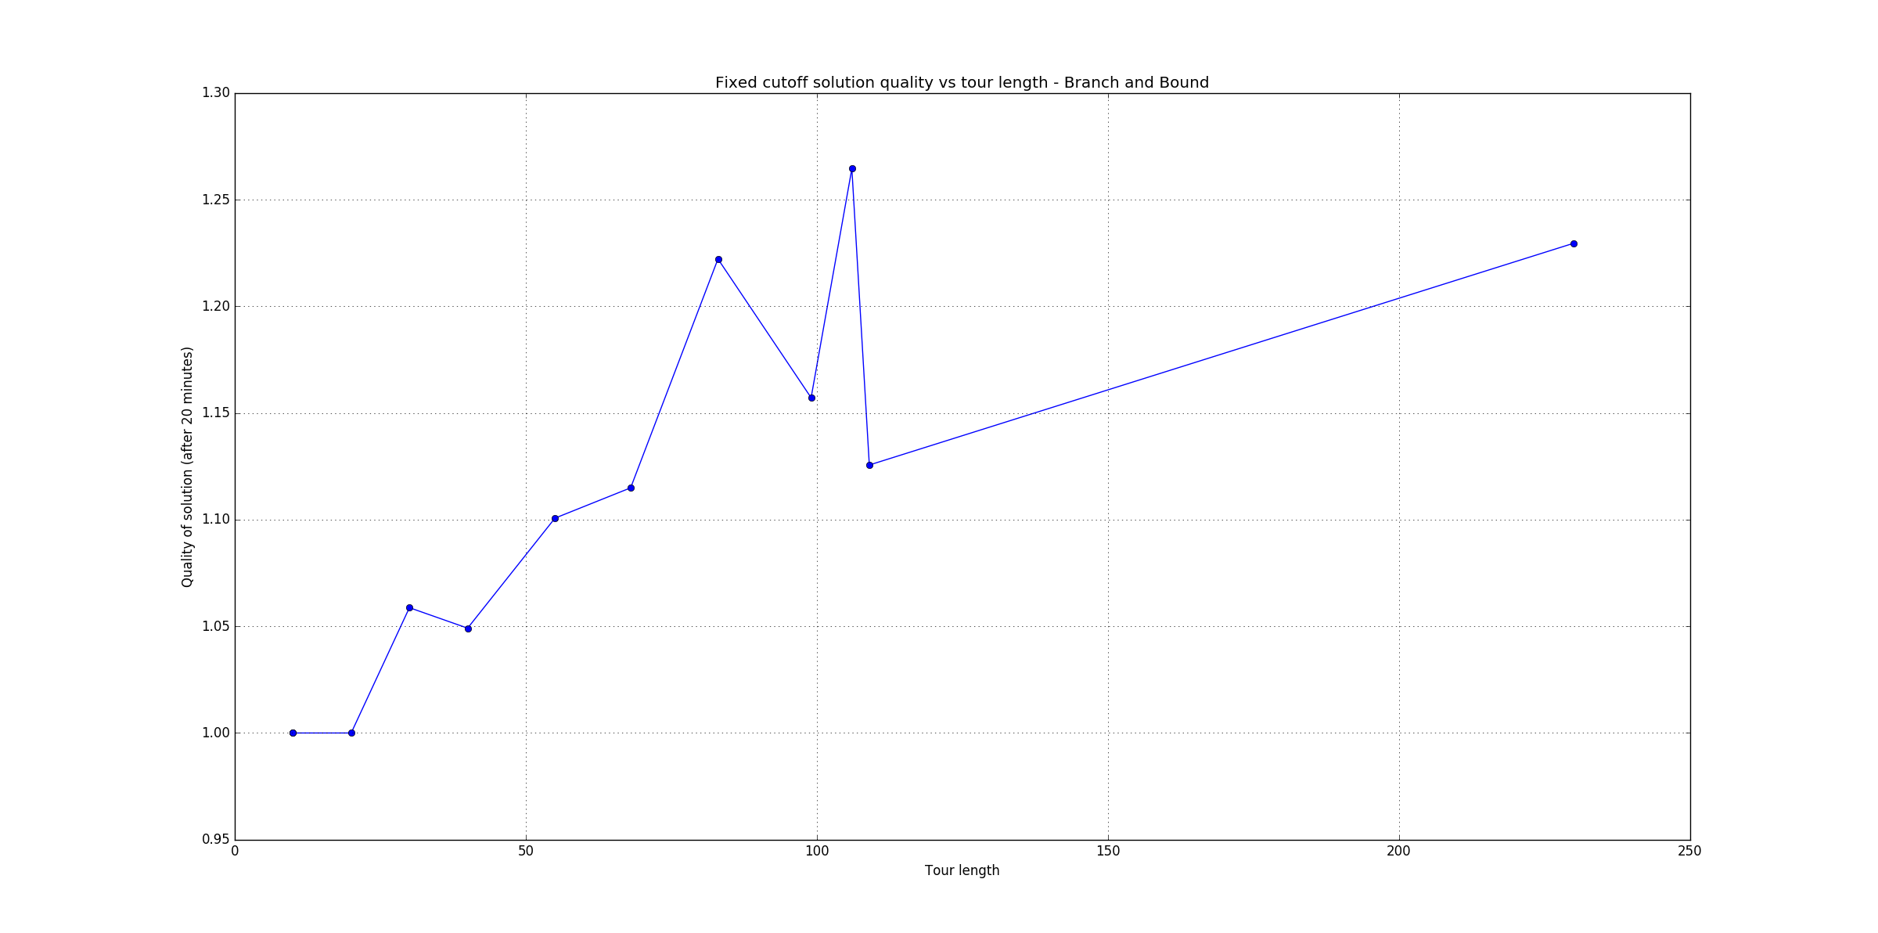
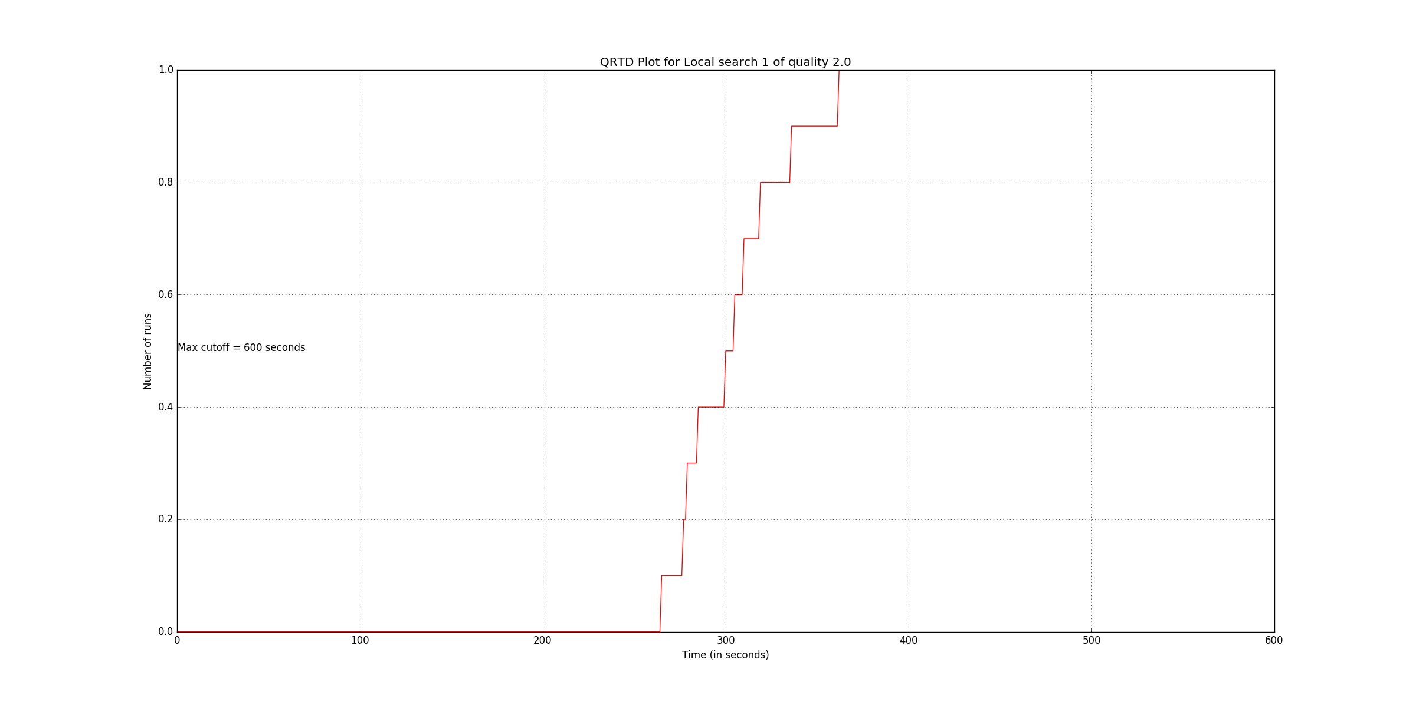
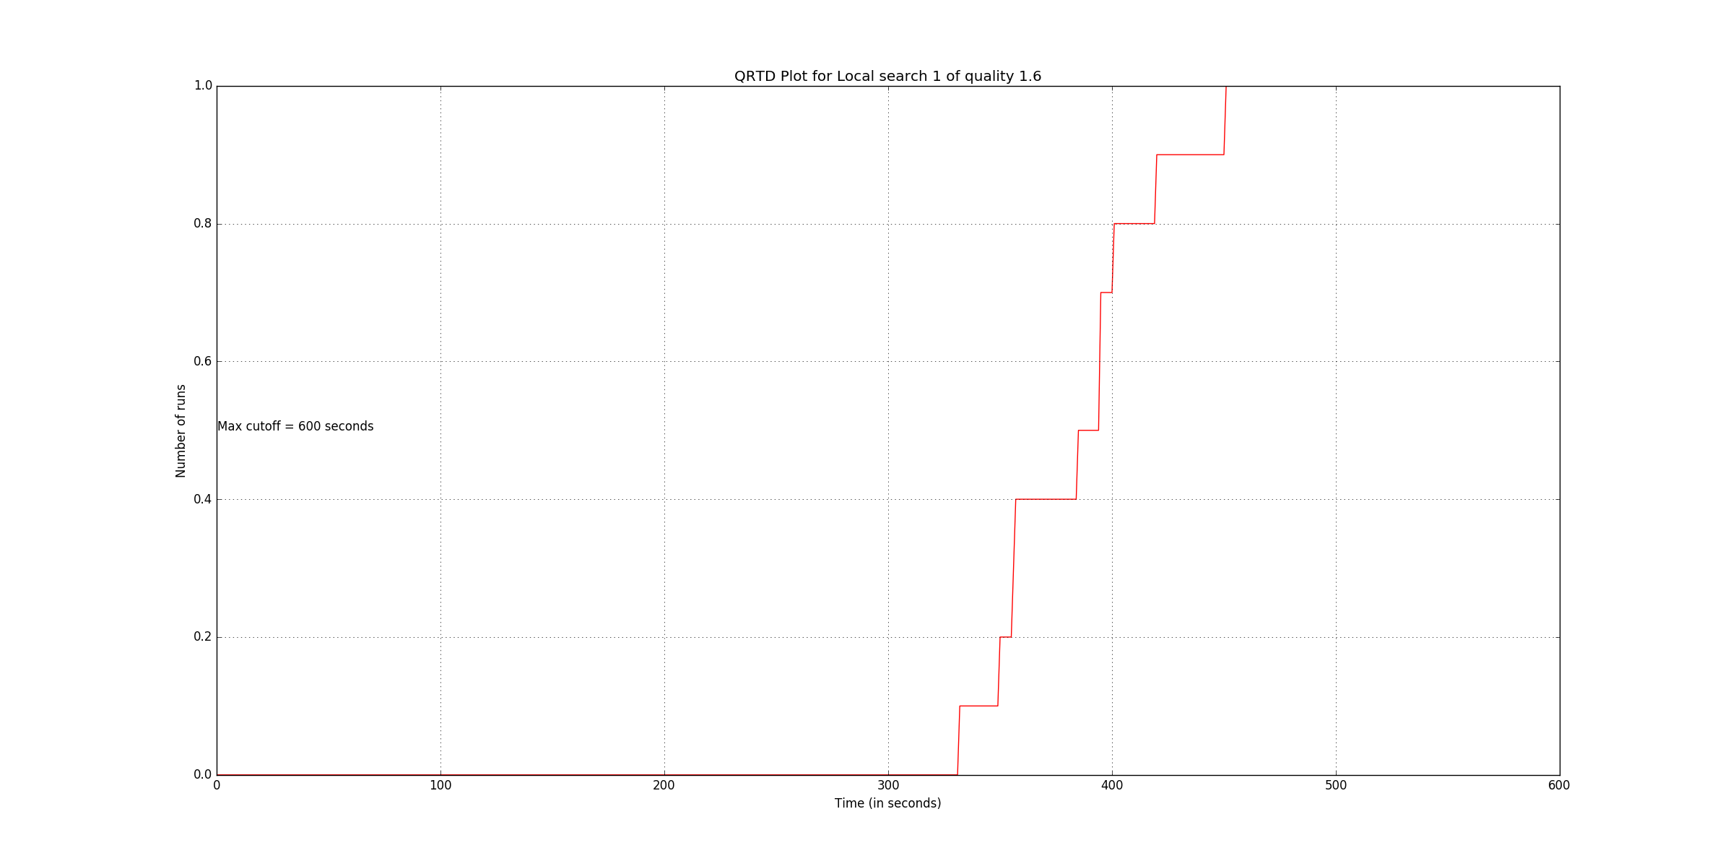
Branch and Bound – Quality after 20 minutes vs Tour size
Local Search 1- QRTD Quality 1.2
Local Search 1- QRTD Quality 1.6
Local Search 1- QRTD Quality 2.0

Slide 3
Local search successes, failures & noteworthy conclusions
Hill Climbing
2-OPT, 3-OPT
Search space = 10*N
First improved neighbor, best neighbor
Random walk, perturbation (4-OPT)
Candidate list, Tabu memory
Simulated Annealing
2-OPT, 4-OPT
Optimized cooling factor
Stopping criteria
N1
N2

