Slide 1
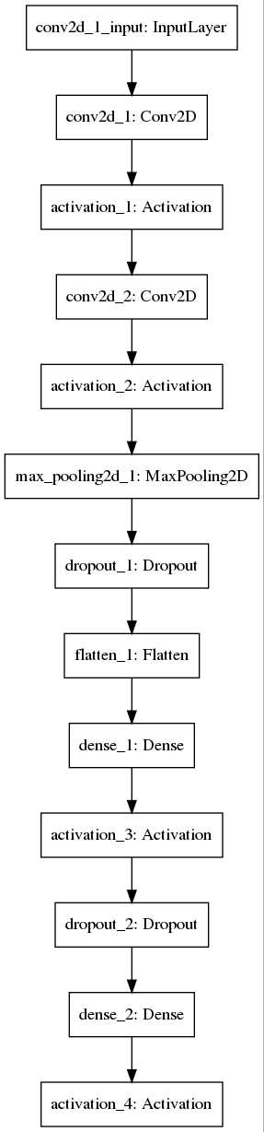
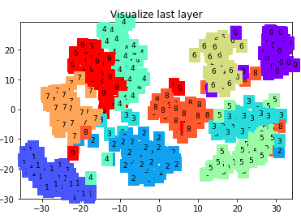
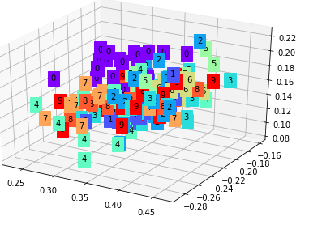
MATH 6380O Mini-Project 1: MNIST Classification by Feature Extraction and Transfer Learning
Ping Liu¹, Yixuan Liu¹ , Yi Rong¹ and Chang Zhu¹
¹: Department of Mathematics, HKUST
1. Introduction
4. CNN with Transfer Learning
5. CNN
For the first mini-project, we decide to use Autoencoder, CNN to extract the features and then classify the MNIST dataset. Because it’s well known that convolution neural network has overwhelming performance in image processing issues. We also use transfer learning which greatly reduces training time.
Methodology
Train a simple convnet on the MNIST dataset the first 5 digits [0..4]
Freeze convolutional layers and fine-tune dense layers for the classification of digits [5..9].
Using last layer classify the test data
Methodology
Using CNN extract the features
Using Manifold learning visualize the features
Using last layer classify the test data
Classification Result
train loss: 0.0570
test accuracy: 0.9805
2. MINST Database
The MNIST database contains 60,000 training images and 10,000 testing images.
3.Autoencoder
Methodology
Using CNN extract the features
Visualize the features
Using SVM classify the test data
CNN trained by digits[0..4]
test loss: 0.0066
test accuracy: 0.9978
CNN transferred to digits[5..9]
test loss: 0.0253
test accuracy: 0.9909
6. Conclusion
Classification Result
train loss: 0.2322
test accuracy: 0.6535
Autoencoder do not have good performance. But CNN has outstanding performance in this classification issue. It also has a great visualization.
7. Contribution
Autoencoder
Yixuan Liu, Ping Liu
CNN
Chang Zhu, Ping Liu
CNN with Transfer Learning
Yi Rong
Poster
Ping Liu, Yi Rong

