Slide 1
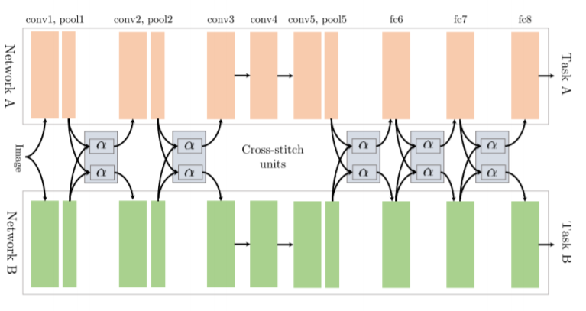
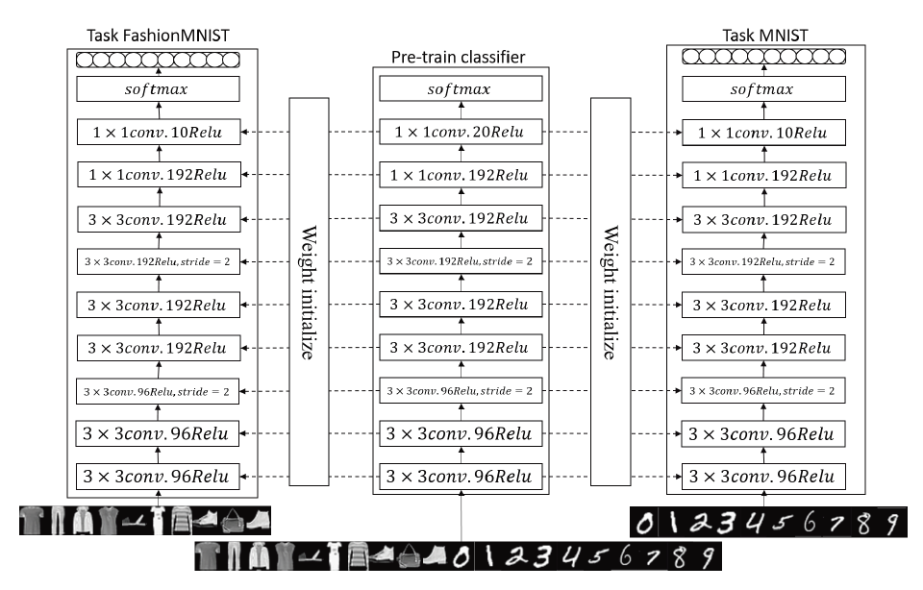
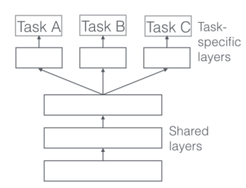
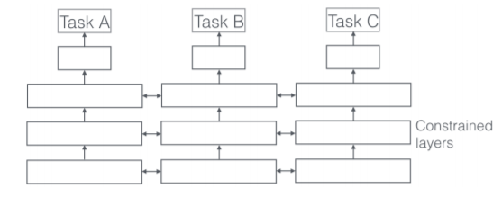
MATH 6380O Project I: Multi-Task CNN on MNIST
Ye Yushi and Mao Hongyu {yyeaf, hmaoab }@ust.hk
Department of Mathematics, HKUST
1. Introduction
The cross-stitch units allows the model to determine in what way the task-specific networks leverage the knowledge of the other task by learning a linear combination of previous layers output.
5. Modeling Training
MNIST has been a benchmark dataset for Deep Learning study for a long time. It has been well solved since the CNN method (LeCun et al. 1998). By far, the state-of-art deep neural network models has reached error rates lower than 0.3%. Since MNIST served as a good test dataset with well-established benchmark, here we use MNIST together with two MNIST-like dataset (FashionMNIST, NotMNIST) to explore if the implementation of multi-task transfer learning method can do better than simple CNN network on MNIST only.
For multi-task learning, firstly we combine the MNIST and Fashion MNIST training set together, i.e. 120,000 examples, each with input size 28*28 and an output 1-hot vector size of 20. Then we train this network with 50 epochs. After that, the parameters of this bi-task model is used to initialize single task classifier. The single-task classifiers are then re-trained to perform their respective classification tasks.
6. Performance and conclusion
2. Multi-task learning framework
4. All-Convolution Network
The results are shown below, we can see multi-task learning do performs well on both datasets, especially for FashionMNIST. It implies that for “hard” learning problems, this method may be very usefull.
In Machine Learning (ML), we typically care about optimizing for a particular metric, whether this is a score on a certain benchmark or a business KPI. In most cases, we can generally achieve acceptable performance, by being laser-focused on our single task, we ignore information that might help us do even better on the metric we care about.
Specifically, this information comes from the training signals of related tasks. By sharing representations between related tasks, we can enable our model to generalize better on our original task. This approach is called Multi-Task Learning (MTL). The two common structures of MTL can be illustrated by the following pictures.
Actually, the multi-task learning can be used not only by initialization with trained parameter, it can be extended to many structures with neuron and parameter sharing. For example, the cross-stich networks for two tasks:
In our practice, we use data combination of three dataset mentioned above as input to train a general pre-train classifier, and use the parameters in trained model as initial values for specific neural networks that are specially used for MNIST/FashionMNIST and NotMINST. Specifically, we use pooling operations that have uniform kernel and Lp-norm as activation function.
Dataset | Single-task | Multi-task
MNIST | 98.33% | 99.17%
FashionMNIST | 93.25% | 94.83%
7. References
[1] Yann LeCun, L´eon Bottou, Yoshua Bengio, and Patrick Haffner. Gradient-based learning applied to document recognition. Proceedings of the IEEE, 86(11):2278–2324, 1998.
[2] Sebastian Ruder, An Overview of Multi-Task Learning in Deep Neural Networks, arXiv:1706.05098
[3] Sebastian Ruder. An overview of multi-task learning in deep neural networks. arXiv preprint arXiv:1706.05098, 2017.
[4] Po-Chen Hsieh, Chia-Ping Chen. Multi-task Learning on MNIST Image Datasets, under review of ICLR 2018.

