Slide 1
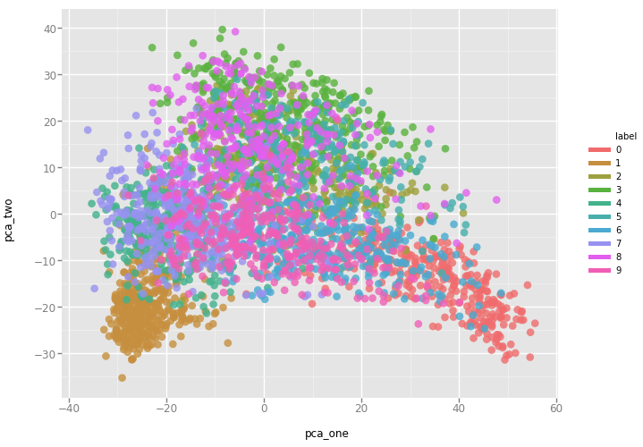
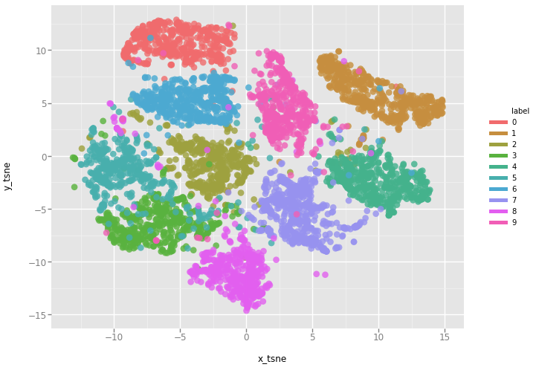
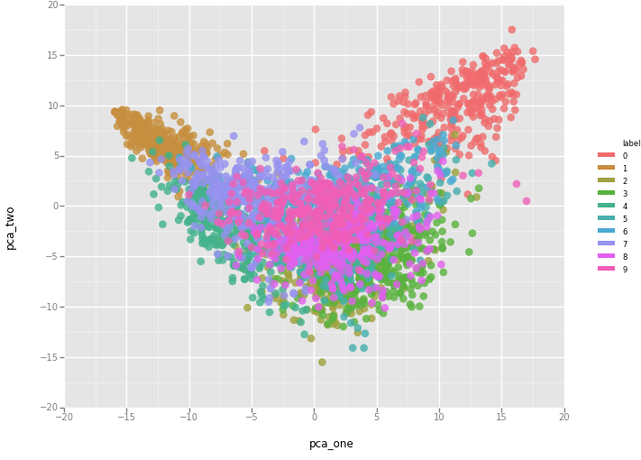
MATH 6380O Mini-Project 1: Feature Extraction and Transfer Learning
LIANG Weijian¹, DENG Didan² and SRAZHIDINOV Radik² {wliangab, tcloaa, ddeng}@connect.ust.hk
¹: Department of Civil and Environmental Engineering, HKUST ²: Department of Electronic and Computer Engineering, HKUST
1. Introduction
3. MNIST with Pretrained Alexnet (on ImageNet)
5. Analysis and Discussion
We have used Pretrained Network VGG16 and Alexnet to extract the features. Then Visualized the extracted features using PCA and t-SNE. Image classification is done by the traditional supervised learning method SVM classification. Lastly, the transfer learning was done by freezing convolutional layers and fine-tuning dense layers.
Using model = AlexNet(x, keep_prob, 1000, []) is because the AlexNet was pretrained on ImageNet with 1000 classes, here we use 1000 as the number of classes for initialization. Since our work is to extract the output of fc7 as features, it really has nothing to do with the number of neurons in the last layer.
The accuracy of two networks trained with/without VGG16 extracted features is similar (e.g. 0.9766 (w. feature) v.s 0.9783 (w.o. features )). This probably due to that features extracted by pretrained network contain enough information for digit recognition. And this test also show that we can use pretrained network to extract feature before training process in order to speed up the whole procedure without great loss in accuracy.
Exploring the feature extraction using AlexNet: Even though AlexNet is relatively shallow NN, but the experiment results showed that AlexNet is good enough for feature extraction. Comparing the Visualization using two different methods: PCA and t-SNE. It turns out t-SNE has better performance of clustering, but it is way more time-consuming than PCA.
Using transfer learning we can reuse the model developed for classification of numbers 0-4 and just fine-tune dense layers to perform same task for different numbers 5-9. This technique allows to save time when we want to reuse the developer NN on other similar problems.
2. Feature Extraction using VGG16
VGG is a convolutional neural network model proposed by K. Simonyan and A. Zisserman from the University of Oxford in the paper “Very Deep Convolutional Networks for Large-Scale Image Recognition” . The model achieves 92.7% top-5 test accuracy in ImageNet , which is a dataset of over 14 million images belonging to 1000 classes.
Visualize using PCA
Visualize using t-SNE
2.1. Methodology
4. Transfer Learning (ConvNet)
Modified the input date to satisfy the VGG requirement
Use PCA to visualize extracted features
Use the extracted features to train a simple network
Use the raw MNIST data to train a simple network
1 - Train a simple ConvNet on the MNIST dataset the first 5 digits [0..4].
2 - Freeze convolutional layers and fine-tune dense layers for the classification of digits [5..9]. 3 - Get to 99.8% test accuracy after 5 epochs for the first five digits classifier
4 – Get to 99.2% for the last five digits after transfer + fine-tuning.
Conclusions/Future Work
The whole features looks like a 'V' shape.
Each digit feature is confined in a certain area.
Using the extracted feature can train the network faster (e.g. 20s/Epoch (w. feature) v.s. 193s/Epoch (w.o. features) ))because of the reduced input data size as well as the associated parameters
6. References
Luuk Derksen, “Visualising high-dimensional datasets using PCA and t-SNE in Python”, Oct 29, 2016, goo.gl/kb3rDW
Frederik Kratzert, “Finetune AlexNet with Tensorflow”, June 15, 2016, goo.gl/EwRfoy
“Transfer learning toy example”, goo.gl/FLmTjy
4.1. Future work related to transfer learning
Is it possible to use this transfer learning technique for more complicated classification? E.g. extract features for Raphael’s painting to identify if it is his or not, and then fine-tune dense layers for the classification of the other painters?
Our group have prepared python code for Raphael’s painting, but unfortunately CPU had crushed and we couldn’t identify if our assumption was right.
7. Contribution
Feature Extraction using VGG16
LIANG Weijian
MNIST with Pretrained Alexnet
DENG Didan
Transfer Learning (ConvNet)
SRAZHDINOV Radik
This feature map

