Slide 1
Introduction to
Database Replication

Slide 2
Agenda
Replication Overview
Database Replication Types
Transaction Replication
Workshop

Slide 3
What is data replication?
  Data Replication is the process of sharing information
  so as to ensure consistency between redundant resources,
  such as software or hardware components,
  to improve reliability, fault-tolerance, or accessibility.
  From Wikipedia

Slide 4
  Why we need data replication?
  Several typical Scenarios

Slide 5

Scenario One
ShangHai
London
New York
Tokyo
Data
Response
Time
Load
Critical

Slide 6
Scenario One (cont.)‏
ShangHai
London
New York
Tokyo
Data
Data
Data
Data
Response
Time
Load
Load
Critical
Critical

Slide 7
Scenario Two
Transaction
Application
Reporting
Application
Master
Slave

Slide 8
Why data replication?
Performance
    Location distributed
    Local Accesses are fast
Fault Tolerance
    Fail over
    By keeping several copies of the data at different sites, single site failures should not affect the overall availability
Application Type
    OLTP
    OLAP

Slide 9
Other applications of data replication
Improving scalability and availability
Data warehousing and reporting
Integrating data from multiple sites

Slide 10
Definition
Database Replication
is the process of sharing information between databases
to ensure that the content is consistent between systems

Slide 11
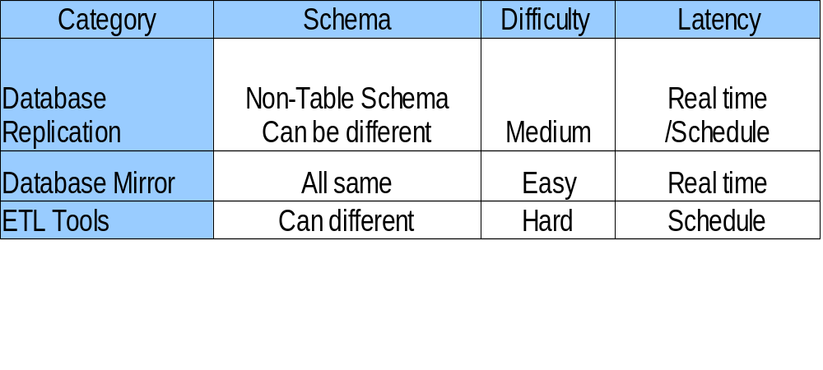
Database Replication V.S. Other replication ways

Slide 12
Agenda
Replication Overview
Database Replication Types
Transaction Replication
Workshop

Slide 13
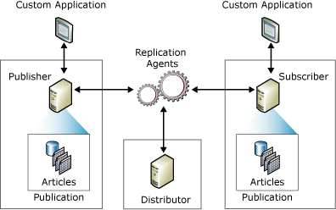

Slide 14
Types of Replication
Transaction Replication
The Publisher streams transactions to the Subscribers after they receive an initial snapshot of the published data
  Master – Slave
  Updatable Subscriber
Merge Replication
The Publisher and Subscribers can update the published data independently after the Subscribers receive an initial snapshot of the published data. Changes are merged periodically
  Multi Master
Snapshot Replication
The Publisher sends a snapshot of the published data to Subscribers at scheduled intervals

Slide 15
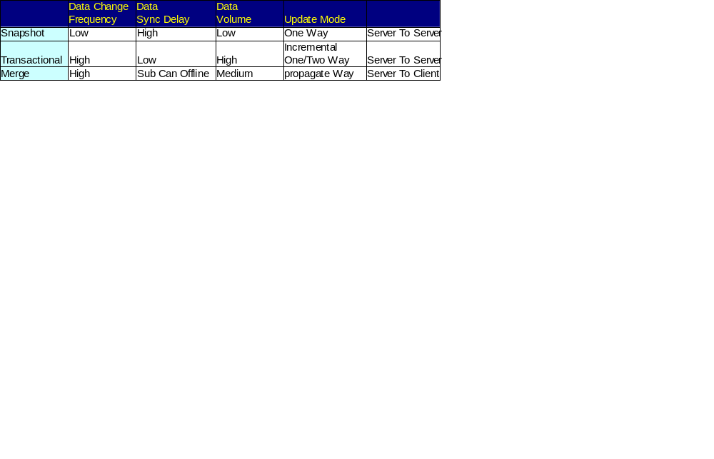
Comparision

Slide 16
Agenda
Replication Overview
Replication Types
Transaction Replication
Workshop

Slide 17
Transactional Replication Overview
Data changes and schema modifications made at the Publisher are usually delivered to the Subscriber as they occur (in near real time).
Incremental changes to be propagated to Subscribers as they occur
Requires low latency
Very high volume of insert, update, and delete activity

Slide 18
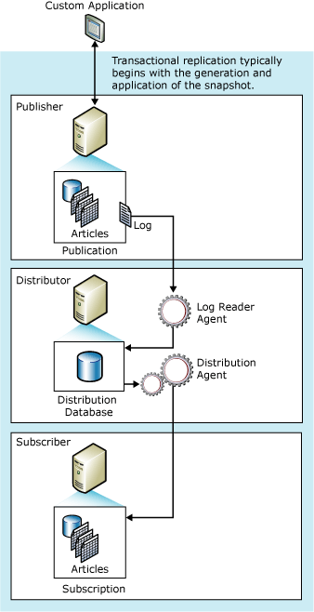
How Transactional Replication Works
Log Reader Agent
Distribution Agent
Publication
Article

Slide 19
Article Types
Table
View
Function
Store procedure

Slide 20
Considerations for Transactional Replication
Transaction log space auto grow
Disk space for the distribution database
Primary keys for each published table
Triggers
Identity Management‏

Slide 21
Agenda
Replication Overview
Replication Types
Transaction Replication
Workshop

Slide 22
Database Replication
Q&A

