Slide 1
BW Training

Slide 2
Overview
Quick Introduction
Components
Basic And Most Used Concepts
Installation

Slide 3
Quick Introduction

Slide 4
Quick Introduction
TIBCO ActiveMatrix BusinessWorks™ is a robust and highly scalable platform that can be used to:
Develop new services
Automate business processes
Integrate applications – minimal code required.

Slide 5
Components

Slide 6
Components
TIBCO Designer(*)
TIBCO Admin(?)
TIBCO Domin Utility(?)

Slide 7
TIBCO Designer

Slide 8
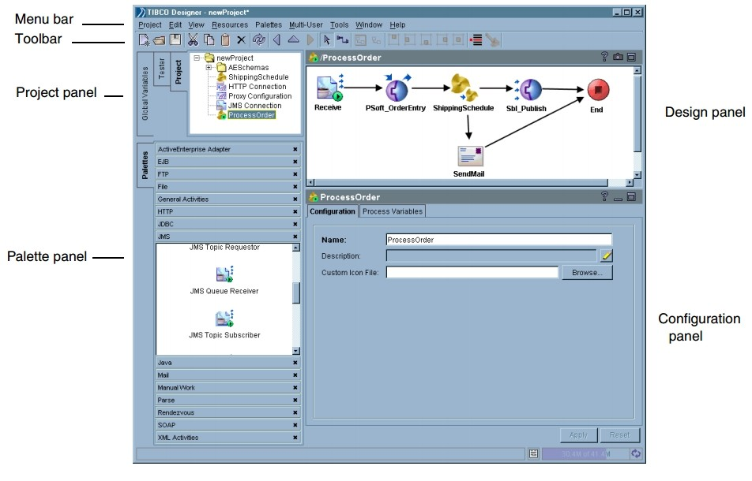
Designer - UI

Slide 9
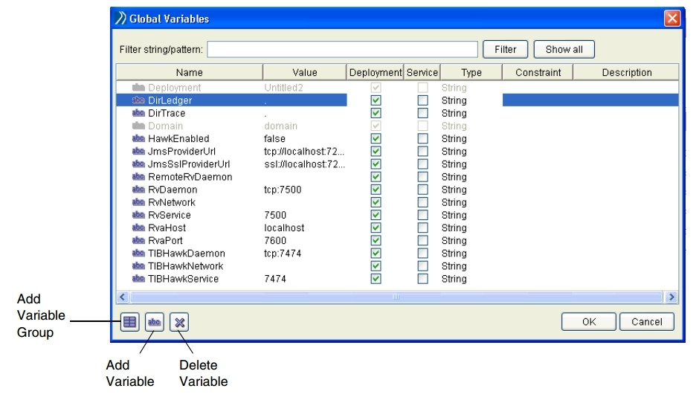
Designer - Global Variable

Slide 10
Process
Process Definitions
Activities
Transitions
Groups

Slide 11
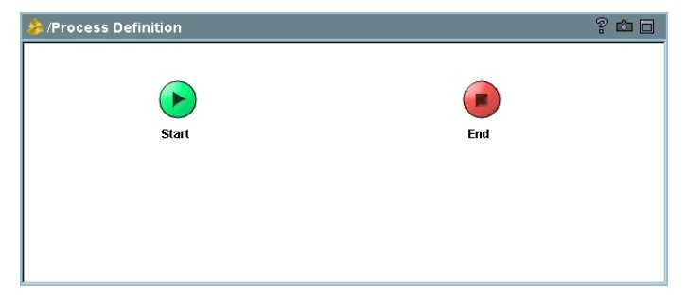
Process Definitions

Slide 12
Activity
Input And Output
Configuration
Process starters
Editor

Slide 13
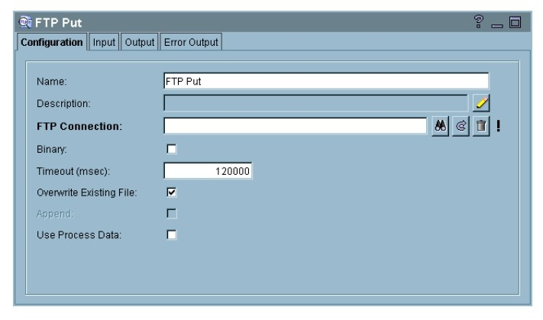
Activity-Configuration

Slide 14
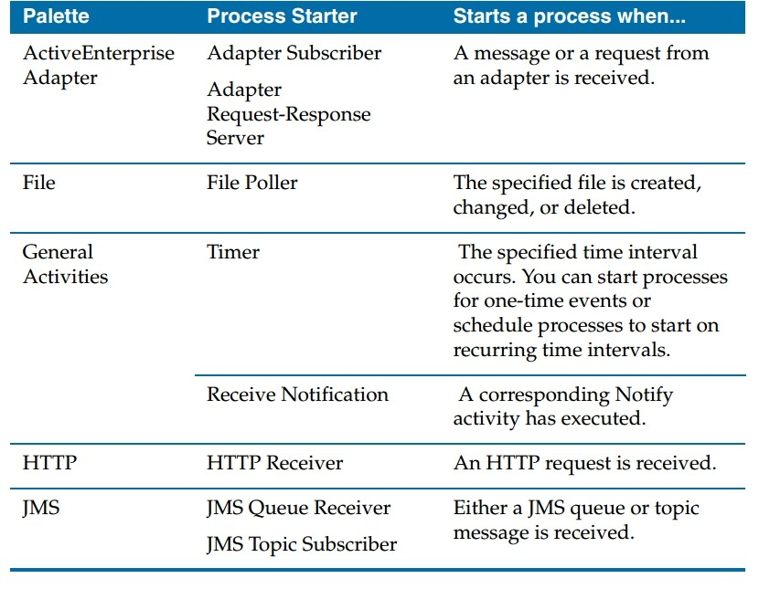
Activity-Starters

Slide 15
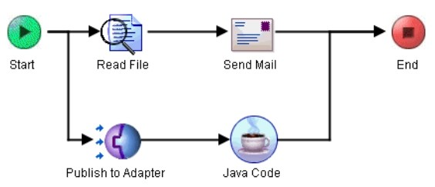
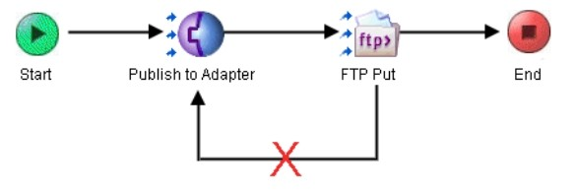
Transitions

Slide 16
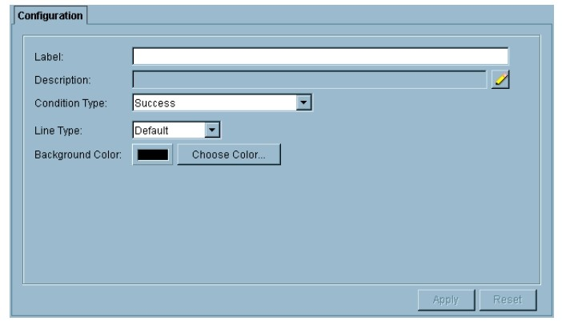
Transitions
Condition type:
Success
Success with condition
Success with no matching condition
Error
Demo

Slide 17
Groups
Action:
None
If
Iterate Loop
Repeat Until True
While True
Repeat On Error Until True
Transaction Groups
Critical Section
Pick First
Demo

Slide 18
Mapping and Transforming Data
Introducing
Repairing Incorrect Mapping
Mapping Required, Optional, and Nillable Elements
Merging Input from Multiple Sources
Converting a List Into a Grouped List
Demo

Slide 19
Sharing Common Resources
Librariy Builder
Demo

Slide 20
TIBCO Admin

Slide 21
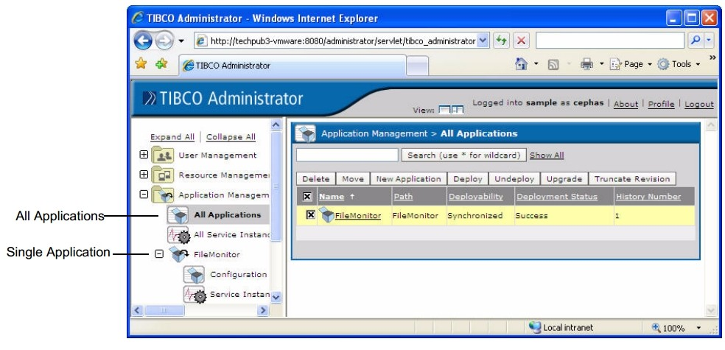
Admin

Slide 22
TIBCO Domin Utility

Slide 23
Tasks
Machine Management
Domain Configuration
Server Settings
TIBCO EMS Plugin
...

Slide 24
Basic And Most Useful Concepts - EMS

Slide 25
EMS
JMS Connection
JMS Queue Sender/Receiver
JMS Queue Reqestor
JMS Topic Publisher

Slide 26
EMS
JMS Queue Receiver/JMS Topic Subscriber
  Set the JMS connection
  Select the message type
  Input the destination
  Receive the message
Demo

Slide 27
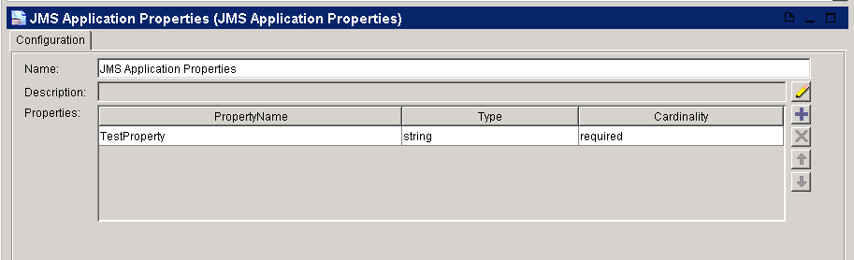
Message Selector
JMS Application Properties
  Add the properties
  Set the name & value pattern

Slide 28
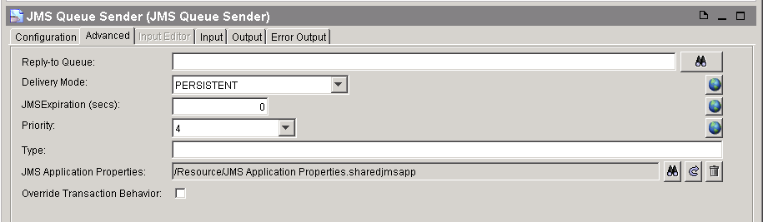
Message Selector
Use JMS Properties
  Set JMS Properties in the advanced tab (queue sender/topic publisher)

Slide 29
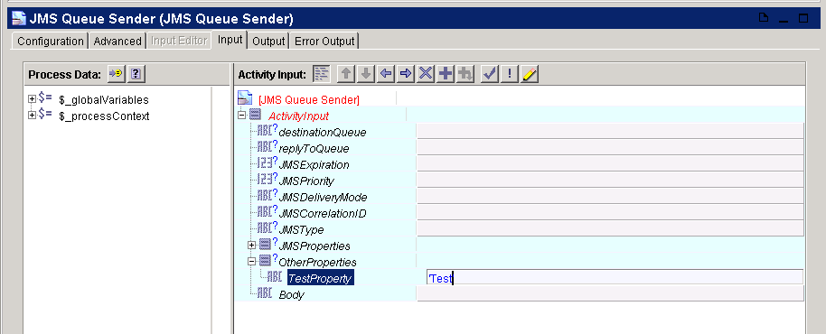
Message Selector
Send message with properties
  Input the value of the properties

Slide 30
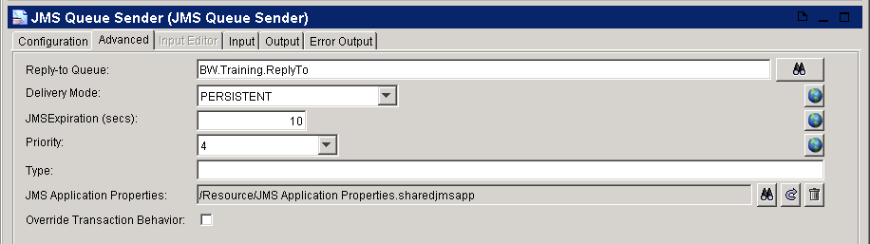
Advanced EMS
Reply To
  Send message and define the destination of the response

Slide 31
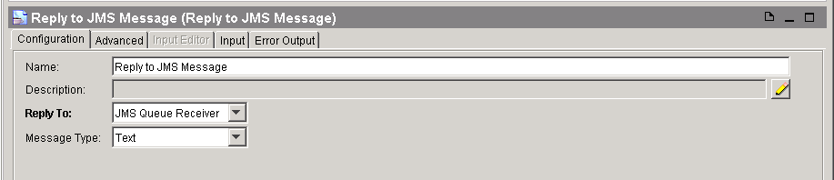
Advanced EMS
Use Reply to JMS Message
  Set Reply To property

Slide 32
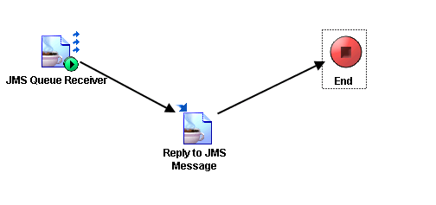
Advanced EMS
Reply To

Slide 33
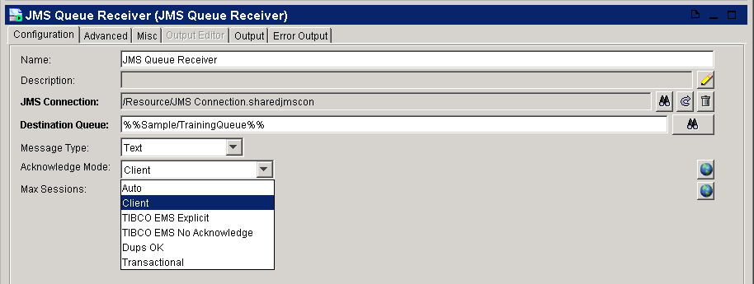
Advanced EMS
Acknowledge Mode
  Auto – automatically confirm the message after received
  Client – confirm the message manually

Slide 34
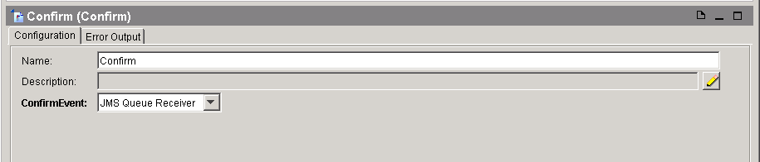
Advanced EMS
Confirm
  Set confirm event

Slide 35
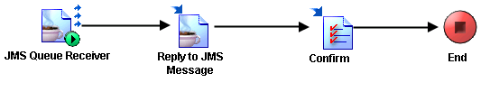
Advanced EMS
Confirm after Reply

Slide 36
Basic And Most Useful Concepts - JDBC

Slide 37

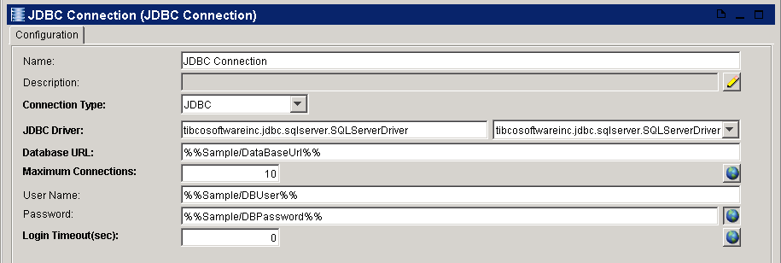
JDBC
JDBC Connection
  Basic setting of the JDBC
  Do test connection

Slide 38
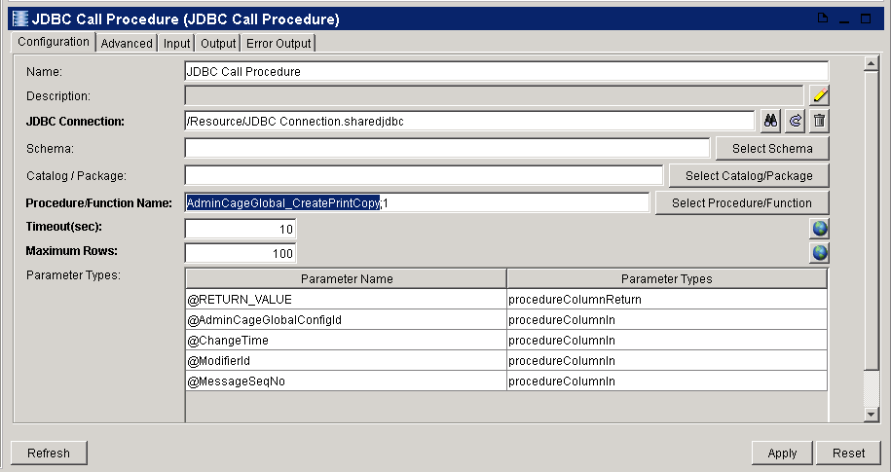
JDBC
JDBC Call Procedure
  Set the JDBC connection and select the store procedure
  Set the time out sec and max row (0 means no limitation)

Slide 39
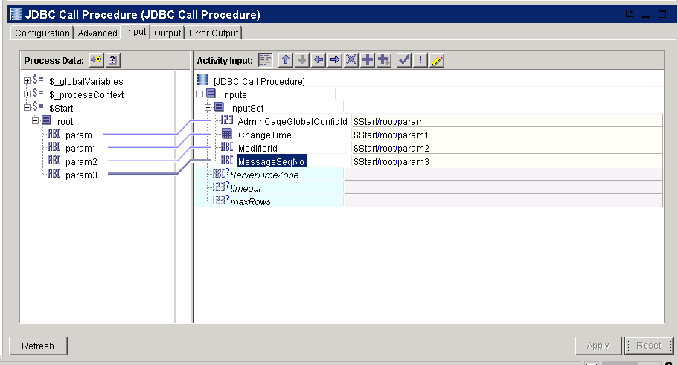
JDBC
JDBC Call Procedure
  Drag and drop the input value

Slide 40
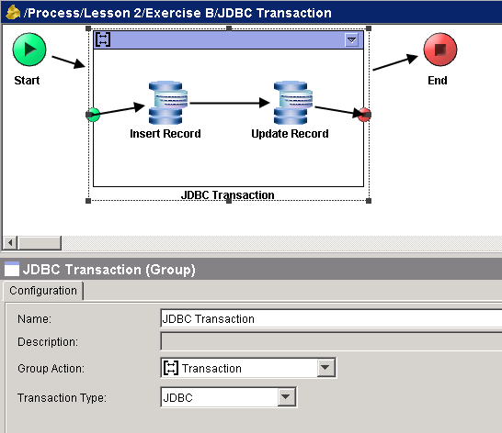
JDBC Transaction
Set up JDBC Transaction
  Group JDBC activities
  Set the group action to transaction
  Set the transaction type to JDBC

Slide 41
Basic And Most Useful Concepts - XML and Schema

Slide 42
Define XML Schema
To define a XML schema
  Add xml schema to project
  Edit root name of the schema
  Define the namespace of this schema
  Define the structure of the schema
  When added the node of the schema please select locally defined

Slide 43
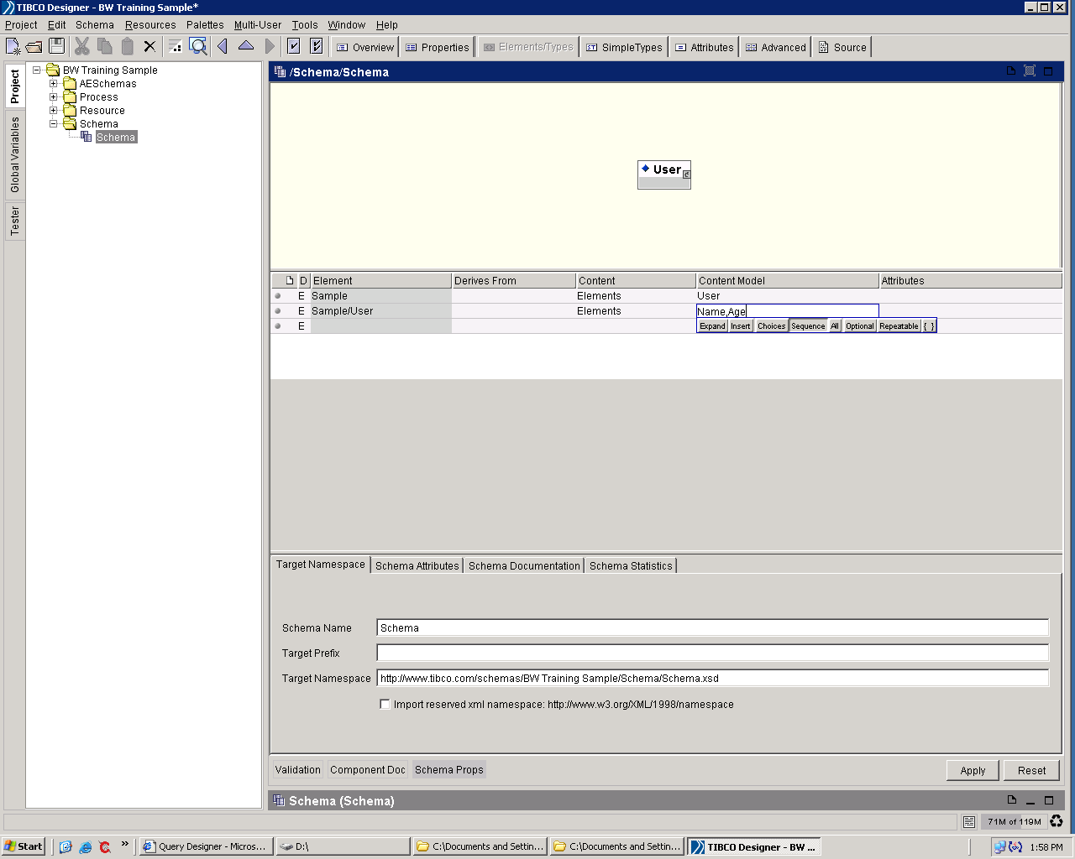
Define XML Schema

Slide 44
Define XML Schema
Content type of an element
  Elements - The content model contains elements only
  Typed - The content is either a simple type (such as string, integer or float) or a named complex type
  Empty - When an element has no content at all, its content model is empty. Essentially, a model is defined that allows only elements in its content but does not actually declare any elements, so the type's content model is empty.
  Any - The content model contains any combination of elements and/or character data (text)
  Mixed - In a mixed content model, an element contains other elements interleaved with character content. Character data can appear alongside child elements and is not confined to the deepest child elements.

Slide 45
Define XML Schema
Import common schema
  You can define a common XML schema in your project so that you do not need to define the same structure again and again
  Click the overview mode
  Import the common schema
  Insert the node you want to the current schema

Slide 46
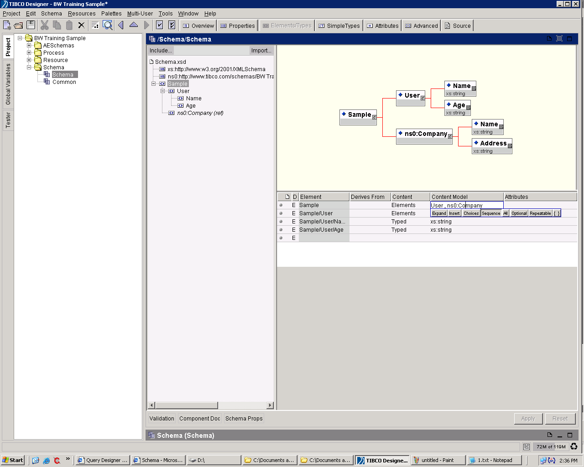
Define XML Schema

Slide 47
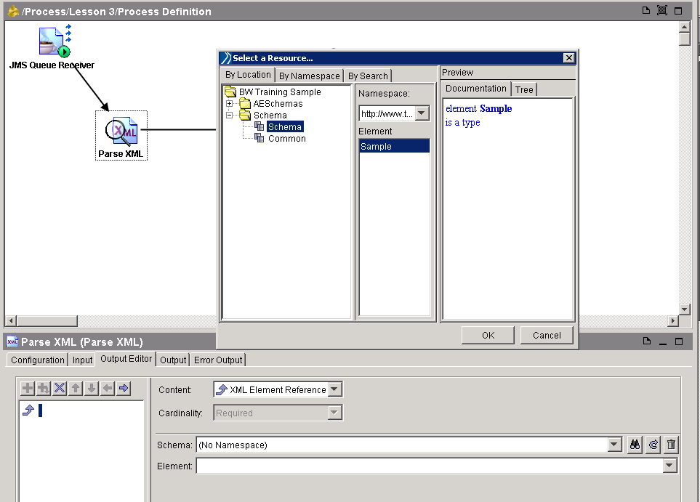
Parse XML

Slide 48
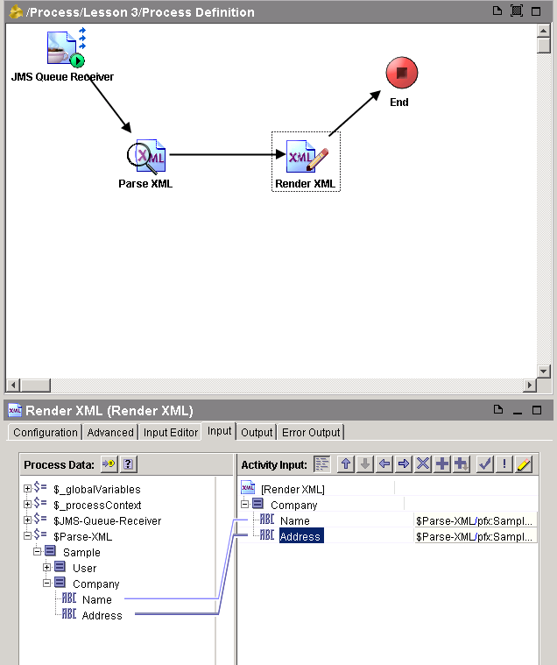
Render XML
Transfer Data
  Now we can link the data from parse xml activity to render xml activity
  That means transfer the data from one activity to another activity.

Slide 49
Basic And Most Useful Concepts
- Invoking and Implementing Web Service

Slide 50
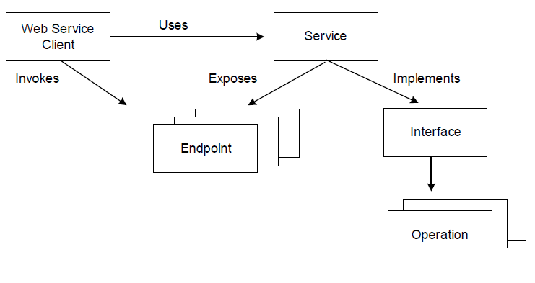
Service Model

Slide 51
WSDL Element
Type
Message
Part
Operation
Port Type
Binding
Port
Service

Slide 52
Configuring a Service
When specifying a Service resource, you must supply the following:
a WSDL file — this defines the interface for the service. This interface describes the operations contained in the service and input, output, and fault messages for the operations.
endpoint bindings — endpoints expose the location of the service to the service partner. An endpoint binding specifies the transport to use for the endpoint, any transport-specific properties, and any SOAP details (such as SOAP version, SOAP action, and so on).
operation implementation — each operation must specify the process definition to execute for the operation.

Slide 53
Create a web service
Create XSDs to define the input, output, and fault messages for the web service.
Create a WSDL File resource that defines the interface to the web service.
Create a process definition that performs the work of the web service.
Create a process definition that retrieves the concrete WSDL file and sends it to web service clients.

Slide 54
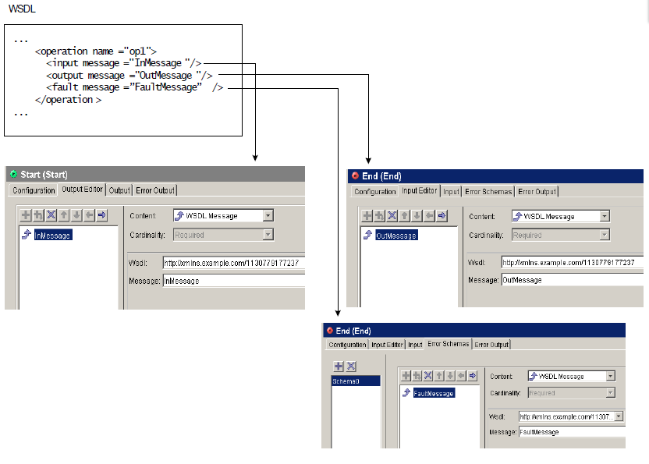
Operation Implementation

Slide 55
Installation

Slide 56
Installation
JRE should be a precondition
Ant Installation
\\192.168.109.46\Share\Software\Server_Installation\apache-ant-1.8.1.zip
TIBCO Installation Guidance:
\\192.168.109.46\Share\Software\Server_Installation\Tibco_upgrade\NewBackendInstallationGuidance.doc

Slide 57
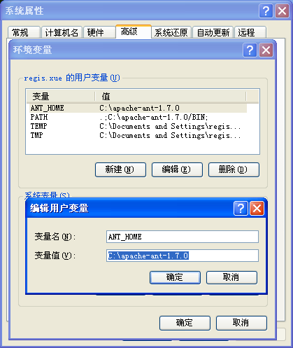
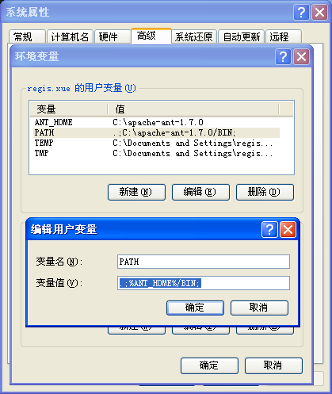
Installation
Configure Environment Variables

