Slide 1
Name : E . JASPER
NM ID : au412721205022
COLLEGE : Tagore Engineering College

Slide 2
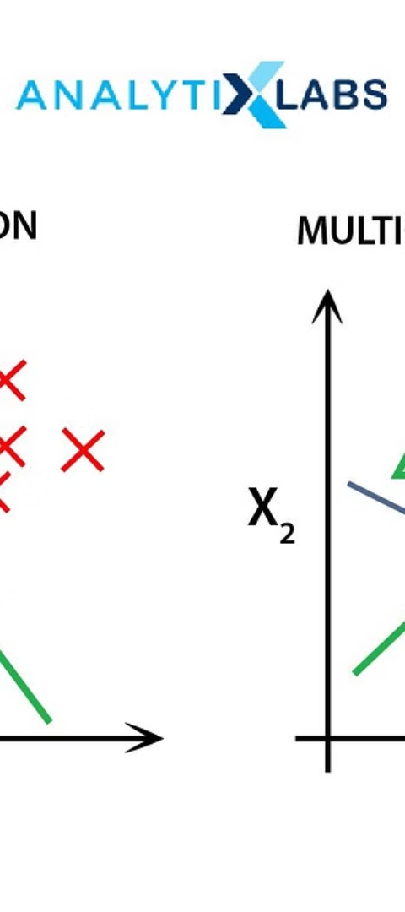
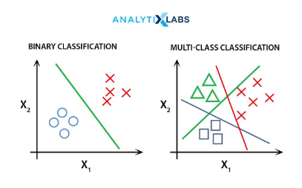
Project Title
An image classification project using Convolutional Neural Networks (CNN) to analyze and categorize images based on their visual content. This innovative project utilizes advanced machine learning algorithms to accurately classify a wide variety of visual data.

Slide 3
Agenda
Objective Setting
Resource Allocation
Project Timeline
Establishing clear and achievable objectives for the image classification project.
Allocating the necessary resources for training and optimizing the CNN models.
Setting a timeline for completion, testing, and deployment of the image classification system.

Slide 4


Problem Statement
1
Visual Data Analysis
Analyzing and interpreting complex visual data from diverse sources.
2
Accuracy & Precision
Ensuring high accuracy and precision in image classification for real-world applications.
3
Performance Demands
Meeting the performance demands for rapid and seamless image recognition tasks.

Slide 5


Who Are the Users
Developers
Researchers
Creating applications with advanced image recognition capabilities.
Utilizing image classification for scientific and academic purposes.

Slide 6

Your Solution and Its Value Proposition
Superior Accuracy
Real-Time Processing
Scalability & Flexibility
Delivering exceptional accuracy through state-of-the-art CNN algorithms.
Providing real-time image recognition and classification solutions.
Scaling to handle large and complex datasets with flexibility in customization.

Slide 7




The Wow in Your Solution
Advanced Technologies
Utilizing cutting-edge CNN models and deep learning techniques for groundbreaking outcomes.
Robust Feature Extraction
Extracting robust visual features to enable fine-grained image classification.
Dynamic Adaptation
Adapting to new visual patterns and changes without retraining the entire model.

Slide 8
Modelling
Framework Selection
Choosing the most suitable deep learning frameworks for model development.
Data Preprocessing
Preparing and augmenting image data for effective model training.
Training & Validation
Conducting rigorous training and validation to enhance model performance

Slide 9
user interface and user experience
Creating an intuitive user interface (UI) that ensures a seamless user experience (UX) throughout the image recognition process.
Interactive Design
Designing an interactive UI with user-friendly features and controls for easy navigation and interaction.
Effortless Workflow
Implementing a streamlined workflow that simplifies the process of uploading, processing, and analyzing images for efficient user engagement.

Slide 10
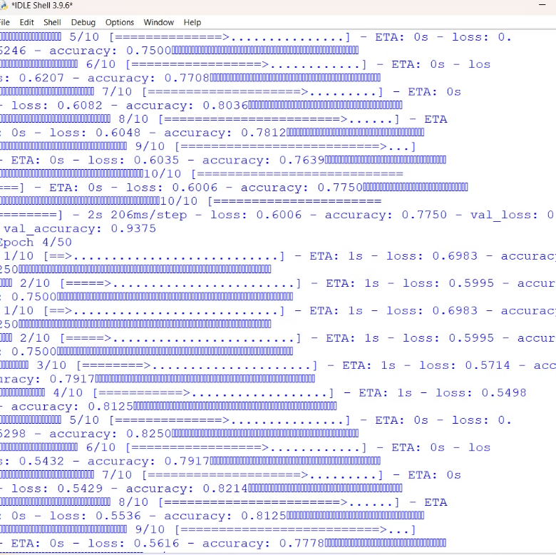
result

Slide 11
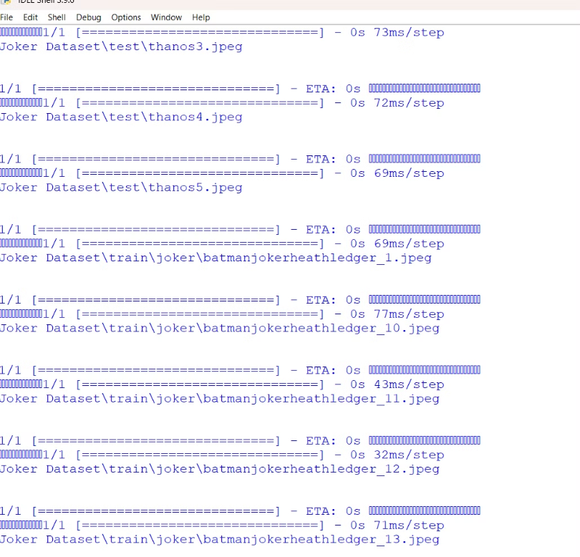
result

