Slide 1
Introduction
This comprehensive report is a presentation to the Hotel paradise stakeholders, who owns one of the most renowned beach resort in Southern Australia.
It’s in its pioneer stage, as high season is approaching, a decision model was created to manage the surge efficiently reaping out the best revenue possible.
This report focuses on analysing the booking operations including accommodation reservations, pricing strategies, and the risks associated.
Our objectives are to maximise daily profits and occupancy rates.
The main concepts we will be considering are:
booking management including room availability, pricing strategies, and refunding policies.
Risk assessment: Potential risks such as overbooking, cancellations, and revenue fluctuations.
Demand fluctuation: strategies to maximise occupancy rates
Profit maximising: Increasing daily profit with increased customer satisfaction.
Easy to understand model and realistic.

Slide 2
Overview of the model
Key Output:
Daily Profit, Sold out: Yes/No
Management Decision Variable:
Overbooking Rate/limit, Room Rate, Late Cancellation Fee
Stochastic Variable:
Daily Reservations, Late Cancellations, Walk-in Guest Visited, Daily miscellaneous Expenses
Fixed Variable:
Staff wages, Number of rooms, Housekeeping cost per room, Minibar Cost
Calculated Variables:
Total cost per day, Number of occupied room, Sales revenue per day, Revenue from late cancellation, Overbooking refund, Walk-in guests allowed, Overbooked rooms.

Slide 3
Overview of the model
This model contains basic resort booking/running structure which includes almost every important attributes needed to analyse and optimise profit and occupancy rate.
To calculate daily profit, we brought together all the costs(staff wages, housekeeping cost, minibar cost, miscellaneous expenses) into total cost including overbooking refund and every inputs (number of guests – reservations, walk-ins and room rates) including revenue from cancellations to generate total sales revenue.
We have added another output to determine whether the rooms are sold out or not
To assess risk factor, we have incorporated cancellations, overbooking refund policies as well.
To analyse demand fluctuations, we have applied three different room rates including weekdays, weekends and high season.
Also, we have decided to have a fixed late cancellation fee and limit for overbooking.

Slide 4
Walkin guests visited
Staff Wages
Walk-in guest Allowed
Number of occupied room
Number of rooms
Late cancellations
Total cost per day
Sold out: Yes/No
Overbooking limit
Housekeeping cost per room
Late Cancellation fee
Daily Profit
Minibar Cost
Revenue from late cancellation
Daily miscellaneous expenses
Sales revenue per day
Overbooking refund
Room rate
Daily Reservations
Overbooked rooms

Slide 5
Conceptual model explanation.
All the fixed inputs such as staff wages, housekeeping cost per room * number of rooms, minibar cost along with stochastic input miscellaneous expenses goes to the calculated variable: total cost per day.
Walk-ins, daily reservations, late cancellations all leads to total number of occupied rooms. Walk-ins allowed are taken from walk-ins visited based on overbooking limit and remaining number of rooms after reservations and cancellations.
Overbooked number of rooms are obtained from number of rooms, reservations, walk-ins and late cancellations
Overbooked rooms with room rates give overbooking refund.
Late cancellations with late cancellation fee gives revenue from late cancellations.
Number of occupied room with room rates and revenue from late cancellations altogether gives total sales revenue per day.
Number of occupied rooms also predicts sold out: Yes/No.
Total sales revenue and total cost will give out the daily profit.

Slide 6
Assumptions & limitations of the models
There is predefined limit of 50 on daily reservations. The cell is restricted using data validation.
Any number of cancellations can occur on daily reservations.
There is 10% of overbooking rate allowed, That is 5 rooms extra. $180 is the resort’s night stay room rate.
Walk-ins are accepted within the overbooking limit, therefore most probably overbooked rooms are caused by walk-ins which is not a logical situation, but the assumption had to be met.
There are three different rates for weekdays($200), weekends($230) and high season($350).
We also assume that miscellaneous expenses is same throughout all seasons (here, room rates), therefore, the mean is fixed at all room rates.

Slide 7
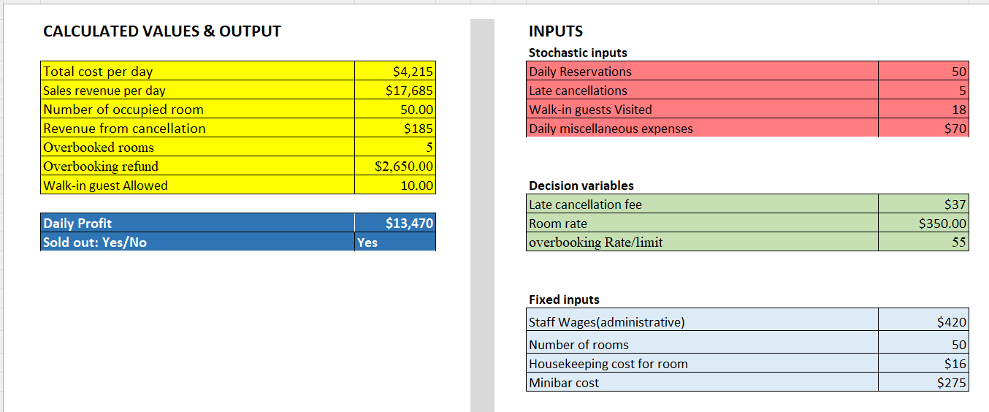
The decision model

Slide 8
Decision model
Stochastic inputs are not deterministic. Therefore, it varies daily.
Decision and fixed inputs are set figures except for room rates with 3 different values as mentioned in previous slides.
Calculated variables:
Total cost: Housekeeping cost * number of rooms + Staff wages + minibar cost + Miscellaneous expenses + Overbooking refund.
Number of occupied rooms: Minimum of total number of rooms or (Reservations + walk-ins - cancellations)
Total sales revenue: Room rate * Number of occupied rooms + revenue from cancellation
Revenue from late cancellation: Number of cancellations * Cancellation fee.
Overbooking refund: (Roomrate + one night stay (Here, it is $180)) * Overbooked number of rooms.
Walk-in guests allowed: Minimum of walk-in guests visited or (total overbooking limit - reservations + cancellations)
Overbooked rooms: Maximum of zero or (number of reservations + walk-ins - cancellations - Total number of rooms in the resort)

Slide 9
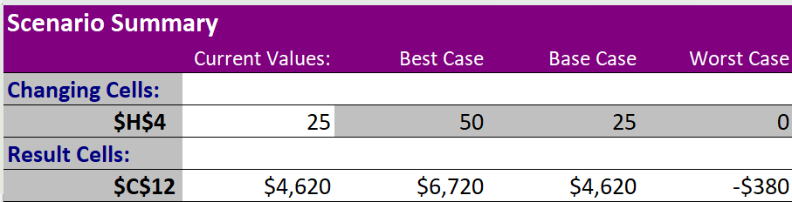
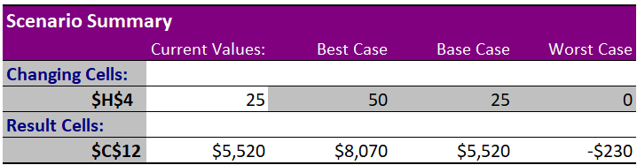
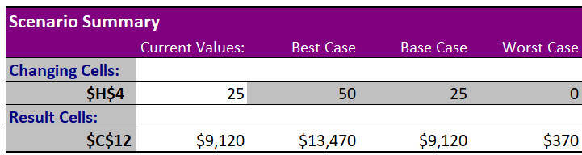
Scenario Analysis and implications
Daily reservations at room rate of $200
Daily reservations at the room rate of $230
Daily reservations at the room rate of $350

Slide 10
Implications
Keeping all the other stochastic inputs constant at the base value of 5 on cancellations and 10 on walk-ins(miscellaneous expenses was not considered as it won’t make a relevant change), daily reservations at the room rates of $200, $230 and $350 in its best case, base case and worst case shows how well the rates and number of reservations affect the daily profit.
Maximum daily profit the resort can get by getting full reservations on weekdays is $6720, on weekends is $8070 and on upcoming high season is $13470.
The loss the resort can suffer without getting any reservations on weekdays is -$380, on weekends is -$230 and on upcoming high season the resort doesn’t get loss if walk-ins are present at a base value of 10.

Slide 11
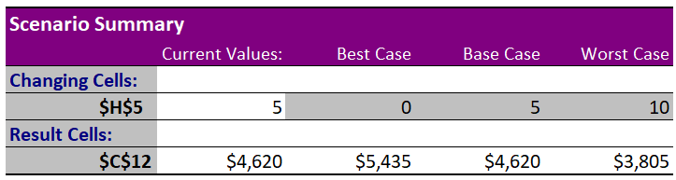
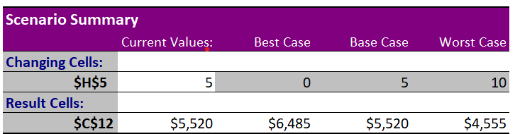

Scenario Analysis and implications
Late cancellations at the room rate of $200
Late cancellations at the room rate of $230
Late cancellations at the room rate of $350

Slide 12
Implications
Keeping all the other stochastic inputs constant at the base value of 25 on reservations and 10 on walk-ins(miscellaneous expenses was not considered as it won’t make a relevant change), late cancellations at the room rates of $200, $230 and $350 in its best case, base case and worst case shows how well the rates and late cancellations affect the daily profit.
Maximum daily profit the resort can get by getting no cancellations at all on weekdays is $4620, on weekends is $5520 and on upcoming high season is $10685.
When the cancellations is 10 which we assume to be the worst scenario that can actually happen, the daily profit on weekdays is $3805, on weekends is $4555 and on upcoming high season, it is $7555.

Slide 13

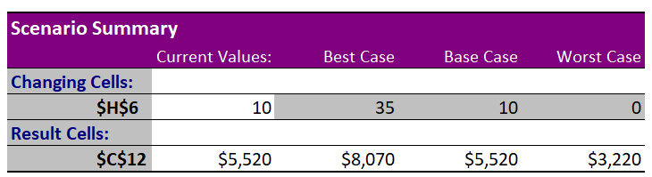
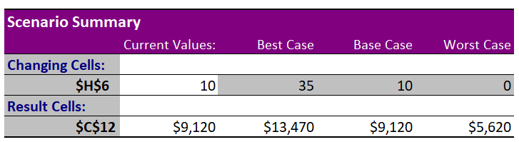
Scenario Analysis Reports
Walk-ins at the room rate of $200
Walk-ins at the room rate of $230
Walk-ins at the room rate of $350

Slide 14
Implications
Keeping all the other stochastic inputs constant at the base value of 25 on reservations and 5 on cancellations(miscellaneous expenses was not considered as it won’t make a relevant change), walk-ins at the room rates of $200, $230 and $350 in its best case, base case and worst case shows how well the rates and walk-ins affect the daily profit.
Maximum daily profit the resort can get by getting the best case of 35 walk-ins is same as getting full reservations; on weekdays, it is $6720, on weekends, it is $8070 and on upcoming high season, it is $13470.
Even if walk-ins are not there, with reservations on base level of 25, on weekdays, resort can get profit of $2620. on weekends, it is $3220, and high season, it is $5620.

Slide 15
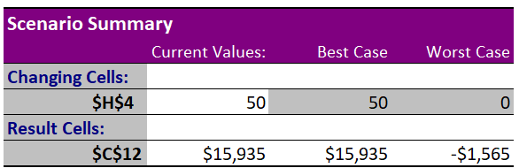
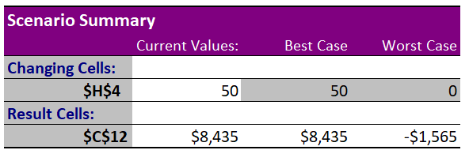
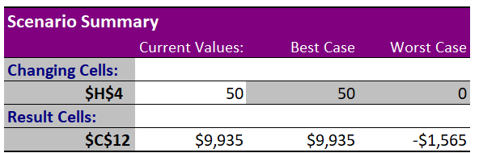
Scenario analysis – Fully occupied without cancellations
The maximum profit the resort can reap on this upcoming high season is $15935 without any risks.
The maximum loss the resort can suffer without any rooms occupied is -$1565 without any risks
The maximum profit on weekdays is $8435, on weekends, it is $9935. Loss without any occupied room is same for all room rates: -$1565.

Slide 16
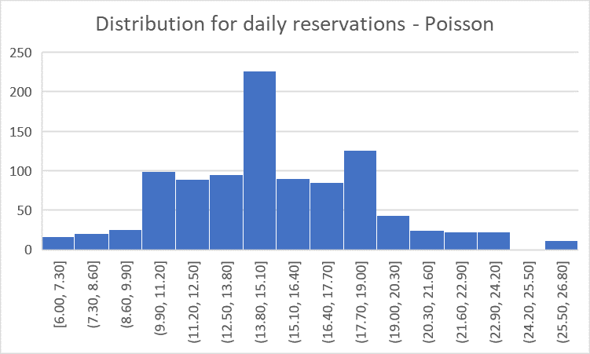
Selecting distributions and its justification
Daily reservations: Poisson distribution
Justification – Daily reservations happens independently with number of occurrences in a given time period and it is a discrete variable. So we used poisson distribution here.
Descriptive statistics: Mean should be equal to its variances.
Mean = 15.07, Variance = 14.60. (Around 15). Also, the graph represents a typical poisson distribution.( a little left-skewed)
Therefore, the selection of poisson distribution is justified.

Slide 17
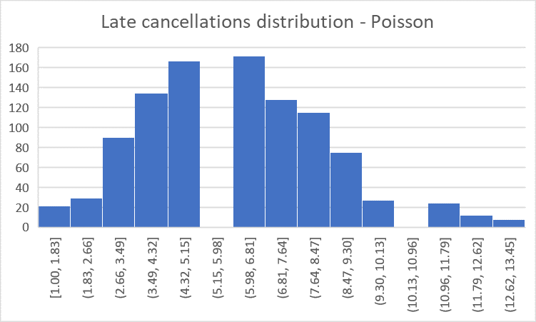
Selecting distributions and its justification
Late cancellations: Poisson distribution
Justification – Late cancellations happens independently with number of occurrences in a given time period and it is a discrete variable. So we used poisson distribution here. We tried binomial distribution, but the graph was skewed.
Descriptive statistics: Mean should be equal to its variances.
Mean = 6.01, Variance = 5.62. (Around 6). Also, the graph represents a typical poisson distribution.( a little left-skewed)
Therefore, the selection of poisson distribution is justified.

Slide 18
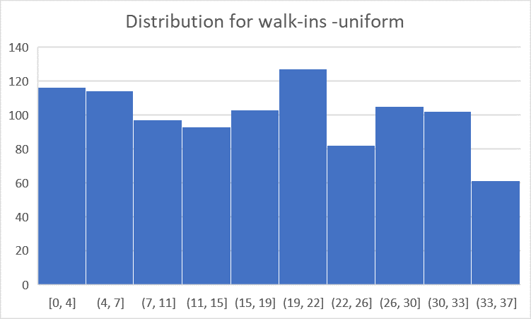
Selecting distributions and its justification
Walk-ins: Uniform distribution
Justification – We have no idea how many walk-ins will arrive in a day, and it is a discrete variable. So, we used uniform distribution here.
Descriptive statistics:
The graph represents a typical uniform distribution.
Therefore, the selection of uniform distribution is justified.
Miscellaneous expenses: Normal distribution
We used normal distribution in the case of miscellaneous expenses as it is a continuous variable with mean = 43.33, standard deviation = 30.13.
We haven’t taken it for further analysis. So descriptive statistics are not done

Slide 19
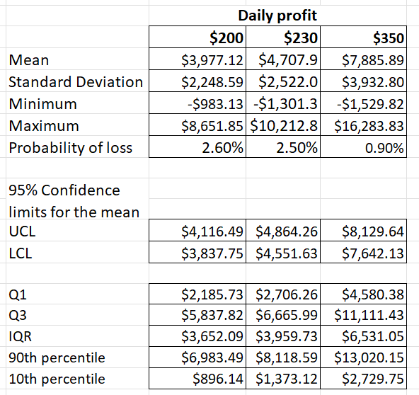
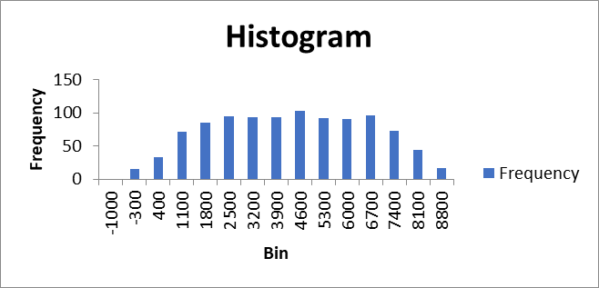
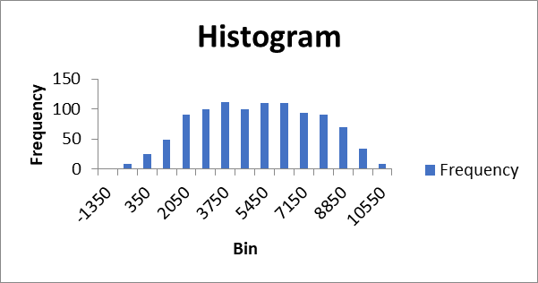
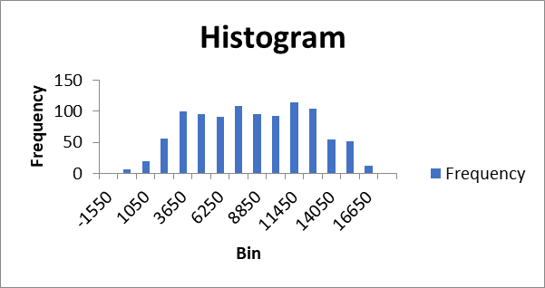
Summary of daily profit at 3 different room rates

Slide 20
Interpretation
Daily profit when room rate is $200 ranges from -$983 to $8652. At $230, it ranges from -$1301 to $10,213 and At $350, the profit ranges from -$1530 to $16,284.
The lowest 1/4th of daily profit at $200 reaches up to $2186, at $230, it reaches up to $2706 and at $350 up to $4580.
The highest 10% of daily profit at $200 starts from $6983, at $230, it starts from $8119, at $350, it starts from $13,020.
We are 95% confident that mean value for room rate $200 lies between $3838 and $4116, for $230, it lies between $4552 and $4864, for room rate of $350, It is between $7642 and $8130.
The probability of loss for $200 is 2.6%, for $230, it is 2.5% and for $350, it is 0.9%.

Slide 21
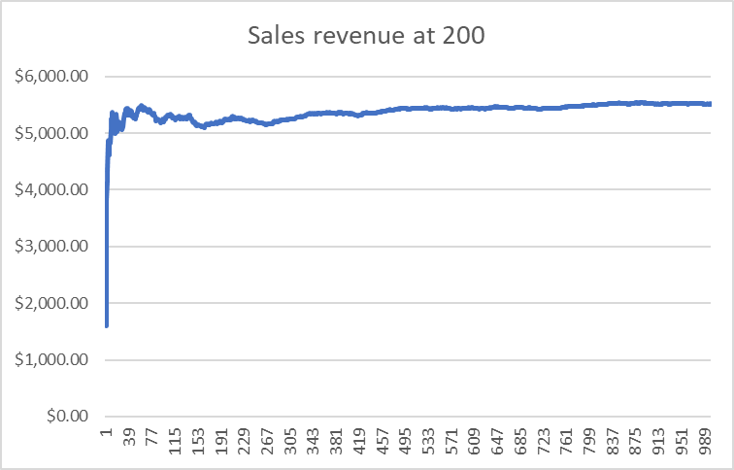
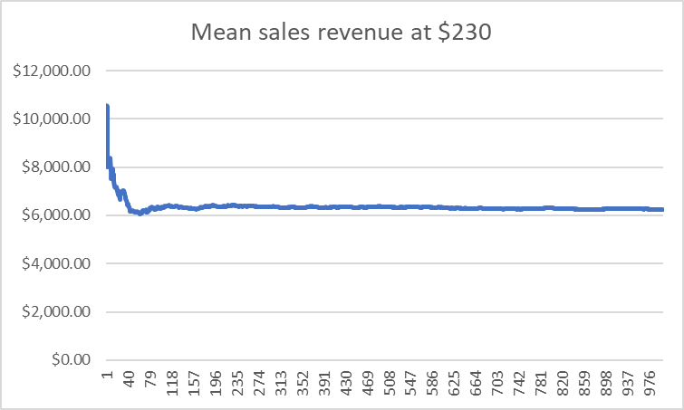
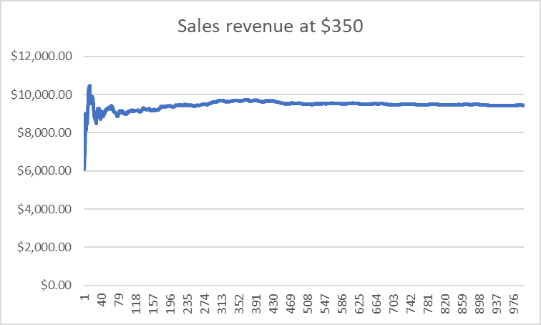
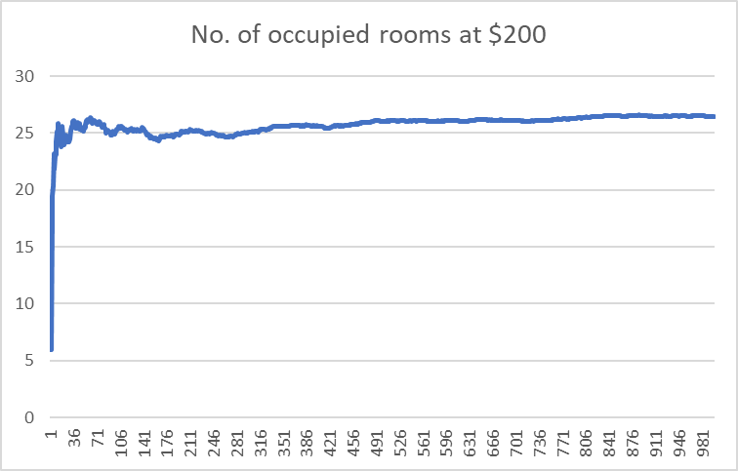
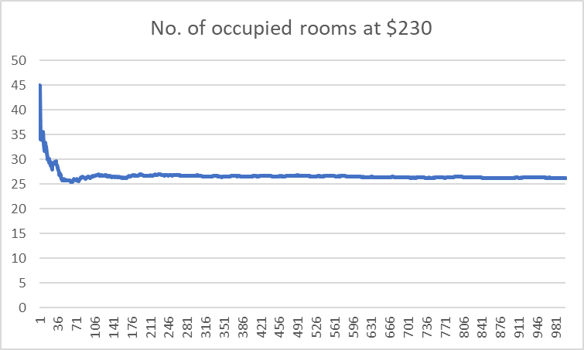
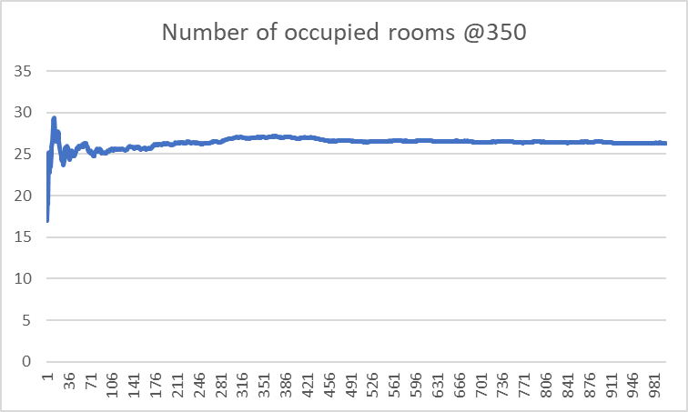
Average graphs of sales revenue & occupied rooms

Slide 22
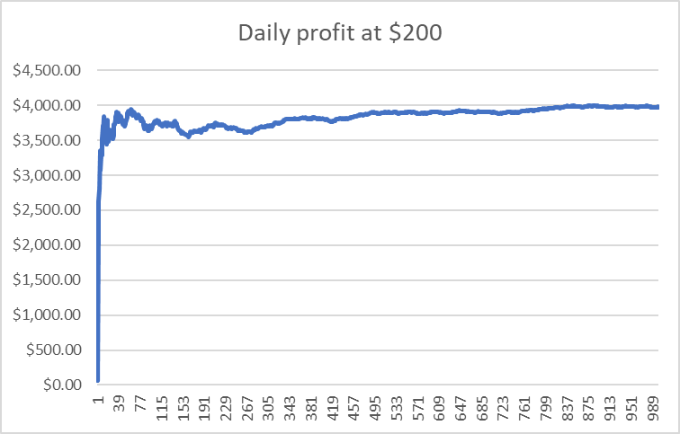
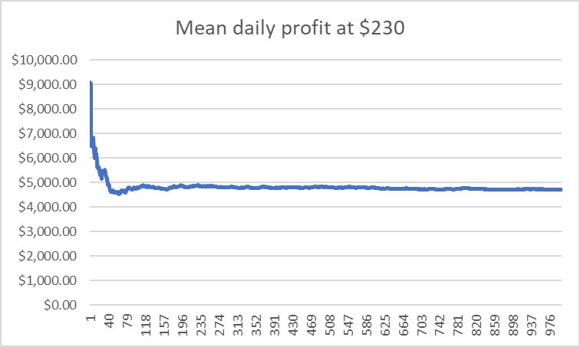
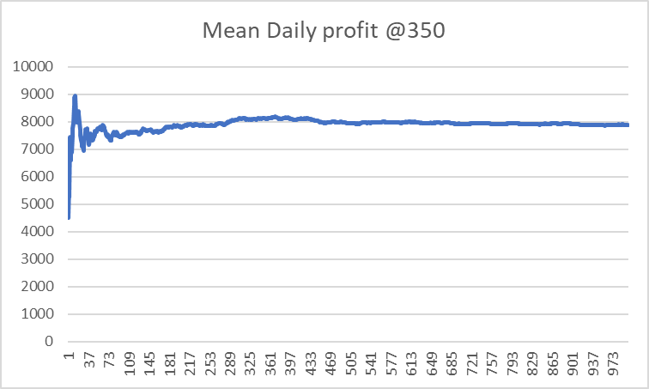
Average graphs of Daily profits
It can be inferred that Sales revenue averages at
$200: $5500
$230: $6100
$350: $8800
Occupancy rate averages around 27 number of rooms at all room rates.
Daily profit averages at
$200: $3900
$230: $4700
$350: $7800

Slide 23
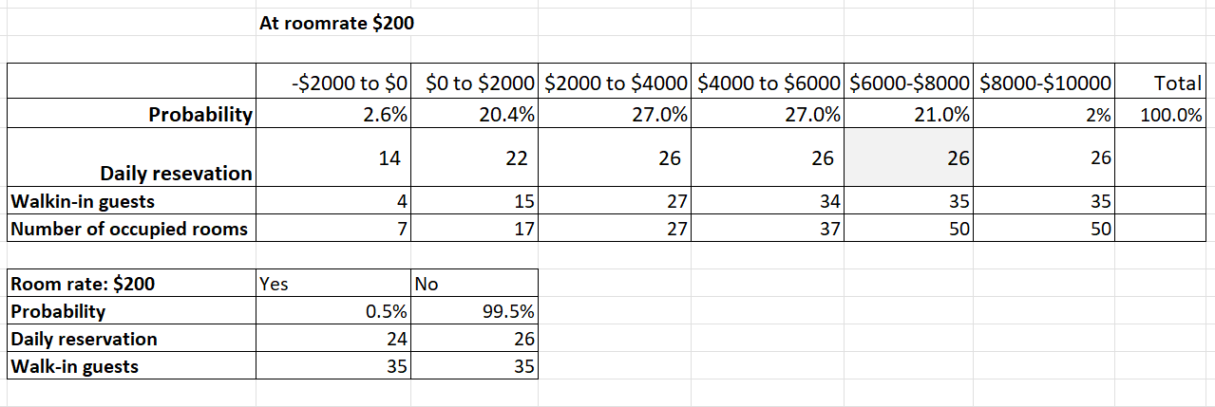
Risk analysis report

Slide 24
Interpretation
At room rate $200, the probability of daily profit going below 0 is 2.6%, between 0 and $2000 is 20.4%, between $2000 and $4000 is 27%, between $4000 and $6000 is 27%, between $6000 and $8000 is 21% and above $8000 is 2%.
It can be concluded that profit on weekdays can most probably vary from $2000 to $6000.
The reservations can be around 26 on these days, walk-ins may vary from 27 to 34 and total number of occupied rooms might be around 27 to 37.
Highest profit can be gained when reservations is 26, walk-ins are 35 and occupied number of rooms is 50.
Loss can be expected when reservations is below 14, walk-ins are below 4 and occupied number of rooms is below 7.
There is a 0.5% chance for the rooms to be sold out.

Slide 25
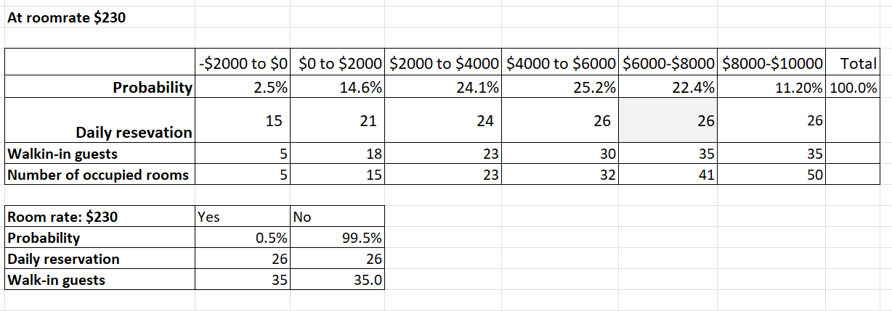
Risk analysis report

Slide 26
Interpretation
At room rate $230, the probability of daily profit going below 0 is 2.5%, between 0 and $2000 is 14.6%, between $2000 and $4000 is 24.1%, between $4000 and $6000 is 25.2%, between $6000 and $8000 is 22.4% and above $8000 is 11.2%.
It can be concluded that profit on weekends can most probably vary from $4000 to $6000.
The reservations can be around 26 on these days, walk-ins may be around 30 and total number of occupied rooms might be around 32.
Highest profit can be got when reservations is 26, walk-ins are 35 and occupied number of rooms is 50.
Loss can be expected when reservations is below 15, walk-ins are below 5 and occupied number of rooms is below 5.
There is a 0.5% chance for the rooms to be sold out.

Slide 27
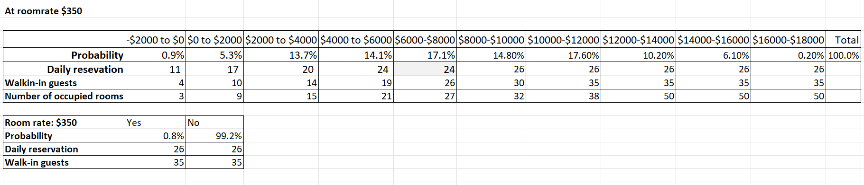
Risk analysis report

Slide 28
Interpretation
At room rate $200, the probability of daily profit going below 0 is 0.9%, between 0 and $2000 is 5.3%, between $2000 and $4000 is 13.7%, between $4000 and $6000 is 14.1%, between $6000 and $8000 is 17.1%, between $8000 and $10,000 is 14.8%, between $10,000 and $12000 is 17.6%, between $12000 to $14000 is 10.2%, between $14000 and $16,000 is 6.1% and above $16000 is 0.2%.
It can be concluded that profit on high season can most probably vary from $10,000 to $12,000.
The reservations can be around 26 on these days, walk-ins may be around 35 and total number of occupied rooms might be around 38.
Highest profit can be reaped when reservations is 26, walk-ins are 35 and occupied number of rooms is 50.
Loss can be expected when reservations is below 11, walk-ins are below 4 and occupied number of rooms is below 3.
There is a 0.8% chance for the rooms to be sold out.

Slide 29
Conclusions
The highest profit Resort can obtain on weekdays is $8652, on weekends, it is $10213 and on high seasons is $16284.
The maximum loss resort have to suffer is same on all days. that is, -$1565.
Sensitivity analysis on decision variable room rate shows that as room rate increases, daily profit increases and the probability of loss decreases as well.
As reservations and walk-ins go high, the daily profit also goes high while late cancellations decreases the daily profit.
There will be an average of 27 occupied rooms all throughout the seasons.
There will be an increase of almost $3900 on daily profits on high seasons compared to normal days.
The maximum loss that can happen might happen in high season. However, occupancy rate is high in high seasons. Therefore, when room rate increases, occupancy rate increases.
Average daily profit can be between $2000 and $6000 on weekdays, around $4000 and $6000 on weekends and around $10000 and $12000 on high seasons.
There is a higher chance for the rooms to be sold out on high seasons. Loss can happen when occupied rooms go below 3.

Slide 30
Recommendations
As probability of loss is lower when room rate is $350, and daily profit is higher, it is an ideal rate for high season.
A good amount of money can be lost when overbooking happens, so there should be a keen restriction on limit of reservations and proper surveillance on cancellations for accepting walk-in guests.
There can be a gradual increase in the room rate on weekdays and weekends in the future to increase the occupancy rate as value increases, demand also increases.
Proper marketing strategies can be adopted for increase in occupancy rate especially in high season.
To conclude, to maximise the daily profit and occupancy rate, increase the room rate, increase the fee for cancellation and decrease the overbooking limit.

