Slide 1
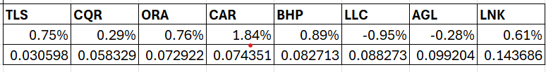
MIS775
INVESTMENT PORTFOLIO OPTIMISATION
Section 1: Preliminary Work
This assignment focuses optimising investment Portfolio by using various optimisation methods.
We have selected 8 stocks based on a reasonable range of volatile risks. 4 were already given and 4 were selected from the list of available industries. We selected wide range of risks and categorised them into 3 types: Low risk, medium risk and high risk. We selected stocks with different risks i.e, Standard deviations and one from each industries. Standard deviations describe how much spread is the data from the average which can fluctuate. It ranged from 0.03 to 0.14.
AVERAGE MONTHLY RETURNS
STANDARD DEVIATIONS
TLS – TELSTRA Group LTD BHP – BHP Group LTD
CQR – CHARTER HALL Retail LNK - LINK administration Holdings LTD
ORA – ORORA LTD AGL - AGL Energy LTD
CAR - CAR Group LTD LLC – LENDLEASE Group

Slide 2
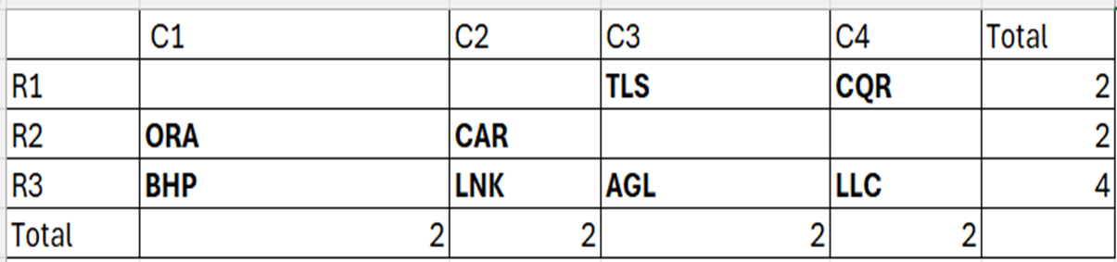
Risk classification
We put TLS (0.03) and CQR (0.05) into low risks (comparatively).
Then, ORA (0.07) and CAR (0.07) into medium risks.
Then we put BHP (0.08) and LLC (0.08) into high risks even though they can also be directed to medium risks. Then AGL (0.09) and LNK (0.14) into high risks.
TLS – TELSTRA Group LTD BHP – BHP Group LTD
CQR – CHARTER HALL Retail LNK - LINK administration Holdings LTD
ORA – ORORA LTD AGL - AGL Energy LTD
CAR - CAR Group LTD LLC – LENDLEASE Group

Slide 3
Section 2 : Optimisation models
2.1 LP Models : Conceptual Model
Mean returns
Sum of investment weights
Investment weights
Maximise portfolio return
=
1
Sum of investment weights of required categories
Required %

Slide 4
LP Model : Algebraic Model
• Define n decision variables: X1, X2, X3, X4, X5, X6, X7, X8.(8 stocks)
• MAX objective function: c1X1 + c2X2 + c3X3 +c4X4 + c5X5+ c6X6 + c7X7 + c8X8.(where ci = average return values)
• Subject to:
X1 + X2 ≤ 10% (constraint 1)
X1 + X2 (=) X5+X6+X7+X8 (constraint 2)
X5 +X6+X7+X8 <= 30% (constraint 3)
X4 +X8 <= 20% (constraint 3)
X3+ X5 >= 10% (constraint 4)
X1 + X7 >= 0 (constraint 5)
X2 +X6 >= 5% (constraint 6)
Xj = 100
and Xj ≥ 0 (j = 1, 2, …, n) (non-negativity conditions)
• The aij , cj are assumed to be known constants or percentages.

Slide 5
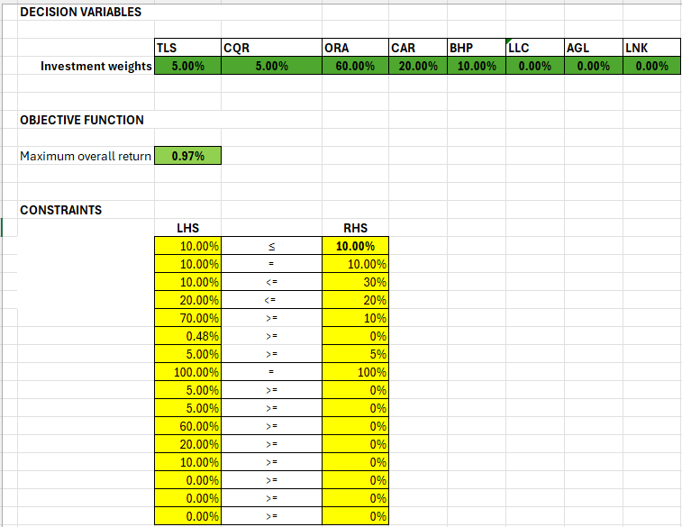
LP Model: Optimal Solution
When you invest in TLS(5%), CQR(5%), ORA(60%), CAR(20%), BHP(10%), you get a maximum return of 0.97%.
The optimum values are given in green cells

Slide 6
LP Optimal Solution- interpretation
We took maximum overall as a sum product of average return and investment weights. So we get a maximum overall return of 0.97% when we put 5% of investment in Telstra, 5% in charter hall Retail, 60% in Orora LTD, 20% in CAR group LTD, and 10% in BHP group LTD. The data guides us to invest most into Orora LTD.
We put constraints involving all the risk categories and industries which ultimately prompted to not invest in very high-risk companies such as LLC, AGL and Lendlease group for the maximum return.
Overall, the data tells us to invest in companies with low and medium risks, involving steady and consistent return.

Slide 7
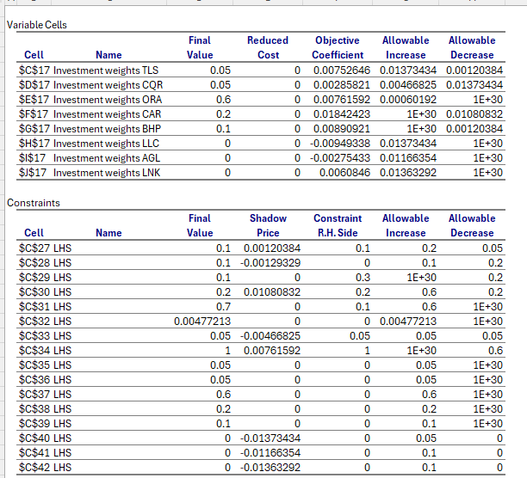
Sensitivity report

Slide 8
Sensitivity report
As the report is for 8 stocks, we will cut short to major impacts if there is a change to coefficients or RHS of the constraint.
Unit margin of TLS can range between 0.58%-2% without changing the optimal solution.
If low risk category RHS constraint is increased to 20%, the average return will increase by 0.012%.
If the RHS of technology sector constraint is decreased to 10%, the average return will decrease by 0.1%.
If RHS of real estate category constraint is increased by 6%, we will have to run solver again to find the optimal solution.

Slide 9
ILP Model : Conceptual Diagram
Mean returns
Sum of investment weights
Investment weights
Average portfolio return
=
Whether to invest
6
Sum of investment weights of required categories
Required number

Slide 10
ILP: Algebraic model
• Decision variables:
Define binary decision variables 𝑊𝑖 = 1, (if company invests in investment )𝑖 0, otherwise
and let r𝑖 denote the average return 𝑖, where 𝑖 = integers
• Objective: Maximise average return= ∑ Wi * ci
• Constraint: W5+W6+W7+W8 <= 2
W1+W2 <= 2
W3+W4 >=1
Sum of Wi = 6
W3+W5, W4+W8, W1+W7, W2+W6 >=1

Slide 11
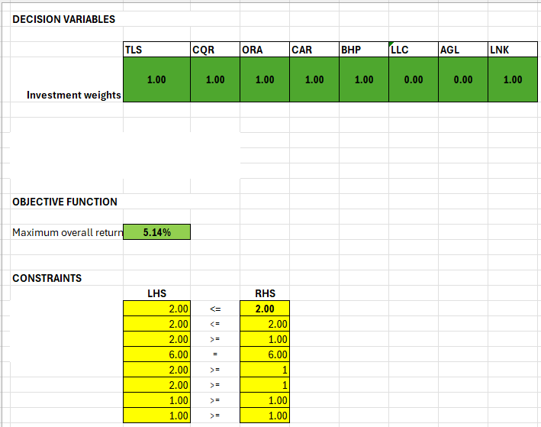
IILP-OPTIMAL SOLUTION: Optimal solution
INTERPRETATION
We are selecting an equal weighted portfolio including TLS, CQR, ORA, CAR, BHP, and LNK with a maximum return of 5.14%.
LLC, AGL are not selected for the right optimum value of return.
The optimum solution is in green colours, the weights and the maximum overall return.

Slide 12
ILP-OPTIMAL SOLUTION(INTERPRETATION)
As we had to invest equal weights in 6 out 8 companies, we decided to do binary constraints.
With the constraints given, we realised investing equally in companies Telstra, charter hall retail, Orora LTD, CAR group LTD, BHP group LTD and lendlease group LTD would give a maximum return of 5.14%, not considering the risk factor.

Slide 13
NLP: MAXIMISE RETURN – CONCEPTUAL MODEL
Required SD
<=
Sum of investment weights
Investment weights
Actual standard deviation
=
1
Variances and covariances between returns
Maximise average portfolio return
Mean returns

Slide 14
NLP-MAXIMISE RETURN- ALGEBRAIC MODEL
• Let ci denote the average monthly return of the 8 stocks (c1, c2, c3,…..c8)
• Let (X1,X2,X3….X8) denote the investment weights
• Decision variables: Let (𝑋i) the percentage of investments to be done in each companies.
• Let di denote the minimized risk calculated using the equation: sqrt(2*sigma1^2*x1^2+2*sigma2^2*x2^2 +……2*sigma8^2*x8^2+2 sum(7)sum(8) Xi*Xj*Cij where I = 1, j = i+1. ( sigma = standard deviation, Xi = investment weights and Cij = correlation between stocks I and j) <=3%
X1+X2+X3….X8 = 100%
• Objective: Maximum return using the equation: c1X1+c2X2…..c8X8.

Slide 15
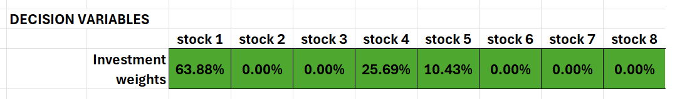
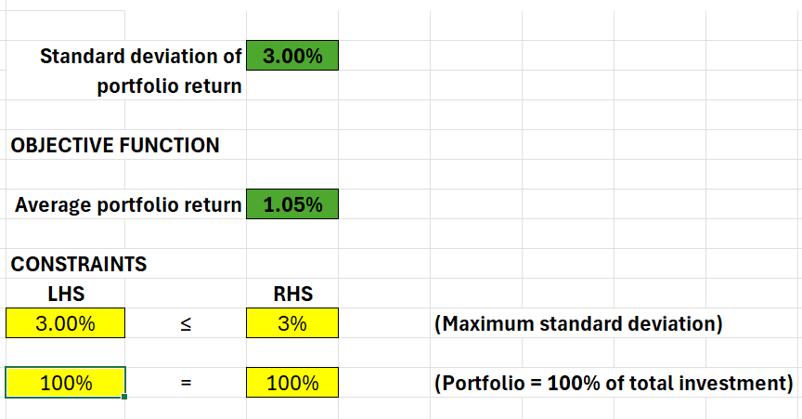
Optimal Solution
If we decide to invest in companies with a minimum risk of 3%, we can invest 63.88% in Telstra, 25.69% in CAR group and 10.43% in BHP with a maximum return of 1.05%.
The optimum solution is in green colours, the weights and the maximum overall return and the standard deviation.

Slide 16
OPTIMAL SOLUTION-INTERPRETATION
With a minimum risk of 3%, we are told by the solver to invest in 3 companies to get a maximum return of 1.05%. 3% was the minimum risk we could put to get a feasible solution.
The companies we invest are Telstra in a proportion of 63.88%, CAR group LTD with proportion of 25.69%, and BHP in a proportion of 10.43%.
It involves all the risk categories, with most investment in low-risk category. They all have the best average monthly returns among the 8 companies.

Slide 17
NLP (Minimize risk)– Conceptual model
Mean returns
Sum of investment weights
Investment weights
Average portfolio return
=
Minimize standard deviations of portfolio return
>=
1
Required mean return
Variances and covariances between returns

Slide 18
Algebraic Model
• Let ci denote the average monthly return of the 8 stocks (c1, c2, c3,…..c8)
• Let (X1,X2,X3….X8) denote the investment weights
• Decision variables: Let (𝑋i) the percentage of investments to be done in each companies.
Constraint: Let di denote Maximum return using the equation: (c1X1+c2X2…..c8X8)>= 1, X1+x2+x3….X8 = 100%.
• Objective function:
Let di denote the minimized risk calculated using the equation: sqrt(2*sigma1^2*x1^2+2*sigma2^2*x2^2 +……2*sigma8^2*x8^2+2 sum(7)sum(8) Xi*Xj*Cij where I = 1, j = i+1. ( sigma = standard deviation, Xi = investment weights and Cij = correlation between stocks I and j)

Slide 19
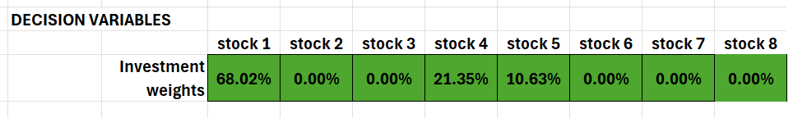
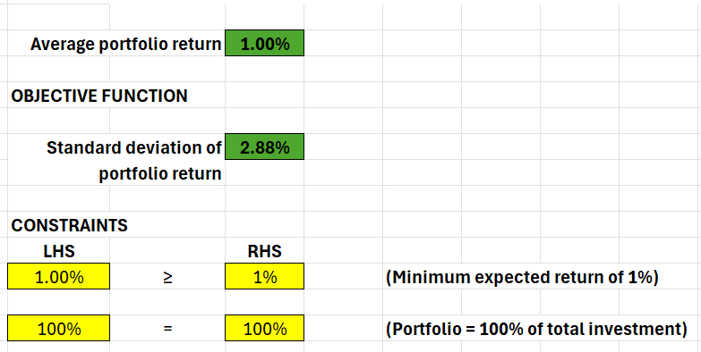
Optimal Solution
Expecting an overall return of more than 1%, the minimum risk which is 2.88% can be achieved by investing in Telstra(68.02%), CAR group LTD(21.35%), BHP Group LTD(10.63%)
The optimum solution is in green colours, the weights and the maximum overall return and the standard deviation.

Slide 20
OPTIMAL SOLUTION-INTERPRETATION
The expected return, we selected was 1%, a feasible solution could not be found for return of more than 1%, when it is input, we get a minimised risk of 2.88%
The companies we got was same as the companies when we maximised return, the weights were also similar with a small change in %.
The companies are Telstra in the proportion of 68.02%, CAR group in the proportion of 21.35%, and BHP group LTD in the proportion of 10.63%.

Slide 21
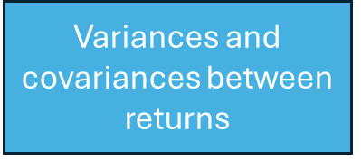
NLP (Sharpe ratio) – CONCEPTUAL MODEL
Mean returns
Sum of investment weights
Investment weights
standard deviation
=
1
Average portfolio return
Maximise sharpe ratio

Slide 22
Algebraic model-sharpe ratio
• Let ci denote the average monthly return of the 8 stocks (c1, c2, c3,…..c8)
• Let (X1,X2,X3….X8) denote the investment weights
• Decision variables: Let (𝑋i) the percentage of investments to be done in each companies.
Let di denote Average return using the equation: (c1X1+c2X2…..c8X8)
Let si denote the minimized risk calculated using the equation: sqrt(2*sigma1^2*x1^2+2*sigma2^2*x2^2 +……2*sigma8^2*x8^2+2 sum(7)sum(8) Xi*Xj*Cij where I = 1, j = i+1. ( sigma = standard deviation, Xi = investment weights and Cij = correlation between stocks I and j)
Xi = 100%
• Objective function:
Sharpe ratio: di-(4.35/12)%/si

Slide 23
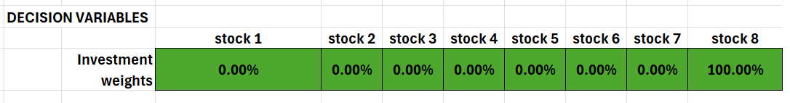
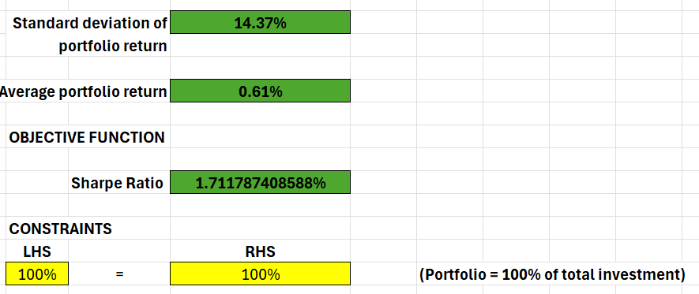
OPTIMAL SOLUTION
A sharpe ratio of 1.71 can be obtained if we put our 100% investment in the highest risk company Lendlease group whose risk can be 14.37% while the return got can be 0.61%.
The optimum solution is in green colours, the weights and the average portfolio return and the standard deviation and the sharpe ratio.

Slide 24
Sharpe ratio solution-interpretation
Our standard deviation is 14.37%, our sharpe ratio is 1.71.
Our actual return is 14.37%*1.71= 0.245 = 24.5%
Our risk free rate is (4.35/12)% converting to monthly rate is 0.36%
So the excess return over risk free rate would be 0.245-0.036 = 0.209 = 20.9%
This higher sharpe ratio indicates a better risk adjusted performance.
So clearly, like per the solution, if we invest 100% in lendlease group which has the highest risk, we can expect higher returns as well.

Slide 25
Optimisation results and recommended strategy
Summary table of all results
 | LP | ILP | Maximise return | Minimize risk | Maximise sharpe ratio-1.71
Average return | 0.97% | 5.14% | 1.05% | 1% | 0.61%
Standard deviation | Not calculated (Not mentioned in brief) | Not calculated (not mentioned in brief) | 3% | 2.88% | 14.37%
Investment weights | TLS – 5% CQR – 5% ORA – 60% CAR – 20% BHP – 10% | Equal % in TLS, CQR ORA, CAR BHP, LNK | TLS – 63.88% CAR – 25.69% BHP – 10.42% | TLS – 68.02% CAR – 21.35% BHP – 10.63% | LNK – 100%

Slide 26
Preferred strategy and Rationale
ILP model has the highest return 5.14% when invested equally but as the risk involved is unknown. I would not prefer to use it.
LP model has lower return than NLP models and the risk is unknown as well, therefore , I would not prefer that either.
Sharpe ratio has a huge rate of risk, I would not prefer to take chance as it might end up being a huge loss.
Comparing between NLP models Maximise return and minimize risk, the results are almost same. The risk is slightly lesser in minimise risk than maximise return. I’m willing to take a little more risk to get a better return.
Therefore, I prefer to use maximise return strategy in this scenario.

