Slide 1

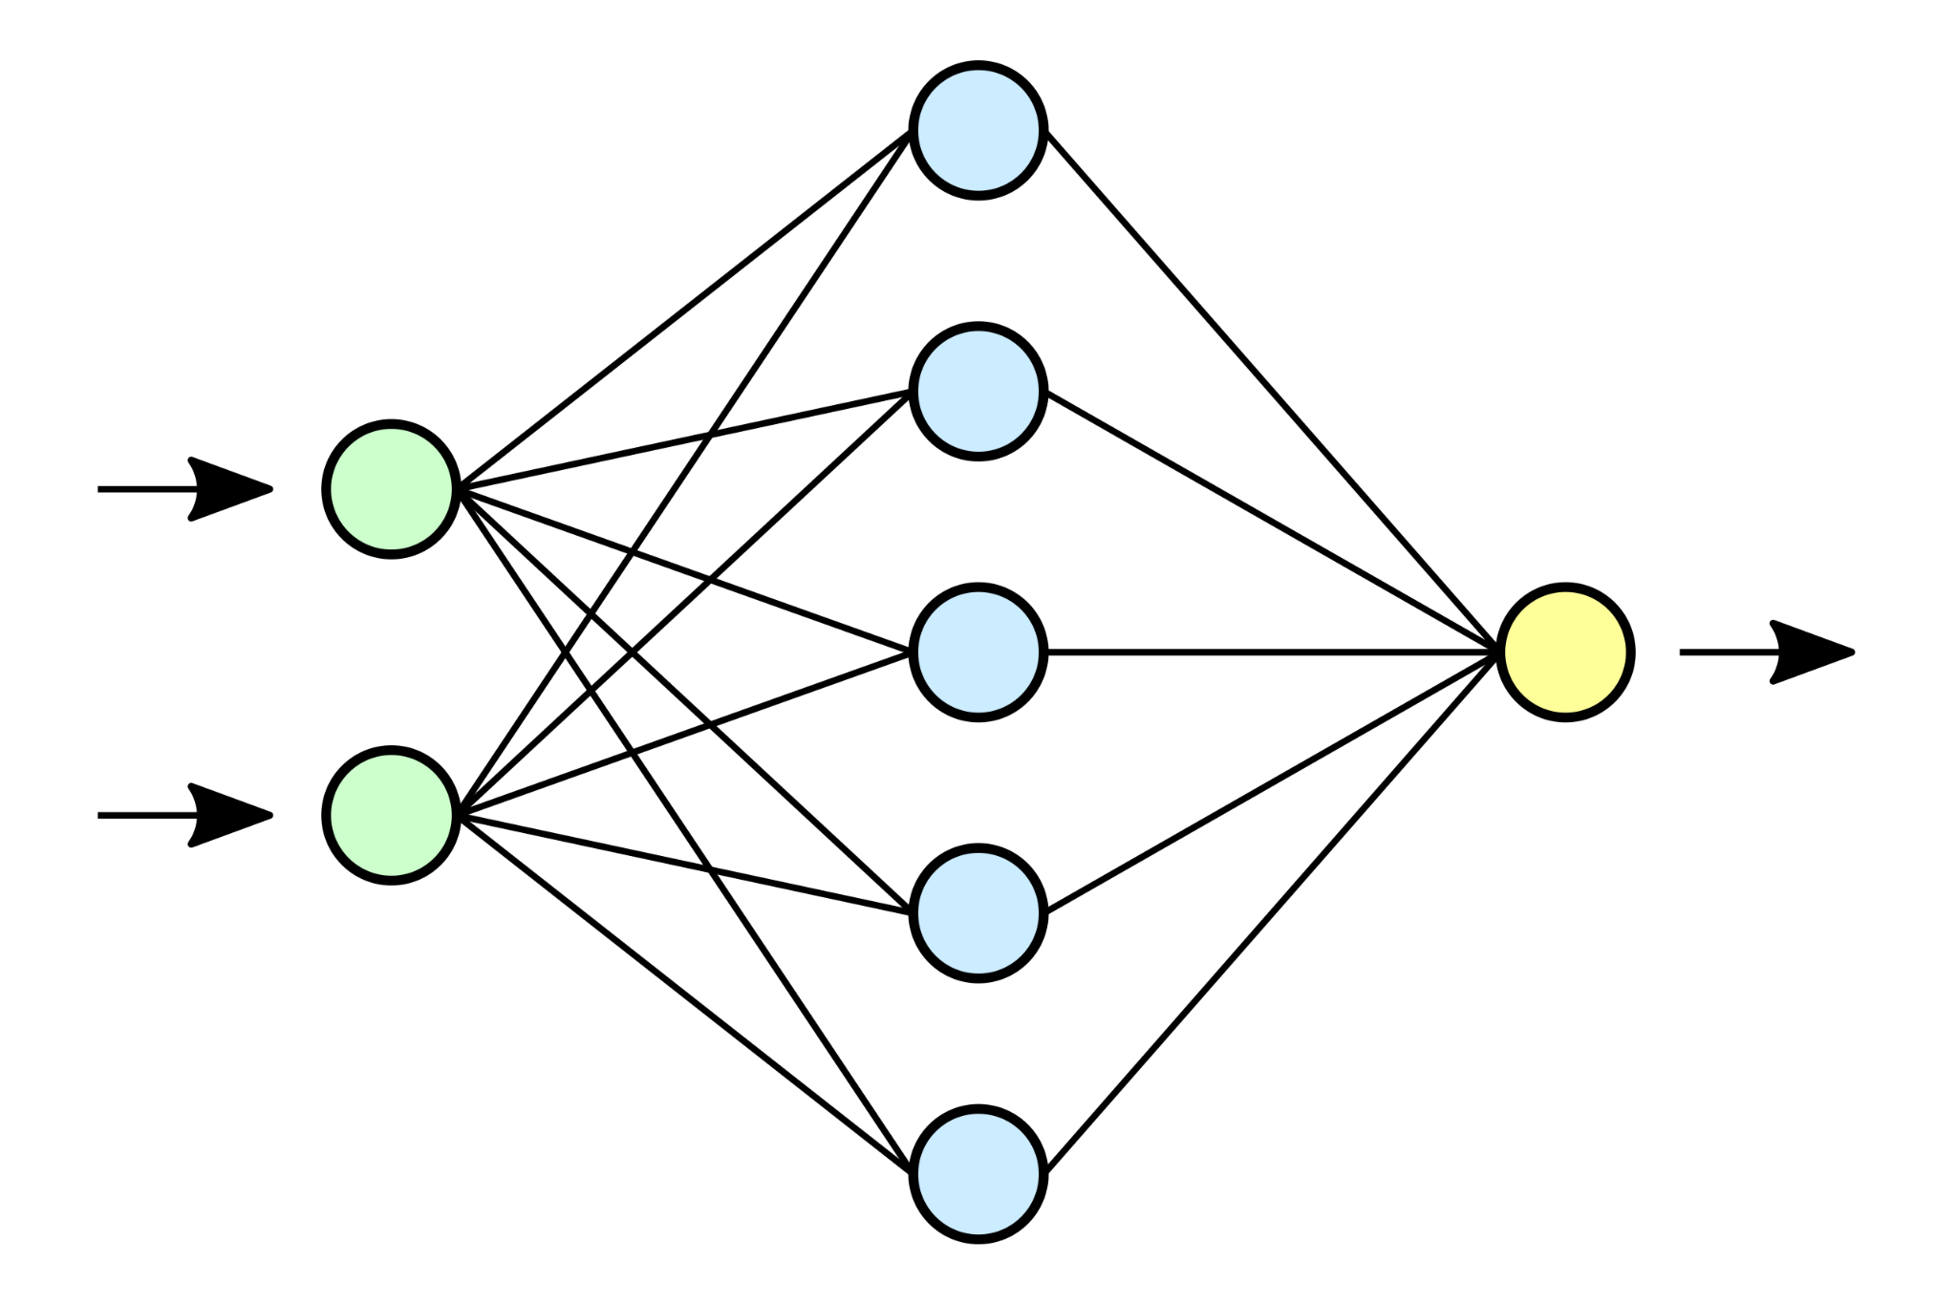
IMAGERY OF THE BRAIN AND THE MACHINE
ASIDA
ASIDA
# pod
#team
#%% work_horses
team = [Fabio Bauer, Mrugsen Gopnarayan, Prerita Chawla,
Jasper Hilliard, Deeksha Rai, Rafe Sharif, Animikha Ghosh]
mentor = [Kohitij Kar] #Ko
Project_ta = [Emeka Ogbuju]
ta = [Alish Dipani]

Slide 2

#Background
#Questions
Early visual areas V1, V2 → Low level features
Later visual areas V4, Lat Occ, IT → Object recognition
Differential representation has been reported for natural and urban landscapes (Andrews et al. 2015, Gwang-Won Kim et al. 2010).
Different correlation between BOLD responses to natural vs. man-made stimuli in the visual cortex?
Are BOLD responses of lower visual areas less correlated than higher visual areas c for natural vs man-made stimuli?
Similarly present in the CNN CORnet-S?
Notes:
Human visual cortex consists of visual areas (V1, V2) capture orientation and edge detection and the later visual areas (V4, Lat Occ) govern initial steps of object recognition.
Differential representation has been reported for natural and urban landscapes in previous studies (Andrews et al. 2015, Gwang-Won Kim et al. 2010).

Slide 3

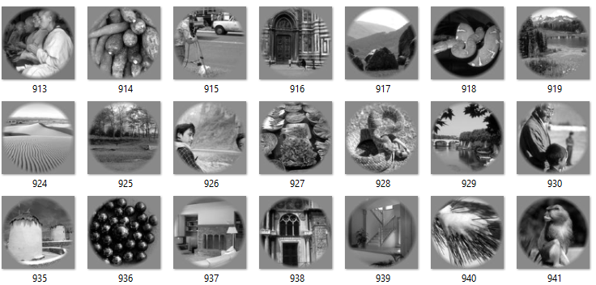
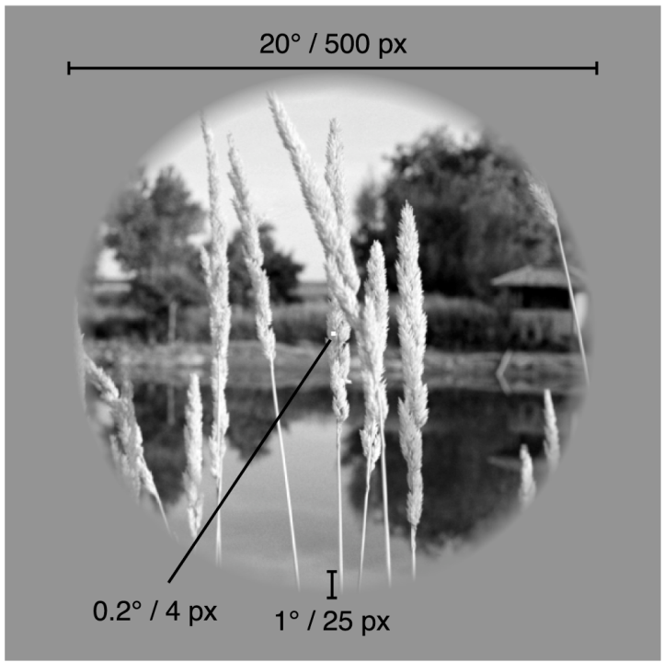

# fMRI Dataset: Kay-images
An excellent exercise in the neuroscience of:
1750 Kay image stimuli
normalized grayscale
passively viewed
No behavioral task
Matrix manipulation
Image processing
Data structures
Correlation analysis
Testing a hypothesis numerically
*Kay et al. 2008

Slide 4
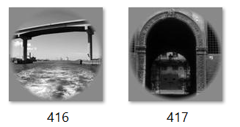
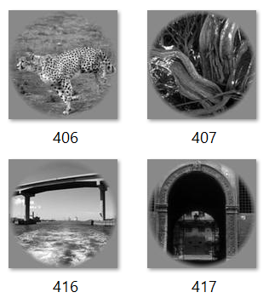
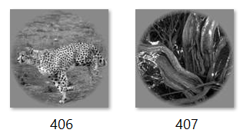
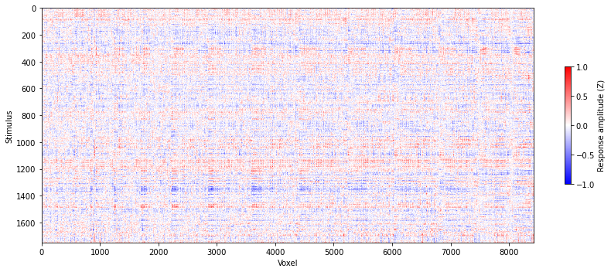
# METHODS: MODEL OF THE ENCODING PROBLEM
Manual Relabelling into natural and man-made stimuli
fMRI responses to the Kay Images
man-made stimuli
(bridge, house, etc.)
natural stimuli
(animal, forest, etc.)
Representational Dissimilarity Matrices for the CNN and brain
Feed all the images into CORnet-S and compute correlations for V1, V2, V4
Compute layerwise correlations from the z-scored fMRI BOLD responses
RDMs and analyse interclass distance between the natural and man made stimuli

Slide 5
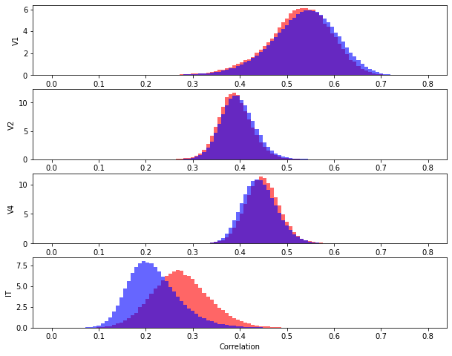
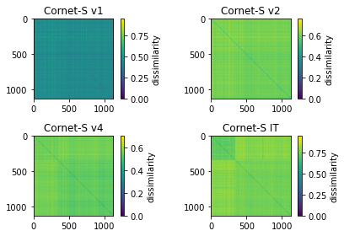
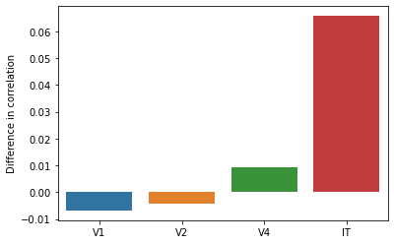
# RESULTS: CORnet-S
Correlation differences across the model layers
RDMs of the image dataset from the deep net
Dissimilarity between the natural and manmade images increases hierarchically from V1 to IT
Highest dissimilarity in IT layer which also is responsible for object recognition in the visual cortex
Kubilius et al. 2018

Slide 6
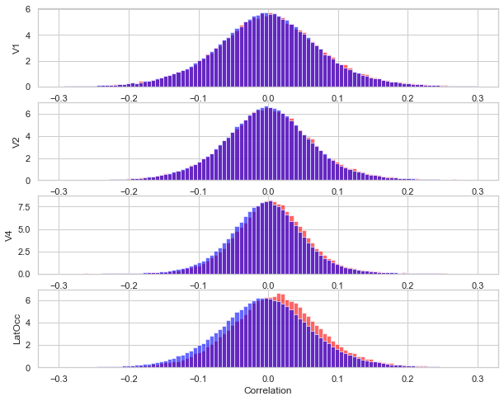
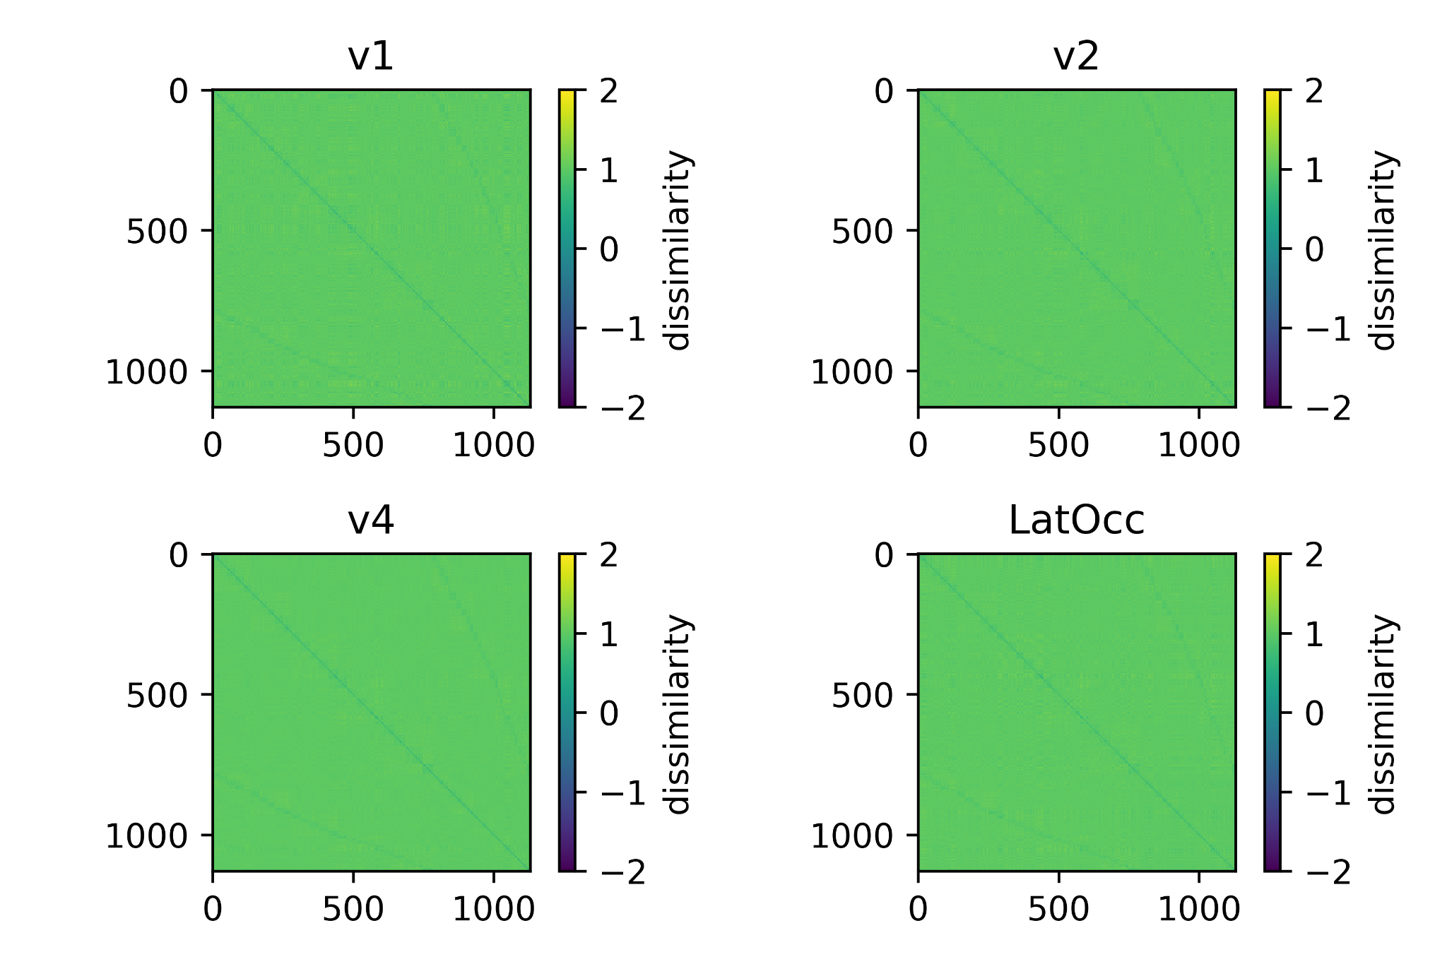
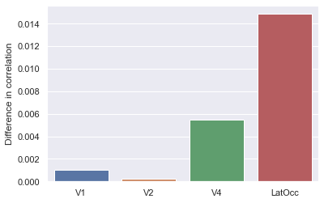
# RESULTS: fMRI BOLD responses
Correlation differences across the visual areas
RDMs of the image dataset from BOLD responses
Dissimilarity appears to be uniform across all layers
V4, LatOcc show correlation differences
Low correlations might be a result of too much noise
Could be addressed by PCA (time constraints)

Slide 7

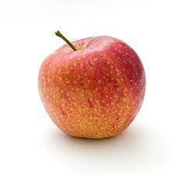
# Interpretation
Differential representation of the natural and manmade images!
Open Question:
Does evolution have to play a role in this?
Over the course of evolution, brain might have developed two-distinct systems for their representations.
Further analysis needed
to evaluate the contributory role of evolution
in IT (layer) of fMRI data
Comments:
Include
trial wise data
data of other brain regions like IT layer

