Slide 1
My Journal to Python
NAME: 葉非爾
TEACHER: MY DEAR GREAT TEACHER

Slide 2
agenda
Python
Input and output: input() and print()
Data types: numerisc, strings, list , dict
Operators ON data type:
CONTROLS : IF- | IF –ELSIF |-F-ELSE
LOOP: FOR |WHILE | RANGE() | BREAK | CONTINUE
FUNCTION:
PARAMETERS(ARGUMETNS)
RECURSIVE FUNCTION
LAMBDA FUNCTION

Slide 3
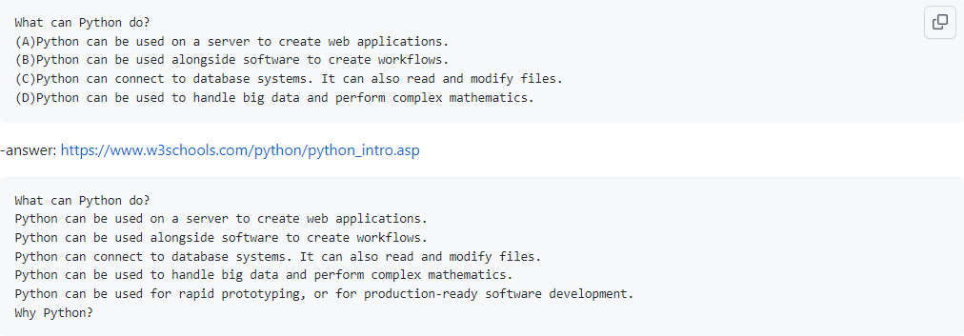

Python

Slide 4


Data types: strings
Strings in python are surrounded by either single quotation marks, or double quotation marks
‘hello’ is the same as “hello”
You can display strings literal with the print() function:
input output
Example:

Slide 5
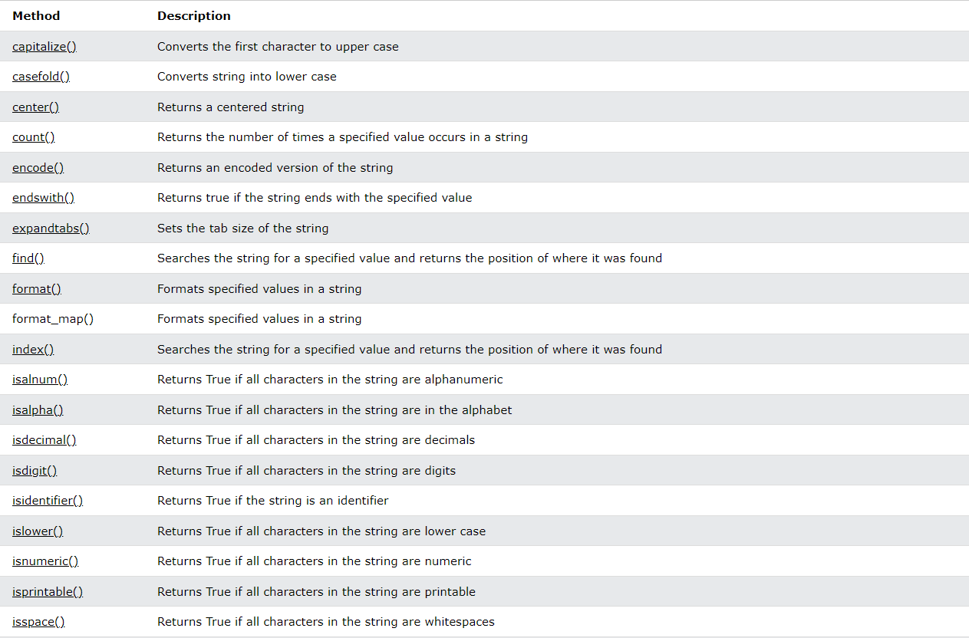
String method:

Slide 6
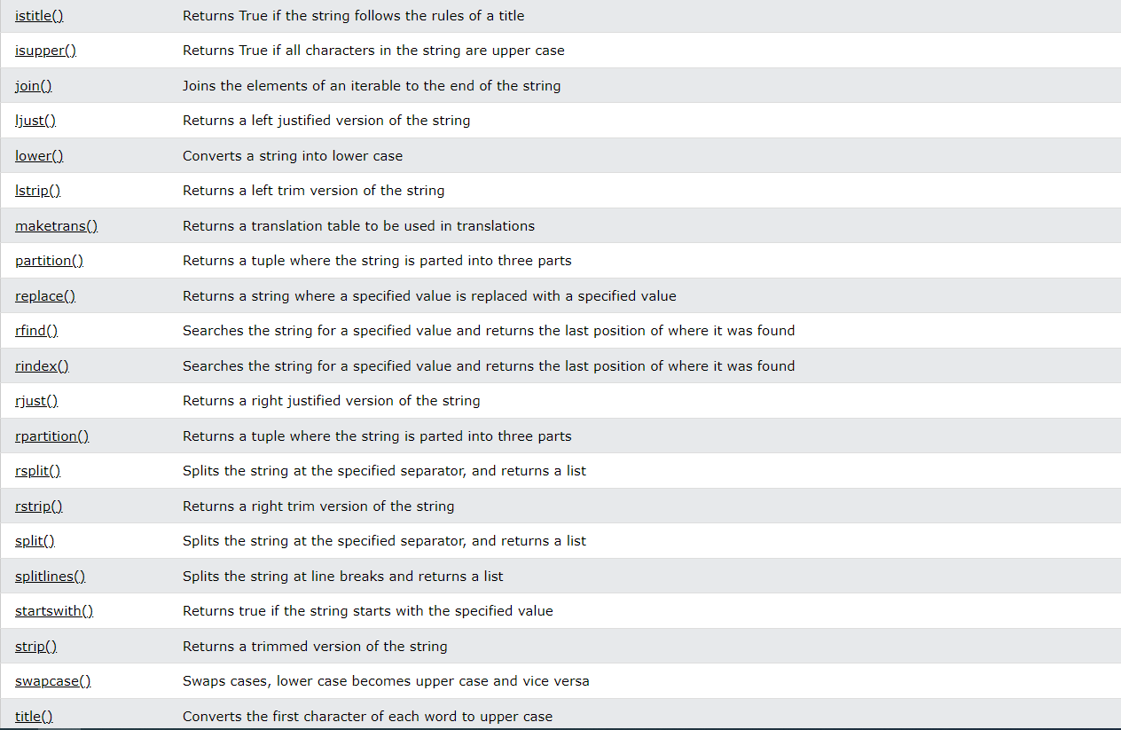

Slide 7
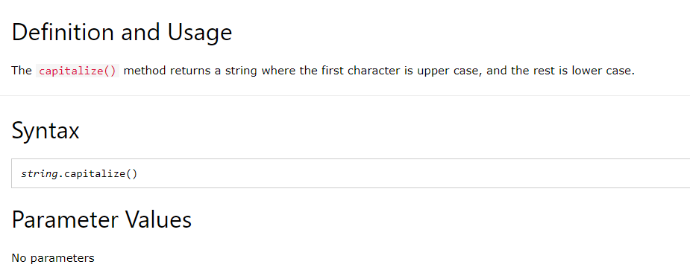
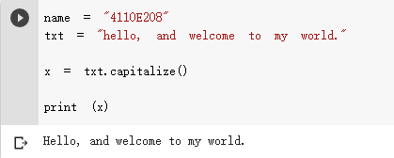
PYTHON STRING CAPITALIZE() METHOD

