Slide 1
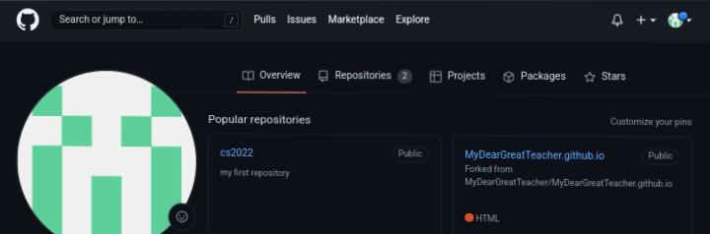
Notes:
Jjj

Slide 2
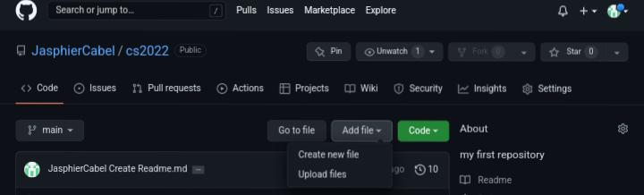
Tap add new Files then click create file

Slide 3
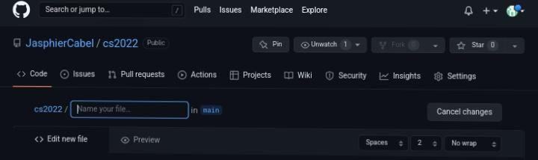
Type Python/

Slide 4
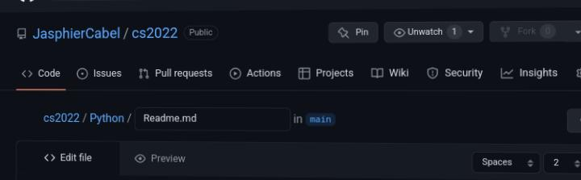
Type Readme.md

Slide 5
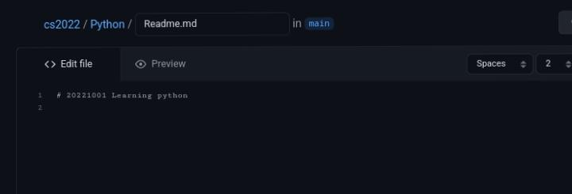
Type # 20221001 Learning Python

Slide 6
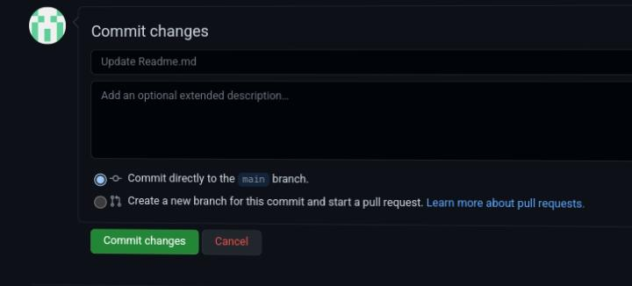
Click commit changes

Slide 7

Now you have a new python file

Slide 8
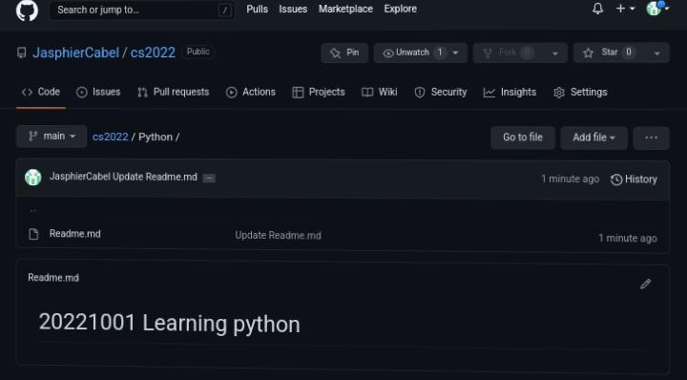
You now have readme.md

Slide 9
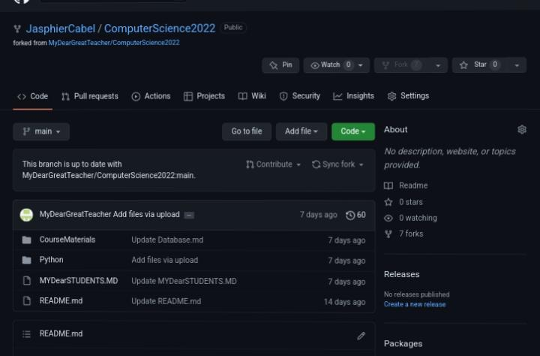
Next go to MyDearGreatTeacher / ComputerScience2022

Slide 10
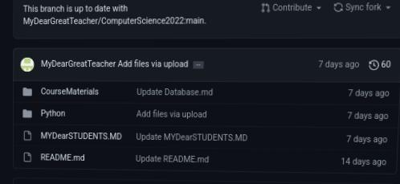
Click python

Slide 11
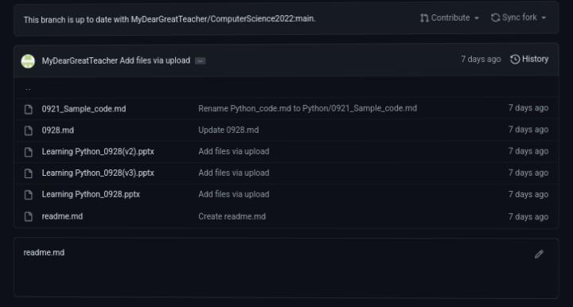
Click 0928.md

Slide 12
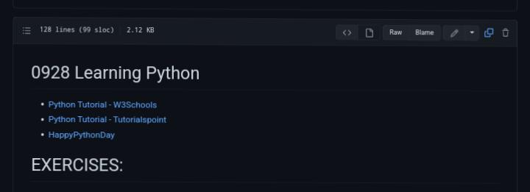
Click the copy icon

Slide 13
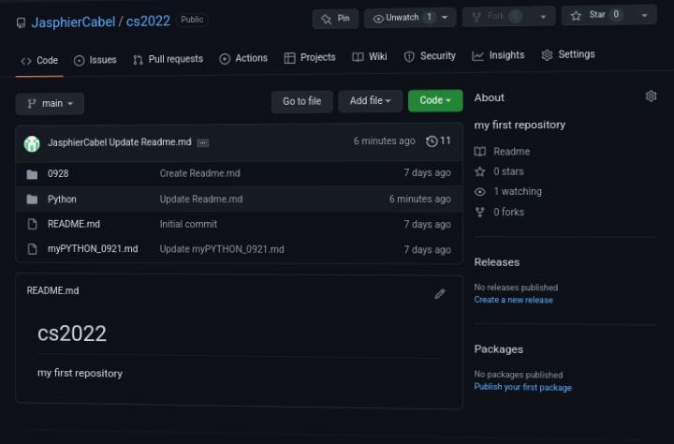
After copying go back to your profile and click python file

Slide 14
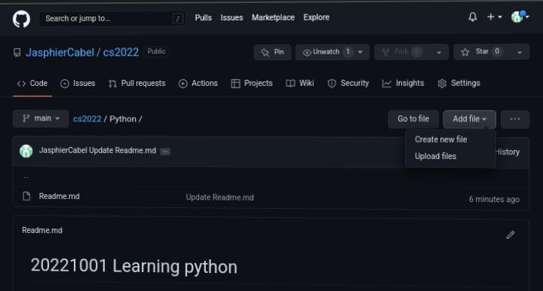
Click add file then create new file

Slide 15
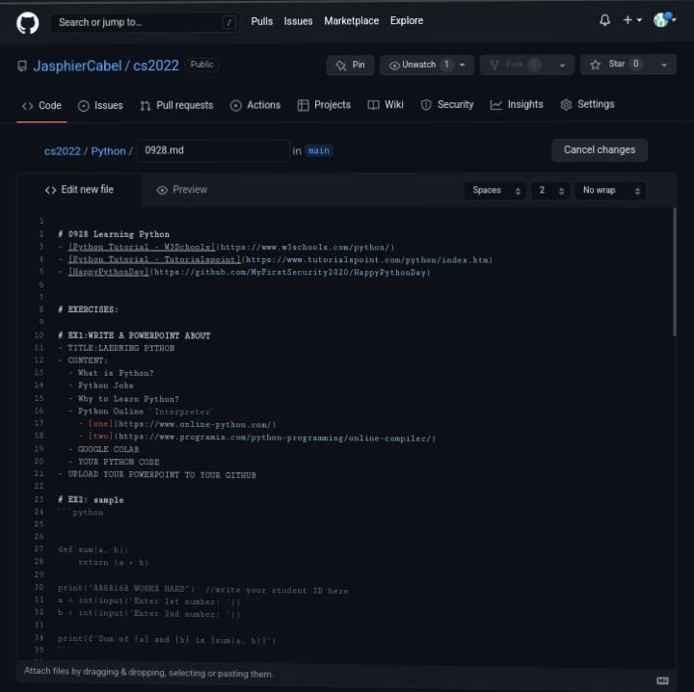
Type 0928.md and paste the copy path here

Slide 16
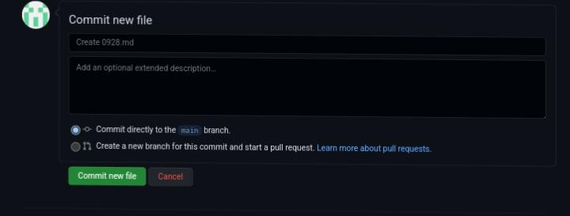
After you paste click commit file

Slide 17

After clicking commit file click 0928.md

Slide 18
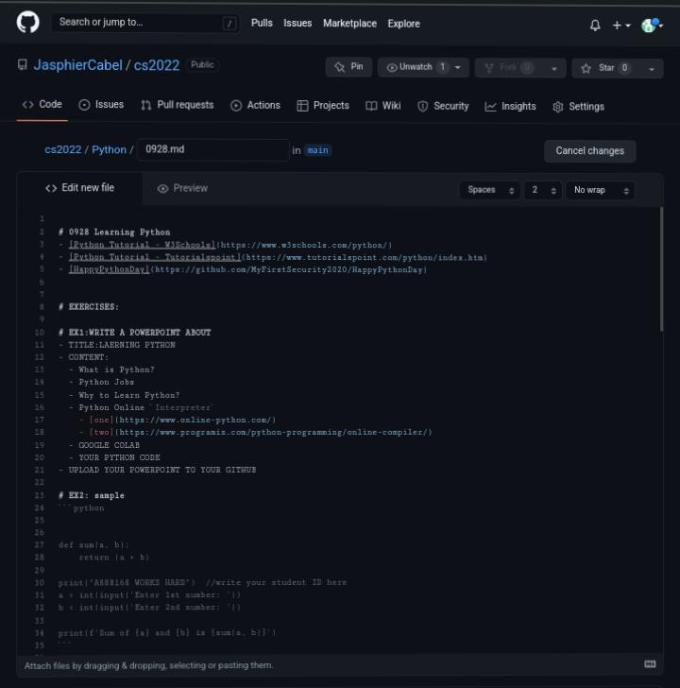
If this is the outcome you can now create your ppt And upload it on your python folder

