Slide 1

LOCAL CHEMIST APP`
(USING TKINTER)
Submitted By: Jaspreet Kaur
Roll no: 12101188

Slide 2

Content
INTRODUCTION
SOFTWARE
PROGRAMMING LANGUAGE USED
ABOUT PROJECT
SYSTEM REQUIREMENTS
SCREENSHOT OF THE APPLICATION

Slide 3

INTRODUCTION
- Managing our health can be a daunting task, especially when it comes to keeping track of medications and their costs. That’s why we’ve developed a local chemist app with a built-in billing system that calculates the total price of your medicines, making it easier than ever to manage your healthcare expenses.
- Our app is designed to connect you with local chemists, providing a seamless and hassle-free way to purchase your medications. With features such as real-time inventory updates, prescription management, and secure payment options, our app takes the stress out of managing your health.
- But our app isn’t just about convenience. It’s also about transparency. Our billing system provides a clear and detailed breakdown of the costs of your medications, allowing you to make informed decisions about your healthcare. And with features such as automatic receipt generation and expense tracking, managing your healthcare expenses has never been easier.
- We believe that technology has the power to improve our lives, and our local chemist app with a billing system that calculates the total price of medicines is just one example of how we’re making that happen. Join us on our journey to revolutionize healthcare and discover the benefits of a connected community.

Slide 4


SOFTWARE
Jupyter notebook is an open source web application that you can use to create and share documents that contain live code equations visualisation and text the name Jupiter comes from the course plot programming languages that it puts Julia Python and R Jupiter ships with the python kernel which allows you to write your programme in python.
Python is an treated high level children purpose programming language python’s design to philosophy emphasises code reliability with its notable use of significant identity

Slide 5
PROGRAMMING LANGUAGE USED
PYTHON : Python is known for its clear syntax, rich ecosystem of libraries and frameworks, and broad applicability in areas like web development, data analysis, machine learning, artificial intelligence, scientific computing, and more.
TKINTER : Tkinter is a standard Python library for creating graphical user interfaces (GUI). It’s simple and very effective for small-to-medium-sized projects.

Slide 6
ABOUT PROJECT
Local chemist app make in Tkinter .
Tkinter is a graphical user interface in python.
In tkinter we use Labels ,Buttons , grid functions.
Libraries are used in project is Tkinter , random ,Time.

Slide 7

SYSTEM REQUIREMENT
Hardware Requirements:
Processor – Core i5
RAM – 8GB
SSD – 512 GB
Software Requirements:
Operating System – Microsoft Windows 11
Front-End – Jupyter Notebook
Python

Slide 8
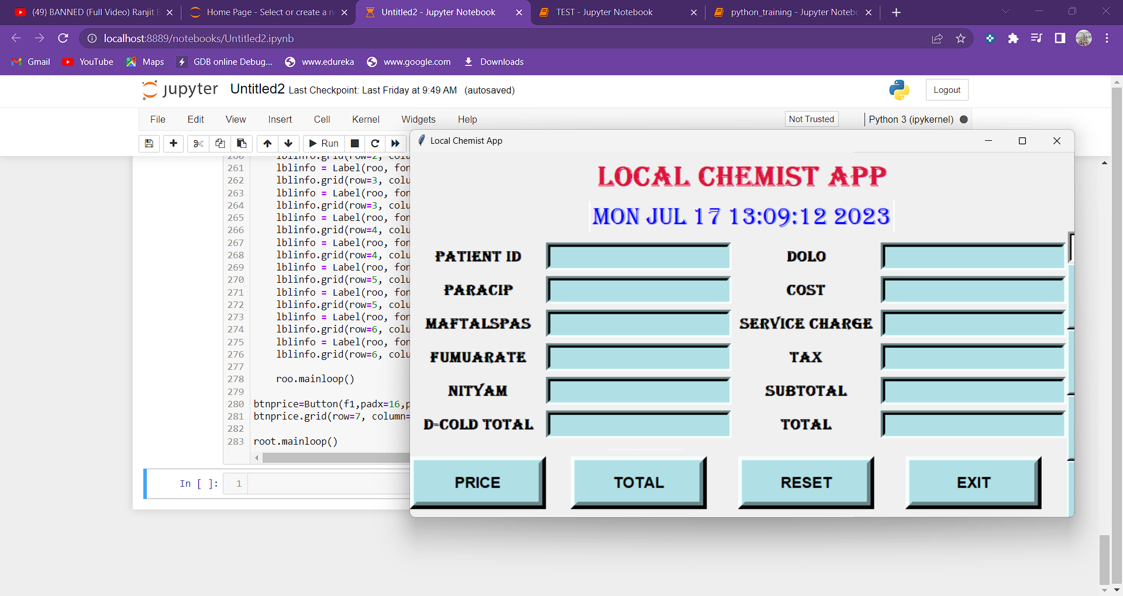
SCREENSHOTS OF APPLICATION

Slide 9
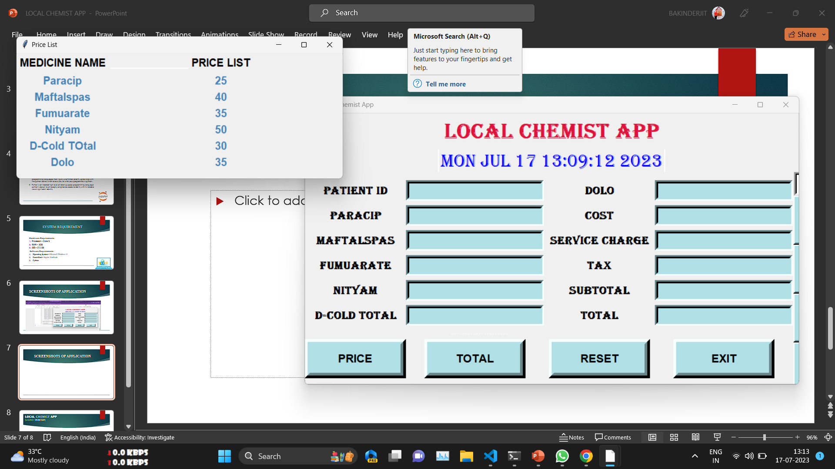
SCREENSHOTS OF APPLICATION

Slide 10
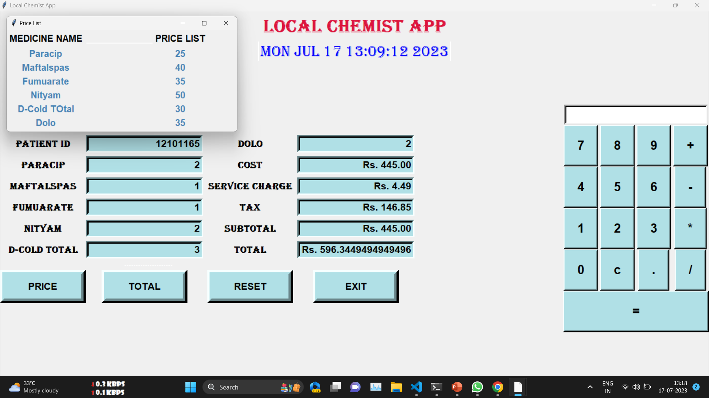
SCREENSHOTS OF APPLICATION

Slide 11
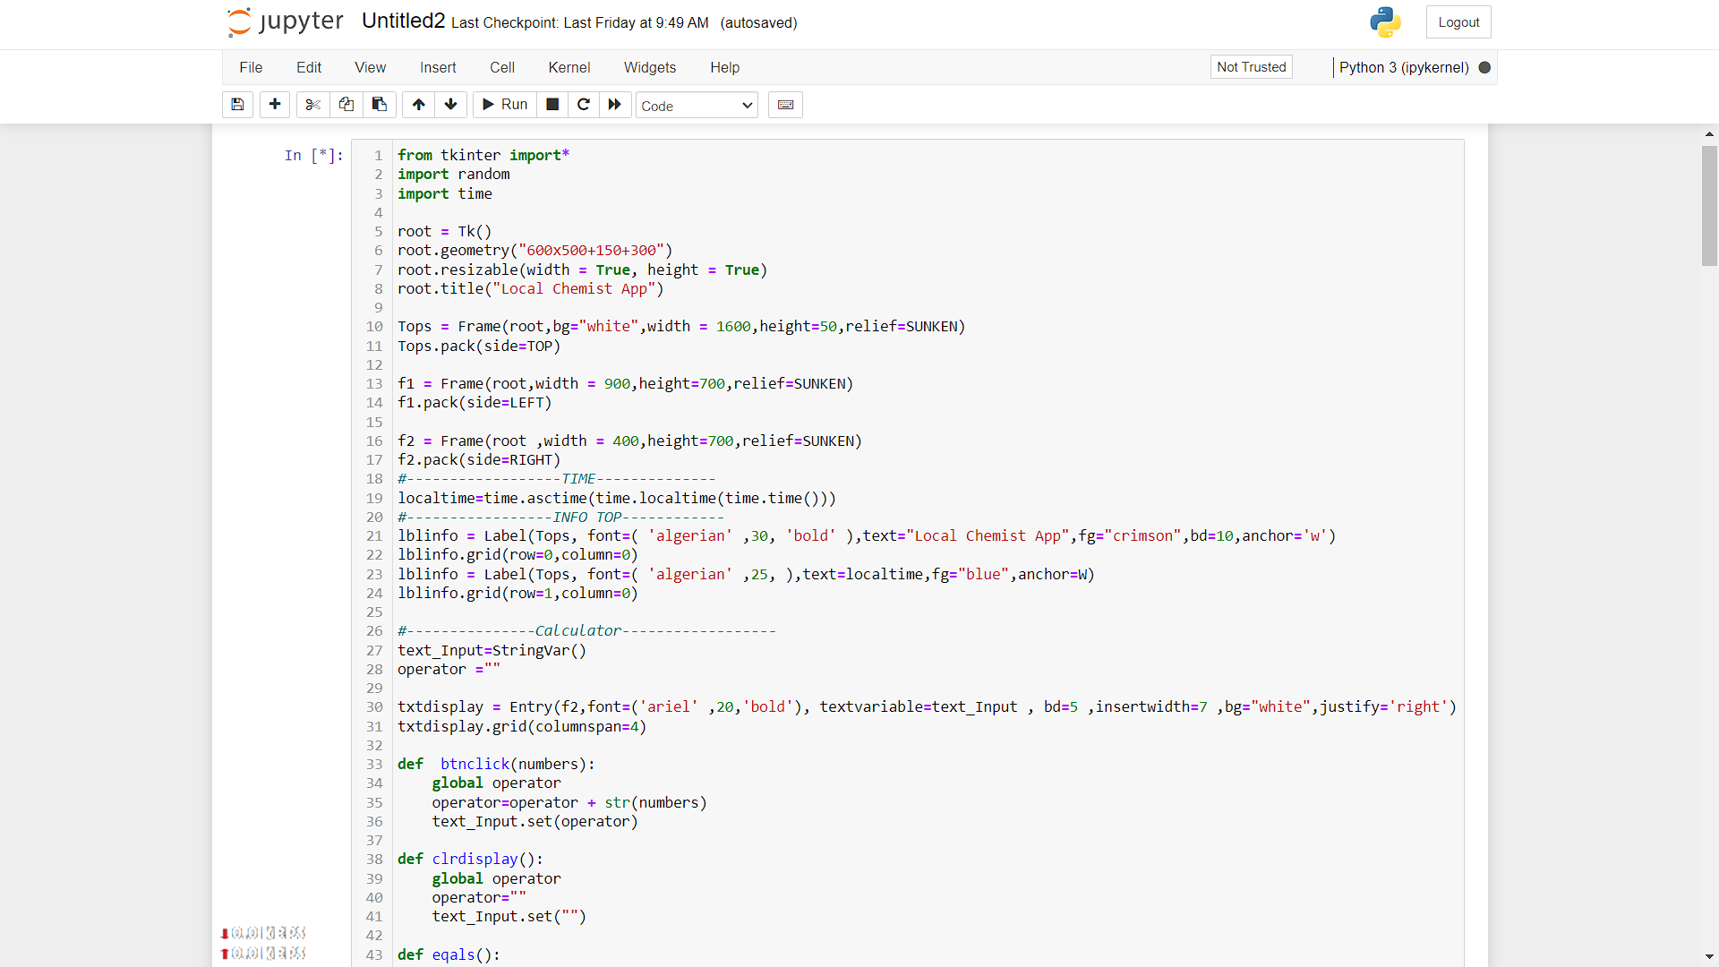
SCREENSHOTS OF APPLICATION

Slide 12
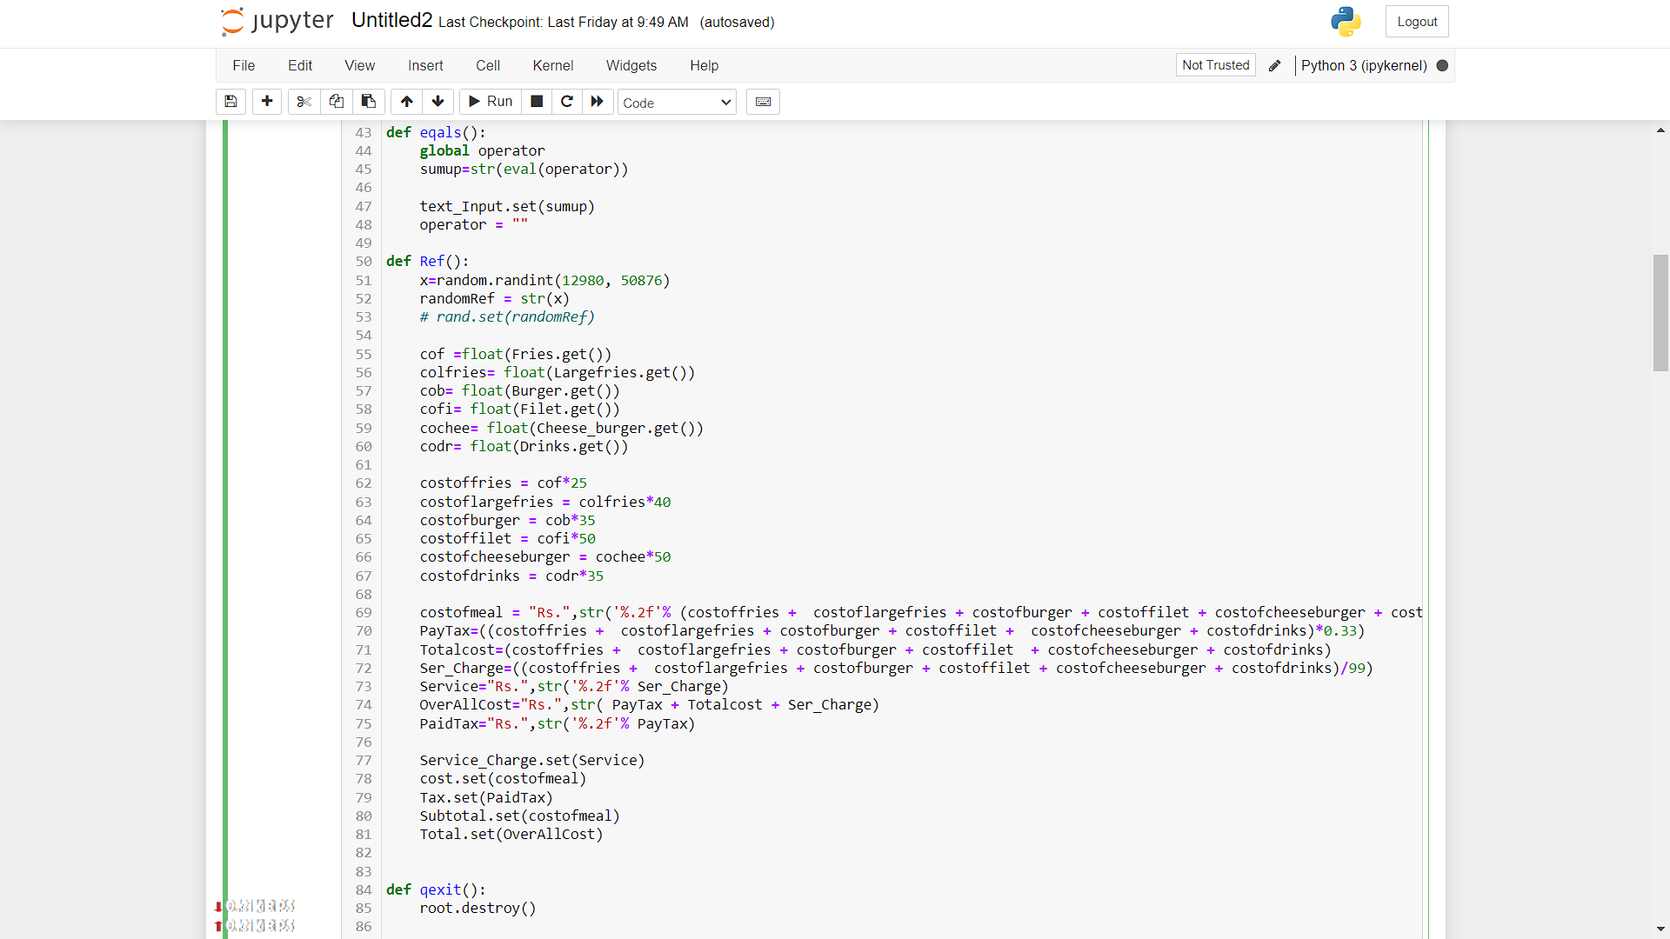
SCREENSHOTS OF APPLICATION

Slide 13
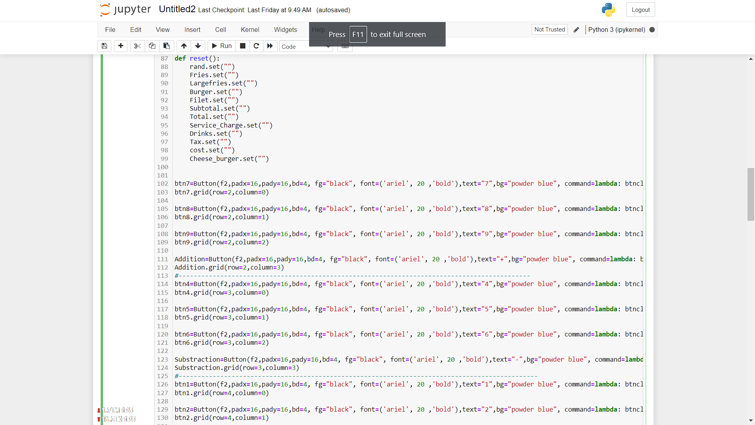
SCREENSHOTS OF APPLICATION

Slide 14
SCREENSHOTS OF APPLICATION

Slide 15
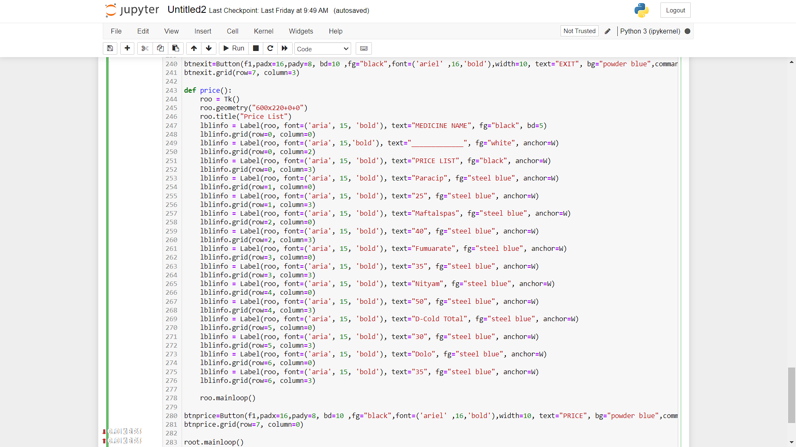
SCREENSHOTS OF APPLICATION

Slide 16


LOCAL CHEMIST APP
(USING TKINTER)

