Slide 1

BUDDING POETRY SPRING MVC AND HIBERNATE

Slide 2
BUDDING POETRY INTRODUCTION
Budding Poetry aims to provide a platform to novice writers
Enable writers to showcase their skills
Multi-User System

Slide 3
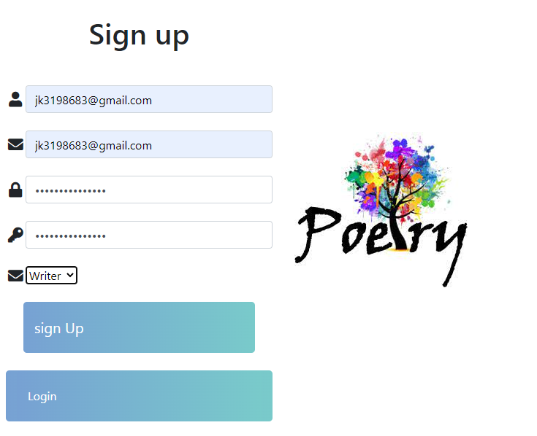
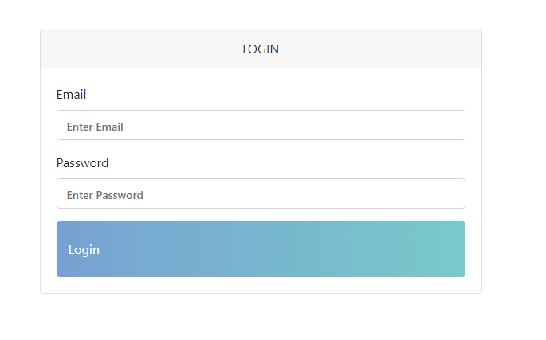
SIGNUP AND LOGIN

Slide 4
Add
Add Post Categories
Create
Create Contest for Writers
Declare
Declare the Winner for the contest
Approve/Decline
Approve/Decline the book
Download
Download the book
See
See the posts
Search
Search the post by writer name
See
See the list of participants for the contest
FUNCTIONALITIES
OF
ADMIN

Slide 5
FUNCTIONALITIES OF WRITER
Request To Sell his/her own book
1
On approval of Admin, sell the book
2
Buy other writer’s book
3
WITHOUT SUBSCRIPTION
CRUD operations on post
LIKE the post
Need to Subscribe for more functionalities
Search poems based on writer name
ON SUBSCRIPTION

Slide 6
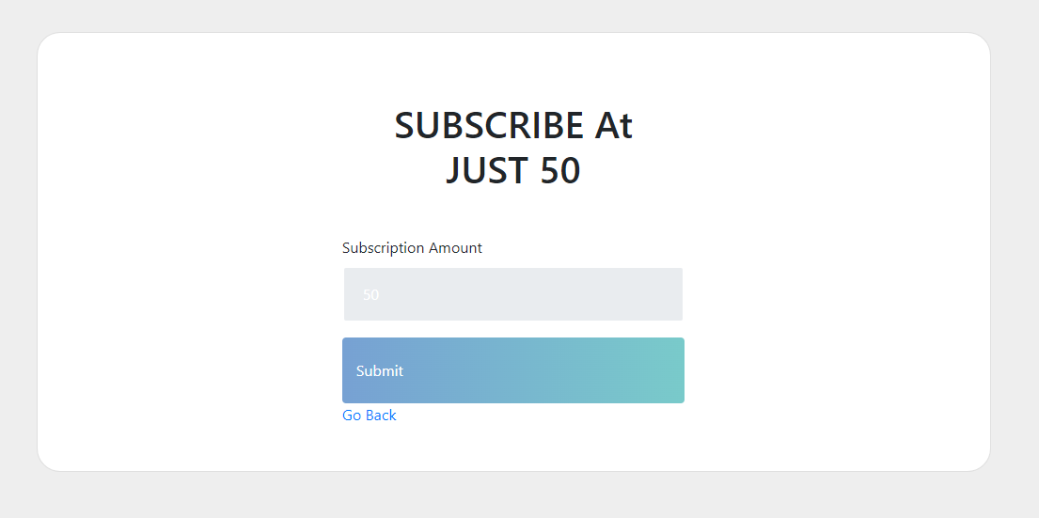
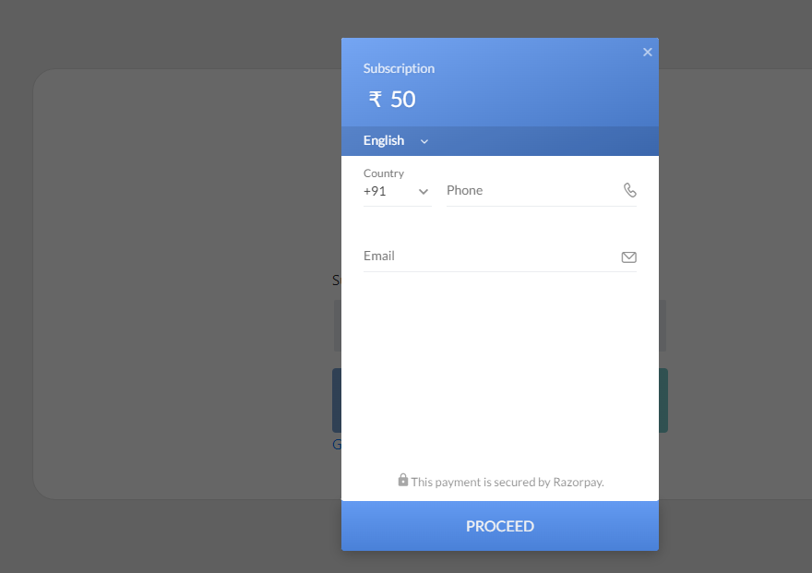
SUBSCRIPTION BY WRITER

Slide 7
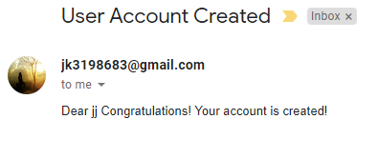
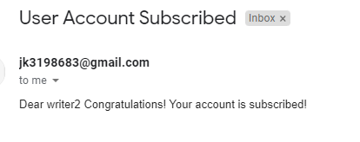
SPEICIAL FEATURES
Integrated RazorPayment Gateway to enable writers to subscribe.
Email is sent to writer on creating account and subscription.

Slide 8
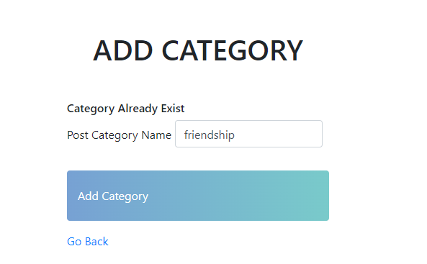
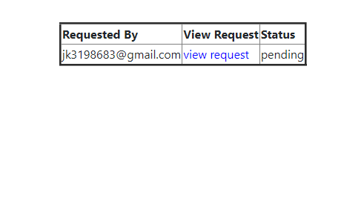
POST CATEGORY AND ADMIN REQUESTS
ADD CATEGORY BY ADMIN
SEE ADMIN REQUESTS

Slide 9
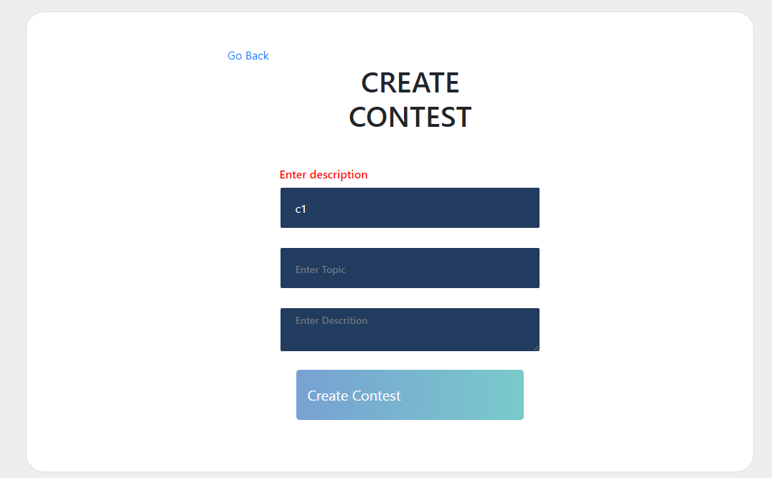
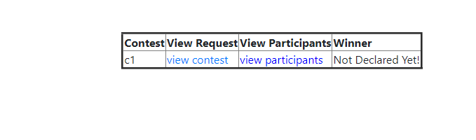
CONTEST
CREATE CONTEST
CONTEST LIST VIEW FOR ADMIN

Slide 10
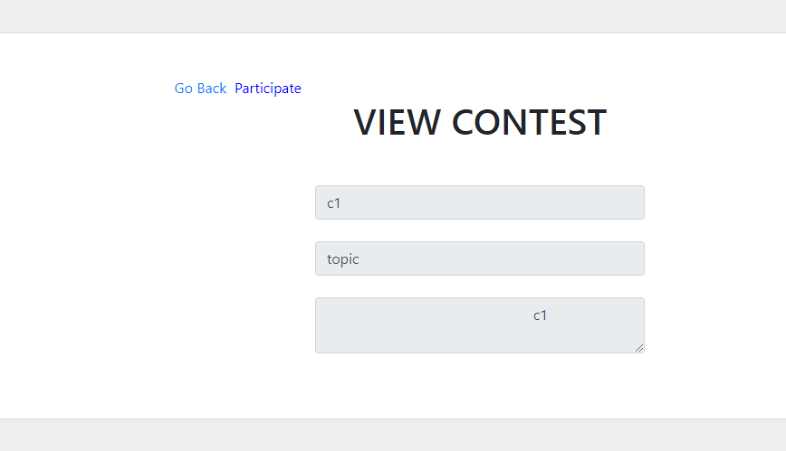
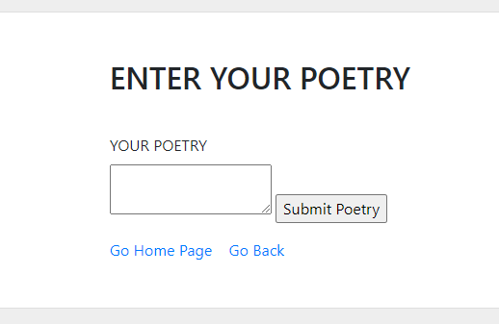
CONTEST
CONTEST VIEWED BY WRITER
PARTICIPATION BY WRITER

Slide 11
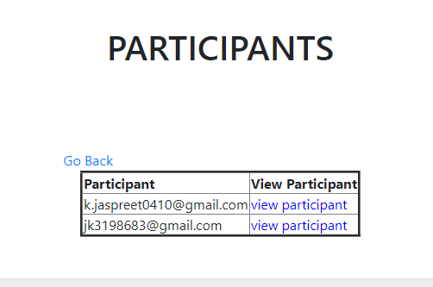
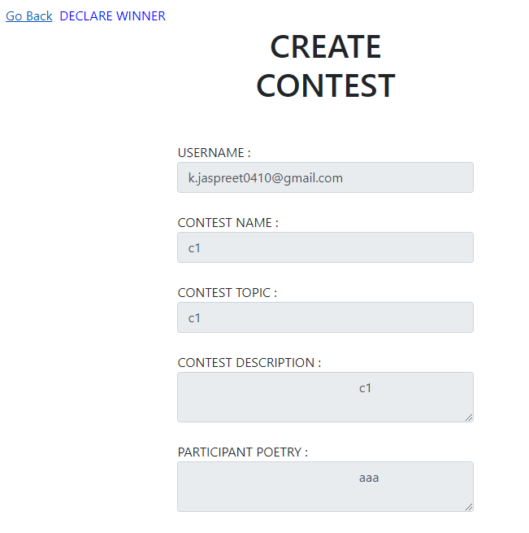
CONTEST
ADMIN VIEW ALL PARTICIPANTS
ADMIN DECLARE THE WINNER

Slide 12
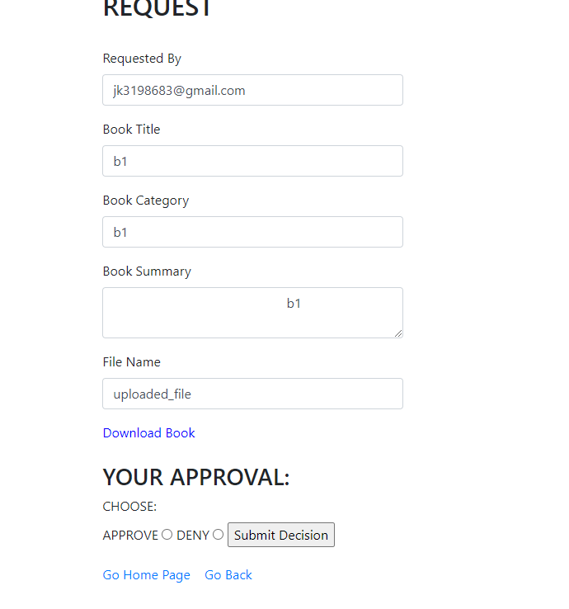
REQUEST BY WRITER TO ADMIN
The admin will either approve or deny the request to sell the book

Slide 13
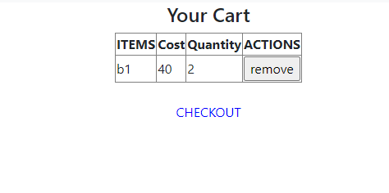
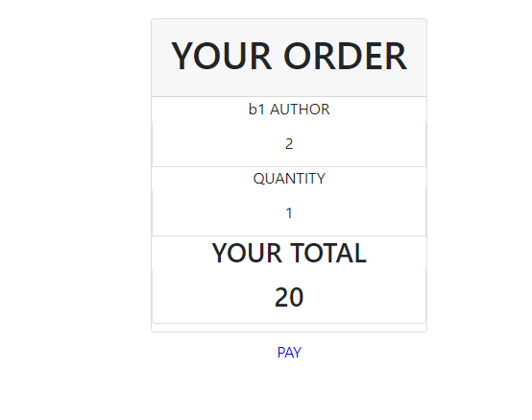
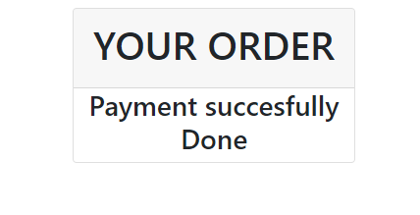
SHOPPING CART
Shopping cart
Payment Done
Order

Slide 14
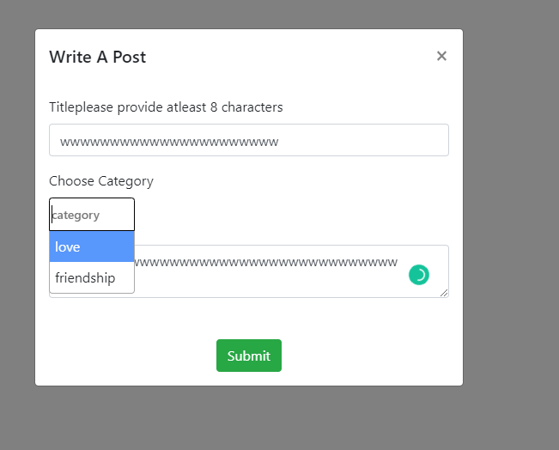
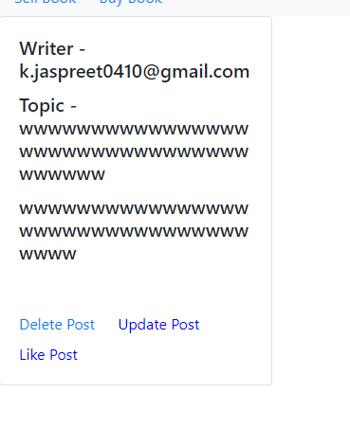
WRITER
Write a Post By Writer
Delete, Update or Like Post

Slide 15
Subscription
Likes
User
Post
PostCategory
Subscritionid
Amount
Orderid
Paymentid
Receipt
Status
Subscription_date
User_id
Likeid
Likebyuserid
Post_id
Id
Email
Password
Role
username
Postid
Content
createDate
Postname
user_id
Categoryid
categoyname
MODEL DIAGRAM FOR USER, POST AND SUBSCRIPTION

Slide 16
BOOK
User
ADMIN
AdminRequests
Contest
Bookid
Approvedtosell
Author_id
Book_category
Book_title
Filedata
Filename
summary
Id
Email
Password
Role
username
Id
Email
Password
Role
username
Admin_request_idapproval_status
User_id
Book_id
Contest_id
Contesname
Description
Topic
Winner_id
request
create
participate
MODEL DIAGRAM FOR
BOOK, USER AND ADMIN

