Slide 1
FOSTER CARE
By JASPREET KAUR

Slide 2
INTRODUCTION
Foster Care aims to provide family to the children so that they can live a wonderful and safe life.
Thousands of children are deprived of home and family and the parents who are willing to adopt a child – making them join together – is our core responsibility.
Many Services are provided to the children – Healthcare, Reimbursements and also multiple events are organised for the children in the Foster Care.
We believe in keeping the interests of the adopter and help them to adopt a child which aligns with their goals.

Slide 3
PROBLEM STATEMENT
The children who are looking for families need to join a family who is financially stable, good background and clear the training session.
Parents needs are also kept in mind and find them a best match.
Medical Services need to be provided to the children in the organisation who are awaiting to be adopted.
We also need to take care of our children entertainment so that they remain rejuvenated.

Slide 4
SOLUTION
Foster Care takes care of the children and before giving their responsibility to anyone – proper background and financial check up is done.
Training is also provided to the parents before adopting a child.
Keeping in mind the requirements of the children – healthcare, reimbursements services are provided. Cultural events are also organised in the organisation.

Slide 5
WHAT WE DO
Adoption
SERVICES
HEALTHCARE
SERVIVES
REIMBURSEMENTS
ORGANISE EVENTS

Slide 6


AT A GLANCE
FOSTER SERVICES
Agency
BACKGROUNDCHECK
HEALTHCARE SERVICES
DOCTOR
OGANISATION
LAB ORGANISATION
REIMBURSEMENTS
REIMBURSEMENTS
ORGANISATION
EVNETS
FINANCE
ORGANISATION
CUlTURAL
EVENT
ORGANISATION
ORGANISER
ORGANISATION
TRAINING
ORGANISATION
PHARAMCY

Slide 7
ADOPTION SERVICES
Parent can register themselves and will be registered only if they pass the financial check.
Children are registered by the foster admin in the agency.
Foster admin is responsible for making a child adopted.

Slide 8
ADOPTION CHECKS
FINACIAL CHECK
At the time of Registeration of Parent
BAckground Check
BACkground Checker
Training
Trainer
Training Organisation
CheckOrganistion

Slide 9
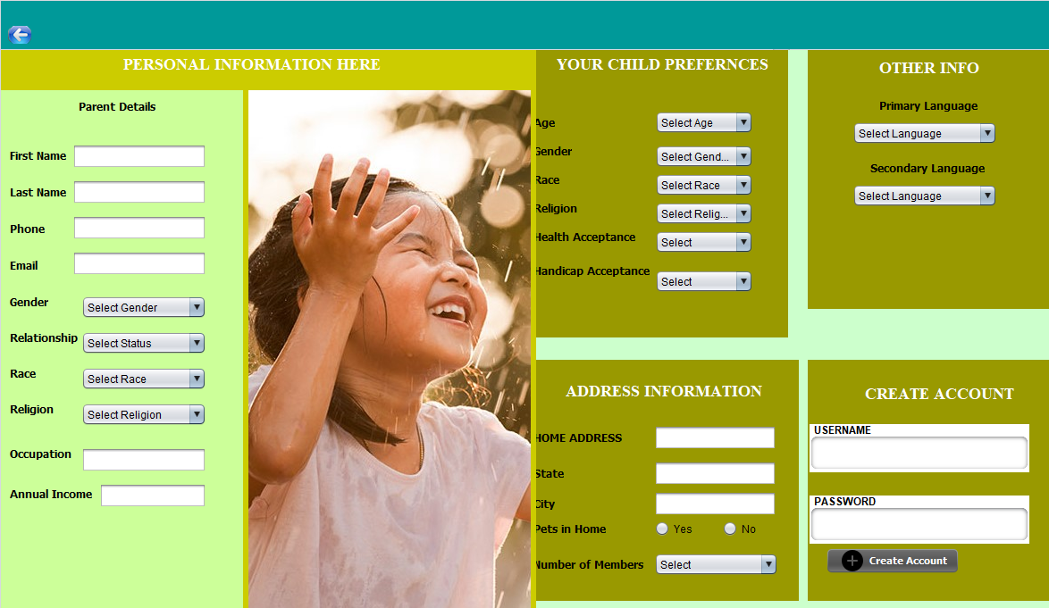
PARENT REGISTRATION

Slide 10
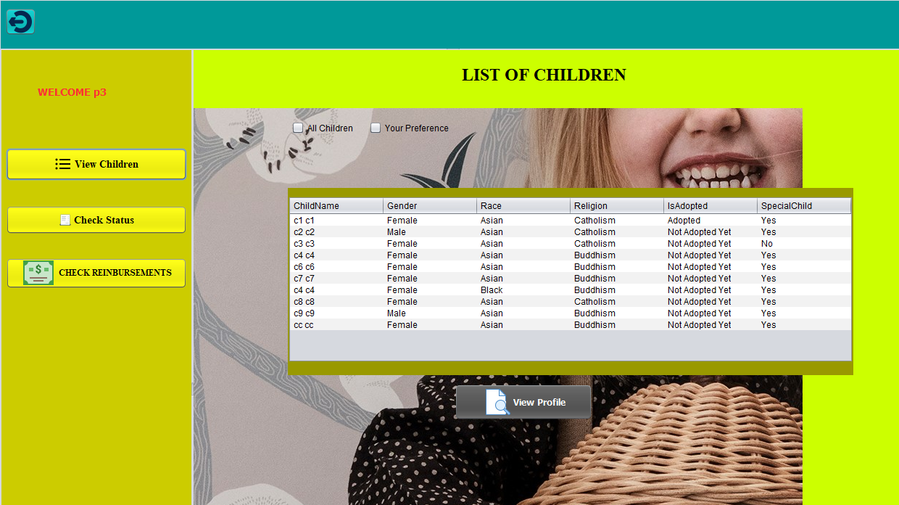
PARENT WORKING

Slide 11
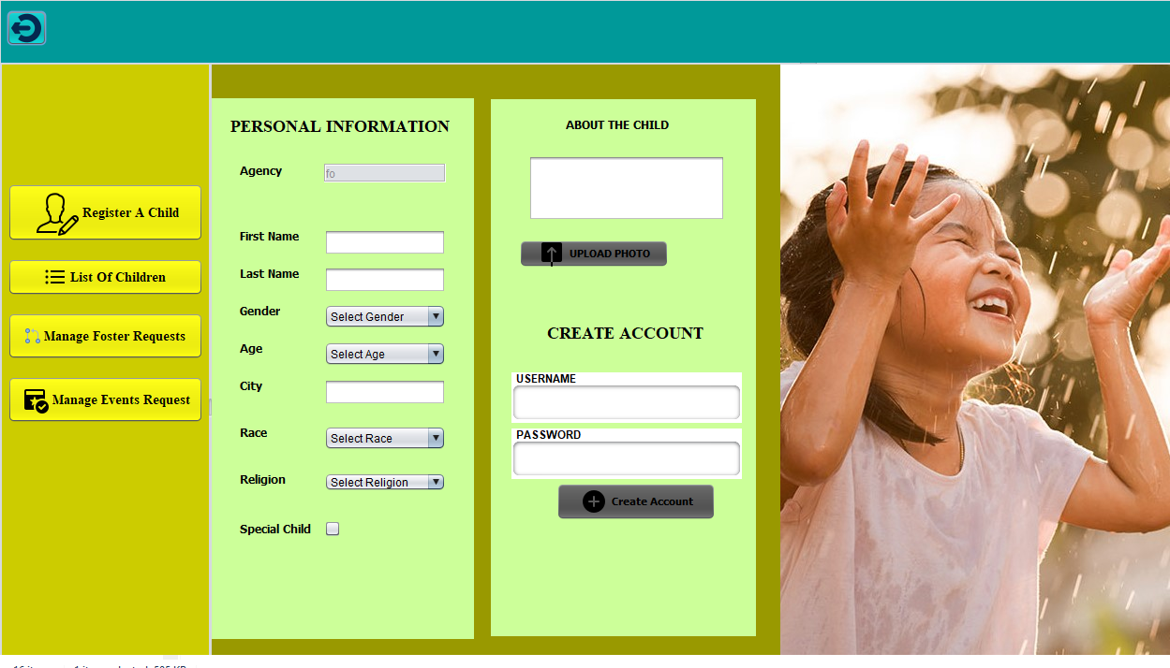
FOSTER ADMIN

Slide 12
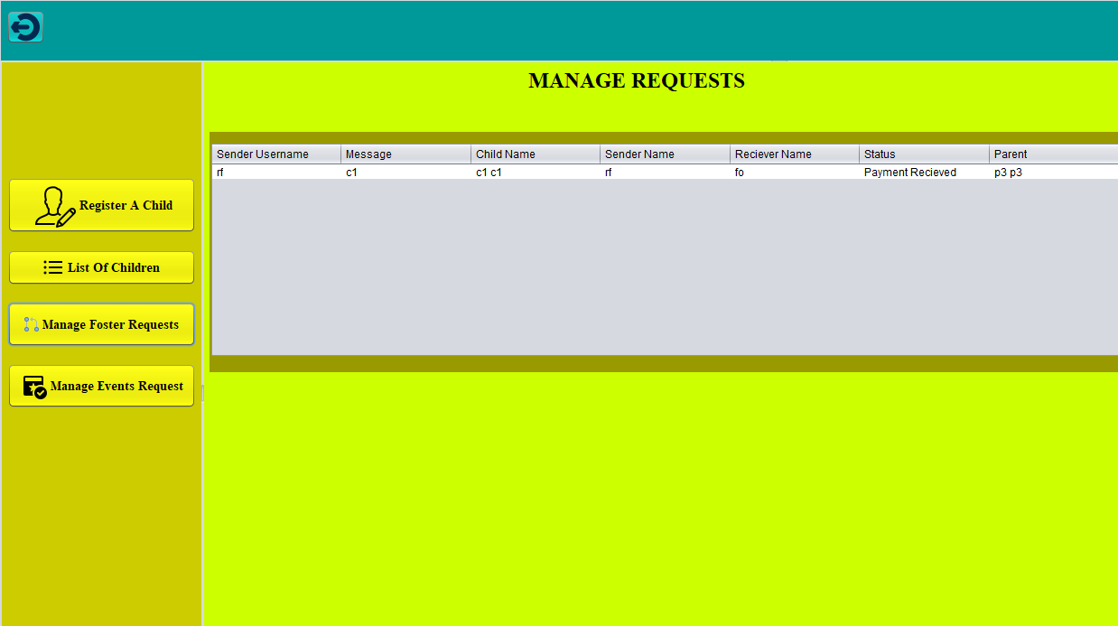
FOSTER REQUESTS

Slide 13
HEALTHCARE SERVICES
FOSTER
SEND REQUEST To HEALTCARE
Healtcare
Doctor Accept the request
Process Medical check
LAB REQUEST
Accept Req
Do Vitals Test
Process Tests according to the specified by doctor

Slide 14
HEALTHCARE SERVICES
LABORTARY ASSistant
SEND TEST RESULTS TO DOCTOR
DOCTOR
Check the results
Phamascist
Accept doctor request
Prescribe medicines if required
Provide Medications

Slide 15
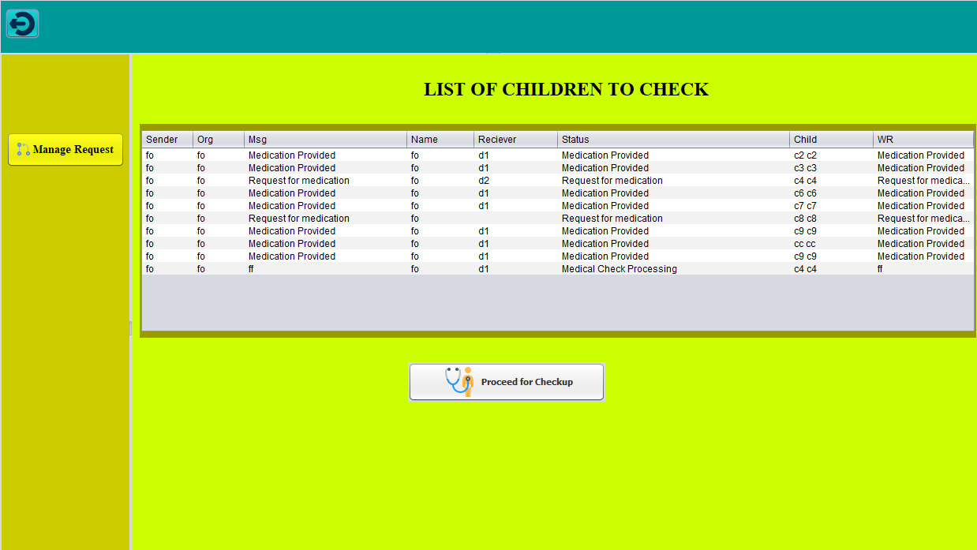
DOCTOR REQUESTS

Slide 16
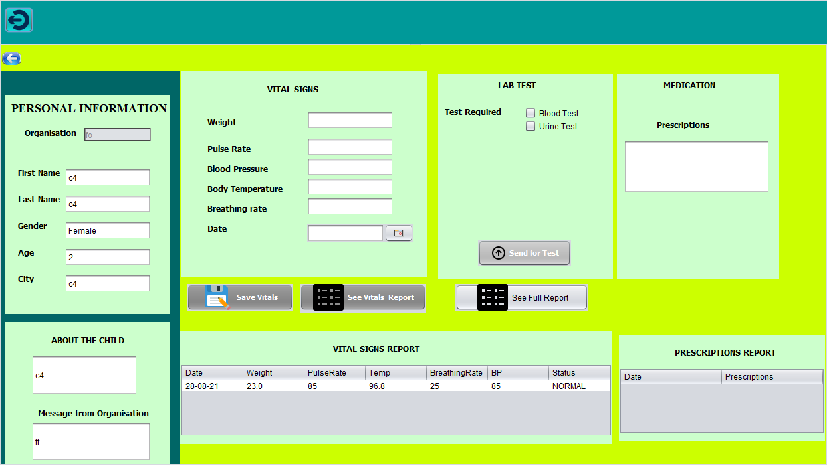
DOCTOR CHECKUP AREA

Slide 17
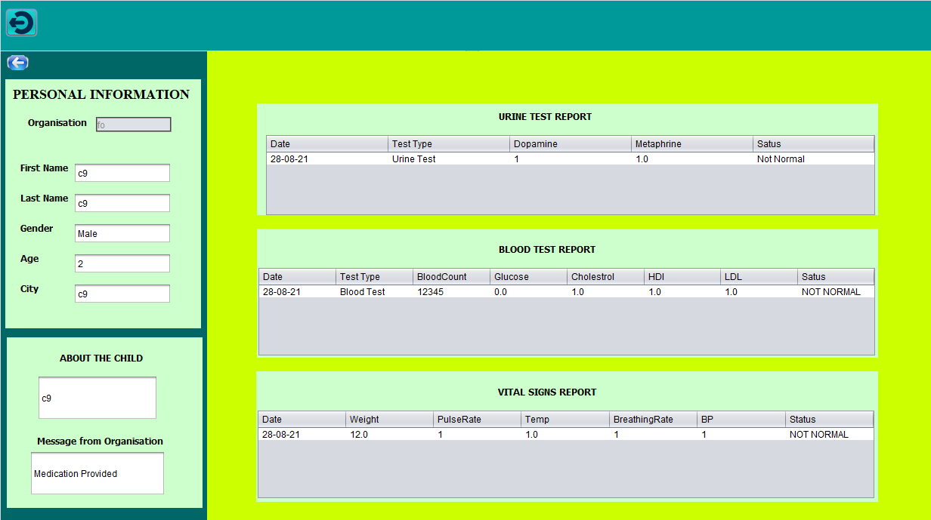
DOCTOR SEE FULL REPORT

Slide 18
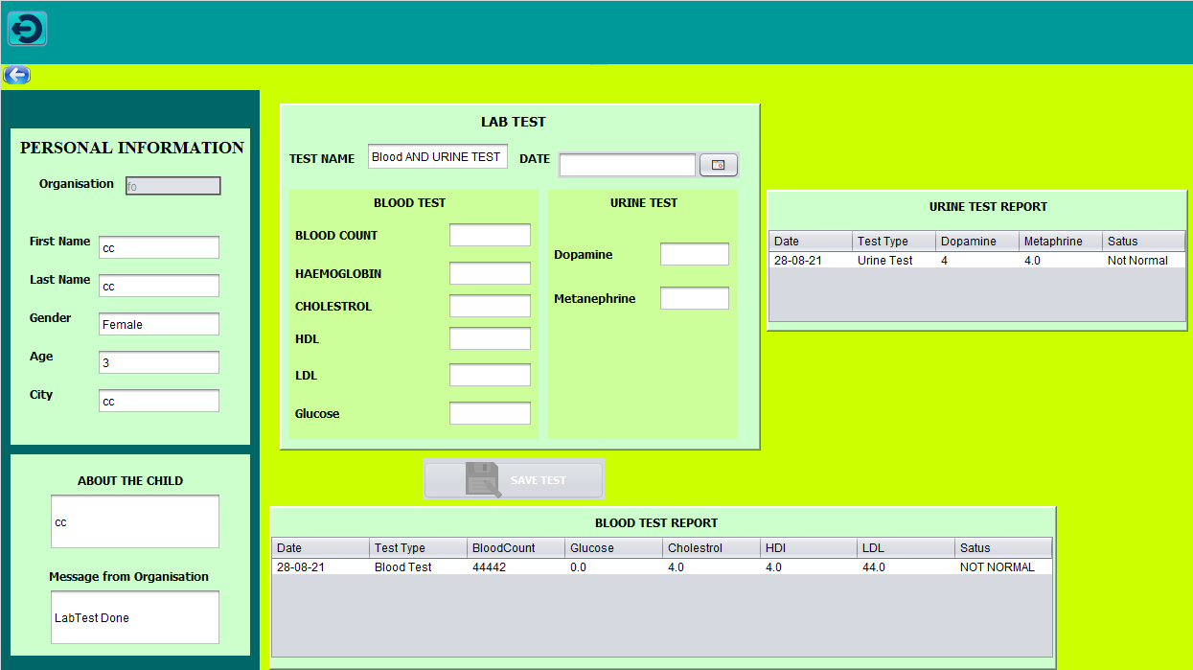
LABORTARY ASSITANT

Slide 19
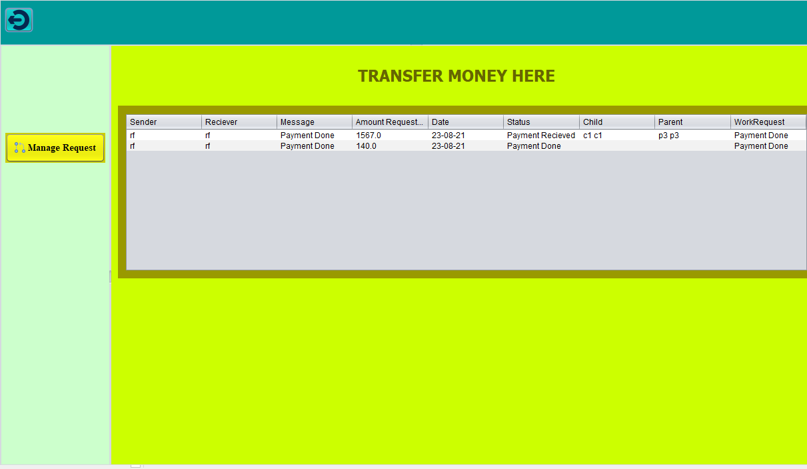
REIMBURSEMETS REQUESTS

Slide 20
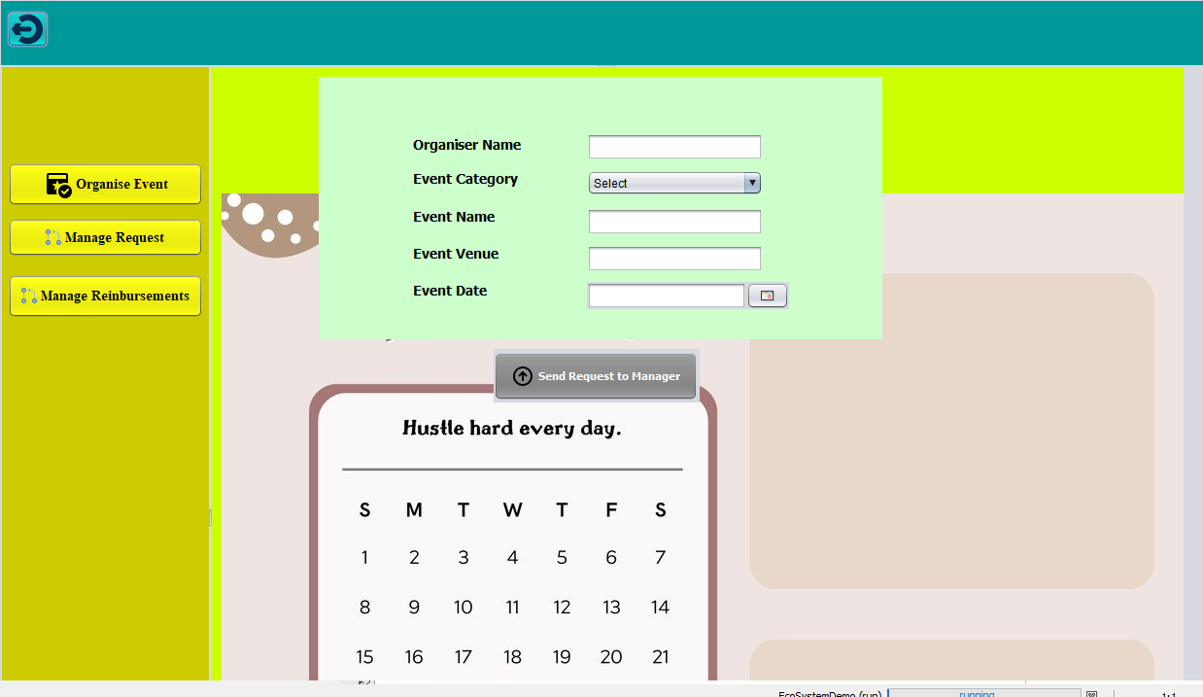
ORGANISE EVENT

Slide 21
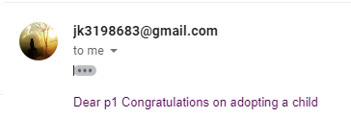

EMAIL SENT TO PARENT
EMAIL IS SENT To A Parent
On Adopting A child
By Foster Admin
ALSO – Backgroud check Organisation
Send Email to parent.

Slide 22
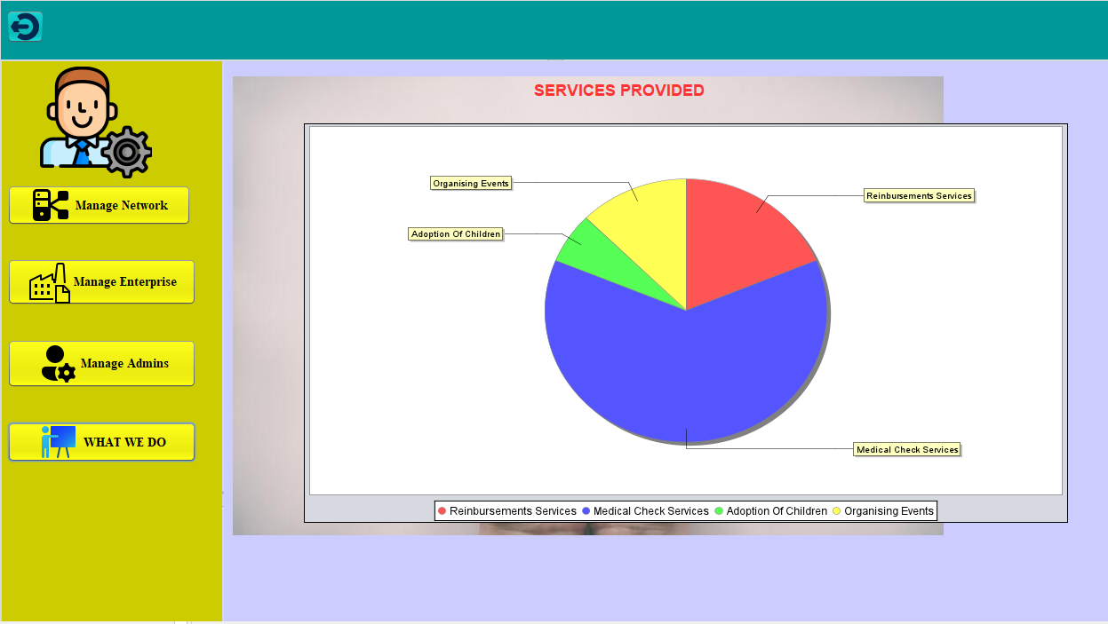
TRACKING SERVICES PROVIDED

Slide 23
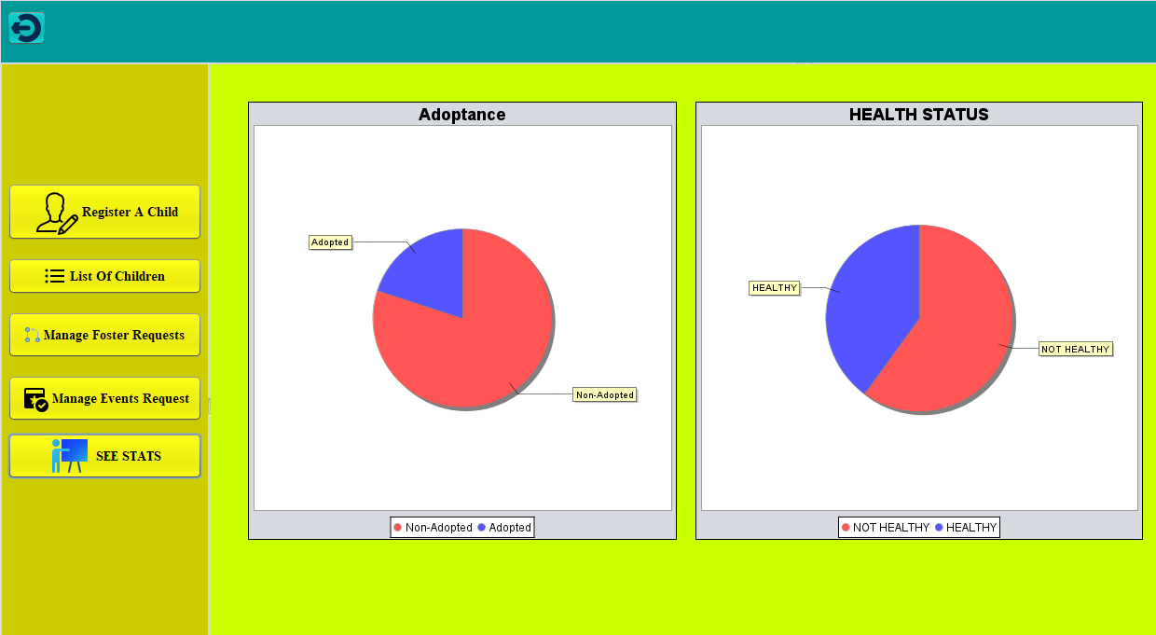
FOSTER ADMIN CAN KNOW CAN SEE THE STATS OF CHILDREN – FOR - HEALTH STATUS AND ADOPTANCE RATE

Slide 24
OBJECT MODELS

Slide 25
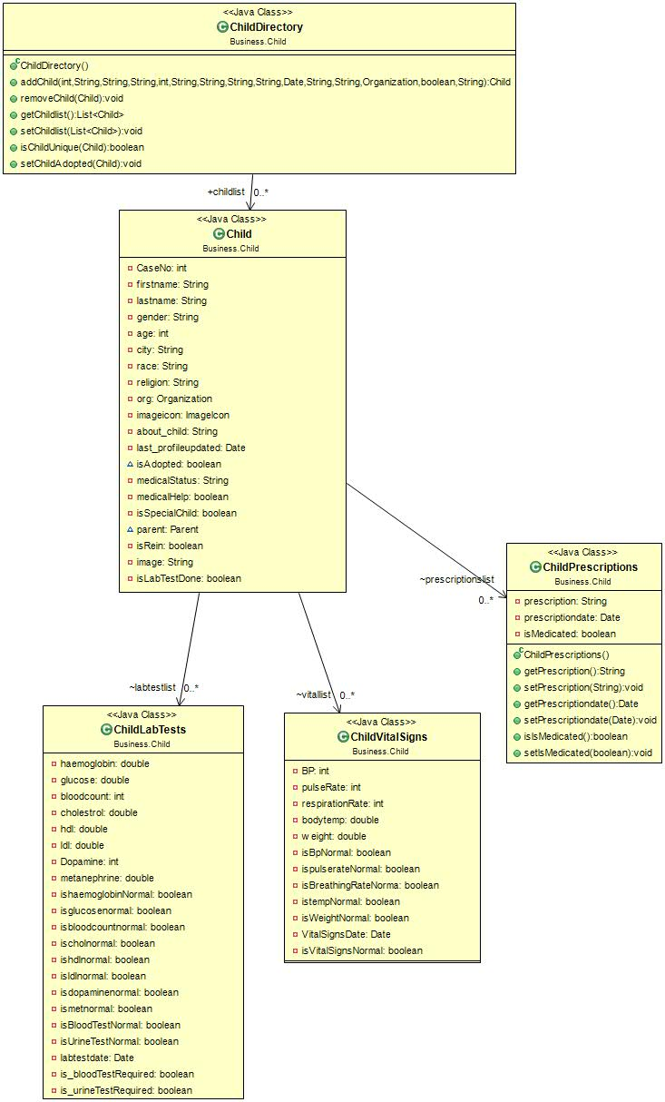
CHILD
MODEL

Slide 26
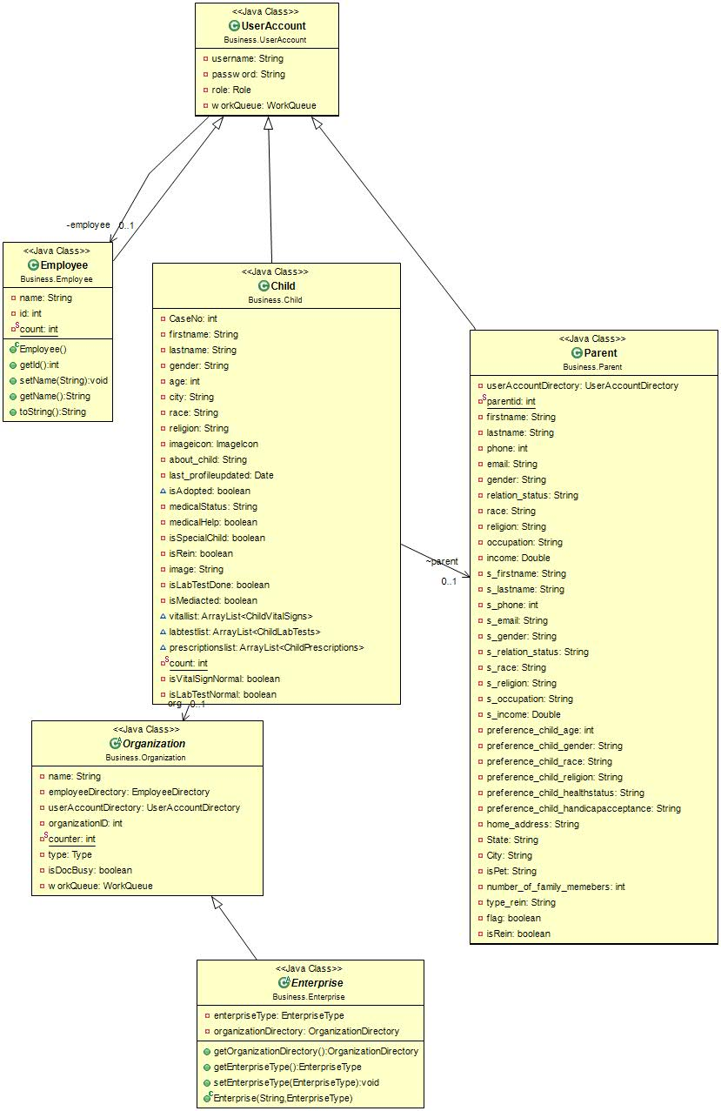
USER
MODEL

Slide 27
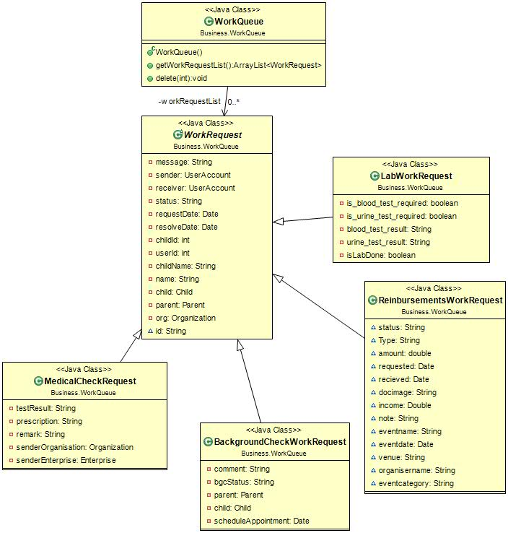
WORK
REQUEST
MODEL

Slide 28
DIAGRAMS
Creates Employees and useraccounts
Creates network and enterprise admins
SYSTEM ADMIN
ENTERPRISE ADMINS
ENTERPRISE ADMINS
FOSTER CARE ADMIN
REIMBURSEMENTS
ADMIN
EVENTS ADMIN
HEALTHCARE
ADMIN

Slide 29
FOSTER SERVICES SEQUENCE DIAGRAM
DECLINED
SEND DECLINE EMIAL
LIST OF PARENTS
PARENT
MEETING COMPLETED
SEND ADOPTIONN REQUEST
DECISION AFTER MEETINNG
CHECK FINANCES
ADOPT CHILD EMAIL
Register
Parent
FOSTER ADMIN
ACKNOWLEDGEMENT
ACKNOWLEDGEMENT
ACKNOWLEDGE FOSTER ADMIN
APPROVED
FINAL APPROVAL
REQUEST SEND TO PARENT
SEND PARENT FOR TRAINING
FOSTER ADMIN
DECISION
SCHEDULE APPOINTMENT
CHEKER MANAGER
APPLICATION
APPROVE
DECLINE
DECLINE
SEND FOR BACKGROUND CHECK
PROVIDE TRAINING
TRAINER
DECLINED
TO ADOPT
DECISION
APPROVE

Slide 30
MEDICAL SERVICES SEQUENCE DIAGRAM
SEND RESULTS TO DOCTOR
SEND MEDICAL HELP
DOCTOR
BUSY CHECK
DO THE TESTS
CHILD
FOSTER
ADMIN
ASSign to someone else
BUSY
BUSY
NO BUSY
SEND VITALS NORMAL STATUS
CHECK VITALS
LABORTARY ASSISTANT
TEST RESULTS
LIST OF CHILDREN
NORMAL
NOT NORML
IF BOTH TESTS NORMAL
NNORMAL
SEND FOR LAB TEST
PRESCRIBE
MEDICINES
CHILDREN
DIRECTORY
SEND HEALTHY STATUS
NOT NORMAL
SEND HEALTHY STATUS TO FOSTER ADMIN
SEND REQUEST
PROVIDE
MEDICATIONS
PHARMASCIST
SEND STATUS isMEdicated
SEND LAB TEST NOT NORMAL STATUS

Slide 31
FUTURE ASPECTS
FOSTER CARE PROJECT CAN BE ENHANCED TO MULTIPLE CITIES AND CREATE MULTIPLE NETWORKS AND ORGNANISATIONS.
MORE SERVICES CAN BE PROVIDED TO THE CHILDREN AS AND WHEN REQUIRED
FOSTER CARE TRY TO REACH TO MILLIONS OF PARENTS AND CHILDREN TOBRING THEM TOGETHER

Slide 32
THANK YOU!

