Slide 1
Project life cycle
Suicide rates in the world
ID19150299 - BCU

Slide 2

Motivation behind chosen domain
The question we choose to awser with this data analysis is:
How the trend of suicides around the globe has evolved in these past years?
For the anwser of this question we think that the data about the suicides all over the world will work the best.

Slide 3
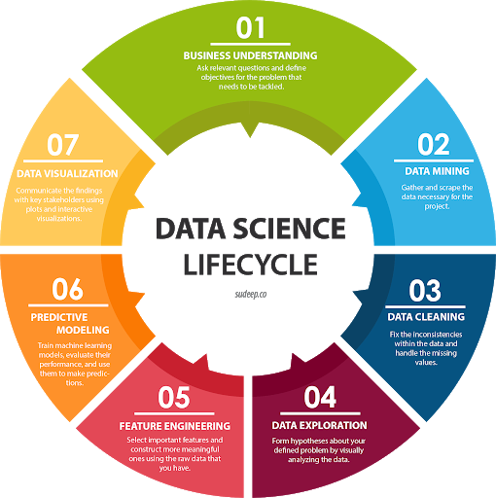
Goals of the chosen data science project
The aim of the project is to obtain an insight on how the number of suicide rates around the globe are moving in order to have a meaningful overview on the frequency of these events.
In the beginning this insight will be obtained by an analysis on the trends created by the data with an ulterior in dept analysis with segmented data that could be cross referenced with some other indicators, this will ultimately give us the real global situation on suicide rates over these past years.

Slide 4
How is the data collected
Excel and CSV
Source: World Bank, Szamil, United Nations Development Program and World Health Organization
Annual and by country and population’s generation
Since 1985, 20-30 years for us
Structured (discrete and continuous)

Slide 5
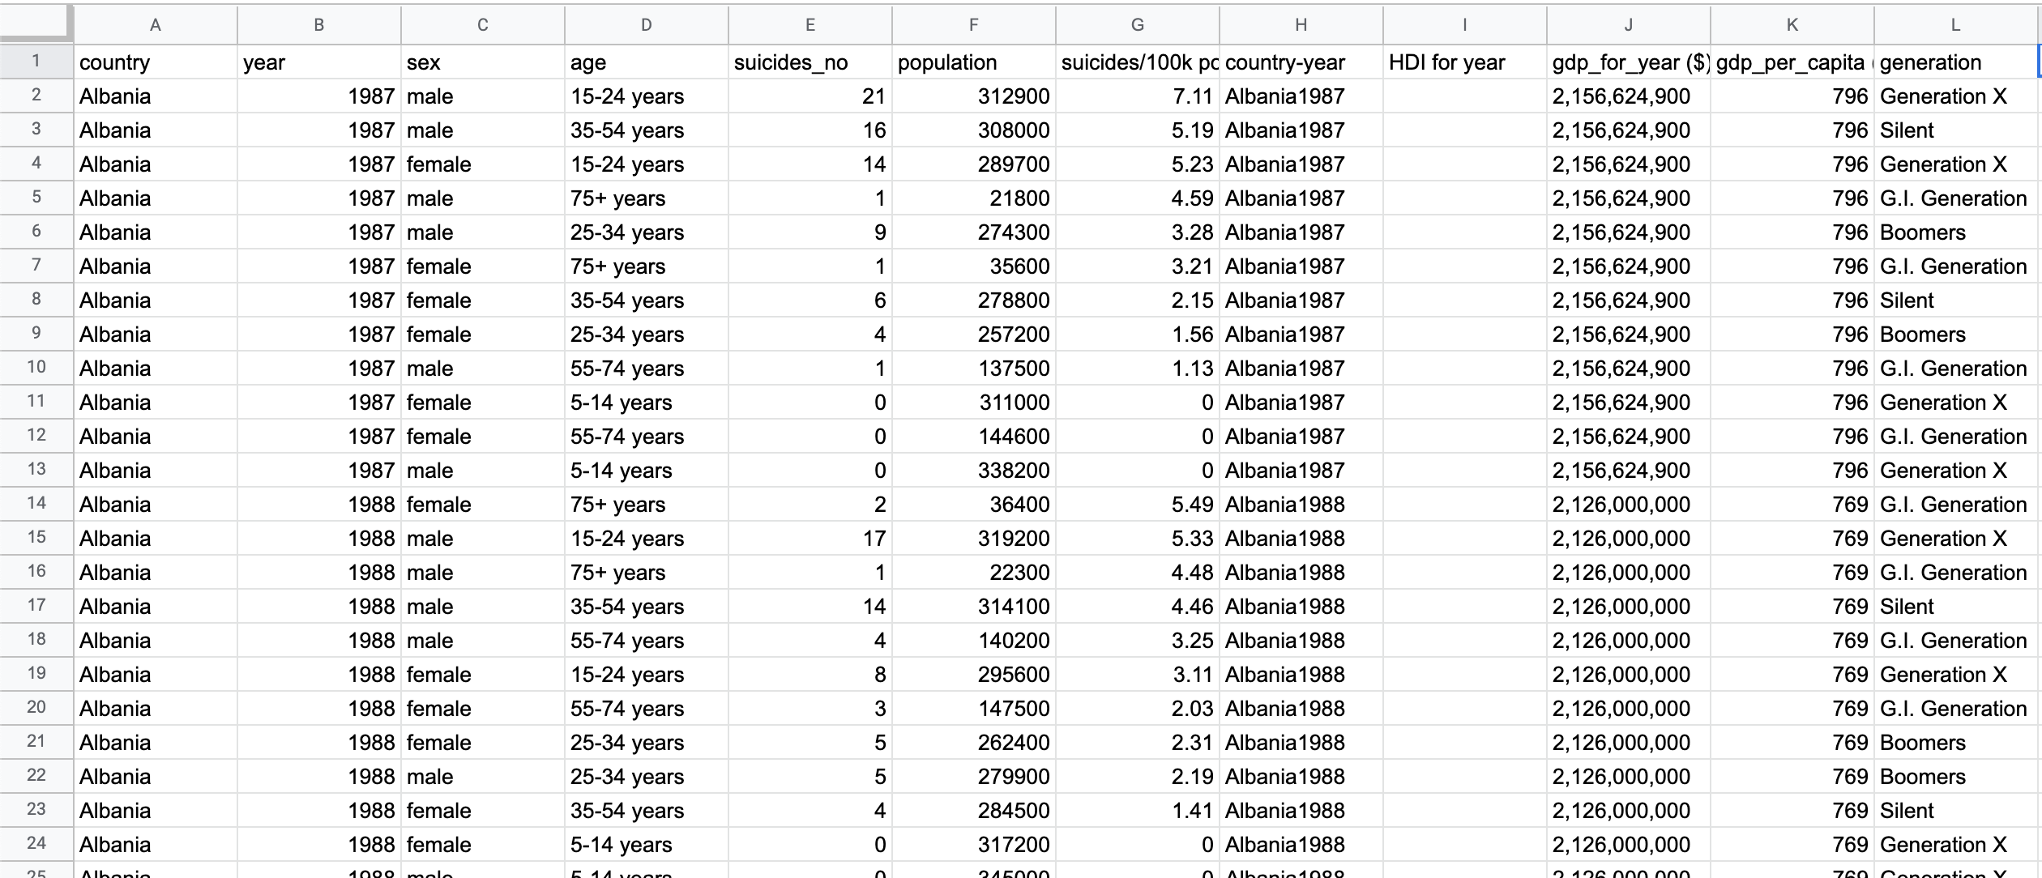
Main dataset

Slide 6
Data cleaning
7 countries removed due to not enough data
2016 data was removed due to too much missing data
Human Development Index was removed due to too much missing data
Continent code was added to the dataset
Only a few African countries providing suicide data

Slide 7
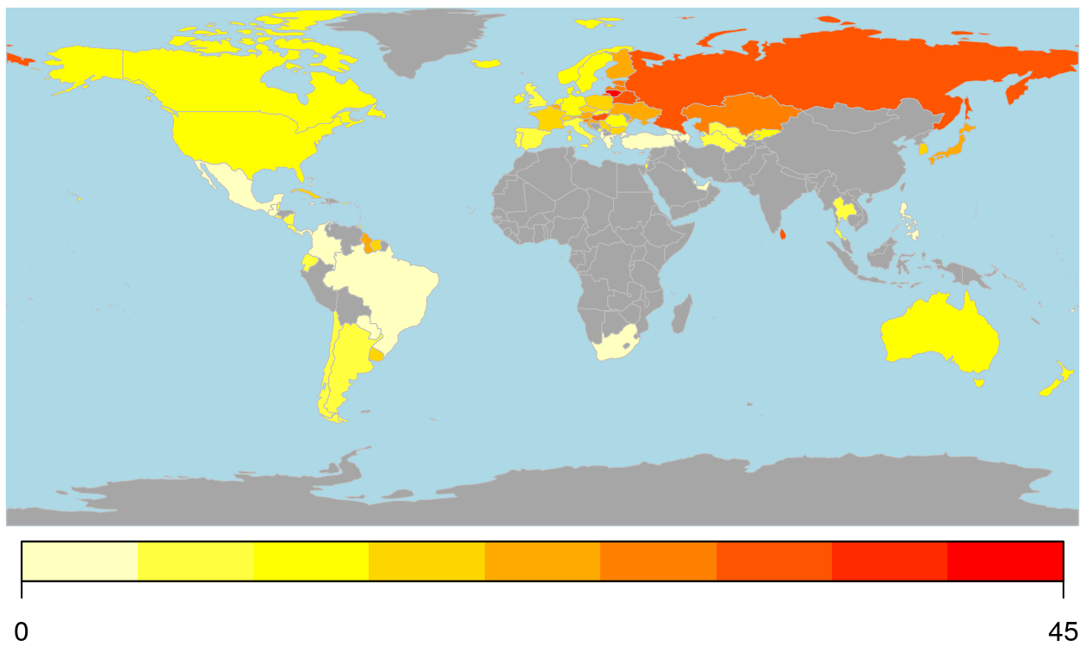
Geographical heat map of the suicide rates, Africa and Asia lack data and 7 countries have been removed due to insufficient data.

Slide 8
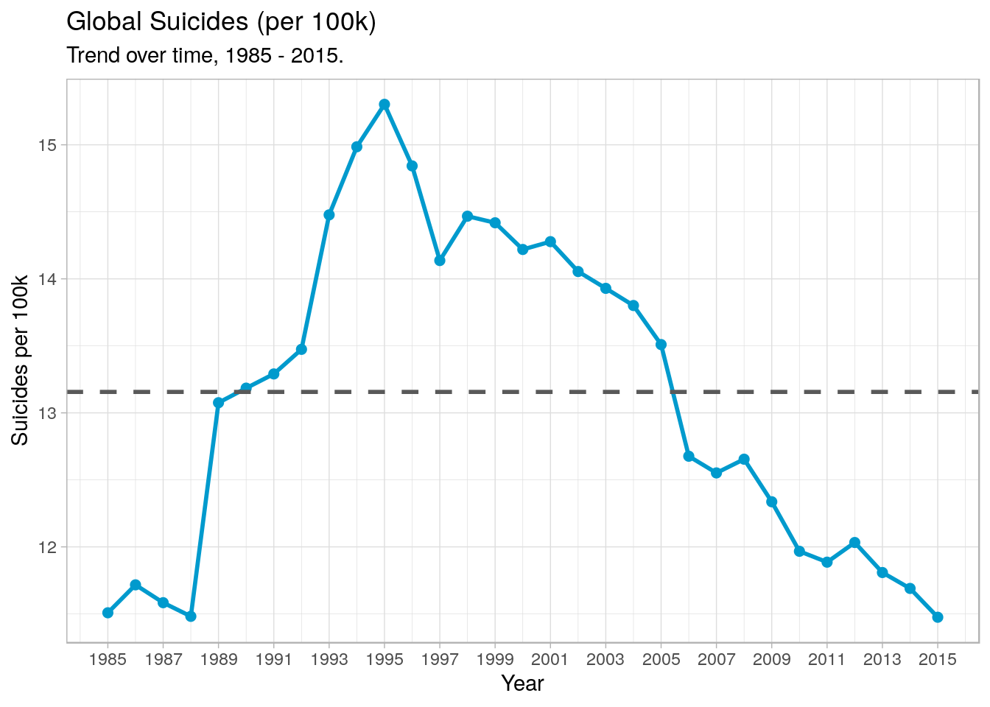
Data exploration: Global numbers
The global average was 13.1
Max suicide rate was 15.3 in 1995
Decreased steadily, to 11.5 in 2015
Rates similar to pre 90’s but the limited data in the 80’s, makes hard to say if that rate really represented the global population.

Slide 9
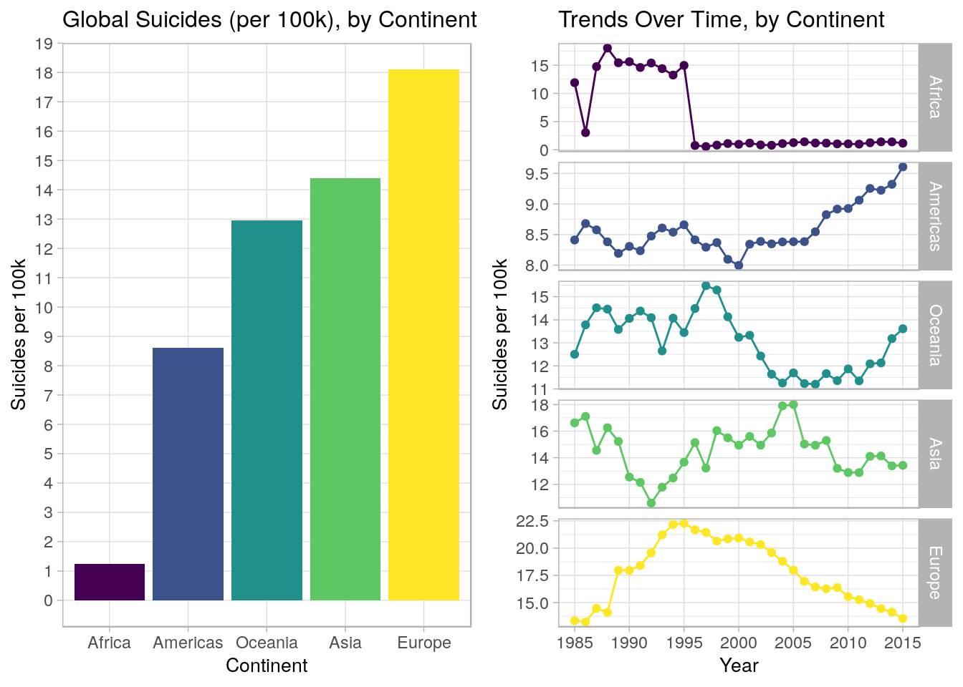
Data exploration: By continent
Europe had the highest rate, but has steadily decreased since 1995
The trendline for Africa is the result of poor data quality
Americas and Oceania started a concerning trend near 2006

Slide 10
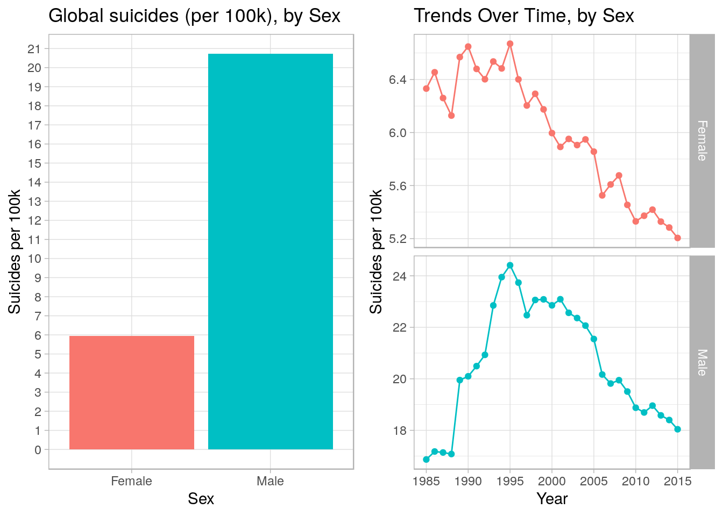
Data exploration: By sex
Globally, the rate of suicide was ~3.5x higher for men, but during the 80’s it was just ~2.7x
Both genders declined after 1995

Slide 11
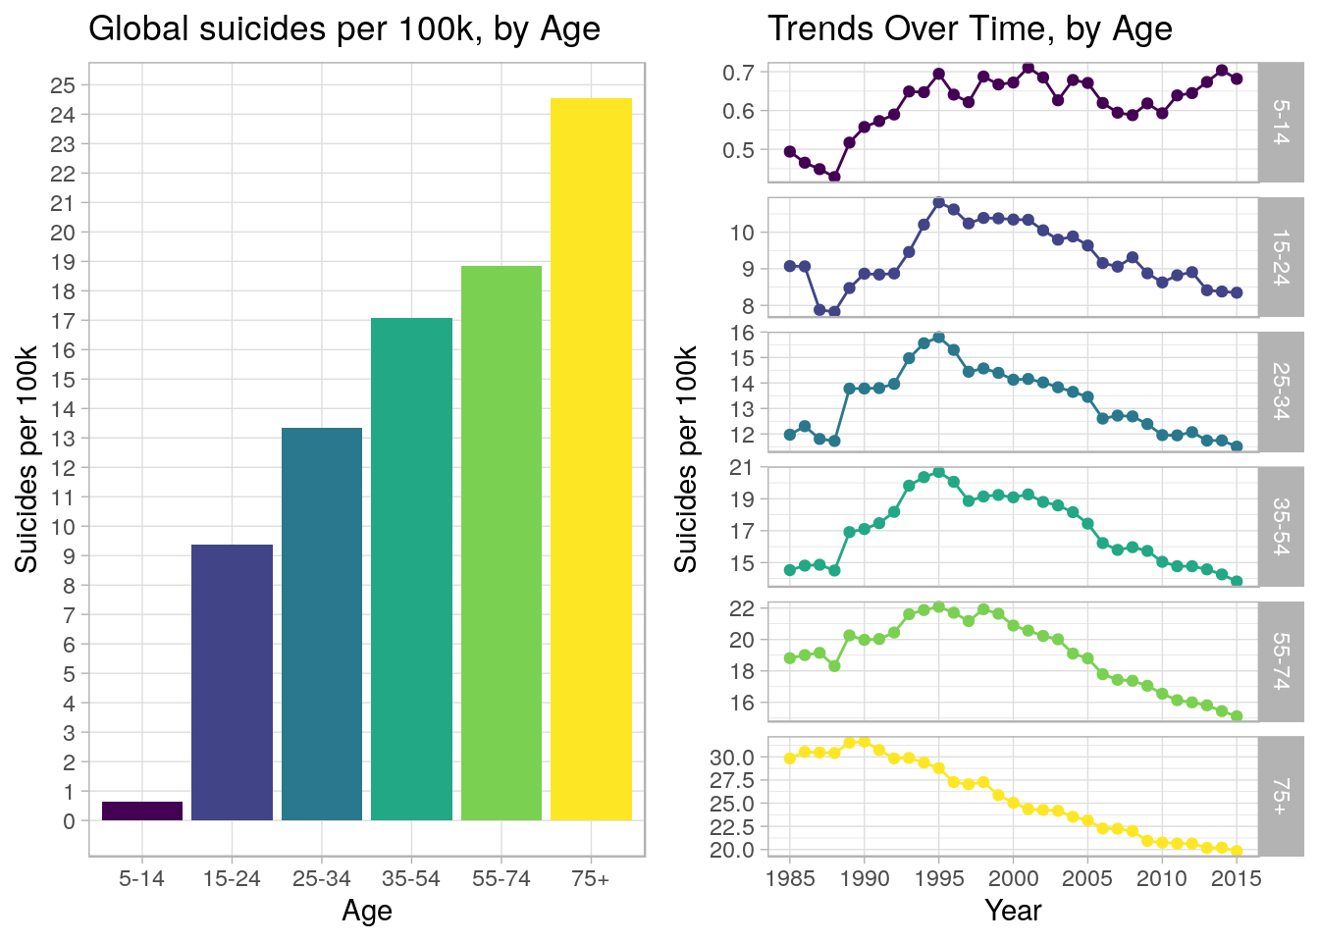
Data exploration: By age
Globally, the probability of suicide increases with age
Since 1995, suicide rate for everyone older than 15 has been linearly decreasing but the ‘5-14’ category remains roughly at the same level

Slide 12
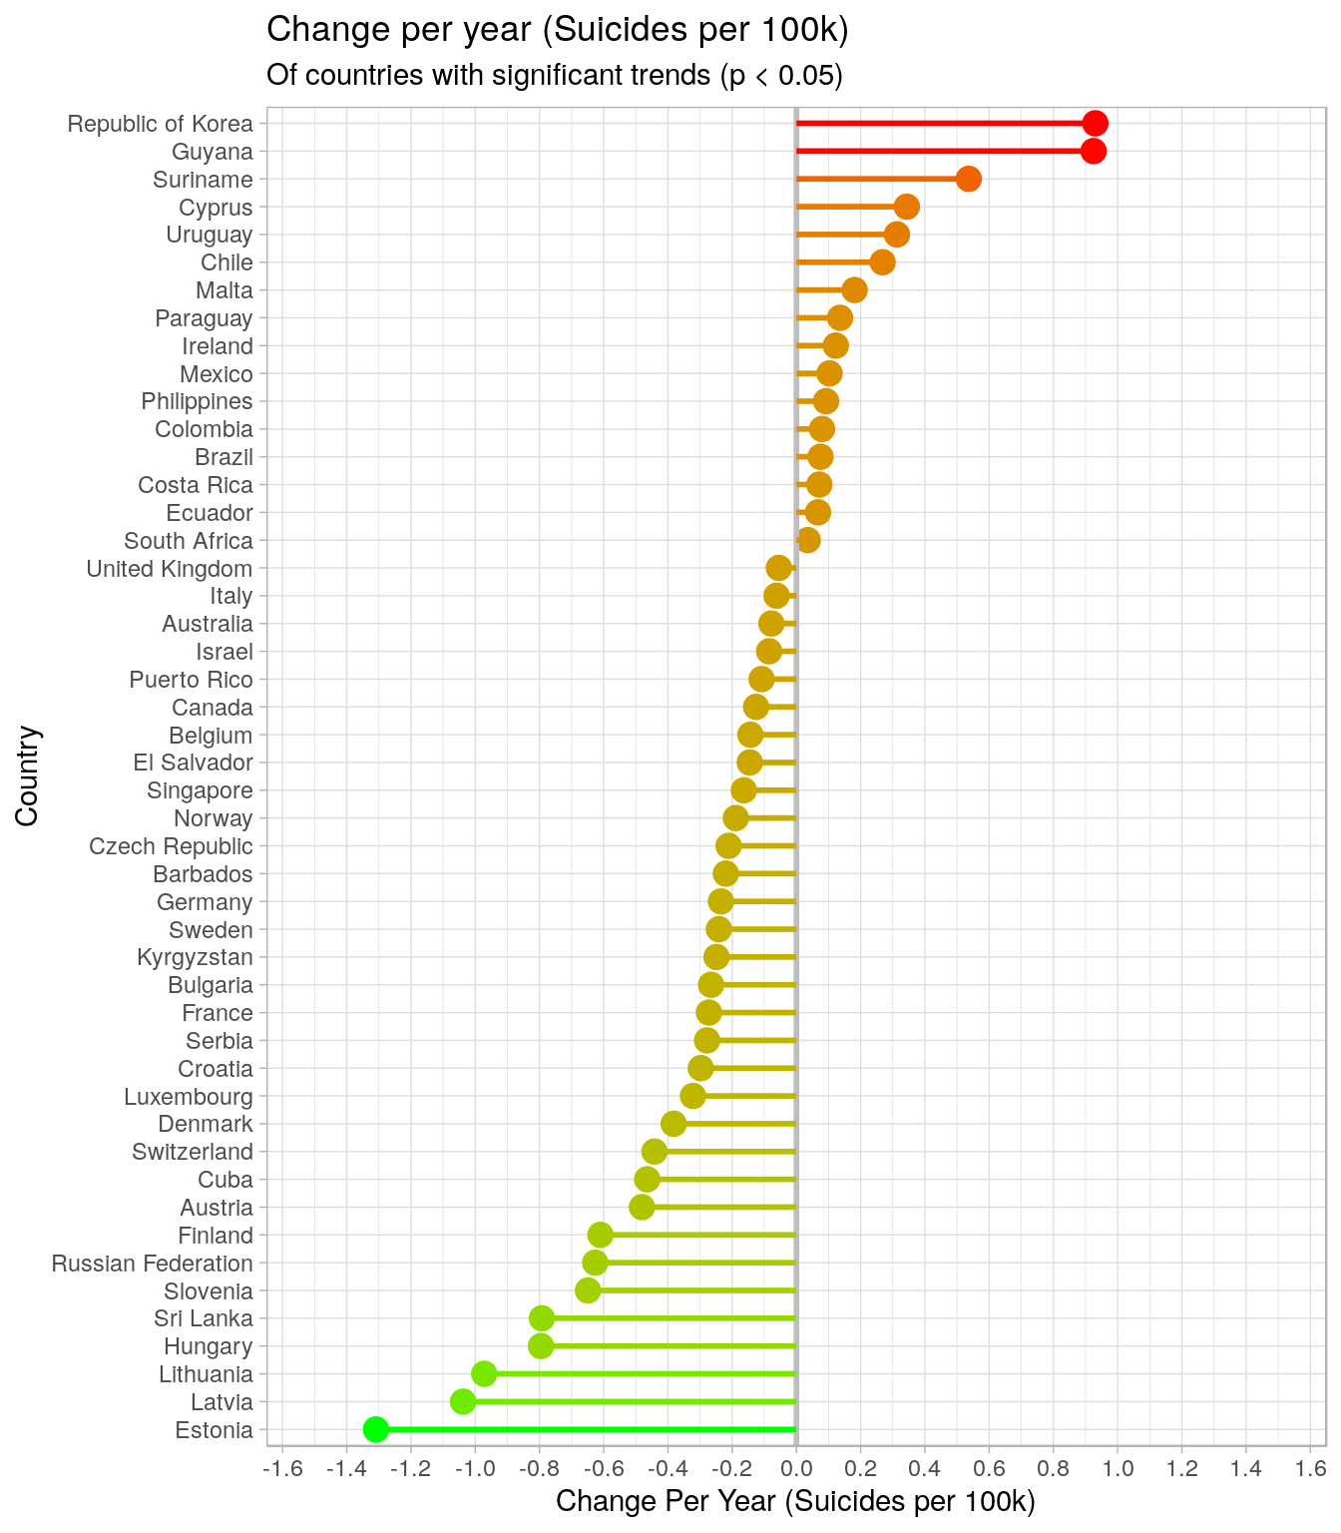
Data exploration: country trends
Only countries where the suicide rate is linearly increasing/decreasing significantly has been selected
~50% of all countries suicide rates are changing linearly with time
~66% of these countries are decreasing

Slide 13
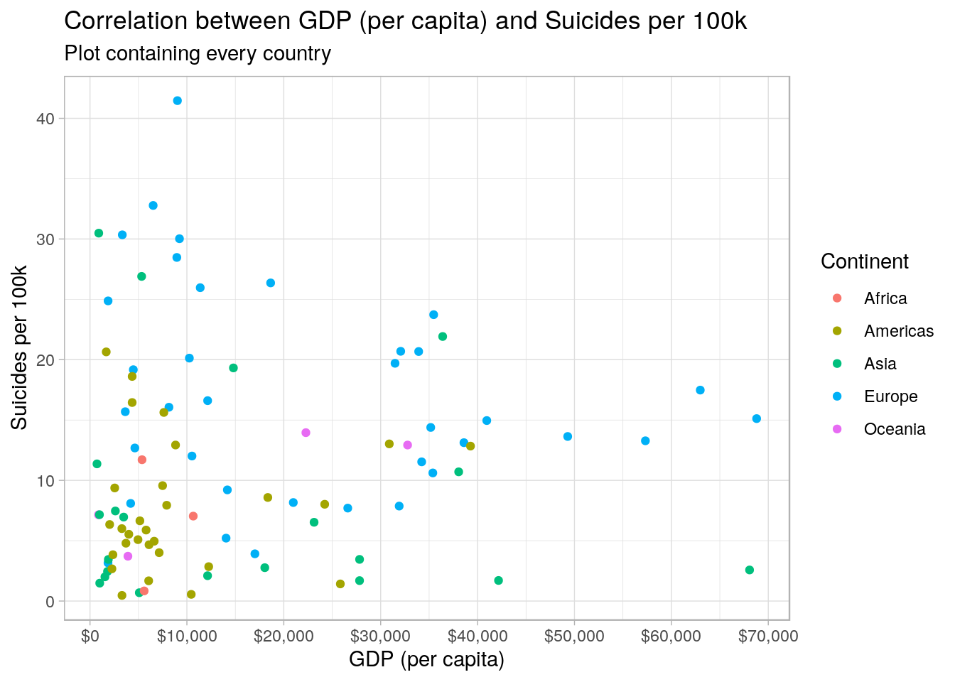
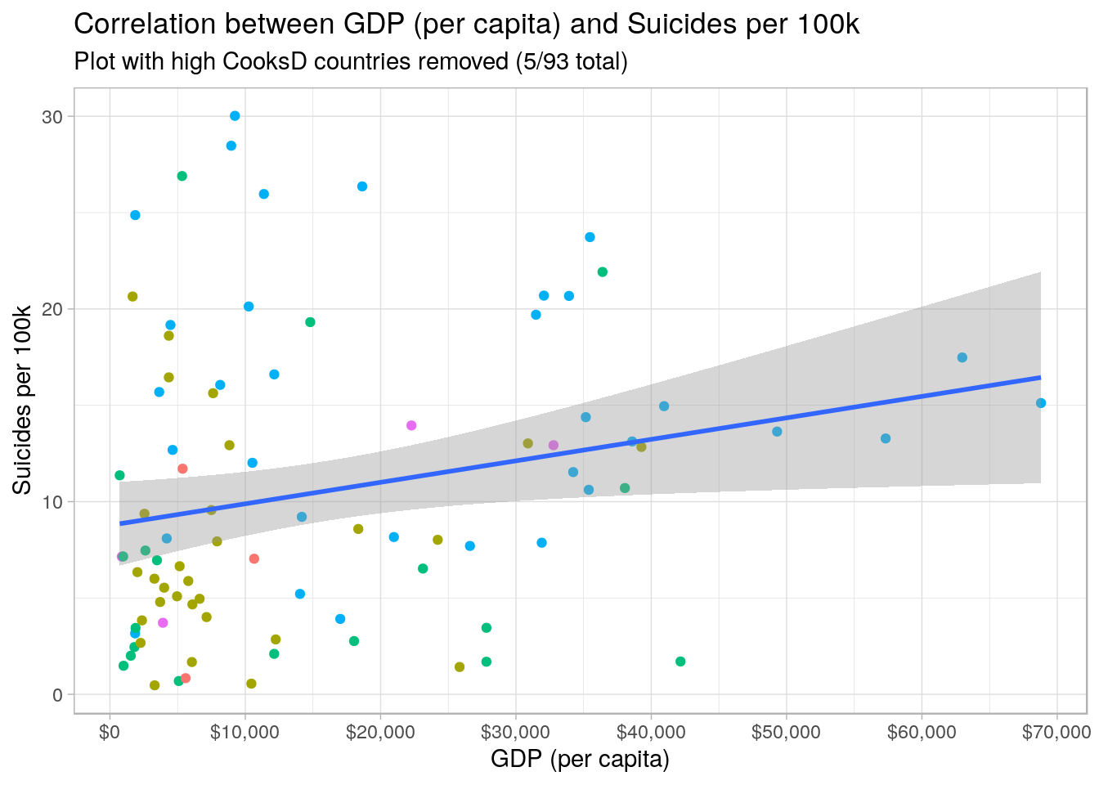
Data exploration: cross referenced
An increase of GDP (per capita) by a certain sum could be associated with 1 additional suicide, per 100k people, per year.
There is a weak linear relationship between richer countries and an higher rates of suicide.

Slide 14
Trending academic literature
Suicide – Our World In Data
https://ourworldindata.org/suicide
Suicide data - WHO
https://www.who.int/mental_health/prevention/suicide/suicideprevent/en/
Suicide and GDP in a global world - is there a correlation?
https://rpubs.com/beancounter/430586
Worldwide impact of economic cycles on suicide trends over 3 decades
https://bmjopen.bmj.com/content/2/3/e000785

Slide 15
Conclusions from our data
Our data rappresents the suicide rates globally, per continent and even more specifically per country
It’s supported by famous and renomate organizzations such as WHO and OWID other than efficent data about the quantity and composition of the suicide events that are under analysis
We found how the composition of the suicide trends changed during the analysed time frame, with this we can explain the main changes occurred in the trend of suicides around the globe has evolved in these past years

Slide 16
Questions?
The end

