Slide 1
«Hack the meal» hackathon User interface and design improvements
Beedlo corers team
(Andrei Donchenko, Vladislav Vishnevsky

Slide 2
Problems
Poor user interface
Almost no marketing
So, not a lot of people using it

Slide 3
Our solution
Renew smartmeal interface
Give smartmeal cards for free in Kasarmina
Make discount for users of smartmeal
Provide easy step by step instructions for smartmeal
Also, quick payment for smartmeal users

Slide 4
How our prototype works
Meal selection
ID recognized
Personal food recommendations are given for the user
Weight detected
Ready for food to be taken on the plate
Weight difference detected
Calculations showing calories and nutritious are shown
When weight is removed, smartmeal is ready for new user

Slide 5
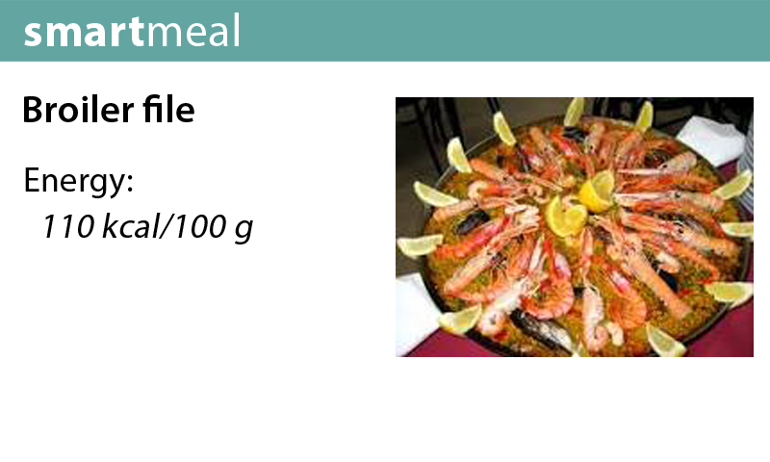

Slide 6
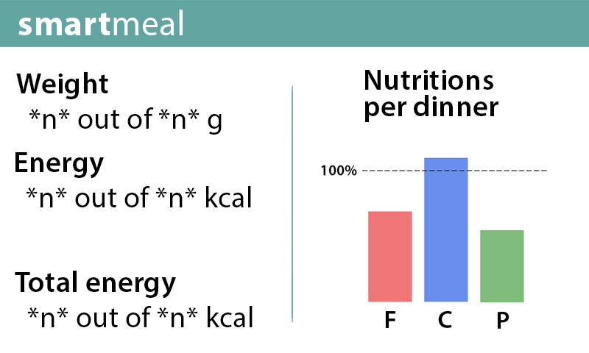

Slide 7
General ideas for improvement
Show warning, when user puts tray on the weights with food that is not suitable for him (vegan, allergic, etc)
Provide can for excess food (more than recommended portion for the user)
Place for final measurement + fast payment
Error resistant algorithm

