Slide 1
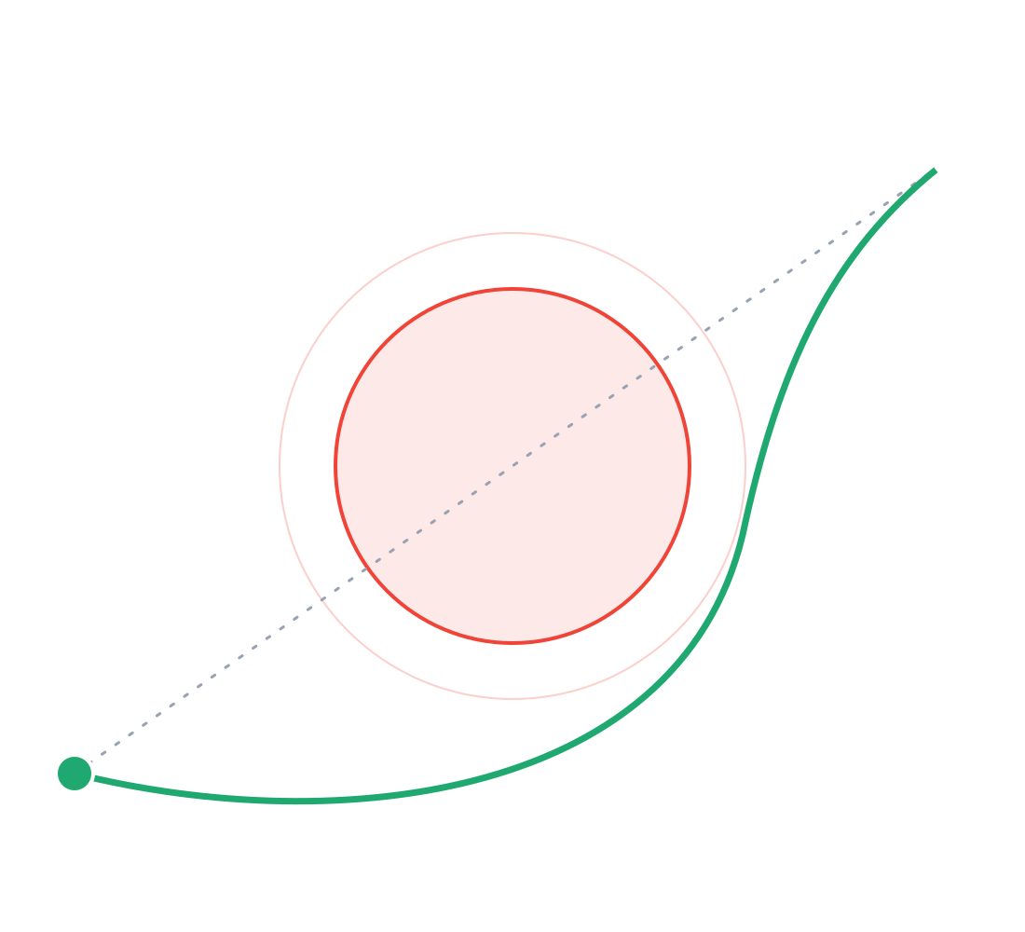
SkyRoute Warsaw
B
DRONE DELIVERY ROUTING
Step into the future of drone delivery
RESTRICTED
TEAM Data_City
A
Notes:
Hi, we are Team Data_City. In one sentence: SkyRoute is Google Maps for drones. You type two Warsaw addresses, and we compute a drone route that flies around airports, military sites, government buildings and tall buildings, then we simulate the flight and dispatch a drone from a fleet. (About 20 seconds.)

Slide 2
Faster deliveries, safer routes
THE VISION
The problem
Urgent and small deliveries get stuck in city traffic.
Road congestion slows exactly the deliveries where minutes matter.
The idea
Drones that fly over the congestion, on routes chosen for both speed and safety.
The router avoids airports, military sites, government buildings and tall buildings.
The goal
Faster deliveries, including emergencies, without adding risk for the people below.
Emergency mode gets no special access: safety is never traded for speed.
Notes:
Urgent and small deliveries get stuck in city traffic. Drones can fly over the congestion, but only if the route is chosen for safety as well as speed. Our goal: faster deliveries, including emergencies, without adding risk for the people below. (About 20 seconds.)

Slide 3



SkyRoute: Maps for drones
OUR SOLUTION
A drone routing system that finds the safest, most efficient, priority-based route from source to destination.
Plan
Simulate
Dispatch
Type two Warsaw addresses. We match the exact building from the official address register and route around every red area, using live wind.
A virtual drone flies the route, then returns on a separately calculated, validated route.
For Emergencies or food order, we pick the nearest hospital as pickup and the drone that can do the round trip fastest.
Notes:
SkyRoute does three things in one map. Plan: you type two addresses, we match the exact building from the official address register and compute a route that avoids every red area, using live wind. Simulate: a virtual drone flies the route and returns on a separately calculated, validated route. Dispatch: for a blood, AED or food order we pick the nearest hospital as pickup and the drone that can do the round trip fastest. (About 35 seconds.)

Slide 4
One pipeline for every route
HOW IT WORKS
1
2
3
4
Address
Red areas
A-Star search
Route + ETA
Geocoded with the official GUGiK address register, matching the exact building.
Airspace zones, 565 OpenStreetMap footprints of airports, military and government sites, and building heights.
Path Finding Algorithm with given constraints
Live Open-Meteo wind along the route sets the flight time.
The map and the router read the same zone data: what you see in red is exactly what the drone avoids.
Notes:
Under the hood every route goes through one pipeline. We geocode with the official GUGiK address register. We load the red areas: airspace zones, plus 565 OpenStreetMap footprints of airports, military sites and government buildings, plus building heights. A* searches a 25-metre grid covering all of Warsaw, never cutting corners. The final line is checked again against the exact polygons, and the ETA uses live wind from Open-Meteo. Key point: the map and the router use the same data, so red on the map means avoided in the air. (About 40 seconds.)

Slide 5
Open-source stack, open data
BUILT WITH
Data sources
Stack
GUGiK PRG
City boundary and the 18 districts
Frontend
Angular 22, Angular Material, Leaflet on OpenStreetMap tiles
GUGiK UUG
Official address points
Backend
Python and FastAPI
OpenStreetMap
Buildings, parks, river, hospitals, airports, military, government
Geometry
Shapely, PyProj and NumPy
Nominatim
Place search
Routing
A-Star Algorithm
Open-Meteo
Live wind along the route
Open Data Warsaw
Weather
Notes:
Quickly, what it is built with. Frontend: Angular 22 with Angular Material and a Leaflet map on OpenStreetMap tiles. Backend: Python and FastAPI, with Shapely, PyProj and NumPy for geometry, our own A* search on a 25-metre grid, and SQLite for the simulated fleet. All data is open: the official GUGiK boundary and address register, OpenStreetMap for buildings and the red areas, Nominatim for place search and Open-Meteo for live wind. (About 20 seconds.)

Slide 6
Where the routing goes next
FUTURE IMPROVEMENTS
01
Further constraints
More factors in the route cost, such as crowd density and noise, so that an even safer path is found.
02
Collision handling
Keep drones separated when several fly at the same time.
03
Drone stations
Landing and charging stations as part of route planning.
04
Integrating with multiple solutions
Open DDS to other solutions, such as hospital and logistics tools.
Notes:
Where does the routing go next? Four technical improvements. Further constraints, so that an even safer path is found. Collision handling, for several drones in the air at once. Drone stations, so landing and charging are part of the plan. And integration with multiple solutions, opening the planner to other systems. (About 20 seconds.)

Slide 7
Time for Prototype
Notes:
Now the live demo. Step 1: pick a start west of Chopin Airport and a destination east of it. Point out that the straight line crosses the airport and the route goes around the red grounds; in our test that was a 6.6 km detour that touched none of the 565 red areas. Step 2: press Start Simulation, switch to 10x. The drone flies to B, shows Destination Reached, then flies a separately calculated return route back to A. Step 3: open the Fleet dashboard, choose Blood delivery, enter Korotyńskiego 19 as the delivery address. The nearest hospital, the University Clinical Centre at Banacha 1.4 km away, becomes the pickup, and a drone is reserved within seconds. Backup if the network fails: the app falls back to sample wind and map clicks still work offline. (About 90 seconds.)

