Slide 1
Solving 8-puzzle problem using A* algorithm.

Slide 2
Heuristic search
Heuristic search uses a heuristic function to help guide the search. When a node is expanded, each of its children is evaluated using a search function.
A* is a type of heuristic search which solves problems by searching among all possible paths to the solution (goal) for the one that incurs the smallest cost.
Typical implementations of A* use a priority queue to perform the repeated selection of minimum (estimated) cost nodes to expand. This priority queue is known as the open set or fringe.

Slide 3
function f(n)
The heuristic function, h estimates how much work must be done to reach a goal from the node in question or the current node. Typically, the search function f is expressed as
f(n) = g(n) + h(n)
where g(n) represents the cost of getting to the node n along the current path from the initial node. Thus, f(n) estimates the cost or effort to successfully get from start to goal by going through node n.

Slide 4
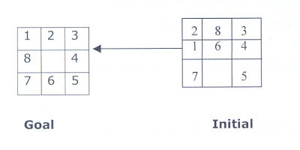
8-puzzle problem
The 8 puzzle consists of eight numbered, movable tiles set in a 3x3 frame. One cell of the frame is always empty thus making it possible to move an adjacent numbered tile into the empty cell.
The program is to change the initial configuration into the goal configuration.

Slide 5
8-puzzle problem using A*
We will be using A* algorithm to solve this problem .
We have considered g to be the length of the path from initial node to a particular node n i.e. depth of node n.
And heuristic h to be equal to the number of displaced tiles in node n with respect to the goal state.

Slide 6
Basic functionality
Main data structure used is list which we have used to store the states of puzzle(node), to store the open nodes, close nodes and have represented empty space as 0.
Few built-in functions used for basic functionality are delete, append, keysort, and write.
User can make queries by giving initial and goal state as input.

Slide 7
Thank You

