Slide 1
HackerEarth
HackBenchers #4
(A HACKATHON FOR ASPIRING AND COLOURFUL MINDS)

Slide 2

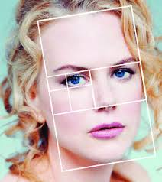
TOPIC :
GOLDEN RATIO…

Slide 3
Acknowledgement
I Jaskeerat Singh with my project partner Bala Yokesh created a website based on the topic of Golden Ratio . It highlights all the key information related to the topic. The viewer may encounter:
Basic Definition of Golden Ratio
How it is calculated(The formula used) ?
From where it came?
How it is used?
Applications of Golden Ratio in various areas depicted using pictures
Various pictures in the GALLERY section according to user’s selection

Slide 4
TECHNOLOGIES WE USED TO DESIGN THE WEBSITE :
HTML
CSS
Bootstrap
Javascript (Jquery lite version, popper.js, Ajax)

Slide 5
The things that definitely gonna catch attention of the viewers are :
Responsiveness
Bug free
Easily maintainable code
Attractive UI

Slide 6
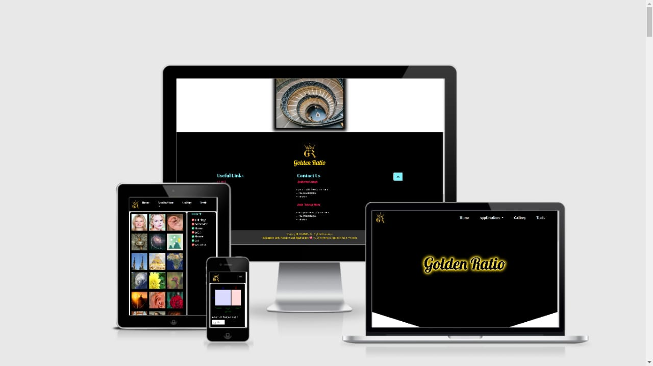
Responsiveness :
The website is complete responsive i.e it will function very well on large devices like (Desktops , Laptops) , on medium devices (Tablets , iPads) as well as on small devices (Mobile phones).

Slide 7

2. Bug free :
A software bug is an error, flaw or fault in a computer program or system that causes the abnormal functioning of the website.
But our website is totally bug free so you won’t be experiencing any of the mentioned problems.

Slide 8
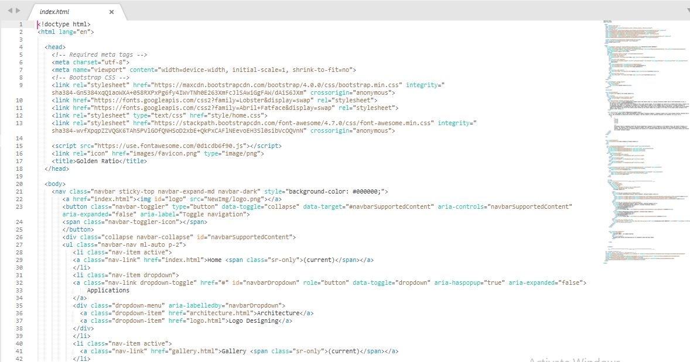
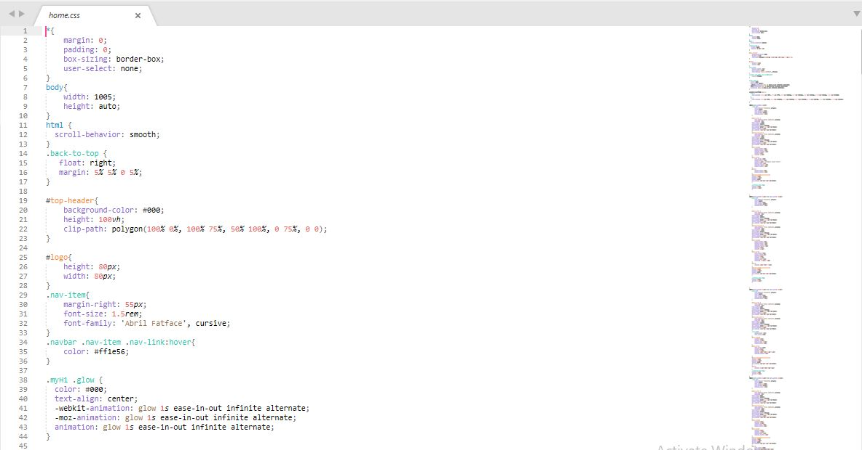
3. Easily maintainable code :
Our code is well and easily maintained for easy access.

Slide 9

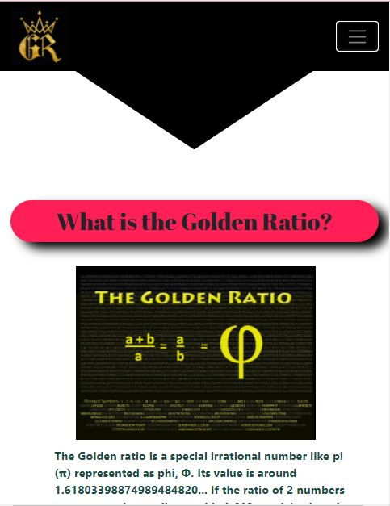
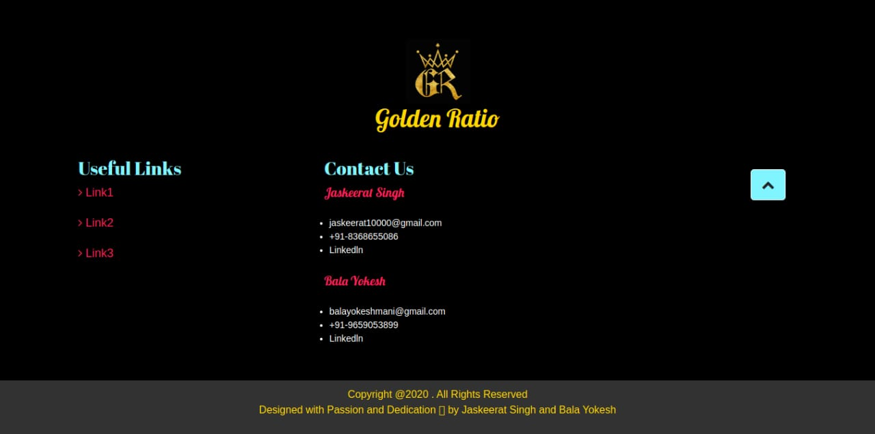
4. Attractive UI :
Our website has a attractive User Interface which can attract anyone’s attention

Slide 10
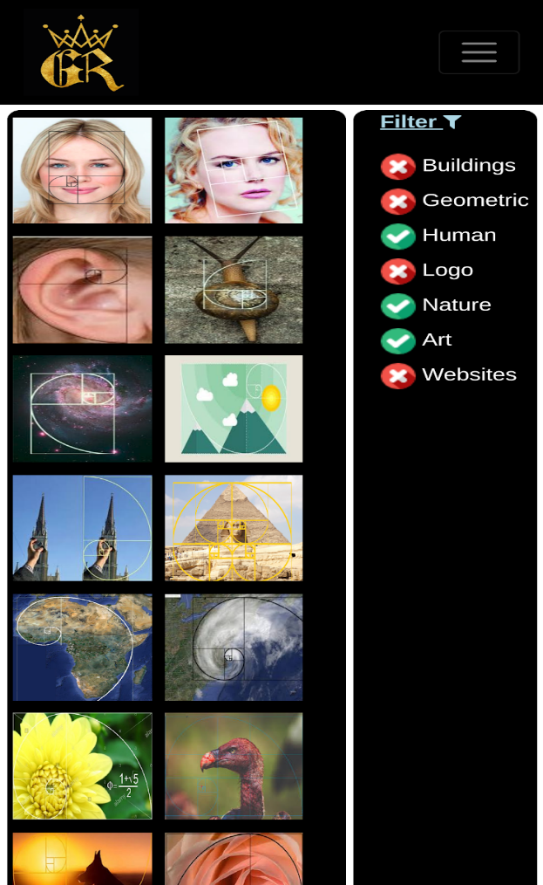

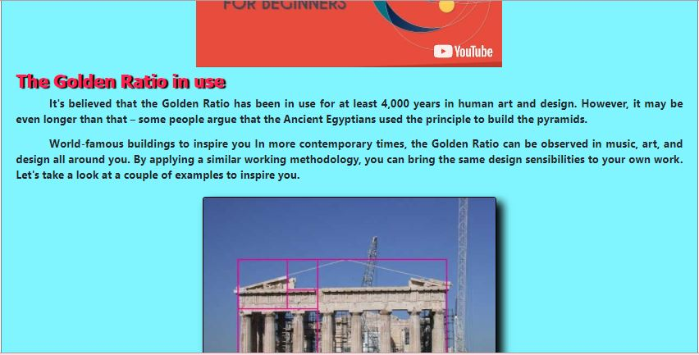
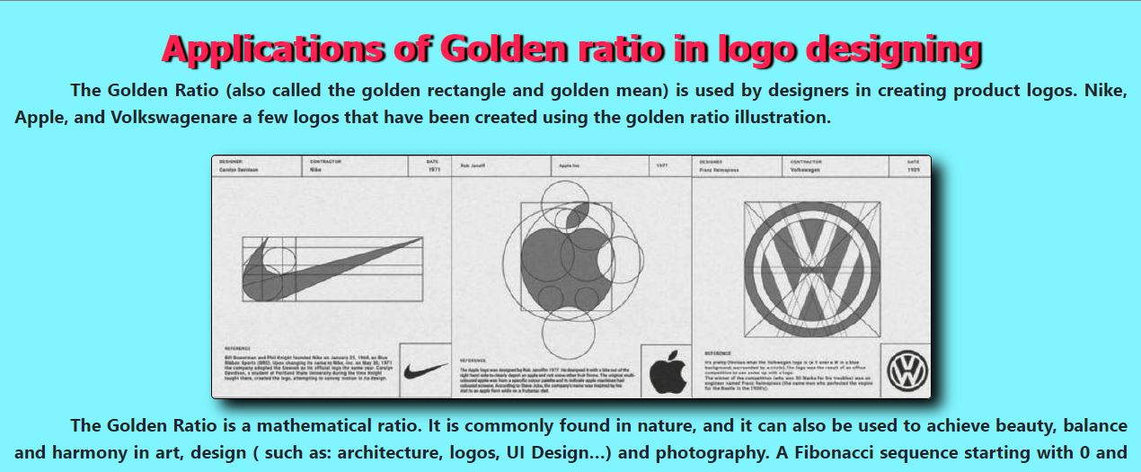
Here are some screenshots of our website on various devices

Slide 11

We hope that our work is satisfactory according to the rules of the HACKATHON and may have delighted you .
Thanking you for ur precious time

