Slide 1


EduGenie
REVOLUTIONIZING THE WAY YOU STUDY
Submitted to:
Submitted By:
Ms. Meenakshi
Mr. Shiv Mohan
Jaskirat Singh
2210990446

Slide 2

CONTENT
01
ABOUT US
02
KEY FEATURES
03
USER FLOW
04
AI-POWERED NOTES GENERATION
05
NOTES PUBLISHING AND SHARING
06
TEST GENERATION
07
BENIFITS AND CONCLUSION

Slide 3
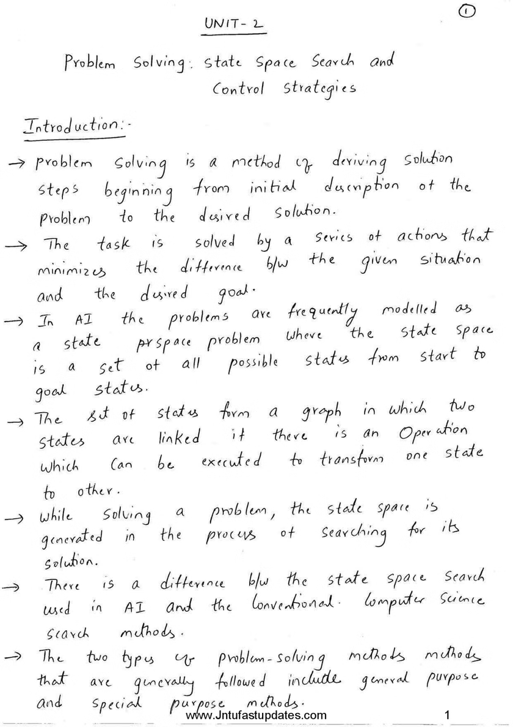

ABOUT US
Unlock Your Learning Potential with AI-Powered Study Tools
Discover a cutting-edge web app that transforms how you approach studying and mastering new topics.
Our AI-driven features empower you to:
Generate personalized study materials
Streamline your learning process
Achieve academic success

Slide 4





KEY FEATURES
AI-Powered Notes Generation
Notes Publishing and Sharing
Test Generation
Generate study notes based on topic, time, and complexity
Options to share notes with others
Publish personal notes for others to use
Like and comment on shared notes
Create tests based on the study topic
Available in both PDF format and interactive online tests

Slide 5

USER FLOW
01
02
03
04
05
LOGIN/
REGISTER
DASHBOARD
GENERATE NOTES
PUBLISH NOTES
GENERATE TEST
User logs into the web app
Access to three main features: Generate Notes, Publish Notes, Generate Test
Input topic, study time, complexity
AI generates notes
Option to share
Upload notes
Visible to others
Users can like/comment
Select topic
AI generates test questions
Choose format (PDF/Online)

Slide 6

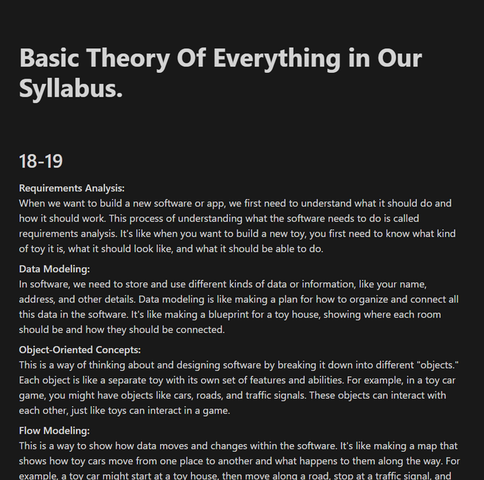
AI-POWERED NOTES GENERATION
Users input the topic, time available for study, and desired complexity
AI generates comprehensive, customized study notes
Example scenario: Studying "Computer Networks" with 1 week left, medium complexity
Options to edit and share the generated notes

Slide 7
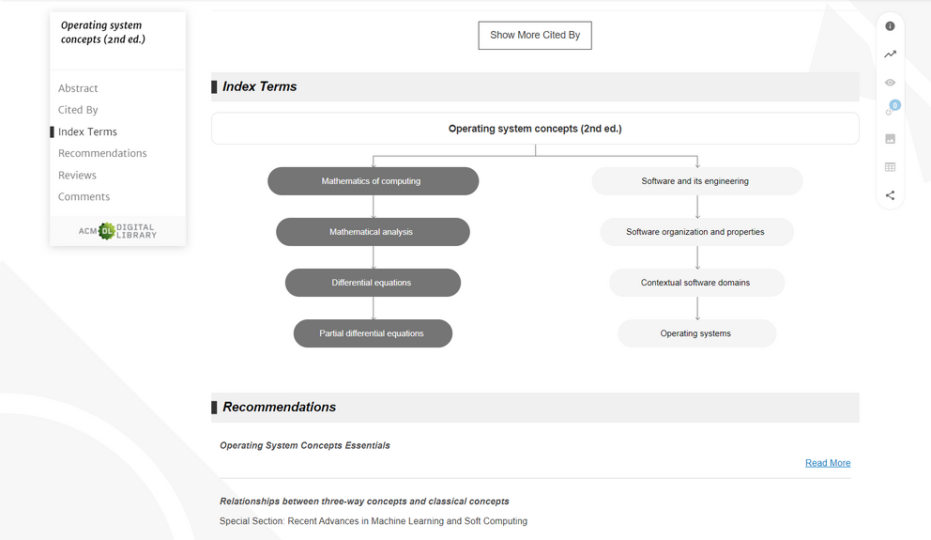
NOTES PUBLISHING AND SHARING
Users can publish their own notes on various topics
Notes are searchable and can be rated by other users
Example: A user publishes notes on "Machine Learning" which others can like and comment on
Enhances collaborative learning and resource sharing

Slide 8
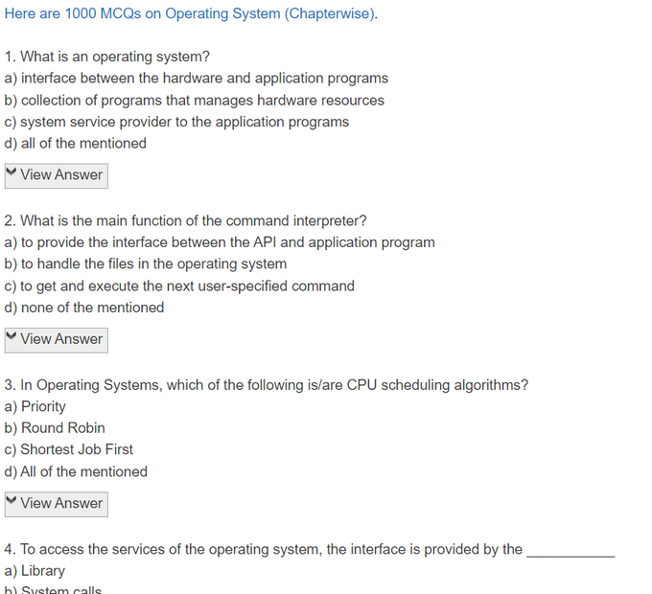
TEST GENERATION
Generate tests based on the chosen topic
Options to take the test online or download as a PDF
Customizable parameters for the test (e.g., number of questions, difficulty level)
Example: Generating a test for "Data Structures" with 20 questions of mixed difficulty

Slide 9
BENEFITS AND CONCLUSION
Benefits:
Personalized study materials improve learning efficiency
Collaborative note-sharing enriches study resources
Easy test generation helps in self-assessment
Conclusion:
Smart Study aims to revolutionize studying with AI and community-driven content
Encourages effective and interactive learning

Slide 10

THANK
YOU

