Slide 1
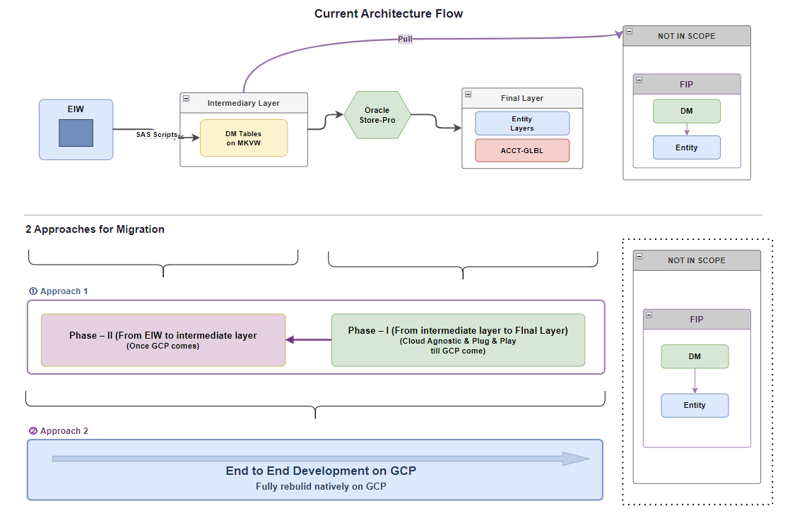
MKVW CDL Cloud Migration
SECTION 01 · ARCHITECTURE
Solution Architecture
End-to-end ETL platform migrating on-prem MKVW fact processing to a metadata-driven cloud data lake.
Figure 1 — Cloud Data Lake (CDL) target-state architecture

Slide 2






MKVW CDL Cloud Migration
SECTION 02 · FEATURES
Metadata-Driven ETL Configuration
A single configuration table drives every load process end to end — no hard-coded pipeline logic per table.
Composite table_id
Watermark column
Generated from target_table + load_process, so multiple processes can load the same target table without colliding.
Tracks incremental progress today and is designed in for future watermark-based loading.
Full source lineage
Configurable DQ rules
source_tables captures every upstream table feeding the load for traceability.
Multiple rules per table, e.g. {"dq_rule":"dq_net_rev","error_threshold_pct":0.0}, validated on every load.
Flexible incremental cutoff
DQ on/off switch
Truncate-and-load currently runs on the 9th of each month, configurable per table as needs change.
dq_status toggles validation per table, independent of the pipeline logic.
MKVW CDL Cloud Migration
Features · Configuration Table
2

Slide 3

MKVW CDL Cloud Migration
SECTION 02 · FEATURES
Configuration Table — Sample Record
Key fields shown below; full table also carries target_system, ingestion_mode, load_frequency, last_watermark_value and partition_col.
table_id | opco | target_table | load_process | cutoff day | watermark column | dq_status
fxg_fac_enti_bill_dly_hist_sp | ground | f6180854.fxg_fac_enti_bill_dly_hist | load_fxg_fac_enti_bill_dly_hist_sp | 9 | ratemnth | TRUE
fxg_fac_enti_bill_dly_hist_bill | ground | f6180854.fxg_fac_enti_bill_dly_hist | load_fxg_fac_enti_bill_dly_hist_bill | 9 | ratemnth | TRUE
source_tables (all upstream lineage for this sample record)
ds_fcst_de_prod.fxg_acct_bill_dly_hist · ds_fcst_de_prod.cust_se_seg_map · ds_fcst_de_prod.cust_ce_seg_map
DQ rule example: [{ "dq_rule": "dq_net_rev", "error_threshold_pct": 0.0 }] — evaluated on every load when dq_status = TRUE
MKVW CDL Cloud Migration
Features · Configuration Table
3

Slide 4



MKVW CDL Cloud Migration
SECTION 02 · FEATURES
Audit & Monitoring Log Table
A dedicated log table records every load process for audit and monitoring, at a granular, per-run level.
Granular process detail
Every table_process is logged individually, down to run batch and attempt number.
Three-state status
SUCCESS / PARTIAL_SUCCESS / FAILED — partial success means only the failed months need reloading, not the whole batch.
DQ results per run
Each process carries its own dq_result, so quality outcomes are traceable at the load level.
Execution summary
A month-by-month execution_summary breaks down rows written and status for every period in the batch.
MKVW CDL Cloud Migration
Features · Log Table
4

Slide 5
MKVW CDL Cloud Migration
SECTION 02 · FEATURES
Log Table — Sample Run Record
Key fields shown below; full table also carries dataset_layer, watermark_start/end, started_at/completed_at and message.
table_id | mode | months | status | duration (min) | rows written | dq_result
fxg_fac_enti_bill_dly_hist_sp | backfill | 202501–202503 | SUCCESS | 19 | 48,623,344 | SKIPPED
fxg_fac_enti_bill_dly_hist_bill | backfill | 202501–202503 | SUCCESS | 19 | 299,000,000 | SKIPPED
execution_summary — per-month breakdown (fxg_fac_enti_bill_dly_hist_sp)
Month | Loaded | Rows Written | DQ Status
202501 | true | 16,413,339 | SKIPPED
202502 | true | 14,860,042 | SKIPPED
202503 | true | 17,349,963 | SKIPPED
Note: SKIPPED = no DQ rule assigned or dq_status inactive for this run.
MKVW CDL Cloud Migration
Features · Log Table
5

Slide 6


MKVW CDL Cloud Migration
SECTION 03 · QA & PERFORMANCE
Performance — 3-Month Load Comparison
New CDL pipeline vs. traditional MKVW load path, ground + smartpost combined, 202501–202503.
Traditional MKVW Load Path | Time / month
FXG (ground) | 20 – 30 min
FXG (smartpost) | 15 – 20 min
MKVW fact → Azure fact (ADF / Ab Initio) | ~30 min
CDL — acct to fact
19 min
to load 3 full months (~6–8 min/month)
Note: figures reflect the legacy step-by-step MKVW pipeline; the new CDL path replaces these discrete hops with a single incremental run.
Per-month load time — new vs. legacy path
Stress test preview — full detail on next slide
3 years of data (Ground + Smartpost): 1 hr 28 min MKVW fact → Azure fact (ADF / Ab Initio): ~40 hrs
MKVW CDL Cloud Migration
QA & Performance
6

Slide 7


MKVW CDL Cloud Migration
SECTION 03 · QA & PERFORMANCE
Stress Testing & QA Validation
Stress Test — 3 Years of Data
QA Validation
CDL — acct to fact (Ground + Smartpost)
All table KPIs validated
1 hr 28 min
Row counts and key business KPIs reconciled against the source for every loaded table.
to load 3 full years of history
Backfill runs (202501–202503) and 3-year stress test both completed with SUCCESS status end to end.
MKVW fact → Azure fact (ADF / Ab Initio)
Configurable DQ rules are in place and ready to enforce thresholds as validation rules are rolled out per table.
~40 hrs
Result: the CDL path completes the same 3-year backfill roughly 27× faster than the legacy ADF / Ab Initio route.
MKVW CDL Cloud Migration
QA & Performance
7

