Slide 1
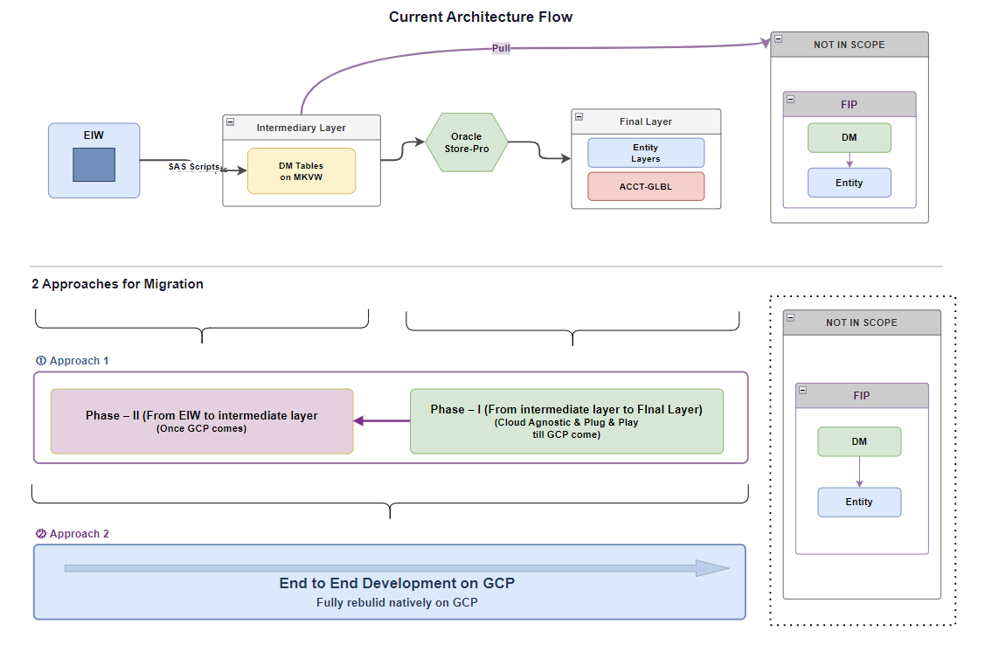
MKVW CDL Cloud Migration

Slide 2
MKVW CDL Cloud Migration
Feature added: A metadata driven ETL framework where config _table drives the whole ETL.
table_id | opco | source_table | target_system | target_table | load_process | ingestion_mode | incremental_cutoff_day | load_frequency | watermark_column | last_watermark_value | partition_col | dq_rules | dq_status
fxg_fac_enti_bill_dly_hist_sp | ground | ds_fcst_de_prod.fxg_acct_bill_dly_hist,ds_fcst_de_prod.cust_se_seg_map,ds_fcst_de_prod.cust_ce_seg_map | delta_lake | f6180854.fxg_fac_enti_bill_dly_hist | load_fxg_fac_enti_bill_dly_hist_sp | incremental | 9 | daily | ratemnth | null | ratemnth | null | TRUE
fxg_fac_enti_bill_dly_hist_bill | ground | ds_fcst_de_prod.fxg_acct_bill_dly_hist,ds_fcst_de_prod.cust_se_seg_map,ds_fcst_de_prod.cust_ce_seg_map | delta_lake | f6180854.fxg_fac_enti_bill_dly_hist | load_fxg_fac_enti_bill_dly_hist_bill | incremental | 9 | weekly | ratemnth | null | ratemnth | null | TRUE
Feature:-
table_id is generated with combination of target_table and it's load process, it basically help to distinct process if it is loading up to same target table
source_tables = all source table info
incremental_cutoff_day:- so currently we are following 9 th of the month to do the truncate and load in incremental process, but it flexiable in nature and can be chnages for different table depend on the need.
watermark column:- watercolumn is good to have for incremental process, for futture nedd
DQ Rule:- A multiple DQ rule can be set [{"dq_rule": "dq_net_rev", "error_threshold_pct": 0.0}] so that whenever data I sloaded from source it can validateed for each
DQ-sttus:- for tuning it on//off as per the need

Slide 3
MKVW CDL Cloud Migration
run_batch_id | log_time | opco | dataset_layer | table_name | table_id | load_process | mode | load_mnth_start | load_mnth_end | status | message | attempt_number | watermark_start | watermark_end | started_at | completed_at | duration_minutes | rows_written | dq_result | execution_summary
BATCH_None_20260728_132106_728FA6 | 2026-07-28T13:40:26.359+00:00 | ground | facility | f6180854.fxg_fac_enti_bill_dly_hist | fxg_fac_enti_bill_dly_hist_sp | load_fxg_fac_enti_bill_dly_hist_sp | backfill | 202501 | 202503 | SUCCESS | Completed. Ingested: 202501, 202502, 202503 | 1 | - | - | 2026-07-28T13:21:08.510+00:00 | 2026-07-28T13:40:26.358+00:00 | 19 | 48623344 | SKIPPED | { "month_details": [ { "month": "202501", "dq_status": "SKIPPED", "Loaded": true, "rows_written": 16413339, "message": "Either DQ rules not assigned or DQ status is inactive" }, { "month": "202502", "dq_status": "SKIPPED", "Loaded": true, "rows_written": 14860042, "message": "Either DQ rules not assigned or DQ status is inactive" }, { "month": "202503", "dq_status": "SKIPPED", "Loaded": true, "rows_written": 17349963, "message": "Either DQ rules not assigned or DQ status is inactive" } ] }
BATCH_None_20260728_132106_728FA6 | 2026-07-28T13:40:09.180+00:00 | ground | facility | f6180854.fxg_fac_enti_bill_dly_hist | fxg_fac_enti_bill_dly_hist_bill | load_fxg_fac_enti_bill_dly_hist_bill | backfill | 202501 | 202503 | SUCCESS | Completed. Ingested: 202501, 202502, 202503 | 1 | - | - | 2026-07-28T13:21:08.525+00:00 | 2026-07-28T13:40:09.180+00:00 | 19 | 2.99E+08 | SKIPPED | { "month_details": [ { "month": "202501", "dq_status": "SKIPPED", "Loaded": true, "rows_written": 88809987, "message": "Either DQ rules not assigned or DQ status is inactive" }, { "month": "202502", "dq_status": "SKIPPED", "Loaded": true, "rows_written": 115576505, "message": "Either DQ rules not assigned or DQ status is inactive" }, { "month": "202503", "dq_status": "SKIPPED", "Loaded": true, "rows_written": 94723942, "message": "Either DQ rules not assigned or DQ status is inactive" } ] }
A dedicated log table for audit and monitoring puprose, some of the important column featuers is hsown here:-
Feature:-
1. FOr each table_process detail ata granular level.
2. Status - SUCCESS/PARTIAL_SUCCESS/FAILED (partial_success, if some month loaded some failed so that we do not need to load successful months again)
3.Dq _results for each proceess
4. Excutipn summary-- Each months log details

Slide 4
MKVW CDL Cloud Migration

